Slide 1
Object Oriented Programming
Lab2

Slide 2
Context
Java language & programs
Variables in Java
Strings in Java
Console Input & Output
Comments

Slide 3
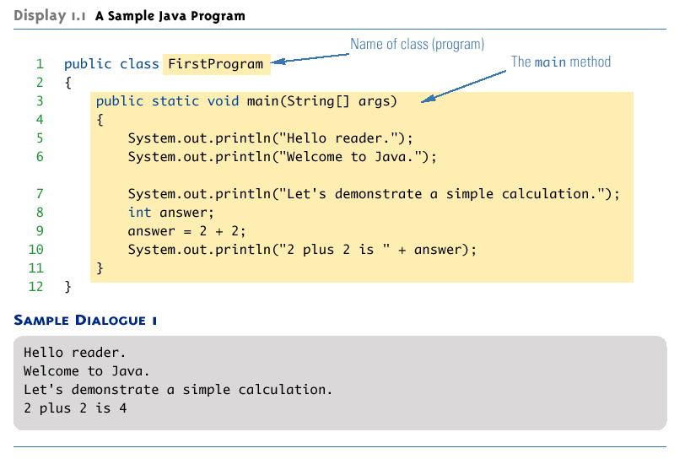
Java Language
q Identifiers must not start with a digit
q All letters must be letters, digits or underscore
Convention:
for variables, objects, methods the first letter is always lowercase
for classes the first letter is Uppercase
subsequent words start with an uppercase letter.
E.g. topSpeed
4

Slide 4
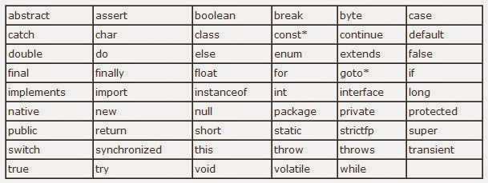
Keywords
Some words are reserved, and can’t be used as identifiers.

Slide 5
Identifiers
Identifiers are names for variables, classes, etc.
Identifier may contain a-z, A-Z, 0-9, $, _.
Must not start with a digit, all the characters must be letters, digits or the underscore symbol.
Valid
myVariable
myVariable1
my_Variable
$myVariable
Invalid
my-Variable
myVariable!
1myVariable
my Variable
public

Slide 6
Identifiers
Identifier are case sensitive so followings are n-ot the names of same variable.
myJava
MyJava
MyJAVA
myjava
MYJAVA

Slide 7
Primitive variable types
Java has 8 primitive types:
float
double
boolean
char
byte
short
int
long
floating point numbers
two values: true and false a single character
integer numbers

Slide 8
Primitive boolean type
The boolean type has only two values:
true
false
There are boolean-specific operators
&& is and
|| is or
! is not

Slide 9

Type Casting
Consider the code.
Is it possible to assign the value of a
variable of one type to a variable of another type?
Yes.
You can assign the value of any type to that of another type that is lower in the following list:
byte → short → int → long → float → double

Slide 10
Constants
Consider the following:
final int x = 5;
The value of x can NEVER be changed!
The value assigned to it is “final”
This is how Java defines constants
Constants have a specific naming scheme
MILES_PER_KILOMETER
All caps, with underscores for spaces

Slide 11
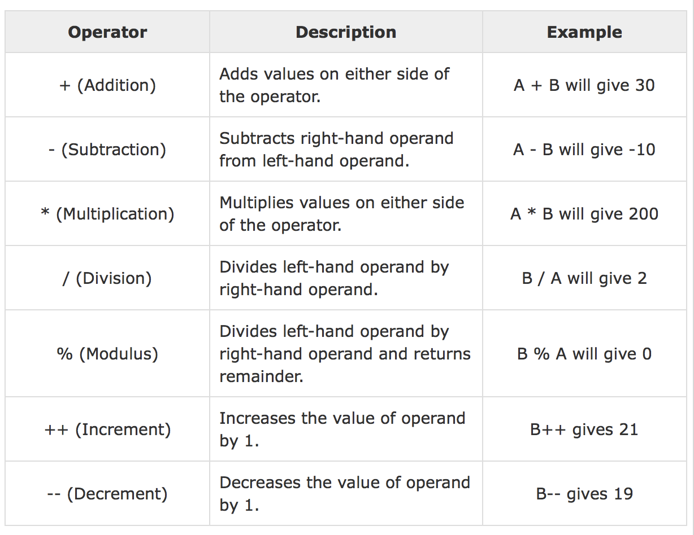
The Arithmetic Operators

Slide 12
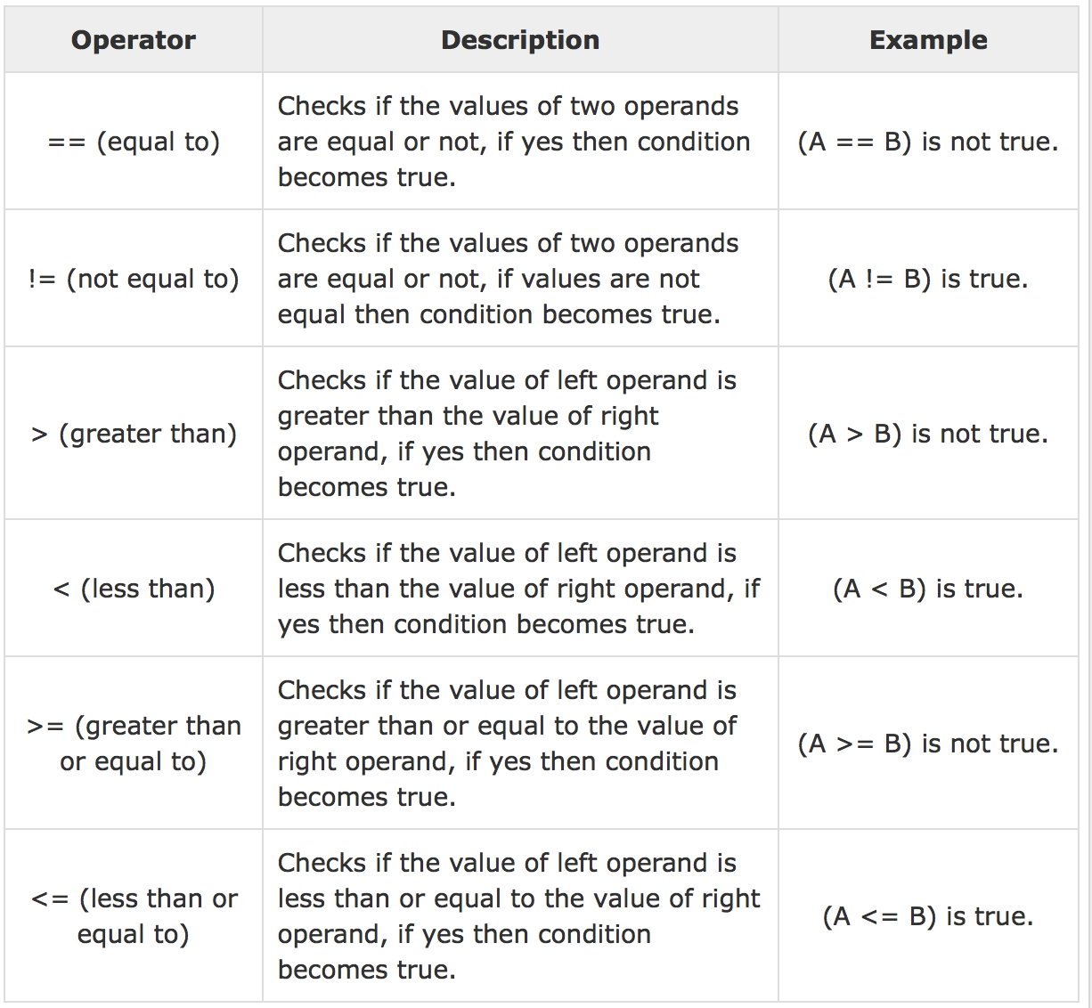
The Relational Operators

Slide 13
Java Operator Precedence
Type (Operator)
Unary Operator (++, --)
Arithmetic Operator (+, -, *, /, %)
Relational Operator (<, >, <=, >=, ==, !=)
Logical Operator (&&, ||)
Bitwise Operator (&, |, <<, >>, ~, ^)
Assignment Operator (=, *=, /=, %=, +=, -=)

Slide 14
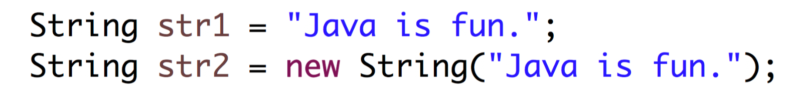
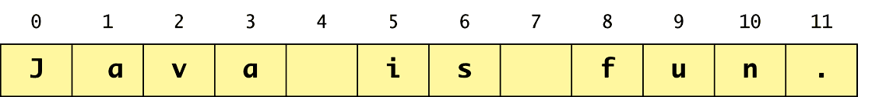
The String Class
The String class is used to store and process strings of characters
A string is a sequence of characters gathered together, like the word "Hello", or the phrase "practice makes perfect"
String creation:

Slide 15
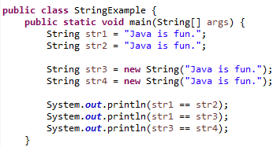
The String Class
Consider
What is the output?
True
False
false
String str5 = str3
(참조 값) (객체)
System.out.println(str3 == str5)
-> true

Slide 16
Working with Strings
A convenience is in String concatenation:
String a String b
= “hello ”;
= “world”;
String c; c = a + b;
c
Hello World
This returns a new string c that is a with b added to it at the end The + operator is widely used in print statements
We accept that we’re not arithmetically adding these two Strings.

Slide 17
Working with Strings
Take the following example, where we are concatenating a String a with an int i:
String a
= “Ten ”;
int i = 4;
;
String c
c = a + i;
c
Ten 4

Slide 18
Working with Strings
c = a + i;
Anytime you concatenate a String with another type, the other type is first converted into a String and then the two are concatenated. Really, this is done using m-ethod toString()which every object inherits from Object

Slide 19
Working with Strings
String a = ““;
int | b | = | 2;
int | c | = | 3;
a = b + c;
The above statement is a Syntax error.
To force the conversion to String, at least one of the operands on the + sign must be a String.

Slide 20
Sub-Strings
You can extract a substring from a larger String object with the substring() method of class String.
String greet = “Howdy”;
String s = greet.substring( 0, 4 );
Howdy
The first argument 0, is the 1st character of the substring that you do want to copy.
The 4 is the 1st character that you don’t want to copy.
0 1
So...{s is equal to
2 3 4
“Howd”}

Slide 21
Sub-Strings
String greet = “Howdy”; String s = greet.substring( 0, 5 ); System.out.println(s); Output : Howdy
H | o | w | d | y
0 1 2 3 4 5

Slide 22

Sub-Strings
Consider
What is the output?
Month is August.

Slide 23
Replacing Substrings
This returns a string with the specified substrings replaced.
String | b | = | “hacker | heaven”;
String | n | = | “”;
n = b.replace( ‘h’, ‘H’ );
Note: This does not change the original, it returns a new String object in which the changes have been made.

Slide 24
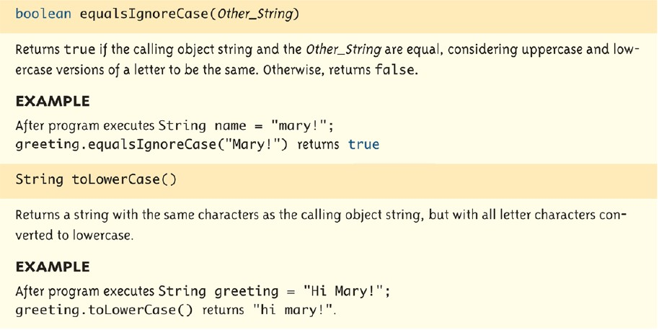
Some more methods

Slide 25
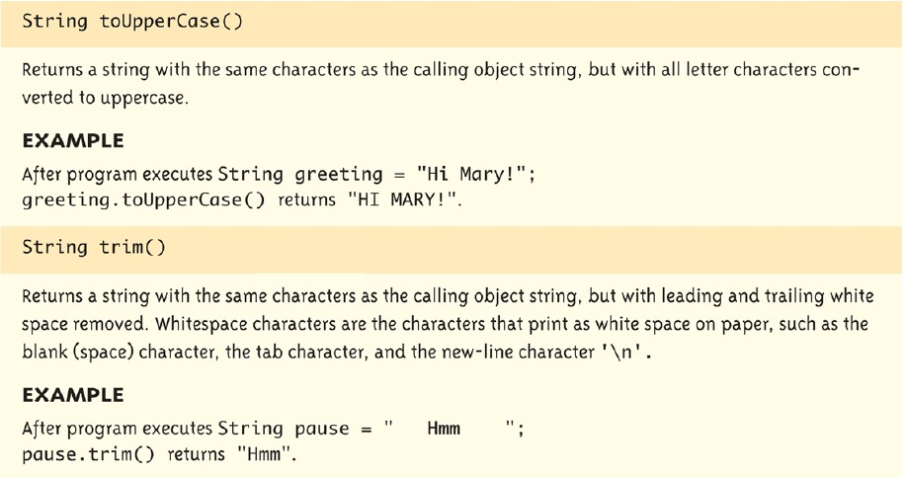
Some more methods

Slide 26
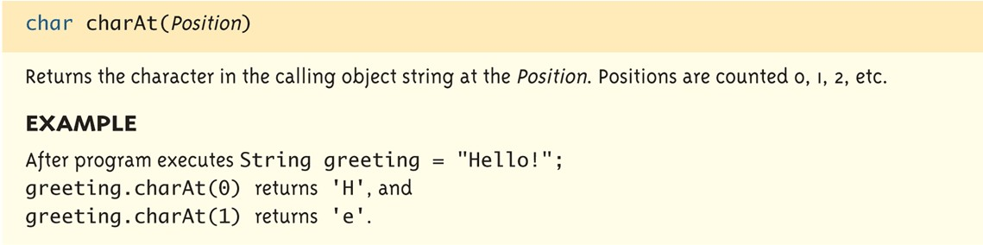
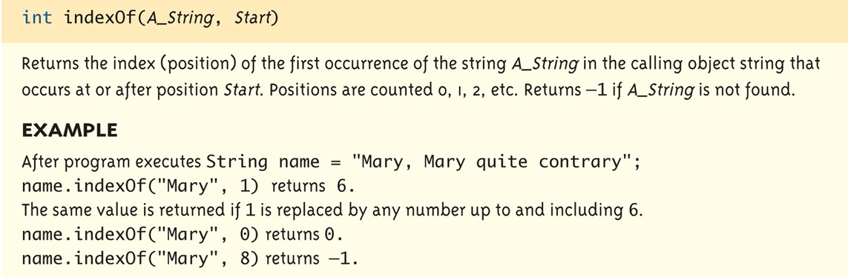
Some more methods

Slide 27
String method examples
// index
String s1 = String s2 =
012345678901
"Stuart Reges"; "Marty Stepp";
System.out.println(s1.length()); | // | 12
System.out.println(s1.indexOf("e")); System.out.println(s1.substring(7, 10)); | // // | 8 "Reg"
String s3 = s2.substring(1, 7); System.out.println(s3.toLowerCase()); | // | "arty | s"
Given the following string:
String book = “Hello Java Programs";
– How would you extract the word "Java" ?

Slide 28
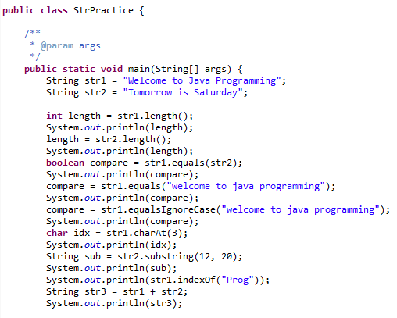
String Example
What will be the output?

Slide 29
Console Output
Output to the console can be performed using the
System.out.println(<arguments>).
There are various methods associated with printing.
Print()
Println()
Printf()
Each accepting different parameters.

Slide 30
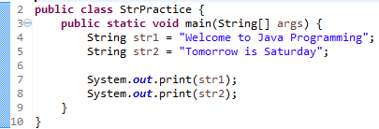
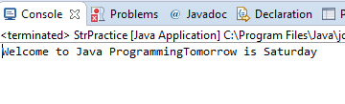
Print vs Println
If the print method is used then the cursor is not moved to a newline.

Slide 31
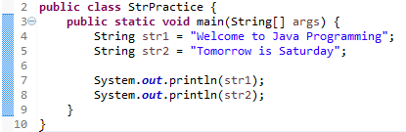
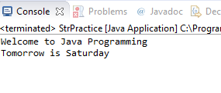
Print vs Println
If the println method is used then the cursor is moved
to a newline

Slide 32
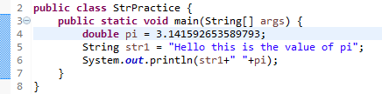
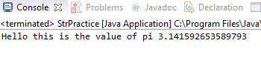

Formatting Output
The output of the code is the entire float given to 15 decimal places
Java allows us to format out output using one of two ways
Format() method of the string class.
Printf() method of the System.out object.

Slide 33
Formatting Output
If we analyze the arguments of the methods then
The first argument is the format string
The other arguments are the variables or values to be output
The number of variables/values must correspond to the number of format specifiers in the format string.
The following will result in an error
System.out.printf("Hello this is also the value of pi %f formatted %4.2f", pi);

Slide 34
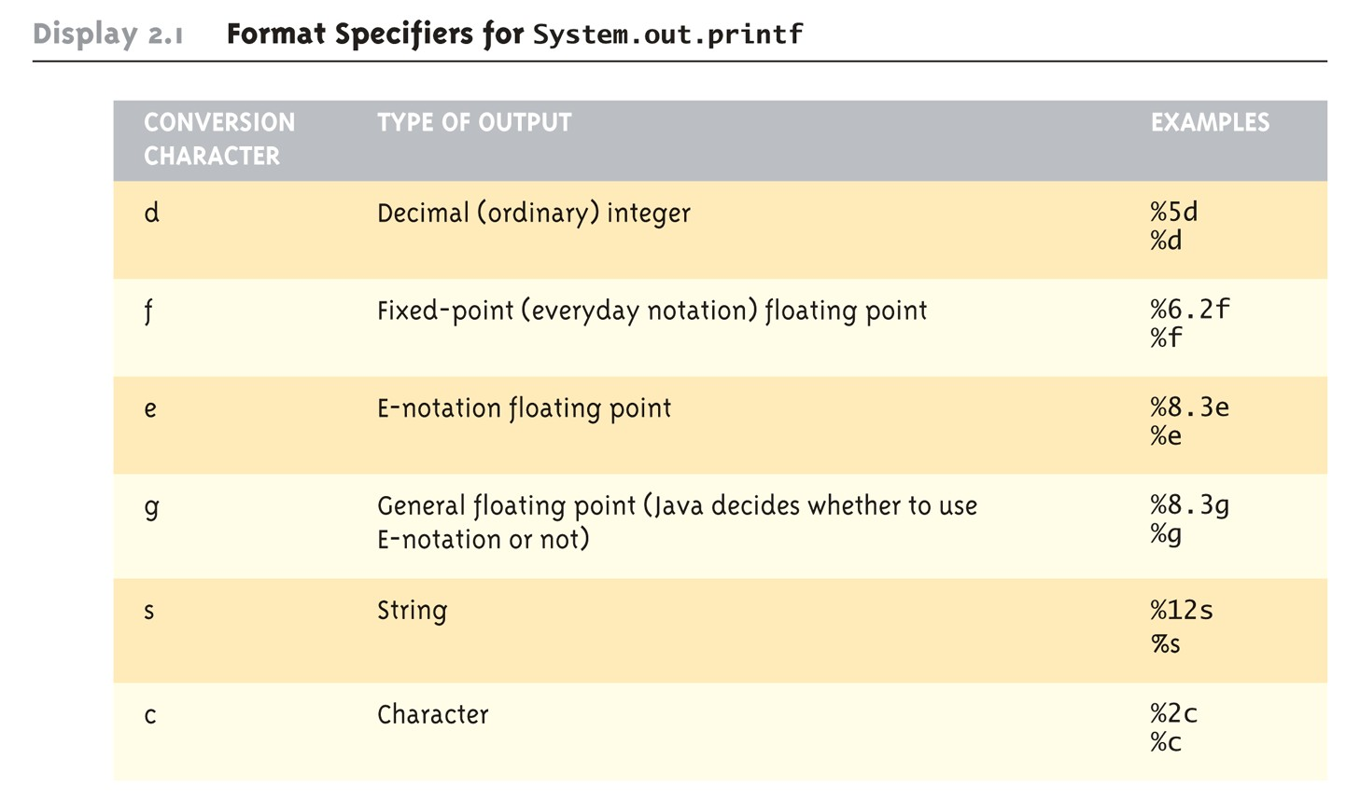
Formatted specifiers

Slide 35
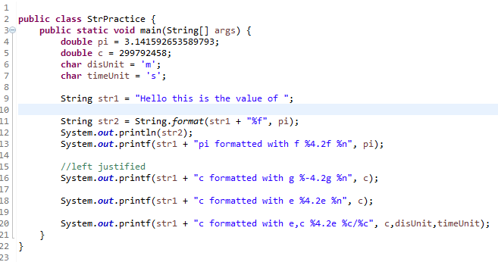
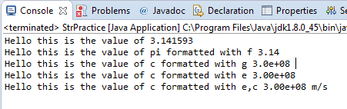
Formatting Output
왜 %n??
‘-’붙이는 이유
앞에 숫자 붙이는 이유

Slide 36
Printing variables
To print a variable to the screen, put it in a System.out.println() statement:
int x = 5;
System.out.println ("The value of x is " + x);
Important points:
Strings are enclosed in double quotes
If there are multiple parts to be printed, they are separated by a plus sign. This will automatically concatenate the parts.

Slide 37
Console Input
It is just as important to input information into your programs as it is to output information.
Prior to java 5.0 there was no simple method to read data from the keyboard.
Programmers needed to create a BufferedReader
Programmers also had to be aware of and handle exceptions that may occur.

Slide 38
Console Input
Java allows for keyboard input using the Scanner class.
Scanner is a part of the java.util package
Before you can use the Scanner class you must first import that package.

Slide 39

Importing Packages
Packages are collections of “pre-compiled” classes that can be utilized.
We must import the package containing the class we would like to use before we can use that class.
– This is done by using the keyword import and the package name at the start of you code.
q The name of the class you would like to import.
q If * is used then we can use any class in the package.
q Name of the package containing the class we wish to use.

Slide 40
Console Input
To use the Scanner within you applications you must import the Scanner class as follows
import java.util.Scanner;
A Scanner object can be created by declaring a variable as type Scanner
Scanner keyboard = new Scanner(System.in);

Slide 41
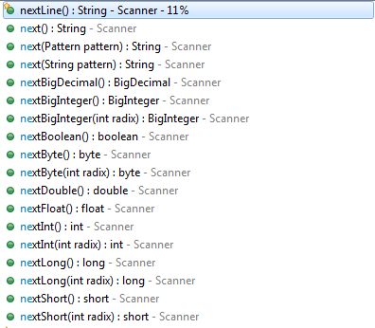
Console Input
The Scanner object provides us with various methods for reading input.

Slide 42
Console Input
int intValue = keyboard.nextInt();
double dValue = keyboard.nextDouble();
Reads one integer or double value.
Each number separated by a whitespace is
considered different.
Multiple inputs must be separated by whitespace and read by multiple invocations of the appropriate method
– Whitespace is any string of characters, such as blank spaces, tabs, and line breaks that print out as white space
String str = keyboard.next ();
Reads a word/string. – A word is a contiguous string of characters not including whitespaces.

Slide 43
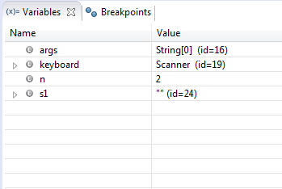
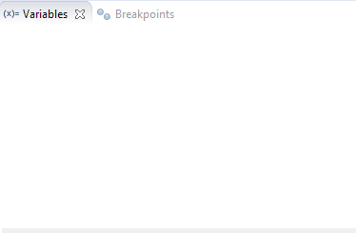
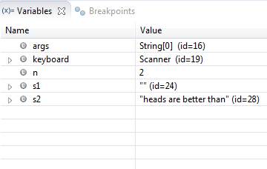
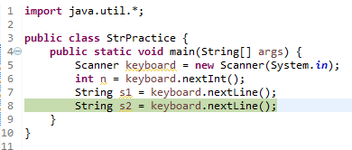
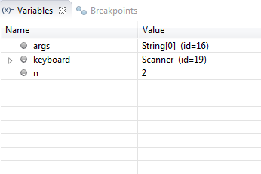
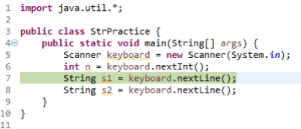
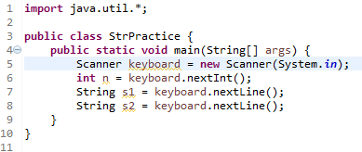
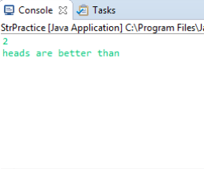
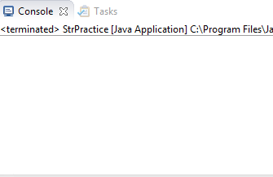
Console Input
nextLine()
This method reads the remaining strings up to the end of the line and discards the EOL (end of line) character.

Slide 44
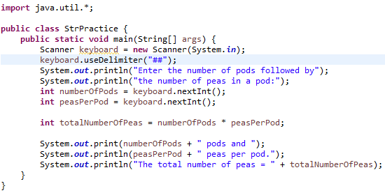
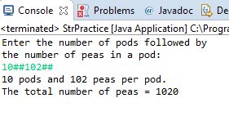
Scanner Class
It is possible to change the delimiters used by the scanner class
This changes the delimiters from being whitespaces to the user-specified value
Scanner keyboard2 = new Scanner(System.in);
Keyboard2.useDelimiter("##");

Slide 45
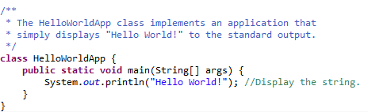
Comments
Double slashes ( //) are used in the Java programming language, and tell the compiler to treat everything from the slashes to the end of the line as text.
Instead of double slashes, you can use C-style comments ( /* */) to enclose one or more lines of code to be treated as text.
Comments are ignored by the compiler but are useful to other programmers

Slide 46
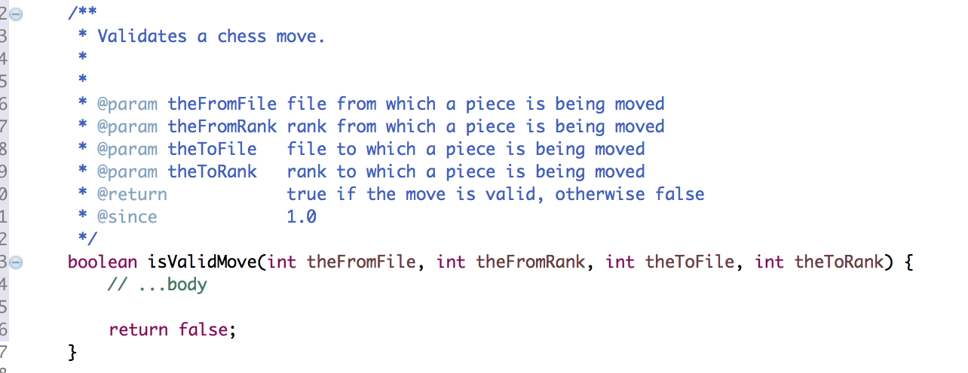
JavaDoc
Generates HTML pages of API documentation from Java source files.
Eclipse Auto Generating
Source → Generate Element Comment

Slide 47
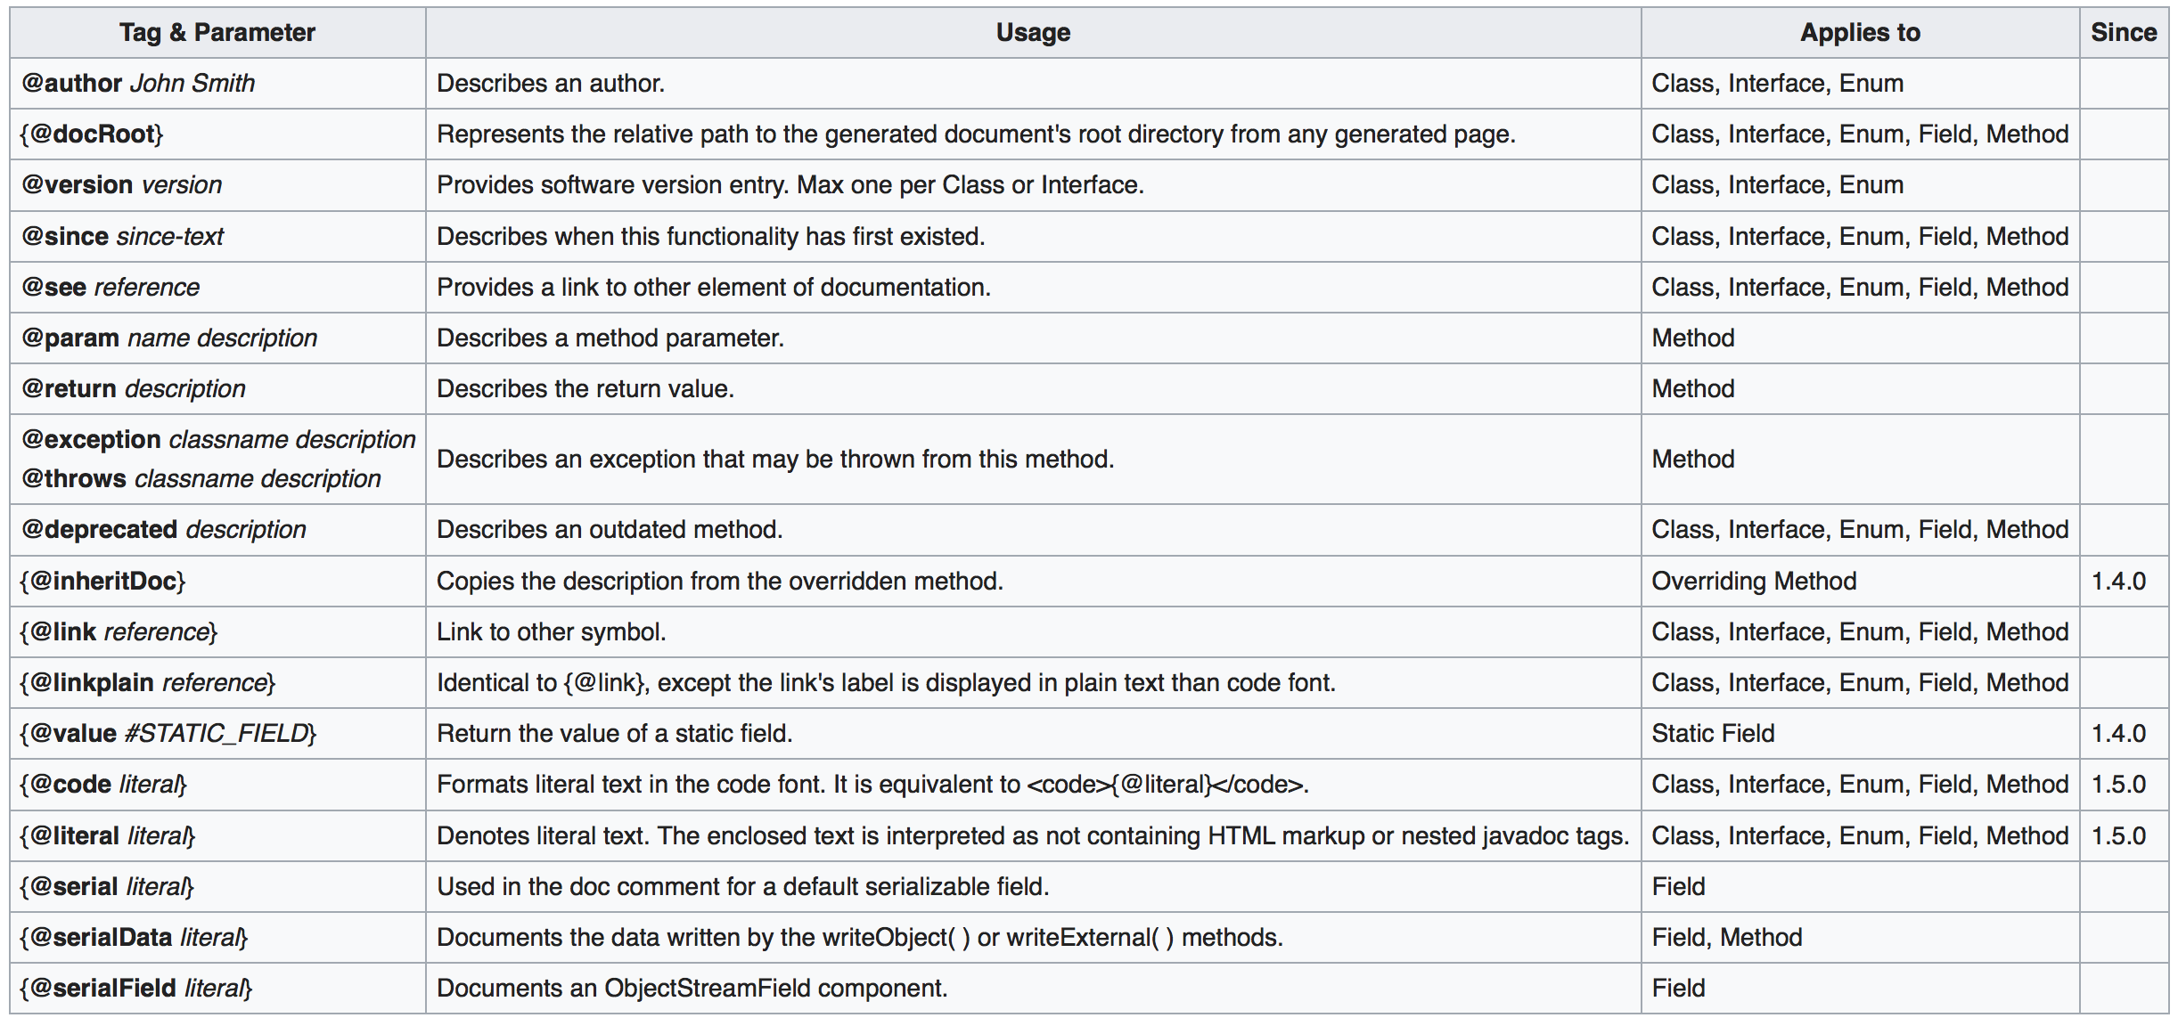
JavaDoc
Generates HTML pages of API documentation from Java source files.

Slide 48
QnA
Questions?

