Slide 1
Star-Pattern Identification Using a Correlation Approach on the Celestial Sphere
Hyosang Yoon
Doctorate Qualifying Exam
Advisor: Prof. Kerri Cahoy
1/26/2015
Notes:
Hi. My name is Hyosang Yoon and I am a first-year graduate student working with professor Kerri Cahoy. I am going to present my research about “Star-Pattern Identification using a correlation approach”.

Slide 2
Outline
Introduction
Motivation
Literature Review
Approach
Simulation Results
Conclusions
Notes:
The outline of my talk will first be an introduction which covers the motivation and background literature. Then I will describe my approach to this problem. I will then present the results and conclusions.

Slide 3
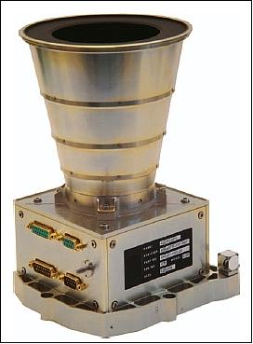
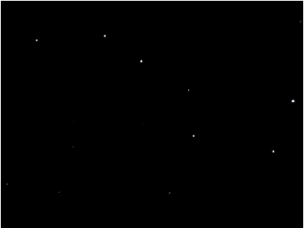
Introduction: Star Sensors
One of the most accurate attitude sensors for spacecraft
Typical accuracy: < 10 arcsec
Determines attitude from image of stars
Notes:
Introduction. A star sensor is one of the most accurate attitude sensors for spacecraft. It estimates a spacecraft’s attitude from images of star patterns.
(Click) This is a picture of a typical star sensor. It looks like a camera, and it is a camera.
(Click) It takes a picture of stars
(Click) and the image will look like this.
(Click) The star sensor will recognize these stars

Slide 4
Introduction: Star Identification
Match the imaged stars to a star catalogue
Star Catalogues
Provide star coordinates in inertial frame (J2000)
SKY2000, Bright Star Catalog (BSC), ect.
2032
Star Catalogue
# | RA (J2000) | DEC (J2000)
⁞ | ⁞ | ⁞
2000 | 8.549865432495 | 34.2687654387
2001 | 8.598732198687 | 33.6875643248
2002 | 8.768735436556 | 34.9687654324
⁞ | ⁞ | ⁞
2045
?
?
2027
?
2011
?
2016
?
Star Identification
2009
?
1998
?
1985
?
Spacecraft Attitude Determination
Notes:
Star identification is a process to match the imaged stars to a star catalogue. Once you have the star image like this
(Click) You do not know which stars these are.
(Click) By star identification which means matching the star pattern to the catalogue,
(Click) You will have their ID numbers and their positions from a star catalogue.
(Click) Then, you can estimate the attitude.
(Laser Pointer) My project focused on this step.

Slide 5

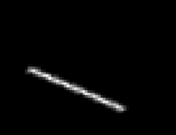
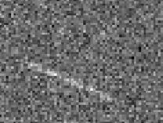
Motivation
Problem: using star sensors in dynamic environment
A star sensor needs a certain integration time for star light
Range: 10 ms ~ 1 sec
Rotation causes image blurring
Increases centroiding error
Weak stars can disappear
Hard to estimate the minimum magnitude of stars on image
Star Image (Blurred)
Star Image (Blurred + Noise)
Star Image (Static)
Notes:
Now, I will talk about the motivation and the objective of my research. There is a problem with using star sensors in a dynamic environment. A star sensor needs a certain time to integrate star light. If a spacecraft is rotating, the star image will be blurred. These pictures show the blurring. In addition, there would also be background noise. Because of both blurring and noise, it may be hard to determine the center position of this star. This increases star centroiding error and some weak stars will disappear on the image.

Slide 6
Research Objective
Make a robust star identification algorithm for a dynamic environment
Robust: possible to identify stars in the presence of noise and errors
The algorithm shall work without preliminary attitude information (i.e. Lost-in-Space)
The sensor should be stand-alone
The algorithm shall be robust with respect to:
Centroid error (star position error)
Missing stars (stars that are missing on the image, but are known to exist based on catalogs)
False-positive (false star or stars not in the catalogue)
Tentative goal
Identification rate > 90% with centroiding error of 60 arcsec and presence of missing stars and false-positives
Notes:
So, I set my research goal to make a robust star identification algorithm for a dynamic environment. “Robust” means that it is possible to identify stars in the presence of noise and errors. There were two requirements for the algorithm. First, the algorithm shall work without preliminary attitude information. In other words, the sensor should be able to give attitude from a single image. Also, the algorithm shall be robust to centroid error, missing stars and false-positives.

Slide 7
Literature Review
Roughly two approaches to star identification
Subgraph Isomorphism
Pattern Recognition
Padgett, 1997 [7]
Junkins, 1977 [3]
Lindsey, 1997 [8]
Motari, 2001 [6]
Na, 2009 [11]
Groth, 1986 [4]
Yoon
Kim, 2004 [9]
Li, 2004 [10]
Bezooijen, 1994 [5]
Notes:
There are several previous researches for star identification algorithms. They can be categorized into roughly two groups – Subgraph Isomorphism and Pattern Recognition.

Slide 8
Approach 1: Subgraph Isomorphism
Compares angular distance and geometric figure
Finds the intersection pairs for each angular distance from pre-constructed star-pair catalog
Triangle Algorithm (Junkins, 1977):
Θ₁-δθ< Θ < Θ₁+δθ
(A,B) | (1, 6), (2, 5), (3, 6), (8, 12)
A: 2 B: 5 C: 8
Θ₂-δθ< Θ < Θ₂+δθ
(B,C) | (2, 8), (1, 4), (5, 8), (9, 13)
Θ₃-δθ< Θ < Θ₃+δθ
(C,A) | (2, 8), (1, 5), (7, 8), (3, 11)
Notes:
Basically, subgraph isomorphism compares angular distance and geometric figures such as triangles that consist of stars. It finds the intersection pairs for each angular distance from pre-constructed star-pair catalog.

Slide 9
Approach 2: Pattern Recognition
Regards a star image as a 2D image and generate 2D discrete pattern
Grid algorithm (Padgett, 1997):
Pattern Generation
Finds the most similar pattern with a pre-constructed onboard pattern database
Notes:
Pattern recognition regards a star image as a 2D image and generate 2D discrete pattern from it. Then, it finds the most similar pattern from onboard database.

Slide 10
Comparison of Approaches
Item | Subgraph Isomorphism | Pattern Recognition
Required # of Stars | Fewer (3 ~ 4) | More (> 5~10)
Performance: Centroiding Error | Weak | Robust
Performance: Missing Stars | Robust | Weak
Performance: False Positive | Robust | Weak
Memory Usage | High | Low
Notes:
This is the comparison of the two groups. They have almost opposite characteristics. Pattern recognition is more robust to centroiding error, or star position error, while Subgraph Isomorphism is better for missing stars and false positives.

Slide 11
Research Gap
Subgraph Isomorphism
Compare angular distance between stars directly
Possible to identify stars, using a small number of stars
Absence of metrics
Unable to resolve ambiguity for several possible solutions
Vulnerable to centroiding error
Pattern Recognition
Uses metrics to represent similarity
Uses angular distance to generate discrete pattern
Insensitive to centroiding error
Needs larger number of stars
Arrangement to fit in 2D frame
Arrangement by pre-defined reference stars
Vulnerable to missing stars and false-positives
Notes:
(continued from the previous slide) The differences are from their methodologies. Subgraph isomorphism uses angular distance directly to select the candidate star-pairs. This is a strong point that enables the identification with a small number of stars. However, the absence of metrics makes it vulnerable to centroiding error because without some metrics, it is hard to resolve ambiguity between several possible solutions.
Unlike subgraph isomorphism, pattern recognition uses metrics that represent similarity of two patterns. But it uses angular distance between stars only to make a discrete pattern. This means pattern recognition is less sensitive or robust to centroiding error. However, it also means it needs larger numbers of stars. Another drawback is the arrangement process of stars to fit in a 2D frame

Slide 12
Outline
Introduction
Motivation
Literature Review
Approach
Simulation Results
Conclusions
Notes:
The outline of my talk will first be an introduction which covers the motivation and background literature. Then I will describe my approach to this problem. I will then present the results and conclusions.

Slide 13
Approach Concept
Pattern recognition with continuous pattern
Combine the advantages of subgraph isomorphism
Using metrics to represent similarity
To determine the most likely one among possible solutions
Using stars’ relative feature (i.e. relative positions) directly to calculate the metrics in continuous domain
To identify star patterns with less number of stars
Resolve the problem with arrangement by pre-defined reference stars
Not using pre-constructed pattern database for each star
Notes:
From this slide, I will talk about my approach to this problem. I decided to use pattern recognition technique, but I tried to combine the advantages of subgraph isomorphism by using stars’ relative positions directly to calculate the metrics in continuous domain. Also, I tried to resolve the problem with arrangement by pre-defined reference stars by NOT using pre-constructed star-pattern database for each star.

Slide 14
Star Pattern Model
Fundamental Question for Star Pattern
What does it mean to say that the i^{th} star’s center is located at (x_{i}, y_{i}) coordinate?
Possible Answer^{1,2}
The probability of the i^{th} star being located at (x_{i}, y_{i}) is high
Model the location of stars as a normally distributed probability density function (PDF)
¹⁾ Yoon, et al., JSR, 2011
²⁾ Yoon, et al., IEEE TAES, 2013
Notes:
From this slide, I will get into my approach in details. This work has been published in these two references. To construct star pattern model, I asked a fundamental question. What does it mean to say that the i-th star’s center is located at (xi, yi)?
My answer to this question is that “The probability of the i-th star being located at (xi, yi) is high”. So, I modeled the location of stars as a normally distributed PDF.

Slide 15
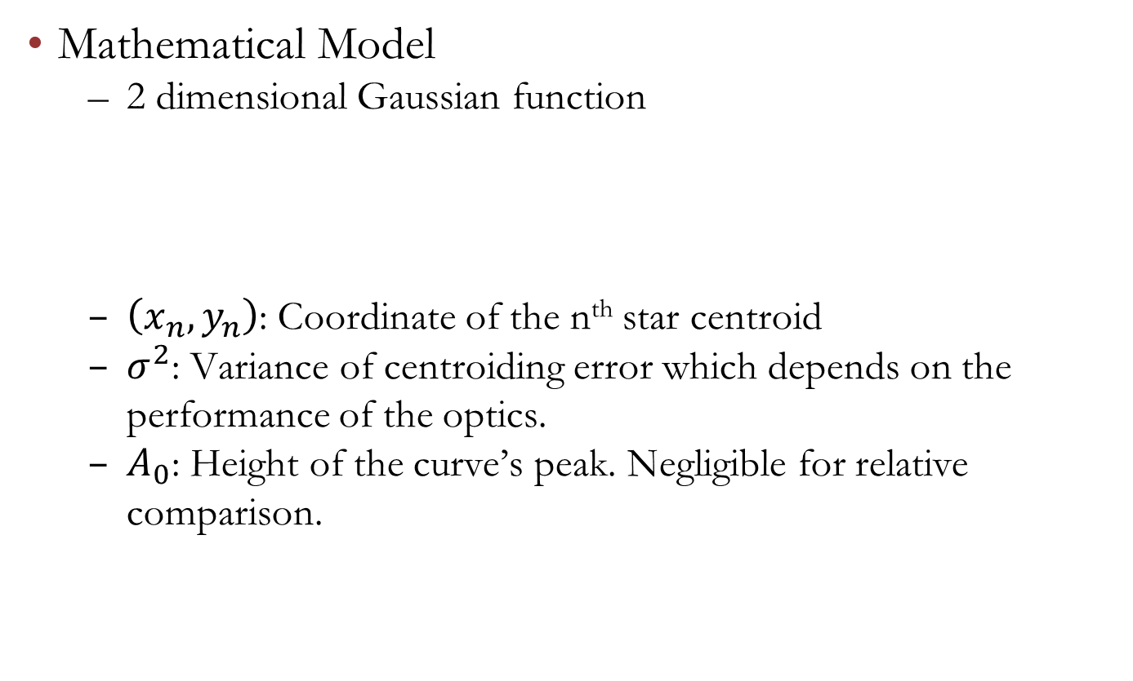
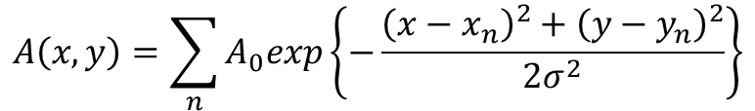
Star Pattern Model
Mathematical Model
2 dimensional Gaussian function
$\left(x_{n},y_{n}\right)$: Coordinate of the n^{th} star centroid
$σ^{2}$: Variance of centroiding error which depends on the performance of the optics.
$A_{0}$: Height of the curve’s peak. Negligible for relative comparison.
$$A\left(x,y\right)=\sum_{n}{A_{0}exp\left\{−\frac{{\left(x−x_{n}\right)}^{2}+{\left(y−y_{n}\right)}^{2}}{2σ^{2}}\right\}}$$
Notes:
If I describe it in mathematical formula, the PDF becomes this. xn yn is the coordinate of the n-th star centroid, sigma square is the variance of centroiding error, which depends on the optics’ performance. A0 is the height of the curve and it is negligible for relative comparison.

Slide 16
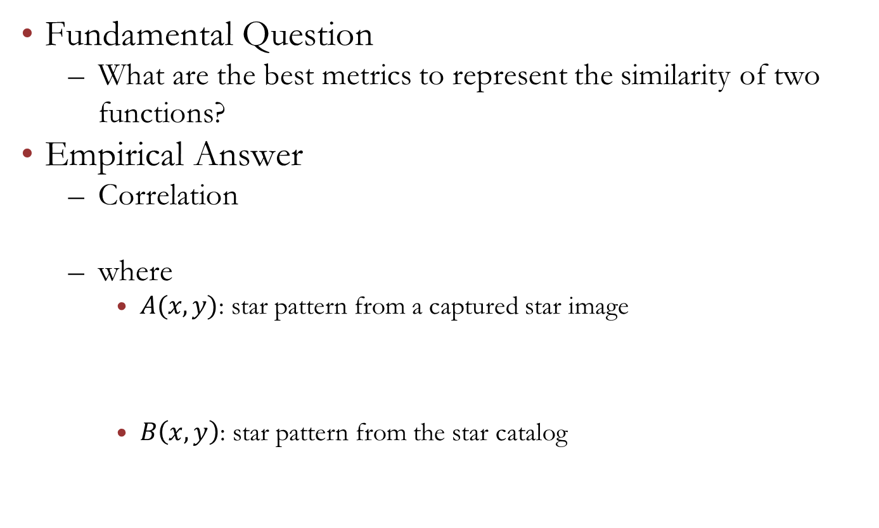
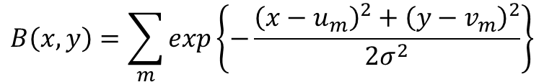
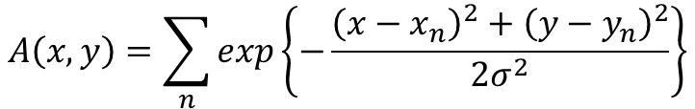

Star Identification Metric
Fundamental Question
What are the best metrics to represent the similarity of two functions?
Empirical Answer
Correlation
where
$A(x,y)$: star pattern from a captured star image
$B\left(x,y\right)$: star pattern from the star catalog
$$S=\iint_{−∞}^{∞}{A\left(x,y\right)B\left(x,y\right)dxdy}$$
$$A\left(x,y\right)=\sum_{n}{exp\left\{−\frac{{\left(x−x_{n}\right)}^{2}+{\left(y−y_{n}\right)}^{2}}{2σ^{2}}\right\}}$$
$$B\left(x,y\right)=\sum_{m}{exp\left\{−\frac{{\left(x−u_{m}\right)}^{2}+{\left(y−v_{m}\right)}^{2}}{2σ^{2}}\right\}}$$
Notes:
For metrics to compare, I asked another fundamental question. “What are the best metrics to represent the similarity of two functions?” There is an empirical answer, which is correlation. 2 dimensional correlation is generally given in this form. A is star pattern from a captured star image and B is the star pattern from the star catalog.

Slide 17

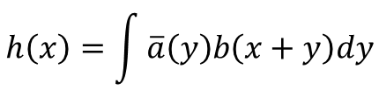
Star Identification Metric
Score Function
Defines metrics to compare in continuous domain
How can we calculate the score function?
Take advantage of Fourier transform
According to the cross-correlation theorem (one-dimensional case),
$$S=\iint_{−∞}^{∞}{\sum_{n}{exp\left\{−\frac{{\left(x−x_{n}\right)}^{2}+{\left(y−y_{n}\right)}^{2}}{2σ^{2}}\right\}}\sum_{m}{exp\left\{−\frac{{\left(x−u_{m}\right)}^{2}+{\left(y−v_{m}\right)}^{2}}{2σ^{2}}\right\}}dxdy}$$
$$h\left(x\right)=\int{\overline{a}\left(y\right)b\left(x+y\right)dy}$$
$$H\left(ω\right)=\overline{A}\left(ω\right)B(ω)$$
Notes:
So, I chose the correlation as the score function. The full formula is like this. It defines metrics to compare in continuous domain unlike previous discrete pattern. This equation seems to be difficult to solve since it has double integrals, sigmas and exponentials of squares.
However, we can just take advantage of Fourier transformation. According to the cross-correlation theorem, the correlation becomes just multiplication in frequency domain.

Slide 18
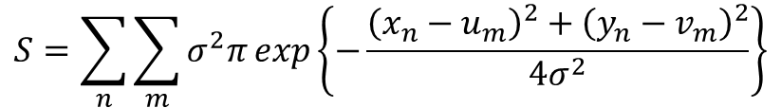
Star Identification Metric
Solve the integral using a Fourier transform
Suitable form for onboard calculation
This score function provides continuous metrics
However, the arrangement problem for the 2D pattern still exists. If one of the reference stars is missing or incorrectly identified, the algorithm fails.
$$S=\sum_{n}{\sum_{m}{σ^{2}π}exp\left\{−\frac{{\left(x_{n}−u_{m}\right)}^{2}+{\left(y_{n}−v_{m}\right)}^{2}}{4σ^{2}}\right\}}$$
Notes:
After some calculation, we can derive the score function as this. This form is very suitable for onboard calculation. This score function provides continuous metrics. However, the arrangement problem for 2D pattern still exists.

Slide 19
Vector Pattern Matching
Stars are on the celestial sphere, not on 2D plane
Each star can be modeled as a unit vector (directional vector) with 3 components
A star can be modeled as a point on a sphere of radius 1
Notes:
So, I proposed vector pattern matching. First, Stars are on the celestial sphere, which is 3D space, not 2D plane. Each star can be modeled as a unit vector and it is a point on a sphere of radius 1.

Slide 20
Vector Pattern Matching
Arrangement in the celestial sphere
Rotates star patterns using the reference pairs
Selects the candidate pairs by searching star-pair catalog
Not needs to generate 2D pattern
Enables to use the star catalog directly in pattern matching
Eliminates the needs of pre-constructed 2D pattern database
Notes:
Therefore, the arrangement should be done on the celestial sphere. The arrangement process uses any two-star pair as the reference. Once we select a reference pair in the imaged pattern, we can select candidate pairs from the pair catalog. Then, rotate imaged patterns so that the reference pairs are superimposed and calculate the score function. This enables to use the star catalog directly in pattern matching. Accordingly, this eliminates the needs of pre-constructed 2D pattern database.

Slide 21
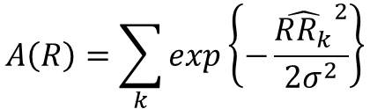
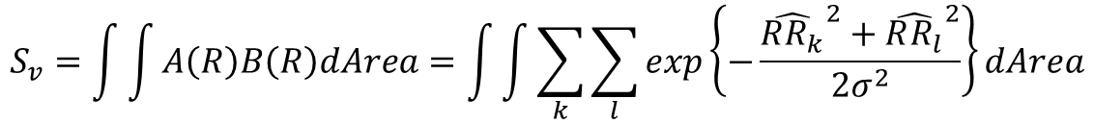
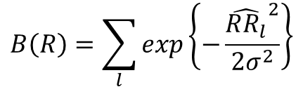
Vector Pattern Matching
Star model and score function in spherical formulation
$$A\left(R\right)=\sum_{k}{exp\left\{−\frac{{\hat{RR_{k}}}^{2}}{2σ^{2}}\right\}}$$
$$B\left(R\right)=\sum_{l}{exp\left\{−\frac{{\hat{RR_{l}}}^{2}}{2σ^{2}}\right\}}$$
$$S_{v}=\int{\int{A\left(R\right)B\left(R\right)dArea}}=\int{\int{\sum_{k}{\sum_{l}{exp\left\{−\frac{{\hat{RR_{k}}}^{2}+{\hat{RR_{l}}}^{2}}{2σ^{2}}\right\}}}dArea}}$$
Notes:
For these vector pattern on the celestial sphere, the mathematic model and the score function becomes like this. This RRk is the arc length between R and Rk. The score function is modified with the arc length as well. This integral is over the sphere surface, so it is hard to get an exact solution.

Slide 22
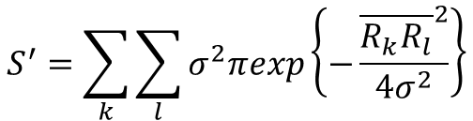
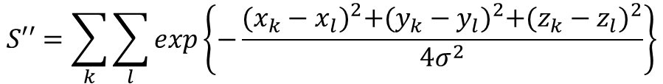
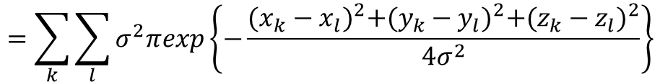
Vector Pattern Matching: Solution
Approximation for meaningful score area
The approximated score function:
For convenience in calculation, neglect the leading term
$$S^{′}=\sum_{k}{\sum_{l}{σ^{2}πexp\left\{−\frac{{\overline{R_{k}R_{l}}}^{2}}{4σ^{2}}\right\}}}$$
$$=\sum_{k}{\sum_{l}{σ^{2}πexp\left\{−\frac{{(x_{k}−x_{l})}^{2}+{(y_{k}−y_{l})}^{2}+{(z_{k}−z_{l})}^{2}}{4σ^{2}}\right\}}}$$
$$S′′=\sum_{k}{\sum_{l}{exp\left\{−\frac{{(x_{k}−x_{l})}^{2}+{(y_{k}−y_{l})}^{2}+{(z_{k}−z_{l})}^{2}}{4σ^{2}}\right\}}}$$
Notes:
However, we can approximate the score function as this, using the properties of the exponential function. The arc length becomes just a line distance in this approximation. For convenience in calculation, we can neglect the leading term as this. This is the new score function for my algorithm.

Slide 23
Outline
Introduction
Motivation
Literature Review
Approach
Simulation Results
Conclusions
Notes:
The outline of my talk will first be an introduction which covers the motivation and background literature. Then I will describe my approach to this problem. I will then present the results and conclusions.

Slide 24
Simulation Description
General Condition
Target Star Sensor: SST-20S (Satrec Initiative, Korea)
CCD size: 1024x1024 (pixels)
FOV: 15 deg (iFOV: 52 arcsec)
Master Star Catalog: SKYMAP 2000 Version 5
Onboard Star Catalog: 4975 stars, Min Mag.: 5.5Mv
Star Centroiding Error: 0-60 arcsec (1σ)
False Positives: 0-3 (brighter than 3.0Mv)
Monte-Carlo simulation (N=10,000) with random attitude
Performance Comparison
Pyramid algorithm (Subgraph isomorphism)
Modified Grid algorithm (Pattern recognition)
Notes:
I now present the results. I conducted monte-carlo simulation to verify the performance of the algorithm. This is the condition of the simulation. The onboard star catalog has 4975 stars where the minimum magnitude of stars is 5.5. I added star centroiding error from 0 to 60 arcsecond, and put 0 to 3 false positives. 10,000 simulations were conducted for each condition. The result was compared to two other algorithms. These two are popular algorithms from each category.

Slide 25
Simulation Description
Performance Metrics
Identification rate
(# of success identification) / (# of total simulation )
Success criterion: more than 2 stars identified correctly without any misidentified stars
At least 2 stars are needed to estimate the attitude
Subsidiary Metrics
Memory usage
Processing time
Notes:
The main metrics for performance is identification rate. It is the percentage of successful identification out of total simulation. The criterion of success is that more than 2 stars identified correctly without any misidentified stars.
Also, there are other metrics to look at for applications. Memory usage and processing time are sometimes considerable for embedded systems.

Slide 26

Simulation Results
Case 1: Standard Case
Minimum star magnitude of 5.5 Mv, same as catalogue
Notes:
In case 1, the stars appeared on the image is identical to that of the star catalog. In plot 2, 3, 4, there is 1, 2, and 3 false positive added to the image. This result shows the pros and cons of the two categories clearly. The subgraph isomorphism is robust to false positives and the pattern recognition is robust to position error. The new algorithm demonstrate the best robustness to both false positives and centroiding error.

Slide 27
Simulation Results
Case 2: “Missing” Stars
Minimum star magnitude of 5.0 Mv rather than 5.5Mv in catalogue
Catalogue: 4975 stars, Simulation: 2911 stars (i.e. 20% of stars “missing”)
Notes:
In case 2, the detection power is less resulting in missing stars compared to star catalog. The results showed that my algorithm gave the accurate performance compared to the algorithms from the other two categories.

Slide 28
Simulation Results
Case 3: False Positives
Minimum star magnitude of 6.0 Mv rather than 5.5 Mv in catalogue
Catalogue: 4975 stars, Simulation: 8559 stars (i.e. 40% dark false-positives)
Notes:
In case 3, more stars appeared on the image than the onboard star catalog. The stars not included in the onboard star catalog are just false positives for the star sensor. In this case, the new algorithm showed consistently high performance while the others showed significantly decreased performance.

Slide 29
Outline
Introduction
Motivation
Literature Review
Approach
Simulation Results
Conclusions
Notes:
The outline of my talk will first be an introduction which covers the motivation and background literature. Then I will describe my approach to this problem. I will then present the results and conclusions.

Slide 30
Conclusions
Developed star identification algorithm which is robust to centroiding error, missing stars, and false-positives
The performance was verified by numerous Monte-Carlo simulations
Drawback
Complexity
Pair-catalog search, arrangement, score calculation
Memory usage for database
874KB (Proposed), 667KB (M. Grid), 2,961KB (Pyramid)
Identification time
10,000 times on 2.4 GHz Intel Core2 Quad
738 sec (Proposed), 365 sec (M. Grid), 279 sec (Pyramid)
More processing steps
Calculation of exponentials
Notes:
Conclusions. I developed a star identification algorithm which is robust to centroiding error, missing stars, and false positives. The performance of the new algorithm was verified by numerous Monte-Carlo simulations.
However, the algorithm does have some drawbacks. It is more complicated than the others since it goes through the processes from the both categories. Also, it uses more memory than traditional pattern matching algorithms. The identification time is the biggest drawback of this algorithm. The identification time is greater than twice that of the modified grid algorithm and the pyramid algorithm. This is because it goes through more processing steps and the calculation of an exponential in the score function takes more time.

Slide 31
Conclusions
Future Work
Reduce identification time
By optimization of exponential calculation
Arrangement by three reference stars
Needs larger star-pair catalog
Correlation calculation in frequency domain
Fourier transform on the sphere’s surface
Finds the best-fit position in the celestial sphere in frequency domain
Will dramatically reduce the complexity of the algorithm
Can take advantage of digital processing technology specialized in Fast Fourier Transform
Notes:
For future study, the most pressing issue is to reduce the identification time. It can be done by optimization of the exponential calculation. Also, I want to find a method to calculate the correlation in frequency domain, like correlation pattern matching technique in image processing. If I can find a method to take Fourier transform on a sphere’s surface, we can find the best-fit position of the imaged star pattern in the celestial sphere in frequency domain. This will dramatically reduce the complexity of the algorithm as well as the identification time.

Slide 32
References
References
[1] Yoon, H., et al., “New Star-Pattern Identification Using a Correlation Approach for Spacecraft Attitude Determination”, Journal of Spacecraft and Rockets, Vol. 48, No. 1, 2011, pp. 182-186.
[2] Yoon, H., et al., “New Star Pattern Identification with Vector Pattern Matching for Attitude Determination”, IEEE Transactions on Aerospace and Electronic Systems, Vol. 49, No. 2, 2013, pp. 1108-1118.
[3] Junkins, J. L., White, C., and Turner, J., “Star pattern recognition for real-time attitude determination”, Journal of the Astronautical Sciences, Vol. 25, 1977, pp. 251-270.
[4] Groth, E. J. “A pattern matching algorithm for two-dimensional coordinates lists”, Astronomical Journal, Vol. 91, 1986, pp. 1244-1248.
[5] Bezooijen, R. W. H. V., “True-sky demonstration of an autonomous star tracker”, Proceedings of SPIE-International Society for Optical Engineering 2221, 1994, pp. 156-168.
[6] Mortari, D., Junkins, J. L., and Samman, M. A., “Lost-in-space pyramid algorithm for robust star pattern recognition”, Paper AAS 01-004 Guidance and Control Conference, Breckenridge, Colorado, 2001.
[7] Padgett. C., and Delgado. K. K., “A grid algorithm for star identification”, IEEE Transactions on Aerospace and Electronics Systems, Vol. 33, Jan. 1997, pp, 202-213.
[8] Lindsey, C. S., Lindblad, T., and Eide, A. J., “Method for star identification using neural networks”, In Proceedings of SPIE International Society of Optical Engineering, 1997, pp. 471-478.
[9] Kim, K. T., and Bang, H., “Reliable star pattern identification technique by using neural networks”, Journal of theAstronautical Sciences, Vol. 52, No. 1-2 Jan.-June 2004, pp. 239-249.
[10] Li, L. H., Zhang, F. E., and Lin, T., “An all-sky autonomous star map identification algorithm based on genetic algorithm”, Opto-Electronic Engineering, Vol. 27, No. 5, 2000, pp. 15-18.
[11] Na, M., Zheng, D., and Jia, P., “Modified Grid Algorithm for Noisy All-Sky Autonomous Star Identification”, IEEE Transactions on Aerospace and Electronics Systems, Vol. 45, No. 2, April 2009, pp. 516-522.

Slide 33
Back-up
From this, Back-up Slides!

Slide 34


Tentative Goals
Success identification rate: > 90 %
Usually, a spacecraft has 2 or more star sensors
To guarantee 99% of attitude acquisition rate
Centroiting error (star position error): 60 arcsec
iFOV (1 pixel) of the target star sensor: 52 arcsec
Targeting the worst position error as 1 pixel
Maximum false-positives (bright): 3
Main causes of false-positives
The planets of our solar systems (bright)
Noise (dark)
$$0.99=1−{(1−p)}^{2}$$
$$p=0.9$$

Slide 35
Two Approaches
Subgraph Isomorphism
Compare angular distance and geometric figure
Find the intersection pairs for each angular distance from pre-constructed star-pair catalog
Pattern Recognition
Regard a star image as a 2D image and generate 2D discrete pattern
Find the most similar pattern with an pre-constructed onboard pattern database
Notes:
Basically, subgraph isomorphism compares angular distance and geometric figures such as triangles that consist of stars. It finds the intersection pairs for each angular distance from pre-constructed star-pair catalog.
Pattern recognition regards a star image as a 2D image and generate 2D discrete pattern from it. Then, it finds the most similar pattern from onboard database.

Slide 36
Approach 1: Subgraph Isomorphism
Compare angular distance and geometric figure
E.g. Triangle Algorithm (Junkins, 1977), Pyramid Algorithm (Mortari, 2001)
Find the intersection pairs for each angular distance from pre-constructed star-pair catalog
Triangle Algorithm:
Θ₁-δθ< Θ < Θ₁+δθ
(A,B) | (1, 6), (2, 5), (3, 6), (8, 12)
A: 2 B: 5 C: 8
Θ₂-δθ< Θ < Θ₂+δθ
(B,C) | (2, 8), (1, 4), (5, 8), (9, 13)
Θ₃-δθ< Θ < Θ₃+δθ
(C,A) | (2, 8), (1, 5), (7, 8), (3, 11)
Notes:
Subgraph isomorphism is the first concept for star identification and it started from the 1970s. It compares angular distance and geometric figures. Basically, it identifies stars by finding the intersection pairs for each angular distance from a pre-constructed star-pair catalog. Triangle algorithm is a basic concept of this category.
Let’s say you have three stars on the image. You can calculate the angular distance between the stars, theta1, theta2 and theta3. With a proper margin of delta theta, you will pick the candidates for each pairs from star-pair catalog. By finding the intersection pairs, you can identify the A, B, C stars.

Slide 37
Approach 2: Pattern Recognition
Find the most similar image pattern with an onboard database pattern
Grid algorithm (Padgett, 1997), Neural network algorithm (Lindsey, 1997), Genetic Algorithm (Li, 2000)
Grid algorithm:
Pattern Generation
A_{ij}
Notes:
Pattern recognition is a method to identify the stars using pattern matching techniques. It regards a star image as a two dimensional image and finds the most similar image pattern from an onboard pattern database. Grid algorithm is a representative one in this category.
These pictures show the pattern generation process in grid algorithm. First, it chooses a prospective center star and selects the other stars within a certain radius. After positioning the stars to locate the center star at the center of image, it chooses the star nearest to the center star and rotates the field of view so that the closest star is located on the X-axis. Then, a grid is placed on the image and each grid is designated 1 if there is a star and 0 if there is not.
(click) This grid or matrix is your pattern for matching.

Slide 38
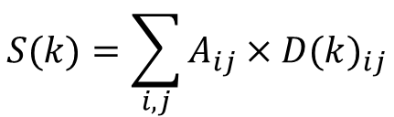
Approach 2: Pattern Recognition
Grid algorithm
Score function
where D(k)_{ij} is the pre-generated pattern for k^{th} star
Identify stars with pattern matching
Find k^{th} star’s pattern that maximizes the score function S(k)
Identify the imaged stars with the k^{th} star pattern
$$S(k)=\sum_{i,j}{A_{ij}{×D(k)}_{ij}}$$
Notes:
For matching the patterns, you can calculate the score value as this equation, which is a correlation between two patterns. You can find the most similar pattern that maximizes this score function and identify the stars with it.

Slide 39
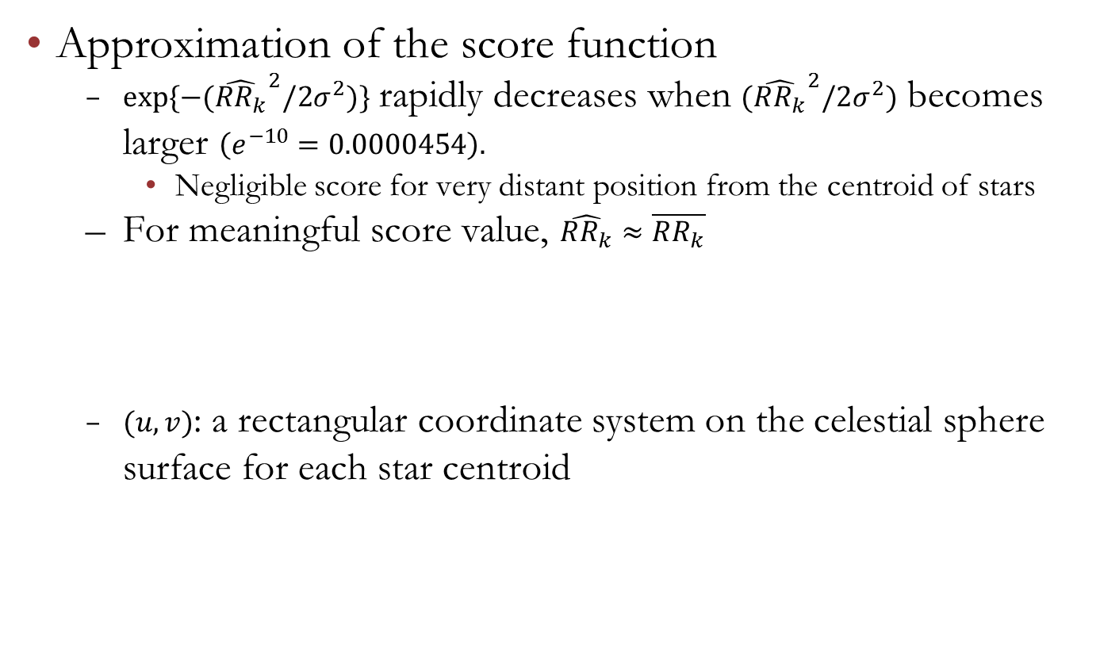
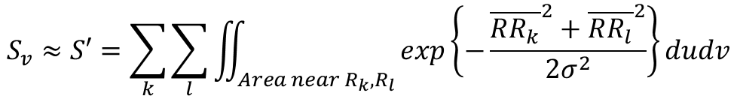
Vector Pattern Matching
Approximation of the score function
$exp⁡\{−{(\hat{RR_{k}}}^{2}/2σ^{2})\}$ rapidly decreases when ${(\hat{RR_{k}}}^{2}/2σ^{2})$ becomes larger $\left(e^{−10}=0.0000454\right).$
Negligible score for very distant position from the centroid of stars
For meaningful score value, $\hat{RR_{k}}≈\overline{RR_{k}}$
$(u,v)$: a rectangular coordinate system on the celestial sphere surface for each star centroid
$$S_{v}≈S′=\sum_{k}{\sum_{l}{\iint_{Area near R_{k},R_{l}}{exp\left\{−\frac{{\overline{RR_{k}}}^{2}+{\overline{RR_{l}}}^{2}}{2σ^{2}}\right\}dudv}}}$$
Notes:
But, we can get an approximation of the score function. This approximation is based on the exponential property. This exponential decreases rapidly as this value becomes large. This means the score for distant position from the centroid of stars is negligible. The meaningful score values are at near Rk and Rl, and for these areas, we can approximate the arc-length as the line distance. So the score function becomes this.

Slide 40
Summary of Approach
Generate unit star vectors from the star image
Select two stars for the reference pair of rotation
Select candidate star pairs from star-pair catalog
Rotate star vectors in order to fit the reference pair to the candidate pairs
Calculate the score for each candidate pair
Compare and select the highest score pair
Notes:
To summarize my approach. First, generate unit star vectors from the star image. Select two stars for the reference pair of rotation and select candidate star pairs from star-pair catalog. Then rotate star vectors in order to fit the reference pair to the candidate pairs. Calculate the score for each pair and compare them. Finally, you can select the highest score pair.

