Slide 1
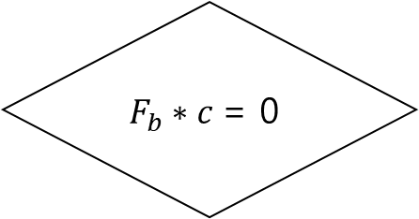
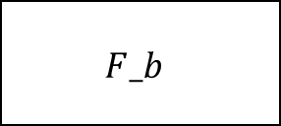
Block Information
$$F_b$$
Decoder
nonce
SHA-256
$$F_{b}∗c \text{= 0}$$
No : change nonce
Yes : success

Slide 2
Code word
Generated error
Correctable error
2bit
1bit

Slide 3
Convert outputs
LDPC -> Bitcoin
Bitcoin
LDPC decoder
Convert parameters
Bitcoin -> LDPC

Slide 4
function1
function2
LDPC decoder
function3
.
.
.
Function n

Slide 5
LDPC -> Bitcoin
function1
function2
Bitcoin
LDPC decoder
function3
.
.
.
Function n
Bitcoin -> LDPC

