Slide 1
Relational Reasoning
Relationship of object and human
20191003 Hyoungsung Kim
hyoungsung@gist.ac.kr

Slide 2
Compositional Learning for Human Object Interaction
Publish : ECCV 2018

Slide 3
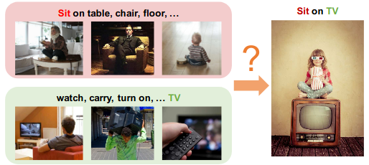
Contribution of this paper
Previous approaches about modeling actions and human-object interaction(HOI) require a lot of data
It is weak to new categories(zero shot learning)
Authors mentioned, zero shot learning is “Categories at testing time are not presented during training”
To handle unseen categories, authors propose a model with method using external knowledge graph and graph convolutional network

Slide 4
Why compositional learning
Human actions are naturally compositional and humans have amazing ability to achieve similar goals with different objects and tools.
For example , while one can use hammer for the hitting the nail, we can also use a hard-cover book for the same.
We can thus leverage this unique composition to help recognizing novel actions.

Slide 5
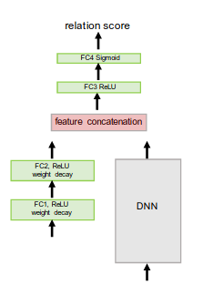
Intuitive understand of this paper
This part is replaced to Graph
Basic architecture for ZSL

Slide 6
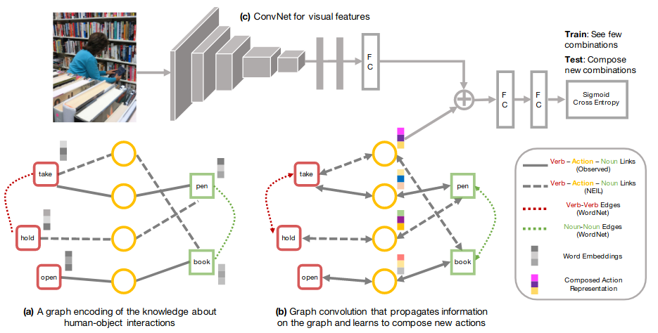
How…?
How can a model learn to compose a novel action within the context?
Authors propose to explore using external knowledge to bridge the gap of contextuality, and to help the modeling of compositionality for human object interactions.
Specifically, authors extract Subject, Verb and Object (SVO) triplets from knowledge bases to build an external knowledge graph.
These triplets capture a large range of human object interactions, and encode our knowledge about actions.
Notes:
gap of contextuality : 하드 커버 책을 망치 대신 사용하게 하는 방법을 어떻게 알게 할 것인가?

Slide 7
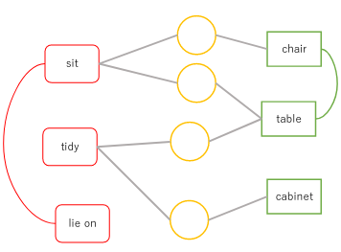
Graph representation of interactions
Pairs of verb-noun nodes are linked via action nodes (circle), and verb-verb/noun-noun pairs can be connected.
These action nodes start with all zero features, and must learn its representation by propagating information along the graph during training.
This information passing is achieved by using a multi-layer graph convolutional network

Slide 8
Model architecture - overview

Slide 9
Model architecture - Encoding knowledge
In this part, it encodes SVO(subject, Verb, Object) pairs to graph
Each verb or noun is represented as a node and comes with its word embeddings as the node’s features (word embedding : A kind of way to map natural language to vector space)
Verb and noun are connected by observation or external knowledge (WordNet : data from dictionary database, NEIL : data from web)

Slide 10
Model architecture - Graph convolutional network
Learning will propagate features on the graph, and fill in new representations for the action nodes. These action features are further merged with visual features from a convoluational network (Remember at first time actions start with all zeros features)

Slide 11
Model architecture - Convolution, concatenate, and ge score
CNN extract visual features from image
Extracted features are concatenated with action representation of graph

Slide 12
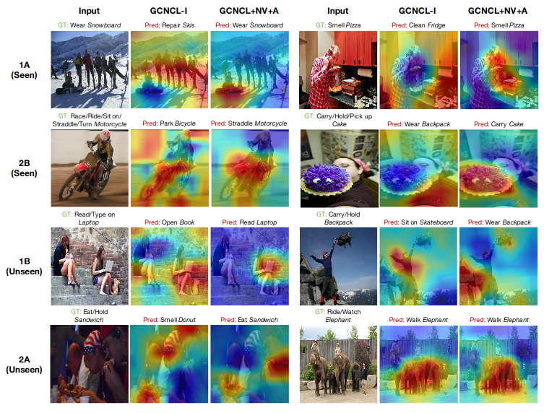
Result(Attention map using top-1 predict labels)
Red regions correspond to high prediction scores
GCNCL-I : Only include link of (verb, noun), (object, noun). e.g, There is no (verb, verb) or (object, object)
GCNCL : Add action edge using WordNet
A : Add action links from external knowledge
NV : Include new tokens(1 hop on WordNet)
1A, 2B, 1B, 2A : Name of subset
1 / 2 : Noun group
A / B : verbs group
For example, if 1A and 2B are used in training set, then 1B and 2A are not used in training
However testing set consists of {1A, 1B, 2A, 2B}
Notes:
(Authors mentions that this show best result.)

Slide 13
Recap
It increase neighborhood nodes of graph using external knowledge (Compositional learning)
Therefore, it is possible to get more features in GCNN
These features are helpful to recognize unseen categories

Slide 14
Learning to Detect Human-Object Interactions With Knowledge
Publish : CVPR 2019

