Slide 1
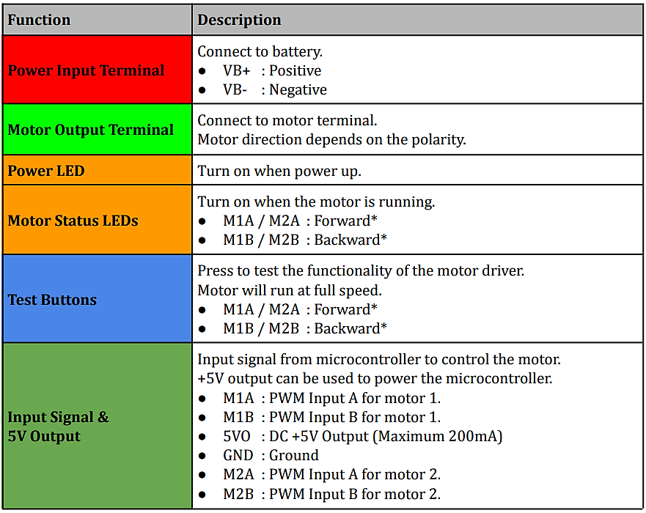
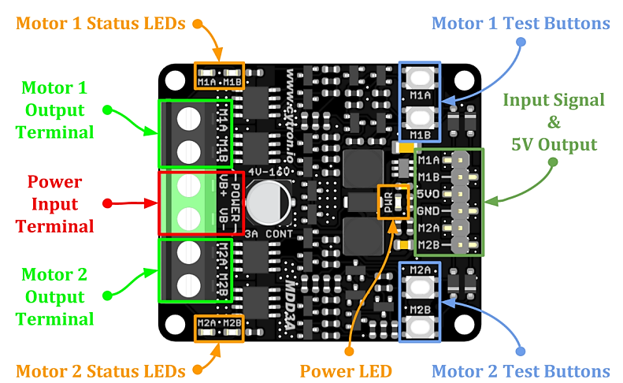
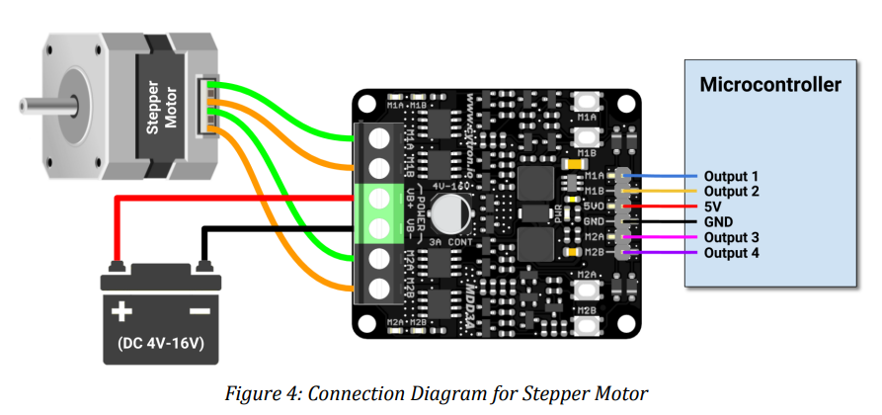
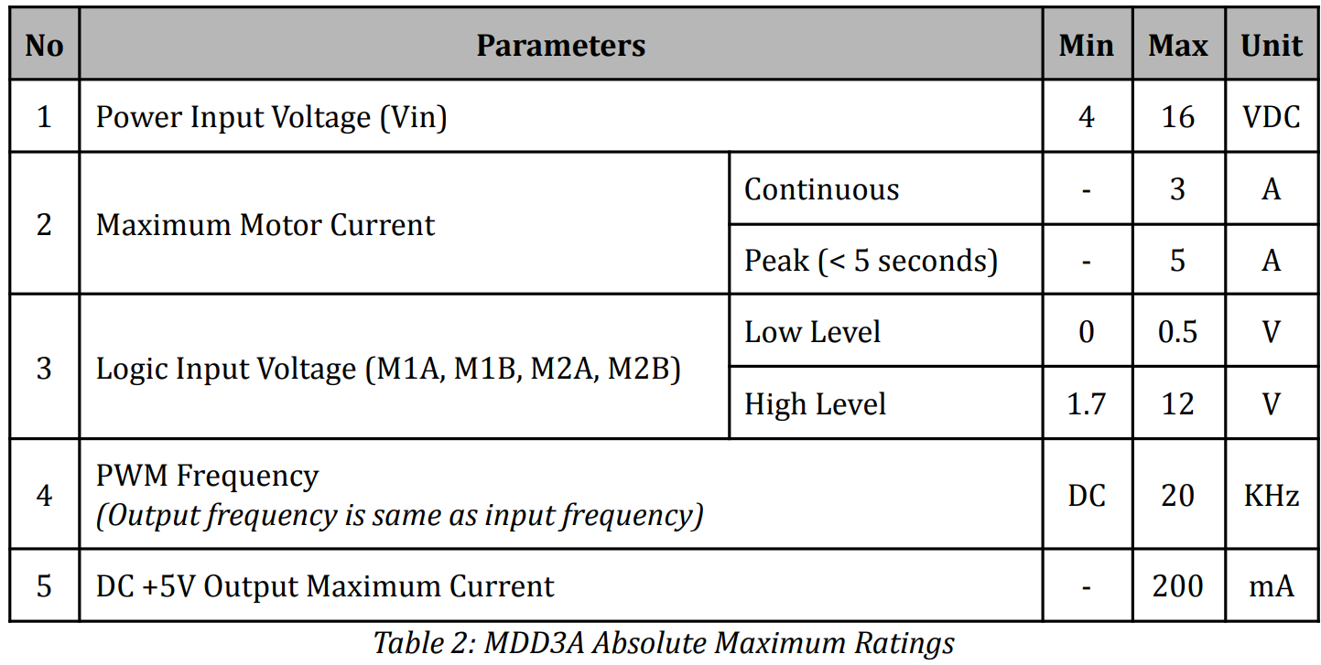
https://www.electrokit.com/uploads/productfile/41018/MDD3A%20Datasheet.pdf

Slide 2
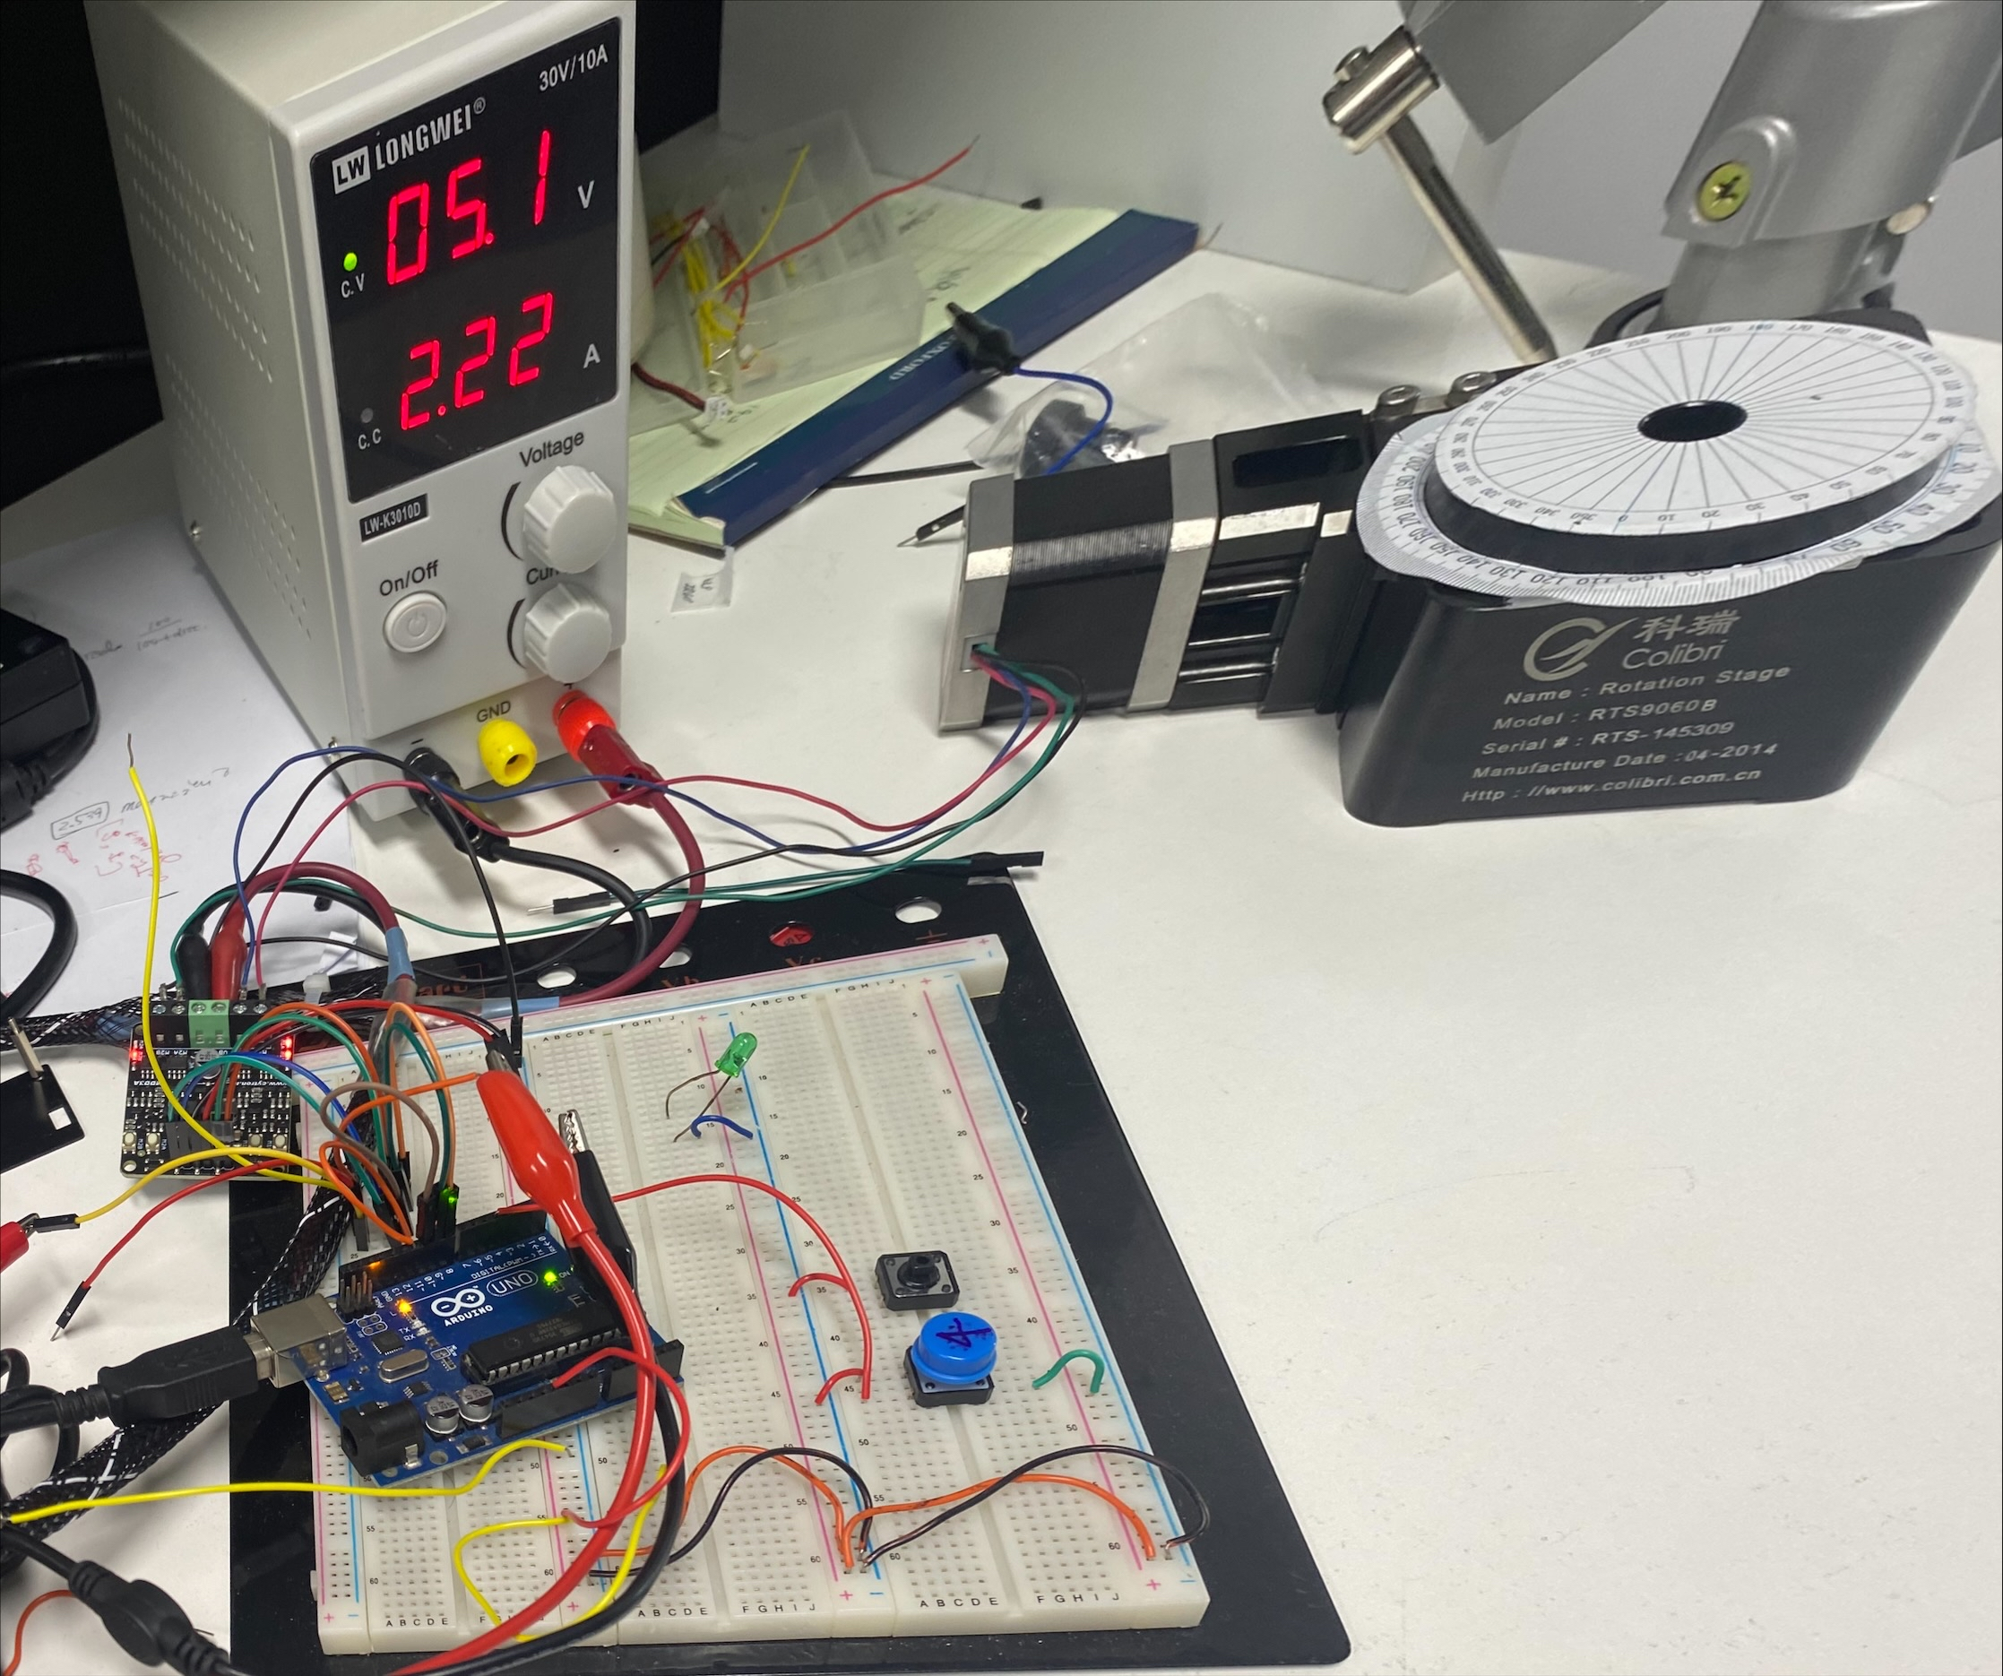
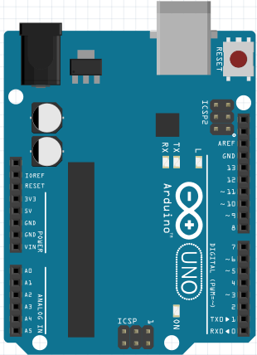
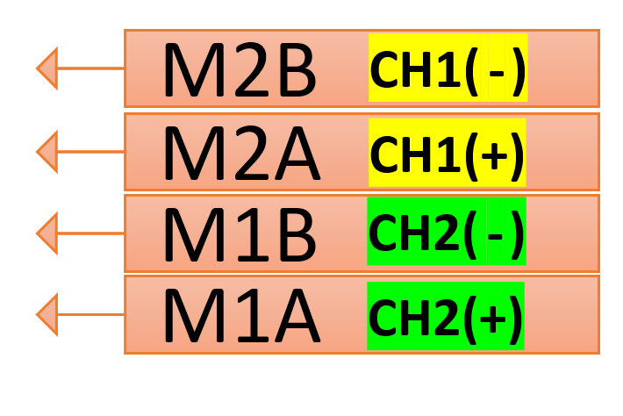
#define MotorInterfaceType 4 // Full 4 wires (2-phase)
#define MP1 8 //M1A
#define MP2 9 //M1B
#define MP3 10 //M2A
#define MP4 11 //M2B
//Steps per revolution 2phase stepper stage(gear ratio :60) AccelStepper stepper = AccelStepper(MotorInterfaceType, MP1, MP2, MP3, MP4
const int SPR = 12000;
const int rev = int(round(SPR/4.0));
1회전 : 12000 [steps]
90° 회전 : 12000/4 [steps]
stepper.setMaxSpeed(100);//maximum motor speed in steps per second
stepper.setAcceleration(50);//maximum acceleration in steps per second^2
stepper.setCurrentPosition(0.0);
최대속도 : 100 [steps/sec ]
가속도 : 50 [steps/sec²]
Clockwise
stepper.move(rev);
stepper.runToPosition();
Counter-Clockwise
stepper.moveTo(0);
stepper.runToPosition();

Slide 3
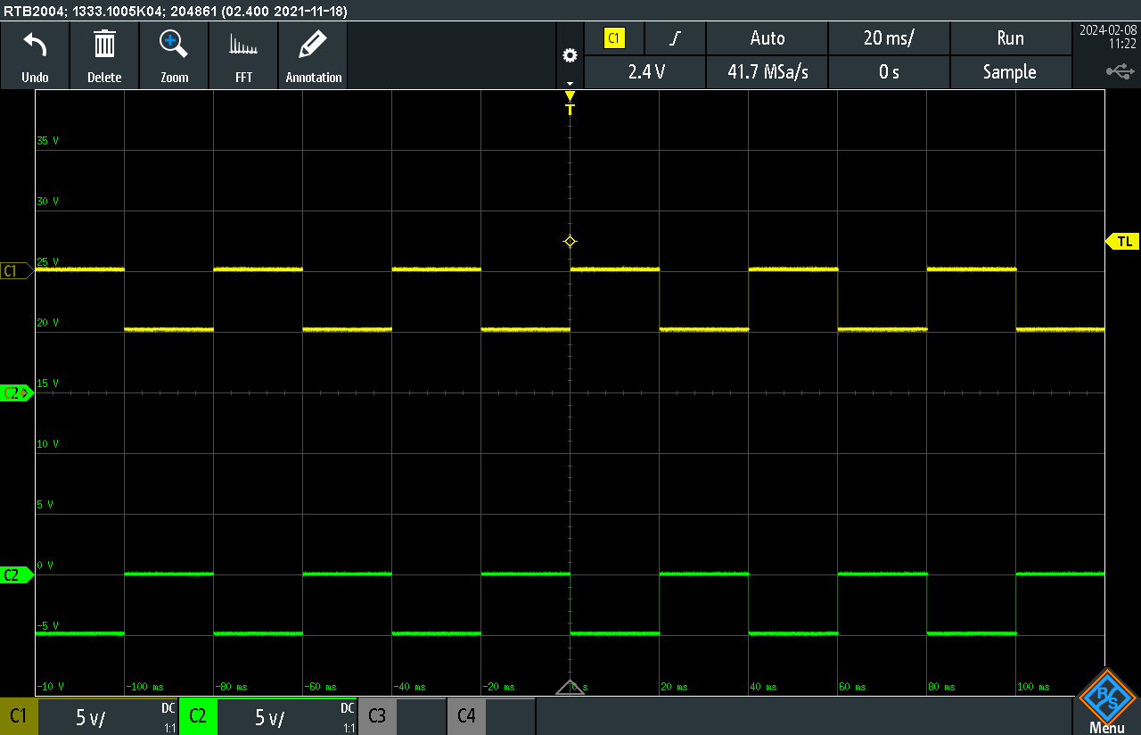
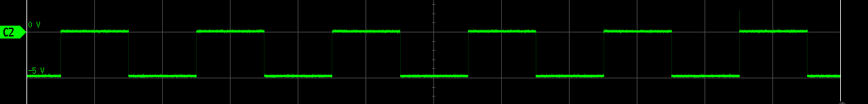

Clockwise
M1A
M1B
M2A
M2B

Slide 4



Counter-Clockwise
M1A
M1B
M2A
M2B

Slide 5
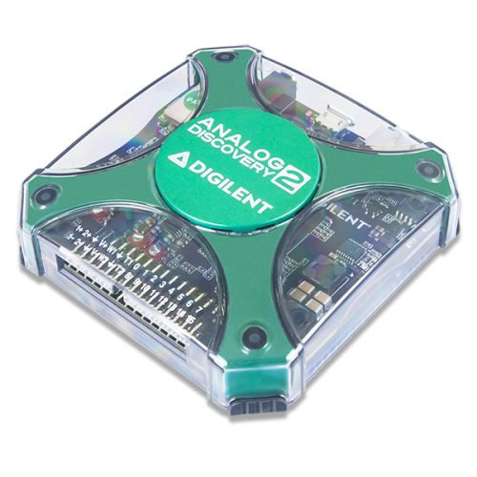
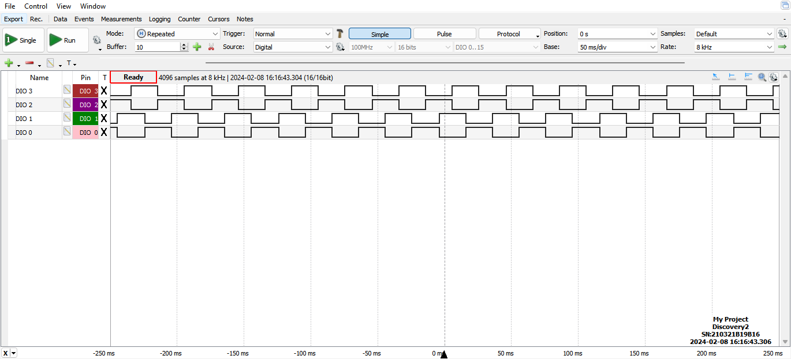
https://digilent.com/shop/software/digilent-waveforms/
https://digilent.com/reference/software/waveforms/waveforms-3/start

