Slide 1
Book Shop Create Order System
Class Name: PF1121
Group Name: H&T
Member: Nguyễn Hoàng Hiệp
Đinh Thanh Tuấn

Slide 2
Objectives
For the Book shop create order system, the main objective is to provide functionalities related to order management and daily revenue tracking. This ensures efficiency and convenience in business operations management. Specifically, the key objectives include:
- Staff login: Develop a secure and user-friendly login interface for staff members to access the system.
- Create orders: Provide the capability for staff to create order, payment and export invoices.
- View staff revenue in Today: Display information regarding the revenue generated by each staff member inToday. This helps monitor individual performance and evaluate contributions.
- Confirm or cancel payments: Allow staff to confirm receipt of payments or cancel payments. This helps manage payment statuses accurately and efficiently.
In summary, the system aims to enhance business operations management by offering convenient functionalities for staff, including order creation, confirm order and payment, then export invoices, revenue tracking.

Slide 3
Introduction to Project
1.Proposed System
Creating a program for Staff create order and confirm payment or cancel order, then confirm export invoices.
Creating a program for Staff view their revenue .
2.The scope of the project to be applied.
The scope of the project includes the development of core functions of the system, such as user authentication, data management, and reporting.
3.System Name
System named “Book shop create order system”.
4.Deployment Environment
The system will be deployed on a personal computer platform, ready and easily accessible. And can only be accessed on 1 device
5.Development Tools
Visual Studio Code
Draw.io Diagram
MySQL Workbench 8.0 CE.
Book Shop Create Order System

Slide 4
Customer Requirements
"Customer Requirements for Book Shop Create Order System:
User-Friendly Staff Login: Staff expect an intuitive and secure staff login process that ensures authorized access to the system. The login interface should prioritize ease of use and data security.
Effortless Order Creation: Staff require a seamless process for staff to create new orders. The system should allow staff to input customer details, order items, quantities, and allow staff to confirm order.
Transparent Daily Revenue Tracking: Staff expect the ability to view detailed staff revenue reports for each day. The system should provide clear breakdowns of revenue generated by individual staff members.
Accessible Invoice Information: Staff require the system to display invoices in a user-friendly manner. Invoices should include comprehensive information, such as itemized lists of products or services, pricing, and payment statuses. Customers should easily understand their financial transactions.
Efficient Payment Handling: Staff want the option to confirm or cancel payments associated with their orders. The system should ensure that payment confirmations are straightforward and that cancellations are promptly processed. This feature boosts customer confidence in payment accuracy.
Overall, the customer requirements center around a user-friendly and efficient Book Shop Create Order System that empowers staff to create orders seamlessly, provides insights into daily staff revenue, offers transparent invoicing details, and enables hassle-free payment confirmation or cancellation. Meeting these requirements will contribute to a positive customer experience and streamlined business operations.
Book Shop Create Order System

Slide 5
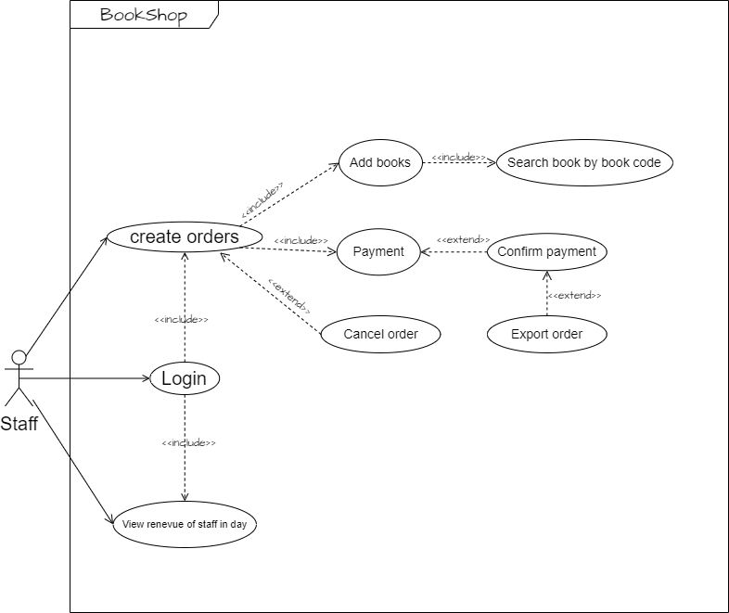
Use Case

Slide 6
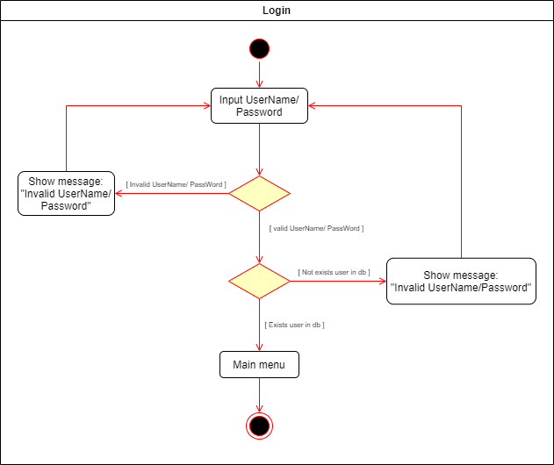
Activity Diagram
1.Login

Slide 7
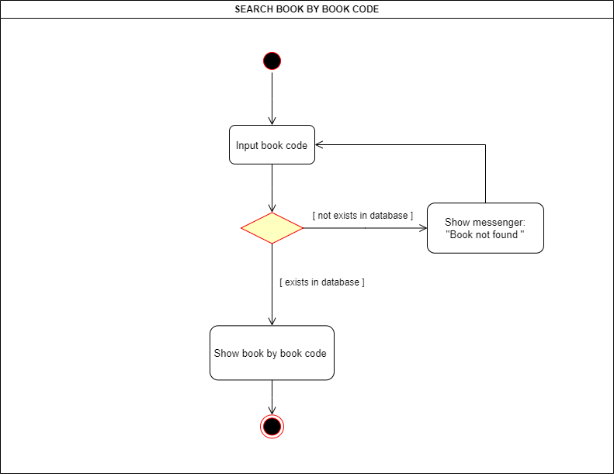
Activity Diagram
2.Search book by code

Slide 8
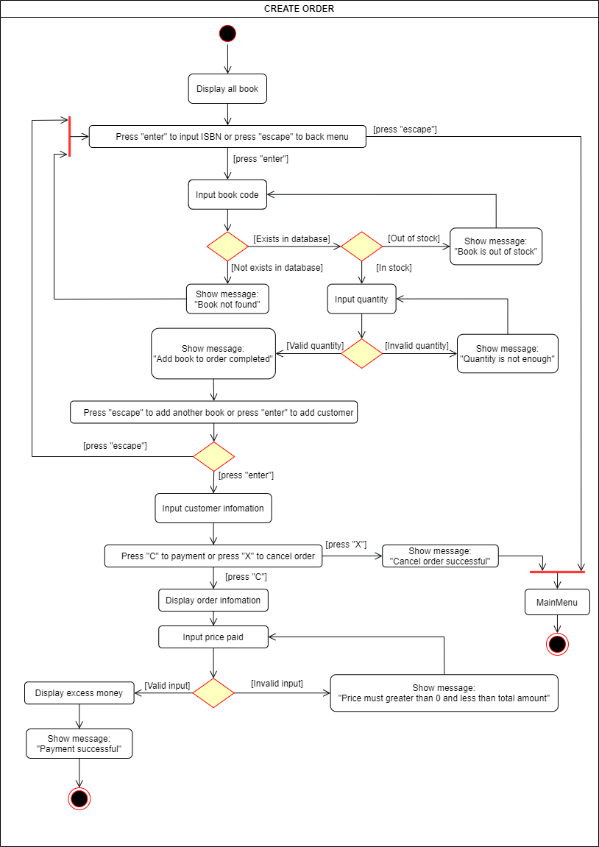
Activity Diagram
3. Create order

Slide 9
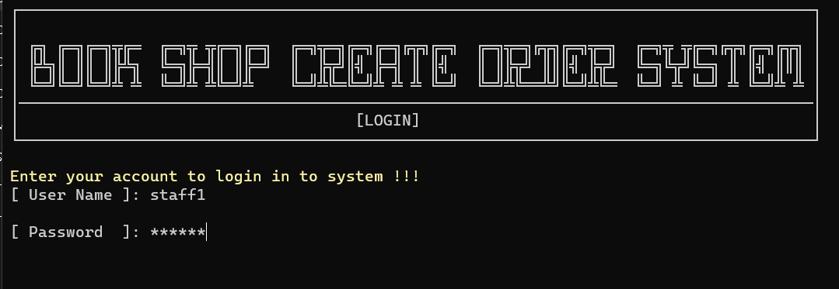
UI Design
1 Login UI

Slide 10
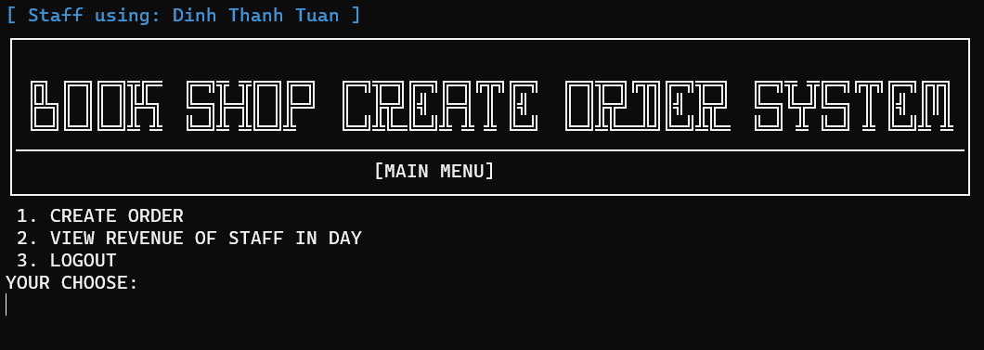
UI Design
2 Main Menu UI

Slide 11
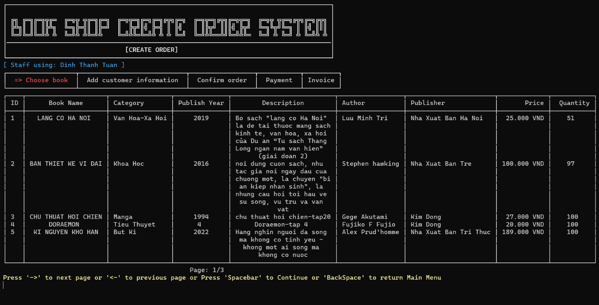
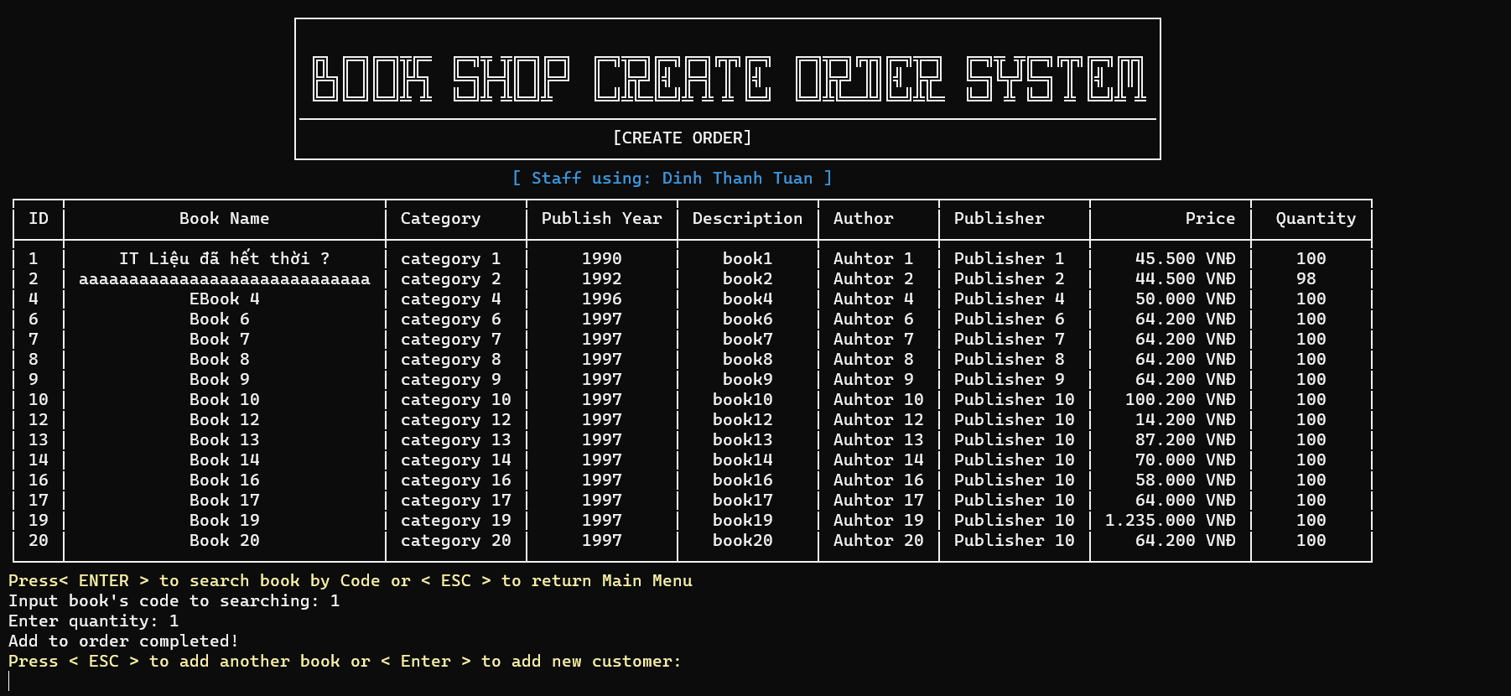
UI Design
3 Create order UI

Slide 12
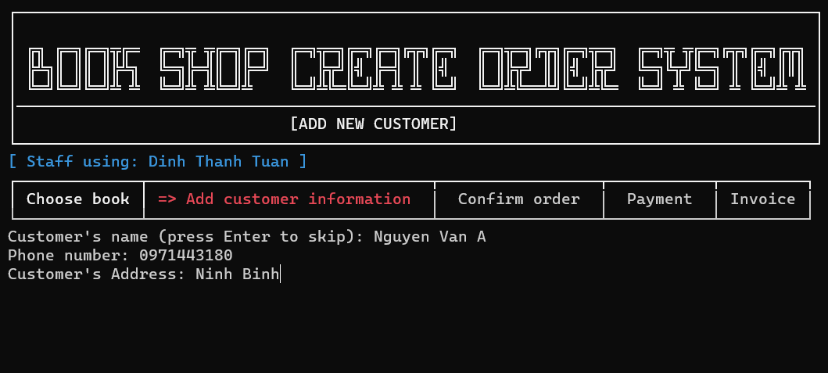
UI Design
4 Add new customer UI

Slide 13
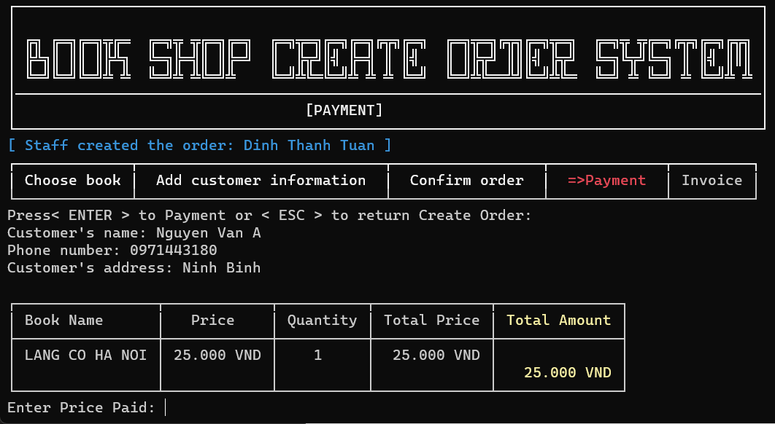
UI Design
5 Payment UI

Slide 14
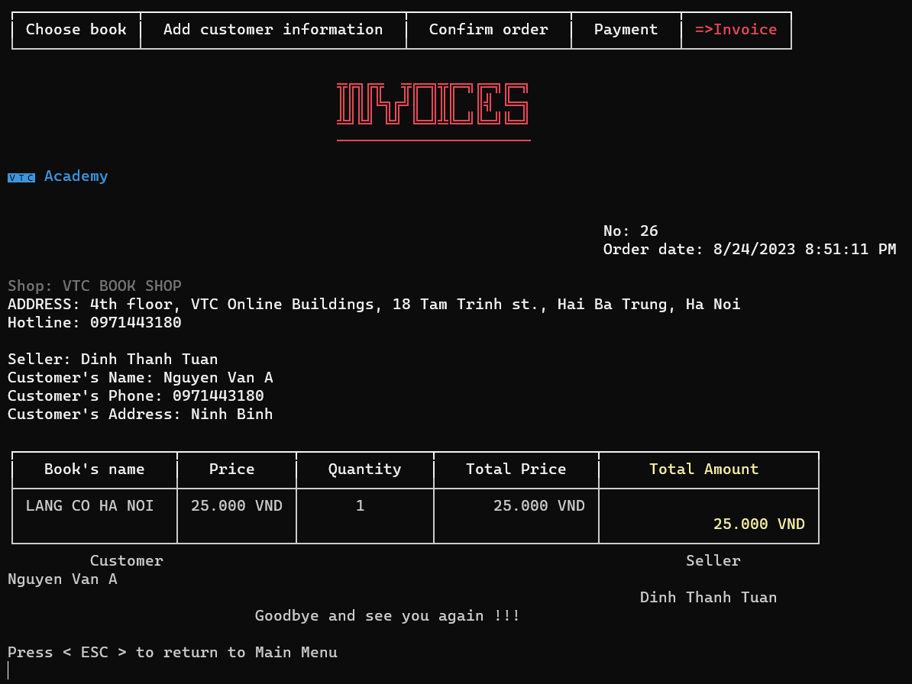
UI Design
6 Invoice UI

Slide 15
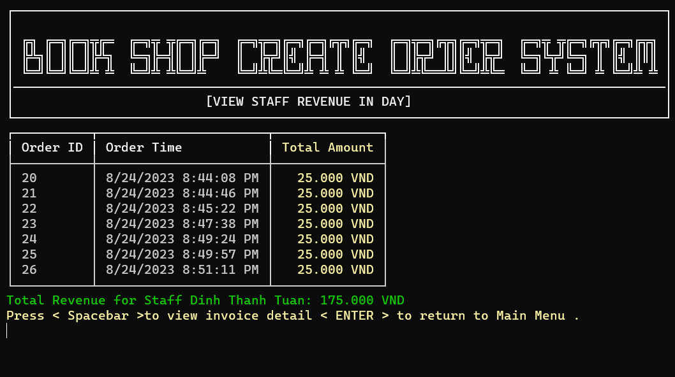
UI Design
7 View staff revenue in day UI

Slide 16
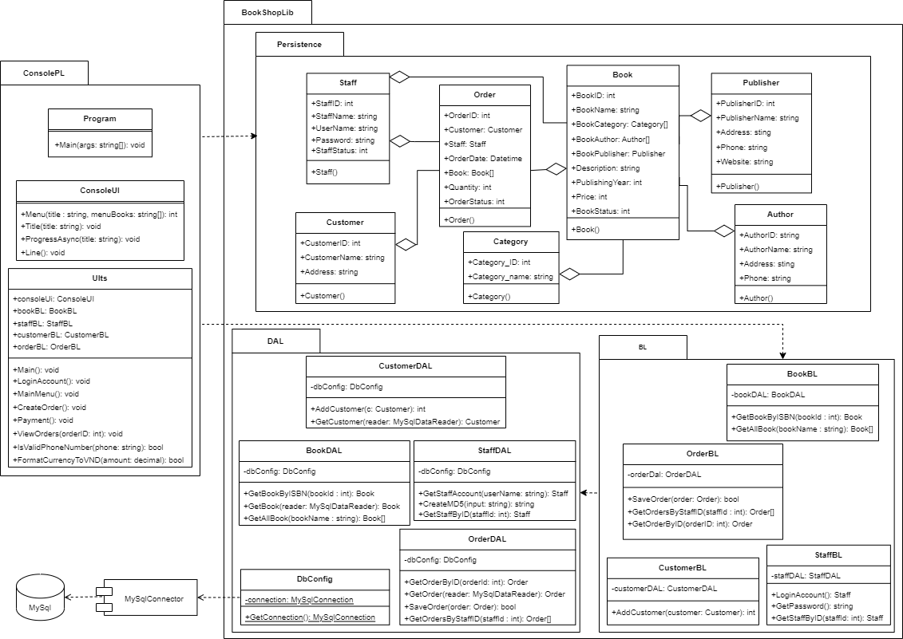
Class Diagram

Slide 17
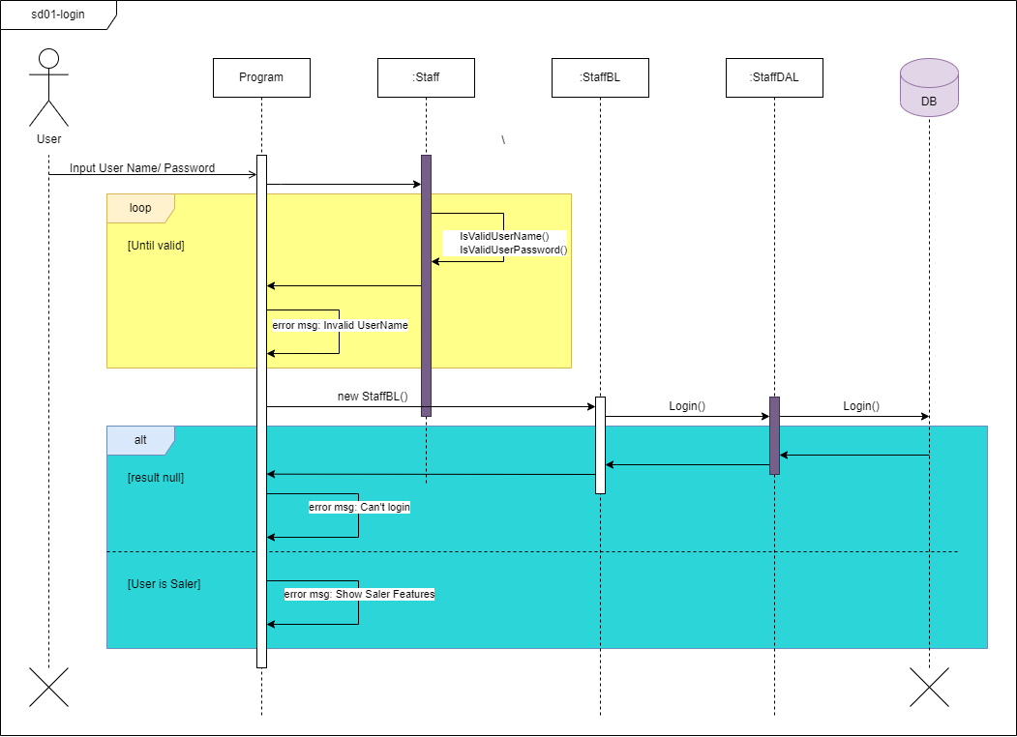
Sequence Diagram
1. Login

Slide 18
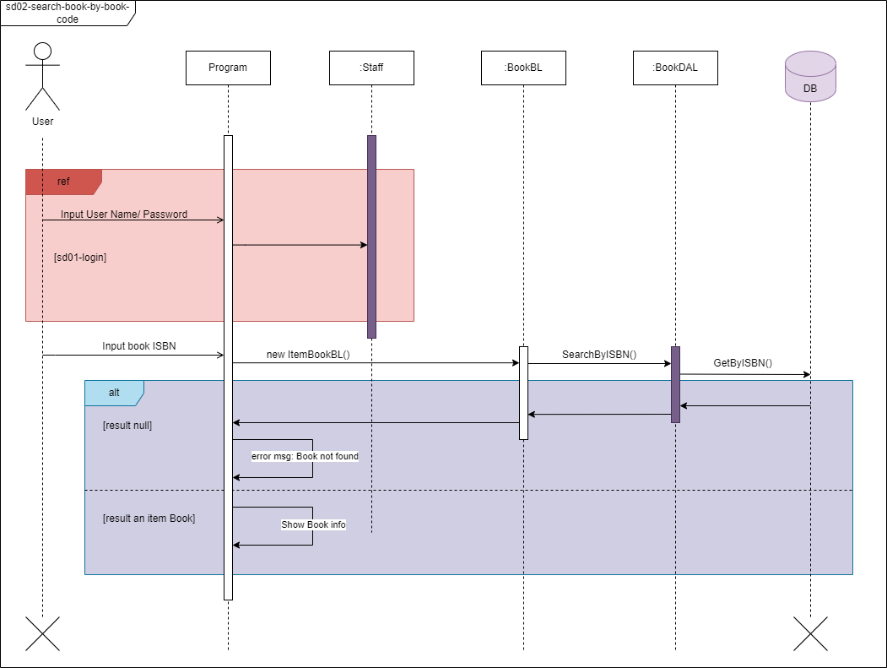
Sequence Diagram
2. Search book by code

Slide 19
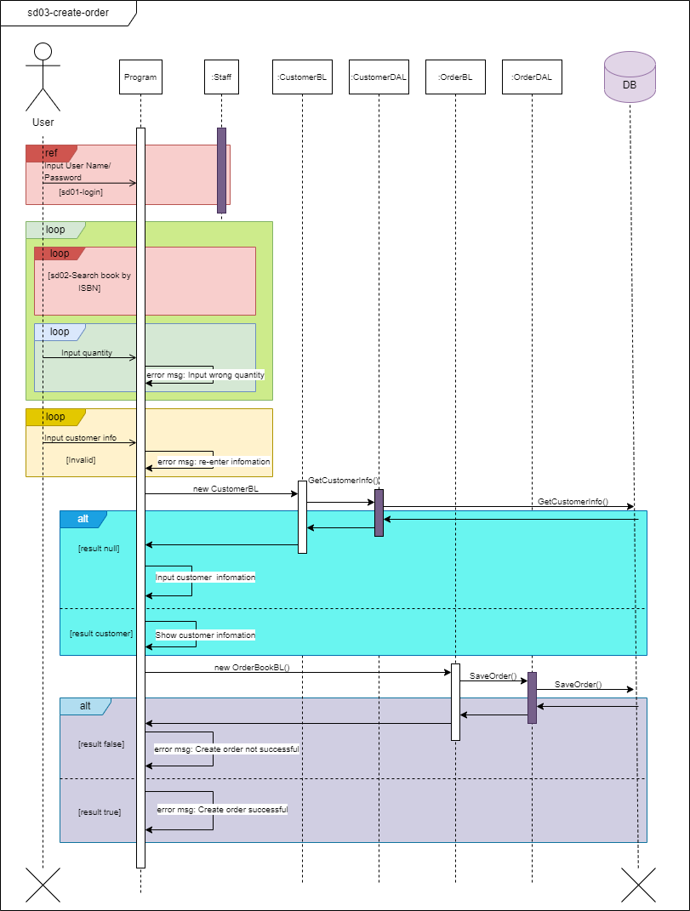
Sequence Diagram
3. Create Order

Slide 20
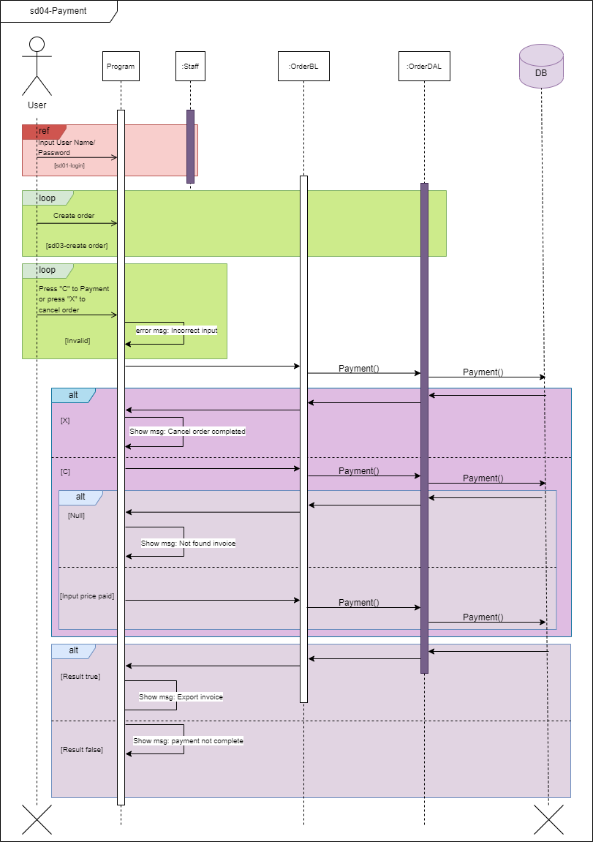
Sequence Diagram
4. Payment

Slide 21
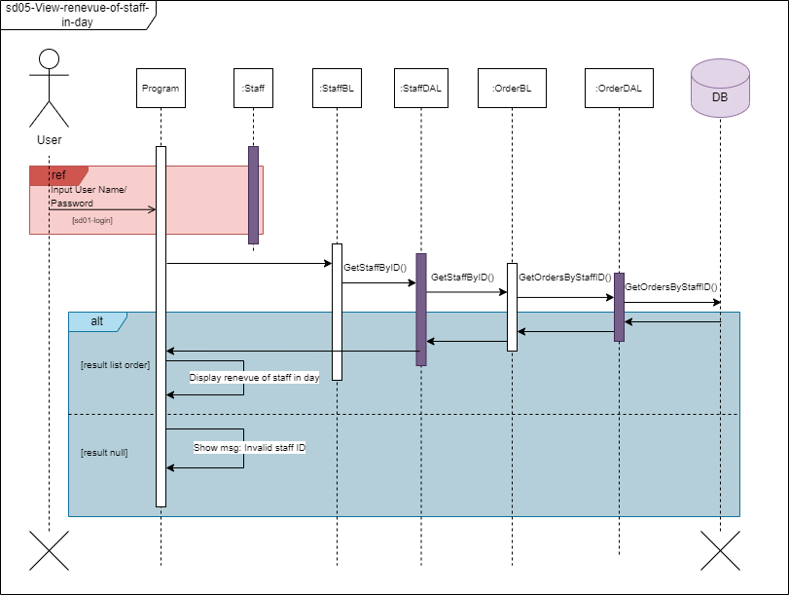
Sequence Diagram
5. View staff revenue in day

Slide 22
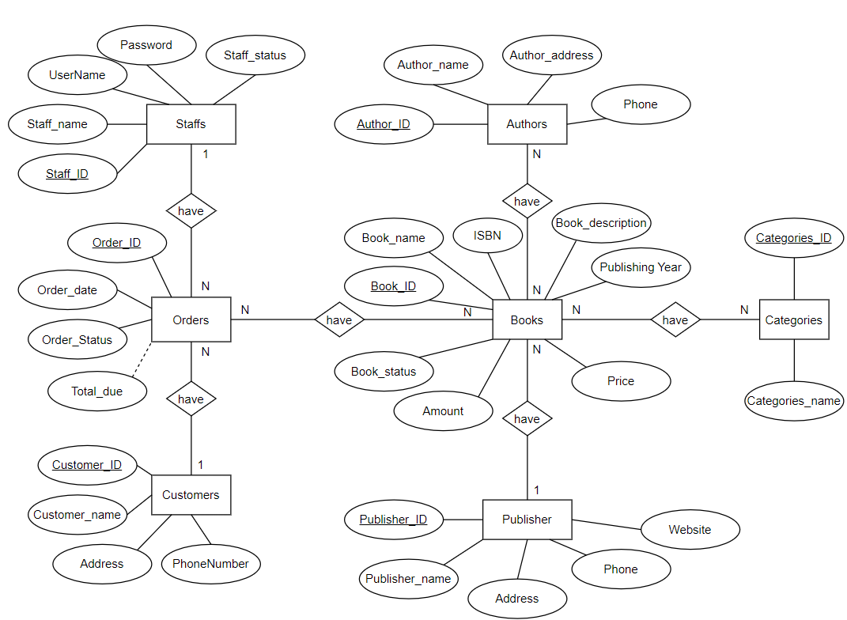
Entity Relationship Diagram

Slide 23
Task Assign (to each team member)
H&T Team | Book Shop Create Order System
No | Task name | Description | Start Date | End Date | Member | Self-assessment
1 | Write report | Write report on the Bookshop project | 24th June | 25th June | Hiep, Tuan
2 | Use case, Activity, Sequence, class diagram |  | 26th June | 4th July | Tuan, Hiep
3 | UI design | Using Spectre.Console to create a friendly UI. | 4th July | 5th July | Hiep
4 | Database | Data MySQL | 4th July | 6th July | Tuan, Hiep
5 | ERD | Entity Relationship Diagram | 7th July | 9th July | Tuan
6 | Login ,Create order, Payment | Using MD5 for more protection | 10th July | 13th July | Hiep
7 | Code search book by book code | Update search book by book code | 15th July | 17th July | Tuan
8 | Code view revenue staff in day |  | 20th July | 23rd July | Hiep
9 | Test case | Test main feature | 26th July | 29th July | Tuan

Slide 24
Experience Learned
We learned how to team-working has effect
Responsibility with our assigned work
Learned how to use github for team-work.
After this Project, our team can understand how to communicate and identify current problems to overcome.

Slide 25


