Slide 1

Introduction To Eagle (and PCBs)

Slide 2
PCBs are Made of Layers
Silkscreen – documentation labels
Metal – for making wires
Dialectric – insulation and structure
Solder mask – protective outer coating

Slide 3
Metal Layers
The Metal layers
Conductive “traces” to connect components
Attaching components
More layers -> more expensive
Top and bottom layers are for mounting components and routing traces
Internal layers can serve several purposes
Ground and power planes
Other signal planes
Internal routing layers

Slide 4
Metal Layers (cont.)
Thickness is measured in oz per square foot.
Standard copper is 1oz
About 0.034 mm

Slide 5
Dielectric
The dielectric in the insulator between metal layers
Most PCBs use FR4
“glass reinforced epoxy laminate”
i.e., fancy fiberglass
“FR” means “flame retardant”
Other specialized dielectrics are are available
To support high speed circuits
To manage thermal expansion

Slide 6
Solder Mask
Plastic coating on the top and bottom of the board
Protects the top and bottom metal from oxidation.
Helps prevent solder bridges
Gives the board color
FR4 is brown
Solder mask comes in several colors.

Slide 7
Silkscreen
It’s an opaque, (usually) white epoxy or polymer
It provides documentation and markings
References designators
Part outlines
Logos
Serial numbers etc.

Slide 8
Lots of Choices, in Theory
There are many, many choices when designing a PCB
We will get to make very few of them
Cheap, fast PCB manufacturers provide a standard setup. E.g.:
FR4
1oz copper
2, 4, or 6 layers
A few colors

Slide 9
Making Connections Between Layers
Plated holes connect metal layers.
Drill a hole
Electroplate it with copper
Cover it with a non-corroding metal.

Slide 10
Throughholes and Vias
Through hole pads
Mount devices with pins
Sized for the pin + solder
Always plated with non-oxidizing metal.
Vias are electrical connections
As small as possible
Problems
Takes up space in all layers
Throughhole pins are generally pretty big
Pin-to-pin spacing >= 1mm

Slide 11
Surface Mount Devices (SMD)
No drill required
No pins
Smaller parts
Finer ‘pitch’ (pin-to-pin distance)
Parts on both sides
Easier automated placement
Pitch >= ~0.3 mm

Slide 12
Eagle uses odd terminology
”Pads” are through hole connections
SMD (surface mount device) are surface mount connections.

Slide 13
Designing PCBs

Slide 14
Steps for Designing PCBs
Create/acquire a library of components
Assemble your schematic
Lay out the board
Perform design checks
Generate CAM files
Check them carefully
Submit for manufacturing

Slide 15
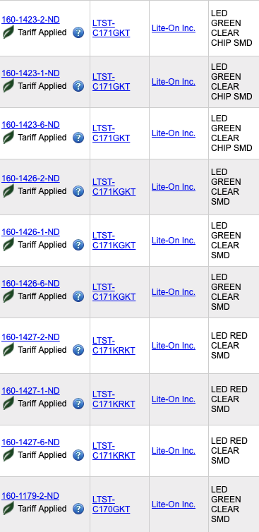
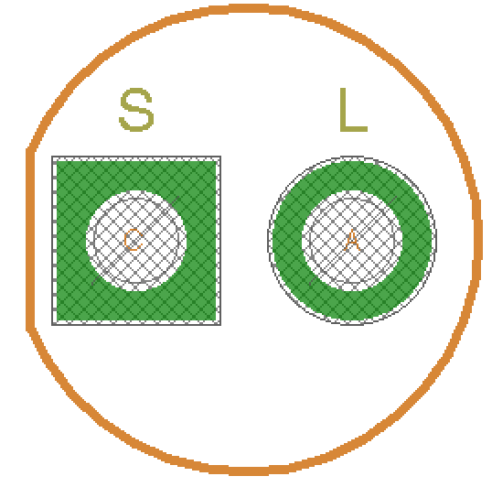
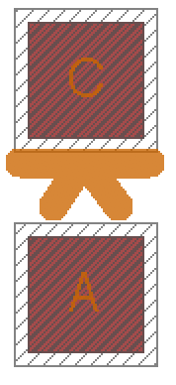
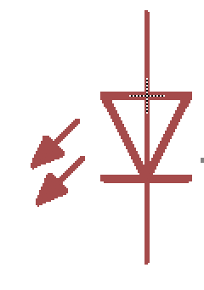
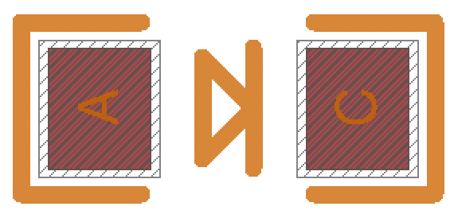
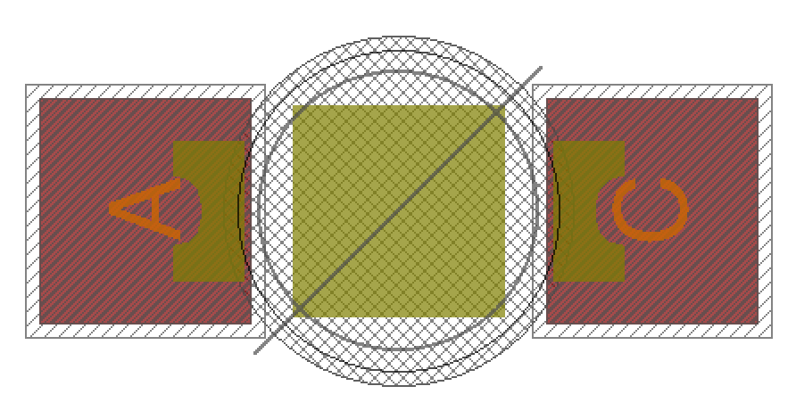
PCB Library
One Symbol
Many Packages
Many Parts

Slide 16
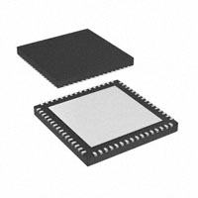
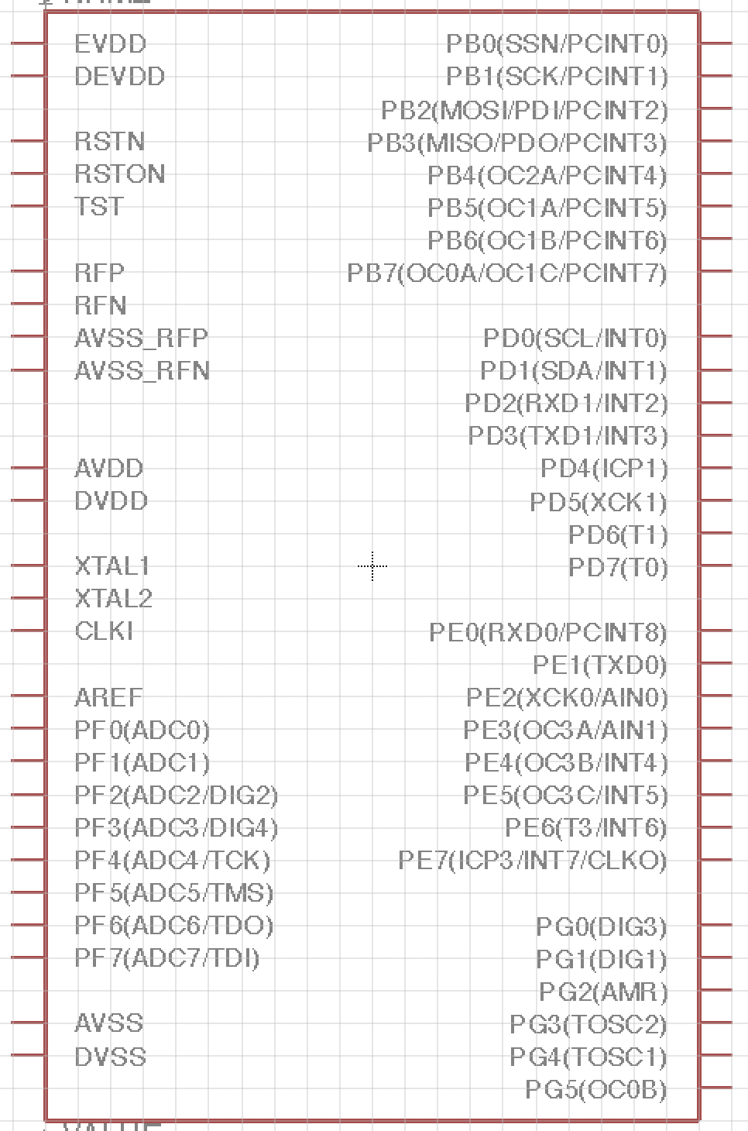
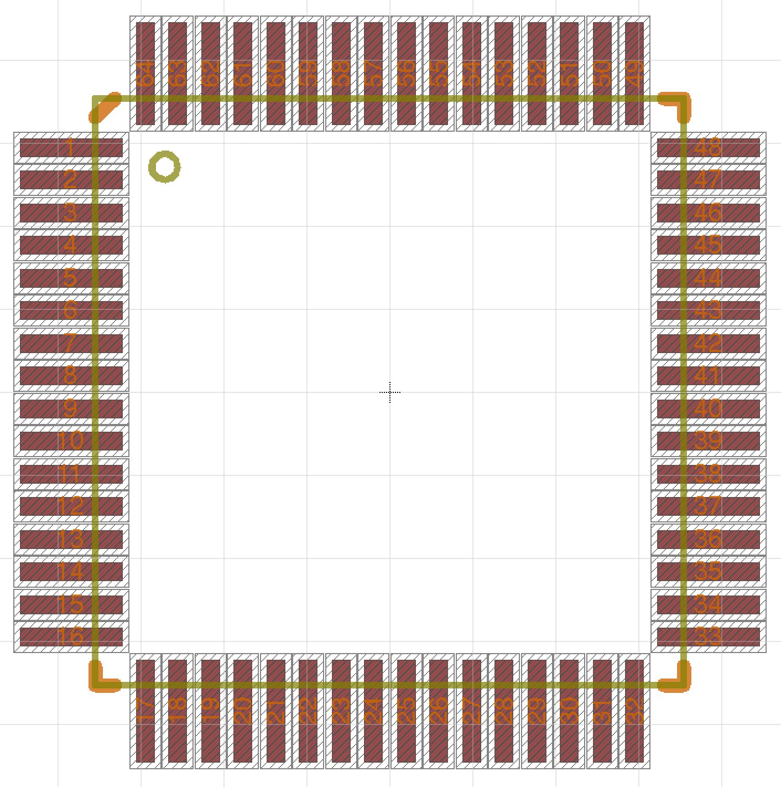
The Library
Physical part
Package
Device Pin Mapping
Symbol

Slide 17
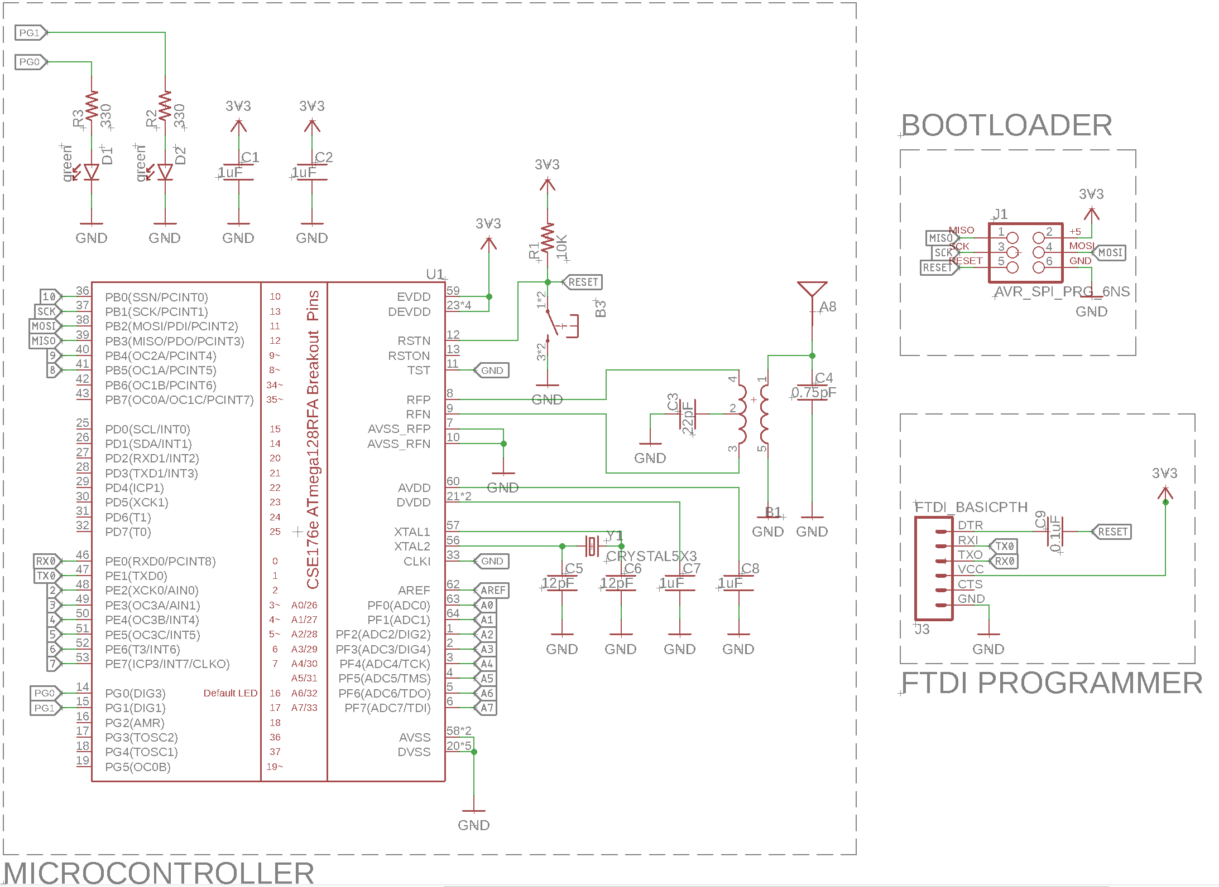
Schematics

Slide 18
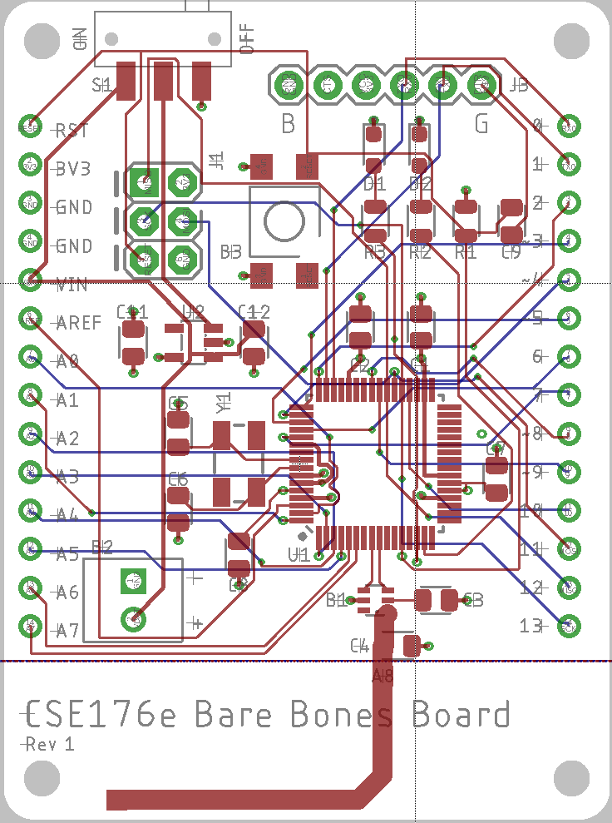
Layout

Slide 19
Schematic vs. Board

Slide 20
Designing with Layers
Eagle (and other board design tools) use layers to specify different types of information about a board. E.g:
Where wires should go on each physical layer
Where wires should not go on each physical layer
Documentation
Mechanical information
Eagle defines 52 layers by default
‘t’ prefix means top.
‘b’ prefix means bottom (displayed mirrored)

Slide 21
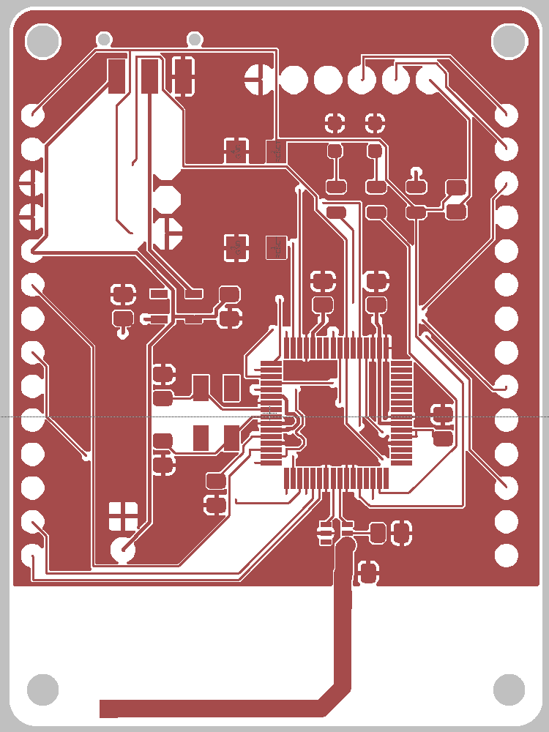
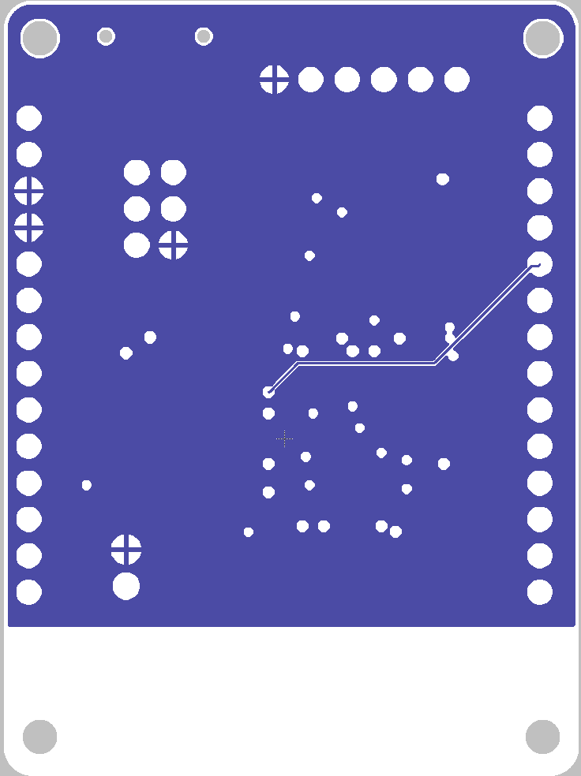
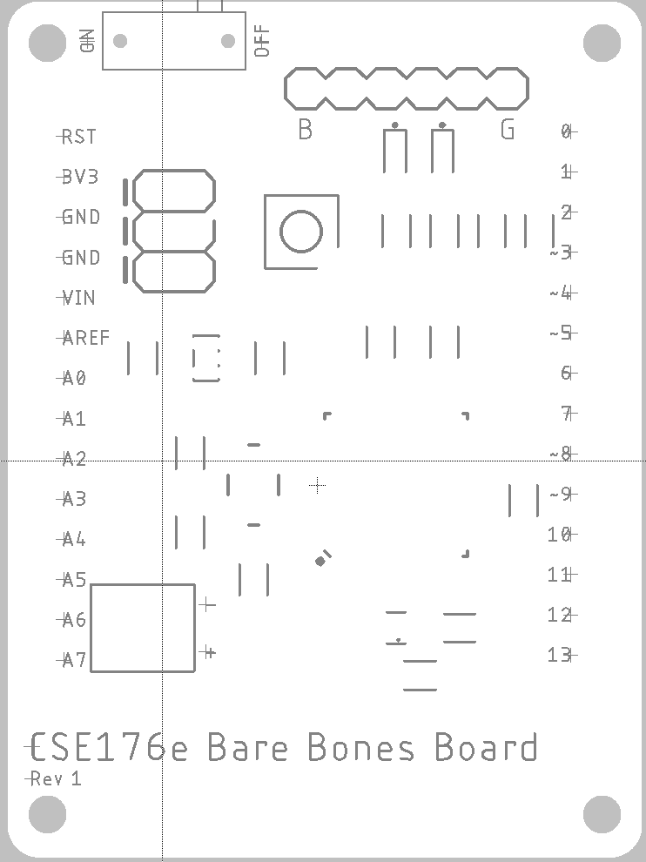
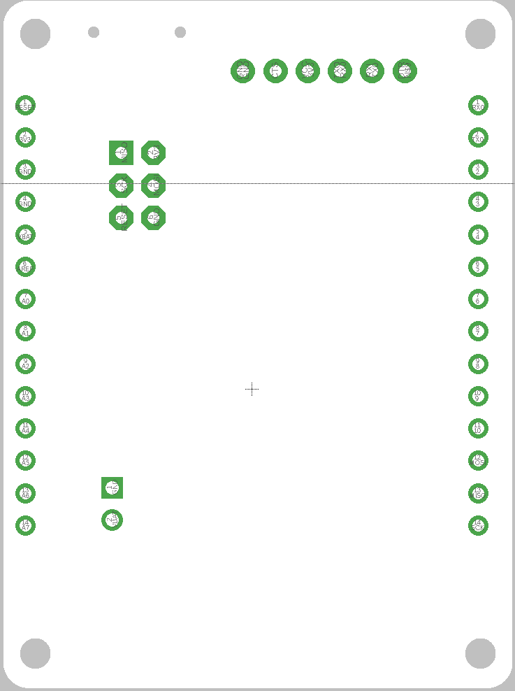
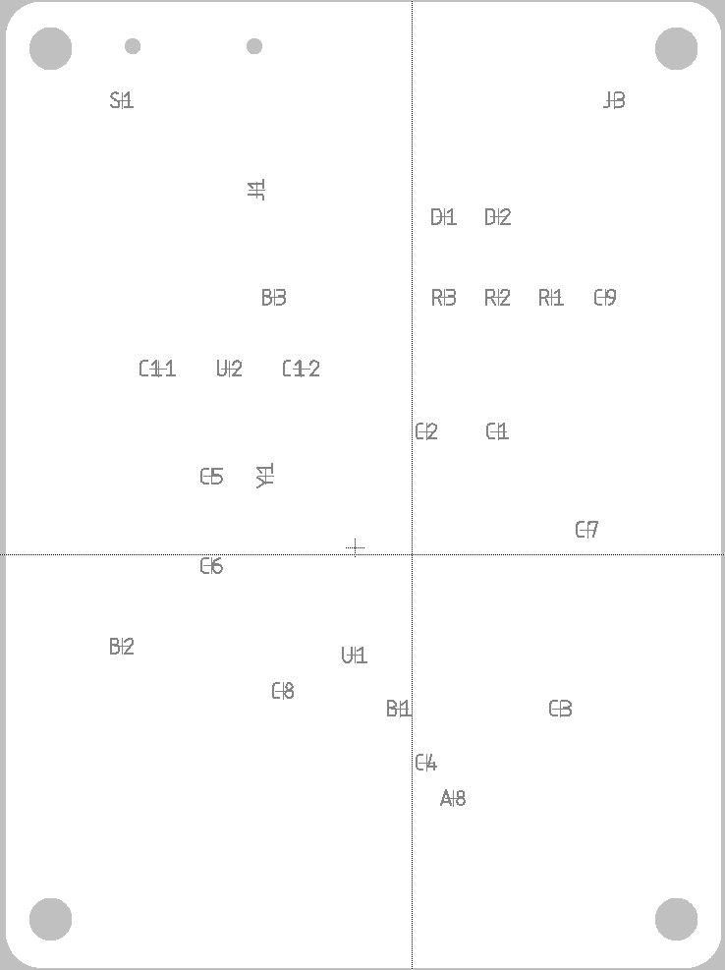
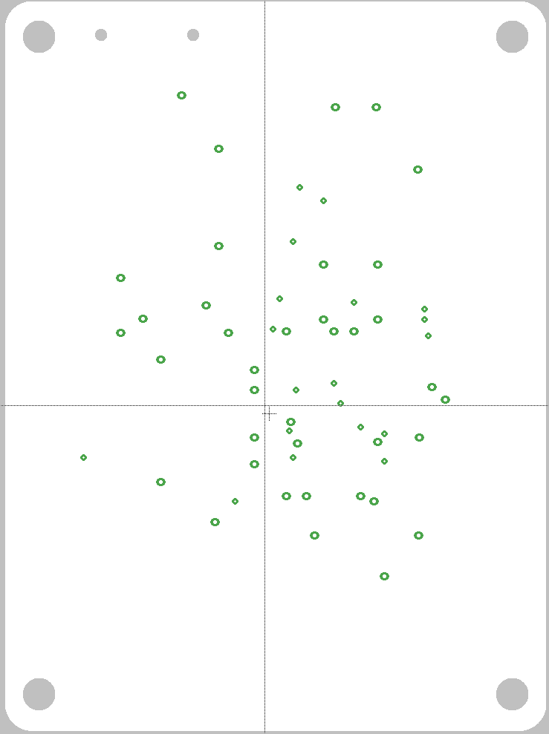

Slide 22
Eagle Layers
Top | Tracks, top side |  | 27 | tValues | Component VALUE, top side
Route2 | Inner layer |  | 28 | bValues | Component VALUE, bottom side
Route3 | Inner layer |  | 29 | tStop | Solder stop mask, top side (gen. autom.) |  | Design
Route4 | Inner layer |  | 30 | bStop | Solder stop mask, bottom side (gen. Autom.) |  | Documentation
Route5 | Inner layer |  | 31 | tCream | Solder cream, top side |  | Tool guidance
Route6 | Inner layer |  | 32 | bCream | Solder cream, bottom side
Route7 | Inner layer |  | 33 | tFinish | Finish, top side
Route8 | Inner layer |  | 34 | bFinish | Finish, bottom side
Route9 | Inner layer |  | 35 | tGlue | Glue mask, top side
Route10 | Inner layer |  | 36 | bGlue | Glue mask, bottom side
Route11 | Inner layer |  | 37 | tTest | Test and adjustment information, top side
Route12 | Inner layer |  | 38 | bTest | Test and adjustment inf., bottom side
Route13 | Inner layer |  | 39 | tKeepout | Restricted areas for components, top side
Route14 | Inner layer |  | 40 | bKeepout | Restricted areas for components, bottom s.
Route15 | Inner layer |  | 41 | tRestrict | Restricted areas for copper, top side
Bottom | Tracks, bottom side |  | 42 | bRestrict | Restricted areas for copper, bottom side
Pads | Pads (through-hole) |  | 43 | vRestrict | Restricted areas for vias
Vias | Vias (through all layers) |  | 44 | Drills | Conducting through-holes
Unrouted | Airlines (rubber bands) |  | 45 | Holes | Non-conducting holes
Dimension | Board outlines (circles for holes) |  | 46 | Milling | Milling
tPlace | Silk screen, top side |  | 47 | Measures | Measures
bPlace | Silk screen, bottom side |  | 48 | Document | Documentation
tOrigins | Origins, top side (generated autom.) |  | 49 | Reference | Reference marks
bOrigins | Origins, bottom side (generated autom.) |  | 51 | tDocu | Detailed top screen print
tNames | Service print, top side (component NAME) |  | 52 | bDocu | Detailed bottom screen print
bNames | Service print, bottom s. (component NAME)

Slide 23
Useful Layer Commands
“display <layer>” -- show the layer
“display -<layer>” – hide the layer
“display last” return to previous view
Click and hold the layer tool icon to get a list of present layers sets.
Select “new…” to save the current view
Then “display foo” to switch to the view named “foo”

Slide 24
Manufacturing
Eagle layers are partly Eagle-specific
Some are semantic
Some are documentary
Boards manufactures need
Metal layers
Silkscreen
Soldermask
Drills
In a standard format

Slide 25
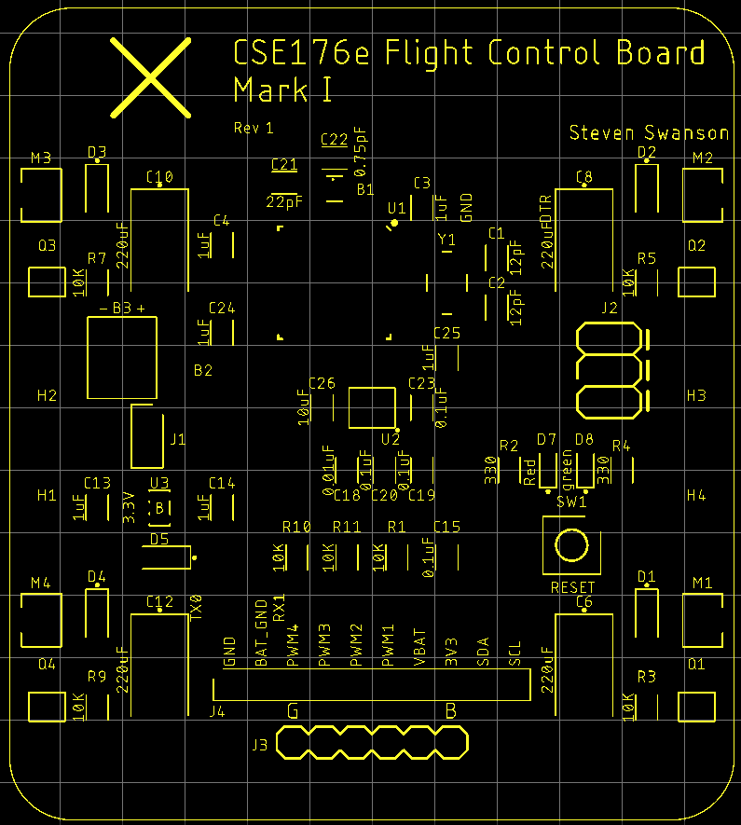
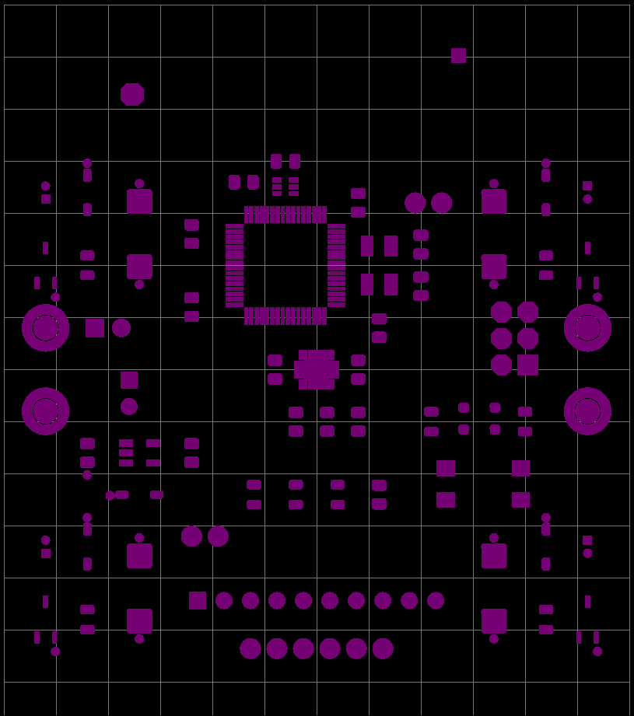
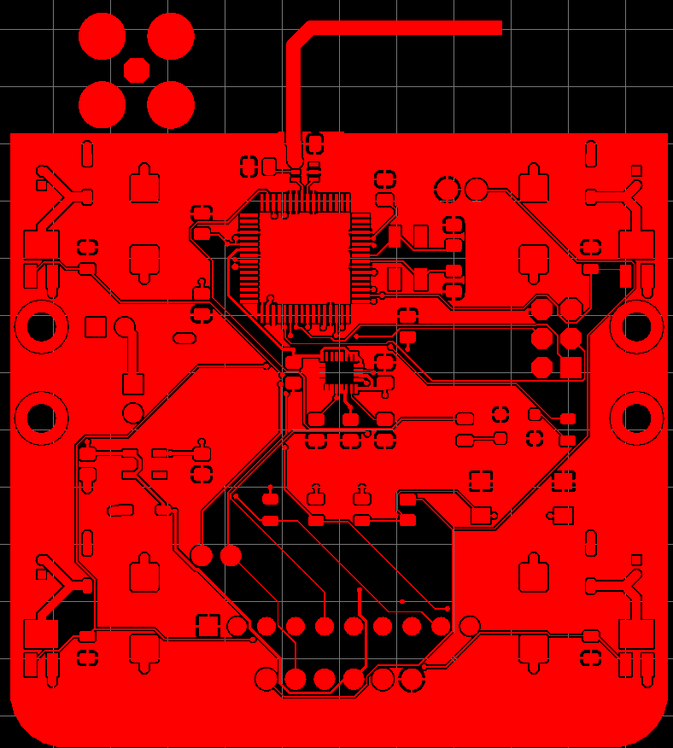
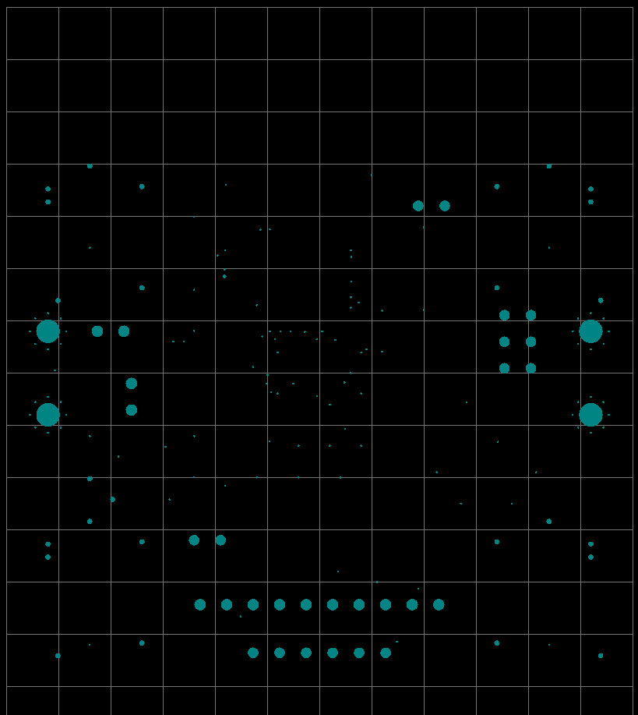
Computer Aided Manufacturing (CAM) Files: Gerbers
Eagle’s CAM processor generates CAM files
“Gerbers”
“Drill file”
Manufacturing Reqs
Minimum drill size
Minimum feature width
File formats
Our manufacturer: https://jlcpcb.com/capabilities/Capabilities
Our configuration encodes their requirements
QuadClass-Resources/Eagle/DRU/jlcpcb-4layer-5mil-small-cream.dru
QuadClass-Resources/Eagle/CAM/jlcpcb-4layer-values-eagle9.cam

Slide 26
The Lab
Use Eagle to design a simple schematic and board.
Run it through the tool flow.
Submit it through Eaglint

Slide 27
Eagle Lint
lint:
Tool to check coding standards and other invariants about a system.
Eaglint will check your libraries, schematics
Check for correctness
Check for style
Also checks for other files in your repo
Eaglint will tell you what it’s looking for.
Pay attention.
Provides a workflow for me to review your designs and provide feedback.
To use
Visit http://eaglint.nvsl.io
You received a welcome email a couple of nights ago.

Slide 28
Eagle Lint Process
Commit and push your changes to github
Submit your repo to Eaglint for a quick check
Submit your repo to Eaglint for a full check
If warnings/errors
Fix and goto 1.
Submit for human review
If rejected
Read comments; goto 1.
Else if accepted
Goto next lab

Slide 29
Grading on PCB Labs
The key to PCB design is attention to detail.
Building a real board can take 4 months.
If you make a mistake, it takes 4 months to fix.
Contrast to software: just recompile and rerun!
Don’t make any mistakes! Check your work!
Grading for PCB labs
A “perfect” score is 10 points
You start out with 11-12 points (depending on the lab).
Every time you submit a design to Eaglint, you lose 1 point.
Every time you submit a design for human review Eaglint, you lose 1 point.
You must complete the labs.
“Quick checks” are free.

Slide 30
Next time:
Major points of confusion in this lab
How to set and align to grid
How to make wires straight
Where to look for the SMD location in the button datasheet
Adafruit tutorial is not consistent with our guidance

Slide 31
Resources
Good PCB manufacturing videos
https://www.youtube.com/playlist?list=PL8zP8UuDk8a0ZNWiteC-7PHx1HCeBY0qB

