Slide 1
Laying Out the Board

Slide 2
Board Layout Goals
Mechanical constraints – Some things need to be in specific locations
Electrical constraints – Does the layout meet signal integrity/EM requirements
Will digital interference mess up the antenna?
Are decoupling caps near IC Supply pins?
Keep the noisy power/ground for the motors away from the digital logic.
Correctness – things don’t overlap or hang off the board.
Ease of routing – Connected items should be physically close.
Make it pretty – you want a nice looking board
Potentially other, design-specific requirements

Slide 3
Layout Steps
Define board shape.
Place mechanically important parts.
Define power planes
Place other parts
Route the board
Run DRC

Slide 4
Some Possible Configurations
Hexa +
Hexa x
“Plus”
“X”
Octa +
Octa x
“Octothorpe”
Y 6

Slide 5
Device Placement: Style
Put all your components on a 1mm grid
Reference designators can go on 0.5 or 0.1mm grid.
Orient all your parts the same way for easy assembly.
Leave space between components for easy assembly.

Slide 6
Layout Demo
Use the remote

Slide 7
Eagle Layout Tools
You can rotate components with the rotate tool.
Control-click snaps parts to grid.

Slide 8
Routing

Slide 9
The Three Ways to Route
Manual
You can do anything you want (including things you shouldn’t)
Auto router
Fully-automatic routing, subject to constraints that you can set.
The Eagle auto router is not good enough to do it all for you.
“Follow me”
Assisted manual routing. The router will enforce the constraints you set.
Fan out
Create circuit stubs to connect devices to power/ground

Slide 10
Auto Router
Mixed reputation
It can’t do everything
Sometimes it does a bad job
When it works, it’s great.
Usually it needs some touch up.
Net classes (“Edit->Net Classes…”)
Lets you set widths and clearances for different kinds of nets

Slide 11
Semi-Automatic Routing
Route critical nets with follow me router
Wires to antenna
Wires to crystal
Ground isolation for antenna and crystal
Fan out power and ground.
Autoroute everything else.

Slide 12
Commands for Routing
“Auto;” – run the auto router (leave off the “;” to configure the router.
“Ripup;” – unroute signals
“Show <thing>” – Highlight a net or part

Slide 13
Design Rules Check
Checks that your board layout meets design requirements for manufacturing.
Distance between traces and traces, traces and vias, etc.
Trace width
Etc.

Slide 14
Electrical Rules Check
This checks for common problems in schematics.
Make sure you understand the reason for the errors.
Fix them if you can.
Run it!

Slide 15
Semi-Auto Routing Demo

Slide 16
Routing and Layout Examples

Slide 17
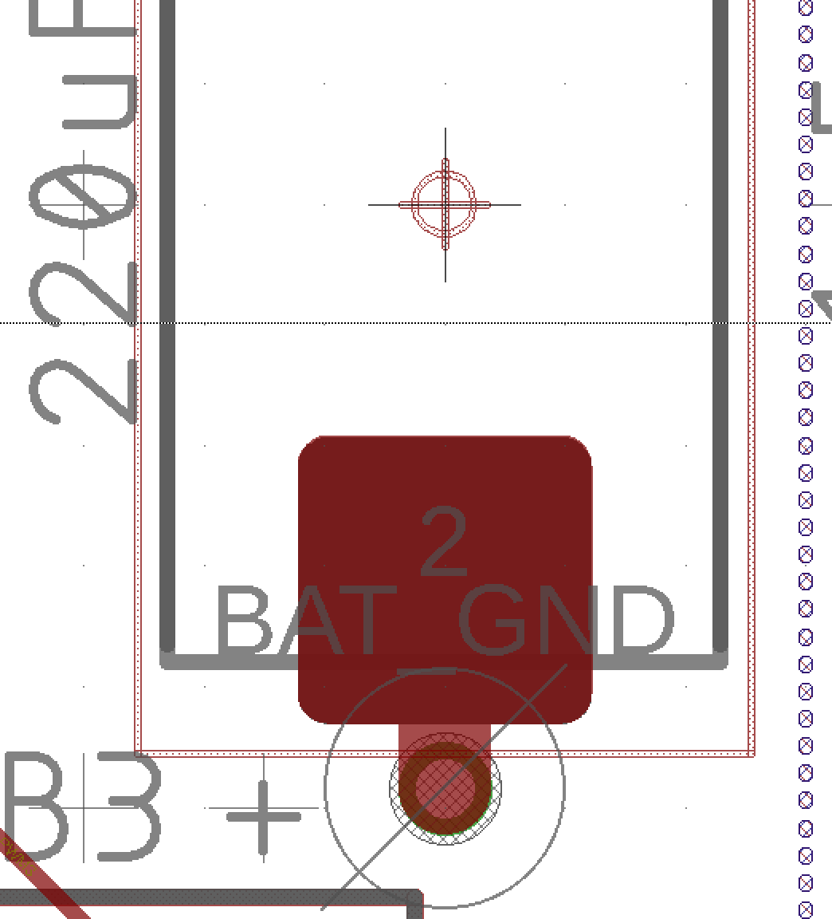
High-current Via
Via diameter matches trace width

Slide 18
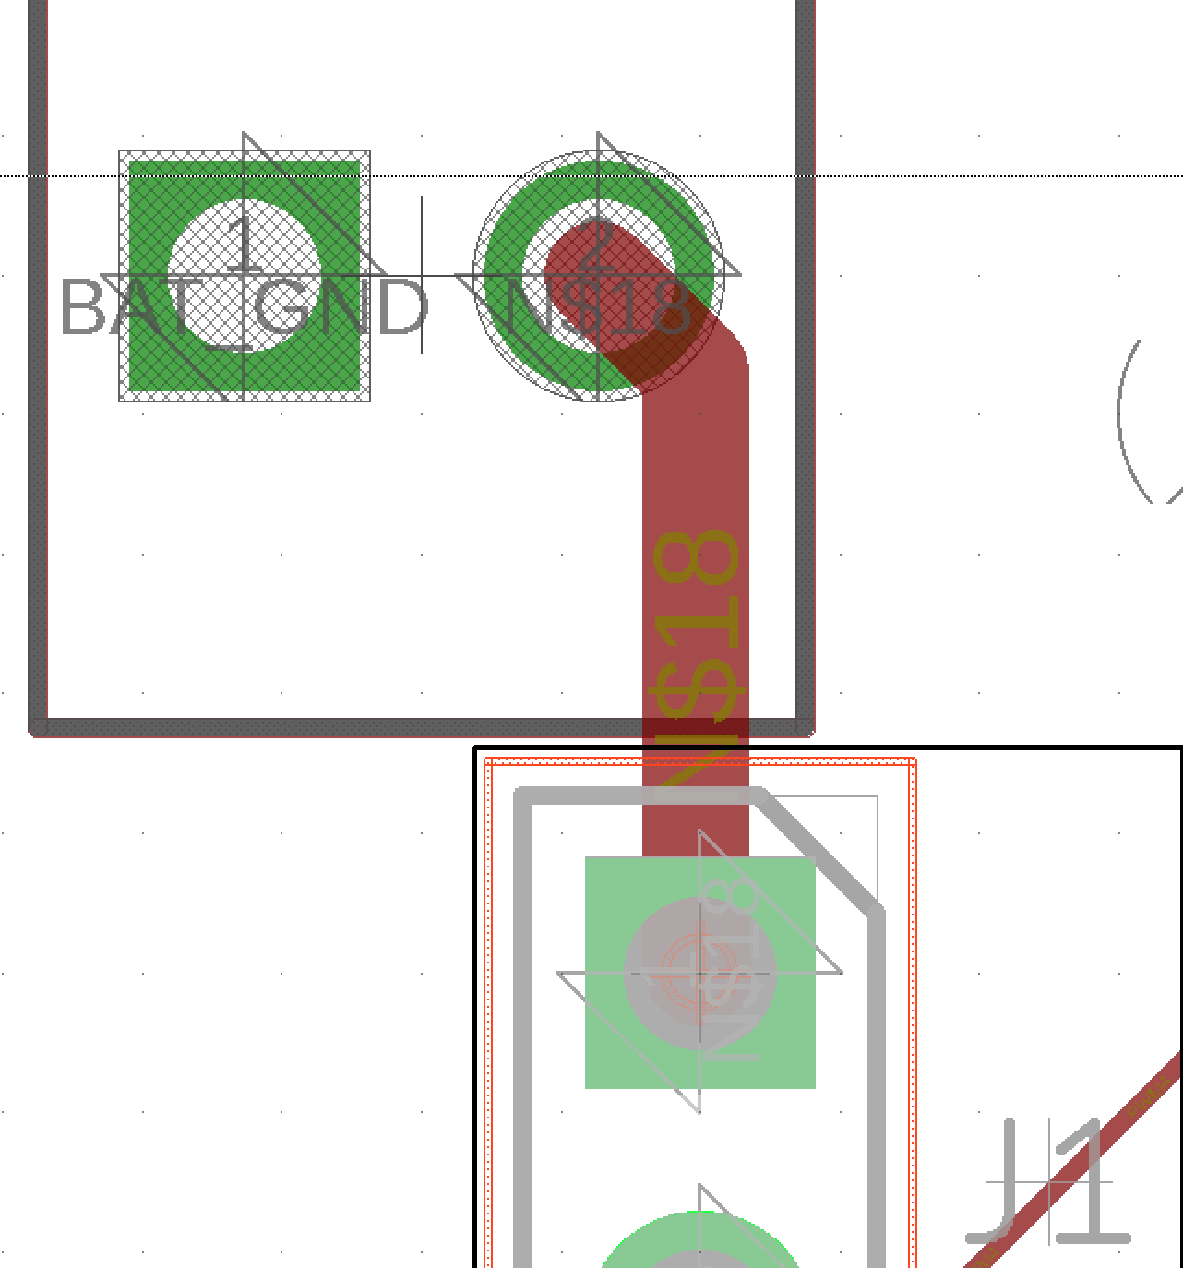
Battery to Jumper

Slide 19
CAM Files

Slide 20
CAM Layers (Gerber files)
Eagle layers are for design.
CAM layers are for manufacturing
“Gerber” files are for lithographic steps
Drill files are for drilling holes.
Each CAM layers corresponds to one layer of the resulting board
Top silk screen (.PLC)
Top solder mask (.STC)
Top metal (.TOP)
Inner metal layers
Bottom metal (.BOT)
Bottom solder mask (.STS)
Bottom silk screen (.PLS)
Different board houses have different suffixes.
One drill file specifying where all the pads, vias, and mounting holes are located and their diameters (.DRD)
Other files too, depending on the manufacturing process
Solder paste stencil
Assembly drawings

Slide 21
The CAM Processor
The CAM Processor generates CAM files
The exact configuration for the gerber files varies by board house
Should the board outline be in every layer?
Which format should the files be in (there are many)
Should the back side layers be mirrored?

Slide 22
CAM Setup
To prepare Gerbers for a particular board house, you need CAM setup files (*.cam for Eagle)
This specifies how to generate each layer the board house needs.
See example in Button and Light Tutorial.

Slide 23
CAM Demo

Slide 24
Checking Your Gerbers!
Eagle can’t display Gerber files itself
You need a 3rd party tool
See the Button and Light tutorial for recommendations
You should always check your Gerbers!
Eagle has bugs (you should assume)
You may have misconfigured something
You may have put something in the wrong layer.

Slide 25
Gerber Viewer Demo

Slide 26
Quad Design Details

Slide 27
Motor Power: Resistance
Motors take a lot of current!
We want all the power to go to the motors
Copper is an imperfect conductor
Voltage drop on power lines is non-trivial
Resistance is a function of aspect ratio
0.5 mΩ/square
So, make the power lines wide!
Use a trace-width calculator
https://www.4pcb.com/trace-width-calculator.html

Slide 28
Next Time
These slides need significant improvement.
Talk about placement of decoupling caps.
Update tips and tricks
Put more screen shots in to show how things should be laid out.
Discuss differential pairs
Had about 20 min of questions about previous labs
Then, demoed for about 1.5 hours.
Didn’t get past slide the “layout demo” slide

Slide 29
Part Placement Demo
Dr. Steven Swanson
CSE176e/276e
swanson@cs.ucsd.edu

Slide 30
Power Planes Demo
Dr. Steven Swanson
CSE176e/276e
swanson@cs.ucsd.edu

Slide 31
Net Classes and Routing Demo
Dr. Steven Swanson
CSE176e/276e
swanson@cs.ucsd.edu

Slide 32
Silkscreen Demo
Dr. Steven Swanson
CSE176e/276e
swanson@cs.ucsd.edu

Slide 33
CAM File Demo
Dr. Steven Swanson
CSE176e/276e
swanson@cs.ucsd.edu

