Slide 1
Sensing and Filtering

Slide 2
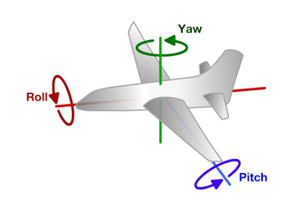
Principles of Operation (1)
An even number of motors provides lift and control in 6 dimensions
Spatial dimensions: x, y, z
Pitch: rotation around left-right (y) axis
Roll: rotation around the front-back (x) axis
Yaw: rotation around the top-bottom (z) axis
A flight computer operates a closed-loop controller to maintain stability and implement pilot commands.
Z
X
Y

Slide 3
Maintaining Stability
Multi-rotor aircraft are inherently unstable
Mismatched motor power (voltage variation, manufacturing variation in motors or props)
Variation in air currents and density.
Once perturbed, there’s no force acting on the aircraft to return it to equilibrium (unlike an airplane).

Slide 4
Lab Tasks
Read values from IMU.
Use Arduino’s plotting tool
Run your serial port at max speed!!!
Read the pitch of your test stand with the motors on
Configure the filters on the IMU
Implement a complimentary filter in software.

Slide 5
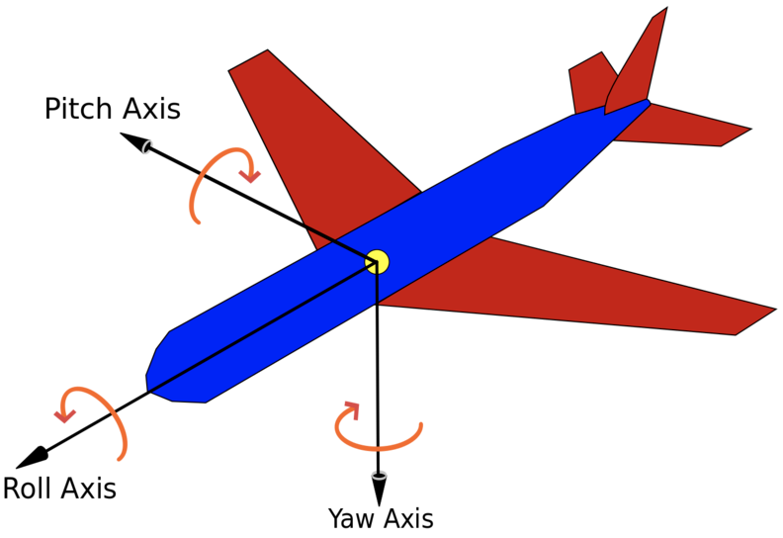
Euler Angles
3 angles to specify an orientation
The AHRS library gives you the pitch and roll angles
We are only using ‘pitch’ in this lab.

Slide 6
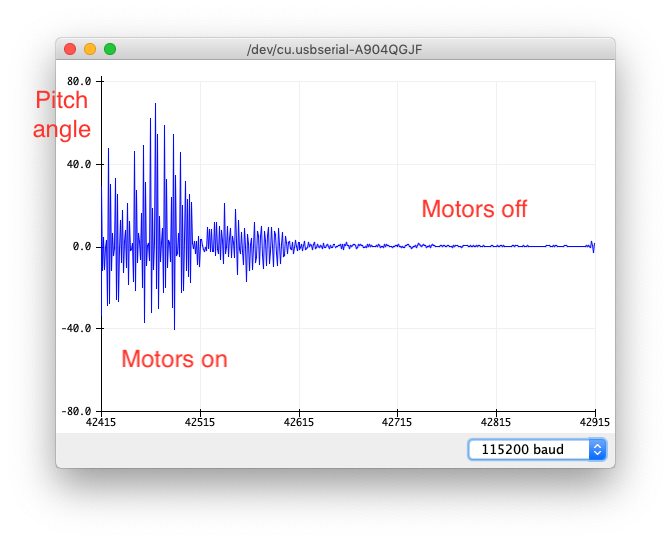
Accelerometer
Measure forces acting on the quadcopter (mostly gravity)
Some trigonometry will yield Euler angles
Strengths
No drift
Good low-frequency performance
Weakness
Susceptible to vibration
Poor high-frequency performance

Slide 7
Computing Euler Angles
Pitch
Roll

Slide 8
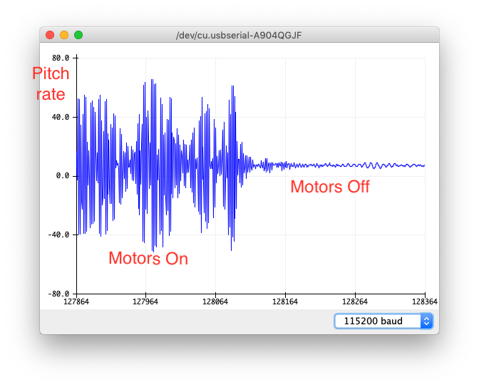
Gyroscope
Measure rate of for Euler angles
Integrating will give you Euler angles
Strength
Less susceptible to noise
Good high-frequency performance
Weakness
The integral will drift
Poor low-frequency performance

Slide 9
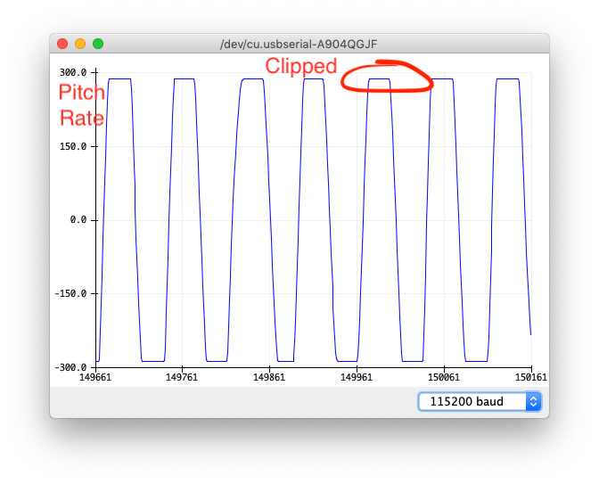
Gyro Clipping
Clipping occurs when the measured value exceed what the IMU can measure
Since we are integrating the gyroscope, clipping is especially bad.
Fix it by setting the resolution of your gyroscope.

Slide 10
Filtering
High frequency vs. low frequency
High-pass filters
Low-pass filters

Slide 11
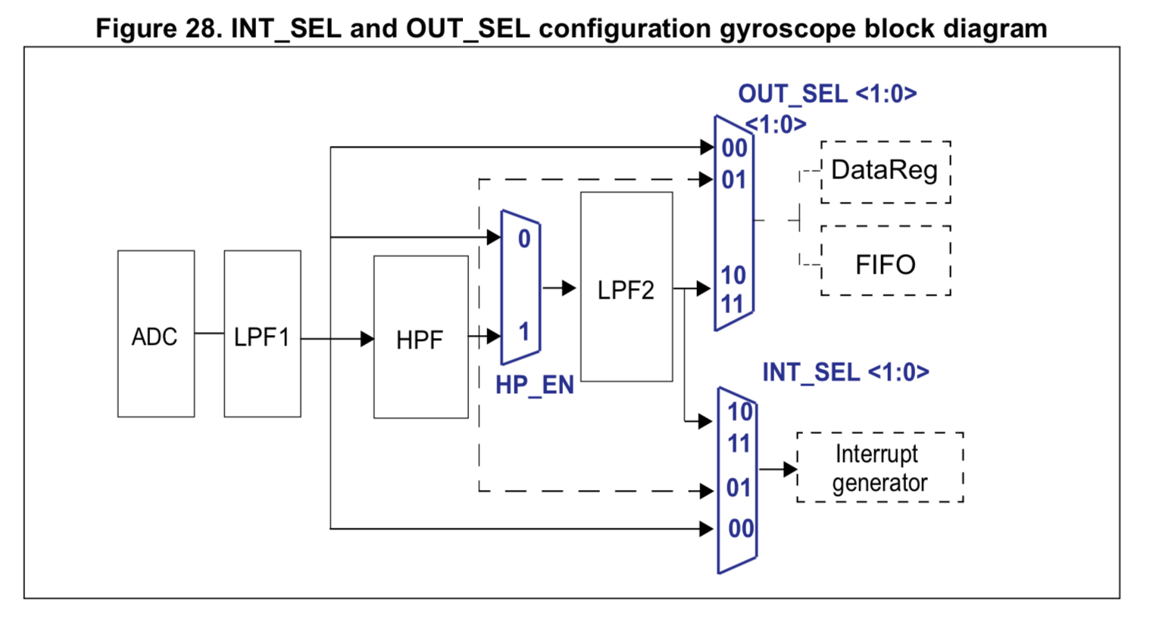
Gyroscope Datapath

Slide 12
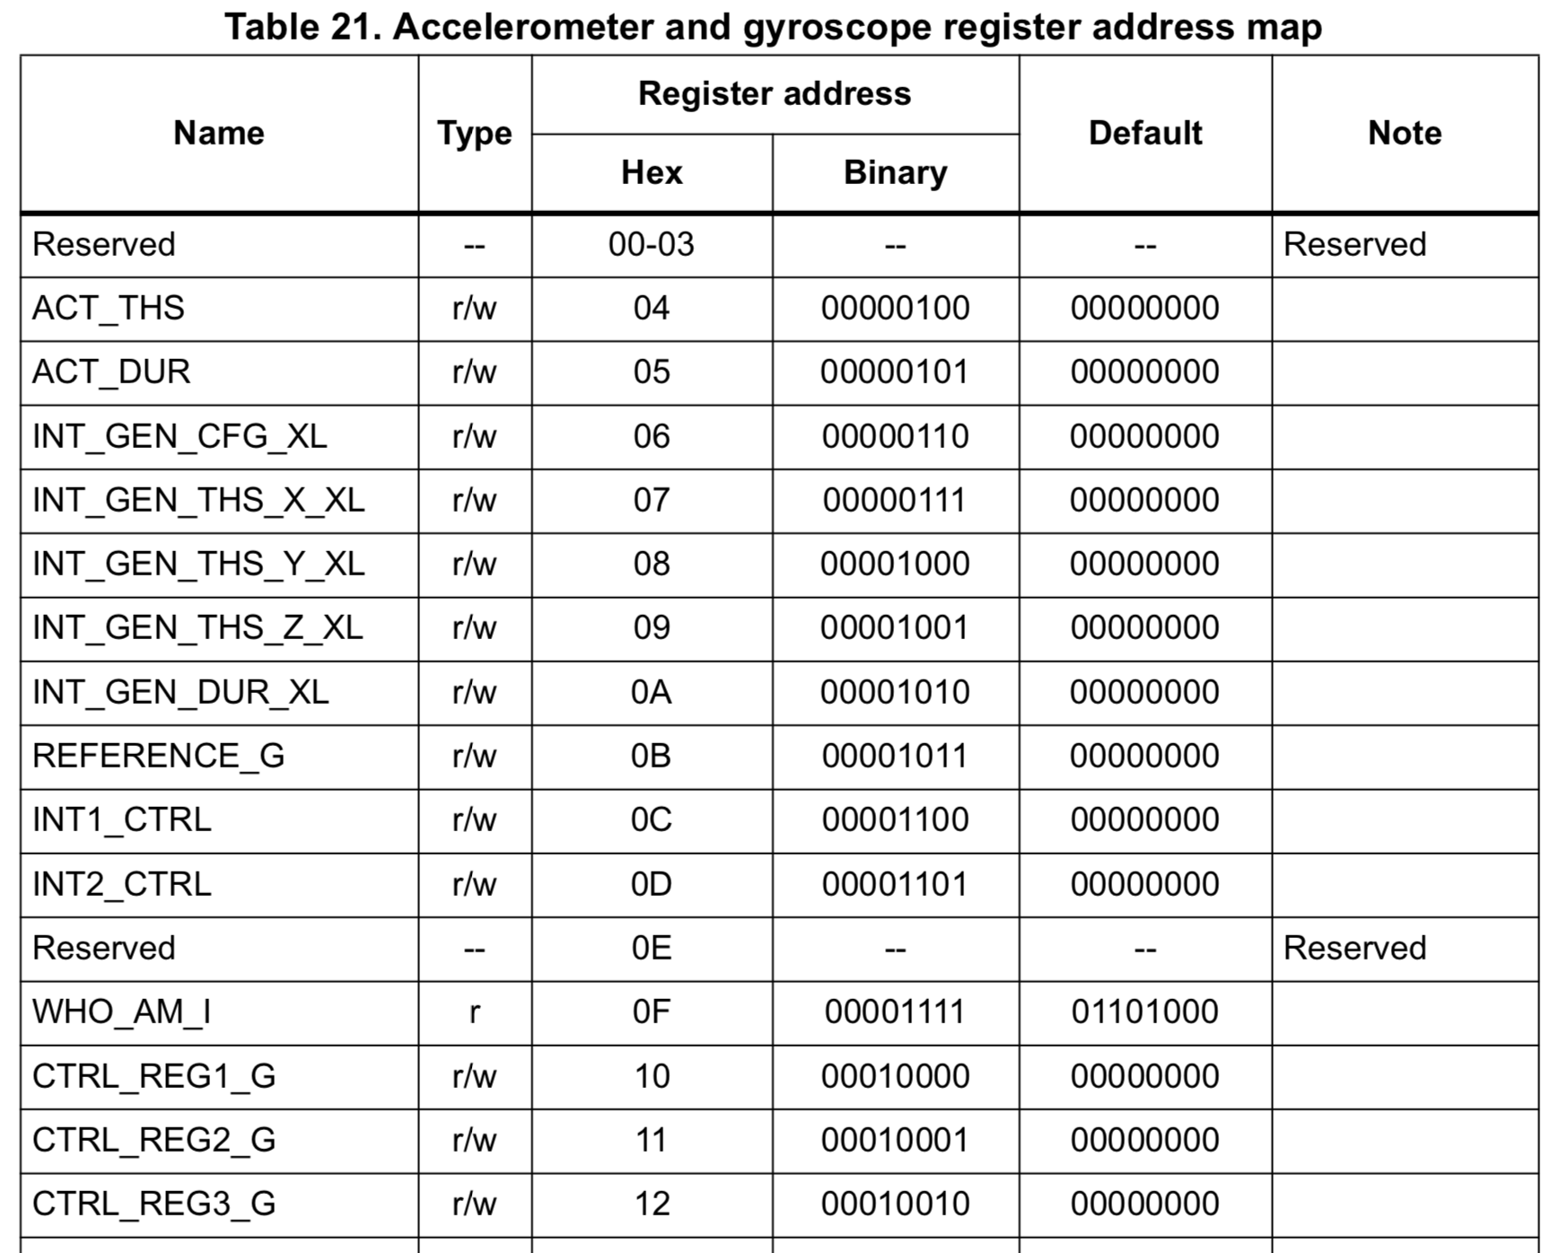
Hardware Registers
Configuration variables for a piece of hardware

Slide 13
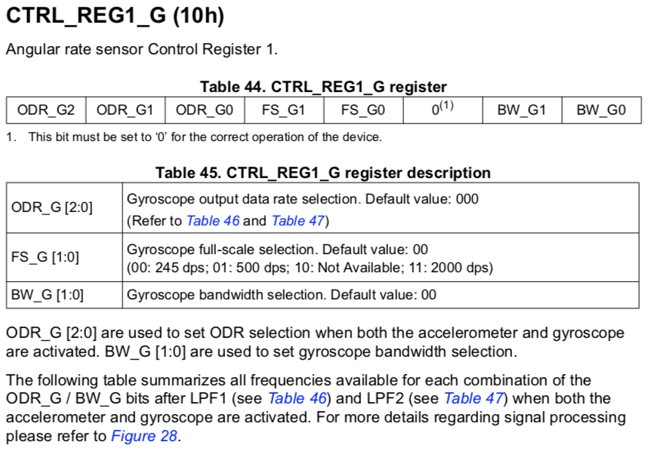

Slide 14
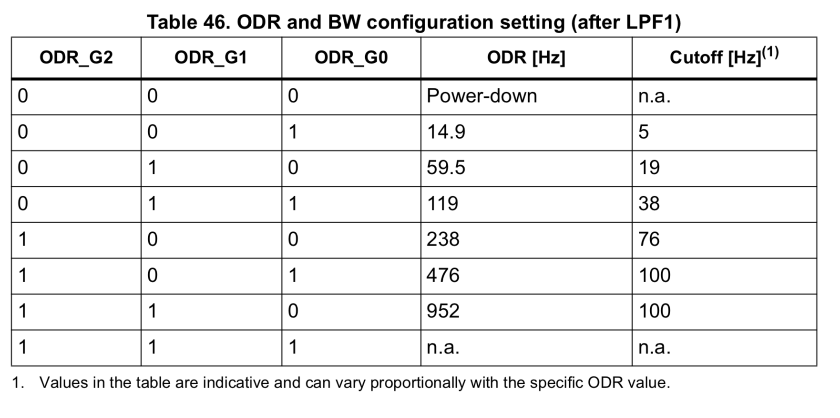

Slide 15
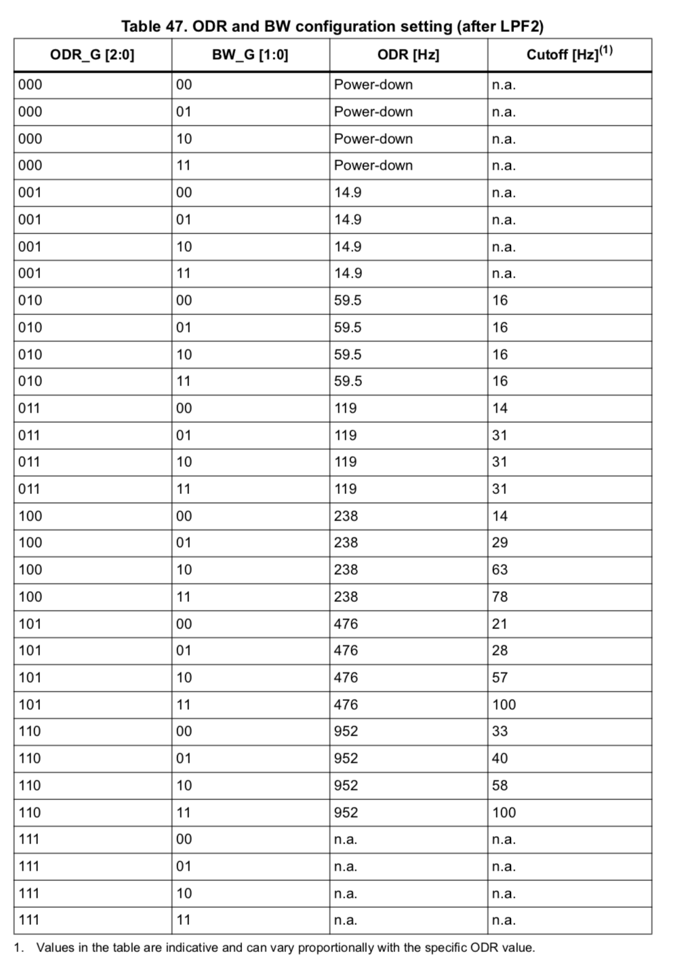

Slide 16
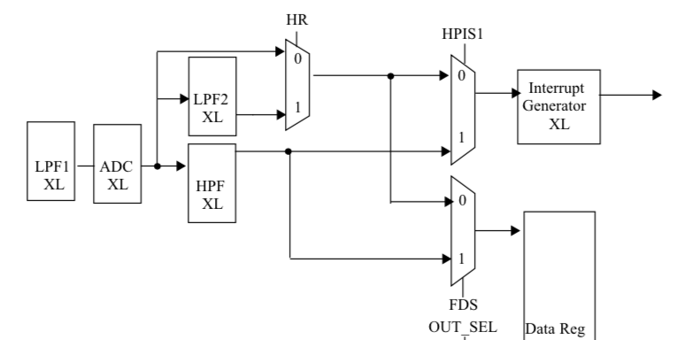
IMU Internal Accelerometer Filter

Slide 17
I2C Peripherals

Slide 18
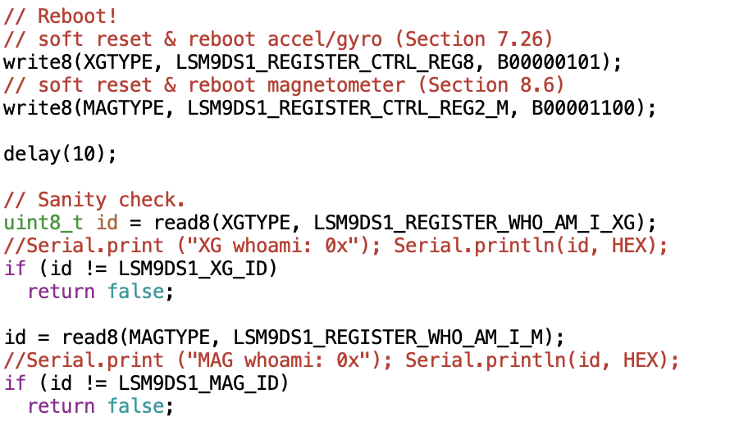

Slide 19
Filter Demo

Slide 20
Complimentary Filter
Combine the best of accelerometer and gyro
High-frequency from the gyroscope
Low frequency from the accelerometer
The math is pretty simple
θ_{new} the new estimated Euler angle
Θ_{old} the previous estimated Eurler angle
dθ/dt gyro measurement
Δt Time since last gyro measurement
θ_{e} Euler angle from the accelerometer
C The “complimentary gain”
θ_{new} = C*(θ_{old} + Δt*dθ/dt ) + (1-C)*θ_{e}

Slide 21
Tuning
Two goals
Low noise
Low lag

Slide 22
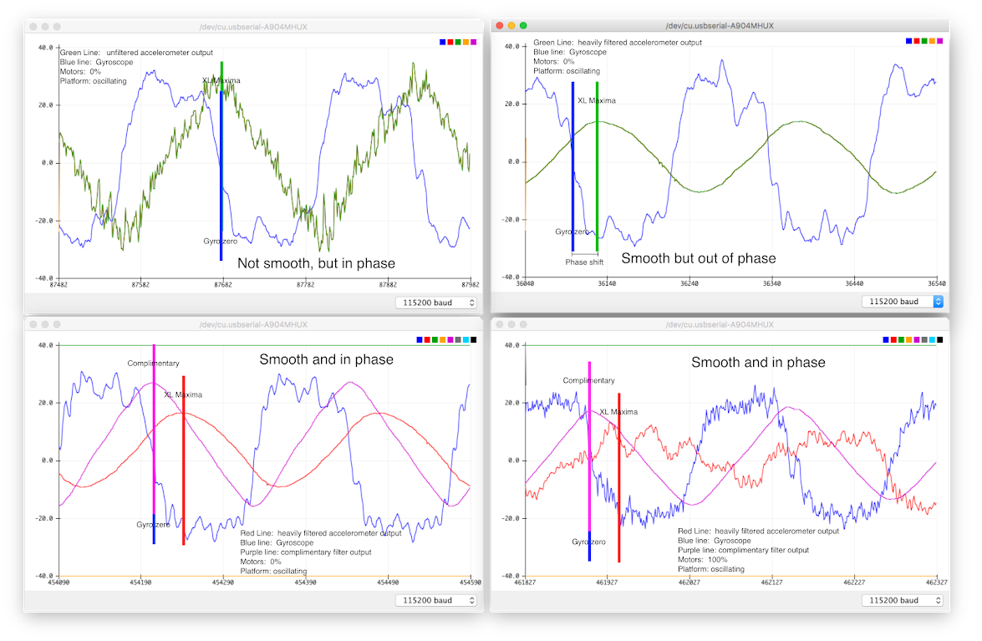

Slide 25
Quadcopter Datapath
Use complimentary filter to blend acc. And gyro data
Pitch and roll
Complimentary gain should come from the remotse

Slide 26
The End

Slide 27
Next time
More details and updated code about writing to registers
More detailed discussion of XL datapath and filtering.
Slides about LP and HP filters.
These slides + assembly slides took about 60 min.
30 min of questions at the start.
Adjust complimentary filter demo, so it’s easier to get to C = 0

Slide 28
The PID Controller

Slide 29
To add
Discuss different ways they can control their quad
Pitch/roll -> rate of change of angle
Pitch/roll -> angle of attack
Pitch/roll -> velocity
Pitch/roll -> position
Throttle -> throttle
Throttle -> rate of climb
Throttle -> altitude
Discuss higher-order control
How to integrate GPS
How to integrate barometer

Slide 30
Note for Next Class
Demo
Integral windup
Tuning PID
Combine this lecture with the flight control software lecture

Slide 31
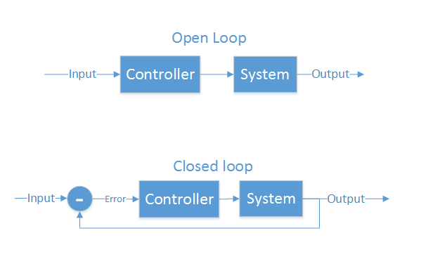
Control Theory
Making a physical system do what you want
“Open loop” and “closed loop”
Open loop - cannot see the system’s output
Motor controllers
LCD/LED/CRT screens
Closed loop - Can see output, make corrections
Autopilot
GPS guided munitions
Our quadcopter

Slide 32
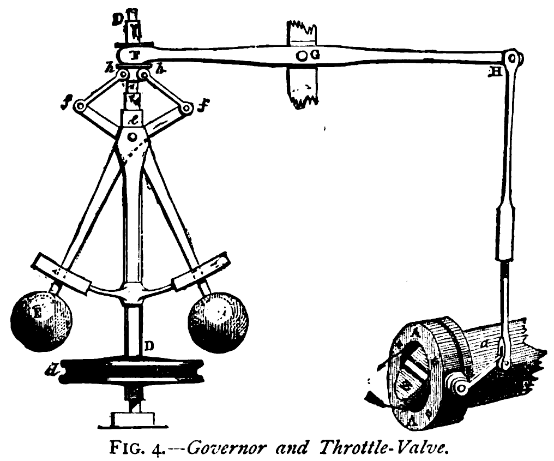
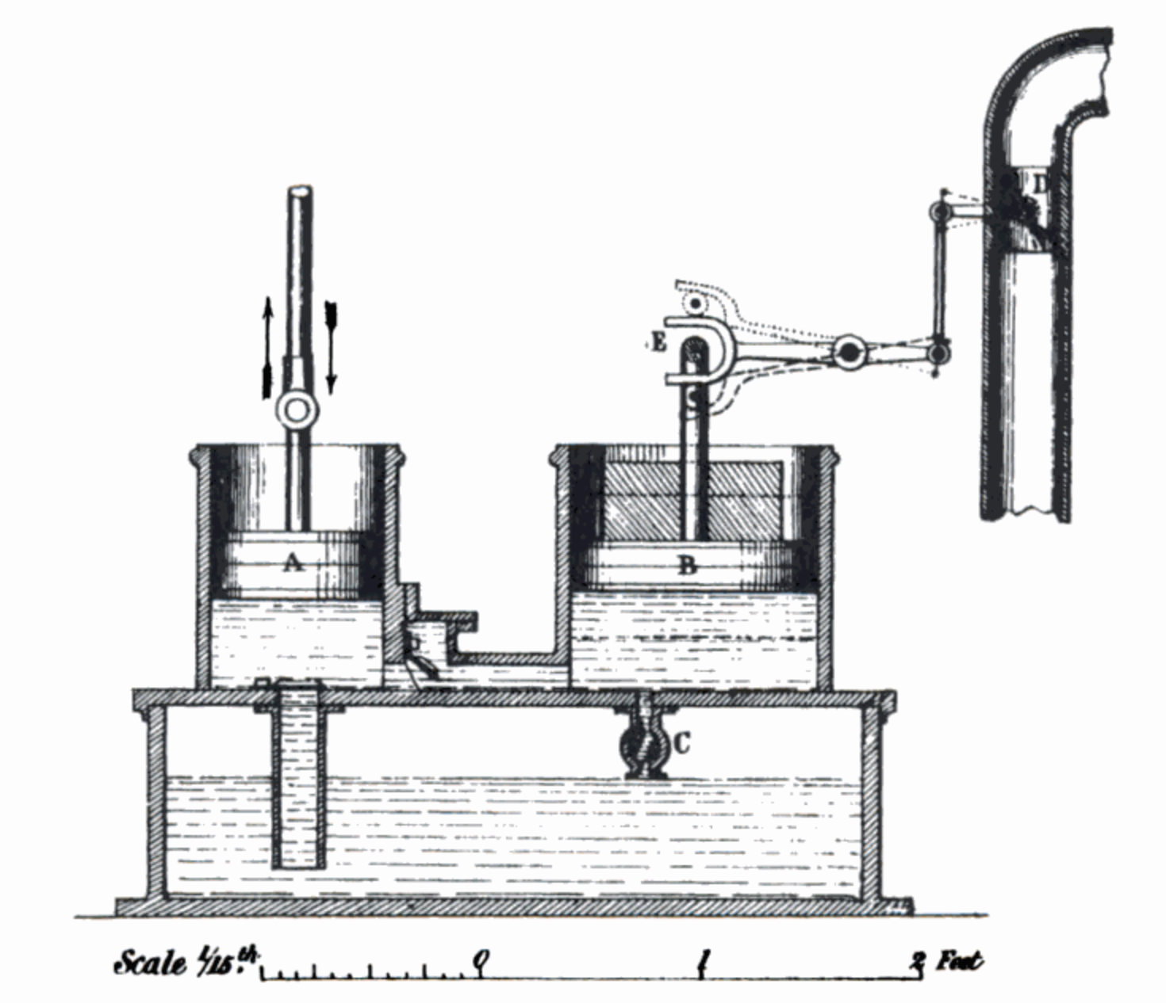
What is PID?
Make a system follow a set point
“Proportional, Integral, Derivative”
A brief history:
1788 - James Watt’s flyball governor (P)
1837 - Louis Molinié hydraulic regulator (PI)
1857 - H.N. Throop marine engine governor (PD)
1868 - Maxwell gives theoretical basis
1911 - Elmer Sperry, ship steering (PID)

Slide 33
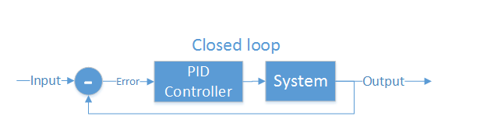
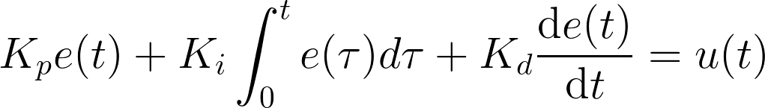
Closed loop control
PID is the most common closed loop controller
Proportional: Directly against error
Integral: Remembers error over time
Derivative: Dampens response to avoid oscillations

Slide 34
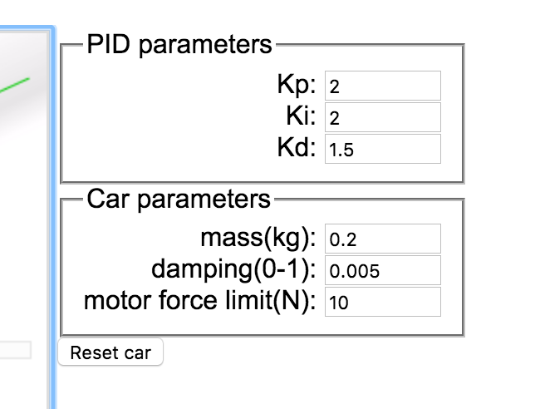
Example
https://sites.google.com/site/fpgaandco/pid

Slide 35
PID on the Quadcopter
3 separate controllers
PID set point is from user

Slide 36
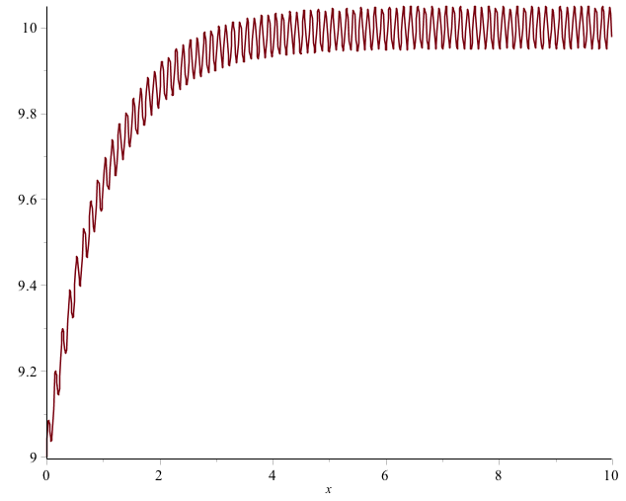
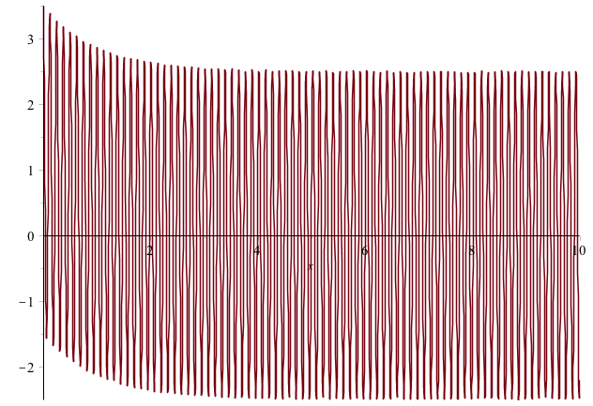

Pitfalls of PID
Integral term “Windup”
One solution: Exponential decay on integral (E.g., I = I/2 + error)
Derivative noise: beware of noise.
Solution: moving average of last several values. Or median of last several values.
Using the serial plotter in arduino to watch the D term.
3. Tweaking PID values
Tune P first, then D, then I.
Error term with vibration
Derivative term causes your system to go insane

Slide 37
Implementation
NOTES:
Where to get the derivative?
Integral windup
Pay attention to rate (hz)
Relative scale of inputs and outputs
Make sure timestep is consistent

Slide 38
How important in speed?
The key number is how many times/sec your PID loops (Hz)
The internet suggests > 100Hz (10ms/cycle) is necessary for stable flight.
My non-optimized code runs at 400Hz (2.5ms/cycles)
Action | Latency (ms)
Reading IMU | 7.360
analogWrite() | 0.012
analogRead() | 0.104
Integer PID (one channel) | 1.880 (531Hz)
FP PID (one channel) | 1.888 (529Hz)
AHRS getOrientation() | 1.860
rfWrite() 16 bytes | 0.812
Serial.write(“a”) | 0.906

Slide 39
Maintaining Stability
Multi-rotor aircraft require a closed loop controller
Sensors detect aircraft movement and orientation
Controller adjusts the power to motors to maintain desired location and orientation
Multi-rotor aircraft use a few sensors to maintain stability
Accelerometers (absolute pitch and roll)
Gyroscopes (changes in pitch, roll, and yaw)
The flight computer implements the control algorithm
Usually a proportional, integral, derivative (PID) controller implemented in software.
We will talk more about this later.
With PID controllers for pitch, yaw, and roll multirotor aircraft can achieve stable flight.

Slide 40
Tuning
Tuning PID is a bit of an art form.
Simple algorithm
Set P=I=D = 0
Increase P until it starts oscillating, reduce until it oscillates just a bit
Increase D to till it stabilizes pretty quickly
Increase I to fix offset
Increase D as much as possible with causing oscillation.

Slide 41
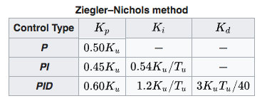
Tuning
Zeigler-Nichols method.
P=I=D= 0
Increase P until oscillations start. P is now at Ku, oscillation is at frequency Tu.
Follow the chart.
It’s important that your PID look incorporate its execution interval correctly.

Slide 42
Slides on Sensors
Accelerometer
Demo the data we get (3-axis accelerations)
Conversion to Euler angles. Show math.
Conversion to acceleration along x,y,z?
Maybe talk about coordinate systems?
Gyroscope
Demo the data we get
Other sensors
GPS
Barometer
Magnetometer
Temperature (for correcting measurements)
https://wiki.dronecode.org/_media/u01.imu_temperature_compensation_-_hessel_van_der_molen.pdf

Slide 43
New Slides on Filters
Noise
Calibration
Demo of noisy measurements
Demo of progressive improvements
Calibration
Tuning filters in the quadcopter
Tuning complimentary filter
Demo Drift from integrating gyroscope
Tuning moving average on euler angles
Demo of “good” pitch/roll angle measurements
Discuss magnetometer?
Calibration: https://github.com/kriswiner/MPU-6050/wiki/Simple-and-Effective-Magnetometer-Calibration
Heading calculations

Slide 44
Higher-order Navigation
Large multi-rotor aircraft can do more
Maintain geographic position
Maintain altitude
Follow an prescribed/pre-programmed path
More sensors required
Magnetometers (absolute yaw or heading)
GPS (absolute location and altitude)
Barometers (altitude)

Slide 45
Controlling Pitch
Pitch forward
More thrust to the rear
Less to the front
Pitch backward
Less thrust to the rear
More to the back

Slide 46
Controlling Roll
Pitch Left
More thrust to the right motor
Less to the left
Pitch Right
More thrust to the left motor
Less to the Right

Slide 47
Controlling Yaw
Rotate CCW
More thrust to the CCW motors
Less to the CW
Rotate CW
More thrust CW motors
Less to the CCW

Slide 48
Some Possible Configurations
Hexa +
Hexa x
“Plus”
“X”
Octa +
Octa x
“Octothorpe”
Y 6

