Slide 1
Implementing PID

Slide 2
Some Possible Configurations
Hexa +
Hexa x
“Plus”
“X”
Octa +
Octa x
“Octothorpe”
Y 6

Slide 3
Maintaining Stability
Multi-rotor aircraft are inherently unstable
Mismatched motor power (voltage variation, manufacturing variation in motors or props)
Variation in air currents and density.
Once perturbed, there’s no force acting on the aircraft to return it to equilibrium.

Slide 4
Maintaining Stability
Multi-rotor aircraft require a closed loop controller
Sensors detect aircraft movement and orientation
Controller adjusts the power to motors to maintain desired location and orientation
Multi-rotor aircraft use a few sensors to maintain stability
Accelerometers (absolute pitch and roll)
Gyroscopes (changes in pitch, roll, and yaw)
The flight computer implements the control algorithm
Usually a proportional, integral, derivative (PID) controller implemented in software.
We will talk more about this later.
With PID controllers for pitch, yaw, and roll multirotor aircraft can achieve stable flight.

Slide 5
Higher-order Navigation
Large multi-rotor aircraft can do more
Maintain geographic position
Maintain altitude
Follow an prescribed/pre-programmed path
More sensors required
Magnetometers (absolute yaw or heading)
GPS (absolute location and altitude)
Barometers (altitude)

Slide 6
To add
Discuss different ways they can control their quad
Pitch/roll -> rate of change of angle
Pitch/roll -> angle of attack
Pitch/roll -> velocity
Pitch/roll -> position
Throttle -> throttle
Throttle -> rate of climb
Throttle -> altitude
Discuss higher-order control
How to integrate GPS
How to integrate barometer

Slide 7
Note for Next Class
Demo
Noise
Noise reduction
Complimentary filter.
Integral windup
Tuning PID
Control registers for IMU
Register maps
Writing registers
Relationship between registers and circuit schematics of IMU internals
Combine this lecture with the flight control software lecture

Slide 8
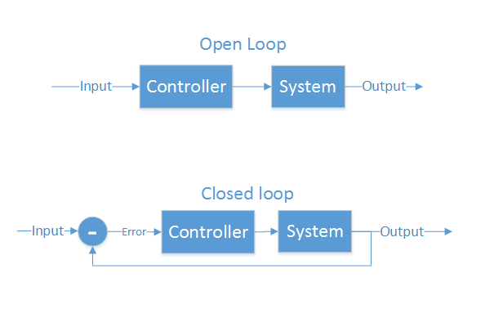
Control Theory
Making a physical system do what you want
“Open loop” and “closed loop”
Open loop - cannot see the system’s output
Motor controllers
LCD/LED/CRT screens
Some ICBMs
Closed loop - Can see output, make corrections
Autopilot
GPS guided munitions
Our quadcopter

Slide 9
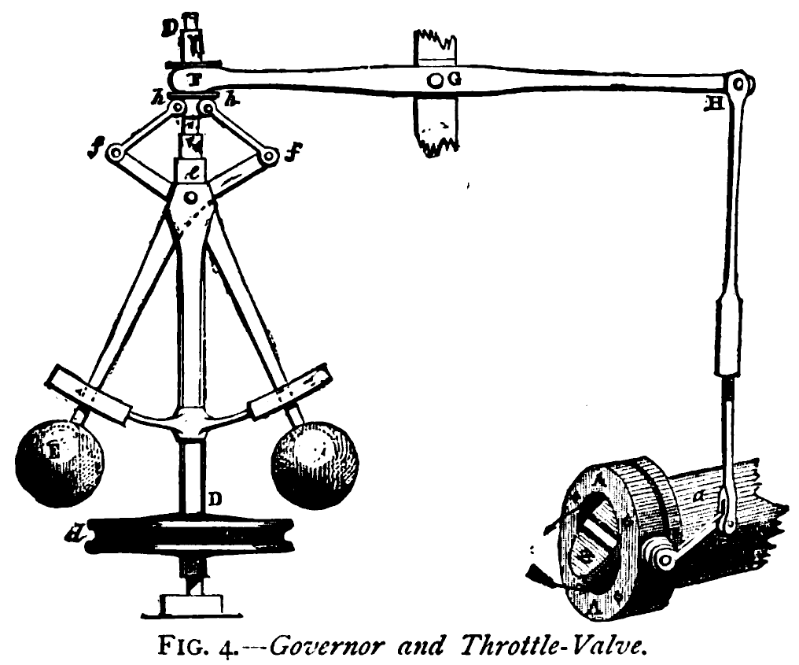
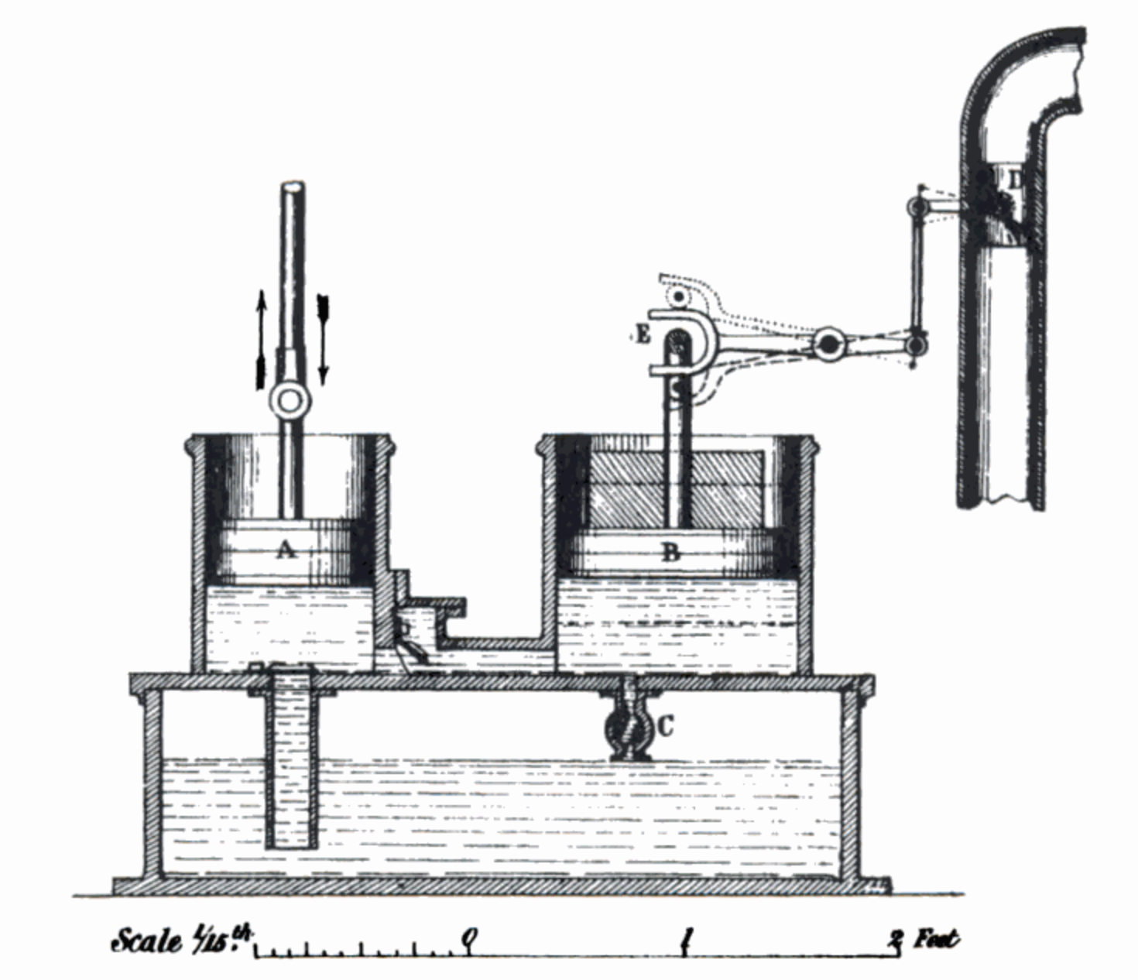
What is PID?
Make a system follow a set point
“Proportional, Integral, Derivative”
A brief history:
1788 - James Watt’s flyball governor (P)
1837 - Louis Molinié hydraulic regulator (PI)
1857 - H.N. Throop marine engine governor (PD)
1868 - Maxwell gives theoretical basis
1911 - Elmer Sperry, ship steering (PID)

Slide 10
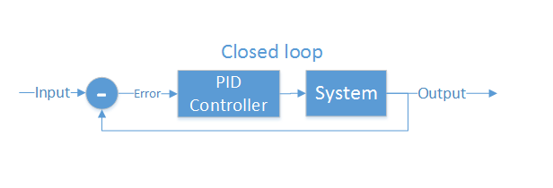
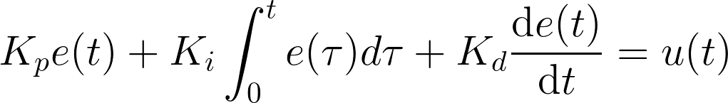
Closed loop control
PID is the most common closed loop controller
Proportional: Directly against error
Integral: Remembers error over time
Derivative: Dampens response to avoid oscillations

Slide 11
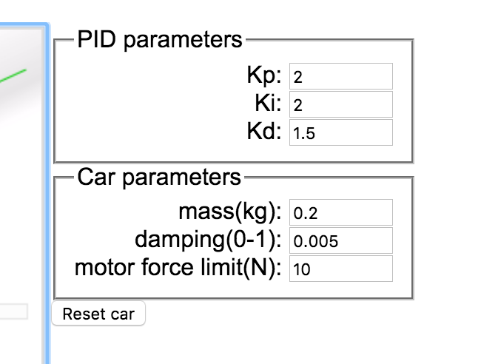
Example
https://sites.google.com/site/fpgaandco/pid

Slide 12
PID on the Quadcopter
3 separate controllers
PID set point is from user

Slide 13
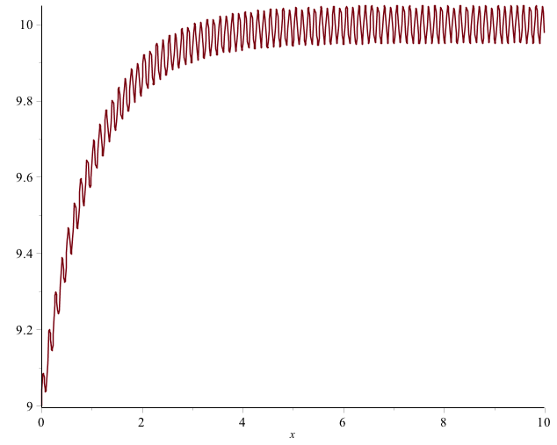
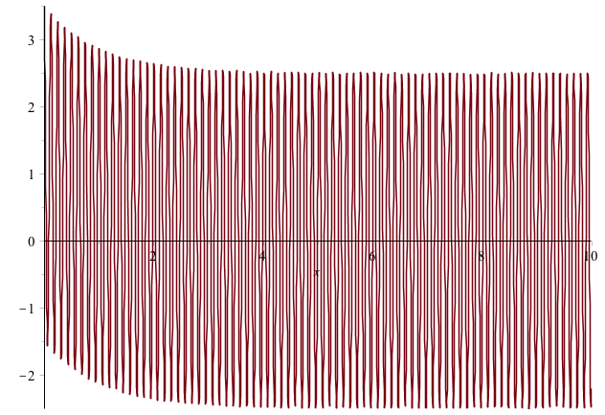

Pitfalls of PID
Integral term “Windup”
One solution: Exponential decay on integral (E.g., I = I/2 + error)
Derivative noise: beware of vibrations
Error term with vibration
Derivative term causes your system to go insane
Solution: moving average of last several values. Or median of last several values.
Using the serial plotter in arduino to watch the D term.
3. Tweaking PID values
Tune P first, then D, then I.

Slide 14
Implementation
NOTES:
Where to get the derivative?
Integral windup
Pay attention to rate (hz)
Relative scale of inputs and outputs
Should you include the time step?
Make sure timestep is consistent

Slide 15
How important in speed?
The key number is how many times/sec your PID loops (Hz)
The internet suggests > 100Hz (10ms/cycle) is necessary for stable flight.
My non-optimized code runs at 400Hz (2.5ms/cycles)
Action | Latency (ms)
Reading IMU | 7.360
analogWrite() | 0.012
analogRead() | 0.104
Integer PID (one channel) | 1.880 (531Hz)
FP PID (one channel) | 1.888 (529Hz)
AHRS getOrientation() | 1.860
rfWrite() 16 bytes | 0.812
Serial.write(“a”) | 0.906

Slide 16
Remote Software Path
Scale gimbal readings (-512-512 for P,R, Y; 0-1023 for T)
“deadband” avoids noise near the mid point.
Performance is not critical 10-20Hz updates is more than enough.

Slide 17
Quadcopter Datapath
Slow: Translate gimbal reads into ‘set points’
Fast: Use PID to track set points.
Add Filter to Diagram

Slide 18
Controlling Pitch
Pitch forward
More thrust to the rear
Less to the front
Pitch backward
Less thrust to the rear
More to the back

Slide 19
Controlling Roll
Pitch Left
More thrust to the right motor
Less to the left
Pitch Right
More thrust to the left motor
Less to the Right

Slide 20
Controlling Yaw
Rotate CCW
More thrust to the CCW motors
Less to the CW
Rotate CW
More thrust CW motors
Less to the CCW

