Slide 1

HyperDbg Debugger
A debugger designed for analyzing, fuzzing, and reversing

Slide 2

Who Am I?
Sina Karvandi
Researcher, Institute For Research In Fundamental Sciences (IPM)
Spring 2022

Slide 3
If debugging is the process of removing software bugs, then programming must be the process of putting them in. Edsger Dijkstra

Slide 4
Before start…
Website
Documentation
https://hyperdbg.com
https://docs.hyperdbg.com
Doxygen
Source code (GitHub)
Social Networks
https://doxygen.hyperdbg.com
https://github.com/HyperDbg
https://twitter.com/HyperDbg
https://youtube.com/c/HyperDbg

Slide 5
Why a debugger?
Programming Research
Security Research
Finding bugs,
OS/Application level functionality test
A platform to use modern processor features,
Performance monitoring & statistical analysis
etc.
The main tools for reverse engineering,
Analyzing system and application behaviors,
Fuzzing assistant,
Discover and fix vulnerability,
etc.

Slide 6
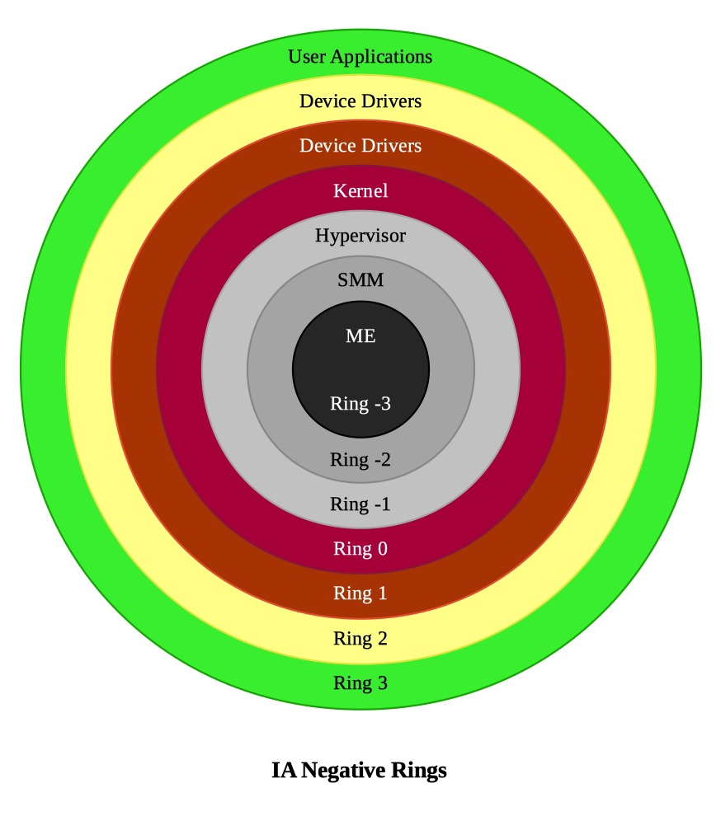
Protection Rings
In modern protected mode + paging enabled systems, there are 7 protection rings.
HyperDbg Debugger
Microsoft WinDbg, GNU Debugger (gdb), LLDB
x64dbg, edb, gdb, ollydbg, immunity, windbg, etc.

Slide 7


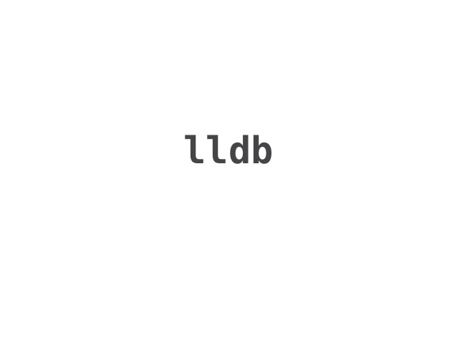
Kernel Debugger Family Members
WinDbg,
Over 30 years of develop
Windows is made by using WinDbg
Not open-source but its source code leaked multiple times
LLDB,
Mostly used as OS X debugger by researchers
Open-source
GDB,
Main kernel debugger for Linux
Open-source

Slide 8
A new family member
HyperDbg Debugger,
More privileged (Rings)
Unique features
An efficient and complicated design
Hidden by its nature
Academic innovation combined with practical implementation
Open-source
You can debug WinDbg or any other kernel debug with
HyperDbg :)

Slide 9

Concepts

Slide 10
Concepts
Execution Modes
Events
Actions
VMI Mode
Virtual Machine Introspection Mode
Also known as Local Debugging
Debugger Mode
Transparent Mode
Everything in HyperDbg is an event
Breakpoints are events
EPT hooks are events
Syscall executions are events
etc.
Consist of zero to n actions
Either
Conditional
Unconditional
Each action is either
Break
Script
Custom code

Slide 11
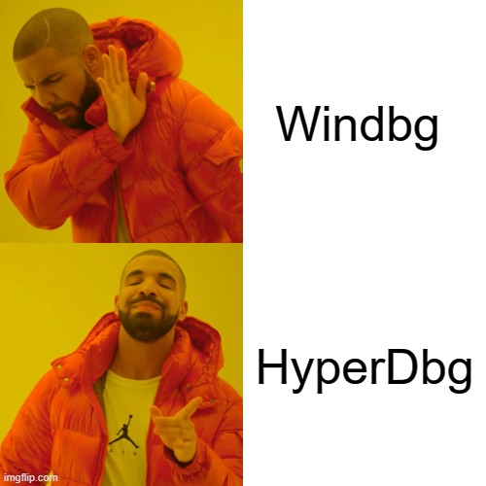

Slide 12

Events and Features

Slide 13
Features based on emulating systems’ behavior
Hooking system-Calls
Hooking system calls is possible by using !syscall command
Hooking return of system-calls
Hooking the result of system-calls is possible by using !sysret command.

Slide 14
!syscall command
Description
Features
Fast & Transparent
Triggers when the debugging machine executes a syscall instruction or, in other words, when Windows tries to run a system call, this event will be triggered.
Read more
https://docs.hyperdbg.com/commands/extension-commands/syscall
https://docs.hyperdbg.com/design/features/vmm-module/design-of-syscall-and-sysret

Slide 15
!sysret command
Description
Features
Fast & Transparent
Triggers when the debugging machine executes a sysret instruction or, in other words, when Windows tries to return to user-mode from a previous syscall.
Read more
https://docs.hyperdbg.com/commands/extension-commands/sysret
https://docs.hyperdbg.com/design/features/vmm-module/design-of-syscall-and-sysret

Slide 16
Features based on Virtual Machine Extensions - VMX
Classic EPT Hook
Monitor
Classic EPT hook is implemented in !epthook command
You can overcome the limitation of hardware debug registers with !monitor command
Inline EPT Hook
Fast inline EPT hook is implemented in !epthook2 command

Slide 17
!epthook command
Description
Features
Resist on anti-debugging methods related to memory hashing
Hook without limitation (inline-hooking problems)
Puts a hidden breakpoint (0xcc) on the target function in user-mode and kernel-mode without modifying the content of memory in the case of reading/writing.
Read more
https://docs.hyperdbg.com/commands/extension-commands/epthook
https://docs.hyperdbg.com/design/features/vmm-module/design-of-epthook

Slide 18
!epthook2 command
Description
Features
Resist on anti-debugging methods related to memory hashing
Super fast
Puts an in-line, detours-style kernel EPT hidden hook.
Read more
https://docs.hyperdbg.com/commands/extension-commands/epthook2
https://docs.hyperdbg.com/design/features/vmm-module/design-of-epthook2

Slide 19
!monitor command
Description
Features
Without any limitation in size
Without any limitation in quantity
Monitors read or write or read/write to a range of addresses. If any read or write on your range address (memory), it will be triggered.
Read more
https://docs.hyperdbg.com/commands/extension-commands/monitor
https://docs.hyperdbg.com/design/features/vmm-module/design-of-monitor

Slide 20
Intercepting Special Instructions
Intercept and modify CPUID
Intercept and modify hypercalls
Intercepting and modifying CPUID is possible using !cupid command
It’s possible to use !vmcall command to monitor hypercalls.
Intercept access to performance counter register
Intercept timing instructions
Any access to performance counter registers is monitored using !pmc command.
If any user-mode/kernel-mode application use RDTSC or RDTSCP then it’s monitored using !tsc command.

Slide 21
!cpuid command
Description
Features
Transparent monitoring CPUID execution
Triggers when the debugging machine executes a CPUID instruction in any level of execution (kernel-mode or user-mode).
Read more
https://docs.hyperdbg.com/commands/extension-commands/cpuid

Slide 22
!vmcall command
Description
Features
Generate a log from vmcalls
Triggers when the debugging machine executes VMCALL instruction.
Read more
https://docs.hyperdbg.com/commands/extension-commands/vmcall

Slide 23
!tsc & !pmc command
Description
Features
Monitor performance counter usage
Monitor rdtsc/rdtscp
Triggers when the debugging machine executes RDTSC or RDTSCP instructions in any execution level (kernel-mode or user-mode).
Read more
https://docs.hyperdbg.com/commands/extension-commands/tsc
https://docs.hyperdbg.com/commands/extension-commands/pmc

Slide 24
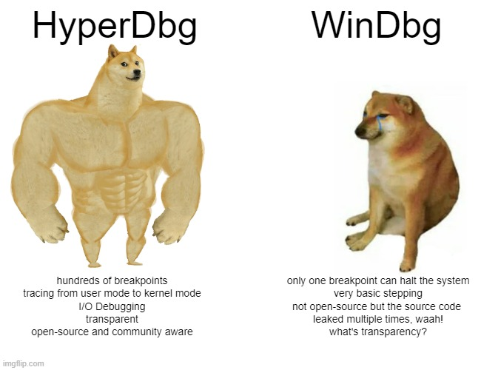

Slide 25
Monitoring systems’ behavior
Monitor any read from Model Specific Registers
Monitor any write from Model Specific Registers
You can monitor any read to MSRs using !msrread command
It’s possible to monitor any write to any MSRs using !msrwrite command
Monitor any access to debug registers
Monitor external-interrupts
You can use !dr command to monitor access to debug registers anywhere
You can monitor external-interrupts using !monitor command

Slide 26
!msrread & !msrwrite command
Description
Features
Triggers when the debugging machine executes an RDMSR instruction or, in other words, when Windows or a driver tries to read a Model-Specific Register (MSR).
Detects any change using rdmsr and wrmsr
Read more
https://docs.hyperdbg.com/commands/extension-commands/msrread
https://docs.hyperdbg.com/commands/extension-commands/msrwrite

Slide 27
!dr command
Description
Features
Detect access to debug registers e.g., detect anti-debugging methods
Triggers, when the debugging machine accesses one of the hardware debug registers.
Read more
https://docs.hyperdbg.com/commands/extension-commands/dr

Slide 28
!exception & !interrupt command
Description
Features
Detect all exception before operating system is notified
Triggers when the debugging machine encounters an exception (faults, traps, aborts) or NMI or interrupt. This command applies to only the first 32 entries of IDT (Interrupt Descriptor Table). If you need to hook entries between 32 to 255 of IDT, you should use !interrupt instead.
Read more
https://docs.hyperdbg.com/commands/extension-commands/exception
https://docs.hyperdbg.com/commands/extension-commands/interrupt
https://docs.hyperdbg.com/design/features/vmm-module/design-of-exception-and-interrupt

Slide 29
Monitor and Modify I/O
Monitor I/O Inputs
Monitor any inputs to I/O ports using !ioin command
Monitor I/O Outputs
Monitor any outputs to I/O ports using !ioout command

Slide 30
!ioin & !ioout command
Description
Features
You can monitor all I/O ports
Triggers when the debugging machine executes IN or IN* instructions or, in other words, when Windows or a driver tries to use I/O ports.
Read more
https://docs.hyperdbg.com/commands/extension-commands/ioin
https://docs.hyperdbg.com/commands/extension-commands/ioout

Slide 31

Stepping in HyperDbg

Slide 32
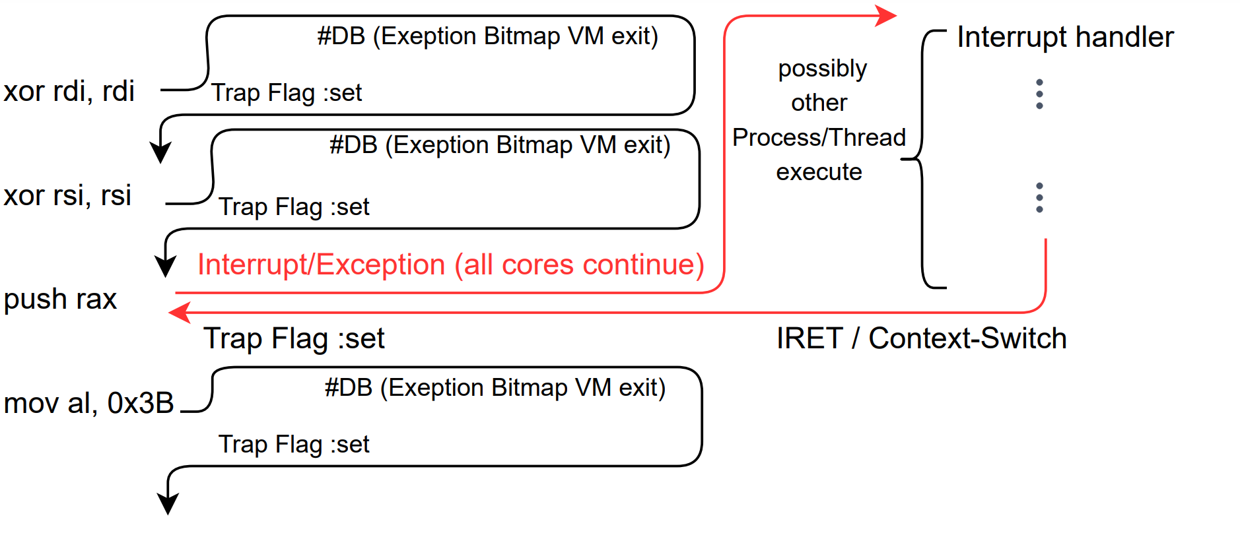
Step-in (t command)
Like normal debugger but uses hypervisors to intercept events
All cores are continued
Trap flag is used

Slide 33
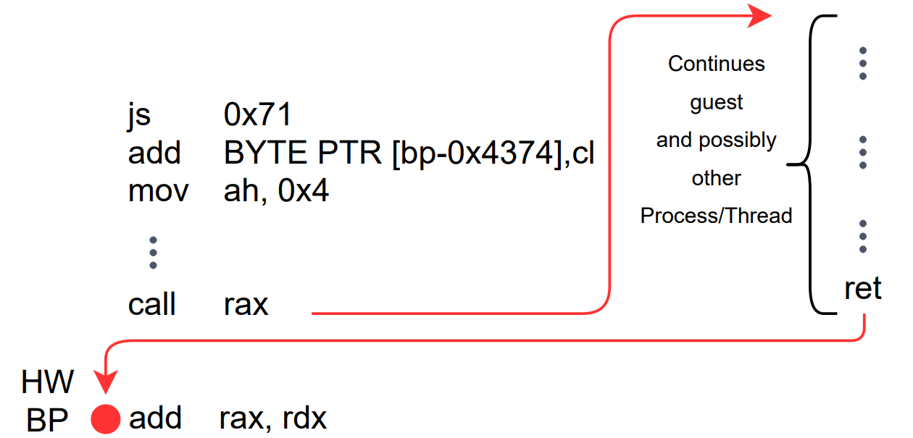
Step-over (p command)
Like normal debugger but uses hypervisors to intercept events
All cores are continued
Trap flag is used
Uses Hardware Debug Registers for calls

Slide 34
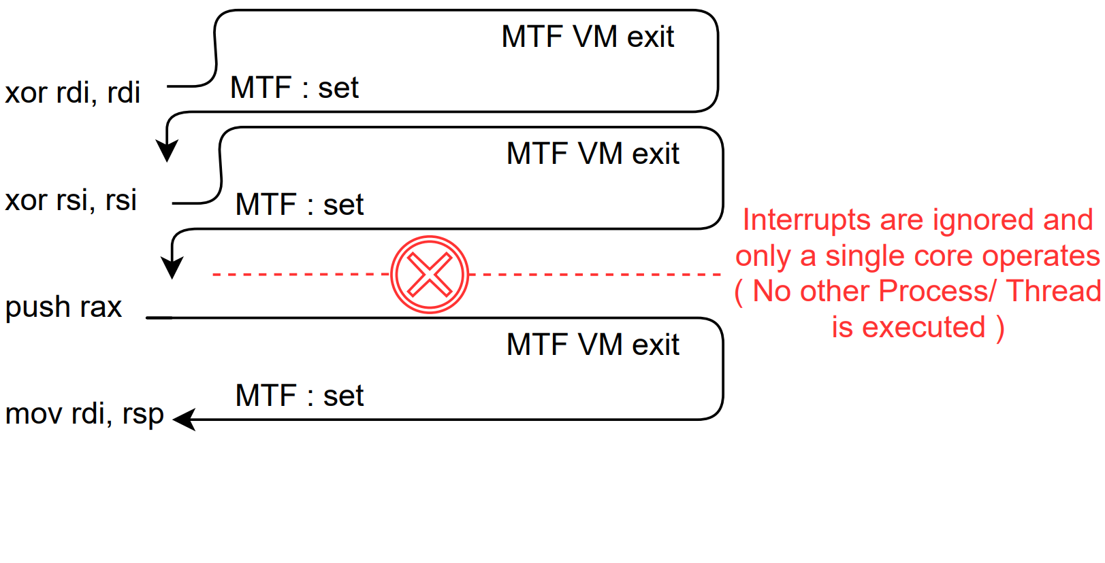
Instrument Step-in (i command)
Only in HyperDbg
Only the current executing core is continued
MTF is used
No interrupts is allowed
No other threads/processes executes
Guarantees only the current thread, executes just one instruction

Slide 35

A VMX-root Compatible Script Engine

Slide 36
Our Powerful Script Engine
HyperDbg’s script engine is designed to work on vmx-root
A MASM-Style language, combined with C keywords and features (if, else, for, etc.)
We designed everything from scratch like basic operating system spinlock, memory check, even functions like sprintf and strlen.
There is a term called “unsafe behavior” in HyperDbg.
Read more : https://docs.hyperdbg.com/tips-and-tricks/considerations/the-unsafe-behavior
RFLAGS.IF bit is cleared ! No interrupt ! No page-fault (#PF).

Slide 37
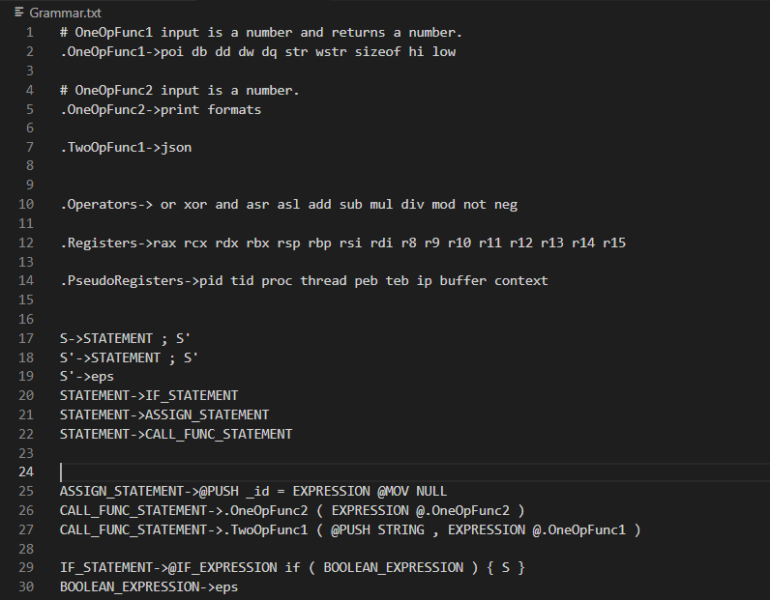
Our Powerful Script Engine
LL(1) and LALR(1) parsers are used to reach the most possible performance
Grammar of Script Engine can be customized

Slide 38
Keywords
Keyword | Description
poi | Pointer-sized data from the specified address.
hi | High 16 bits
low | Low 16 bits
db | Low 8 bits
dd | Low 16 bits
dw | Low 32 bits
dq | 64 bits
sizeof | Size of the target variable
not | Flip each and every bit
neg | True/False logic flipping

Slide 39
Pre-defined Functions
Function | Description
Print | Print the result of an expression.
Printf | Print the result like classic printf.
Pause | Halt the system and give control to the debugger.
EnableEvent | Enable an event.
DisableEvent | Disable an event.

Slide 40
Pseudo-registers
Pseudo-register | Description
$pid | The process ID (PID) of the current process.
$proc | The address of the current process (that is, the address of theEPROCESS block).
$tid | The thread ID for the current thread.
$thread | The address of the current thread. In kernel-mode debugging, this address is the address of the ETHREAD block.
$peb | The address of the process environment block (PEB) of the current process.
$teb | The address of the thread environment block (TEB) of the current thread.
$ip | The instruction pointer register (rip).
$buffer | The pre-allocated buffer if the user requests a safe buffer.
$context | The context of the triggered event (It has a different meaning in each event).

Slide 41
Challenges: User requests an invalid address
What if the user entered an invalid address?
CPU never knows whether an address is valid or invalid unless it access the address.
#PF are disabled in vmx-root mode (RFLAGS.IF Cleared).
If we access an invalid address in user-mode, then the program crashes, one way to avoid these crashes is to use try { } catch { } which uses Windows SEH mechanism.
Using SEH is a bottleneck as it is SLOW.
If we access an invalid address in kernel-mode then a BSOD happens.
If we access an invalid address in vmx-root mode then system halts !

Slide 42
TSX and page-table traversing to rescue
Current version of script-engine operates in kernel-mode and vmx-root mode.
First, we check whether the target system supports Intel Transactional Synchronization Extensions.
If it supports TSX (RTM) then we create a transaction by using xbegin… xend.
If the transaction failed then it shows that the address was invalid and if it is successful then it shows that the address is valid.

Slide 43
TSX and page-table traversing to rescue
If the target system didn’t support TSX, then, we traverse each page-table (pml4 → pdpt → pd → pt).
If the page address was valid and was PRESENT, then the address is valid; otherwise, it’s invalid.
Using TSX is super fast and using the above methods we solved the problem of accessing invalid addresses in script engine by adding a check before accessing the address.

Slide 44


Slide 45

Transparency

Slide 46
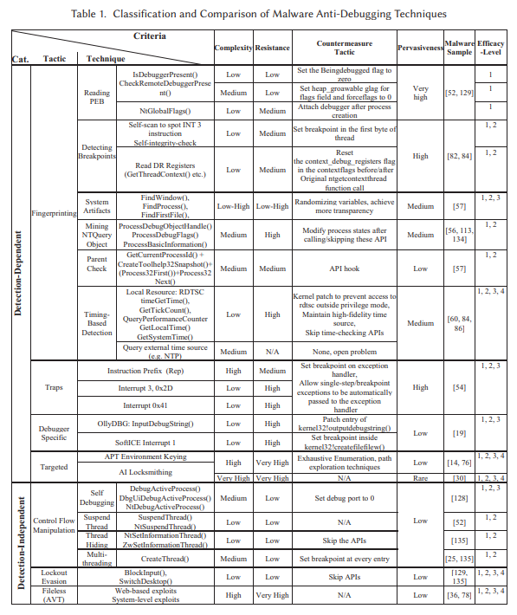
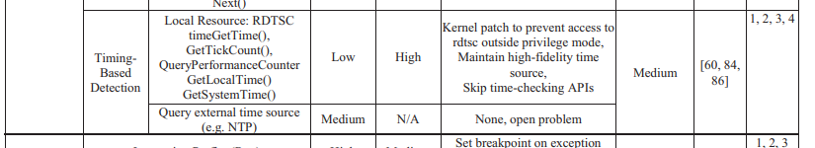
Anti-Malware and Anti-Debugging
Afianian, Amir, et al. "Malware dynamic analysis evasion techniques: A survey." ACM Computing Surveys (CSUR) 52.6 (2019): 1-28.

Slide 47
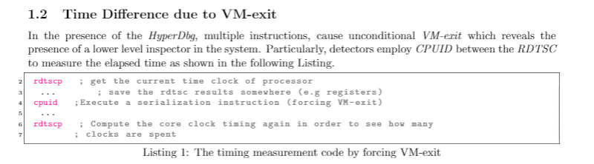
Timestamp Check

Slide 48
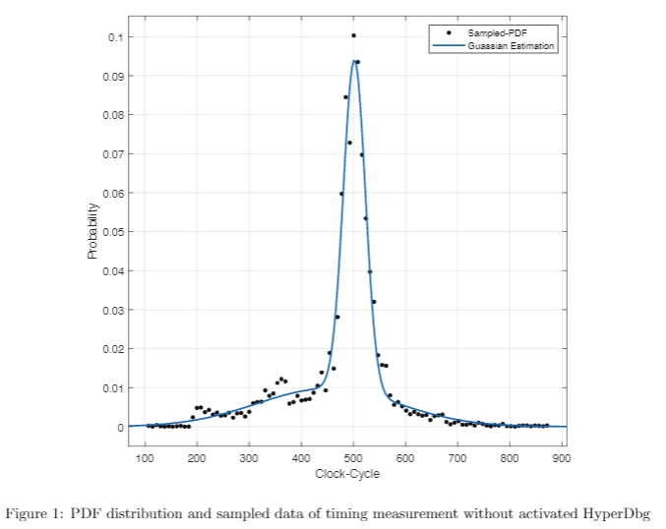
CPUID without HyperDbg
10,000 instances
Follow Gaussian Curve by Interpolation

Slide 49
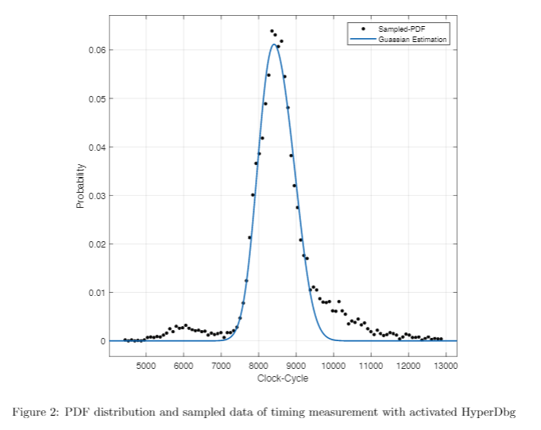
CPUID with HyperDbg
10,000 instances
Follow Gaussian Curve by Interpolation

Slide 50
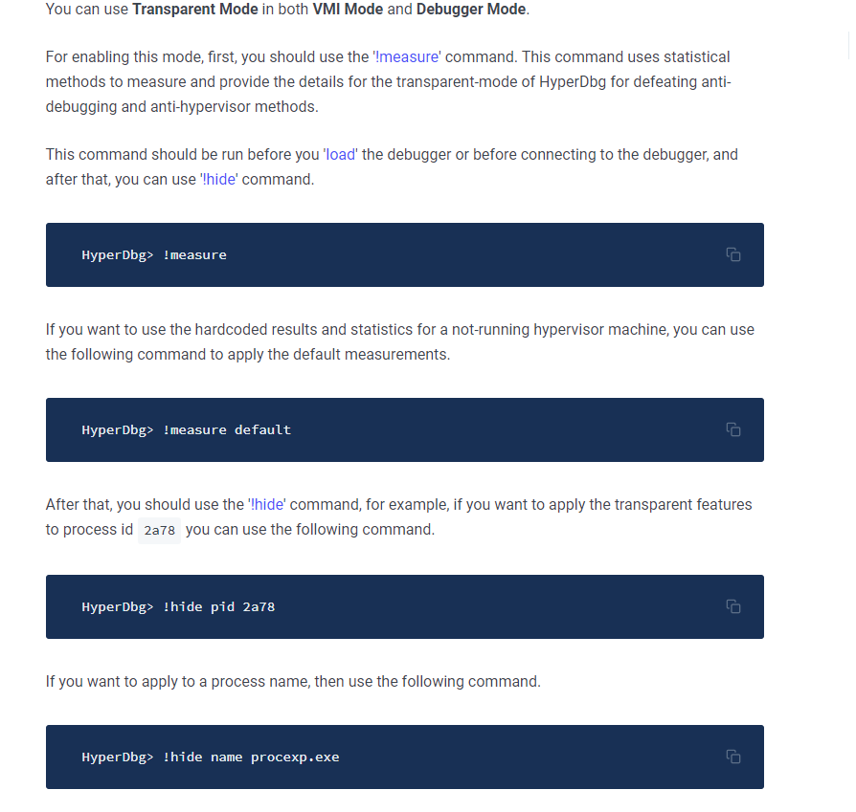
Automate the measurement Procedure
!measure
!measure default
!hide pid 2487
!hide name proexp.exe

Slide 51
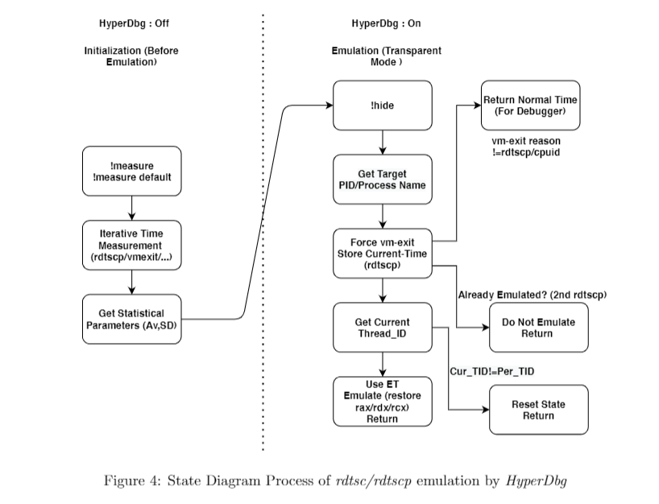
Procedure Diagram

Slide 52
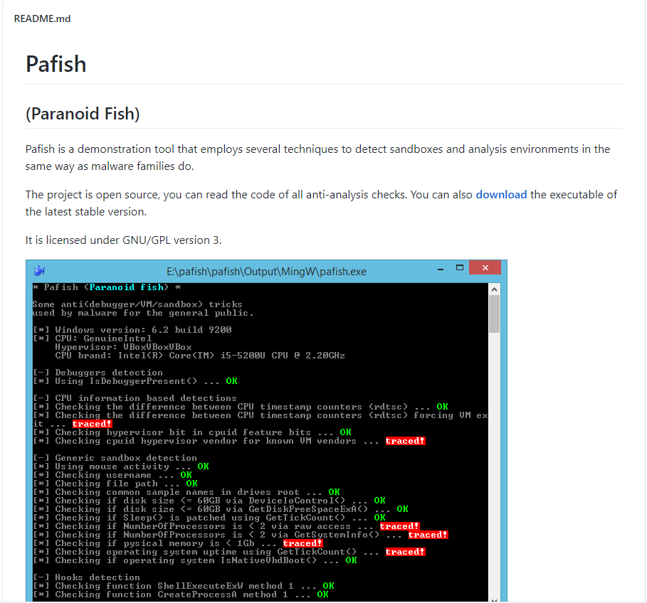
Evaluation on Pafish

Slide 53
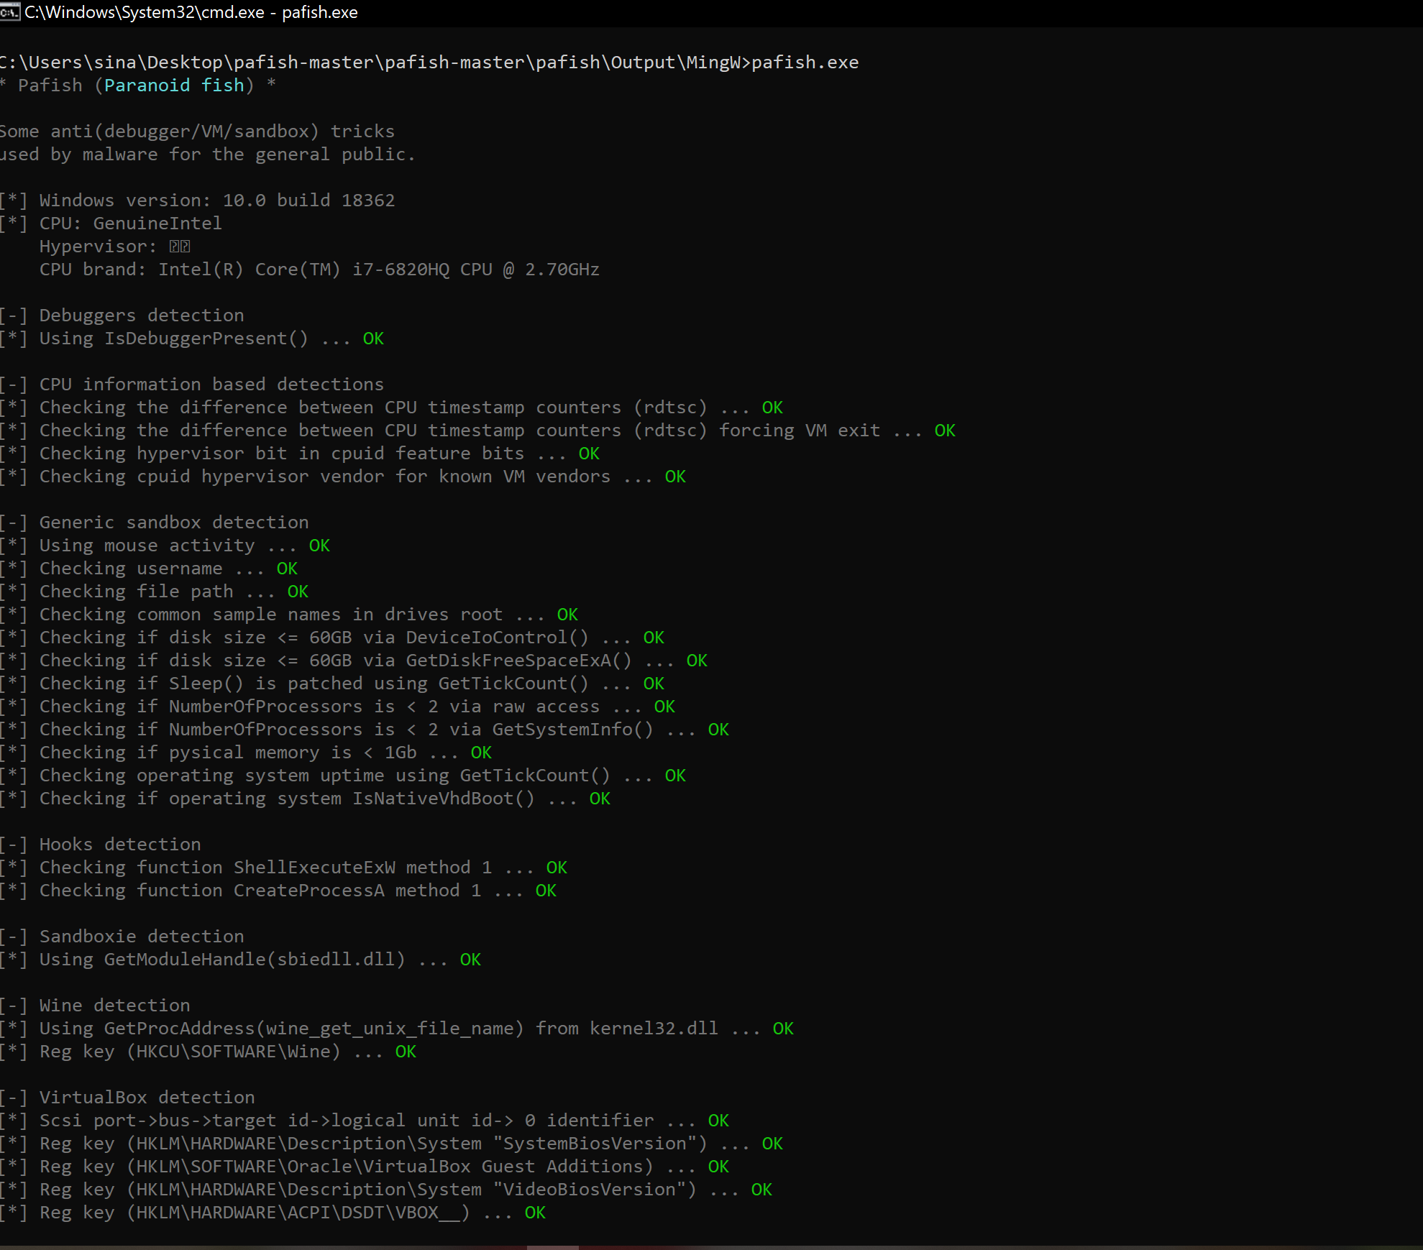
Demo Time

Slide 54
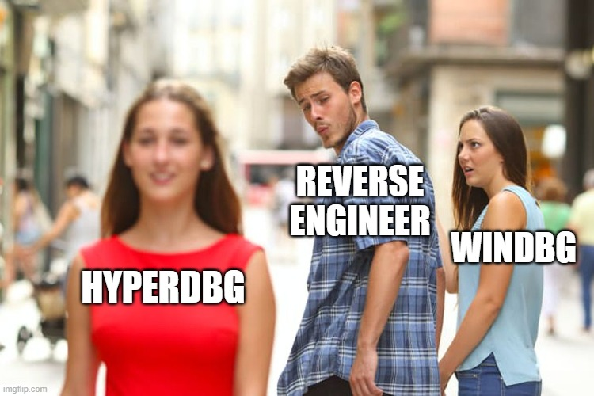

Slide 55
Any Questions?

Slide 56

Thank you

