Slide 1
Update 18/06/2025
Previously…
Recorded data with the 3M electrodes
Pipeline finished
Real-time accuracy: worse than bad, shameful
What is happening??
Recorded again with Ambu electrodes
Discovered that OpenBCI is NOT FILTERING the stored signal!!

Slide 2
With Ambu electrodes & discrete movement
Around 82% of offline accuracy with samples that were not in the same recording session as those use for training! I use session 1,2 for training and session 3 for testing.
This is double the accuracy with the 100 3M electrodes!
If using samples from the same session I can get more than 90% accuracy
Real time: works well but does not detect classes l, lf, and f.
Promising if I train it with continuous rather than discrete tongue movements
Bought 100 3M electrodes myself for Spain
The Ambu ones are too expensive
3M are very noisy. Can I apply gel to the 100 3M electrodes? Yes

Slide 3
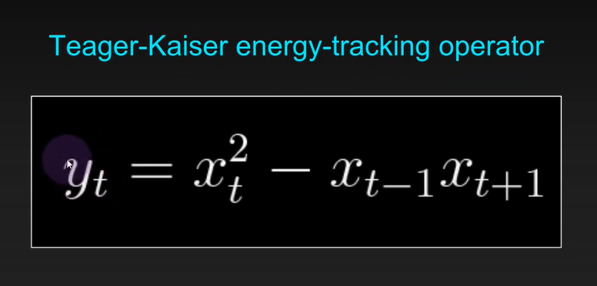
Checked pitfalls and recommendations:
The pipeline doesn’t seem to fall on one of the mentioned common mistakes.
Implemented TKEO used in Krabben 2016
Bought 100 3M electrodes myself for Spain
The Ambu ones are too expensive
They are very noisy. Can I apply gel to the 100 3M electrodes?
Tested 3M electrodes with gel
Recorded continuous signal with those electrodes
Tested online
Better offline results without bandpass, but very bad in online

Slide 4
Recorded with discrete movements
Played with:
Window size
Which sets I use for train and which for test
Bandpass interval
Align or not signal to 0 in the window (locally)
Use or not bandpass
Window position in respect to the annotation
User or not notch
Use envelope
Use Z-score
Use or not feature scaling
Use or not feature selection
Type of classifier (SVM, kNN, RF, logistic regression)
Parameters of the classifier
TKEO
Better offline results without bandpass, but very bad in online
Best results with:
Window size 375
Bandpass 5-50 Hz
Notch 50 Hz
Features: RMS, ZC, WL, MAV
Feature scaling: No
Feature selection: No
Classifier: RF with 500 estimators.
TKEO: No
Discovered that: the saved signal by OpenBCI is not filtered at all!
Session1.csv
Session2.csv
Session3.csv
Combined_df
Windowed_data
(sessions 1,2)
Windowed_data_test
(session 3)
Filter window-by-window
Filtered
Filtered_test
Then, get features window-by-window
X: features, y: labels
X, y
Xt, yt
Is there data leakage here? I preprocess window by window, each feature can only ‘look’ to their window, thereby they are not affected by the test data
X_train, X_test, y_train, y_test
Trained Random Forest classifier
Accuracy with X_test and y_test:
0,762
Cross val. Mean accuracy =
0,754
Accuracy with Xt and yt: 0,771

Slide 5
Recorded with duration-based logging
Played with:
Window size
Create windows from offset
Bandpass interval
Use or not bandpass
User or not notch
Use Z-score
Use or not feature scaling
Use or not feature selection
TKEO
Features
Comments
If I use z-score, the accuracy drops.
Didn’t test the envelope
Best results with:
Window size 0,5s
Train with offset: Yes
Offset: [0, -0.1, 0.1]
Bandpass 5-50 Hz
Notch 50 Hz
Features: RMS, RMS_SD, ZC, WL, MAV, STD, VAR, IAV, MF
Feature scaling: Yes
Feature selection: No
Classifier: RF with 500 estimators.
TKEO: Yes
Session1.csv
Session2.csv
Session3.csv
Combined_df
Windowed_data
(sessions 1,2)
Windowed_data_test
(session 3)
Filter window-by-window
Filtered
Filtered_test
Then, get features window-by-window
X: features, y: labels
X, y
Xt, yt
Is there data leakage here? I preprocess window by window, each feature can only ‘look’ to their window, thereby they are not affected by the test data
X_train, X_test, y_train, y_test
Accuracy with Xt and yt: 0,810
Trained Random Forest classifier
Accuracy with X_test and y_test:
0,853
Cross val. Mean accuracy =
0,844 (std 0,015)
Training with the 3 sessions: 0,929 (cross val 0,919)
Good online accuracy!

Slide 6
Recorded with duration-based logging
Session1.csv
Session2.csv
Session3.csv
Windowed_data
(sessions 1,2)
Windowed_data_test
(session 3)
Filter window-by-window
Filtered
Filtered_test
Then, get features window-by-window
X: features, y: labels
X, y
Xt, yt
X_train, X_test, y_train, y_test
Accuracy with Xt and yt: 0,810
Trained Random Forest classifier
Accuracy with X_test and y_test:
0,853
Cross val. Mean accuracy =
0,844 (std 0,015)

Slide 7
Recorded with duration-based logging
Session1.csv
Session2.csv
Session3.csv
This part can be removed if the model is trained with all data
Windowed_data
(sessions 1,2)
Windowed_data_test
(session 3)
Filter window-by-window
Filtered
Filtered_test
Then, get features window-by-window
X: features, y: labels
X, y
Xt, yt
X_train, X_test, y_train, y_test
Accuracy with Xt and yt: 0,810
Trained Random Forest classifier
Accuracy with X_test and y_test:

Slide 8
Example of how I used the cell: Additional Test
Today, I recorded 3 datasets with 2 users. Each dataset is a different session.
Dataset 1
User: Natalia
Samples: 20
Dataset 2
User: Natalia
Samples: 10
Dataset 3
User: MAR
Samples: 20
I train and test the classifier with Dataset 1 and Dataset 3. With this, I get Accuracy 1.
Then, I use the previously trained classifier to classify the samples in Dataset 2. This is to test how well it generalizes across sessions, obtaining Accuracy 2. This is just a test I like to do and does not influence Accuracy 1 at all.
The reported accuracy in the weekly reports will always be Accuracy 1.

Slide 9
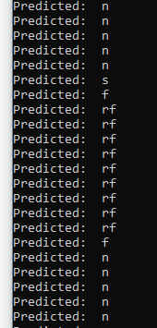
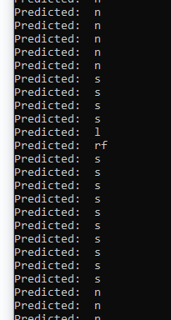
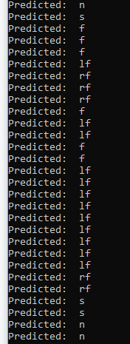
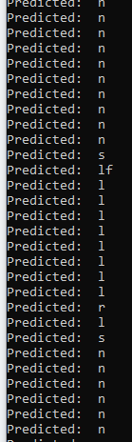
Right-front
Swallow
Left-front
Left

Slide 10
More things to test
Carvalho 2023
Preprocessing:
Wavelet Transform
Hilbert Filter
Kalman filter
Classification
Threshold method?

Slide 11
Noraxon
Sampling rate: 4000Hz. That’s the main difference with OpenBCI.
Many studies use this sampling rate, or lower, around 2500 Hz.
User test
Can I take some electrodes? Mine arrive next week.
How should i setup the UX environment? Talk about possible classes and inputs.
Try swings left to right.
If we briefly pass trhoug the classs it is a class.
FOCUS ON TESTING ON NEW USERS!

Slide 12
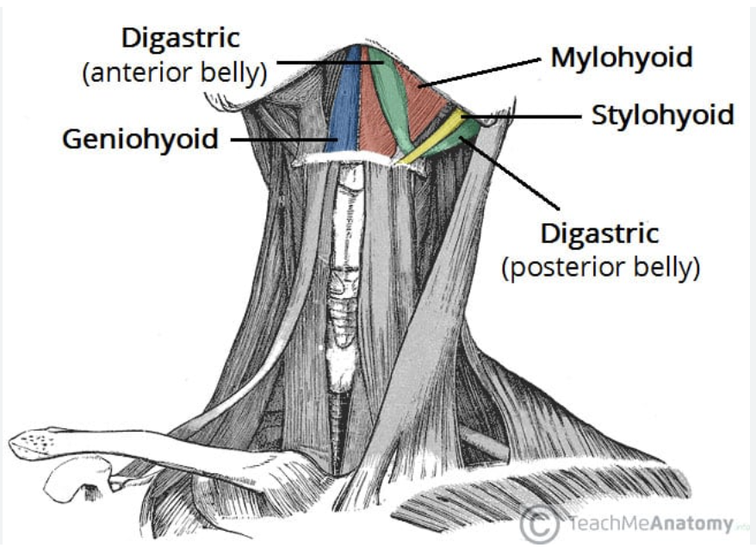
Channel 1 (red): Geniohyoid
Channel 2 (gray): Right Mylohyoid
Channel 3 (blue):
Left Mylohyoid
Distance between electrodes: 3cm

