Slide 1
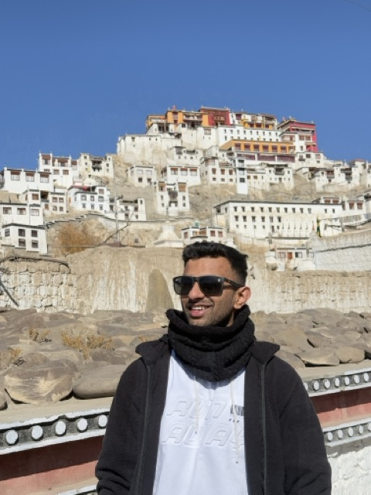
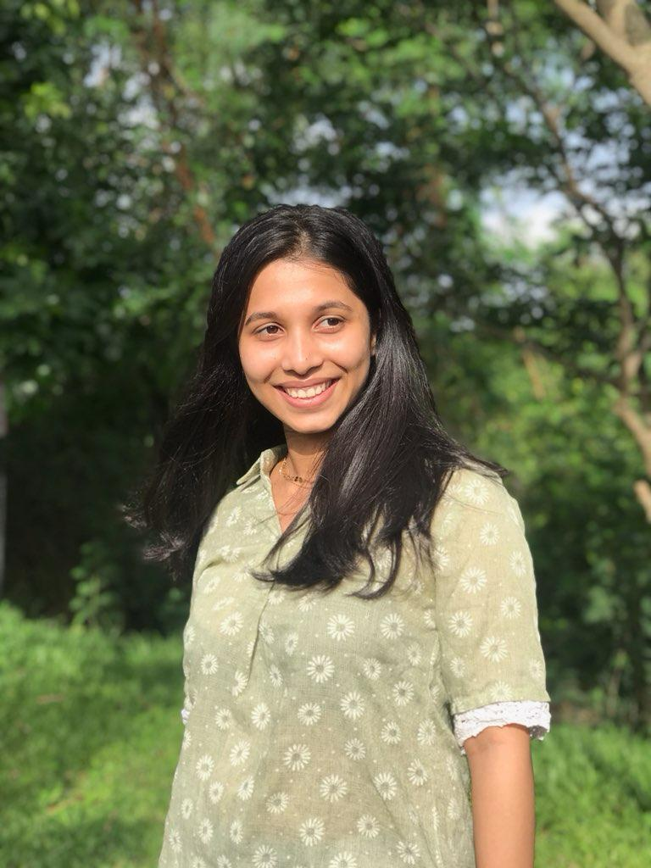
Parth Jagtap
&
Sai Sawant
Sangeet Night

Slide 2
BLESSING & INVOCATION
Ganesh Vandana
May all obstacles be removed
Led by family

Slide 3
MEET THE GROOM
Parth Jagtap
The man with the infectious laugh
Ready to start forever

Slide 4
MEET THE BRIDE
Sai Sawant
The woman with the brightest smile
Ready to say yes

Slide 5
HOW THEY MET
The Love Story
A chance encounter at IIT
A smile that changed everything

Slide 6
LOVE CELEBRATION
Pyaar Ho Gaya
The moment they knew
Forever started here

Slide 7
BOTH SIDES UNITED
The Families
Miloji: Marathi heritage & warmth
Jagtap: Punjab pride & joy

Slide 8
DANCE 1
Ganesh Vandana Dance
Devotional opening
Performed by Anvi

Slide 9
DANCE 2
Boys Dance
Teasing Parth with style
Cousins

Slide 10
DANCE 3
Girls Dance
Celebrating Sai
Friends

Slide 11
DANCE 4
Didi & Jiju Dance
Comedy & romance
Sister & Brother-in-law

Slide 12
DANCE 5
Parth & Sai Dance
The centerpiece moment
The Couple

Slide 13
DANCE 6
Chiku & Varsha Dance
Family pride
Uncle & Aunt

Slide 14
DANCE 7
Mama, Mami & Extended Family
Nostalgia & chaos
Extended Family

Slide 15
DANCE 8
Sonu & Devika Dance
Sibling love
Siblings

Slide 16
DANCE 9
Young Cousins Dance
Modern energy
Cousins

Slide 17
DANCE 10
Niece & Nephew Dance
Joyful & adorable
Kids

Slide 18
DANCE 11
Flash Mob Grand Finale
The grand celebration
Everyone

Slide 19
Parth & Sai
Forever Starts Now

