Slide 1

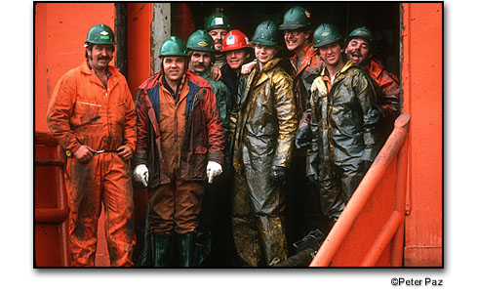
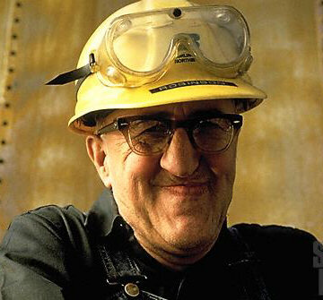





SHIFTWORK SOLUTIONS
(415) 265-1621 | www.shift-work.com

Slide 2
Trends in Shiftwork Scheduling
Where did we come from and where are we going?
Time permitting strategies and solutions to address the increasing complexity of operational scheduling in a labor environment where flexibility and adaptation are becoming the new normal. Time-permitting

Slide 3
First…
Let’s set the stage

Slide 4
Which do you prefer?

Slide 5
Assuming you get the same amount of pay, Which is more important to you?

Slide 6
Labor Environment?
When unemployment drops below 6%, we notice.
When unemployment drops below 5%, labor becomes the “Price Maker”
When unemployment drops below 3%, everyone that wants a job has a job.
During the last 5 years Shiftwork Solutions is hearing:
We can’t fill our current position, much less new positions.
We can’t staff non-day shifts.
We have high absenteeism, especially on weekends.
Today’s kids don’t stick around.

Slide 7
Management’s Perspective with regard to a work schedule
“The schedule tells me when people will be at work. I can see if I have the coverage I need when I need it”

Slide 8
An Employee’s Perspective with regards to a work schedule
“The schedule tells me when I don’t have to come to work. It tells me when I can plan the rest of my life.”

Slide 9
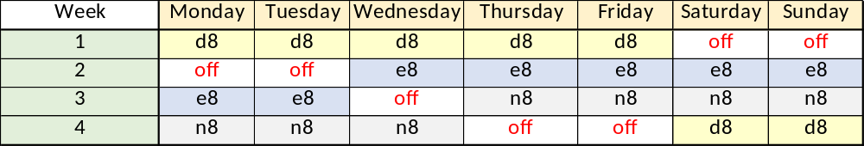
Where we came from
And where some of us still are
The Southern Swing
Created in the 1930’s to comply with Federal overtime rules (>8 hours and >40 hours)
4 Crews
42-hour average work week
1 weekend off a month
273 annual days of work
8-hour rotating shifts
(-) Too many days of work
(-) Not enough weekends off
(-) Seven days of work in a row
(-) Rotating
(+) Absentee coverage is relatively easy
(+) All crews are equal
(+) Management sees all crews
(-) Very difficult to recruit into

Slide 10
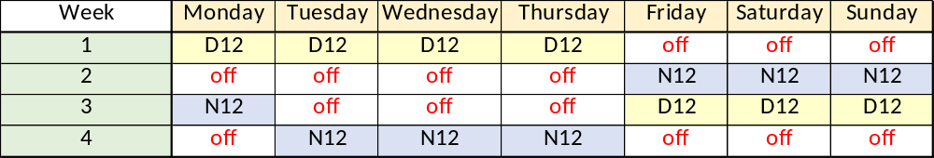
Where were we recently
Dupont rotating 12-hour schedule
Created in the late 1980’s when Federal law no longer mandated overtime after 8-hours
4 Crews
42-hour average work week
2 weekends off a month (+13)
182 annual days of work (-91)
12-hour rotating shifts
(-) Rotating
(+) 7-day break every month
(+) All crews are equal
(+) Management sees all crews
(-) Fixed shifts can be easier to recruit into

Slide 11
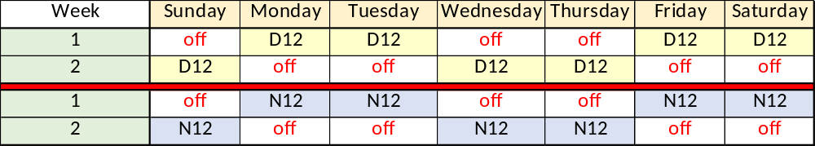
Where are we now
2-2-3 12-hour schedule
Most popular pattern in the county (counting the variations)
4 Crews
42-hour average work week
2 alternating 3-day weekends off a month
182 annual days of work
12-hour fixed shifts
(+) Alternating 3-day weekends
(-) Day shifts are preferred to night shifts
(-) Nights can be very difficult to adjust to

Slide 12
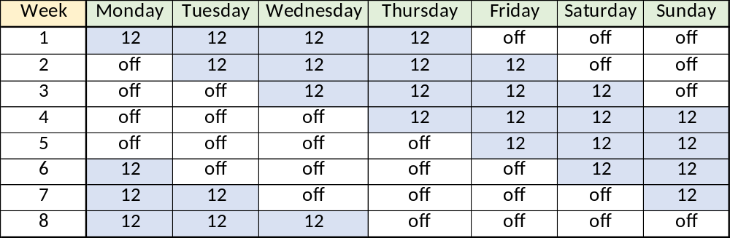
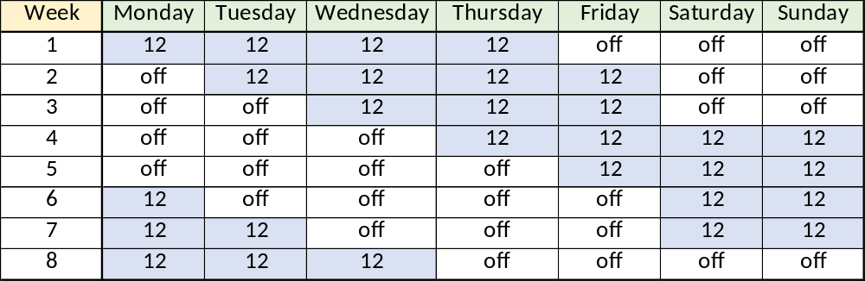
Offering Nights something different

Slide 13
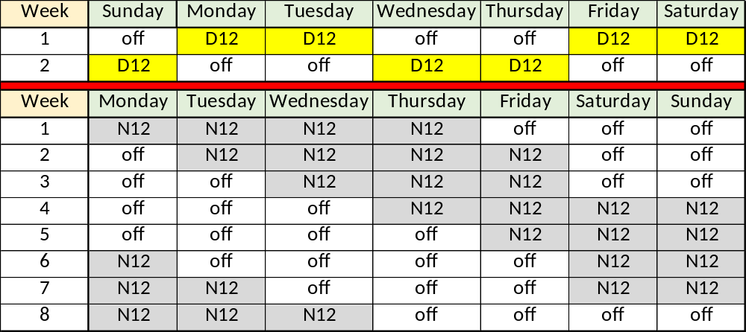
Match 24/7 schedule to the preference of the Crews
Crew A
Crew B
Crew C
Crew D

Slide 14
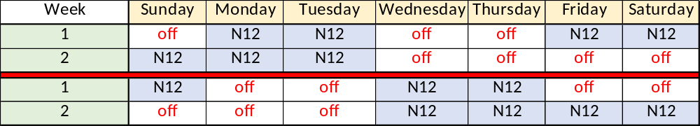
Fixing the night shift
2-2-3 12-hour schedule
5&2 12-hour schedule

Slide 15
To be the “best choice” you need to know what labor wants.
Wages are important.
Non-wage benefits are relatively unimportant to younger employees.
Having a lot of days off from work is important.
Predictability & flexibility are important.
Fixed shifts are easier to hire in to.
Overtime: Some love it. Some hate it.
75% want to work only day shift.
Weekends off.
Talk to me. Impress me. I want to feel important.

Slide 16
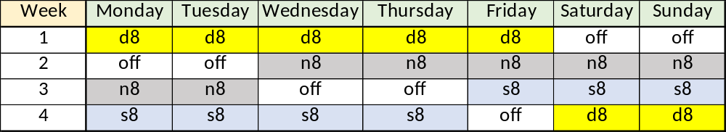
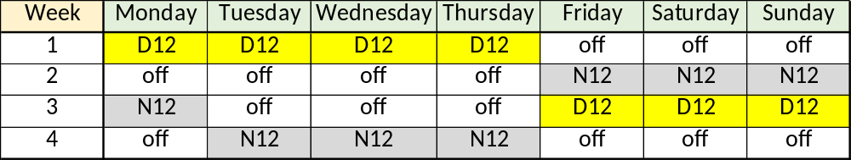
Framing is Important: Get them in the door
4-crew, 42-hour schedule
273 days on and 91 days off
1 weekend off a month
4-crew, 42-hour schedule
182 days on and 182 days off
2 weekends off a month

Slide 17
Framing is Important: Get them in the door
All day shifts.
All weekends off.
8-hour shifts
40-hour paycheck
2-day breaks.
260 days of work per year
5 workdays in a row
40 hours of vacation = 1 week off
Rotating shifts.
Work half of the weekends
12-hour shifts.
44-hour paycheck
8-day break every month
182 days of work per year
48 hours of vacation = 2 week off

Slide 18
I depend on overtime worked outside of my schedule to help me make ends meet:

Slide 19
A few notes about overtime.
Overtime is a function of staffing and workload. The schedule itself does not play a role in the AMOUNT, but can tell you WHERE it occurs.
Overtime probably costs about the same as straight time.
Overtime allows employees to earn more even if their wages are lower than they would like.
20% want all the overtime they can get. 20% avoid all overtime.
“Heads Up” is important to minimize overtime dissatisfaction.
Beware of the impact of fatigue from too much overtime.
MANDATORY OVERTIME is the opposite of a satisfactory Work-Life Balance.
Employees are forgiving if there is light at the end of the tunnel.

Slide 20
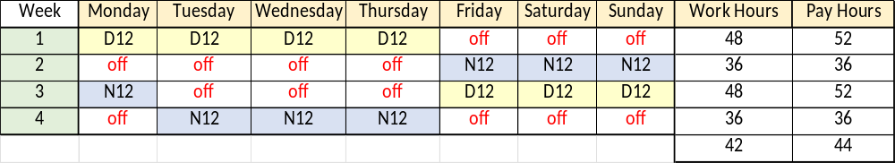
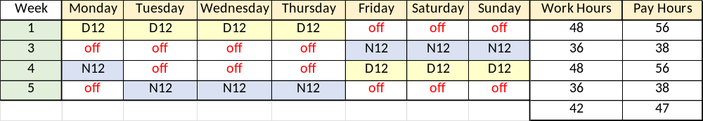
Where are we going?
4-crew, 12-hour, Overtime after 40 hours
4 crews times 44 pay-hours = 176 pay hours per week
4-crew, 12-hour, Overtime after 32 hours
4 crews times 47 pay-hours = 188 pay hours per week

Slide 21
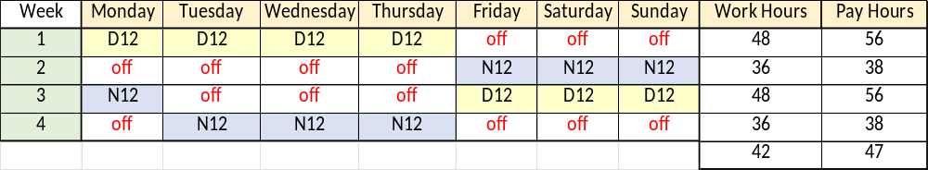
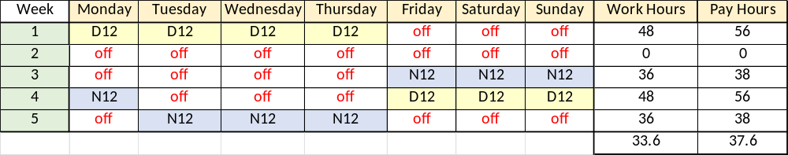
4-crew, 12-hour, Overtime after 32 hours
4 crews times 47 pay-hours = 188 pay hours per week
5-crew, 12-hour, Overtime after 32 hours
5 crews times 37.6 pay-hours = 188 pay hours per week
5 crews times 40 pay-hours = 200 pay hours per week

Slide 22
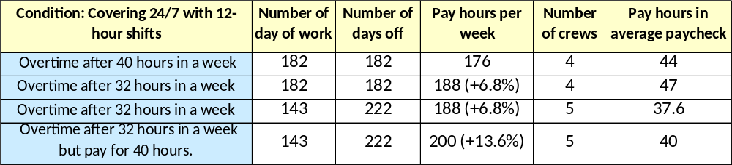
Summary
Employees will love the time off but may resist a schedule with a 40-hour paycheck if their current schedule gives them 44 hours.
Companies will find the schedule easier to recruit into compared to a traditional, 4-crew schedule. Pay hours go up 13.6% compared to current overtime over 40 rules. A fifth crew has some additional non-payroll costs such as healthcare which can be significant (estimated to be an additional 10%).

Slide 23
Time Permitting
The weekend Warrior Trap
Flexing from 5 to 6 days
Flexing from 5 to 7 days

Slide 24
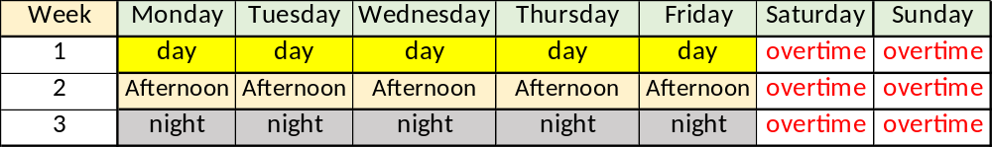
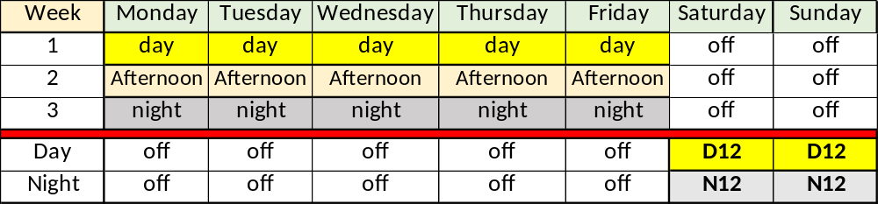
The Weekend Warrior Trap
Workforce: “We are tired of working so much overtime on the weekends.”
Management: “I have an idea. Let’s hire some people to work the weekends for you”
Workforce: “Hurray!!”

Slide 25
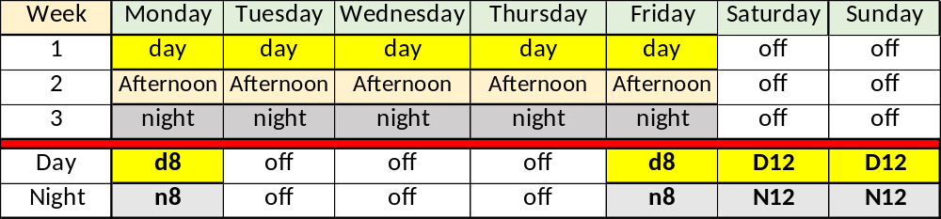
The Weekend Warrior Trap
The weekend crew Will Operate Differently from the weekday crew.
Pay too little and the weekend crew will be poorly staffed and low-skilled with high turnover.
Pay too much and the cost of the schedule becomes prohibitive.
Having weekend crew show up at other times to get 40 hours offers little value to the company.
After 3 to 5 years of trying to make this work, companies will get rid of it.
The workforce will not take kindly to losing this schedule.
Note: There are instances where variations of this can work.

Slide 26
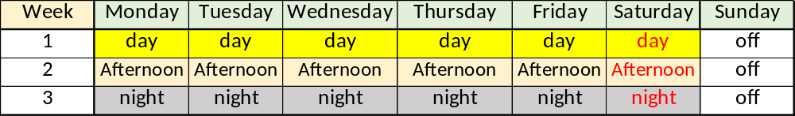
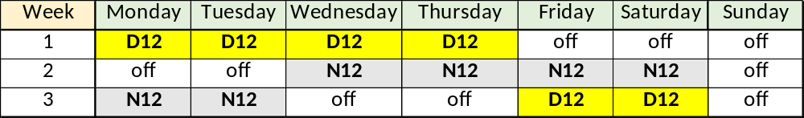
Flexing from 5-day to 6 day
Both schedules use 3 crews.
Both schedules average 48 hours per week.
The 8-hour schedule has 52 annual days off.
The 12-hour schedule has 106 annual days off.

Slide 27
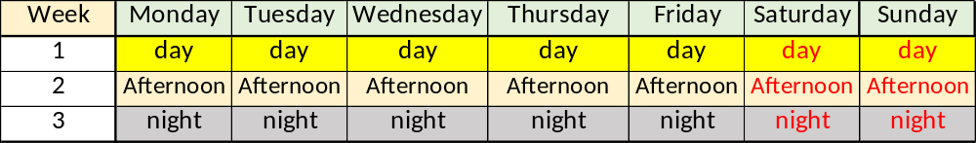
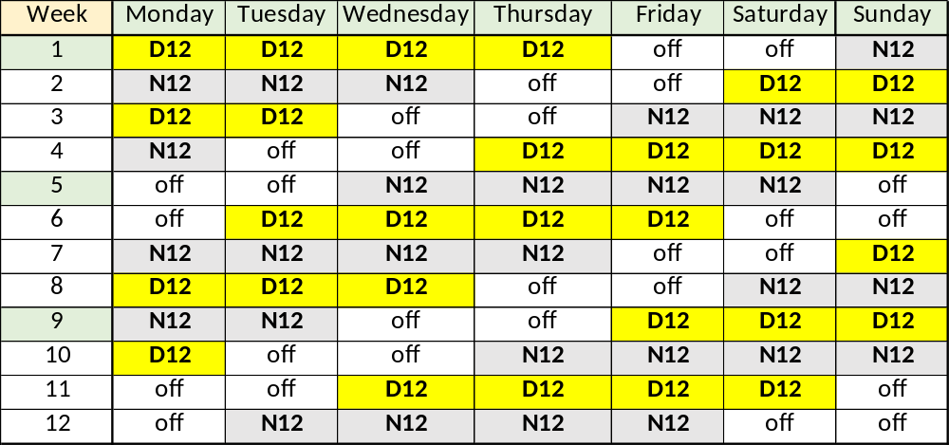
Flexing from 5-day to 7 day
Both schedules use 3 crews.
Both schedules average 56 hours per week.
The 8-hour schedule has 0 annual days off.
The 12-hour schedule has 122 annual days off.

Slide 28
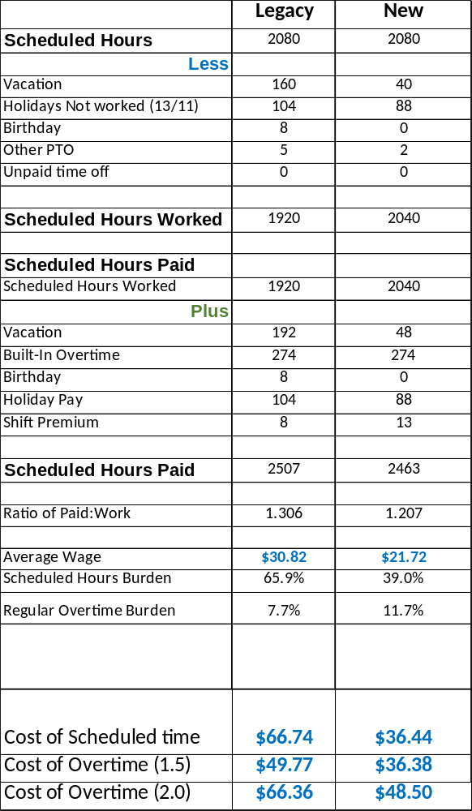
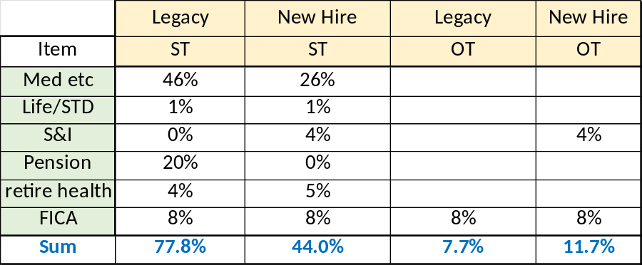
The Cost of Time

Slide 29


