Slide 1
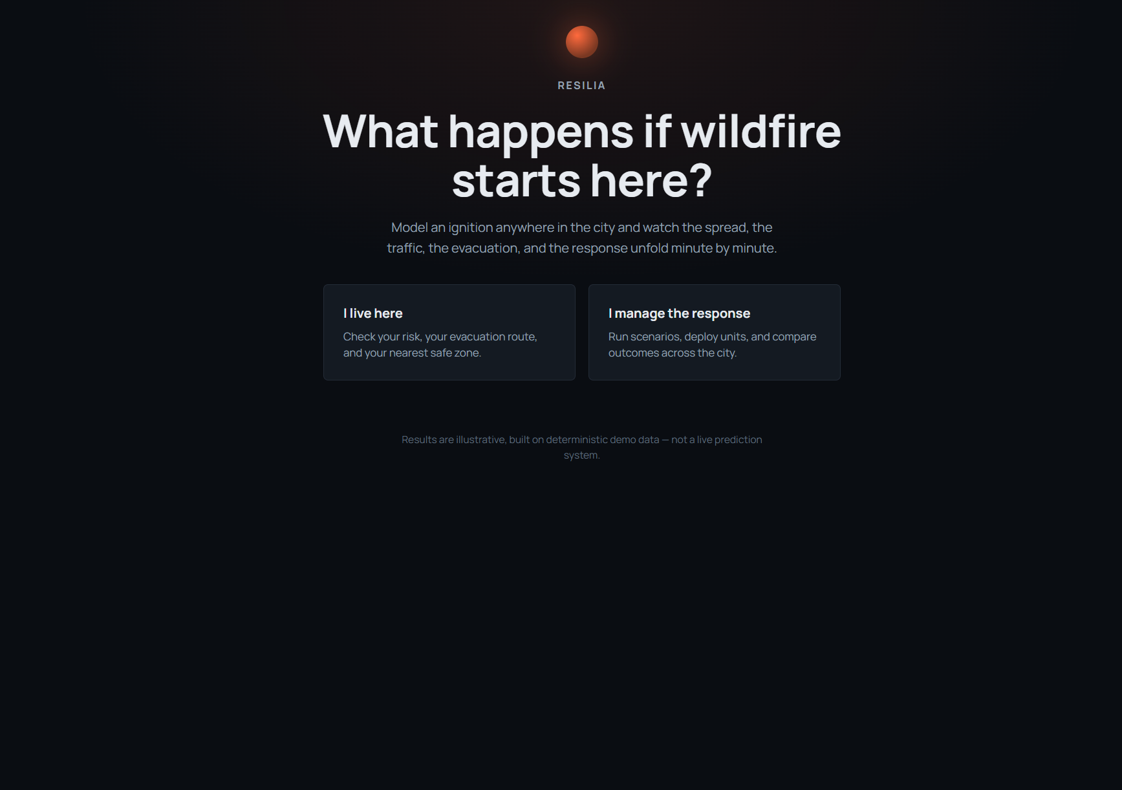
RESILIA
What happens if a wildfire starts here?
A digital twin of a demo town, Cedar Ridge.
Choose where the fire starts and how bad the day is.
The app plays the next hour. The same settings always produce the same hour.

Slide 2
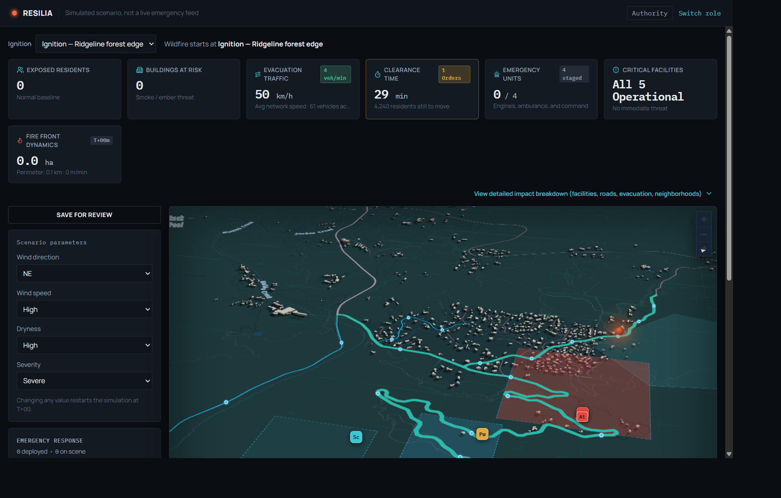
The town at the first minute
Authority view. Ignition on the ridgeline forest edge. Wind NE, high and dry, severity severe. Clearance is 29 min. The fire is still a point.

Slide 3
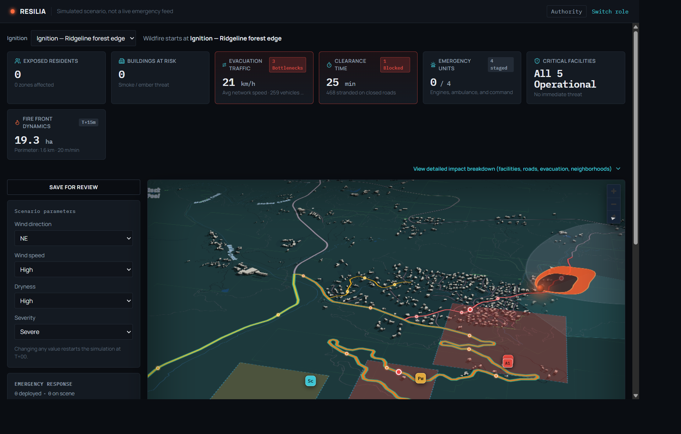
Fifteen minutes later
T+15. 19.3 ha burned, perimeter 1.6 km, about 20 m/min. Roads average 21 km/h, with 3 bottlenecks. Clearance is 25 min. One road is blocked and 468 people are stranded.

Slide 4
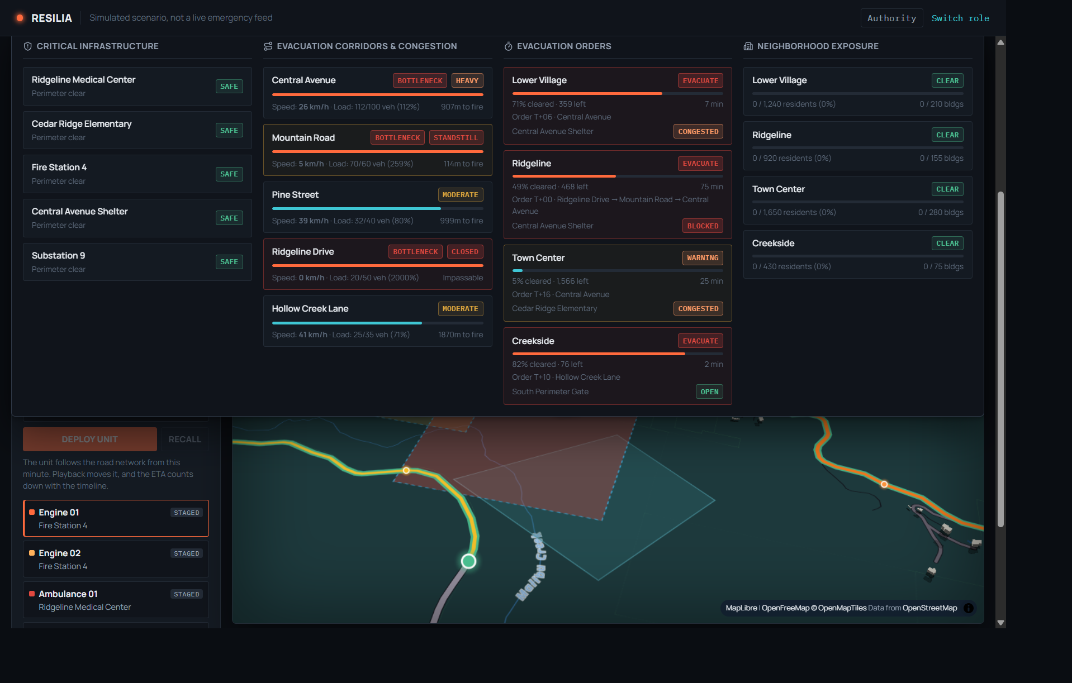
The town number hides the split
Ridgeline still has 468 people and a blocked route, about 75 min. Creekside has 76 left and an open road, about 2 min. Town Center is on warning, with its order at T+16.

Slide 5
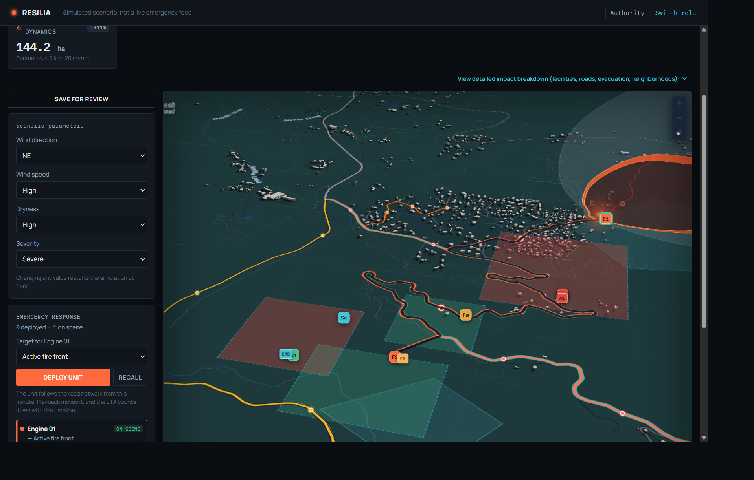
Send Engine 01 to the fire
Deployed at T+15 to the active fire front. ETA 17:37, and the route uses a closed road. Playback carried the engine to the front. The captured frame is on scene at T+41.

Slide 6
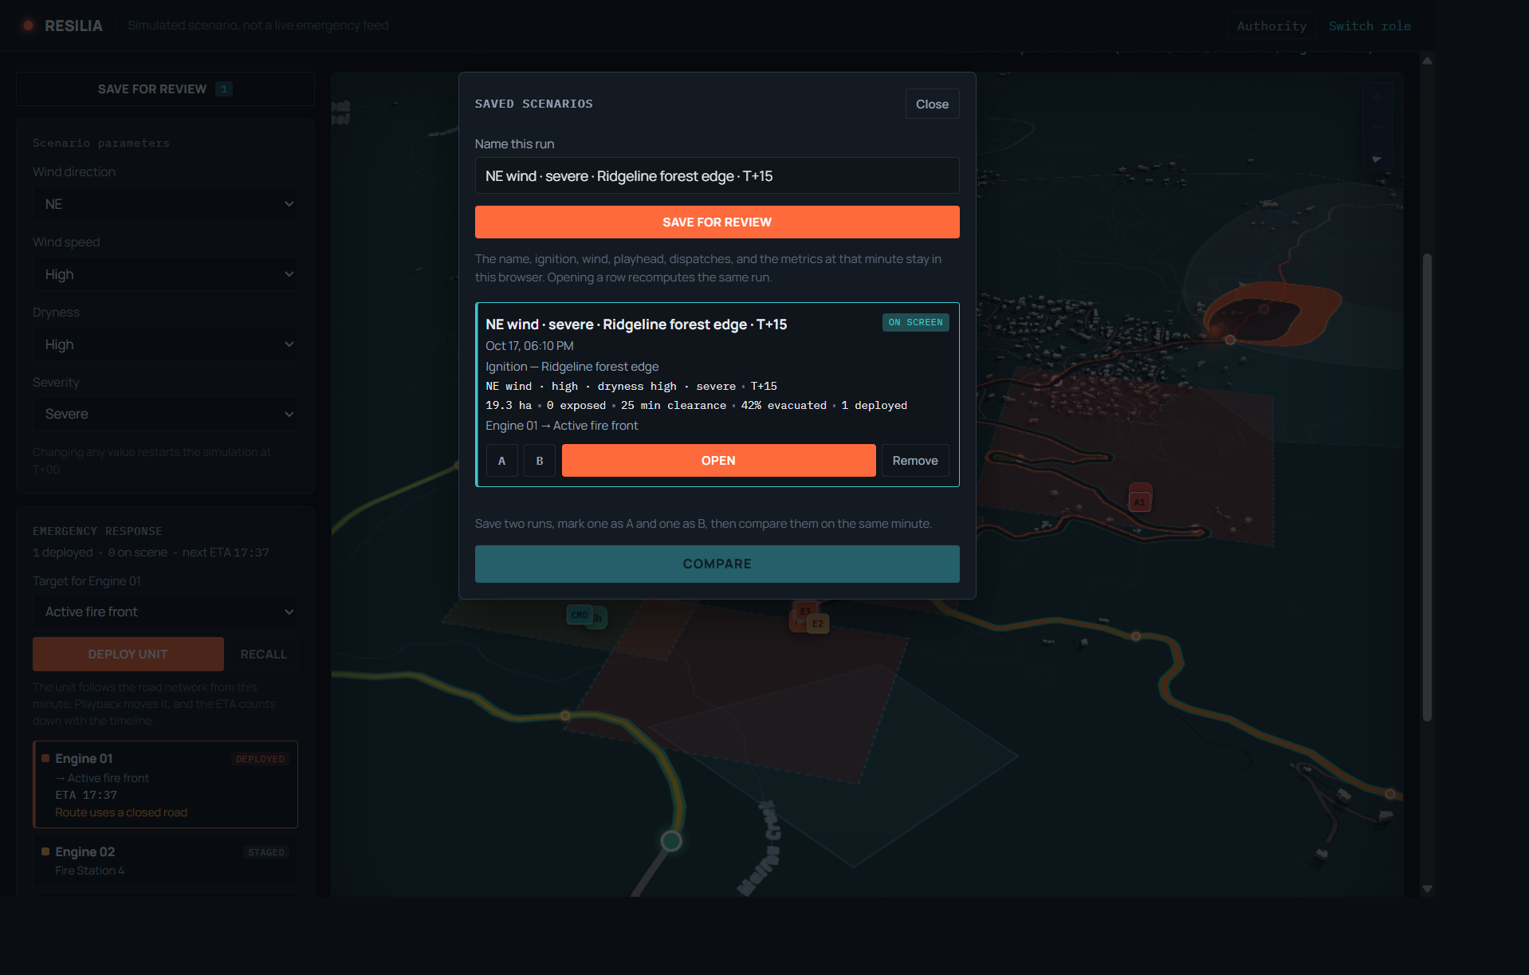
Save that hour
Saved as NE wind, severe, ridgeline forest edge, T+15. The row shows 19.3 ha, 25 min clearance, 42% evacuated, and Engine 01 deployed.

Slide 7
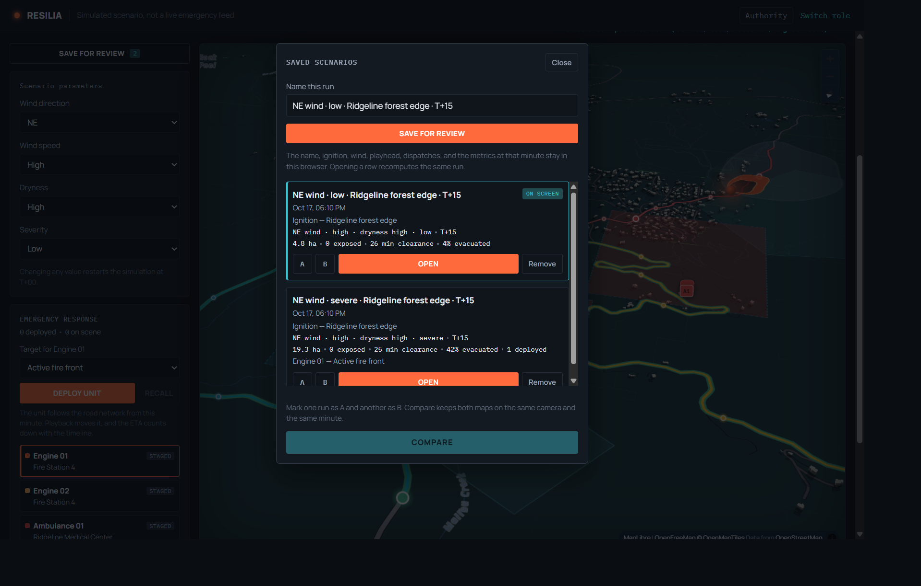
A quieter hour, saved beside it
Severity set to low. The clock returns to T+00 and the dispatch clears. Saved again at T+15: 4.8 ha, 26 min clearance, 4% evacuated.

Slide 8
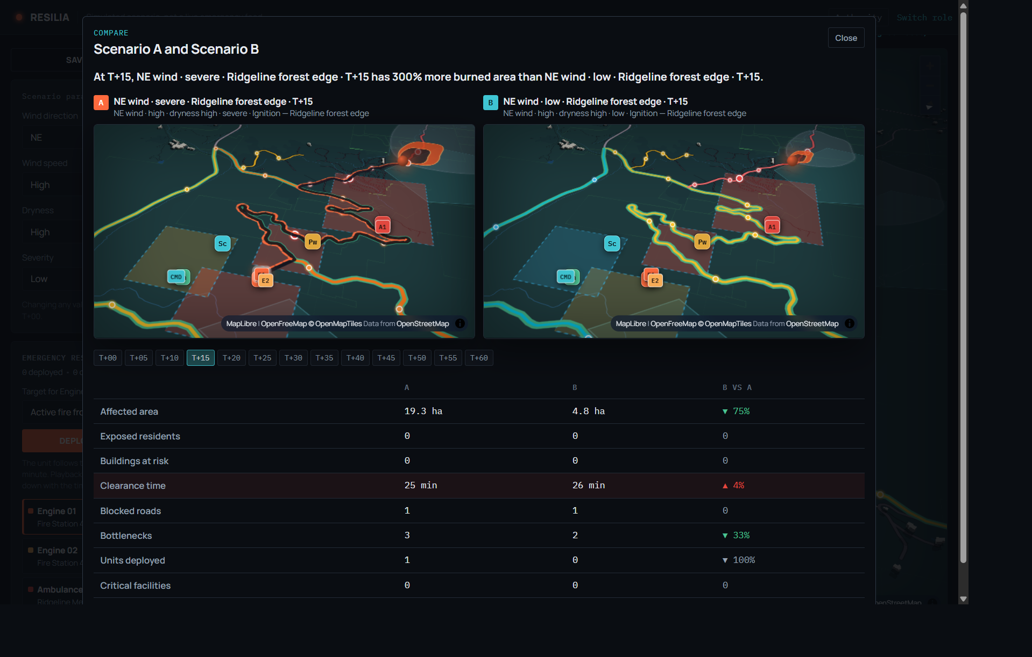
The same minute, two hours
A is severe, B is low. The screen says the severe run has 300% more burned area. At T+15: 19.3 ha versus 4.8 ha, clearance 25 min versus 26 min, bottlenecks 3 versus 2, units 1 versus 0.

Slide 9
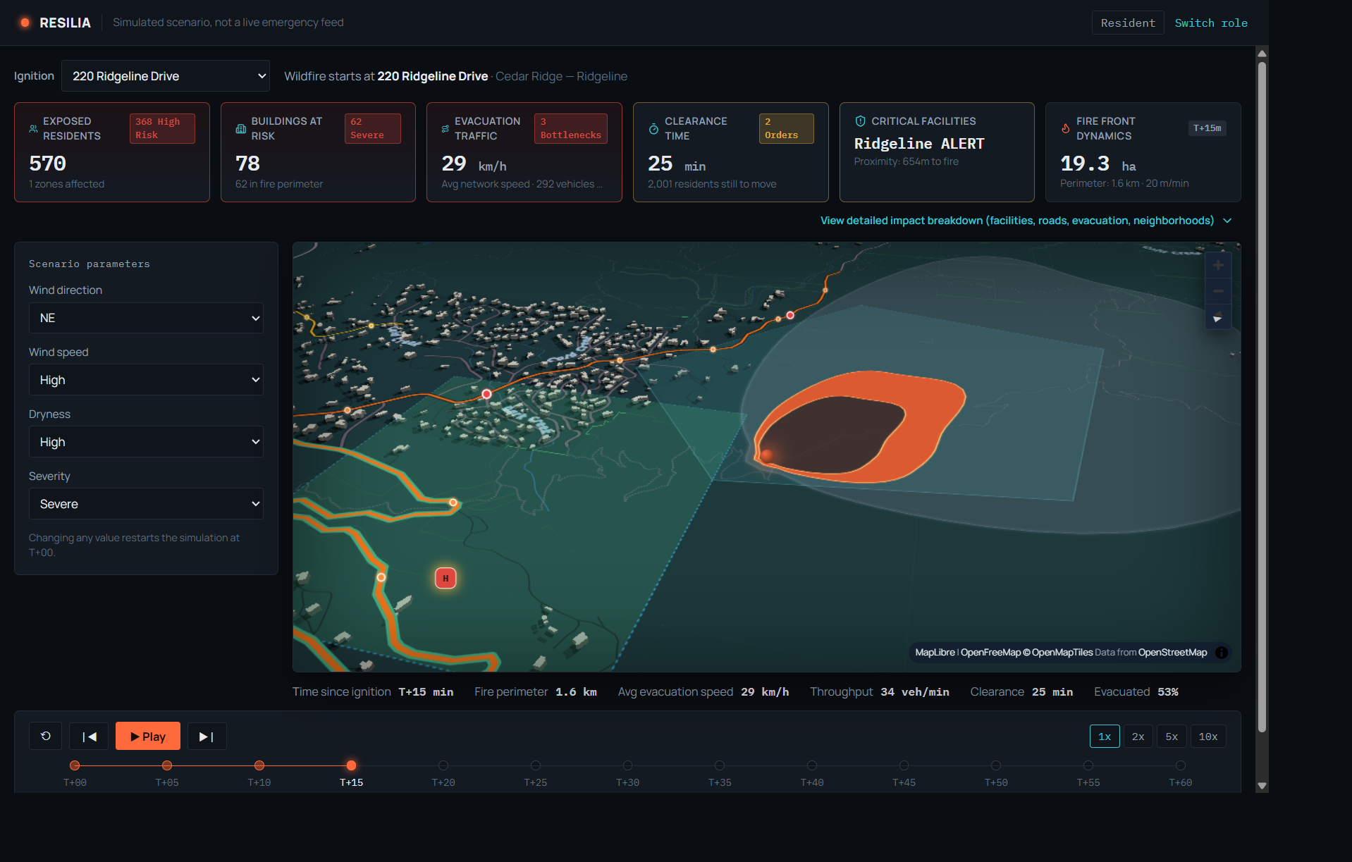
The person who has to leave
Resident view. No units and no saved runs. Fire at 220 Ridgeline Drive, T+15. 570 residents are inside the fire, Ridgeline is on alert, and 53% have left.

Slide 10
RESILIA
One hour, two questions
The resident asks whether the road is still open, and which way leads to a safe place.
The authority asks who leaves, which road fails, and where the engine should go.
Cedar Ridge and this fire are demo data. This is a rehearsal of the hour, not a live forecast.

