Slide 1
Comment Classification By Using DL Methods
In an era of on-demand entertainment, movie spoilers have become a significant nuisance for audiences worldwide. A spoiler is any piece of information that reveals a crucial plot point, character fate, or surprise twist, potentially diminishing the viewing experience for those who haven't seen the content yet.
Many platforms currently rely on manual methods to combat this issue. For instance, streaming services like Crunchyroll and community forums like Reddit often depend on moderators and user reports to flag and remove spoiler-filled comments. This approach is not only labor-intensive and slow but also reactive, meaning many users are exposed to spoilers before they can be removed.
This project addresses the need for an automated, proactive solution to identify and manage spoilers in real-time, enhancing the user experience on content-sharing platforms.

Slide 2
Project Overview & Technical Requirements
Input and Output
Dependencies & Requirements
Input
Software Dependencies
The model takes two primary inputs for each movie:
torch & torch.nn: For building and training the neural network models.
A subtitle file (.srt format) containing the complete dialogue of the movie.
transformers: To leverage the pretrained language model from Hugging Face.
A corresponding comments file (.csv format) where each comment is labeled as either "spoiler" or "non-spoiler".
pandas & numpy: For data manipulation.
scikit-learn: For calculating performance metrics like accuracy.
matplotlib: For plotting training and validation curves.
Output
The model processes a given comment in the context of the movie's subtitles and outputs a binary classification:
Hardware & Pretrained Model
Hardware Requirements: Training deep learning models of this complexity typically requires a GPU (Graphics Processing Unit) to handle the large-scale matrix computations efficiently.
1 (Spoiler)
0 (Non-Spoiler)
Pretrained Word Embedding Model: The core of the feature extraction is the allenai/scibert_scivocab_uncased model from Hugging Face, a powerful BERT-based model pre-trained on a large corpus of scientific text, which provides rich semantic embeddings for the text data.

Slide 3
Model Architecture - Part 1 (Subtitle Processor)
Model 1: Processing Movie Subtitles
The first model in our pipeline is designed to understand and encode the entire movie script.
Output
Architecture
The model outputs a tensor of shape [20, 1024], representing 20 hidden states that summarize the narrative content of the movie's subtitles.
Purpose
Chunking: The entire dialogue string is split into 20 equal-sized chunks. This breaks down the movie into manageable segments.
To read the full text from the .srt subtitle file and convert it into a sequence of meaningful numerical representations (hidden states).
Embedding: Each chunk is passed through the pretrained scibert_scivocab_uncased model to generate high-dimensional word embeddings.
Aggregation: A Gated Recurrent Unit (GRU), a type of recurrent neural network, processes the sequence of embeddings for each chunk. The final hidden state of the GRU for each chunk is captured.

Slide 4
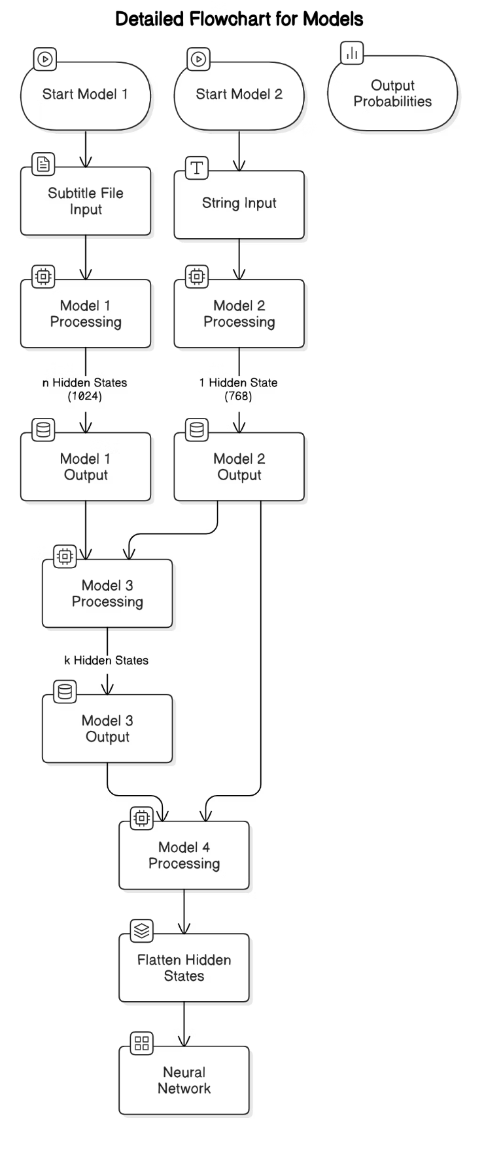
Model Architecture - Part 2 (Comment Processor)
Model 2: Processing User Comments
The second model runs in parallel to the first and is responsible for understanding the user comments.
Purpose
To take a batch of user comments and convert each one into a single, representative hidden state vector.
Architecture
Embedding: Similar to Model 1, each comment is passed through the scibert_scivocab_uncased model to generate word embeddings.
Padding & Truncation: To handle comments of varying lengths, they are truncated to a maximum of 100 words and then padded with zeros to ensure they all have the same sequence length within a batch.
Aggregation: A GRU processes the sequence of embeddings for each comment.
Output
The model outputs a tensor of shape [batch_size, 768], where each row is a vector that captures the semantic meaning of a single comment.

Slide 5
Model Architecture - Part 3 (Attention Mechanism)
Model 3: Finding the Context
This model is the bridge between the movie subtitles and the user comments. It uses an attention mechanism to identify which parts of the movie are most relevant to a given comment.
Purpose
Architecture
Output
To select the most relevant subtitle hidden states (from Model 1) for each comment hidden state (from Model 2).
Transformation: Both the comment and subtitle hidden states are passed through separate linear layers to project them into a common dimensional space.
The model outputs a tensor of shape [batch_size, 2, 1024], which represents the two most relevant subtitle contexts for each comment in the batch.
Attention Scores: The model calculates the similarity between each comment and all 20 subtitle chunks using a dot product. This generates attention scores.
Top-K Selection: Based on these scores, the model selects the top 2 most relevant subtitle hidden states for each comment.

Slide 6
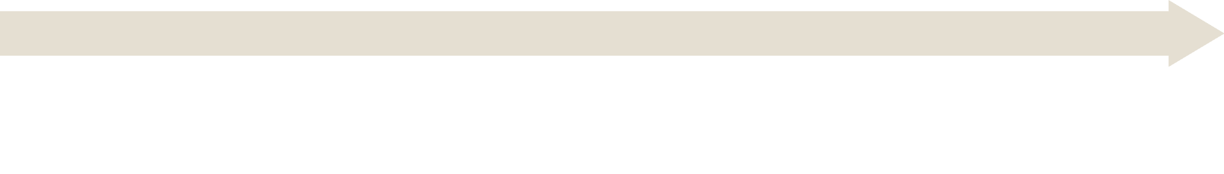
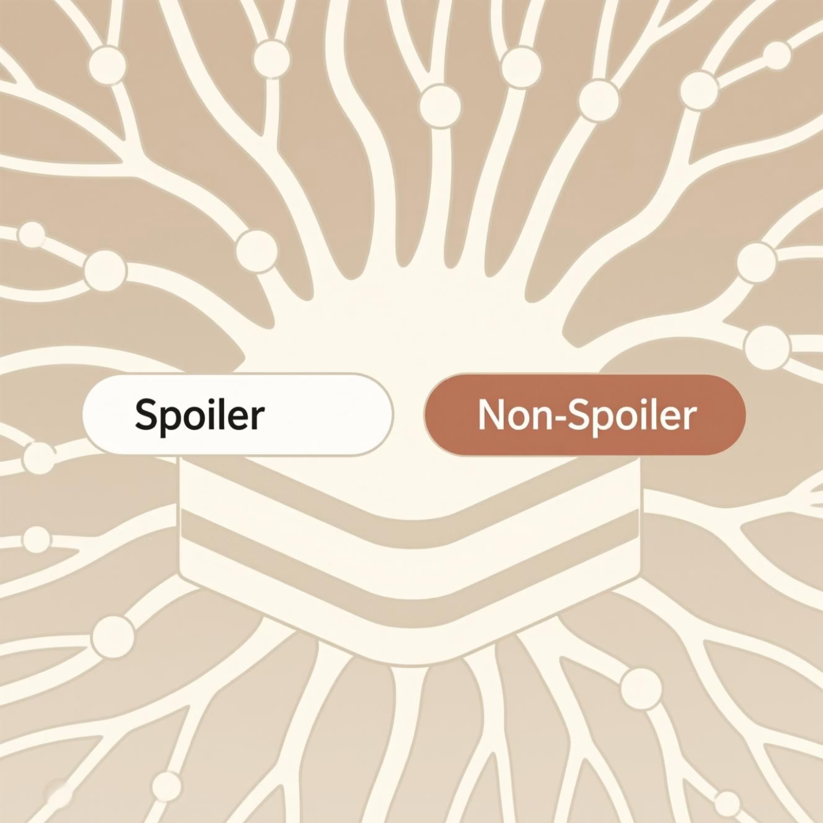
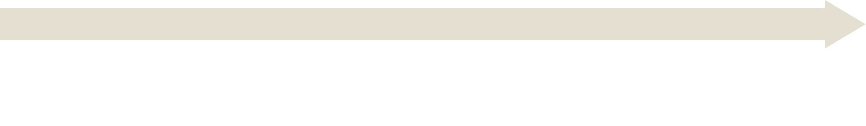

Model Architecture - Part 4 (Final Classifier)
Model 4: The Final Verdict
The final model in the pipeline takes all the processed information and makes the ultimate spoiler vs. non-spoiler prediction.
Purpose
To classify each comment as a spoiler or not, based on its content and the relevant context from the movie subtitles.
Architecture
Concatenation: The model takes the comment's hidden state (from Model 2) and concatenates it with the flattened top-2 subtitle context states (from Model 3).
Classification Network: This combined tensor is then fed through a sequential network consisting of several fully connected linear layers with ReLU activation functions, BatchNorm for stabilization, and Dropout for regularization to prevent overfitting.
Output
The model outputs a final tensor of shape [batch_size, 2], providing the raw scores (logits) for the "non-spoiler" and "spoiler" classes for each comment. The class with the higher score is the final prediction.

Slide 7
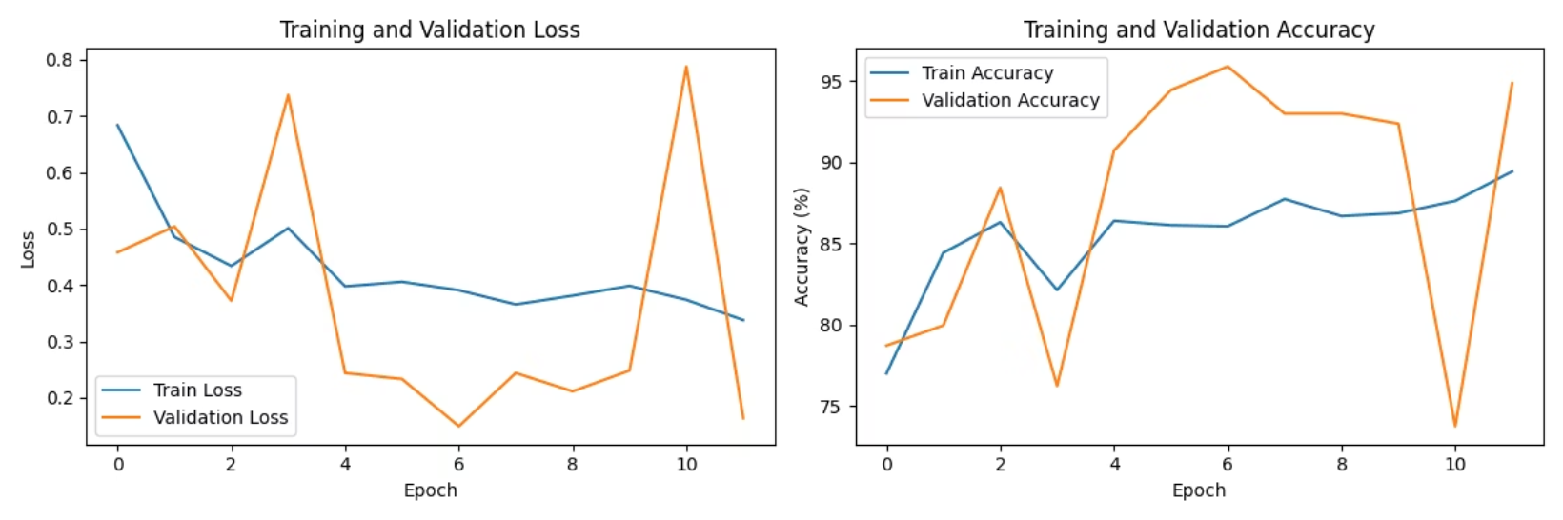
Training and Results
Reaching High Accuracy
The model was trained on a dataset of 35 movies and validated on a separate set of 4 movies. The training process used early stopping to prevent overfitting, halting when the validation accuracy no longer improved.
95.87%
Sample Test Predictions:
Best Validation Accuracy
The test.log shows the model making nuanced predictions on unseen comments:
Training Performance: The model consistently learned to distinguish spoilers, as shown by the increasing accuracy and decreasing loss over epochs.
Thanos dies -> Classified as Spoiler
Salute to Tony Stark -> Classified as Non-Spoiler
Damn, in the end, Tony sacrifices. -> Classified as Spoiler

Slide 8
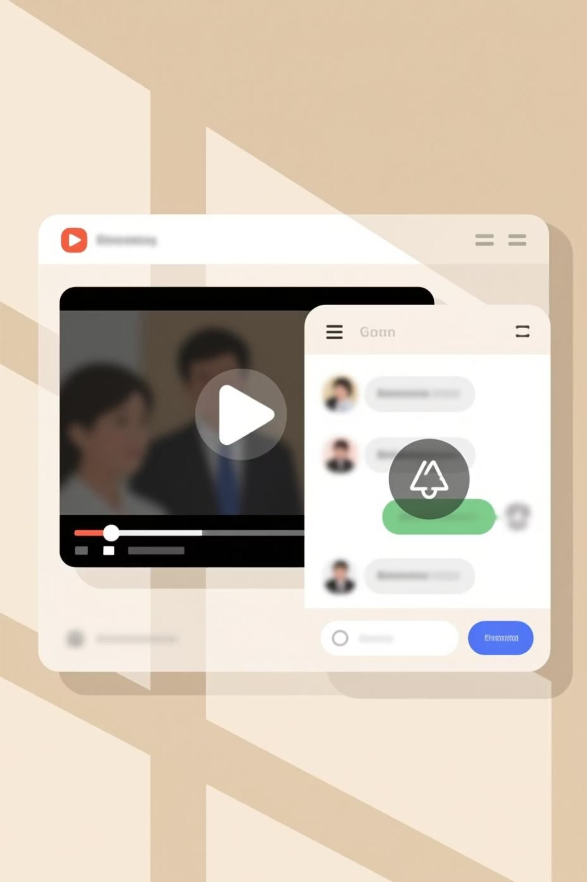


Future Scope - Integration with Streaming Platforms
Creating a Spoiler-Free Environment
The true potential of this project lies in its integration with real-world video streaming platforms.
Automated Subtitle Generation
For content without existing subtitle files, Speech-to-Text (STT) technology can be employed to automatically transcribe the audio into a .srt file. This would allow the model to work with any video content, not just those with pre-made subtitles.
Dynamic Comment Blurring
The model's output can be used to dynamically blur or hide comments identified as spoilers. Users could be given the option to reveal the comment if they choose, providing a customizable, spoiler-free viewing experience in comment sections and live chats.

Slide 9






Future Scope - Deployment and Expansion
From Model to Production Service
To make this model widely available, a robust deployment strategy is essential.
MLOps Pipeline
A full Machine Learning Operations (MLOps) pipeline can be established for continuous integration and deployment (CI/CD). This would automate the process of retraining the model on new data, testing, and deploying updated versions without downtime.
Containerization and Deployment
The entire application, including the models and all dependencies, can be packaged into a Docker container. This container can then be deployed on cloud platforms (like AWS, GCP, or Azure) as a scalable microservice.
Multi-Language Support
The current model is designed for English. A significant future enhancement would be to train and deploy models for different languages, making the spoiler detection feature accessible to a global audience. This would involve collecting and labeling multilingual datasets.

Slide 10

Conclusion and Parting Remarks
A Powerful Tool for a Better Viewing Experience
This project successfully developed a sophisticated, multi-stage deep learning pipeline for the automated detection of movie spoilers.
Key Achievement
The system intelligently uses the context of a movie's subtitles to accurately determine if a comment contains a spoiler, achieving an impressive validation accuracy of over 94%.
Impact
By automating a task that is currently slow and manual, this solution has the potential to significantly improve the user experience on any platform where movie and TV show discussions occur.
The architecture is robust, the results are strong, and the future scope for integration and expansion is vast, making this a valuable and impactful project.

