Slide 1
Data Structures CS-2001 Week#1
Lab 01
02nd Feb 2022
Instructor: Farah Sadia

Slide 2
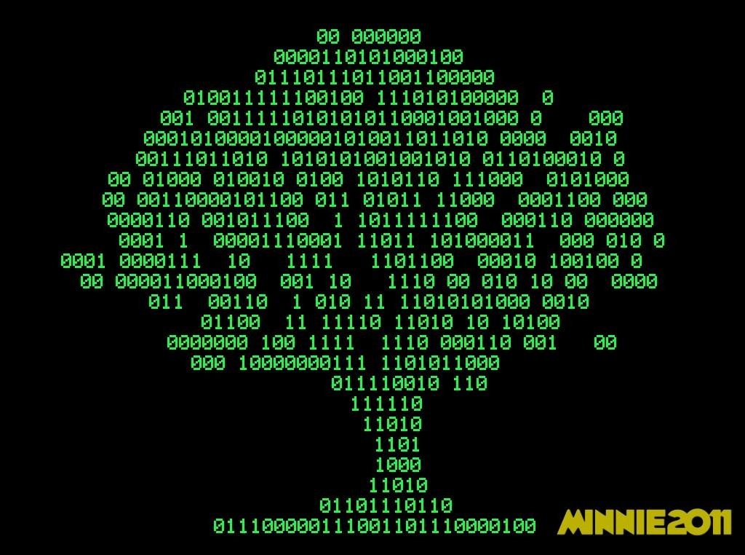


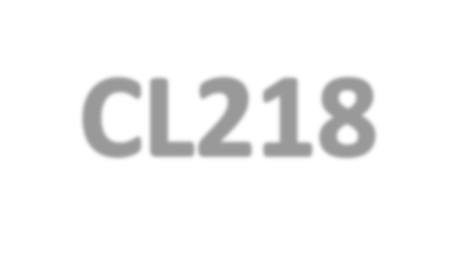
Welcome To
CS-2001

Slide 3
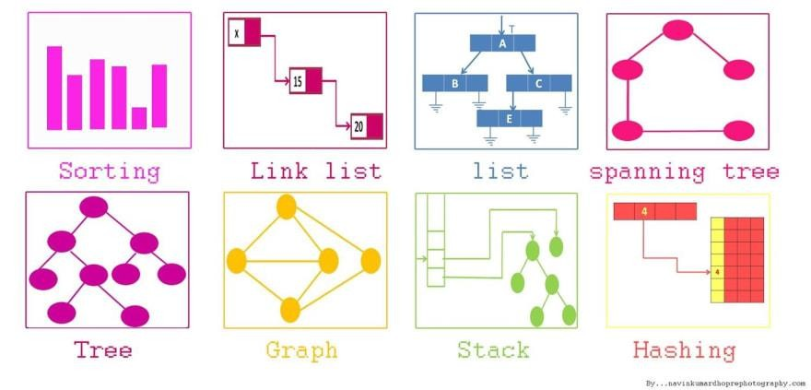

Slide 4
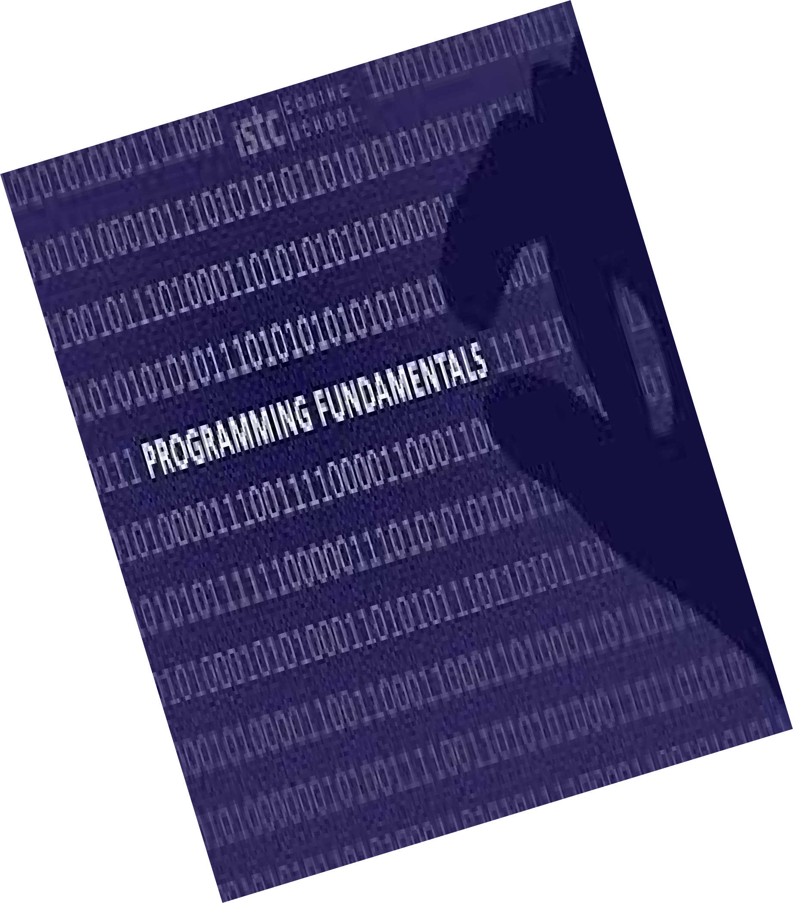
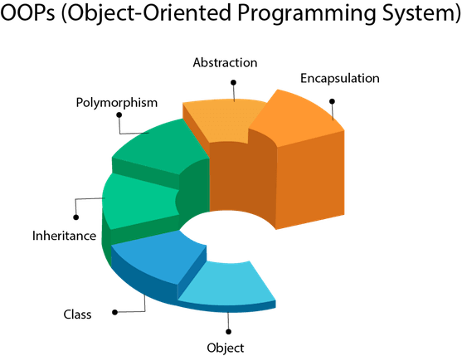
Course Pre-requisites

Slide 5
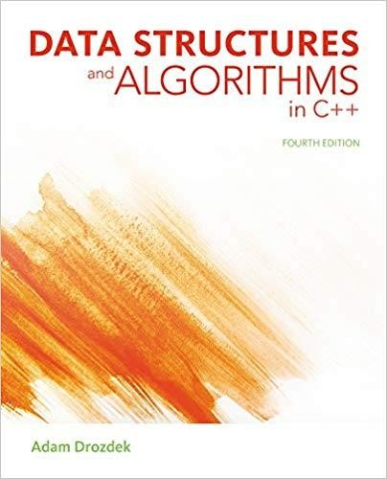
Text Book
Data Structures and Algorithms in C++ 4th Edition- by Adam Drozdek

Slide 6
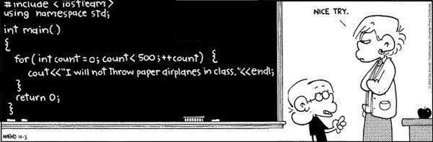
C++
You will be using the C++ programming language in this course

Slide 7
Marks Distribution:
Final Term: 50
Mid(I and II) Terms: 30(2*15)
Project: 10
Quizzes(5)[n-1]: 10

Slide 8
Plagiarism & Late Penalty:
There will be zero tolerance policy in plagiarism.
Late penalty depends upon the reason of late. [ It might be straight zero or somehow to less than the lowest marks assigned to the student who submitted on time].

Slide 9
Consultancy Hours:
Contact Me:
Email: farah.sadia@nu.edu.pk
Google Classroom Code:
DS BCS 3D : qdcmrqv
DS BCS 3G : vcriouo
Office Hours:
Monday: 10:00 to 12:00 in my office
Wednesday: 9:00 to 10:00 in my office.
Tuesday: 08:00 to 10:00 and 02:00 to 04:00 in my office

Slide 10
Lecture # 01

Slide 11

Data vs. Information vs. Knowledge

Slide 12
Data Structures:
Logical and formal abstract way to represent and store data in such a way that it will quickly available for processing within the application context.
It is an organized collection of data which perform a set of operations effectively on the data. These set of operations are formally related to an idea of specific processing related to problem solving.

Slide 13
Algorithm:
An algorithm is a fancy to-do list for a computer. Algorithms take in zero or more inputs and give back one or more outputs.
You explicitly need to tell a computer to perform each step that eventually transform some input into a desire output. It should be finite set of instruction.

Slide 14
Algorithm+ Data Structures = Program
Data structures and algorithm are integral parts of problem solving through computer.
Half of the problem is selecting the right data structures and half of the problem is to select the algorithm.

Slide 15
Lecture # 02

Slide 16
Abstract Datatypes
To process data with a computer, we need to define the data type and the operation to be performed on the data.
The definition of the data type and the definition of the operation to be applied to the data is part of the idea behind an abstract data type (ADT)
ADT means to hide how the operation is performed on the data.
In other words, the user of an ADT needs only to know that a set of operations are available for the data type, but does not need to know how they are applied.
Some examples of ADT are Stack, Queue, List etc.

Slide 17
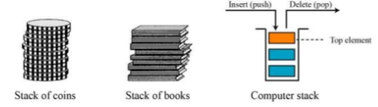
Abstract Datatypes (Stack)
A stack is a restricted data structure in which all additions and deletions are made at one end, the top.
If we insert a series of data items into a stack and then remove them, the order of the data is reversed. This reversing attribute is why stacks are known as last in, first out (LIFO) data structures.
Stack Operation:

Slide 18
Abstract Datatypes (Stack Operations)
isFull(), This is used to check whether stack is full or not
isEmpty(), This is used to check whether stack is empty or not
push(x), This is used to push x into the stack
pop(), This is used to delete one element from top of the stack
peek(), This is used to get the top most element of the stack
size(), this function is used to get number of elements present into the stack

Slide 19
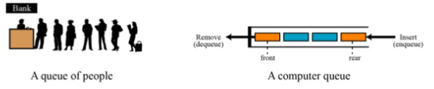
Abstract Datatypes (Queue)
A queue is a linear list in which data can only be inserted at one end, called the rear, and deleted from the other end, called the front.
These restrictions ensure that the data is processed through the queue in the order in which it is received. In other words, a queue is a first in, first out (FIFO) structure.

Slide 20
Abstract Datatypes (Queue Operations)
isFull(), This is used to check whether queue is full or not
isEmpty(), This is used to check whether queue is empty or not
insert(x), This is used to add x into the queue at the rear end
delete(), This is used to delete one element from the front end of the queue
size(), this function is used to get number of elements present into the queue

Slide 21
RULE OF THREE – very important
The Rule of Three is a rule of thumb in C++ (prior to C++ 11) which states that if a class defines one or more of the following, then it should probably explicitly define all three of these. The rule is also called Law of Big Three or The Big Three, three special functions which are:
1) Destructor
2) Copy Constructor
3) Overloaded/Copy Assignment Operator.
Notes:
The rule of three is one of the rules of C++ under rules of thumb for building an exception safe code. These rules prescribe how default members of the class should be used for exception free practice.
The rule of three is also known as the Law of Big Three or The Big Three and prescribes for class that, if a class defines any of the mentioned three then it should probably explicitly define all three −
destructor
copy constructor
copy assignment constructor
These three are special member functions of class. If none of them is explicitly defined by the programmer, then the compiler provides implicit versions. If any one of the above is explicitly defined that means implicit versions for the other two must be improper and must be redefined.
This happens because implicitly generated constructors and assignment operators’ shallow copy the data members. We require deep copy when class contains pointers pointing to dynamically allocated resources.
The default destructors remove the unused objects. When there is no copy constructor defined then the destructor will run twice, once for objects that contain the copy and second for objects from which the data members are copied. To avoid this, explicit definition becomes necessary.

Slide 22
Destructor:
Destructor is a member function which destructs or deletes an object.
Destructor function is automatically invoked when the objects are destroyed.
It cannot be declared static or const.
The destructor does not have arguments.
It has no return type not even void.
A destructor should be declared in the public section of the class.
The programmer cannot access the address of destructor.
There can only one destructor in a class with class name preceded by ~, no parameters and no return type.
The main reason of a destructor is to wipe of all the data members initialize by a constructor and the object life cycle.
Notes:
If we do not write our own destructor in class, compiler creates a default destructor for us. The default destructor works fine unless we have dynamically allocated memory or pointer in class. When a class contains a pointer to memory allocated in class, we should write a destructor to release memory before the class instance is destroyed. This must be done to avoid memory leak.
Can a destructor be virtual? Yes, In fact, it is always a good idea to make destructors virtual in base class when we have a virtual function.
When does the destructor get called?
A destructor is automatically called when: 1) The program finished execution. 2) When a scope (the { } parenthesis) containing local variable ends. 3) When you call the delete operator.

Slide 23
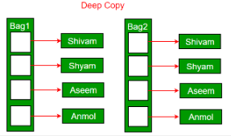
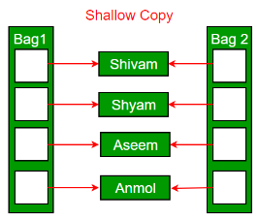
Copy Constructors Types of Copy Constructor
• It is really great way of creating new object initializations and is still widely used by programmers.
• There are two types of copy constructors which are
Default Copy Constructors (Does Shallow Copying)
The objects do not have their individual storage locations, however, are referring to common storage location.
User Defined Copy Constructors (Does Deep Copying)
Deep copy allocates separate memory for copied information. So the source and copy are different. Any changes made in one memory location will not affect copy in the other location. When we allocate dynamic memory using pointers we need user defined copy constructor. Both objects will point to different memory locations.

Slide 24
Copy Assignment Operator
Example:
box& operator=(const box& sample){
length = sample.length;
breadth = new int;
*breadth = *(sample.breadth);
height = sample.height;
return *this;
}
Box first(11,12,13),third;
third=first;

Slide 25
Exercise
Find the largest and the smallest element in an array using pointers.Create a function named MinMax having addresses of Min and Max from main function, use pointers so that it will directly affect the values of the variables defined inside the main function.
create an Animal class (having appropriate attributes and functions) and do following steps.
Dynamically allocate memory to 5 objects of a class.
Order data in allocated memories by Animal names in ascending order.
Write a code that create a Class named Numbers, with private size and pointer variables , a public function to assign values to private member and a destructor to destroy the pointer and memory.Understand what happens when you define an object by providing one object as an argument to another or simply assign one object to another.

