Slide 1
PROBLEM STATEMENT 15
Maze Runner
A maze game where the enemy hunts you with real pathfinding — BFS and A*
TEAM
Akhil Sathish Kumar
Akshay N
Abdullah Subhaan K
Christen Mendis
BUILT WITH
Python 3 + pygame-ce
No dataset, no network,
no hardware
SHIPPED
226 tests passing
500 bot playthroughs
50-maze benchmark
REVA University · B25CS0311 Portfolio Building · 07/10/2026
Notes:
AKHIL — 20 seconds. Open here. 'Good morning. We're presenting problem statement 15 - a maze game where the enemy chases the player using pathfinding. I'm Akhil, and this is Akshay, Abdullah and Christen.' Then hand to Akshay. Do NOT read the three cards out; the examiners can see them. The demo is where the marks are.

Slide 2
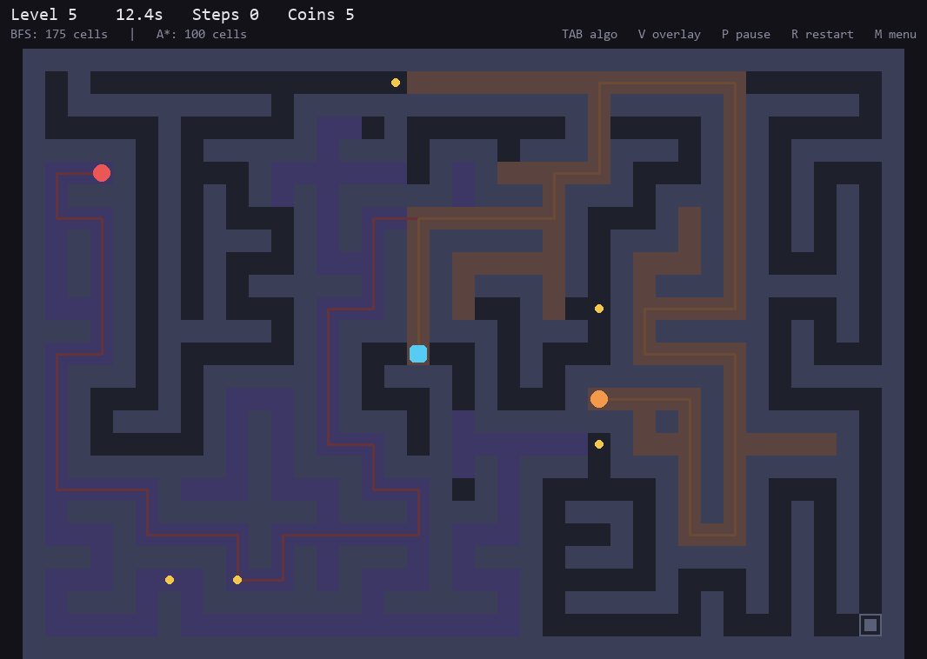
You can see the AI thinking
Both enemies search the maze every step. We draw the cells each one expanded, so the difference is one picture, not a claim.
BFS — 175 cells
A FIFO queue, so it finishes every cell at distance d before touching d+1. Shortest path guaranteed — but it floods outward in all directions.
A* — 100 cells
Scores each cell f = g + h, where h is Manhattan distance. Same shortest path, but it leans toward the player instead of spreading evenly.
Press TAB mid-chase to swap them. The counts update live in the HUD.
Notes:
AKSHAY — 60 to 75 seconds. This is the slide that earns Technical Implementation marks; take your time. Point at the purple region: 175 cells, BFS spreading in all directions because it has no idea where the player is. Then orange: 100 cells, A* leaning toward the player. Both found a path of the SAME length. TRAP QUESTION - 'so A* is better?' Do NOT say yes. Answer: it expands fewer cells but ran SLOWER in wall-clock time, heap at O(log n) versus deque at O(1); at our maze size the per-cell overhead outweighs the cells saved. Christen's slide has the data.

Slide 3
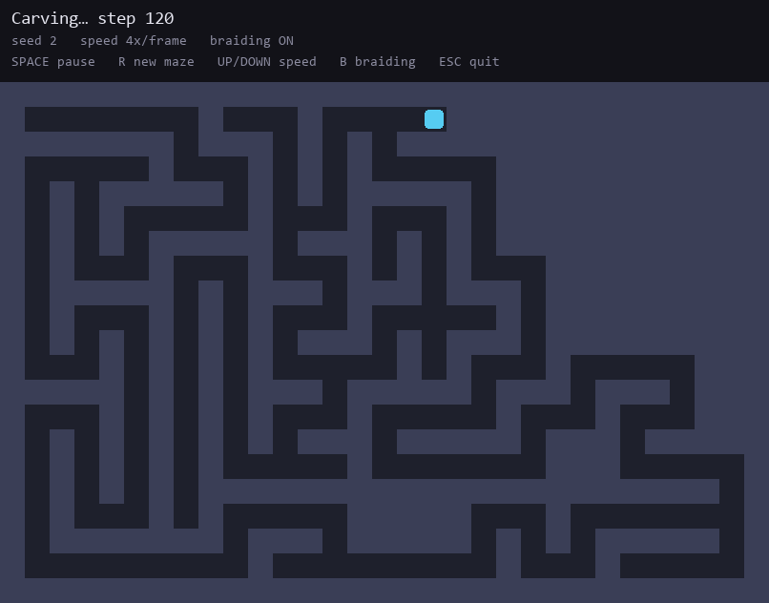
Building the maze
A recursive backtracker carves it at runtime — depth-first search used to dig instead of to search.
Carve two cells at a time
Pick a random neighbour TWO cells away and knock out the wall between. Dead end? Pop the stack and back up. Two cells keeps walls on even coordinates and one cell thick — one at a time dissolves the grid into an open room.
Then braid it open
A finished maze is perfect — one route between any two cells, so it is nothing but dead ends and the player gets cornered. We reopen 35% into loops. That also widened A*'s lead from 11% to 26%.
STACK
Python 3 · pygame-ce · matplotlib
ALGORITHMS
BFS · A* · flood fill · backtracker
OUR TOOLING
benchmark · autoplay · 226 tests
No dataset, no network, no hardware · github.com/Hyperval/maze-runner
Notes:
AKHIL presents the top half (this is your work), ABDULLAH the bottom strip. AKHIL - 45 seconds: the maze is carved at runtime by a recursive backtracker, which is depth-first search used to dig instead of to search. Key detail: carving TWO cells at a time, so walls land on even coordinates and stay one cell thick - one at a time and the grid dissolves into an open room. Then braiding: a finished maze is 'perfect', one route between any two cells, so it is all dead ends and the player gets cornered, so we reopen 35 percent. Mention the measured side effect: that also widened A*'s advantage from 11 to 26 percent. You can run visualise_maze.py live if they want to watch it carve. ABDULLAH - 15 seconds on the three boxes; the point is the right-hand one, that tooling is ours, written to check our own work.

Slide 4
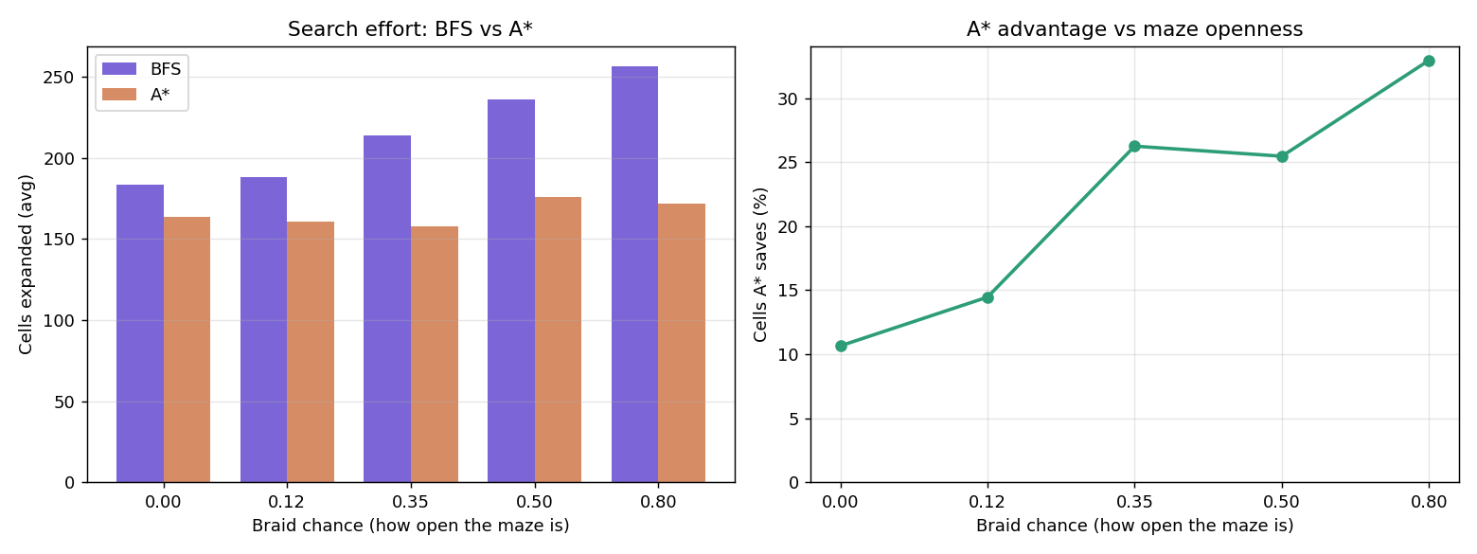
Three things that went wrong
Each one was found by measurement, not by playing.
The enemy camped the exit
We spawned it farthest from the player — which is the opposite corner, exactly where the exit is. Fixed by maximising min(distance to player, distance to exit), using real walking distance so walls count.
The game was unwinnable
Our bot tester reported 0% win rate from level 3. Root cause: the enemy's floor speed was 100ms against the player's 90ms — only 1.1x slower than something that never rests and always takes the shortest route.
The result we did not expect
A* expanded 26% fewer cells — but ran slower in wall-clock time, 0.219ms against 0.169ms. BFS uses a deque at O(1) per operation; A* uses a heap at O(log n) plus a heuristic per neighbour. At 650 cells the overhead per cell beats the cells saved.
After tuning, over 500 runs
Levels 1-3 land at 68-70%, levels 4-10 at 20-38%. No crashes. We tuned difficulty against numbers, not feel.
Notes:
CHRISTEN — 75 to 90 seconds. The team's strongest slide; take your time. Start with the exit-camping bug, it's concrete and instantly understandable. Then the balance finding, and stress that a TOOL WE WROTE found it, not playtesting. Save the blue box for last and deliver it slowly - A* expanded fewer cells but ran slower, and here is why. Pause after it and let it land. If asked 'so which is better': depends on map size and what visiting a cell costs.

Slide 5
FUTURE SCOPE
What we would build next
A predictive enemy
Right now it chases where you are. An enemy that paths to where you are heading could cut you off at a junction instead of trailing you.
Dijkstra with terrain
Mud cells costing 3 steps instead of 1, to show why BFS is really Dijkstra with every edge weighted the same.
A better heuristic
Manhattan distance is weak in a twisty maze. One that accounts for walls would widen A*'s lead — if it can be computed cheaply enough to pay for itself.
Fog of war
Limit the player's vision radius, so the maze has to be learned rather than read off the screen in one glance.
github.com/Hyperval/maze-runner
Thank you — questions welcome.
Notes:
AKHIL — 40 seconds. Pick ONE item, don't read all four. Best is the predictive enemy, because it names a real limitation: the enemy always trails, it never intercepts. 'With more time we'd have it path to where you're heading, so it could cut you off at a junction. That's a different problem - you have to predict intent, not just compute a route.' Then close cleanly and STOP: 'That's our project. Code and documentation are on GitHub. Happy to take questions.'

