Slide 1
Module 3 Machine Guarding & Energy Isolation
Warehouse Operations & Automated Equipment Considerations

Slide 2
Disclaimer
This material was produced under Grant SH-26328-SH4 from the Occupational Safety and Health Administration, U.S. Department of Labor.
It does not necessarily reflect the views or policies of the U.S. Department of Labor, nor does mention of trade names, commercial products, or organizations imply endorsement by the U.S. Government.

Slide 3
Purpose
This presentation is meant to:
Introduce students to machine guarding requirements common in warehousing.
Introduce students to warehouse equipment, particularly conveyors and compactors.
Introduce students to the Lockout/Tagout procedure.

Slide 4
Objectives/Outcomes
At the end of the presentation, students will:
Understand the importance of machine guarding and safe practices in warehousing operations.
Have an increased awareness of the importance of energy isolation in warehousing operations.
Understand when a situation requires the use of the Lockout/Tagout procedure.
Understand the proper implementation of Lockout/Tagout procedures.

Slide 5

Before We Begin
Pre-Test

Slide 6

First, Know Your Rights
There are many hazards related to machinery in warehouses.
As a result, you have rights that protect your safety.
Let’s review some basic rules and regulations
Notes:
Note – Image downloaded from an image search on www.google.com.
Image for visual appeal only.
A much more thorough OSHA Basics presentation is available in Module 1. The next five slides are presented in case Module 3 is done as a stand alone presentation. For those who have been through Module 1, this will serve as a quick recap.
Run through the list on the slide one at a time.

Slide 7

OSHA Basics
Employer responsibilities – Employers MUST:
Provide employees with a safe workplace
Follow all relevant OSHA safety and health standards
Inform employees about hazards through training, labels, alarms, color-coded systems, and other methods
Keep accurate records of work-related injuries and illnesses
Perform tests in the workplace as required by some OSHA standards
Post OSHA citations, injury and illness data, and the OSHA poster
Notify OSHA about serious accidents and fatalities
Not discriminate or retaliate against workers for using their rights under the law
Notes:
Employers have the responsibility to provide safe workplace. Employers must provide their employees with a workplace that does not have serious hazards and follow all relevant OSHA safety and health standards. Employers must find and correct safety and health problems. OSHA further requires employers to try to eliminate or reduce hazards first by making changes in working conditions rather than just relying on masks, gloves, earplugs or other types of personal protective equipment.
The OSHA poster is referenced in this slide. Inform students that they can get a copy of the OSHA poster at https://www.osha.gov/Publications/poster.html. If you have access to the internet, you should take a minute and visit the webpage.
This would also be a good time to discuss the new recordkeeping/reporting requirements. This information is at https://www.osha.gov/recordkeeping2014/index.html.

Slide 8
OSHA Basics
Employee Rights – Employees Have the Right to:
Working conditions that don’t pose a risk of serious harm
Information and training about:
Chemical and other hazards
Methods to prevent harm
OSHA standards that apply to their workplace
Review records of work-related injuries and illnesses
Get copies of test results done to find and measure hazards in the workplace
File a complaint asking OSHA to inspect their workplace
Use their rights under the law without retaliation
Notes:
Employees have the following rights under OSHA:
Working conditions that do not pose a risk of serious harm. • Receive information and training (in a language workers can understand) about chemical and other hazards, methods to prevent harm, and OSHA standards that apply to their workplace. • Review records of work-related injuries and illnesses. • Get copies of test results done to find and measure hazards in the workplace. • File a complaint asking OSHA to inspect their workplace if they believe there is a serious hazard or that their employer is not following OSHA rules. When requested, OSHA will keep all identities confidential. • Use their rights under the law without retaliation. If an employee is fired, demoted, transferred or retaliated against in any way for using their rights under the law, they can file a complaint with OSHA. This complaint must be filed within 30 days of the alleged retaliation.
The next three slides go into Whistleblower Protection to expand on retaliation protection.

Slide 9

Whistleblower Protection
Section 11(c) of the OSH Act
OSHA's Whistleblower Protection Program enforces the whistleblower provisions of more than twenty whistleblower statutes protecting employees who report violations
Notes:
Note – Image downloaded from an image search on www.google.com.
Image for visual appeal only.
Inform students that they can file a complaint if retaliation occurs related to safety and health. If you have access to the internet, take some time to review basic Whistleblower information at http://www.whistleblowers.gov/ .
At the time of development, there were 22 statutes, including 11(c).
Pass out whistleblower factsheet. This factsheet can be found at https://www.osha.gov/OshDoc/data_General_Facts/whistleblower_rights.pdf.

Slide 10

Whistleblower Protection
An employer may not take an adverse action against an employee because the employee engages in protected activity.
Notes:
Note – Image downloaded from an image search on www.google.com.
Image for visual appeal only.
Inform students that they can file a complaint if retaliation occurs related to safety and health. If you have access to the internet, take some time to review basic Whistleblower information at http://www.whistleblowers.gov/ .

Slide 11
Whistleblower Protection
Protected activities may include:
Making a health and safety complaint to a supervisor
Making a health and safety complaint to the Government
Reporting a work-related illness or injury
Cooperating in an inspection/investigation
Requesting Safety Data Sheets
Testifying
Refusing to do dangerous tasks
Notes:
Note - You can refuse to do a serious dangerous work, but not walk off the job.
See https://www.osha.gov/right-to-refuse.html for details on refusing to do work.

Slide 12
Part 1
Common Machinery Hazards

Slide 13
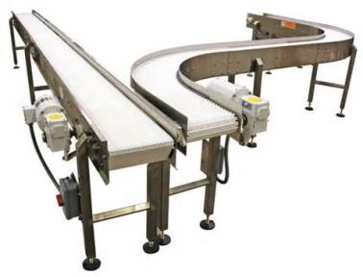
Machinery Common to Warehousing
While there are a number of potential machines used in warehouses, a couple are very common.
Conveyors
Moving materials and boxes
Compactors
Baling cardboard and other material
Guarding is necessary to prevent injury.
Notes:
Note – Image downloaded from an image search on www.google.com.
Image is for visual appeal and to highlight future talking points.
We will first look at conveyors, then compactors

Slide 14
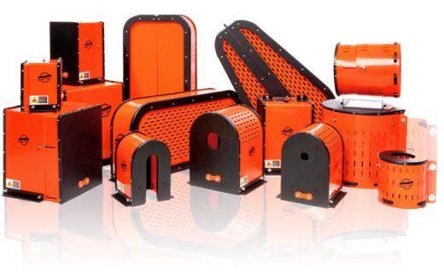
General Machine Guarding Standard
General Industry Standard
Found in 29CFR1910
Subpart O – Machinery and Machine Guarding
29CFR1910.212
General requirements for all machines
Notes:
Note – Image downloaded from an image search on www.google.com.
Image is for visual appeal and to highlight future talking points.

Slide 15
General Machine Guarding Standard
The standard requires
One or more methods of machine guarding shall be provided to protect the operator and other employees in the machine area from hazards such as those created by point of operation, ingoing nip points, rotating parts, flying chips and sparks. Examples of guarding methods are-barrier guards, two-hand tripping devices, electronic safety devices, etc.

Slide 16
Machine Guards
Machine Guards prevent exposure to an identified hazard.
Guards are usually preferred to other control methods because they are physical barriers that enclose dangerous machine parts and prevent employee contact with them.
To be effective, guards must be strong and fastened by any secure method that prevents the guard from being inadvertently dislodged or removed.
Guards typically are designed with screws, bolts and lock fasteners and usually a tool is necessary to unfasten and remove them. Generally, guards are designed not to obstruct the operator's view or to prevent employees from doing a job.

Slide 17
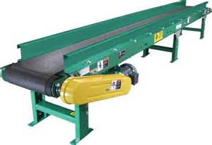
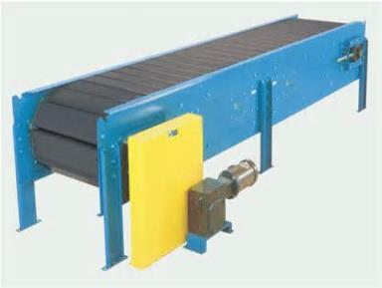
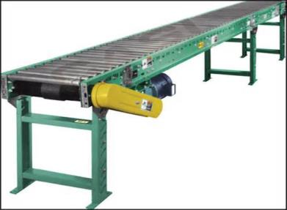
Conveyor Equipment Examples
Belt Conveyor
Slat Conveyor
Roller Conveyor
Fixed Barrier Guards
Notes:
Note – Images downloaded from an image search on www.google.com.
Images meant to show common types of conveyor systems in warehouses and fixed guards.
From a citation standpoint, these are generally cited under 29CFR1910.219 (e) and (f) - Mechanical power-transmission apparatus.

Slide 18

Hazards Associated with Conveyors
Moving Parts – Constant motorized motions of components, such as belts and pulleys.
Circular motion – Rotating parts that may grip clothing or otherwise force a body part into a dangerous location.
Projections – Screws, burrs, bends, or other sharp edges increase the hazard potential.
Notes:
Note – Image downloaded from an image search on www.google.com.
Image is for visual appeal and to highlight future talking points.

Slide 19
Hazards Associated with Conveyors
Conveyors present amputation hazards associated with mechanical motion. Conveyor-related injuries typically involve a employee's hands or fingers becoming caught in nip points on conveyors and may occur in these situations:
Allowing a cleaning cloth or an employee's clothing to get caught in the conveyor and pull the employee's fingers or hands into the conveyor.
Cleaning and maintaining a conveyor, especially when it is still operating.
Reaching into an in-going nip point to remove debris or to free jammed material.

Slide 20
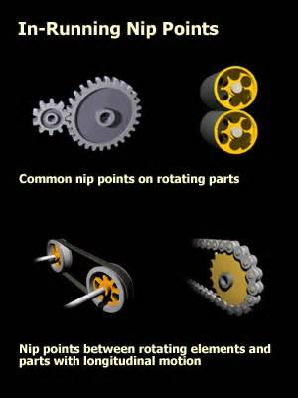
What is a Nip Point?
Nip points occur whenever machine parts move toward each other or when one part moves past a stationary object.
Possible Nip Point
Possible Nip Point
(when fixed guard removed)
Notes:
Note – Images downloaded from an image search on www.google.com.
Images meant to show nip points.
Another thing to note is that rotating protrusions must be covered, such as the example in the upper left of the black image with the two gears coming together.

Slide 21
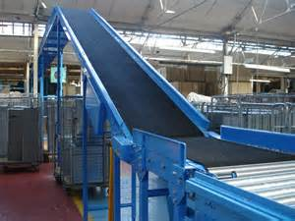
Hazards Associated with Conveyors
Elevated/overhead conveyors present hazards
Low bridge areas where workers can strike their heads
Falling materials and packages
Adequate Height
Fixed Guarding to Prevent Falling Objects
Notes:
Note – Images downloaded from an image search on www.google.com.
Images meant to highlight walkthrough height and guarding.

Slide 22


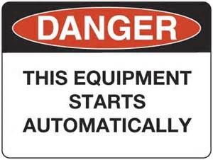
Safe Considerations Around Conveyors
Assure guarding is in place before beginning work.
Do not wear loose clothing.
Tie back hair.
Do not lean against equipment, as it may start automatically.
Utilize signage to emphasize hazards.
Notes:
Note – Images downloaded from an image search on www.google.com.
Images meant show examples of signage.
Note - If a switch can be started accidentally by leaning against it, it must also be guarded.

Slide 23
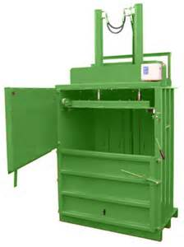
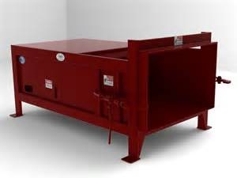
Compactors (aka Balers)
Vertical Compactor
Horizontal Compactor
Notes:
Note – Images downloaded from an image search on www.google.com.
Images meant to show common types of conveyor systems in warehouses.

Slide 24
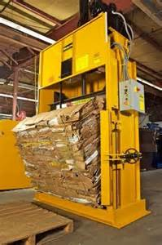
Hazards Associated with Compactors
Meant to crush and compact materials, primarily empty boxes.
Process can produce thousands of pounds of pressure.
Can easily crush a human being.
Guarding and awareness is essential to safety.
Notes:
Note – Images downloaded from an image search on www.google.com.
Images meant to show how a compactor makes bales of cardboard.

Slide 25
Compactor Guarding
A common permanent guard on a compactor is an interlock guard. When this type of guard is opened or removed….
The tripping mechanism and/or power automatically shuts off or disengages.
The moving parts of the machine are stopped.
The machine cannot cycle or be started until the guard is back in place.

Slide 26
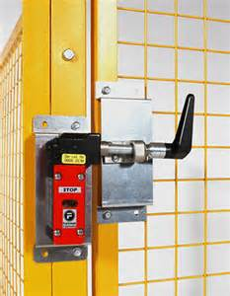
Compactor Guarding
Example of an electrical interlock device.
If gate is open, connection is broke, preventing machine from powering on.
Notes:
Note – Image downloaded from an image search on www.google.com.
Image meant to show what an interlock guard might look like.

Slide 27


Safe Considerations Around Compactors
Never try to operate a compactor while feeding material into it.
Never go into a compactor. It may be considered a confined space.
Never climb on top of a compactor.
Do not load, unload, or operate if younger than 18.
Utilize signage to emphasize hazards.
Notes:
Note – Images downloaded from an image search on www.google.com.
Images meant to show examples of signage and emphasize Department of Labor requirement restricting youth from operating compactors.

Slide 28
Break Time
Notes:
Note – Image downloaded from an image search on www.google.com.
Image for visual appeal only.
Take 15 minutes. After break, we will look at lockout/tagout considerations.

Slide 29
Part 2
Lockout/Tagout

Slide 30
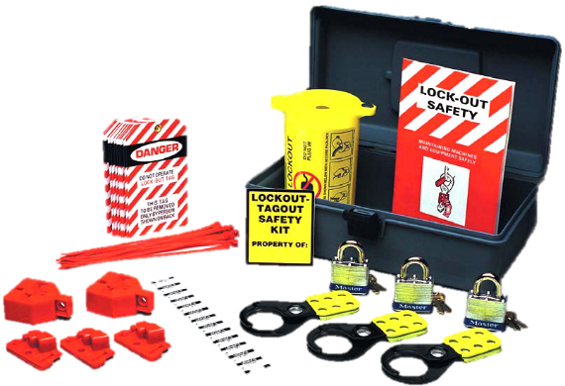
Part 1: Lockout/Tagout (LOTO)
General Industry Standard
Found in 29CFR1910
Subpart J – General Environmental Controls
29CFR1910.147
The Control of Hazardous Energy (LOTO)
Notes:
Note – Image downloaded from an image search on www.google.com.
Image is for visual appeal and to highlight future talking points.
It is recommended that you have a copy of the LO/TO standard. It can be found at https://www.osha.gov/pls/oshaweb/owadisp.show_document?p_table=STANDARDS&p_id=9804. It is also recommended that you have devices, such as hasps, locks, and tags, to distribute as examples.

Slide 31
Why We Lockout/Tagout
Employees servicing or maintaining machines or equipment may be exposed to serious physical harm or death if hazardous energy is not properly controlled.
Compliance with the LOTO standard prevents an estimated 120 fatalities and 50,000 injuries each year.
Specific to warehousing
The fatal injury rate for the warehousing industry is higher than the national average for all industries. Failing to follow LOTO procedures can result in death.
Notes:
Fatality and injury information from https://www.osha.gov/Publications/3220_Warehouse.pdf. It is recommended that you have copies of these documents to distribute.

Slide 32

Implementing Lockout/Tagout
Implement LOTO when an employee removes or bypasses a guard or other safety device.
Implement LOTO when an employee places any part of his or her body into an area on a piece of equipment where an associated danger zone exists.
Notes:
Note – Image downloaded from an image search on www.google.com.
Image is for visual appeal and to highlight future talking points.

Slide 33
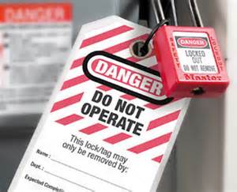
Lockout/Tagout
Lockout/Tagout (LOTO) is:
The placement of a lock or tag by an authorized employee on an energy-isolating device in accordance with an established procedure, indicating that the energy-isolating device is not to be operated until removal of the lock or tag in accordance with the established procedure.
Implemented in any situation where stored energy could harm employees, such as servicing, maintaining, or unjamming machines and equipment with stored energy.
Notes:
Note – Image downloaded from an image search on www.google.com.
Image is for visual appeal and to highlight future talking points.
A good question to ask here is “what types of stored energy do you think you face in warehousing.” Expect electrical, hydraulic, and others to be stated. Energy sources are discussed on the next slide.

Slide 34
Energy Overview
Energized - Connected to an energy source or containing residual or stored energy.
Energy Source - Any source of electrical, mechanical, hydraulic, pneumatic, chemical, thermal, or other energy.
Energy Isolating Device - A mechanical device that physically prevents the transmission or release of energy, including but not limited to the following: A manually operated electrical circuit breaker; a disconnect switch; a manually operated switch by which the conductors of a circuit can be disconnected from all ungrounded supply conductors, and, in addition, no pole can be operated independently; a line valve; a block; and any similar device used to block or isolate energy. Push buttons, selector switches and other control circuit type devices are not energy isolating devices.
De-energization – The process that is used to disconnect and isolate a system from a source of energy in order to prevent the release of that energy. By de-energizing the system, you are eliminating the chance that the system could inadvertently, accidentally or unintentionally cause harm to a person through movement, or the release of heat, light, or sound.

Slide 35
Affected & Authorized Employees
Affected Employee - An employee whose job requires him/her to operate or use a machine or equipment on which servicing or maintenance is being performed under lockout or tagout, or whose job requires him/her to work in an area in which such servicing or maintenance is being performed. Authorized Employee - A person who locks out or tags out machines or equipment in order to perform servicing or maintenance on that machine or equipment. An affected employee becomes an authorized employee when that employee's duties include performing servicing or maintenance covered under this section.
Notes:
It should be emphasized that authorized employees perform LOTO and that an employer’s Energy Control Program will determine who is affected versus authorized. The next slide transitions into Energy Control Programs.
Also – tags by themselves are greatly frowned upon because they are more of a warning and not a control measure. Tags not be used alone!

Slide 36
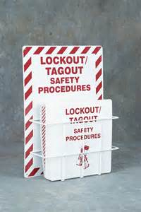
Energy Control Program
An Energy Control Program should include:
Energy control procedures for individual pieces of equipment
Identification of materials and hardware (i.e. locks and tags)
When and how periodic inspections be conducted
Proper training and communication
Notes:
Note – Image downloaded from an image search on www.google.com.
Image is for visual appeal and to highlight future talking points.

Slide 37
Procedures
Procedures shall be developed and utilized for the control of potentially hazardous energy. Procedures should including the following:
A specific statement of the intended use of the procedure
Specific procedural steps for shutting down, isolating, blocking, and securing machines or equipment to control hazardous energy
Specific procedural steps for the placement, removal, and transfer LOTO devices
Specific requirements for testing a machine or equipment to verify the effectiveness of LOTO devices, and other energy control measures

Slide 38
Protective Materials and Hardware
Locks, tags, blocks, or other hardware shall be provided by the employer for isolating, securing or blocking of machines or equipment from energy sources.
Durable enough to withstand work conditions (weather, heat, etc.)
Standardized and not used for other tasks
Substantial enough to prevent unintended removal
Identify the employee who installed the devices and give adequate warnings

Slide 39
Implementing Inspections
The employer should conduct a periodic inspection of the energy control procedure at least annually.
Inspections should be conducted by an authorized employee (but not the same employee utilizing the energy control procedure being inspected).
Inspections should include a review of that employee's responsibilities under the energy control procedure being inspected.
Inspections should correct any deviations or inadequacies identified.

Slide 40

Lockout/Tagout Training Program
Employers are required to establish a program for appropriate energy isolation to prevent the release of stored energy and injury to employees.
This program should consist of a well-defined outline of the scope, purpose, authorization, rules, and techniques to be utilized for the control of hazardous energy, and the means to enforce compliance.
Training and evaluation shall be conducted by a person with the knowledge, training, and experience to train powered industrial truck operators and evaluate their competence.
Notes:
Note – Image downloaded from an image search on www.google.com.
Image is for visual appeal and to highlight future talking points.

Slide 41

Lockout/Tagout Training Program
Training programs should consist of:
Formal instruction (e.g., lecture, discussion, interactive computer learning, written material)
Practical training (demonstrations and exercises performed by the trainee)
Evaluation of performance
Notes:
Note – Image downloaded from an image search on www.google.com.
Image is for visual appeal and to highlight future talking points.

Slide 42
Remember!
Planning is necessary to prevent injury from an uncontrolled release of energy.
Be aware of hazards and never try to bypass safe measures.
Know your limits!
Are you an affected or authorized employee?

Slide 43

Bringing Lockout and Tagout Together
Definitions and Steps Involved
Notes:
Note – Image downloaded from an image search on www.google.com.
Image is for visual appeal and to highlight future talking points.

Slide 44
Lockout: By Definition
Lockout -The placement of a lockout device on an energy isolating device, in accordance with an established procedure, ensuring that the energy isolating device and the equipment being controlled cannot be operated until the lockout device is removed.
Lockout Device - A device utilizes a positive means such as a lock, either key or combination type, to hold an energy isolating device in the safe position and prevent the energizing of a machine or equipment.

Slide 45
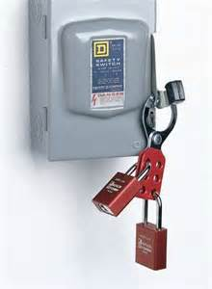
Energy Isolation
The energy-isolating can be initiated in several ways, including:
A manually operated disconnect switch
A circuit breaker
A line valve
A block
In most cases, these devices will have loops or tabs which can be locked to a stationary item in a safe position (de-energized position). The locking device (or lockout device) can be any device that has the ability to secure the energy-isolating device in a safe position.
Notes:
Note – Image downloaded from an image search on www.google.com.
Image is to emphasize the second point about devices having holes or loops to apply locks.
Energy isolating device. A mechanical device that physically prevents the transmission or release of energy, including but not limited to the following: A manually operated electrical circuit breaker; a disconnect switch; a manually operated switch by which the conductors of a circuit can be disconnected from all ungrounded supply conductors, and, in addition, no pole can be operated independently; a line valve; a block; and any similar device used to block or isolate energy. Push buttons, selector switches and other control circuit type devices are not energy isolating devices.

Slide 46


The Lockout Device
Application
Each lockout device should always be affixed to each energy isolating device by an authorized employee.
Each lockout device needs to be affixed in a way that holds the energy isolating devices in a "safe" or "off" position.
Each lockout device requires an attached tagout device--fastened directly to it--that clearly indicates that the operation or movement of energy isolating devices from the "safe" or "off" position is prohibited.
If a tag cannot be affixed directly to the energy isolating device, the tag should be in a position that will be immediately obvious to anyone attempting to operate the device.
Notes:
Note – Images downloaded from an image search on www.google.com.
Images show a hasp to help with multiple personnel working in the same location and a lock to prevent devices from being put in the on position.

Slide 47
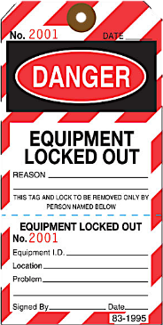
Tagout: By Definition
Tagout -The placement of a tagout device on an energy isolating device in accordance with an established procedure, that indicates that the energy isolating device and the equipment being controlled may not be operated until the tagout device is removed.
Tagout Device - A prominent warning device, such as a tag and a means of attachment, which can be securely fastened to an energy isolating device in accordance with an established procedure, to indicate that the energy isolating device and the equipment being controlled may not be operated until the tagout device is removed.
Notes:
Note – Image downloaded from an image search on www.google.com.
Image is for visual appeal and to highlight future talking points.

Slide 48
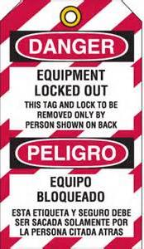
Tagout
“Tags” are essentially warning devices affixed to energy isolating devices, and do not provide the physical restraint on those devices that is provided by a lock.
When a tag is attached to an energy isolating device it is not to be removed without authorization of the authorized person responsible for it, and it is never to be bypassed.
Tags must be legible and understandable by all authorized employees, affected employees, and all other employees whose work operations are or may be in the area.
Tags and their means of attachment must be made of materials which will withstand the environmental conditions encountered in the workplace.
Tags must be securely attached to energy isolating devices.
Notes:
Note – Image downloaded from an image search on www.google.com.
Image is for visual appeal and to highlight future talking points.
This would be a good time to discuss how tags alone may evoke a false sense of security, and their meaning needs to be understood as part of the overall energy control program.

Slide 49
The Tagout Procedure
Tagout is a labeling process that is always used when lockout is required. The process of tagging out a system involves attaching or using an indicator (label) that includes the following information:
Why the LOTO procedure was required (repair, maintenance, etc.).
The date and time that the lock/tag was applied.
The name of the authorized person who attached the tag and lock to the system.
Notes:
This would be a good time to tie lockout and tagout together by emphasizing that ONLY the authorized individual would use tags and that the authorized individual who placed the lock and tag onto the system is the one who is permitted to remove them. This procedure helps ensure that the system cannot be started up without the authorized individual’s knowledge.

Slide 50
The Lockout/Tagout Procedure
Each warehousing operation is unique and requires its own site-specific program, but at a minimum these programs should:
Notify all affected employees that servicing or maintenance is required on a machine or equipment and that the machine or equipment must be shut down and locked out to perform the servicing or maintenance.
The authorized employee shall refer to the company procedure to identify the type and magnitude of the energy that the machine or equipment utilizes, shall understand the hazards of the energy, and shall know the methods to control the energy.
If the machine or equipment is operating, shut it down by the normal stopping procedure (depress the stop button, open switch, close valve, etc.).
Continues on slide 12…
Notes:
Procedure taken from https://www.osha.gov/pls/oshaweb/owadisp.show_document?p_table=STANDARDS&p_id=9805 . This is Appendix A for 29CFR1910.147.

Slide 51
The Lockout/Tagout Procedure
De-activate the energy isolating device so that the machine or equipment is isolated from the energy source.
Lock out the energy isolating device with assigned individual lock.
Stored or residual energy (such as that in capacitors, springs, elevated machine members, rotating flywheels, hydraulic systems, and air, gas, steam, or water pressure, etc.) must be dissipated or restrained by methods such as grounding, repositioning, blocking, bleeding down, etc.
Ensure that the equipment is disconnected from the energy source(s) by first checking that no personnel are exposed, then verify the isolation of the equipment by operating the push button or other normal operating control(s) or by testing to make certain the equipment will not operate.
***More than one energy source may need to be locked out.

Slide 52
Restoring to Service
Check the machine or equipment and the immediate area around the machine to ensure that nonessential items have been removed and that the machine or equipment components are operationally intact.
Check the work area to ensure that all employees have been safely positioned or removed from the area.
Verify that the controls are in neutral.
Remove the lockout devices and reenergize the machine or equipment.
Notify affected employees that the servicing or maintenance is completed and the machine or equipment is ready for use.
Notes:
Procedure taken from https://www.osha.gov/pls/oshaweb/owadisp.show_document?p_table=STANDARDS&p_id=9805 . This is Appendix A for 29CFR1910.147.

Slide 53
Summary
Warehousing facilities rely on machinery everyday.
Machinery is essential to operations, but present hazards.
Guarding and safe practices is essential during operations.
If machinery is in need of service, repair, or unjamming lockout/tagout applies.

Slide 54
Questions
Notes:
Note – Image is standard clip art.
Image for visual appeal only.

Slide 55
Post Test and Evaluation
Notes:
Note – Image downloaded from an image search on www.google.com.
Image for visual appeal only.
Take about 10-15 minutes to complete and review the post-test and complete evaluations.

