Slide 1
Implementing path planning algorithms from research literature
Presenters: Eljas Hyyrynen and Jaakko Mattila
Course Project
Robotics Manipulation, Decision Making and Learning L

Slide 2
What is this presentation about?
Topic: Improved Q-Learning Path Planning Algorithm
Based on a research paper:
Konar, Goswami, Singh, Jain, and Nagar A Deterministic Improved Q-Learning for Path Planning of a Mobile Robot
Table of Contents
Introducing the Improved Q-learning algorithm
Presenting our experiments
Discussion of our findings and conclusion

Slide 3
Motivation
Why this is an interesting topic for you?
Efficient path planning for physical robots
Less turning -> Faster routes
Effectively utilizing available information
Distance to goal -> Less preparation required
Our motivation
Learn to implement based on research papers
Expand over the course material

Slide 4
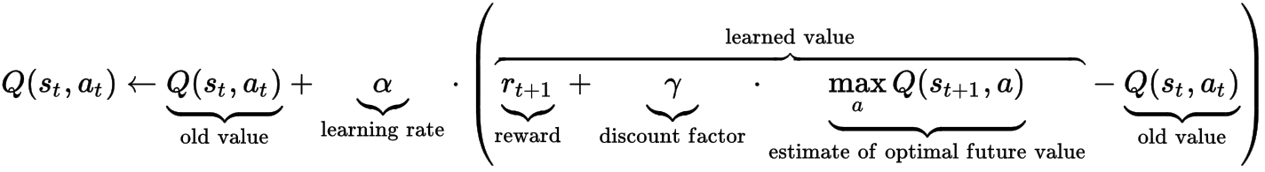
Classical Q-Learning
Q-learning
Q, action value function
Assumes local optimal actions at each step
How to modify this formula to fit our path planning problem?
- one sweep to update Q table
- using the distance information
Notes:
We move from goal onwards -> All other Q-values are zero
We run only once -> learning rate = 1 (does not matter)
Reward is zero for other stats than goal
We always choose the best following action
-→ We get what is in the following slide!

Slide 5
Towards Improved Q-Learning
Modifications
Begin iterating from the goal state
Set the state locked when it needs no further updating
Action value function initialized to 0
One sweep -> learning rate always 1
Reward for non-goal states to 0
Presenting these on the action value function →

Slide 6
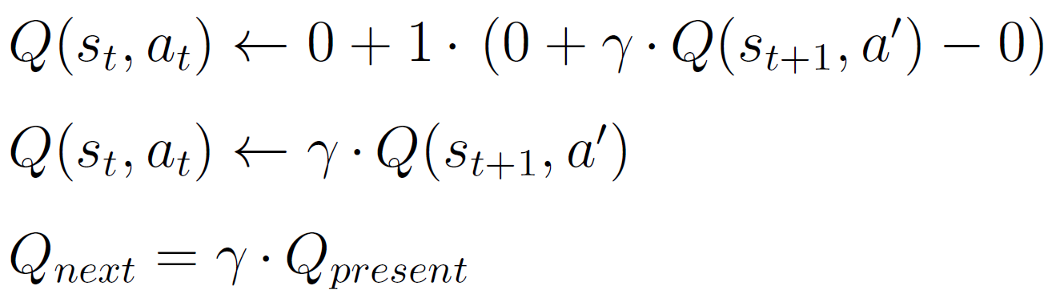
Towards Improved Q-Learning
Applying the modifications to the Classical Q-Learning formula:
Notes:
We move from goal onwards -> All other Q-values are zero
We run only once -> learning rate = 1 (does not matter)
Reward is zero for other stats than goal
We always choose the best following action
-→ We get what is in the following slide!

Slide 7
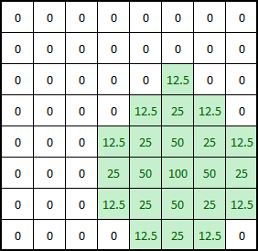
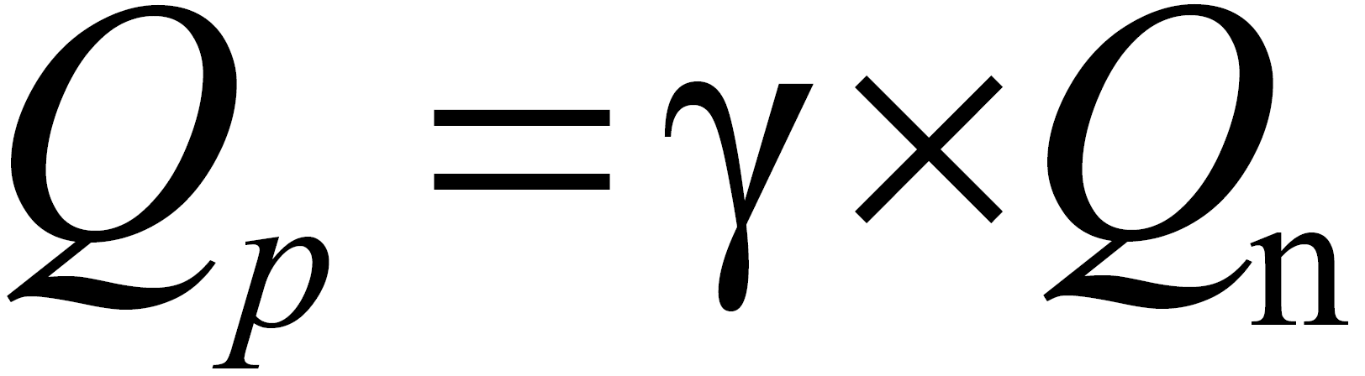
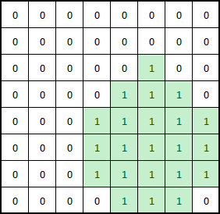
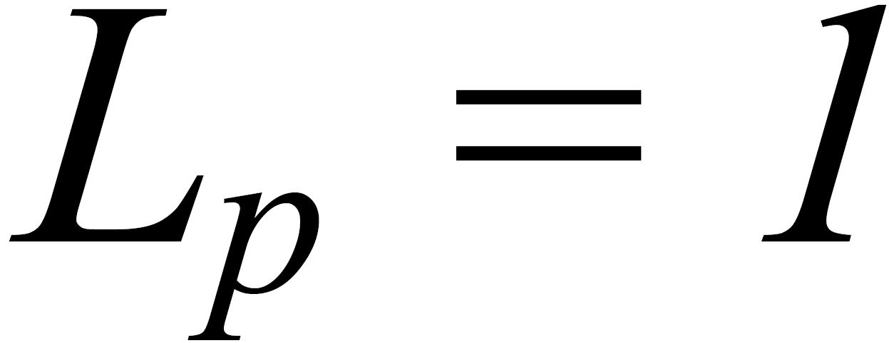
Improved Q-Learning
While there are unlocked states:
Update Q-table
Update Boolean Lock variables
Q value table
Boolean lock table

Slide 8
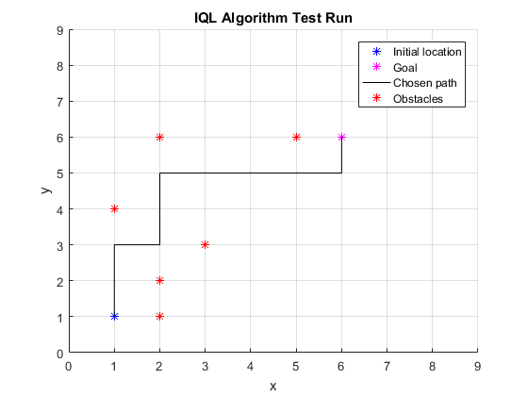
Experiments
Simple test case → optimal solution
8x8 grid

Slide 9
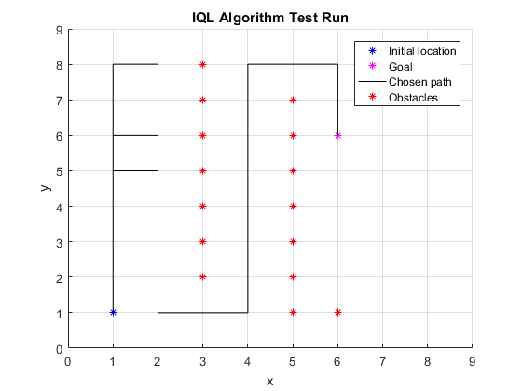
Experiments
Prefers not to changing direction
Is there a bug?
No, turns right at y = 6, then up and makes a loop

Slide 10
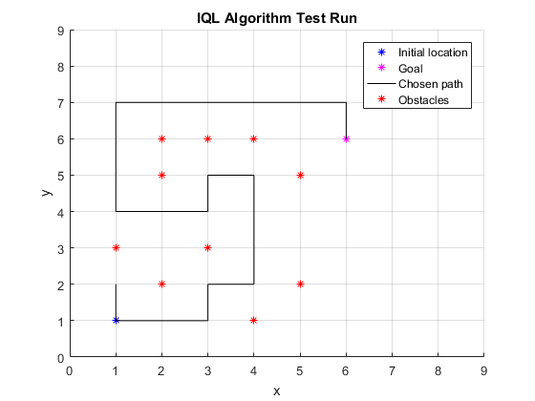
Experiments
Complex test case:
Some inefficient decisions

Slide 11
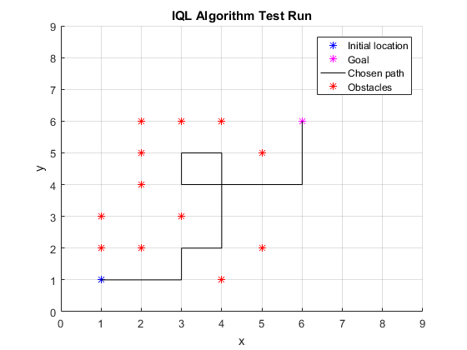
Experiments
Simple changes in obstacle configuration
→ Algorithm shows expected behavior

Slide 12
Conclusion
Evaluation
Reduced energy consumption of extra turns
Priority: Straight > right-angle turn > U-turn
Balancing between the previous point and the distance to goal
Challenging in some cases
Further Work
Reduce complexity of the algorithms
-> same as in the original paper
Work on more complex cases
-> closer to optimal solution
Notes:
Limitations
Works well with simple cases
Higher degree of complexity than the one in the paper
How to deal with dead ends
Currently, not optimal
More work on the code to better utilize the distance information

Slide 13
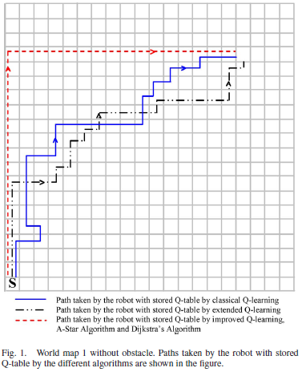
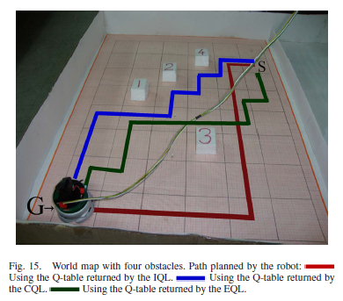
Thank you for your attention! Any questions? Fire away!

