Slide 1
数据库系统
Database Systems

Slide 2
Relational Algebra
Chapter Outline:
3.1 Relational Algebra(RA)
3.2 Simple and Complex Queries using RA
An Introduction to Database System

Slide 3
Relational Algebra
What is relational algebra?
Relational algebra is a collection of operations that are used to manipulate the entire set of relations. The output of any relational algebra operation is always a relation.
What are the Operations?
  Set operations like union, intersection, difference, and Cartesian product.
  Selection, Projection, and Joining.
Notes:
Codd 提议这样一种代数作为数据库查询语言的基础,即使 SQL 的查询语言也松散的基于了关系代数，尽管 SQL 中的操作数(表)不完全是关系.

Slide 4
Union (∪)
The result of this operation, i.e. R ∪ S, is a relation that includes all tuples that are either in R or in S or in both. Duplicate tuples will not appear in the output.
Formally: R ∪ S = { t | t ∈ R or t ∈ S }
Union Compatibility: Let R and S are two relations with attributes (A1, A2, …, An) and (B1, B2, ….., Bn) respectively. If R and S are to be unioned, it should satisfy the following two rules:
Rule 1: The relations R and S must have the same degree.
Rule 2: The domain of the ith attribute of R and the domain of the ith attribute of S must be same.
dom(Ai) = dom(Bi), where, 1 ≤ i ≤ n.

Slide 5
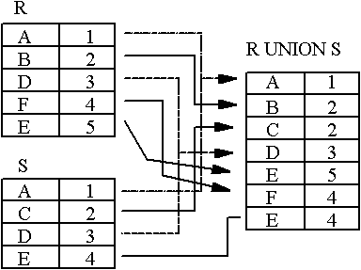
Union (∪)
An Introduction to Database System

Slide 6
Relational Difference (-)
Like union, the relational difference operator also requires its operands to be of the same type.
Format: R - S
Formally: R - S = { t | t ∈ R and t ∉ S}
Semantics: Given two relations R and S of the same type, the difference between those two relations, R- S, is the relation containing all tuples of R that do not appear in S.
An Introduction to Database System

Slide 7
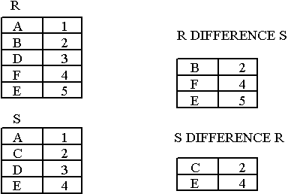
Relational Difference (-)
Notice that Difference has a directionality to it, e.g. R-S and S-R are not the same thing.
An Introduction to Database System

Slide 8
Intersection(∩)
The expression R ∩ S returns all tuples that appear in both the relations R and S.
Like union and difference, the relational intersection operator requires its operands to be of the same type.
Formally: R ∩ S = { t | t ∈ R and t ∈ S}
Derivation from existing operators:
R ∩ S = R - (R - S) = S – (S - R)
An Introduction to Database System

Slide 9
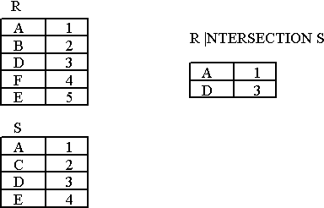
Intersection(∩)
An Introduction to Database System

Slide 10
Cartesian Product (×)
The Cartesian product or cross-product is a binary operation that is used to combine two relations. Assuming R and S as relations with n and m attributes respectively, the Cartesian product, R × S can be written as,
R (A1, A2, …, An) × S (B1, B2, …, Bm)
The result of the above set operation is,
Q (A1, A2, …, An, B1, B2, …, Bm)
Where,
Degree (Q) = n + m
count(Q) = Number of tuples in R * Number of tuples in S.

Slide 11
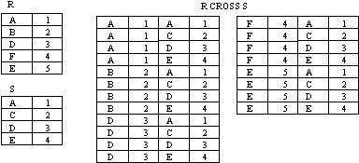
Cartesian Product (×)
R (A1, A2, …, An) × S (B1, B2, …, Bm)
An Introduction to Database System

Slide 12
Special Relational Operations-Sample Relations
Figure 3.5 Student
SSN | SNAME | GPA | AGE | DEPARTMENTID
2007001003 | CHENGLICHONG | 3.33 | 20 | 31
2007001005 | ZHONGWEILONG | 3.62 | 20 | 33
2007001006 | WUYUANLANG | 4.01 | 20 | 33
2006001001 | LUOZI | 3.12 | 20 | 34
2006001002 | GUOHUAXIAN | 3.21 | 21 | 34
2006001004 | LELINGBING | 3.75 | 21
2007002001 | ZHUJIANGUO | 3.05 | 19
An Introduction to Database System

Slide 13
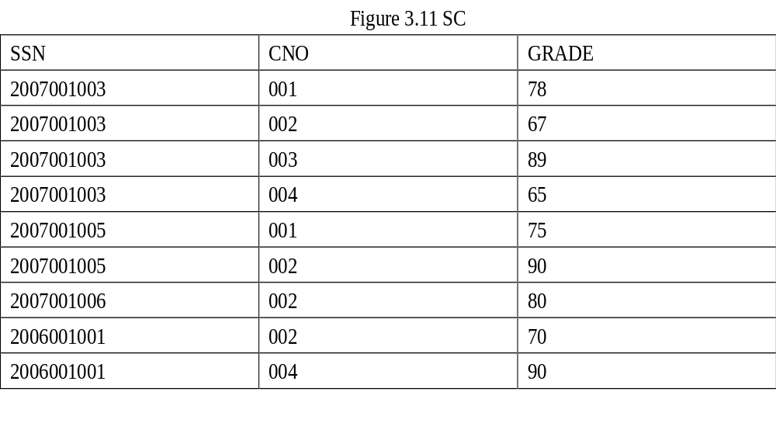
An Introduction to Database System

Slide 14
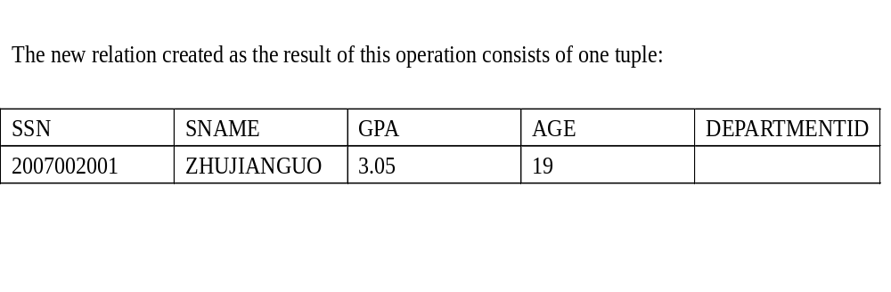
The SELECT operation (σ)
The select operation retrieves a subset of tuples in a relation that satisfy a selection condition.
σ_{<selection-condition>} (Relation)
Query-1: Find the students whose age is 19.
σ

Slide 15
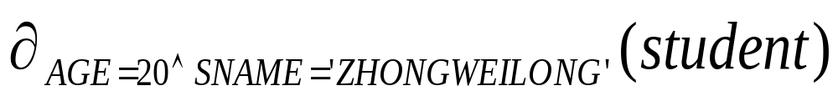
The SELECT operation (σ)
Query-2: Select tuples (rows) of the student relation where the AGE is 20 and Name is ZHONGWEILONG, we could write:
An Introduction to Database System

Slide 16
One of the interesting properties of the selection operation is that it is commutative. Therefore, all the expressions shown below are equivalent,
  σ_{condition-1} (σ_{condition-2} (R))
  σ_{(condition-1 AND condition-2)} (R)
  σ_{condition-2} (σ_{condition-1} (R))

Slide 17

The Projection Operation (π)
The projection operation is used to select only few columns from a relation.
π_{<attributes>} (Relation)
Query-3: List the age of all the students.
π_{age}(student)
π

Slide 18
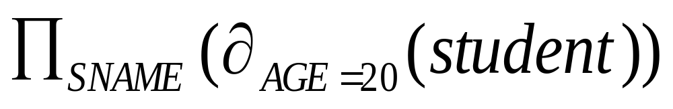
Select and Project
We can perform these operations on the relations resulting from other operations. To get the names of students having the AGE as 20, we write:
An Introduction to Database System

Slide 19
Join (∞)
Join (∞)
  EquiJoin
    Natural Join
    Left Outer Join
    Right Outer Join
    Full Outer Join
  Theta Join

Slide 20
Join (∞)
Format: R ∞ join-condition S
Semantics: Return all tuples in R × S which satisfy the join condition.
Derivation from existing operators:
R ∞ _{join-condition} S = σ_{join-condition}(R × S)
Format of join condition:
R.A op S.B
R.A1 op S.B1 and R.A2 op S.B2 . . .

Slide 21
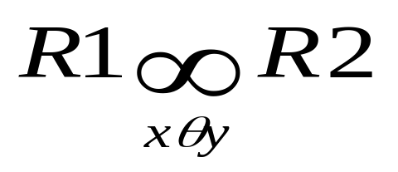
Equijoin (∞ )
A join is called an equijoin if only equality operator is used in all join conditions.
The general form for this kind of join is,
  <Join_condition> must always have = operator

Slide 22
Equijoin
R S R ∞R.B = S.B S
A B B C A R.B S.B C
a b b c a b b c
d b c d d b b c
b c a d b c c d
Most joins in practice are equijoins.

Slide 23
Natural Join (*)
When we omit the condition during joining of two relations, then it is called as natural join (*):
Let relations R1 has attributes(x1,x2,x3,M) and R2 has attributes(y1,y2,y3,y4,y5,M) respectively. That is ,the M attribute is common to the two relations. Then the natural join of R1 and R2 is a relation with heading(x1,x2,x3,M, y1,y2,y3,y4,y5) and body consisting of all tuples that the duplicated attributed M are removed.

Slide 24
Natural Join
R1:(x1,x2,x3,M), R2:(y1,y2,y3,y4,y5,M), M is common to the two relations. Then the natural join of R1 and R2 is a relation with heading(x1,x2,x3,M, y1,y2,y3,y4,y5) and body consisting of all tuples that the duplicated attributed M are removed.
B
E
A
B
C
E
A
B
C
b₁
3
a₁
b₁
5
3
a₁
b₁
5
b₂
7
a₁
b₂
6
a₁
b₂
6
7
a₂
b₃
8
b₃
10
a₂
b₃
8
10
a₂
b₄
12
b₃
2
R
b₅
2
a₂
b₃
8
2
S
R ∞ S

Slide 25
Theta Join (Θ) or NonEqui Join
Let R and S are two relations. Consider an attribute x in R, and an attribute y in S. The theta join of these two relations can be written as,
where Θ indicates any valid relational operator other than =.

Slide 26
Theta Join
A
B
C
B
E
A
R.B
C
S.B
E
a₁
b₁
5
b₁
3
a₁
b₁
5
b₂
7
a₁
b₂
6
b₂
7
a₁
b₁
5
b₃
10
a₂
b₃
8
b₃
10
a₁
b₂
6
b₂
7
a₂
b₄
12
a₁
b₂
6
b₃
10
b₃
2
R
a₂
b₃
8
b₃
10
b₅
2
R ∞ S
S
C＜E

Slide 27
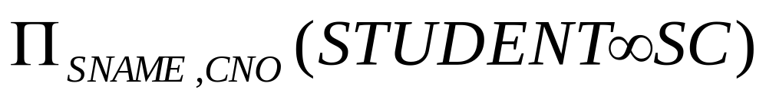
Example
To find all students name and selected courses NO, we need student and SC relations
1.
2. We can rewrite the previous query as:
An Introduction to Database System

Slide 28
Outer Joins (Special Case of EquiJoin)
Usually, only a subset of tuples of each relation will actually participate in a join, i.e. only tuples that match with the joining attributes. Tuples of a relation not participating in a join are called dangling tuples.
How do we keep dangling tuples in the result of a join? Use null values to indicate a no-join situation.
There are three types of outer joins
  - left outer join
  - right outer join and
  - full outer join.

Slide 29
Left outer-join
R1 R2 is similar to a natural join but keep all dangling tuples of R1.
Right Outer-Join
R1 R2 is similar to a natural join but keep all dangling tuples of R2.
Outer Join (full outer-join)
R1 R2 is similar to a natural join but keep all dangling tuples of both R1 and R2.
The advantages of outer join is to take the union of tuples from two relations that are not union compatible.

Slide 30
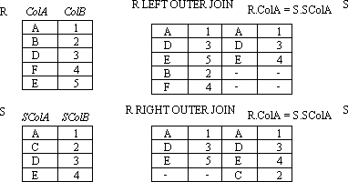
Example:LEFT OUTER JOIN, RIGHT, OUTER JOIN
An Introduction to Database System

Slide 31
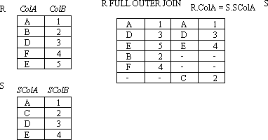
Example:FULL OUTER JOIN
An Introduction to Database System

Slide 32
Division
Not supported as a primitive operator, but useful for expressing queries like: Find students who have taken all courses.
Precondition: in A/B, the attributes in B must be included in the schema for A. Also, the result has attributes A-B..
Notes:
13

Slide 33
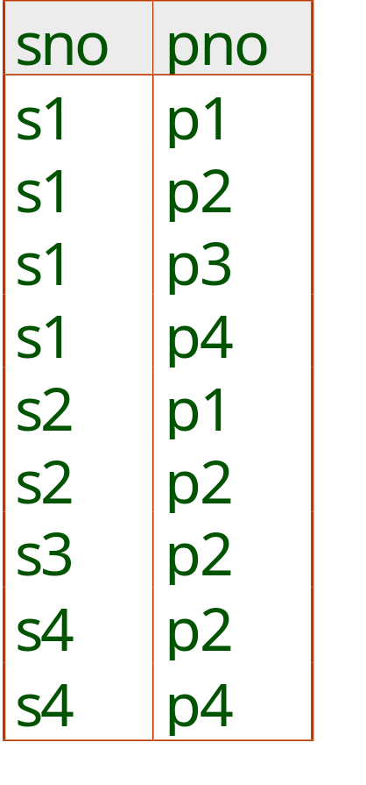
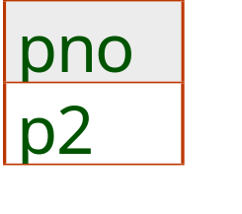
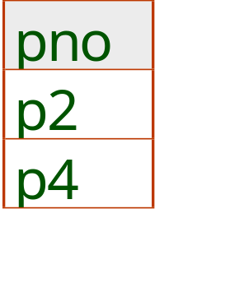
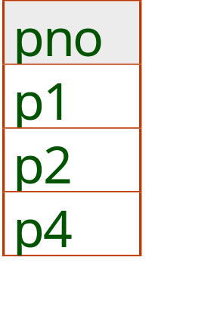
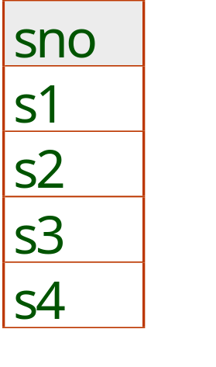
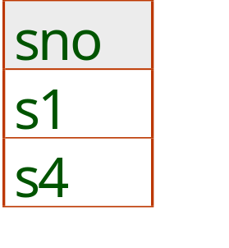
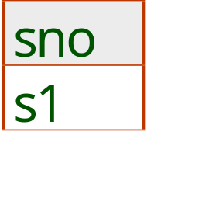
Examples of Division A/B
B1
B2
B3
A
A/B1
A/B2
A/B3
Notes:
14

Slide 34
Another Example
Another example is: Suppose we want to find all the students who have selected all courses (See Figure 3.19 Course Table ) provided by the school.
CNO | CNAME | CREDIT
001 | Math | 3
002 | Multimedia | 3
003 | Computer network | 4
004 | Software engineering | 4
005 | Bioinformatics | 3
An Introduction to Database System

Slide 35
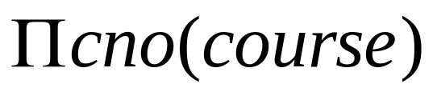
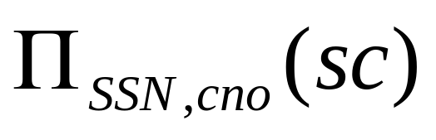
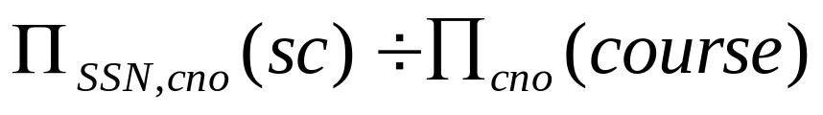
We can think of it as three steps:
1.We can obtain the NO. of all courses provided by the school by:
2.We can also find all SSN, cno pairs for which the student has selected courses by:
3.Now we need to find all students who selected all the courses. The divide operation provides exactly those students:
An Introduction to Database System

Slide 36
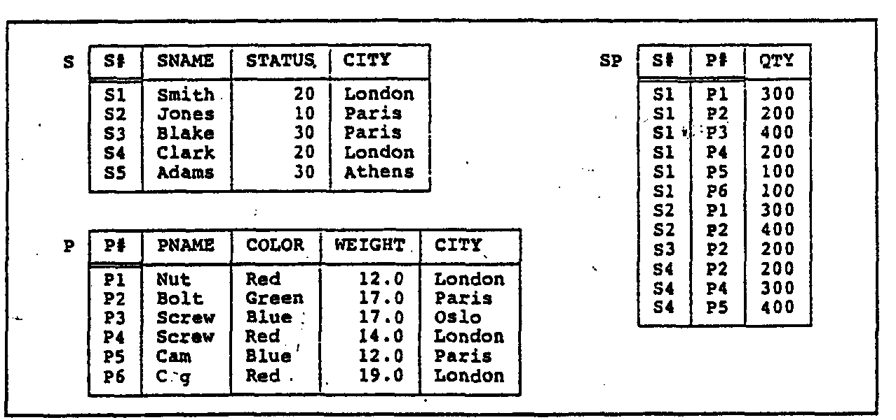
3.2 Simple and Complex queries using RA
An Introduction to Database System

Slide 37
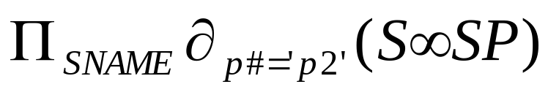
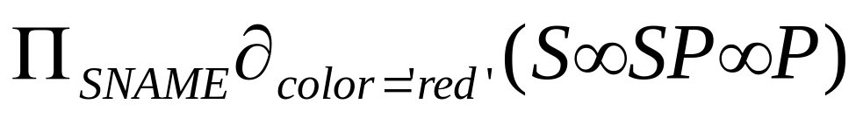
Example
Example 1: Get supplier names for suppliers who supply part P2:
Example 2:Get supplier names for suppliers who supply at least one red part:
An Introduction to Database System

Slide 38
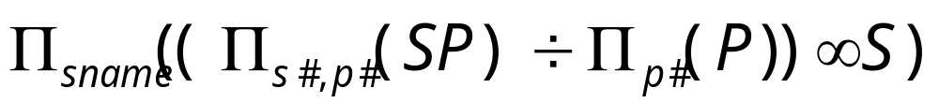
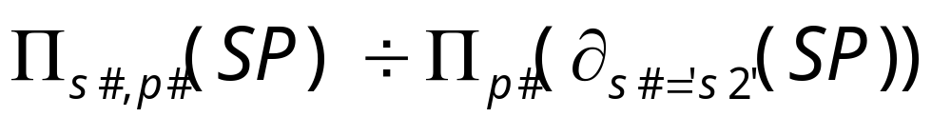
CON…
Example 3:Get supplier names for suppliers who supply all parts:
Example 4:Get supplier numbers for suppliers who supply at least all those parts supplied by supplier S2:
An Introduction to Database System

Slide 39
Example
Example 1: Get supplier names for suppliers who supply part P2:
Example 2:Get supplier names for suppliers who supply at least one red part:
An Introduction to Database System

Slide 40
CON…
Example 3:Get supplier names for suppliers who supply all red parts:
Example 4:Get supplier numbers for suppliers who supply at least all those parts supplied by supplier S2,but not supplied by S3:
An Introduction to Database System

