Slide 1
Lab 1
An Introduction to MATLAB
Lab 1: 2021

Slide 2
MATLAB Overview
What is MATLAB?
Strengths of MATLAB
Weaknesses of MATLAB

Slide 3
What is MATLAB?
MATLAB
  MATrix LABoratory: MATLAB is a program for doing numerical computation. It was originally designed for solving linear algebra type problems using matrices. It’s name is derived from MATrix LABoratory.
  MATLAB has since been expanded and now has built-in functions for solving problems requiring data analysis, signal processing, optimization, and several other types of scientific computations. It also contains functions for 2-D and 3-D graphics and animation.

Slide 4
What is MATLAB - con’t
Considering MATLAB at home
  Standard edition
    Available for roughly 2 thousand dollars
  Student edition
    Available for roughly 1 hundred dollars.
    Some limitations, such as the allowable size of a matrix

Slide 5
Strengths of MATLAB
MATLAB is relatively easy to learn
MATLAB code is optimized to be relatively quick when performing matrix operations
MATLAB may behave like a calculator or as a programming language
MATLAB is interpreted, errors are easier to fix
Although primarily procedural, MATLAB does have some object-oriented elements

Slide 6
Weaknesses of MATLAB
MATLAB is NOT a general purpose programming language
MATLAB is an interpreted language (making it for the most part slower than a compiled language such as C, C++)
MATLAB is designed for scientific computation and is not suitable for some things (such as design an interface)

Slide 7
Matlab Desktop
Command Window
  type commands
Workspace
  view program variables
  clear to clear
  double click on a variable to see it in the Array Editor
Command History
  view past commands
Launch Pad
  access tools, demos and documentation
Notes:
Y:\Win32\Matlab\R2009a

Slide 8
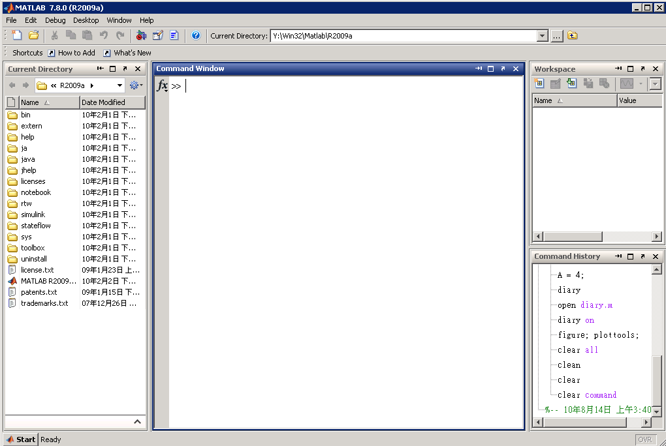
Matlab Desktop - con’t
Launch Pad
Workspace
Current Directory
Command Window
History

Slide 9
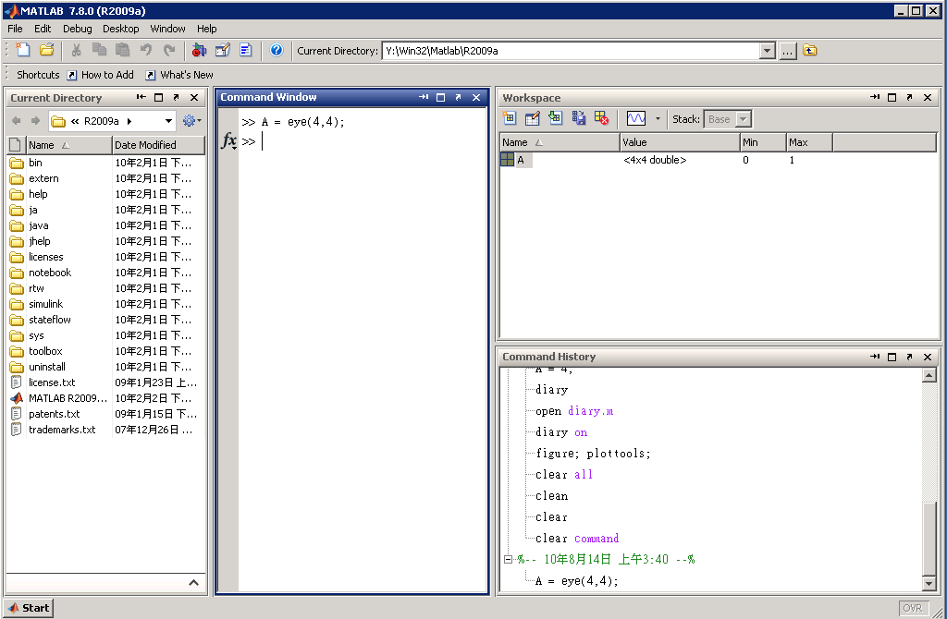
Matlab Desktop - con’t
Launch Pad
Workspace
Command Window
Current DIrectory
History
Notes:
[Instructors: you can spend as much or as little time talking to this picture. Have fun, be a story-teller.]
Key points:
differences in speed
temporary versus permanent
Faster memory is more expensive. (Note cost/megabyte for various storage devices.)
MATLAB variables are stored in RAM. We use LOAD/SAVE to move data from temporary storage (RAM) to permanent storage (hard disk.)
The CPU move memory from RAM to Register for actual computation, then moves the results back to RAM.
This picture highlights the differences between memory.
CPU registers are the fewest, most precious resources on the computer, and also the FASTEST!
The CPU cache either on the CPU (level1) or on the mother board (level 2) are very fast.
The RAM (physical or virtual) is where our normal variables are stored. When we create MATLAB arrays, or work with Word Documents, these data are stored in RAM.
CDROM, DVD, hard disks are “permanent storage devices.”
The input sources interact with memory at different levels, depending on the device.

Slide 10
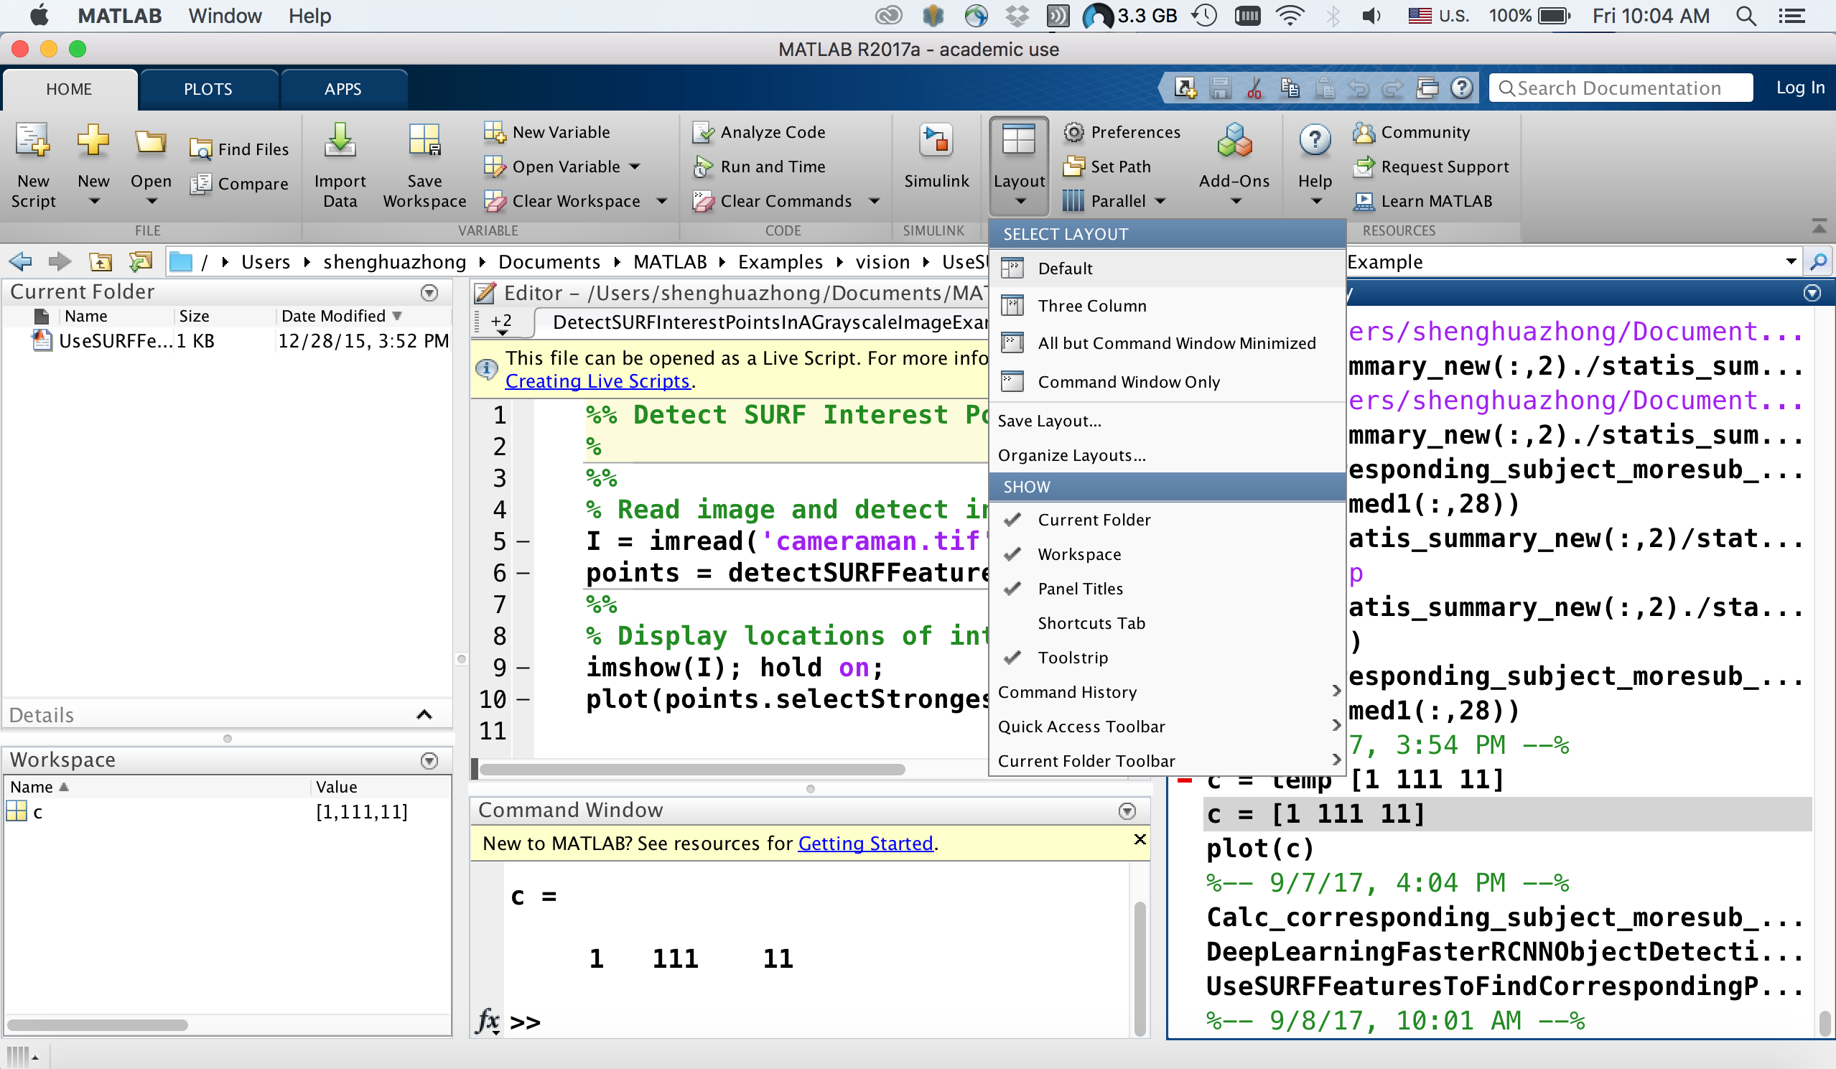
How to Resume Default Desktop

Slide 11
Matlab Help
Different ways to find information
  help
  help general, help mean, sqrt...
  helpdesk - an html document with links to further information
Notes:
Let’s bring the memory discussion to MATLAB.
Examine the upper left pane on the MATLAB window. Several pieces of memory have been “allocated”, “named” and assigned variables.
We used an “assignment statement” (i= 10;) to assign a “value” to a “variable”.
On some computers (and in some languages) the memory must first be “allocated” before any values can be assigned.
KEY ITEMS TO DISCUSS:
A variable is piece of memory that has been given a name.
A value is the contents with the variable.
THE SCREEN SHOWS:
The screen shows the name of the variable,
The size of the variable (in elements and bytes),
The “class” - what kind of data is stored in the piece of memory

Slide 12
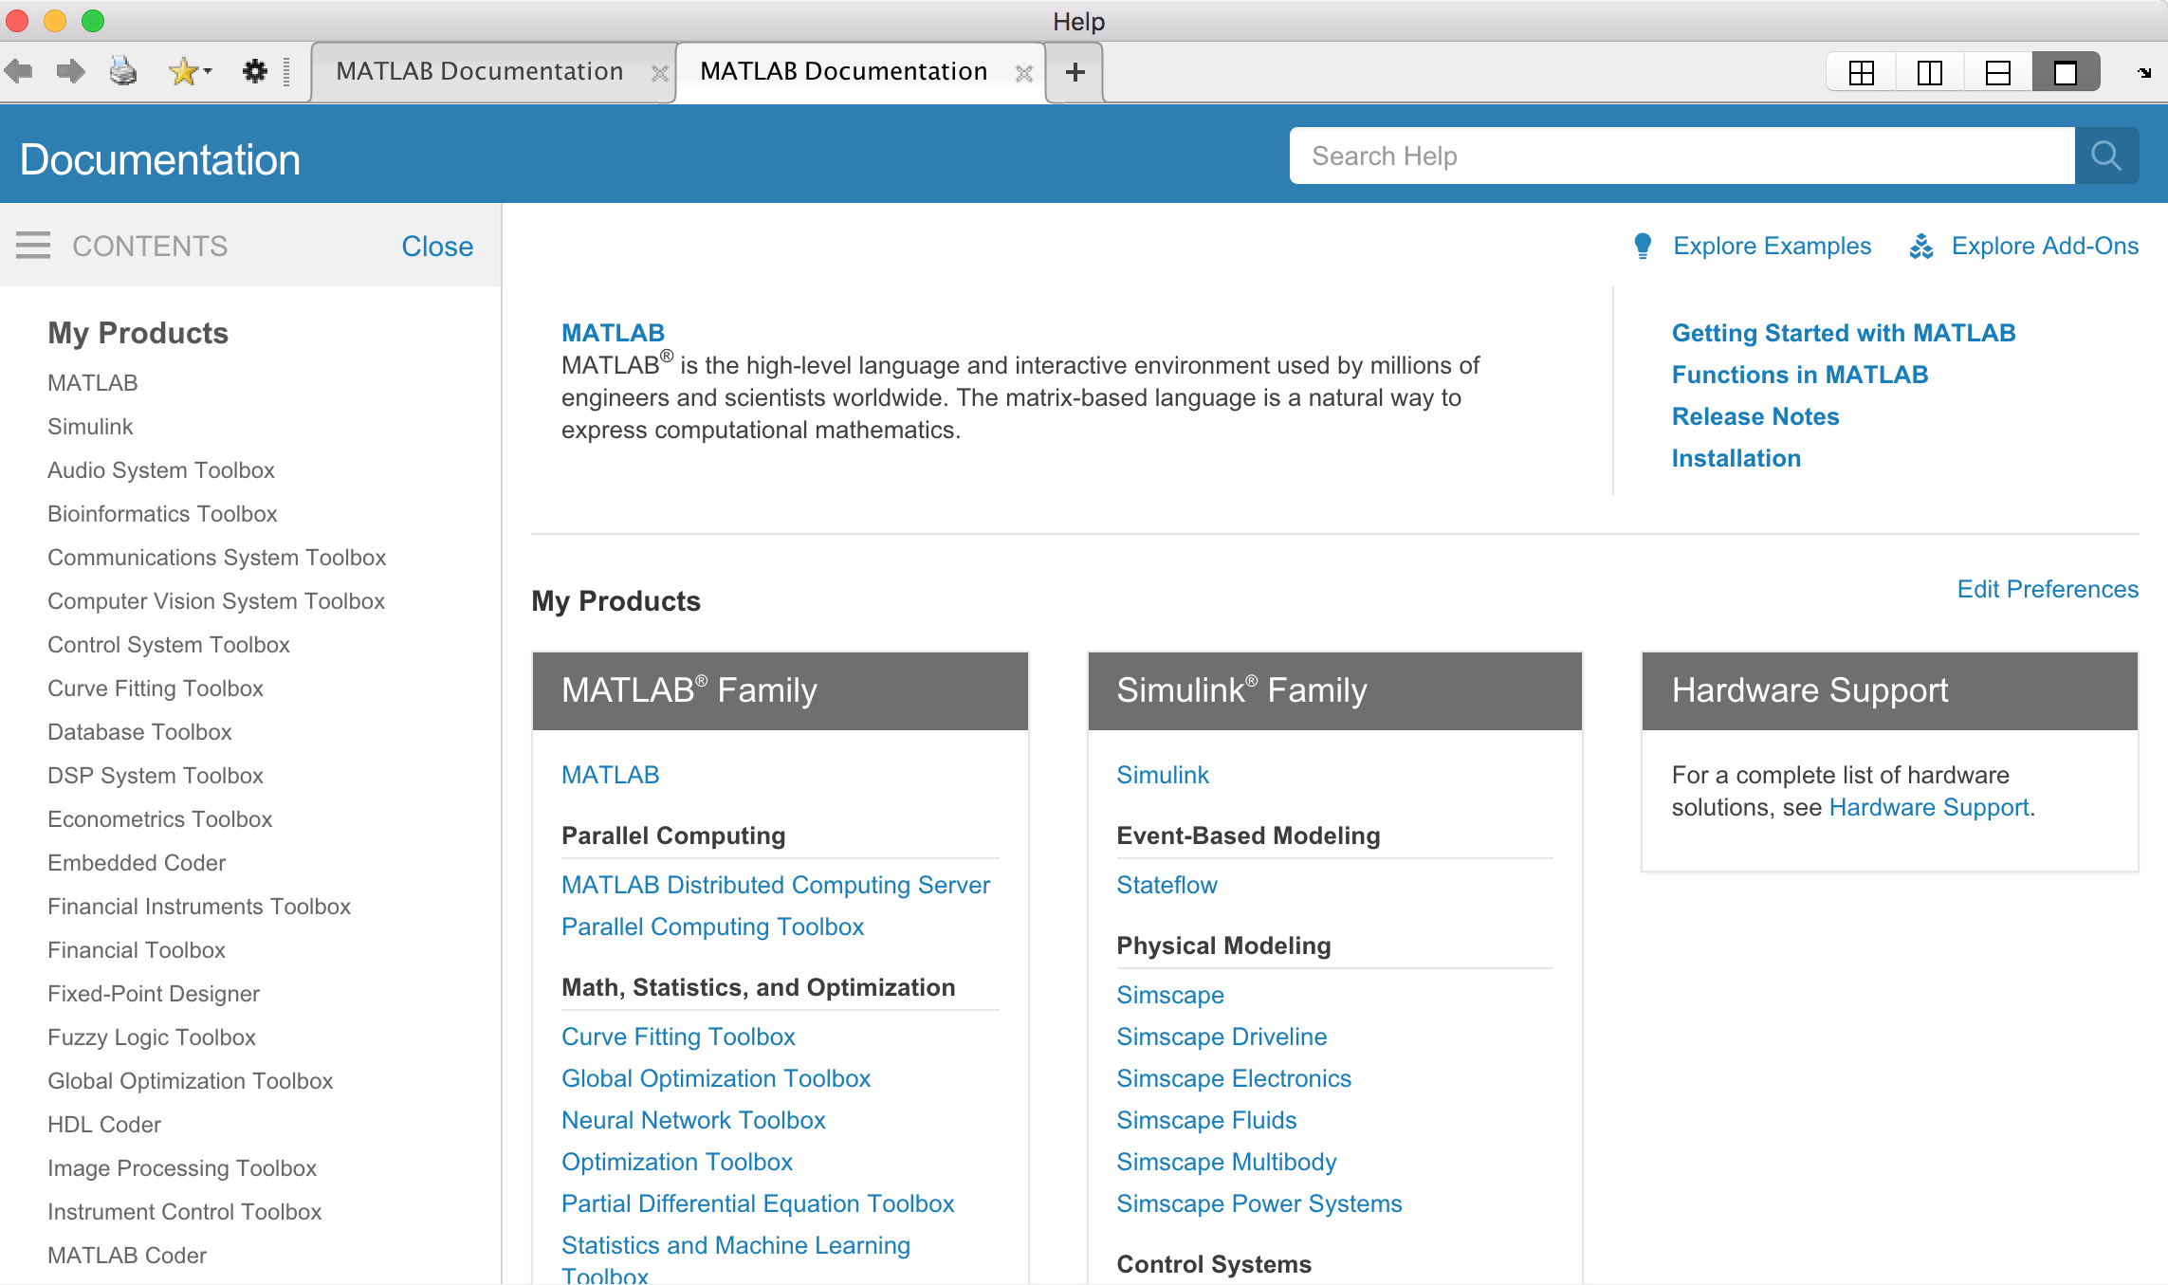
Matlab Help
Notes:
Let’s bring the memory discussion to MATLAB.
Examine the upper left pane on the MATLAB window. Several pieces of memory have been “allocated”, “named” and assigned variables.
We used an “assignment statement” (i= 10;) to assign a “value” to a “variable”.
On some computers (and in some languages) the memory must first be “allocated” before any values can be assigned.
KEY ITEMS TO DISCUSS:
A variable is piece of memory that has been given a name.
A value is the contents with the variable.
THE SCREEN SHOWS:
The screen shows the name of the variable,
The size of the variable (in elements and bytes),
The “class” - what kind of data is stored in the piece of memory

Slide 13
Command window
The MATLAB environment is command oriented somewhat like UNIX. A prompt (>>) appears on the screen and a MATLAB statement can be entered. When the <ENTER> key is pressed, the statement is executed, and another prompt appears.
If a statement is terminated with a semicolon ( ; ), no results will be displayed. Otherwise results will appear before the next prompt.
» a=5;
» b=a/2
b =
2.5000
»

Slide 14
MATLAB Variable Names
Variable names ARE case sensitive
Variable names can contain up to 63 characters (as of MATLAB 6.5 and newer)
Variable names must start with a letter followed by letters, digits, and underscores.

Slide 15
MATLAB Special Variables
ans Default variable name for results
pi Value of π
inf Infinity
NaN Not a number e.g. 0/0
i and j i = j = square root of minus one: (-1) (imaginary number)
e.g. sqrt(-1) ans= 0 + 1.0000i
realmin The smallest usable positive real number
realmax The largest usable positive real number
Notes:
minus
negative

Slide 16
Reserved Words…
Matlab has some special (reserved) words that you may not use, for example, …
for
end
if
while
function
return
elseif
case
otherwise
switch
continue
else
try
catch
global
persistent
break

Slide 17
MATLAB Math Operators
Power ^ or .^ a^b or a.^b
Multiplication * (matrix multiply) or .* (array multiply) a*b or a.*b
Division / or ./ a/b or a./b
or \ or .\ b\a or b.\a
NOTE: 56/8 = 8\56
Addition + a + b
Subtraction - a - b
Assignment = a = b (assign b to a)

Slide 18
Practical Exercise
Type the following expressions into MATLAB at the command window, and observe the results:
  5+2
  5*2
  5/2
  3+2*(4+3)
  2.5*8/5
  6.3-2.104
  3.6^2
  1+2^2
  sqrt(5)
  cos(pi)

Slide 19
MATLAB Relational Operators
MATLAB supports six relational operators.
Less Than <
Less Than or Equal <=
Greater Than >
Greater Than or Equal >=
Equal To ==
Not Equal To ~=

Slide 20
MATLAB Logical Operators
MATLAB supports three logical operators.
not ~ % highest precedence
and & % equal precedence with or
or | % equal precedence with and

Slide 21
Practical Exercise
Type the following expressions into MATLAB at the command window, and observe the results:
  5>2
  5<4
  1.5<=1.5
  2>=pi
  1.8==1.801
  1.8~=2
  1.8==1.80000000000000000000000001 (see what happen)

Slide 22
MATLAB Matrices
MATLAB treats all variables as matrices. For our purposes a matrix can be thought of as an array, in fact, that is how it is stored.
Vectors are special forms of matrices and contain only one row OR one column.
Scalars （標量）are matrices with only one row AND one column

Slide 23
MATLAB Matrices
A matrix with only one row AND one column is a scalar. A scalar can be created in MATLAB as follows:
» a_value=23
a_value =
23

Slide 24
MATLAB Matrices
A matrix with only one row is called a row vector. A row vector can be created in MATLAB as follows (note the commas):
» rowvec = [12 , 14 , 63] or rowvec = [12 14 63]
rowvec =
12 14 63
Notes:
Instructor notes:
A matrix with a single row is called a row vector. Row vectors in Matlab can be created by assigning a variable to a list of individual elements. The elements must be contained within square brackets and can be separated by commas or spaces or both. Matlab is not overly picky about the separators between elements of a given row vector or row within a matrix.
To reemphasize the semicolon as output suppression operator, you might want to point out that putting a semicolon at the end of the line assigning elements to rowvec would have prevented its contents from being displayed.

Slide 25
MATLAB Matrices
A matrix with only one column is called a column vector. A column vector can be created in MATLAB as follows (note the semicolons):
» colvec = [13 ; 45 ; -2]
colvec =
13
45
-2

Slide 26
MATLAB Matrices
A matrix can be created in MATLAB as follows (note the commas AND semicolons):
» matrix = [1 , 2 , 3 ; 4 , 5 ,6 ; 7 , 8 , 9]
matrix =
1 2 3
4 5 6
7 8 9

Slide 27
Extracting a Sub-Matrix
A portion of a matrix can be extracted and stored in a smaller matrix by specifying the names of both matrices, the rows and columns. The syntax is:
sub_matrix = matrix ( r1 : r2 , c1 : c2 ) ;
where r1 and r2 specify the beginning and ending rows and c1 and c2 specify the beginning and ending columns to be extracted to make the new matrix.

Slide 28
MATLAB Matrices
Here we extract column 2 of the matrix and make a column vector:
» col_two=matrix( : , 2)
col_two =
2
5
8
A column vector can be extracted from a matrix. As an example we create a matrix below:
» matrix=[1,2,3;4,5,6;7,8,9]
matrix =
1 2 3
4 5 6
7 8 9

Slide 29
MATLAB Matrices
A row vector can be extracted from a matrix. As an example we create a matrix below:
» matrix=[1,2,3;4,5,6;7,8,9]
matrix =
1 2 3
4 5 6
7 8 9
Here we extract row 2 of the matrix and make a row vector. Note that the 2:2 specifies the second row and the 1:3 specifies which columns of the row.
» rowvec=matrix(2 : 2 , 1 : 3)
rowvec =
4 5 6

Slide 30
Matrices transpose
a vector x = [1 2 5 1]
x =
1 2 5 1
transpose y = x’ y =
1
2
5
1

Slide 31
Scalar - Matrix Addition
» a=3;
» b=[1, 2, 3;4, 5, 6]
b =
1 2 3
4 5 6
» c= b+a % Add a to each element of b
c =
4 5 6
7 8 9

Slide 32
Scalar - Matrix Subtraction
» a=3;
» b=[1, 2, 3;4, 5, 6]
b =
1 2 3
4 5 6
» c = b - a %Subtract a from each element of b
c =
-2 -1 0
1 2 3

Slide 33
Scalar - Matrix Multiplication
» a=3;
» b=[1, 2, 3; 4, 5, 6]
b =
1 2 3
4 5 6
» c = a * b % Multiply each element of b by a
c =
3 6 9
12 15 18

Slide 34
Scalar - Matrix Division
» a=3;
» b=[1, 2, 3; 4, 5, 6]
b =
1 2 3
4 5 6
» c = b / a % Divide each element of b by a
c =
0.3333 0.6667 1.0000
1.3333 1.6667 2.0000

Slide 35
Other operators
[ ] concatenation
( ) subscription
x = [ zeros(1,3) ones(1,2) ]
x =
0 0 0 1 1
x = [ 1 3 5 7 9]
x =
1 3 5 7 9
y = x(2)
y =
3
y = x(2:4)
y =
3 5 7

Slide 36
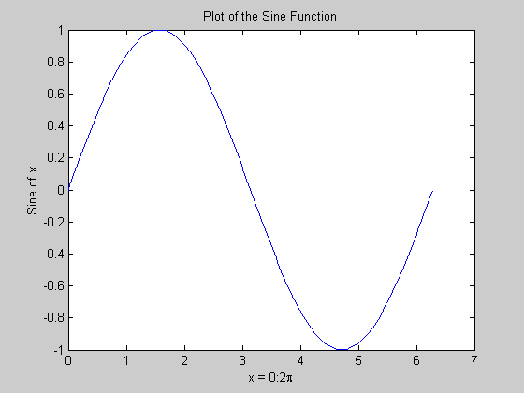
Matlab Graphics
x = 0:pi/100:2*pi;
y = sin(x);
plot(x,y)
xlabel('x = 0:2\pi')
ylabel('Sine of x')
title('Plot of the Sine Function')
Notes:
連續函數和離散函數 continuous, discrete function

Slide 37
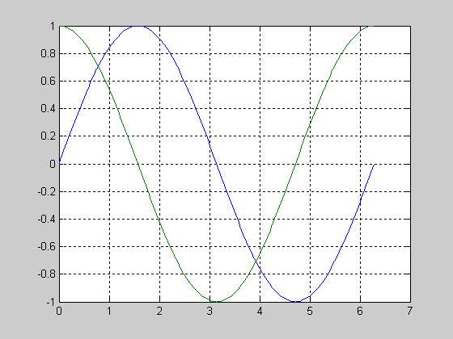
Multiple Graphs
t = 0:pi/100:2*pi;
y1=sin(t);
y2=sin(t+pi/2);
plot(t,y1,t,y2)
grid on

Slide 38
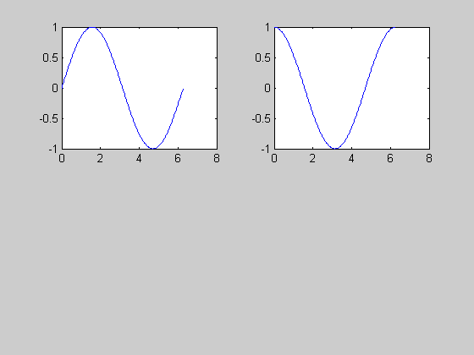
Multiple Plots
t = 0:pi/100:2*pi;
y1=sin(t);
y2=sin(t+pi/2);
subplot(2,2,1)
plot(t,y1)
subplot(2,2,2)
plot(t,y2)

Slide 39
Graph Functions (summary)
plot linear plot
stem discrete plot
grid add grid lines
xlabel add X-axis label
ylabel add Y-axis label
title add graph title
subplot divide figure window
figure create new figure window
pause wait for user response

Slide 40
Some Useful MATLAB commands
who List known variables
whos List known variables plus their size
help >> help sqrt Help on using sqrt
lookfor >> lookfor sqrt Search for keyword sqrt in on
MATLABPATH.
what what ('directory') List MATLAB files in directory
clear Clear all variables from work space
clear x y Clear variables x and y from work space
clc Clear the command window

Slide 41
Some Useful MATLAB commands
dir List all files in current directory
ls Same as dir
type test Display the content of test.m in command
window
delete test Delete test.m
cd a: Change directory to a:
chdir a: Same as cd
pwd Show current directory
which test Display directory path to ‘closest’ test.m

Slide 42
Next lab course
Matrices manipulation
Plots
Image processing
Matlab file (.m) building
More exercises

