Slide 1
Introduction to PHP
(Server side Programming)

Slide 2
List all the news for delete- news2.php
<?php include "conn.php" ?>
<?php
echo "all news are listed below.<br>";
echo "----------------------------------.<br>";
$sql = "select * from news";
$res = @mysqli_query($con,$sql);
if (mysqli_num_rows($res) > 0)
{
while ($dbrow = mysqli_fetch_assoc($res))
{
$id=$dbrow['id'];
$title=$dbrow['title'];
//$content=$dbrow['content'];
$add_time=$dbrow['add_time'];
//$content = str_replace("\r", "<br>", $content);
//$content= str_replace(" ", "&nbsp; ", $content);
echo "ID:". $id;
echo " ";
echo "$title";
echo " ";
echo "<a href='del_news.php?id=$id'><font color='red'>delete</font></a>";
echo "<br>";
}
}
else
{
echo "no data";
}
mysqli_close($con);
?>

Slide 3
Delete the selected news
-Del_news.php
<?php include "conn.php" ?>
<?php
$id=$_GET["id"];
$sql = "delete from news where id=$id";
$res = @mysqli_query($con,$sql);
if($res)
{
?>
<script language=javascript>window.alert('delete successfully!');history.back(1);</script>
<?php
}
?>

Slide 4
Basic Grammar of PHP
- Variables
Store values for future reference, use variable name to refer to the value stored in it
  $x = 42; // store the value 42 in $x
  echo $x; // prints 42
  echo $x+1; // prints 43, value of $x is still 42
  $x = ‘hello!’ // type of $x can change
PHP is a loosely-typed language
  Do not need to declare the type of a variable
  Type can change throughout the program

Slide 5
Basic Grammar of PHP
- Operators
Arithmetic operators
  ! +, -, *, /, % (modulus – remainder after division)
Logical AND (&&), OR (||), NOT (!)
Assignment operators (=)
Shorthand for assignment operators:
    ! $x += $y equivalent to $x = $x + $y
    Also works with subtraction, multiplication, division, modulus, and string concatenation

Slide 6
Basic Grammar of PHP
- Strings
Concatenation of strings – the . operator
  $a = ‘hello’;
  $b = ‘world’;
  echo $a . ‘ ‘ . $b . ‘!’; // prints ‘hello world!’
String functions
    Length: strlen()
    Position of substring: strpos()
    More on string functions:
    http://www.w3schools.com/php/php_ref_string.asp

Slide 7
Basic Grammar of PHP
- Conditional Statements
if (condition / boolean expression)
{ statements }
else if (another condition)
{ statements }
// there may be more than one else if block
else
{ statements }
------------------------------------
Example:
$x = 5;
if ($x == 5)
{ echo ‘The variable x has value 5!’; }

Slide 8
Basic Grammar of PHP
- Loop
$x = 2;
while ($x < 1000) {
echo $x . “\n”; // \n is newline character
$x = $x * $x; }
do { echo $x . “\n”;
$x = $x * $x; }
while ($x < 1000); // note the semicolon
for ($i = 1; $i <= 10; $i++)
{ echo $i . “:” . ($i * $i) . “\n”; }

Slide 9
Basic Grammar of PHP
- Arrays as a list of elements
Use arrays to keep track of a list of elements using the same variable name, identifying each element by its index, starting with 0
  $colors = array(‘red’, ‘blue’, ‘green’, ‘black’, ‘yellow’);
To add an element to the array:
  $colors[] = ‘purple’;
To remove an element from the array:
  unset($colors[2]); $colors = array_values($colors);

Slide 10
Basic Grammar of PHP
- Dealing with forms
Forms are generally used to collect data, whether the data needs to be stored on the server
2 components to a form:
  The HTML generating the form itself
  The server-side script that the form data is sent to (via GET or POST), taking care of the processing involved
    Server should respond appropriately, redirecting the user to the appropriate destination or generating the appropriate page

Slide 11
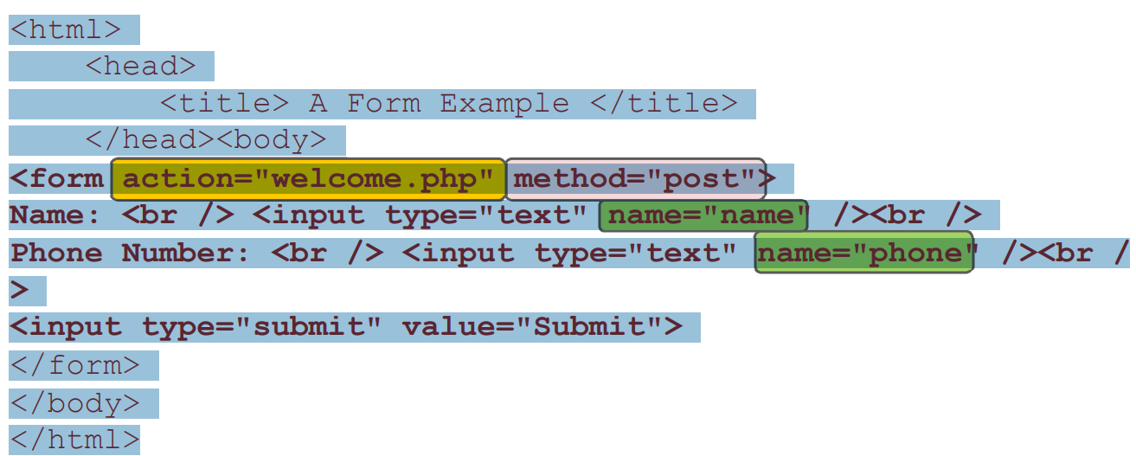
Basic Grammar of PHP
- forms-client side
form action – where to send the form data
method – how to send the data (GET or POST)
Name attributes become the keys used to access the corresponding fields
in the $_GET or $_POST arrays

Slide 12
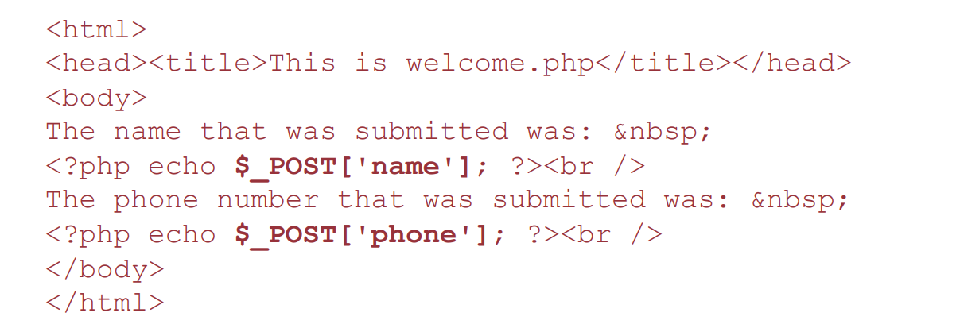
Basic Grammar of PHP
- forms-Server Side
A simple PHP file that displays what was entered into the form
  Can do many other things server-side depending on the situation

