Slide 1
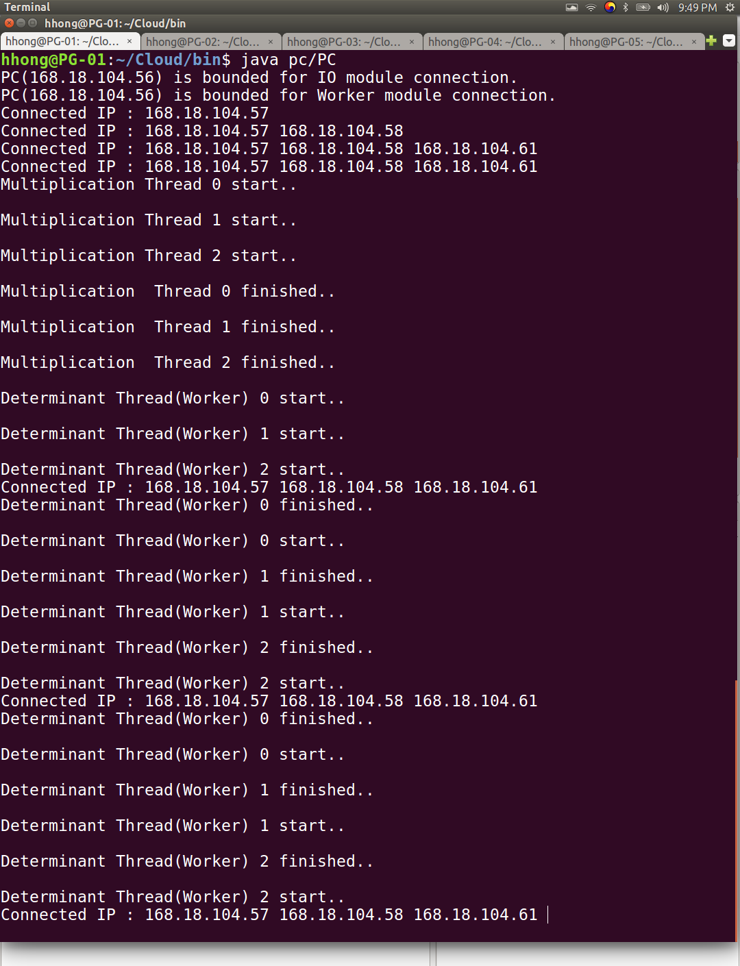
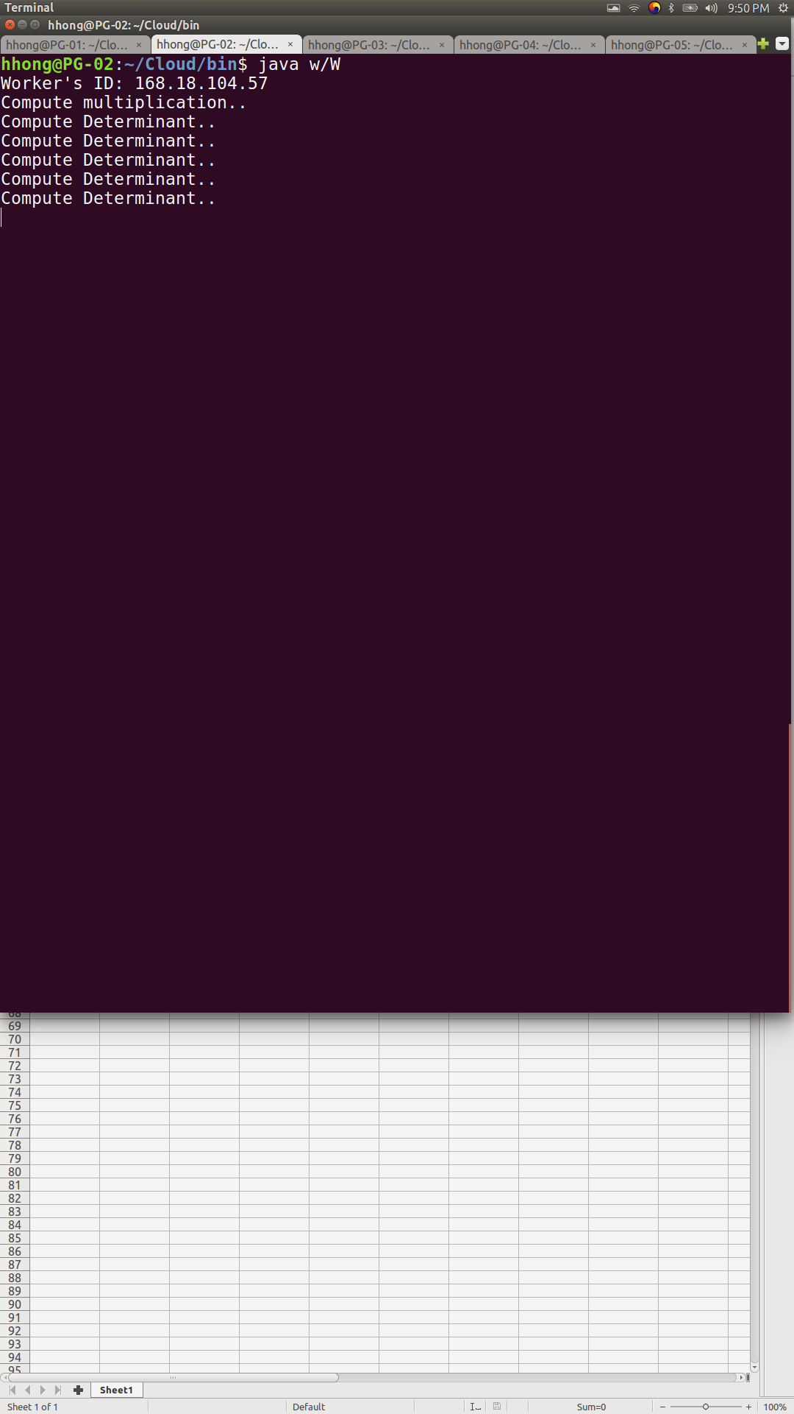
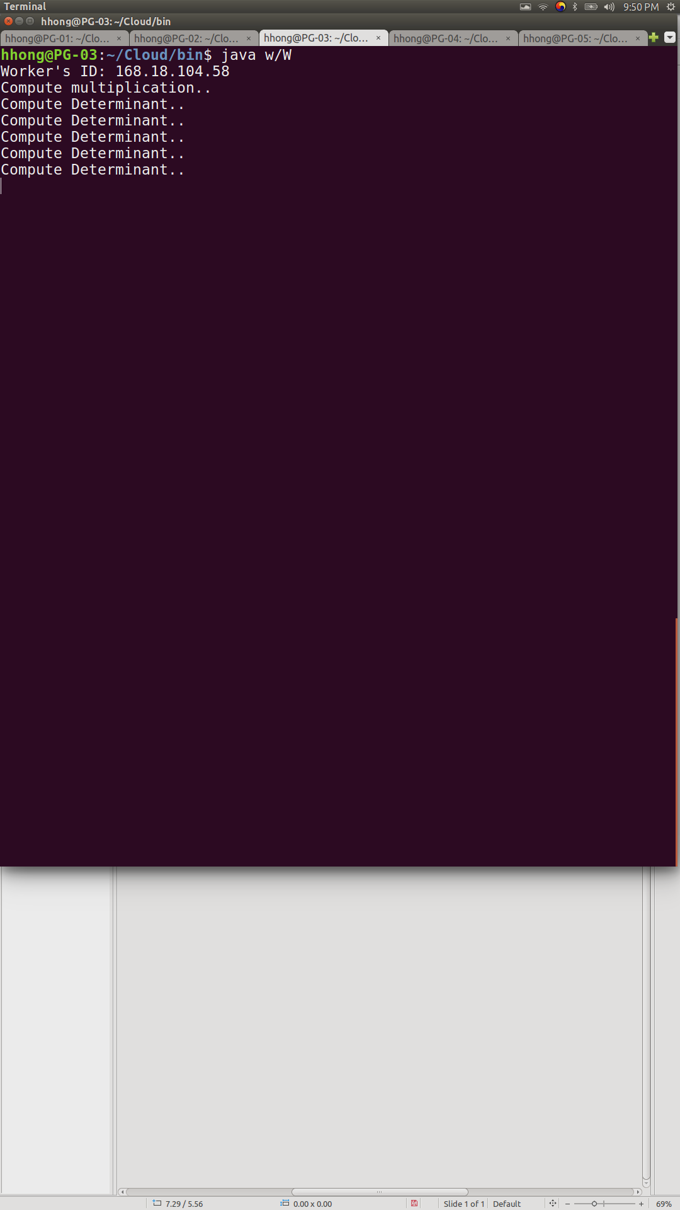
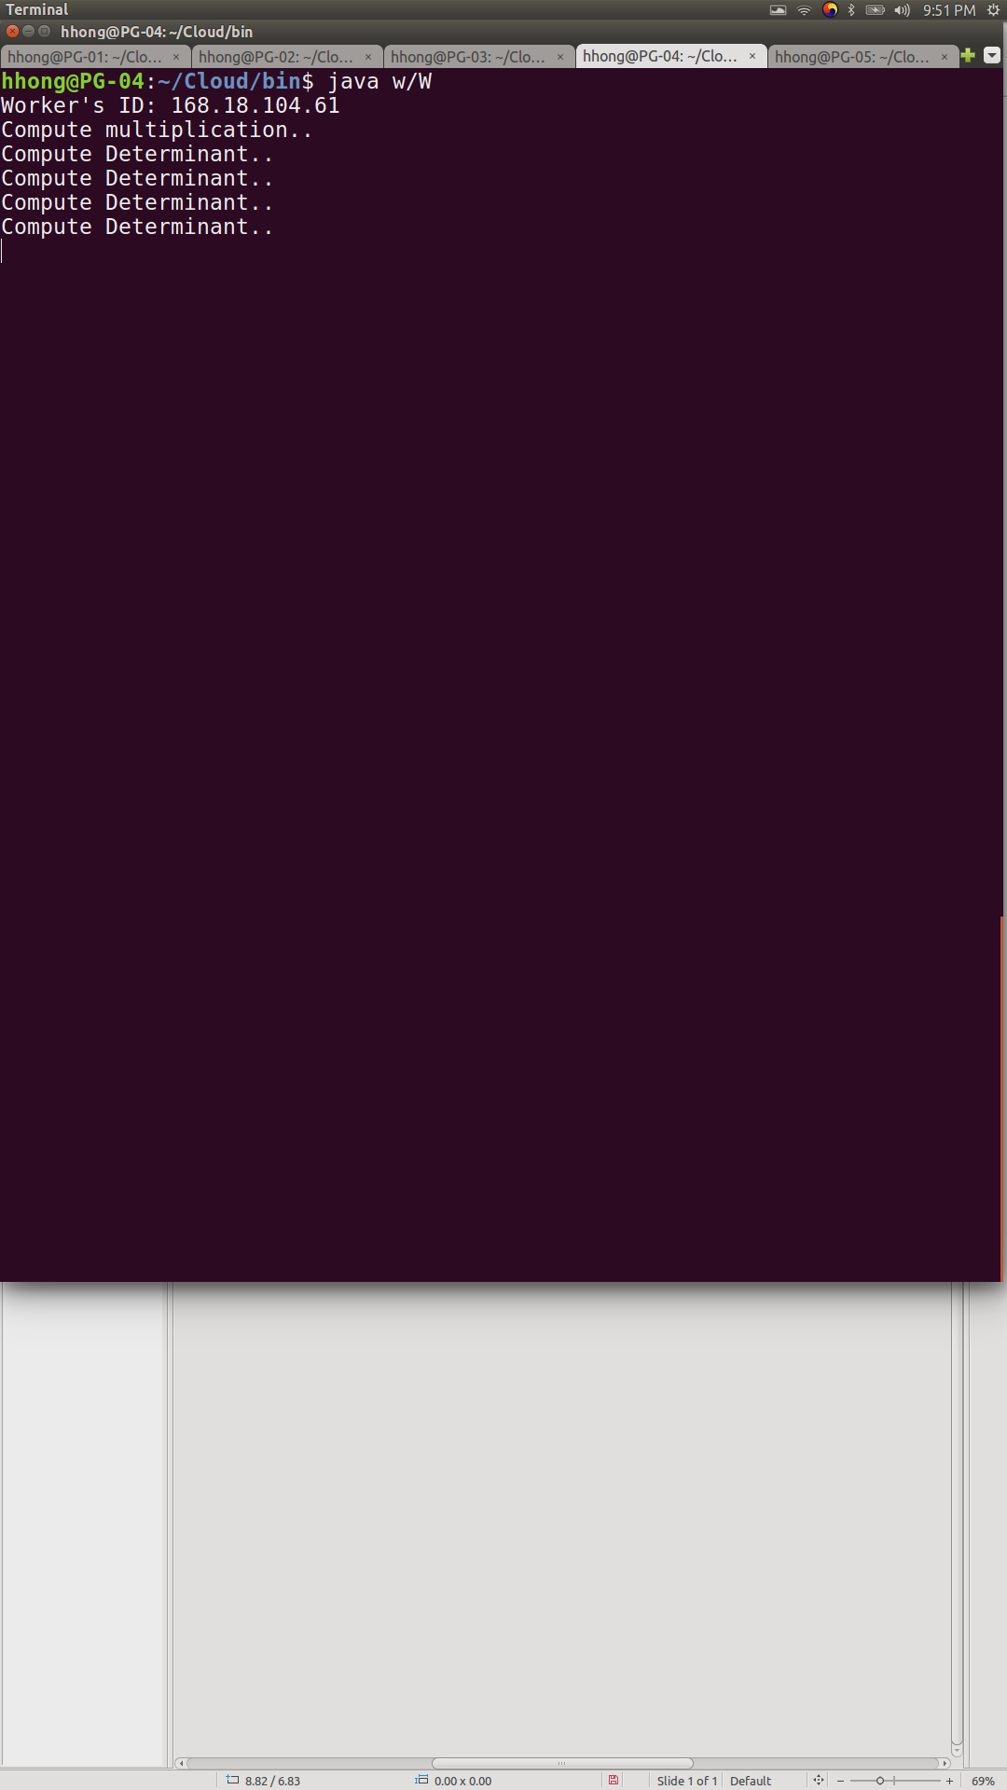
PC side / PG-01
Worker1 / PG-02
Worker2 / PG-03
Worker3 / PG-04

Slide 2
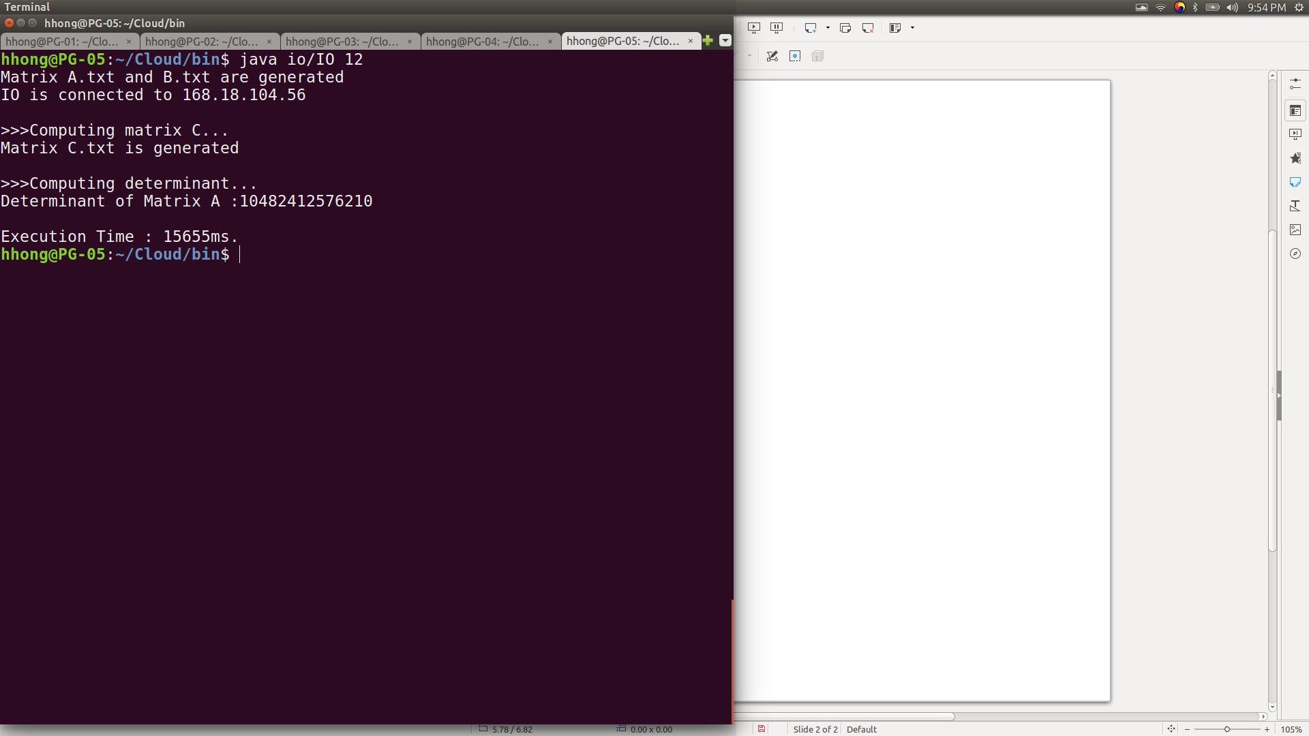
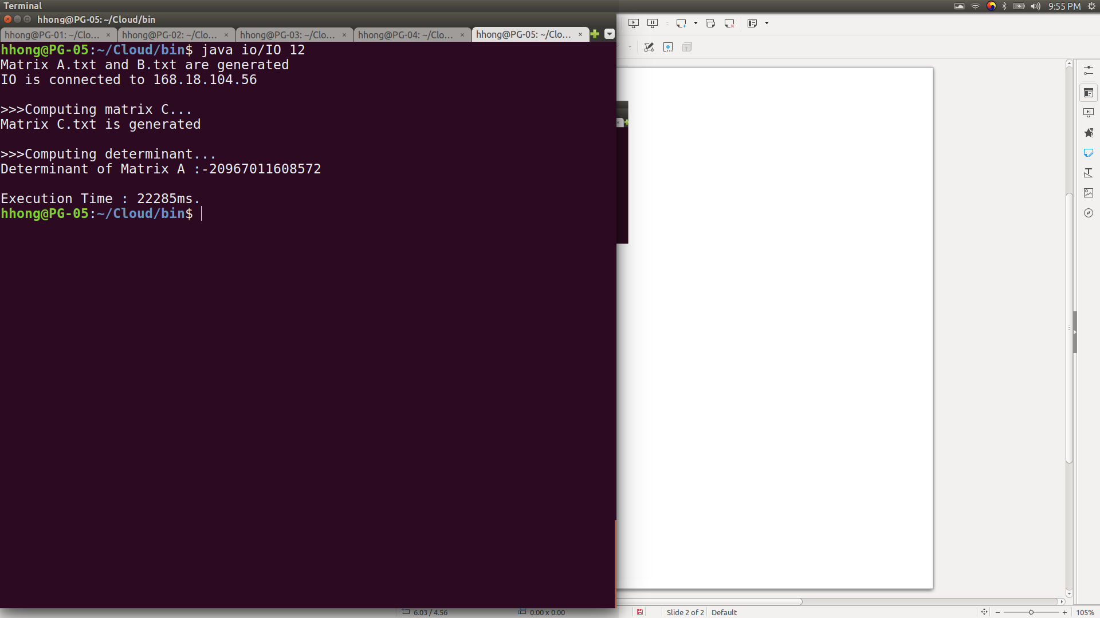
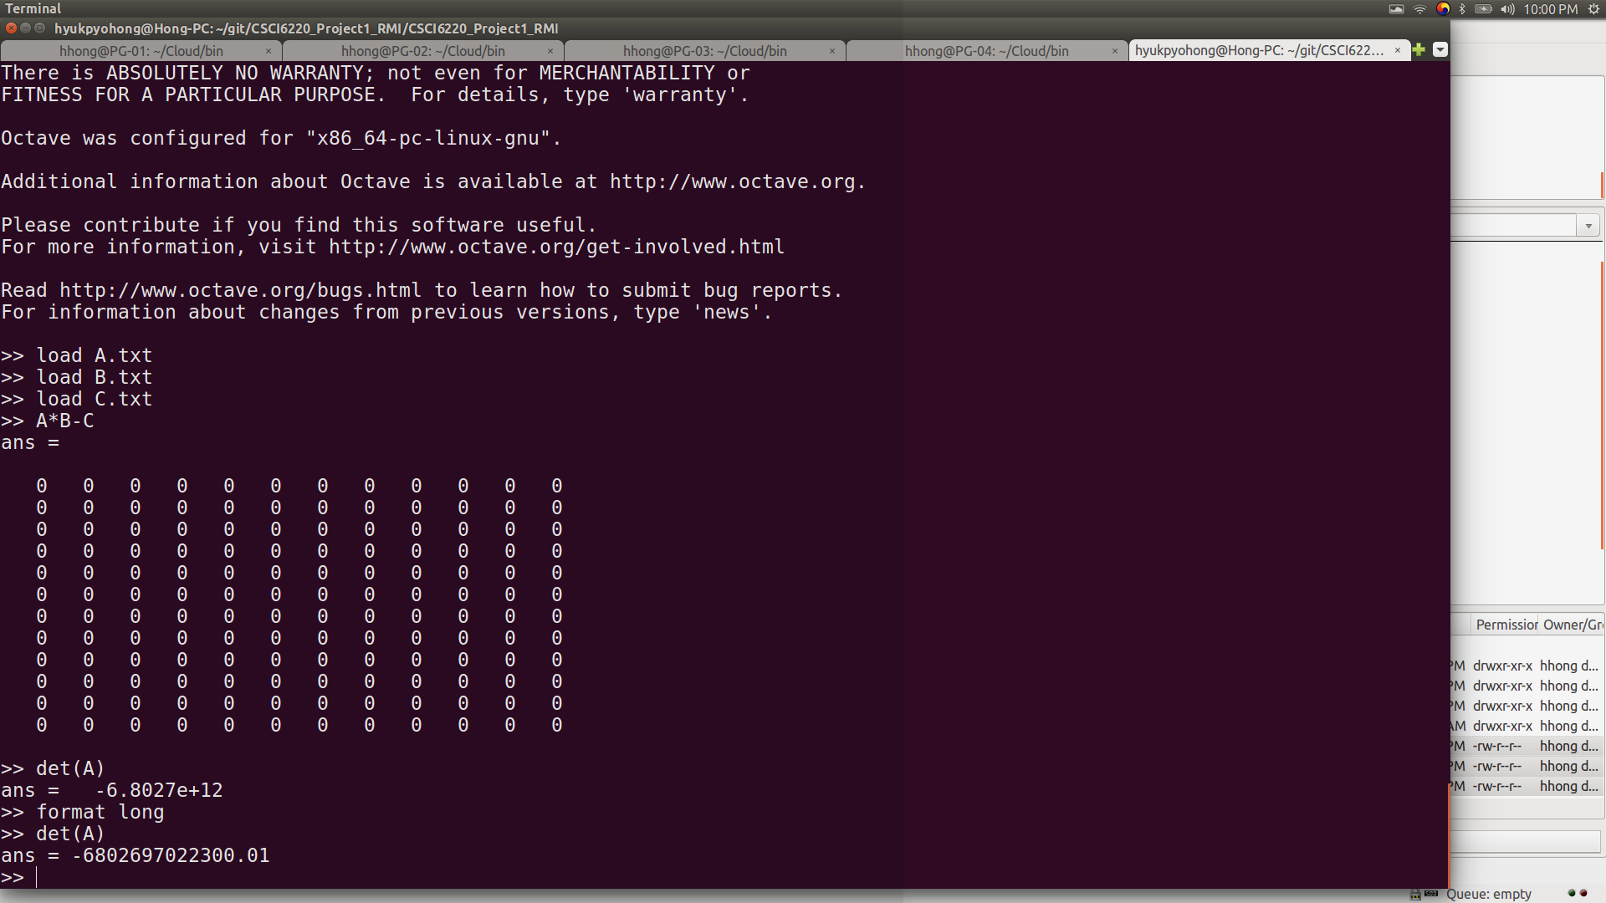
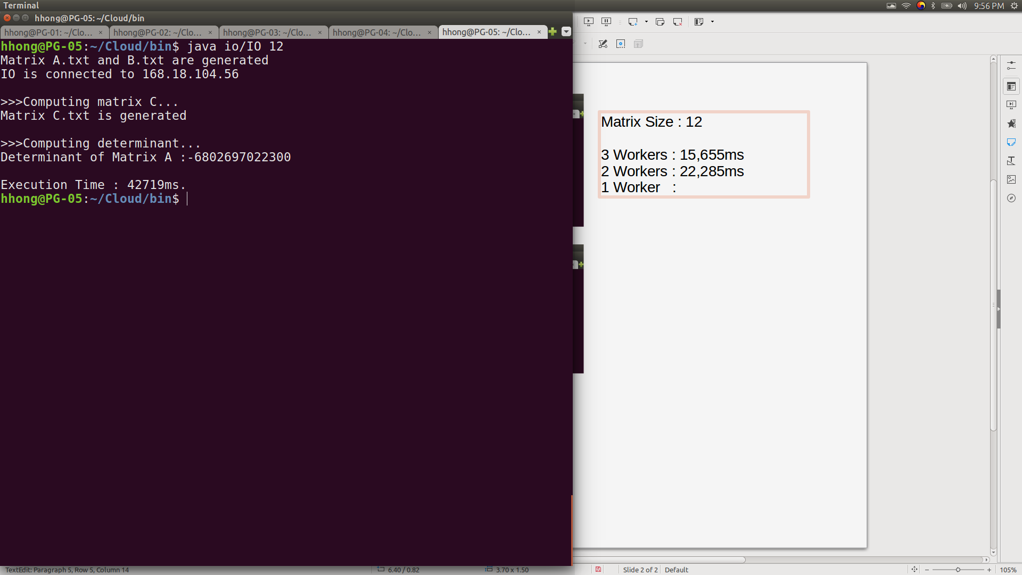
IO / PG-05
Execution time comparison.
Matrix Size : 12
3 Workers : 15,655ms
2 Workers : 22,285ms
1 Worker : 42,719ms
Verify result with octave

