Slide 1


Android Application
Development Plan
Zero ZIKA
Computer Science Department
Hyukpyo Hong

Slide 2
Purpose of the Project
Notification Service(Tip n’ Toss)
when the probability of Virus increased
Provide information about ZIKA Virus

Slide 3





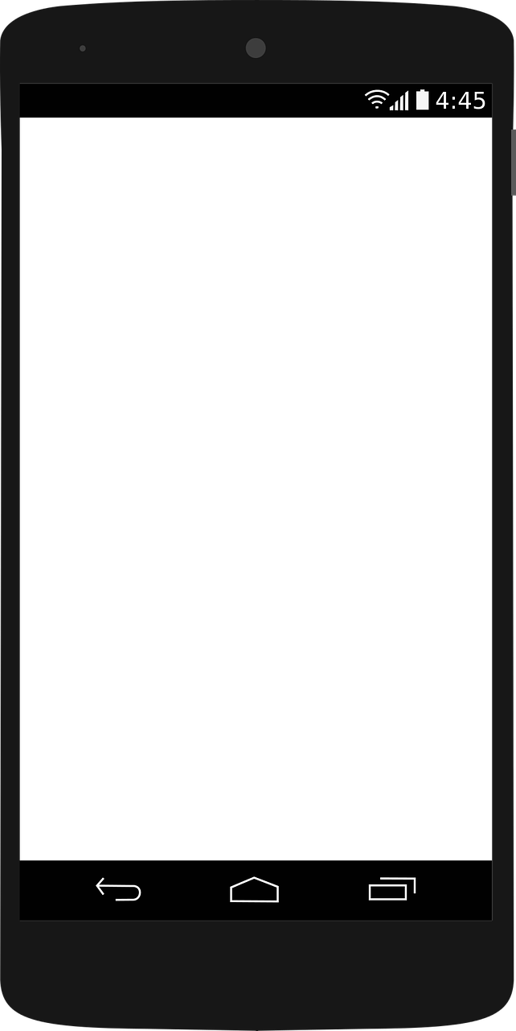

Application Process Flow
3. Address
1. WIFI
3G,4GGPS
2. Location
4. Forecast
(If risk is high)
6. Show Tip n’ Toss
5. Compute Risk

Slide 4

How to compute Risk?
If today is
  April ~ October
  above 50°F
There was rain
  until yesterday
  not today
Risk is High
Show
Tip ‘n toss

Slide 5

Compute Risk – Example 1
D-2
D-1
No
Tip ‘n toss
(It’s still raining)
Today
(Sep.75°F)

Slide 6

Compute Risk – Example 2
D-3
D-2
D-1
Show
Tip ‘n toss
Today
(Sep.82°F)

Slide 7
Compute Risk – Example 3
D-3
D-2
D-1
No
Tip ‘n toss
(It’s too cold)
Today
(Feb.46°F)

Slide 8
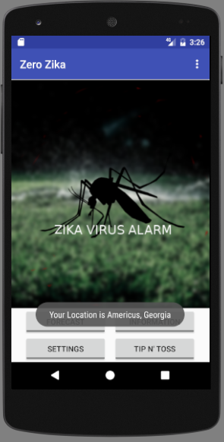
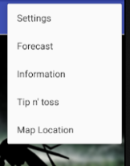

User requirement – Home screen
Navigation
Logo
Buttons
Current
Location
(3sec)
Menu

Slide 9
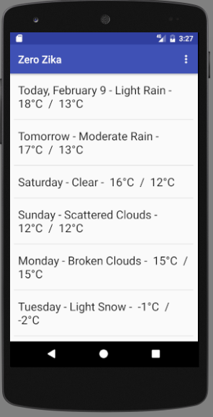
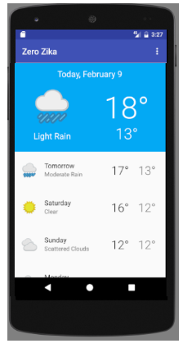
User requirement – Forecast
Forecast for the next 7 days
Temperature
Precipitation
Percentage
(or Symbol)
Current
Plan

Slide 10
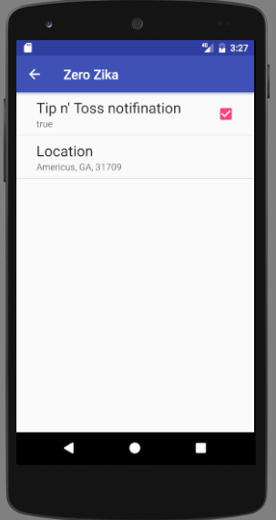
User requirement – Settings
Allow enter area
Allow turn on and off notification

Slide 11
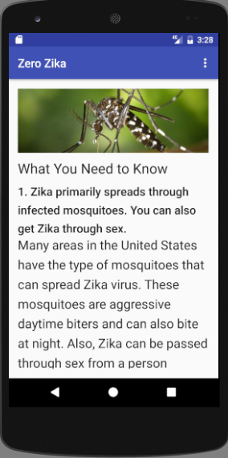
User requirement – Information
Information
about ZIKA
Symptoms, causes of ZIKA, prevention tips, and various stats
(Required)

Slide 12
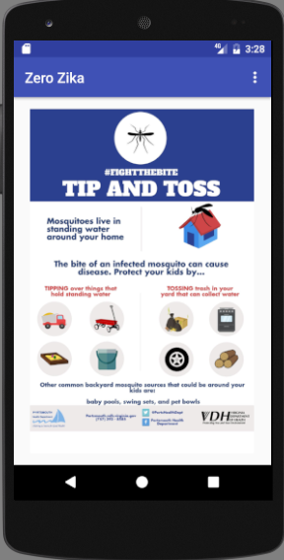
User requirement – Tip n’ Toss
(in app)
Various facts and statistics about the tip and toss campaign
(I need contents).
Example of how to tip n’Toss water

Slide 13
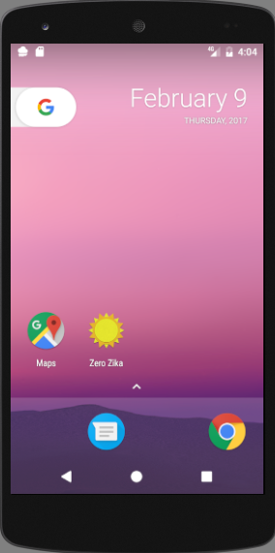
User requirement – Tip n’ Toss
(notification)
I need your description how to show this notification.
[Notification!]
Would you like to
see Tip n’ Toss?
Yes / No

Slide 14
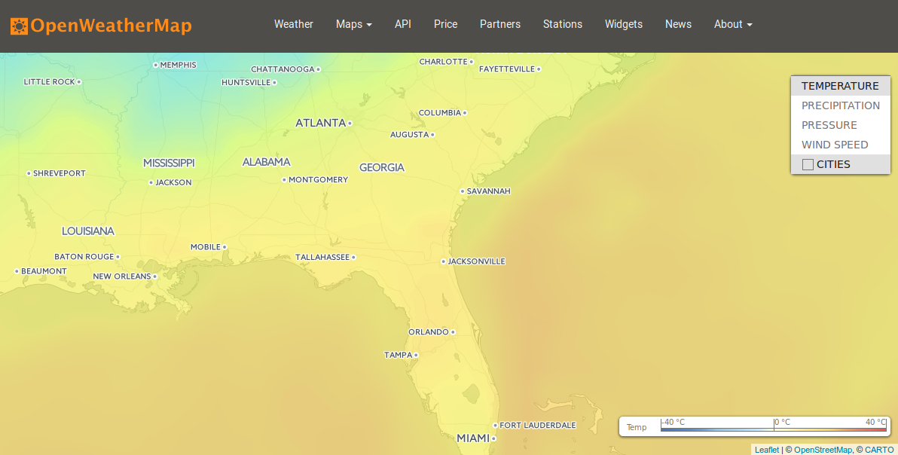
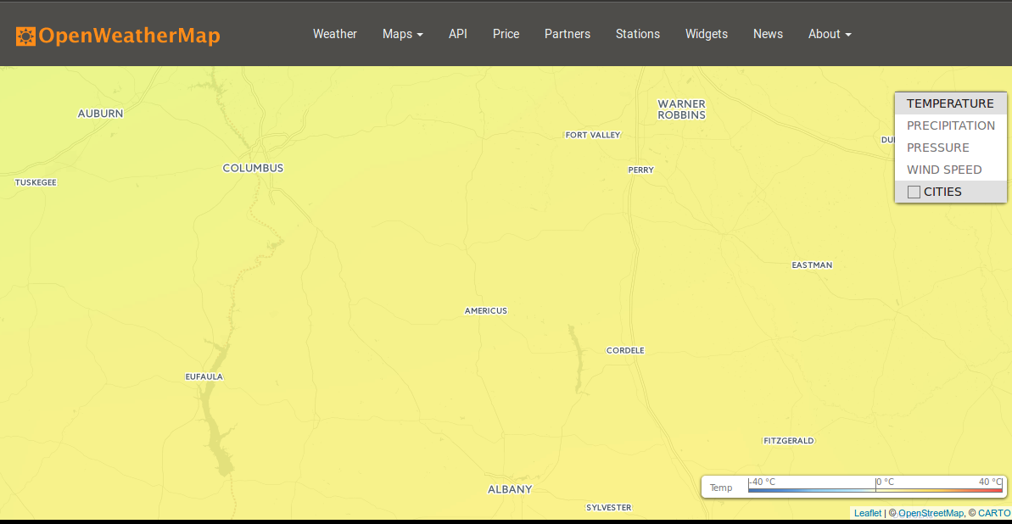
User requirement – Radar map (?)
A few color
variations in US.
Hard to
recognize difference
in small region.
Looks like not so useful.

Slide 15
Further request
Contents of Information section
Contents of Tip ‘n Toss section
Decision for radar map
What to show on notification message

Slide 16
Tentative Plan
Stable reception of location and forecast
~2/28
Input information / Tip ’n toss section
~3/7
Setting activation
~3/14
Make notification function
~3/31
Decorate / Test
~4/15

Slide 17
End

