Slide 1


Android Application
Development Plan
Zero ZIKA
Computer Science Department
Hyukpyo Hong

Slide 2
Purpose of the Project
Notify when Zika Virus risk is high
Provide information about ZIKA Virus
Make Mobile Application

Slide 3





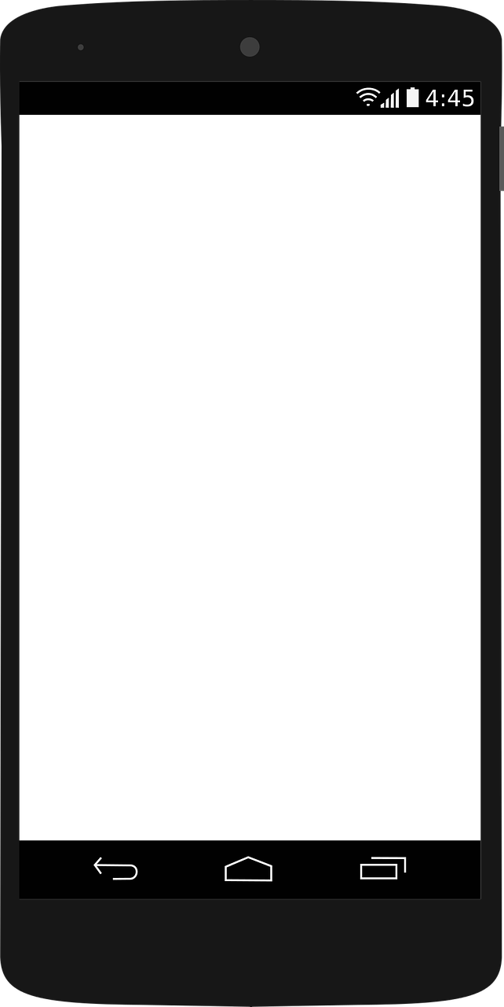

Application Process Flow
3. Address
1. WIFI
3G,4GGPS
2. Location
4. Forecast
(If risk is high)
6. Show Alarm
5. Compute Risk

Slide 4

How to compute Risk?
If today is
  April ~ October
  above 50°F
There was rain
  until yesterday
  not today
Risk is High
Show
Tip ‘n toss

Slide 5

Compute Risk – Example 1
D-2
D-1
No
Tip ‘n toss
(It’s still raining)
Today
(Sep.75°F)

Slide 6

Compute Risk – Example 2
D-3
D-2
D-1
Show
Tip ‘n toss
Today
(Sep.82°F)

Slide 7
Compute Risk – Example 3
D-3
D-2
D-1
No
Tip ‘n toss
(It’s too cold)
Today
(Feb.46°F)

Slide 8
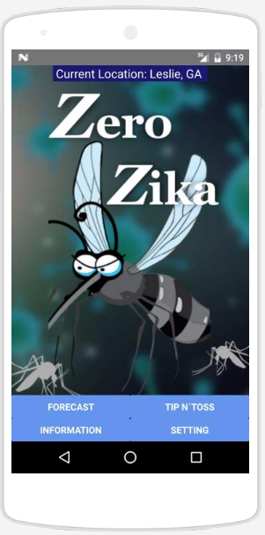
User requirement – Home screen
Current
Location
Forecast TipNToss
Information Setting

Slide 9
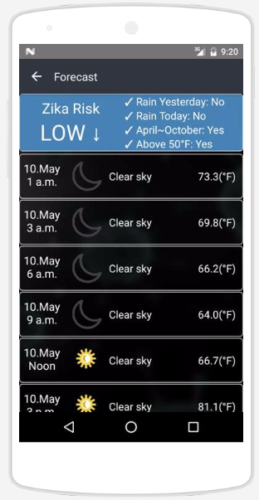
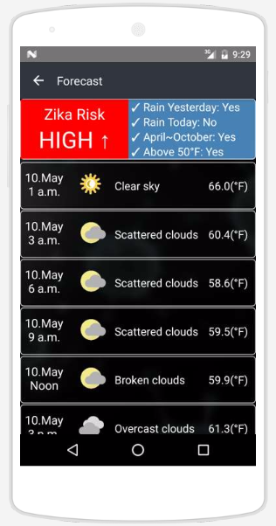
User requirement – Forecast
Forecast for the next 6 days
Show Zika Risk
  - Rain Today
  - Rain Yesterday
  - April ~ October
  - Above 50F

Slide 10
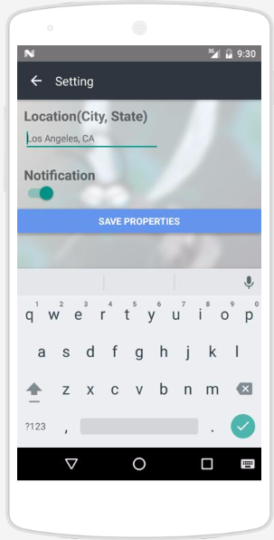
User requirement – Settings
Update Area
Turn on and off notification

Slide 11
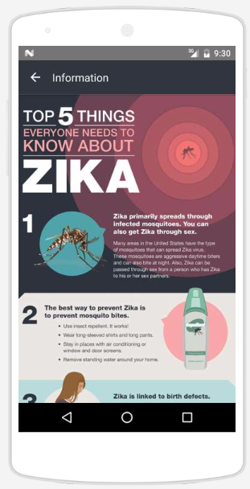
User requirement – Information
Information
about ZIKA

Slide 12
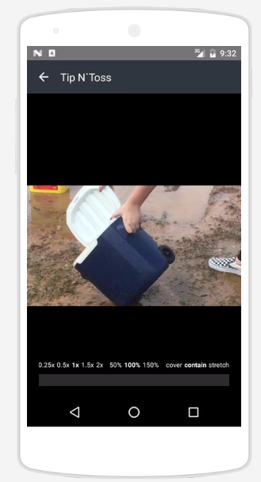
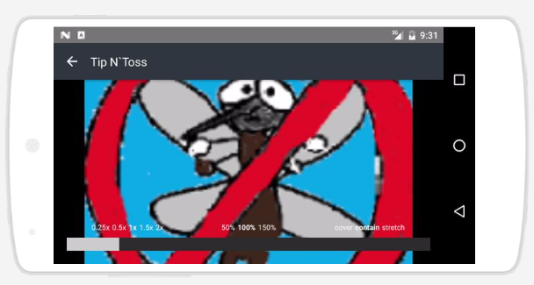
User requirement – Tip n’ Toss
Tip n’ Toss Video

Slide 13
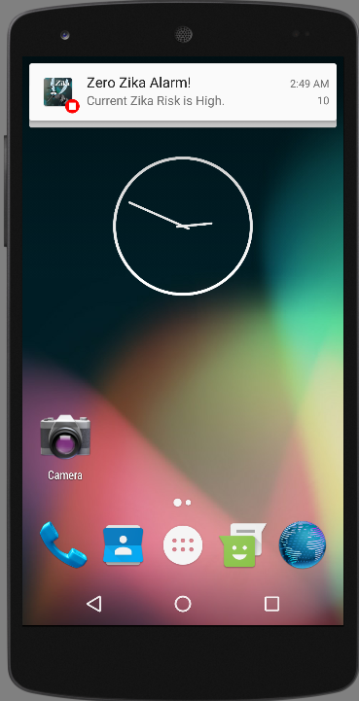
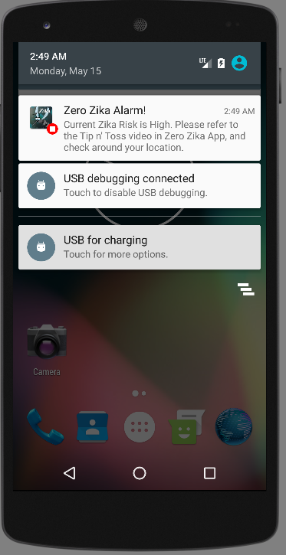
User requirement – Notification

Slide 14
End

