Slide 1
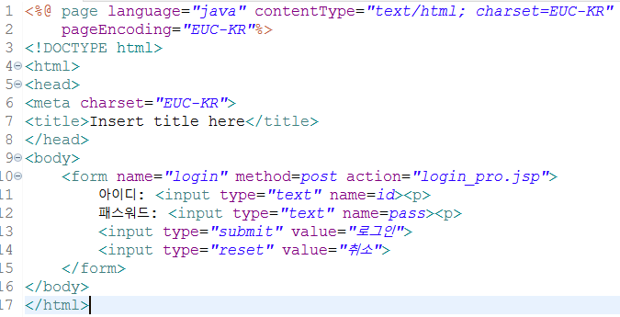
Login.jsp

Slide 2
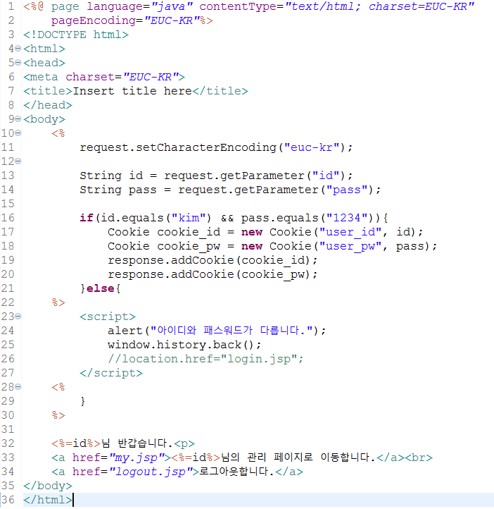
Login_pro.jsp

Slide 3
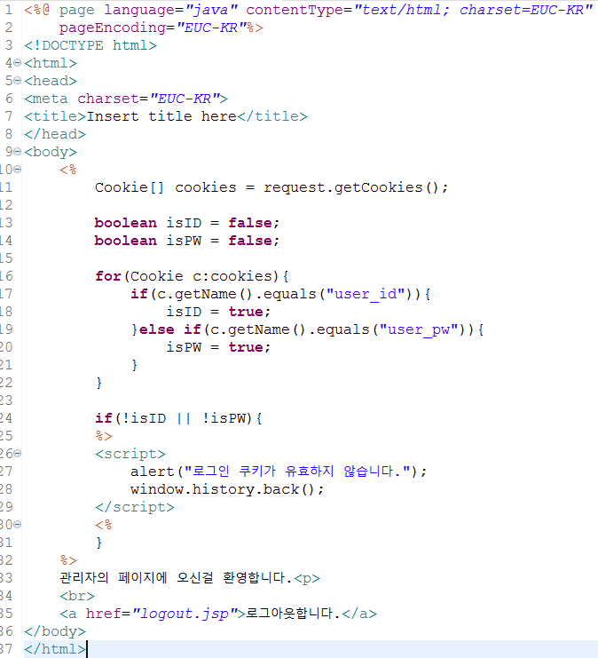
my.jsp

Slide 4
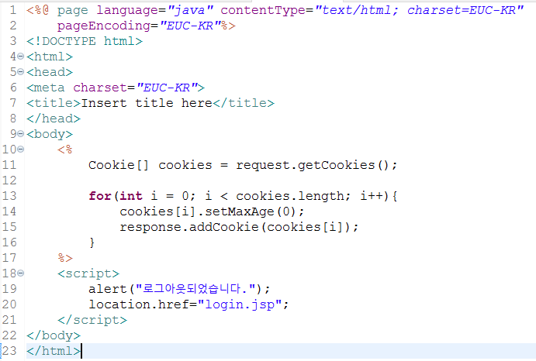
Logout.jsp

Slide 5
