Slide 1
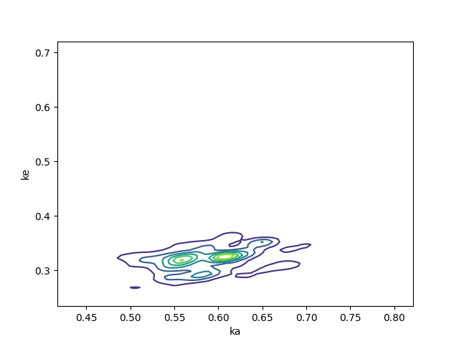
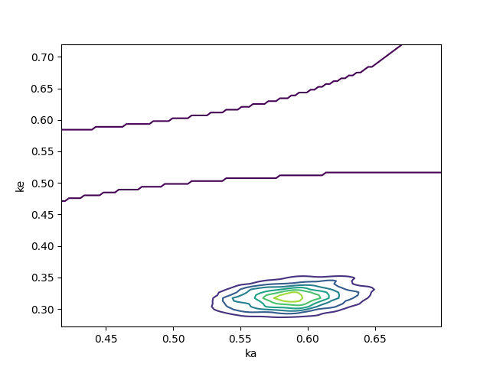
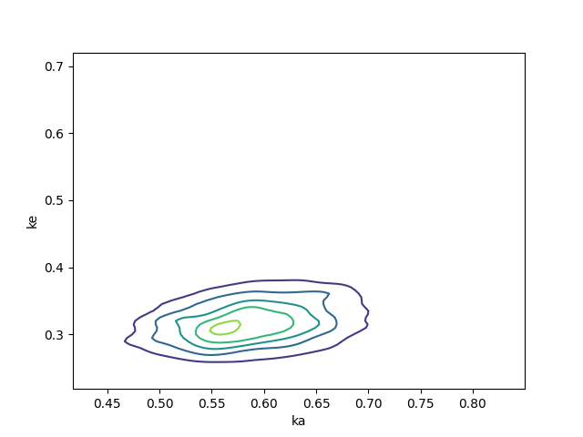
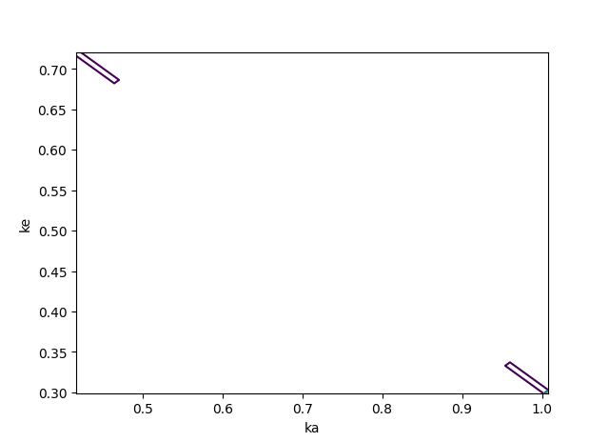
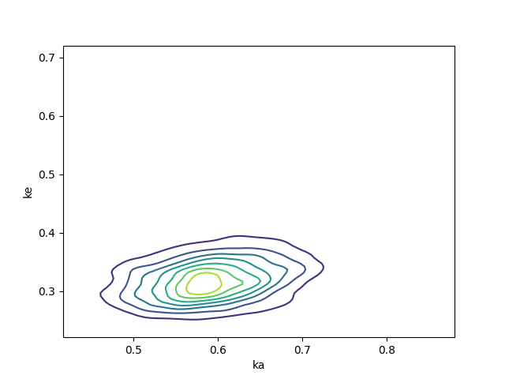
Complex Systems 2024 Sommer
4. Assignment Homework 3 b) i)
Petko Antonov
Hyunchang Oh
Contour Plot
With different parameters for proposal distribution
(proposal, likelihood)
1, 10
0.1, 5
0.1, 10
0.1, 20
0.05, 10
Changing the Proposal parameter: (0.05, 0.1, 1)
Smaller values result in a more ‘centered’ contour plot, while larger values result in a more ‘dispersed’ plot. Proposal parameter is the standard deviation of the distribution from which the proposed ka and ke are drawn, so increasing this parameter will result in a bigger ‘jump’ for each proposal.
Changing the Likelihood parameter: (5,10,20)
The likelihood parameter is the standard deviation of the normal probability density function used for calculating the likelihood of the proposed parameters. Increasing this parameter will result in a wider, more spread-out contour plots, which is not a surprise.

Slide 2
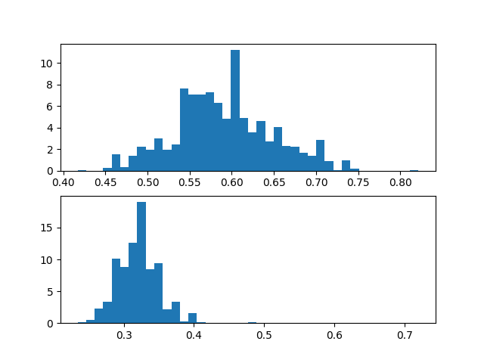
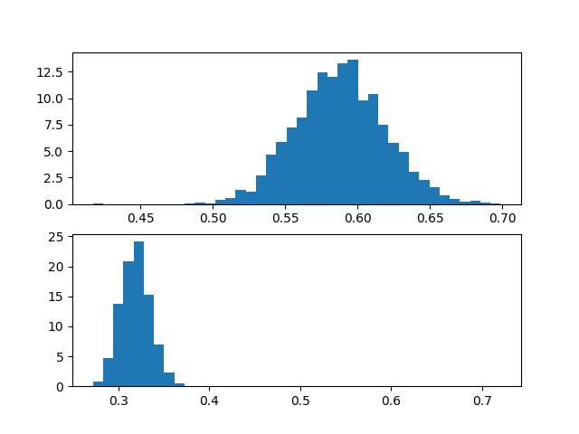
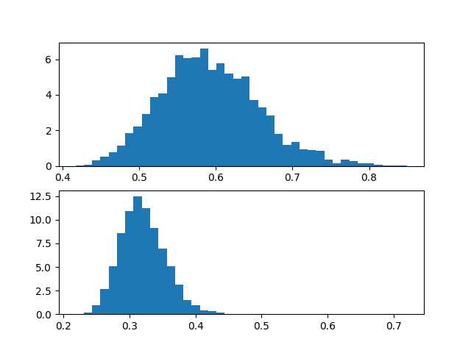
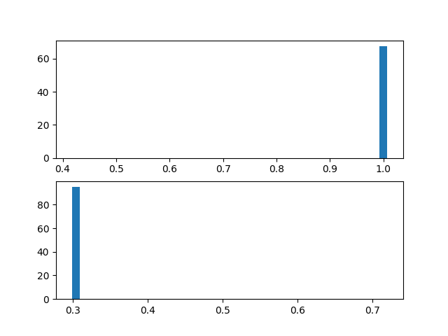
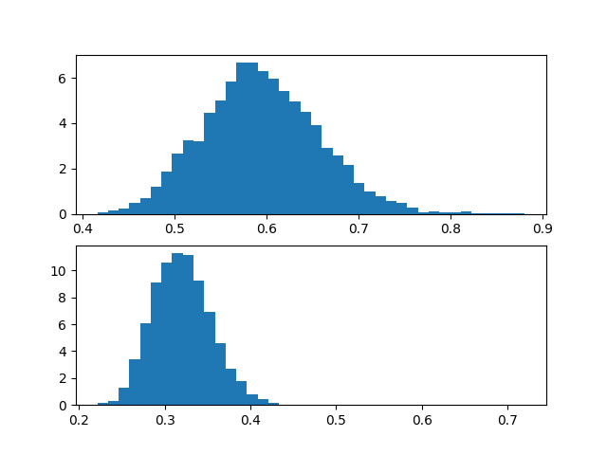
Complex Systems 2024 Sommer
4. Assignment Homework 3 b) ii)
Histogram of derived parameter estimates
With different parameters for proposal distribution
(proposal, likelihood)
1, 10
0.1, 5
0.1, 10
0.1, 20
0.05, 10
Changing the Proposal parameter: (0.05, 0.1, 1)
This reaffirms the claims made from the contour plots to a certain degree. The heaps (or the curve) are smoother with smaller parameters and more spikey with larger parameters, which suggest that these irregular spikes are results from the big jumps made from the large standard deviation of the proposal distribution.
Changing the Likelihood parameter: (5,10,20)
Similarly with contour plots, the distribution of the parameters are more spread-out with larger parameters.

