Slide 1
Words OF HIPHOP
손형철

Slide 2
목차
1.공통 코딩내역
2.(1)WordCloud
3.(2)GGPLOT PIE GRAPH
4.(3)GGPLOT BAR GRAPH

Slide 3
공통 코딩내역(P)
install.packages("KoNLP")
install.packages("wordcloud")
install.packages("RColorBrewer")
install.packages("ggwordcloud")
install.packages("tm")
install.packages("stringr")
install.packages("ggplot2")
library(dplyr)
library(stringr)
library(tm)
library(wordcloud)
library(ggplot2)
library(RColorBrewer)
setwd("D:/workspace/R_Data_Analysis/Part2")
txt<-readLines("hiphop.txt")
head(txt)
txt<-stringr::str_replace_all(txt, "\\\"," ")
txt
txt<- stringr::str_replace_all(txt,"[^[:alpha:]]"," ")
nouns <-sapply(txt,extractNoun,USE.NAMES = F)
wordcount <- table(unlist(nouns))
df_word <- as.data.frame(wordcount, stringsAsFactors = F)
names(df_word)
df_word <- dplyr::rename(df_word,word = Var1,freq = Freq)
df_word
df_word <- dplyr::filter(df_word, nchar(word)>=2)
df_word
top_10 <- df_word %>%
dplyr::arrange(desc(freq)) %>%
head(10)
top_10

Slide 4
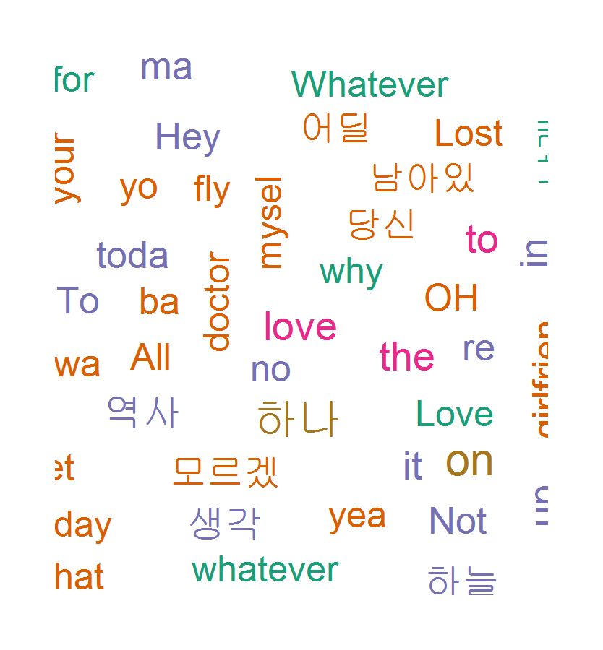
(1)WordCloud
P+wordcloud(words = df_word$word, freq=df_word$freq, min.freq = 10, random.color = F, rot.per = .1, scale = c(4,03), colors=pal)
*최빈도 일수록 중앙에 배치되도록 함

Slide 5
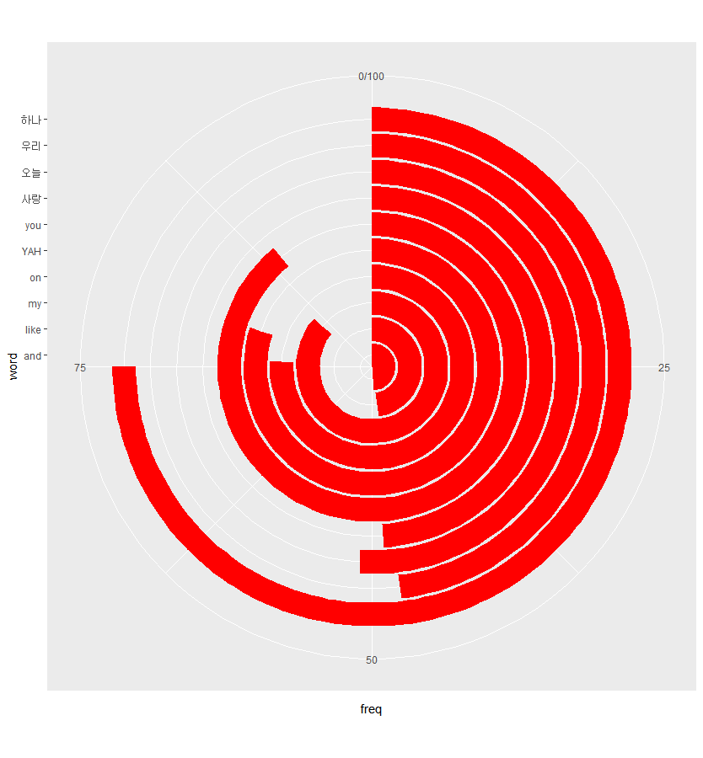
(2)GGPLOT PIE GRAPH
P+
>order <- arrange(top_10, freq)$word
>ggplot(data = top_10, aes(x = word, y = freq))+ylim(0, 100)+geom_col(stat="identity",fill="red")+coord_polar(theta="y")

Slide 6
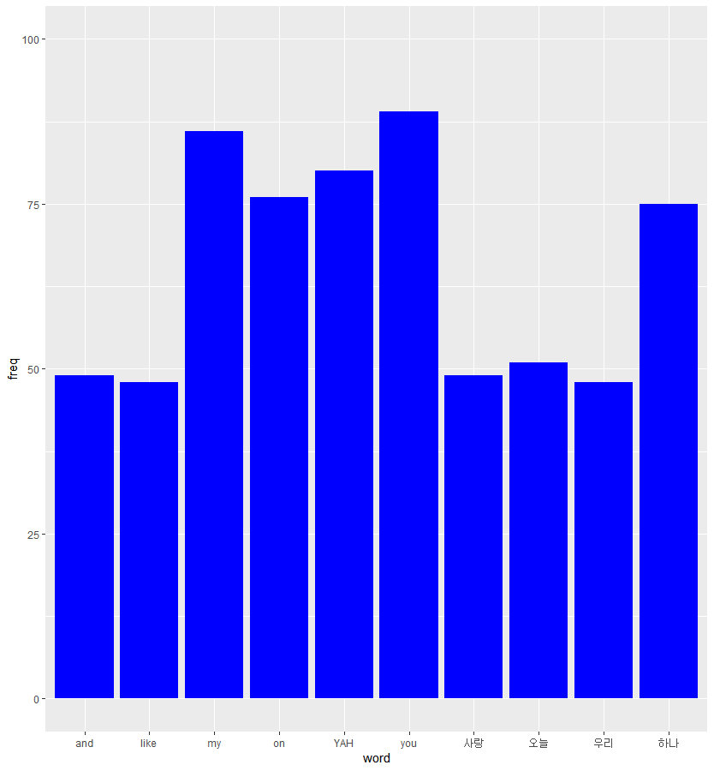
(3)GGPLOT BAR GRAPH
P+
>order <- arrange(top_10, freq)$word
>ggplot(data = top_10, aes(x = word, y = freq))+ylim(0, 100)+geom_col(stat="identity",fill="blue")

