Slide 1
Time series forecasting using CNN architecture
120170181 최현근
서강대학교 전자공학과

Slide 2
Content
Introduction
Proposed model
Results & Conclusion
CNN based forecasting
Purpose
Data Preprocessing
DenseNet
Proposed Model

Slide 3
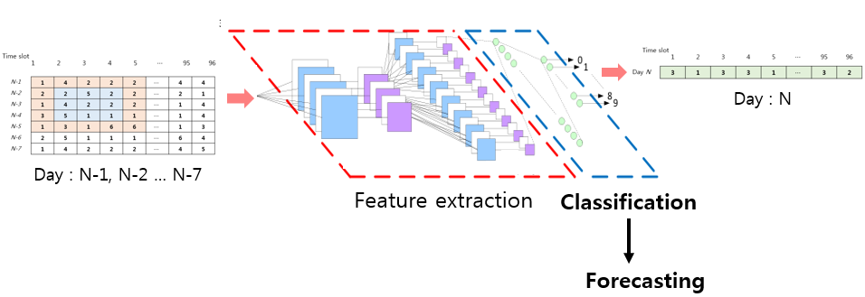
Introduction
Introduction
CNN 기반의 수요 예측
시계열 데이터인 전력사용량 데이터를 CNN 구조를 이용하여 예측을 하는 알고리즘 .
Motive
CNN 경우 이미지를 입력 데이터로 사용하여 classification, segmentation 등의 연구는 많았지만, 시계열 데이터를 이용한 예측에 관한 연구는 많지 않았음.
전력데이터는 시계열 데이터이지만 하루 단위, 일주일 단위 또는 계절별 단위로 그 주기성이 뚜렷하므로 이를 이미지화하여 locality를 유지하면서 CNN을 이용해 예측을 진행해도 그 성능이 좋을 것으로 예상됨.

Slide 4
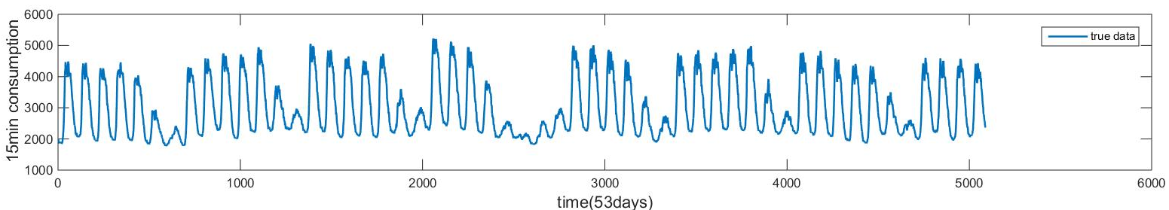
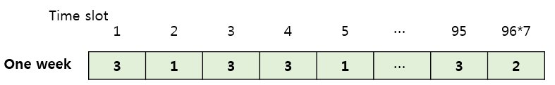
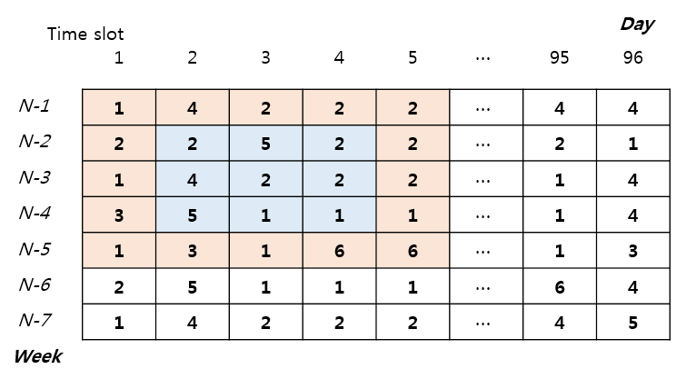
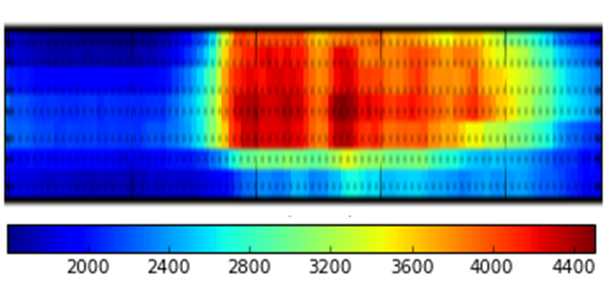
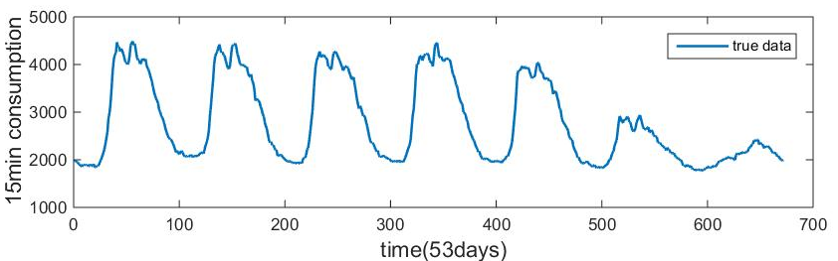
Proposed Model
Data Preprocessing
이상 값 보정, normalization, data augmentation, image transformation
Image transformation
시계열 전력 데이터를 이미지 형태로 바꾸어 진행.

Slide 5
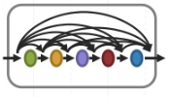

Proposed Model : DenseNet
DenseNet
Dense Block1
Dense Block2
Dense Block3
BN-ReLU-Conv
BN-ReLU-Conv
Pooling
Pooling
Pooling
Pooling
Linear
Output
Conv
Transition layer1
Transition layer2
Global average Pooling

Slide 6
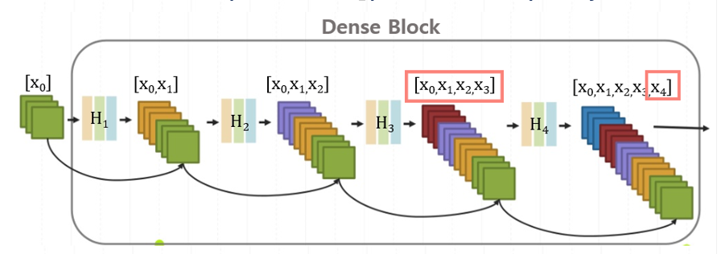
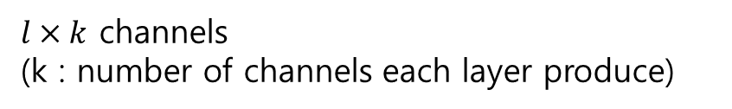
Proposed Model : DenseNet
Dense Block
Composite Layer
x₄= H₄ ([x₀ , x₁, x₂, x ₃ ])
For each layer the feature-maps of all preceding layers are used as inputs and its own feature-maps are used as inputs into all subsequent layers
H_{l}(∙) : composite function
[x₀ , x₁, … x _{l-1} ] : concatenation of the feature maps
produced in layers 0… l-1
x_{l}= H_{l} ( [x₀ , x₁, … x _{l-1} ] )
$l×k$ channels
(k : number of channels each layer produce)

Slide 7
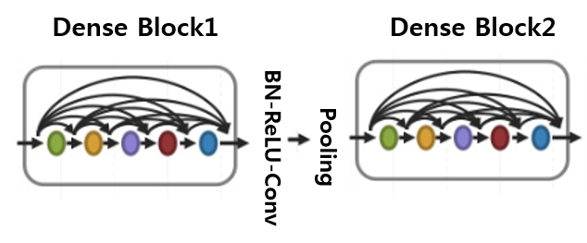
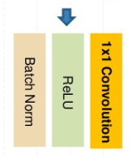
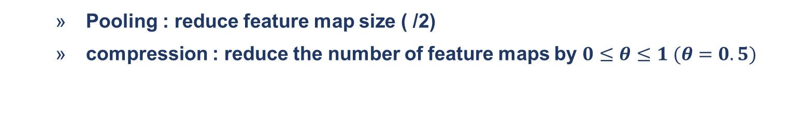
Proposed Model : DenseNet
Transition layer
Down sampling
Pooling : reduce feature map size ( /2)
compression : reduce the number of feature maps by $0≤θ≤1 (θ=0.5)$

Slide 8
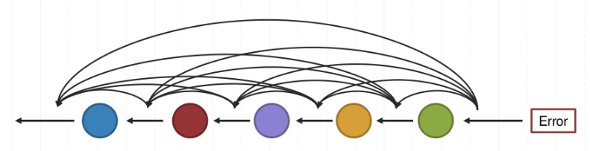
Proposed Model : DenseNet
Strong Gradient Flow
Alleviate vanishing gradient problem
Each layer has direct access to the gradients from the loss function, leading to an implicit deep supervision
( implicit deep supervision : individual layers receive additional supervision from the loss function through the short connections)

Slide 9
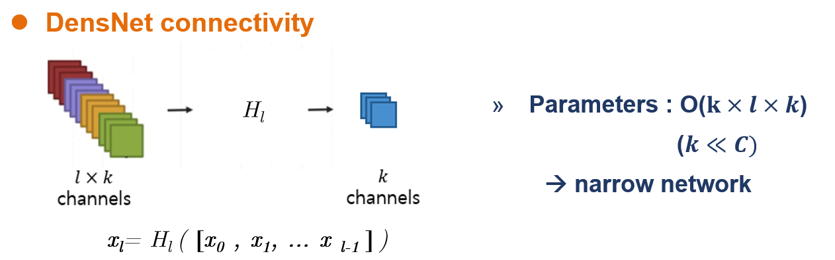
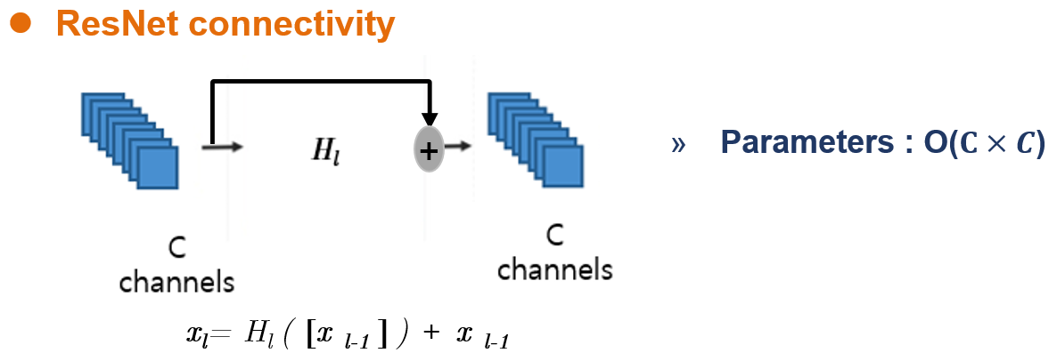
Proposed Model : DenseNet
Parameter & Computational efficiency
Overfitting
Efficient use of parameters make DenseNet to be less to overfitting.

Slide 10
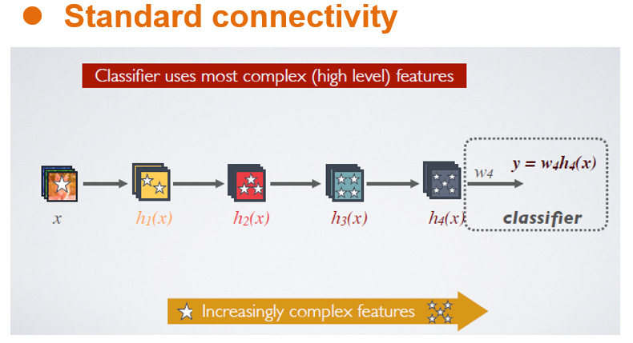
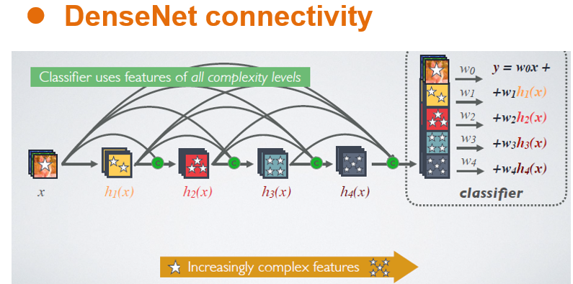
Proposed Model : DenseNet
Feature reuse
Information that is added to the network + information that is preserved
→ “collective knowledge”

Slide 11
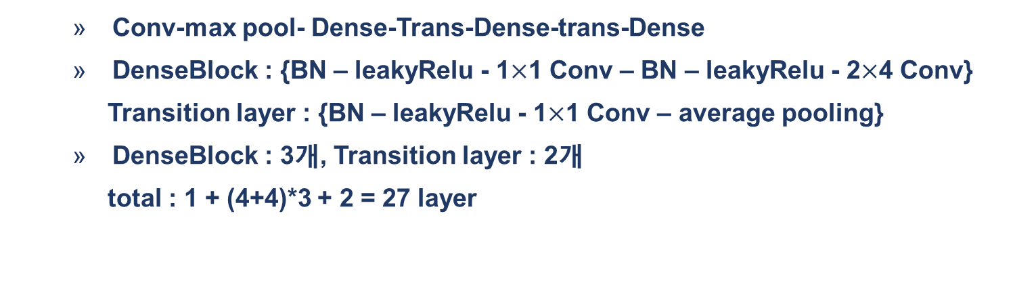
Proposed Model
model architecture
Conv-max pool- Dense-Trans-Dense-trans-Dense
DenseBlock : {BN – leakyRelu - 1$×$1 Conv – BN – leakyRelu - 2$×$4 Conv}
Transition layer : {BN – leakyRelu - 1$×$1 Conv – average pooling}
DenseBlock : 3개, Transition layer : 2개
total : 1 + (4+4)*3 + 2 = 27 layer
Dense Block1
Dense Block2
Dense Block3
BN-ReLU-Conv
BN-ReLU-Conv
Conv
Pooling
Pooling
Pooling
Linear
Output
Transition layer1
Transition layer2

Slide 12


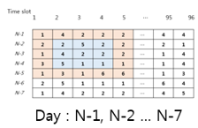

Proposed Model
Locality Maintenance
’96’ locality를 유지시키면서 convolution과 pooling 진행.
global average pooling 대신 growth rate =1 인 DenseBlock으로 대체.
DenseBlock
[7,96,1]
[7,96,30]
[5,96,30]
[3,96,30]
[1,96,30]
[1,96,1]
[7,96]
[1,96]
Transition layer

Slide 13


Proposed model
hour-ahead connection
Network에 나온 최종 [1,96] neuron 사이의 연결을 주어 Forecasting에서 correlation이 가장 높은 전 시간의 데이터 정보 반영.
$$x_{1}$$
Weighted sum
$$x_{2}$$
Network
……..

Slide 14
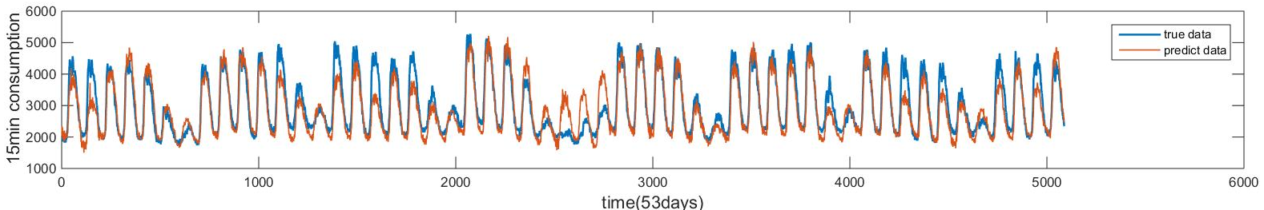
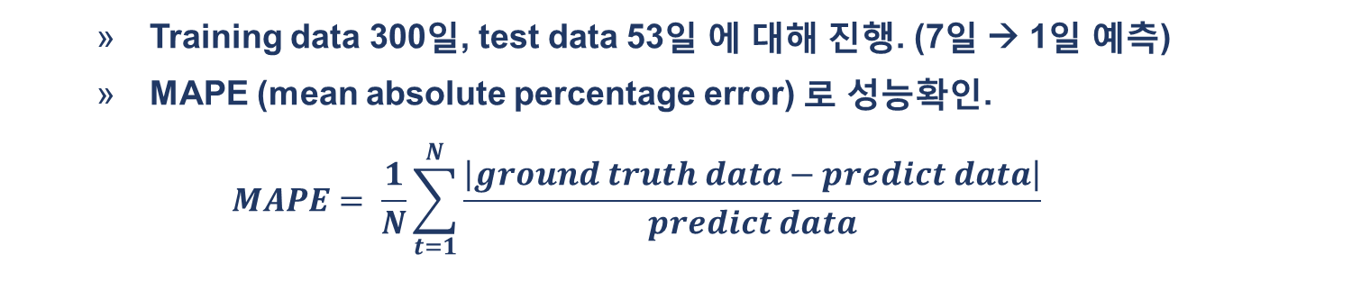
Results
Results
Training data 300일, test data 53일 에 대해 진행. (7일 → 1일 예측)
MAPE (mean absolute percentage error) 로 성능확인.
$$MAPE= \frac{1}{N}\sum_{t=1}^{N}{\frac{\left|ground truth data−predict data\right|}{predict data}}$$
Total test data(53일 전체)
Test MAPE : 9.1% (Train MAPE : 4.1% )

Slide 15
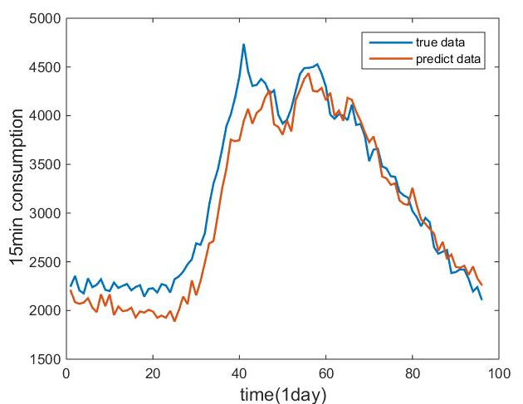
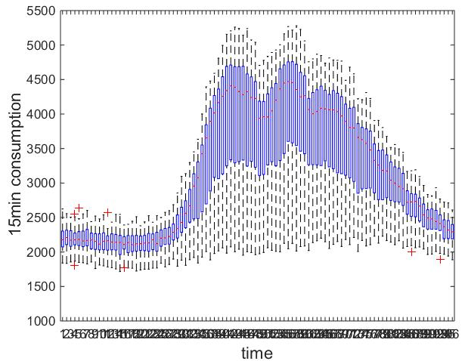
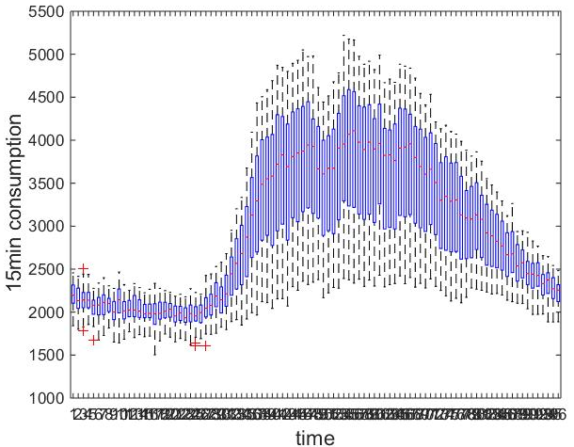
Results
Results
Test data for oneday(day 51)
Box plot (53일 전체)
Ground truth data
Predict data

Slide 16
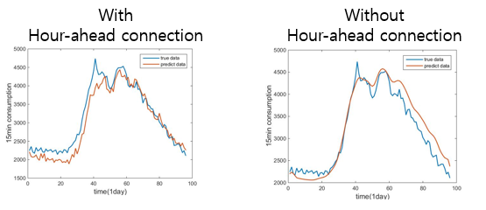
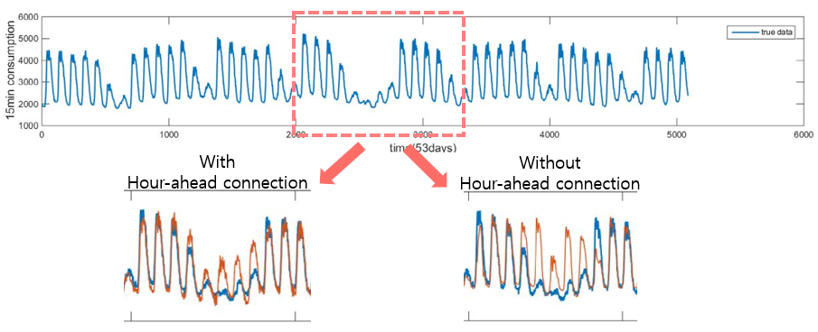
Results
Comparison (without hour-ahead connection)
Oneday
Holiday..

