Slide 1



How to import and use HydroAI library with Google Colab
02. 28, 2024
Statistical Inference and Environmental Big Data Analysis class
(EN5423-01)
TA: Subin Kim

Slide 2
Contents
0. Prerequisites
Mount Google drive
Change your path and check
Import HydroAI library and check
Import all HydroAI packages

Slide 3
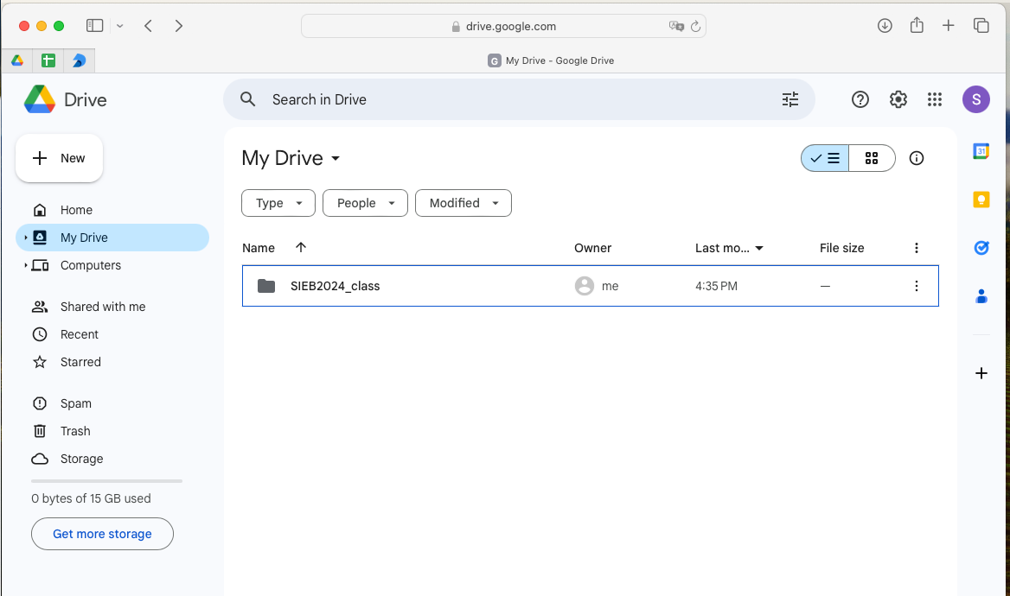
0. Prerequisite
0-1. Prepare Google account to use google drive
Make folder with name “SIEB2024_class” in MyDrive
1 / 15 pages

Slide 4
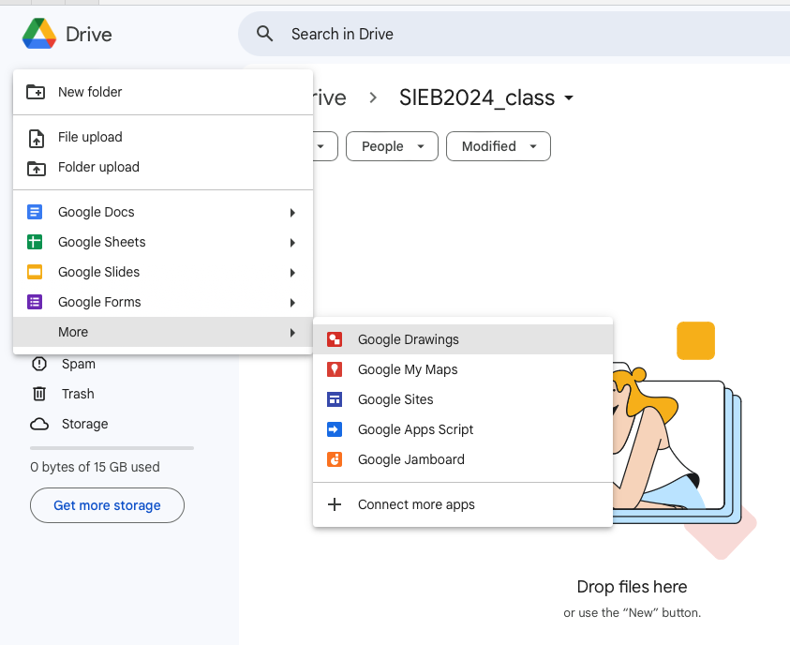
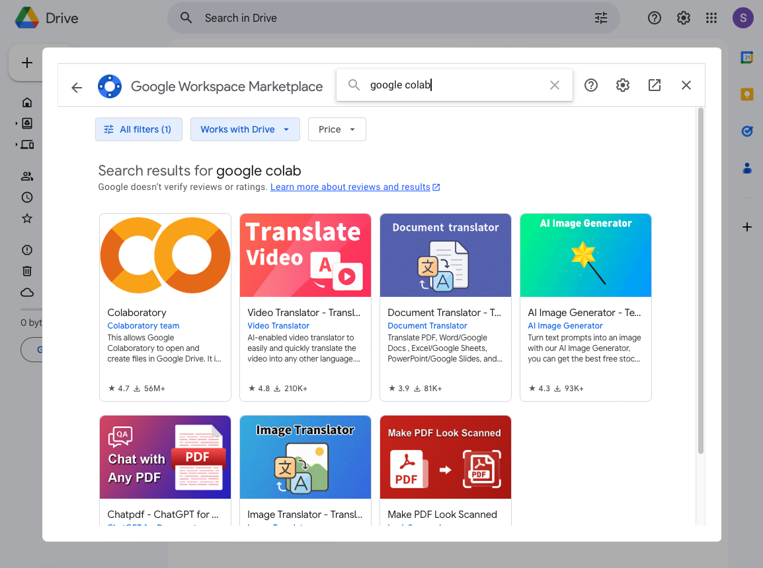
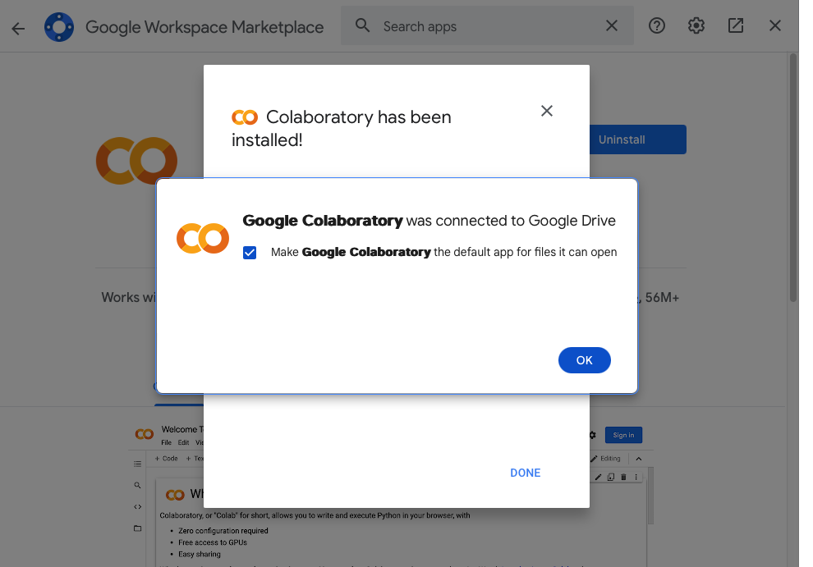
0. Prerequisite
0-2. Add Google Colab app
Search “google colab”
2 / 15 pages

Slide 5
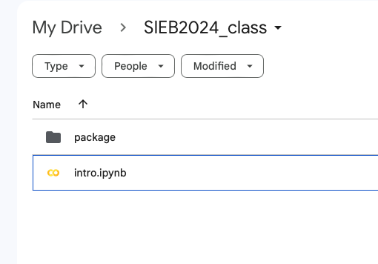
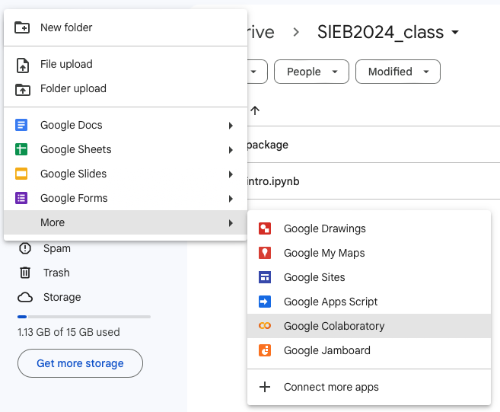
0. Prerequisite
0-3. Make Colab file & package folder in SIEB2024_class
3 / 15 pages

Slide 6
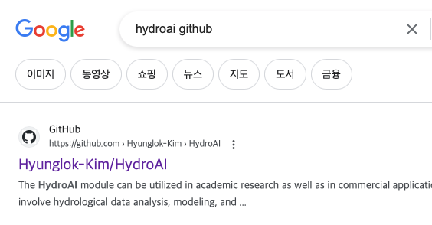
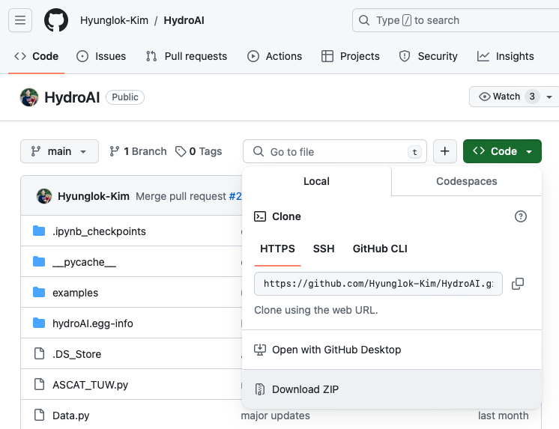
0. Prerequisite
0-4. Download HydroAI library in Github “Hyunglok-Kim/HydroAI”
4 / 15 pages

Slide 7
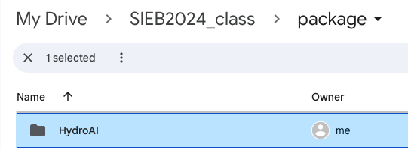
0. Prerequisite
0-5. Add HydroAI library in your package folder
Set folder name “HydroAI”
5 / 15 pages

Slide 8
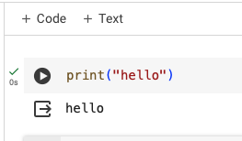
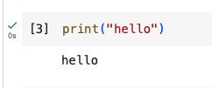

0. Prerequisite
0-6. Run test code with two methods
1. Click play button
2. [Shift] + [Enter]
Done symbol with number of running this code
+@)
Add code, text
Move and delete code cell, etc…
6 / 15 pages

Slide 9
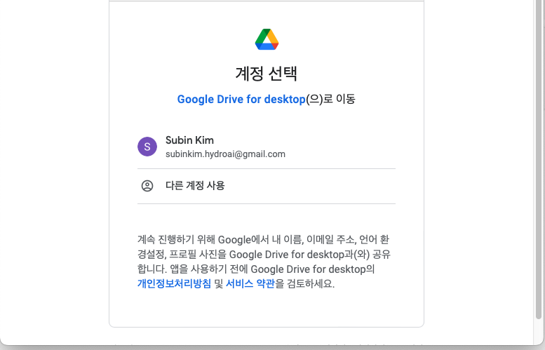
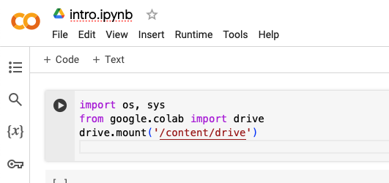
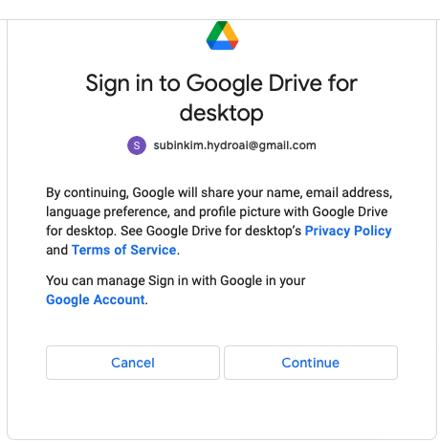
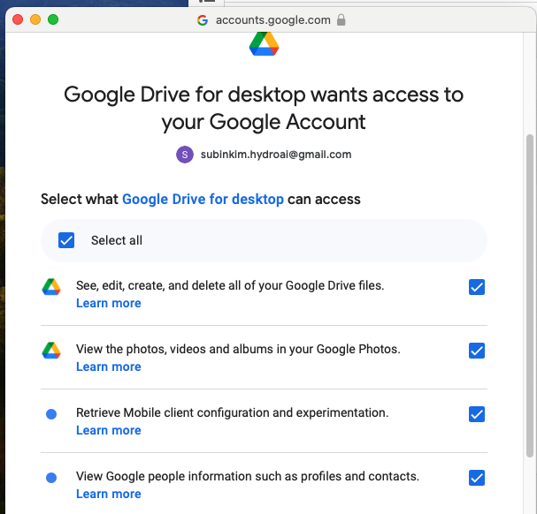
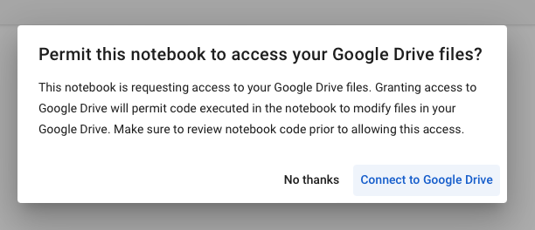
1. Mount Google drive
1-1. Mount drive
Keep clicking continue button
7 / 15 pages

Slide 10
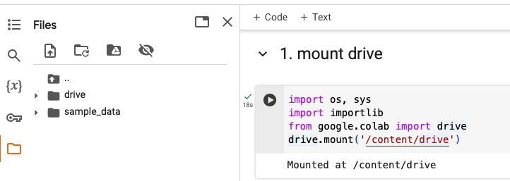
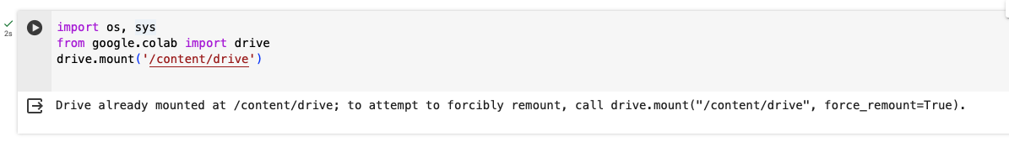
1. Mount Google drive
1-2. Check result your mounted drive folder
Mounted folder
+@) When you run one more time
8 / 15 pages

Slide 11
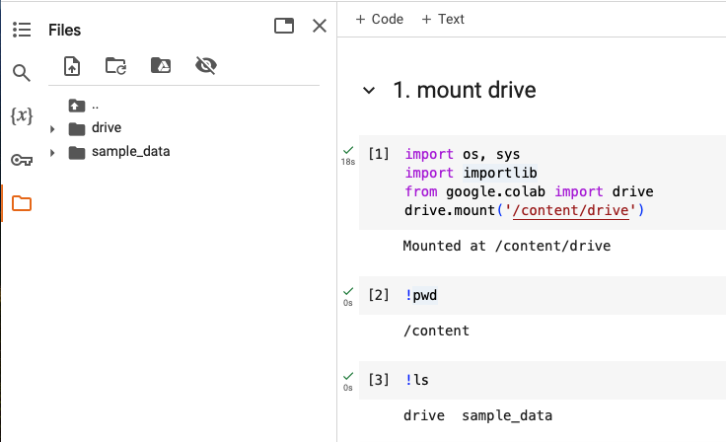
1. Mount Google drive
1-3. Check your current directory & folder lists
Position of working directory
List files or folders in current path
9 / 15 pages

Slide 12
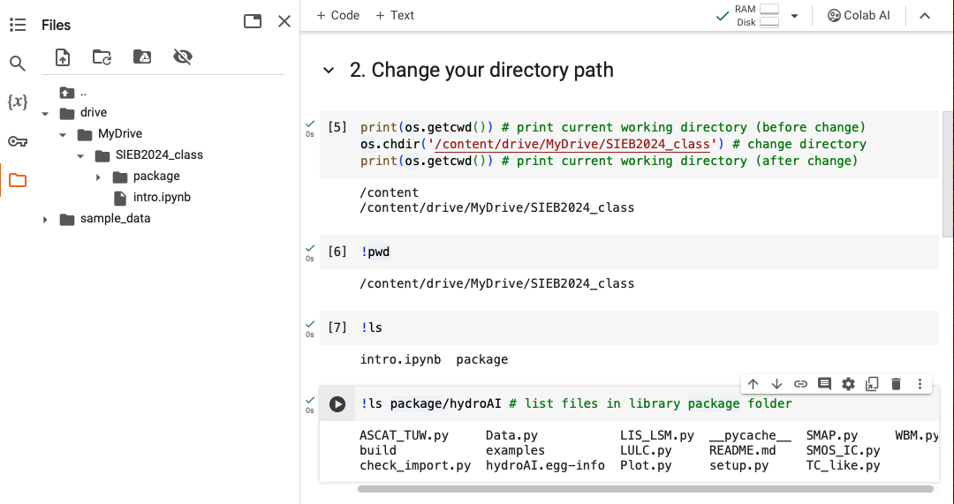
2. Change your path and check
2. Change your directory path and check your HydroAI files
10 / 15 pages

Slide 13
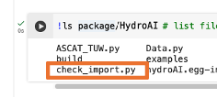
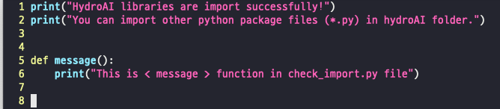
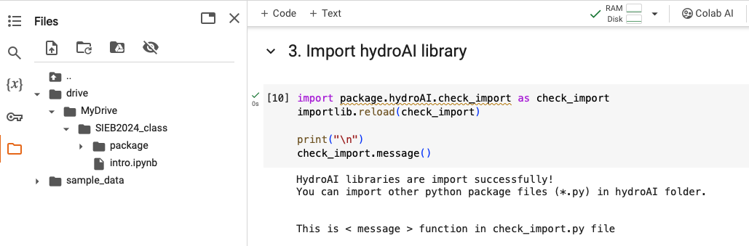
3. Import HydroAI library and check
3. Import HydroAI’s check_import library
In check_import.py file
11 / 15 pages

Slide 14
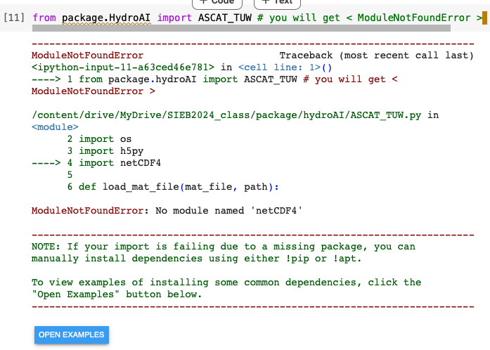
4. Import all HydroAI packages
4-1. How to account <ModuleNotFoundError>
You need to install required other modules.
12 / 15 pages

Slide 15
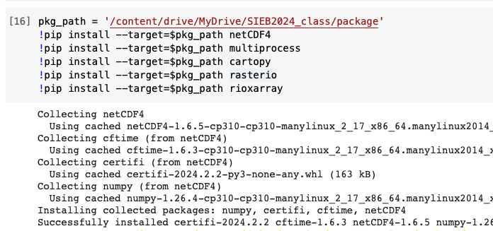
4. Import all HydroAI packages
4-2. Install modules in package path
Package path
Install all prerequisite modules with pip
+@) pip: Package Installer of Python
13 / 15 pages

Slide 16
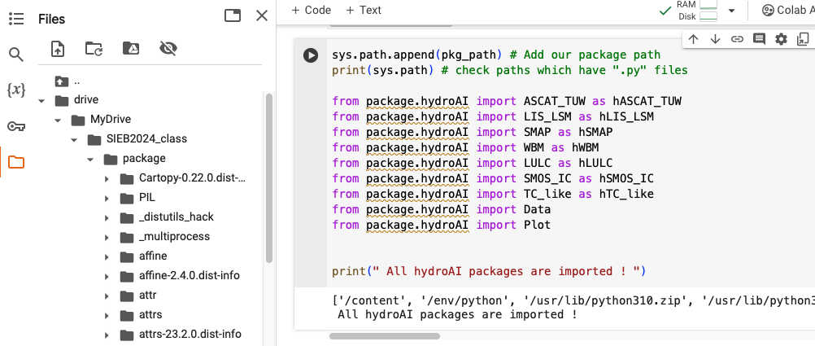
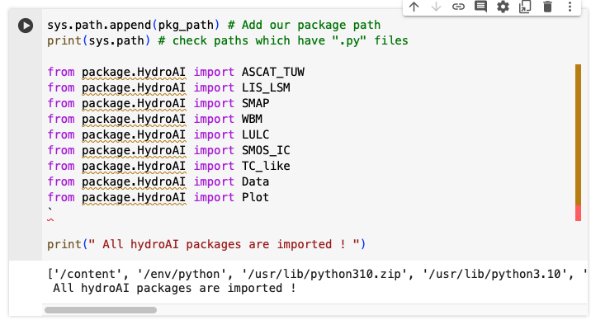
4. Import all HydroAI packages
4-3. All HydroAI packages are imported
You need to install packages
With many packages
14 / 15 pages

Slide 17
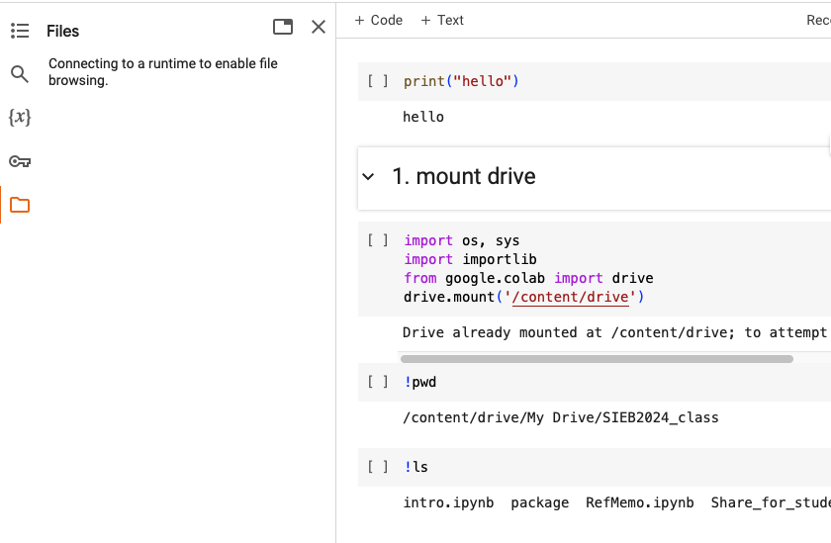
4. Import all HydroAI packages
4-4. When you disconnect & restart your code
You have to do these processes again.
mount drive
Install modules with pip
So, for the next class, please prepare that you can import HydroAI libraries before the next class begins!
If you have any other questions related these processes, send me an email.
(subinkim8774@gm.gist.ac.kr)
Disconnecting mounted drive folder
15 / 15 pages

Slide 18
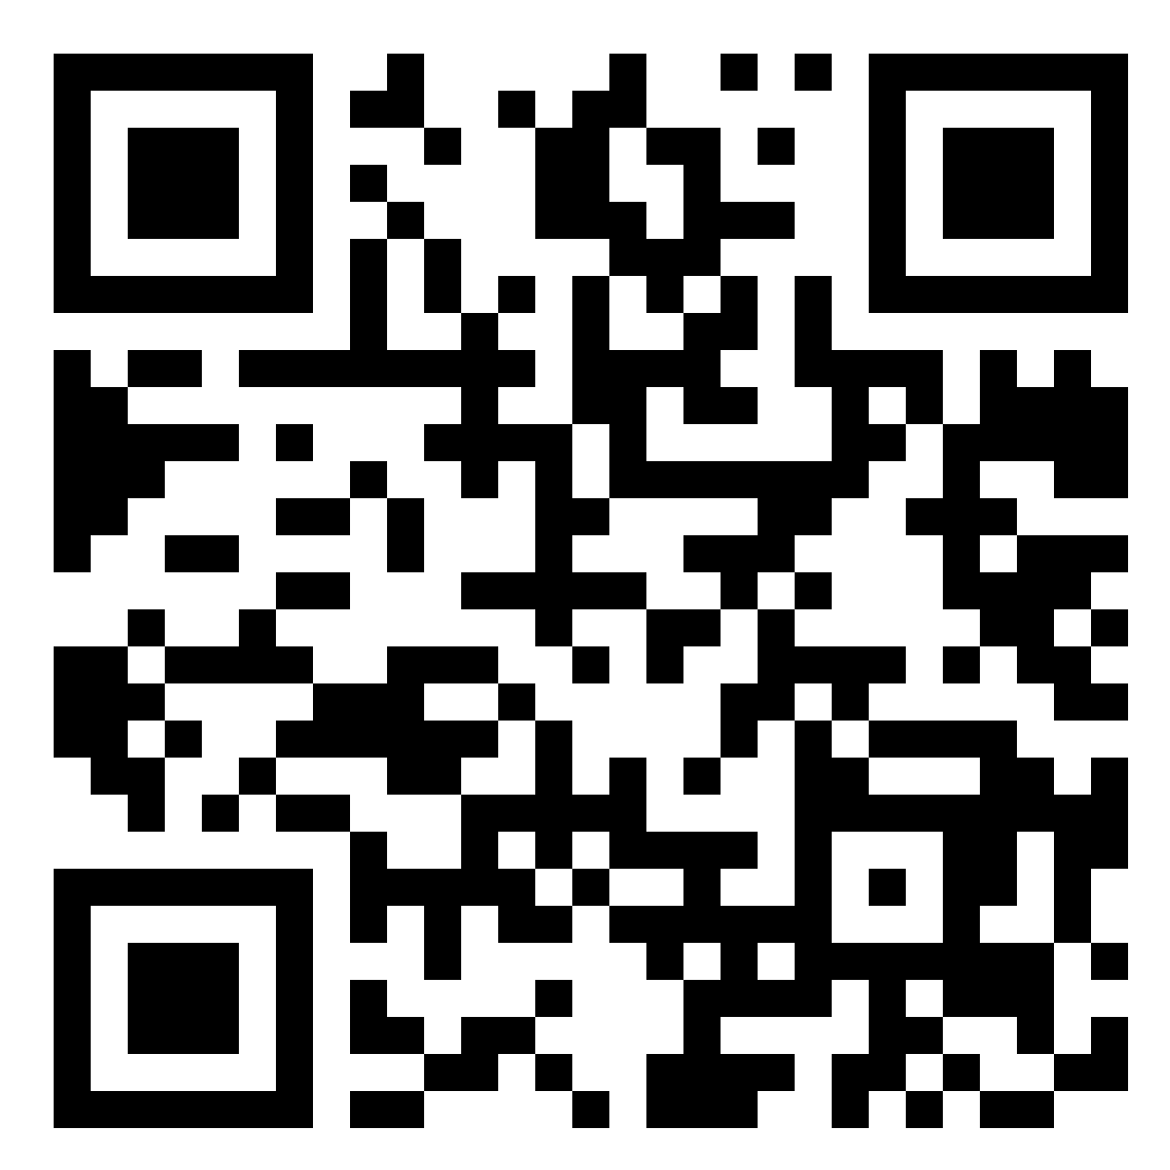


Q & A
Thank You!
https://www.hydroai.net

