Slide 1
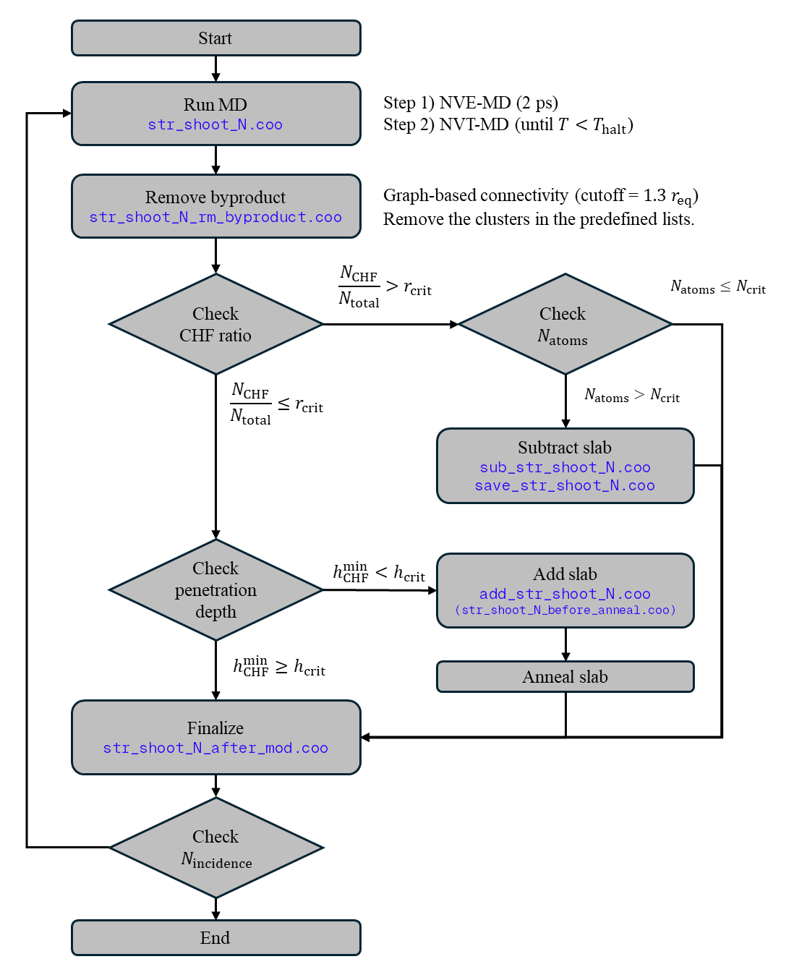



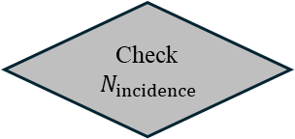


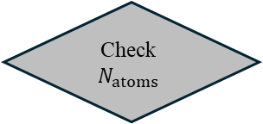

Start
Run MD
str_shoot_N.coo
Step 1) NVE-MD (2 ps)
Step 2) NVT-MD (until $T<T_{halt}$)
Remove byproduct
str_shoot_N_rm_byproduct.coo
Graph-based connectivity (cutoff = $1.3 r_{eq}$)
Remove the clusters in the predefined lists.
Check
CHF ratio
$$\frac{N_{CHF}}{N_{total}}>r_{crit}$$
Check
$$N_{atoms}$$
$$N_{atoms}≤N_{crit}$$
$$\frac{N_{CHF}}{N_{total}}≤r_{crit}$$
$$N_{atoms}>N_{crit}$$
Subtract slab
sub_str_shoot_N.coo
save_str_shoot_N.coo
Check
penetration depth
$$h_{CHF}^{min}<h_{crit}$$
Add slab
add_str_shoot_N.coo
(str_shoot_N_before_anneal.coo)
$$h_{CHF}^{min}≥h_{crit}$$
Anneal slab
Finalize
str_shoot_N_after_mod.coo
Check$N_{incidence}$
End

