Slide 1
PHP Web Game Project
Group9-Hyungmin Jeon
Computer Science Dept, Bellevue College
hyungmin.jeon@bellevuecollege.edu

Slide 2
Introduction
Objective: Develop web-based games (Tic Tac Toe and Rock Paper Scissors)
Technologies: HTML, CSS, JavaScript(Client side), PHP (Server side), SQLite3 DB
Component:
1.Login
2.Registration system
3.Dashboard
4.Game page (Tic Tac Toe and Rock Paper Scissors)
4.Ranking List

Slide 3
Background
HTML: Markup language for web pages and web applications
CSS: Style sheet language for HTML document presentation
JavaScript: Scripting language for dynamic web pages and applications
PHP: Server-side scripting language for dynamic web pages and applications
SQLite3: Lightweight, file-based database management system
Github: Web-based hosting service for version control and collaboration

Slide 4
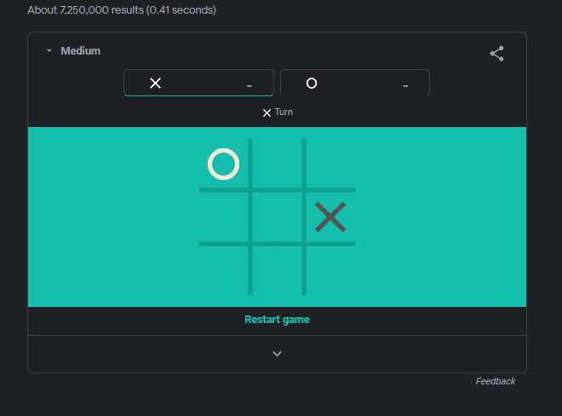
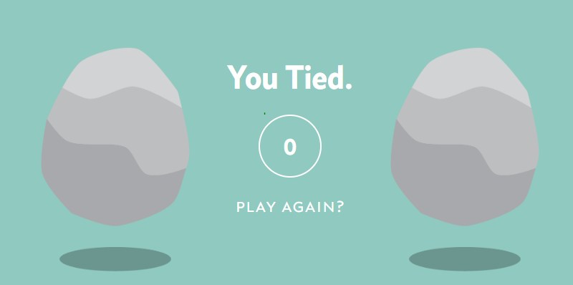
Related Works
Rock Paper Scissors
by “rock-paper-scissors-game.com”
Tic Tac Toe by Google

Slide 5
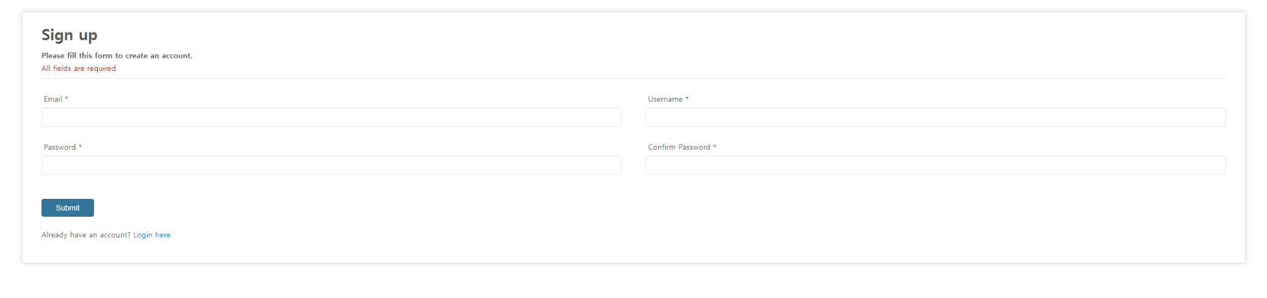
Experiment/Demo
Sign Up

Slide 6
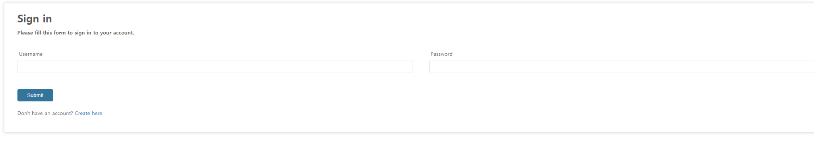
Experiment/Demo
Sign In

Slide 7
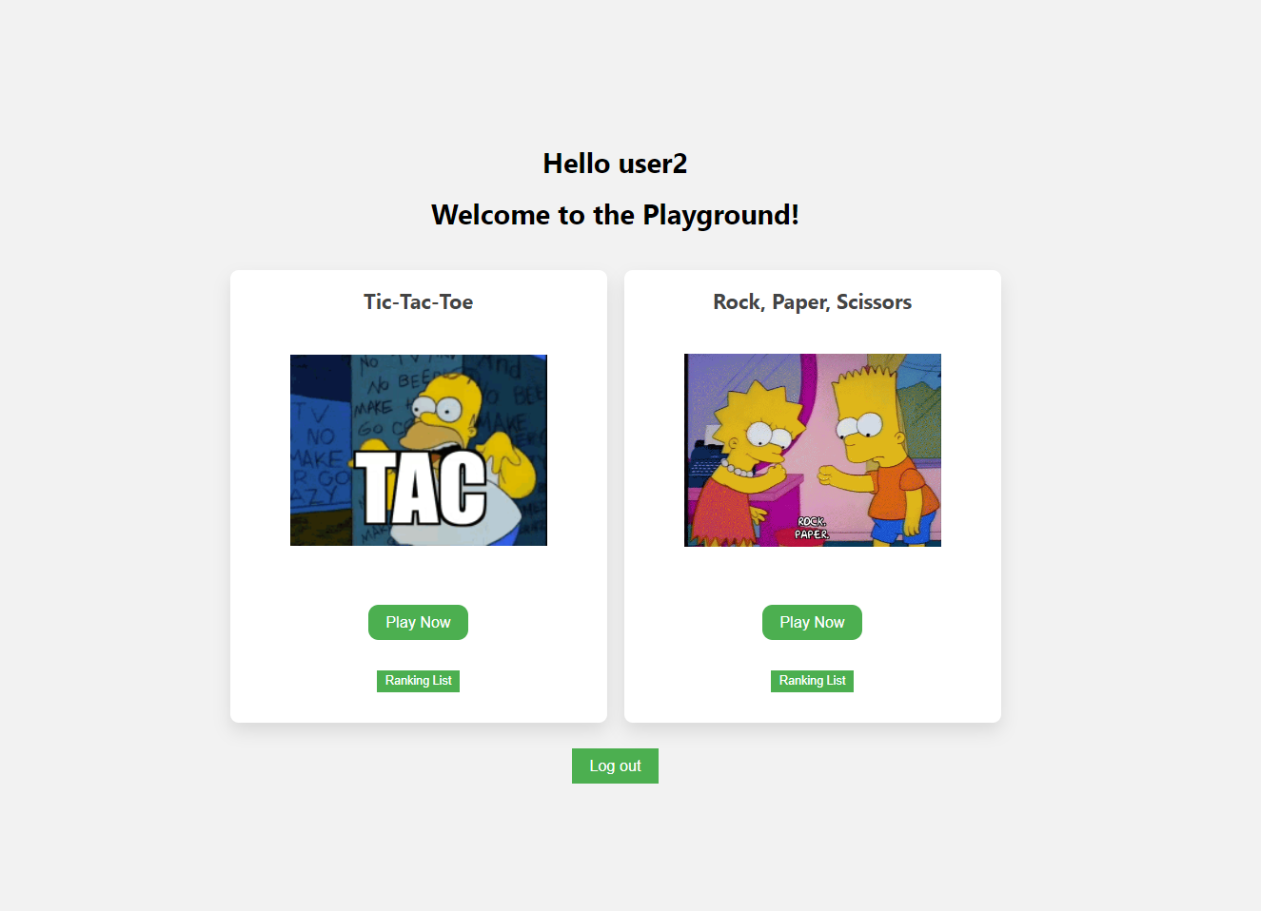
Experiment/Demo
Dashboard

Slide 8
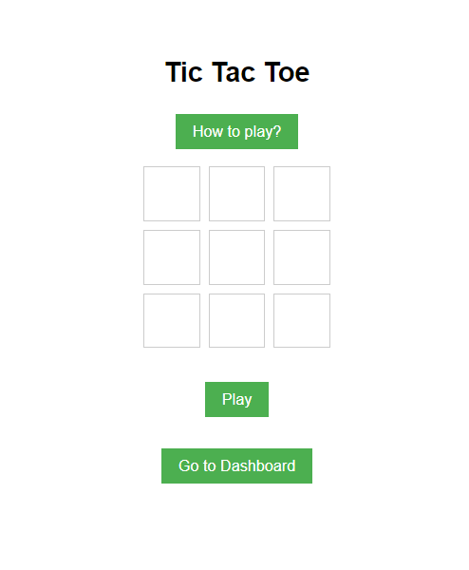
Experiment/Demo
Tic-tac-toe game page

Slide 9
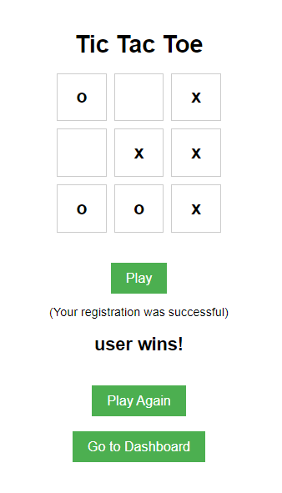
Experiment/Demo
Tic-tac-toe result

Slide 10
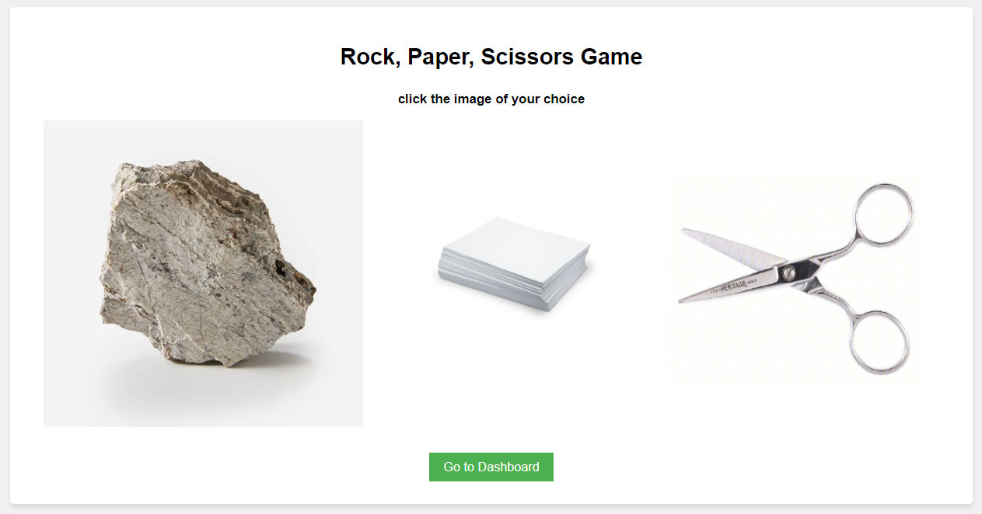
Experiment/Demo
Rock Paper Scissors game page

Slide 11
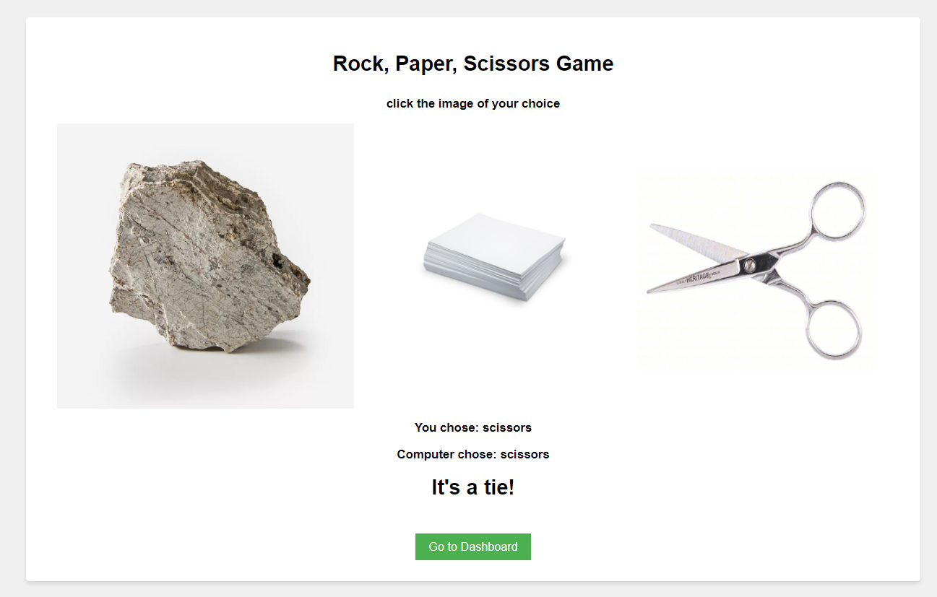
Experiment/Demo
Rock Paper Scissors result

Slide 12
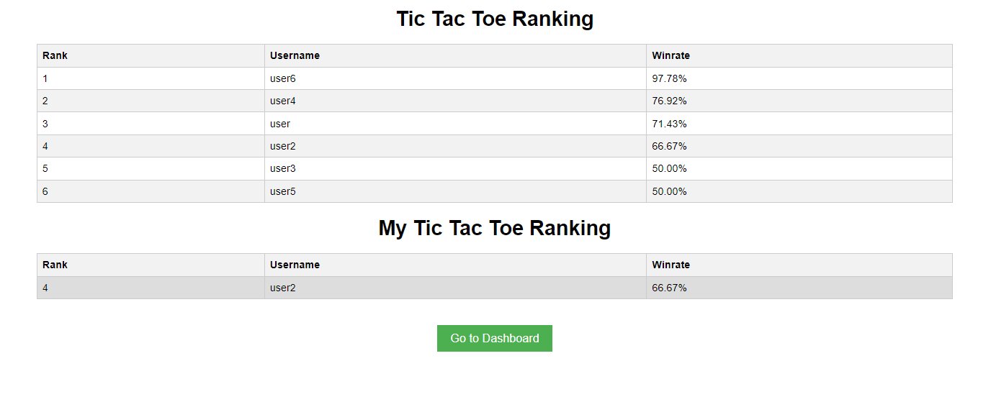
Experiment/Demo
Tic Tac Toe Ranking list

Slide 13
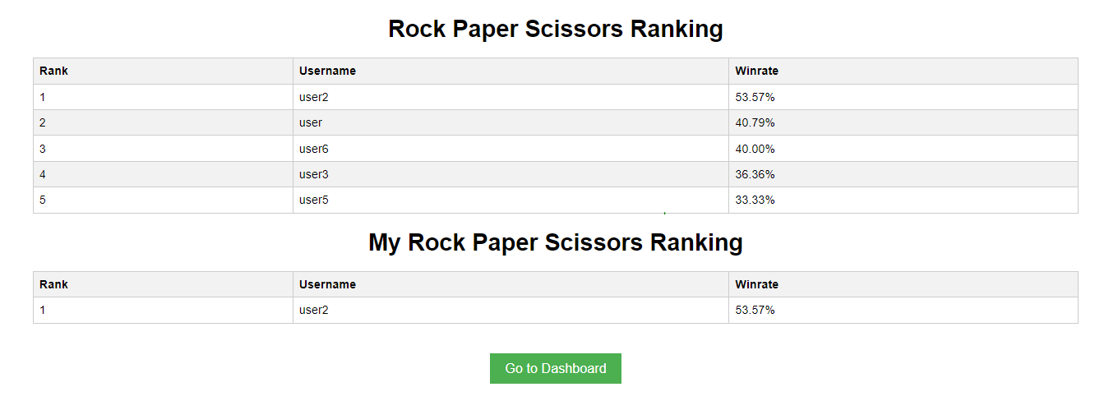
Experiment/Demo
Rock Paper Scissors Ranking list

Slide 14
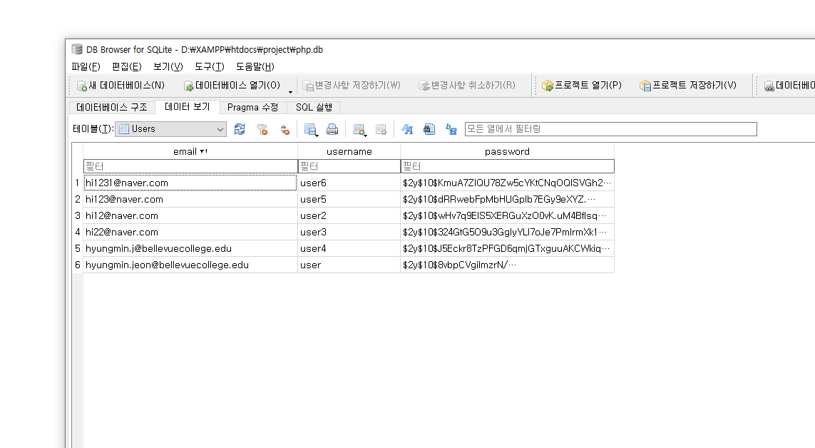
Experiment/Demo
SQLite3 DB- Users Table

Slide 15
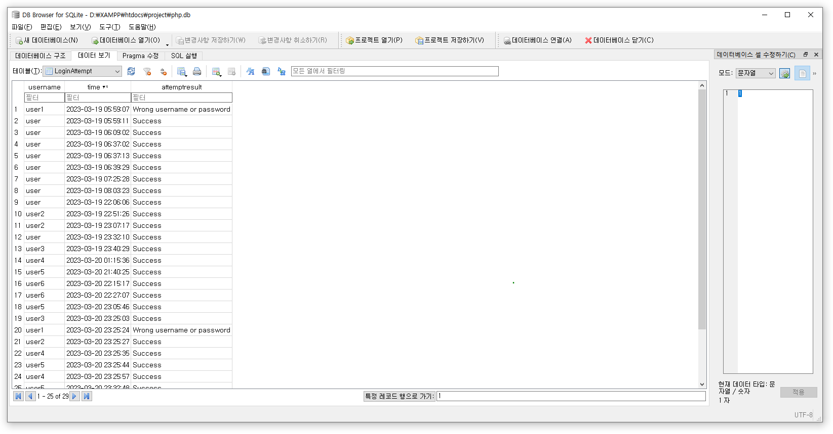
Experiment/Demo
SQLite3 DB- LoginAttempt Table

Slide 16
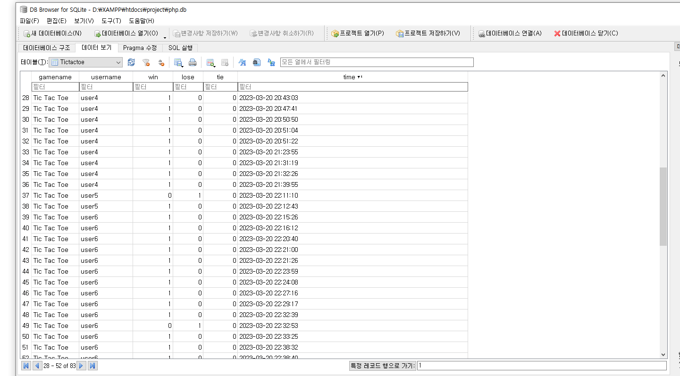
Experiment/Demo
SQLite3 DB- Tictactoe Table

Slide 17
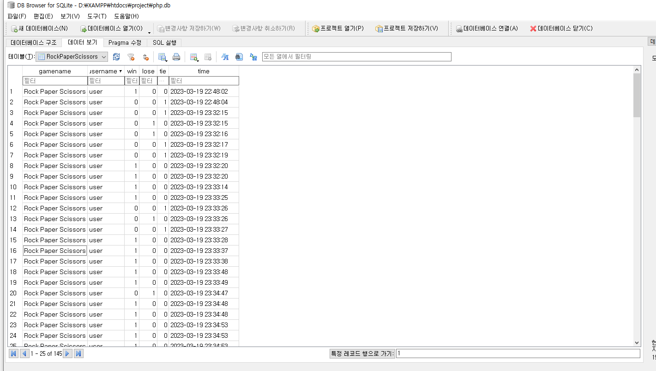
Experiment/Demo
SQLite3 DB- RockPaperScissors Table

Slide 18
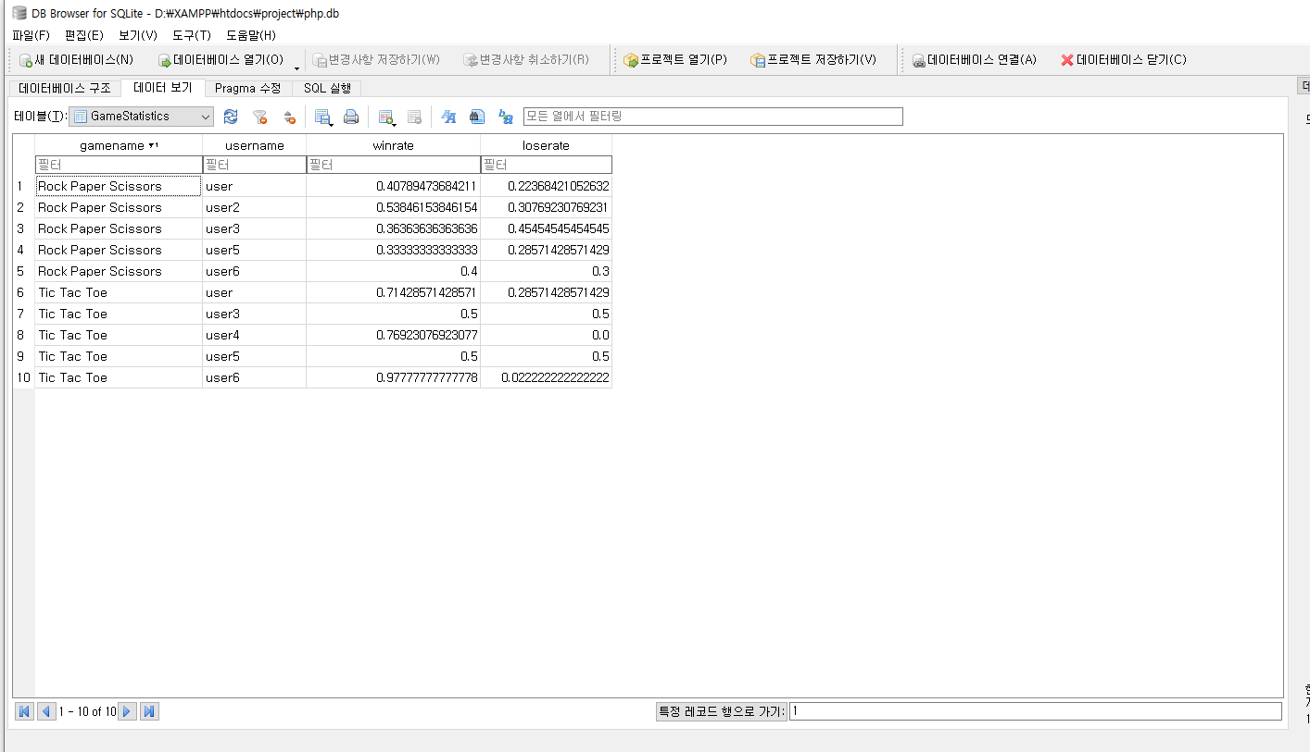
Experiment/Demo
SQLite3 DB- GameStatistics Table

Slide 19
References
[1] PHP documentation. (n.d.). PHP: Hypertext Preprocessor. Retrieved from https://www.php.net/manual/en/
[2] W3Schools. (n.d.). SQL Tutorial. Retrieved from https://www.w3schools.com/sql/
[3] Rascia, T. (2019, January 31). Building a Simple Tic Tac Toe Game with PHP. Tania Rascia. https://www.taniarascia.com/simple-tic-tac-toe-with-php/
[4] Staedefeldt, A. (n.d.). How to Build a Tic Tac Toe Game with PHP. DEV. Retrieved from https://dev.to/anselm/build-a-tic-tac-toe-game-with-php-1ofd
[5] Orejuela, E. (2018, December 12). How to Create a Rock, Paper, Scissors Game in JavaScript. freeCodeCamp. Retrieved from https://www.freecodecamp.org/news/how-to-create-a-rock-paper-scissors-game-in-javascript/
[6] Shah, N. (2018, July 29). Rock Paper Scissors Game with JavaScript. Medium. Retrieved from https://medium.com/@nishantsingh1202/rock-paper-scissors-game-with-javascript-62c573ee5171

