Slide 1
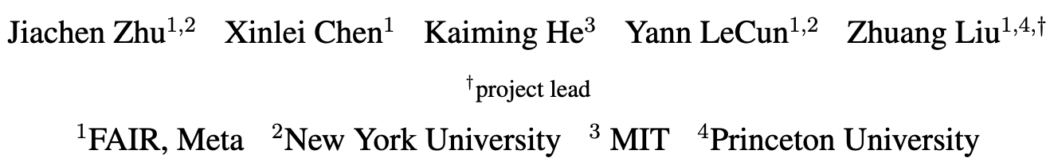

Slide 2

Outline
Intro & Related Works
Training Only BatchNorm
Case Study: ResNet-110, increasing available features by varying depth and width
Are affine parameters special?
Summary
Examining The Values of $γ$ and $β$
Small values of $γ$ disable features
Training only BN sparsifies activations
Summary
Discussion

Slide 3
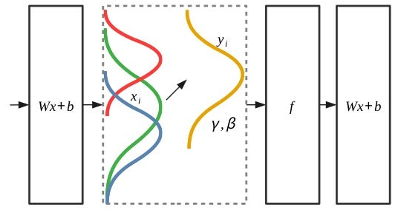
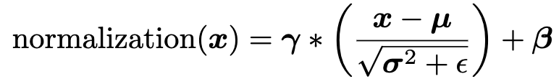
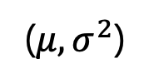
1. Intro & Related Works - BatchNorm
Ioffe, Sergey, and Christian Szegedy. "Batch normalization: Accelerating deep network training by reducing internal covariate shift." International conference on machine learning. pmlr, 2015.
Two statistics ($μ$-mean, $σ^{2}$-variance)
Affine parameters ($γ$-”scaling”, $β$-”shifting”)
https://www.srose.biz/deep-learning/deep-learning-performance-part-3-batch-normalization-dropout-and-noise/
($μ,σ^{2}$)

Slide 4
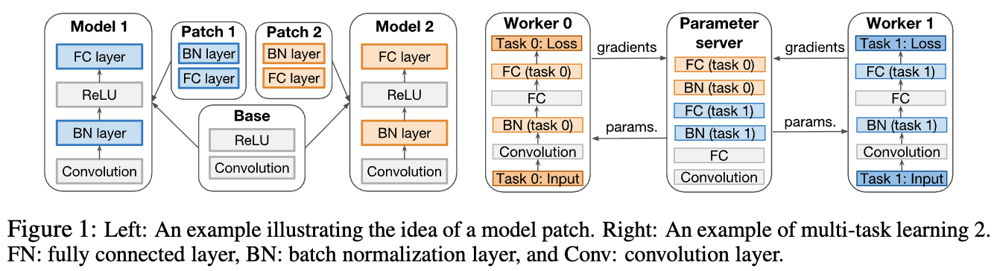
1. Intro & Related Works – The expressive power of affine transformations
”multi-task learning with a shared network backbone (trained on a particular task) and separate sets of per-task BatchNorm parameters (trained on a different task while the backbone is frozen)”
Mudrakarta, Pramod Kaushik, et al. "K for the price of 1: Parameter-efficient multi-task and transfer learning." ICLR (2019)

Slide 5
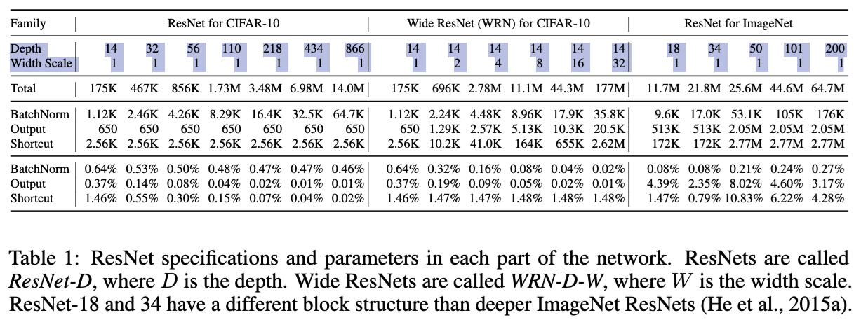
2. Training Only BatchNorm – Settings
ResNet architectures: “We focus on ResNets because they make it possible to add features by arbitrarily (a) increasing depth without interfering with optimization and (b) increasing width without parameter-counts becoming so large that training is infeasible”

Slide 6
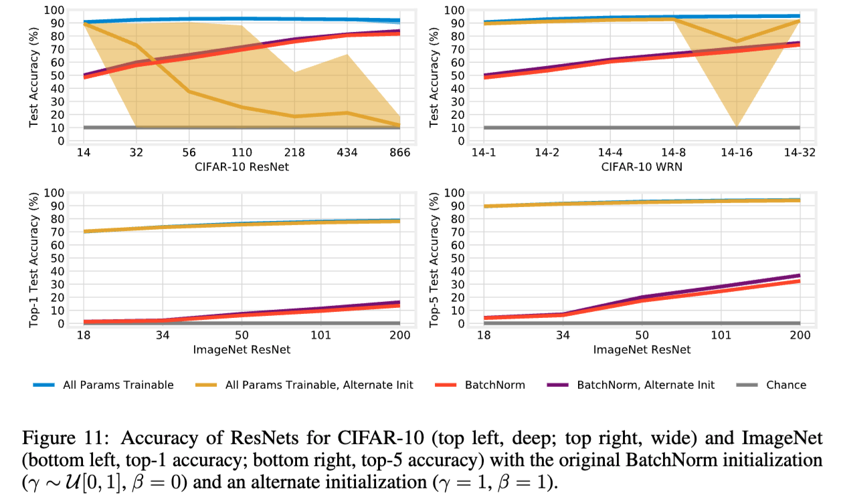
2. Training Only BatchNorm – Settings
BatchNorm Init.: “We initialize $β$ to $0$ and sample $γ$ uniformly between $0$ and 1, although we consider other initializations in Appendix E.”

Slide 7
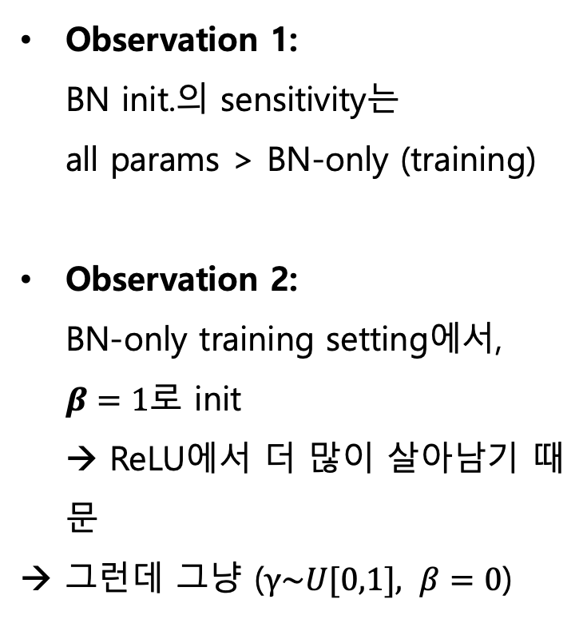
2. Training Only BatchNorm – Settings
BatchNorm Init.: “We initialize $β$ to $0$ and sample $γ$ uniformly between $0$ and 1, although we consider other initializations in Appendix E.”
Observation 1: BN init.의 sensitivity는 all params > BN-only (training)
Observation 2: BN-only training setting에서, $β=1$로 init → ReLU에서 더 많이 살아남기 때문
→ 그런데 그냥 ($γ\sim U[0,1], β=0$)
Notes:
Alternate init이 더 성능이 좋지만 ($γ\sim U[0,1], β=0$) 를 BN init. 으로 선택함
이에 대한 별다른 설명은 없음

Slide 8
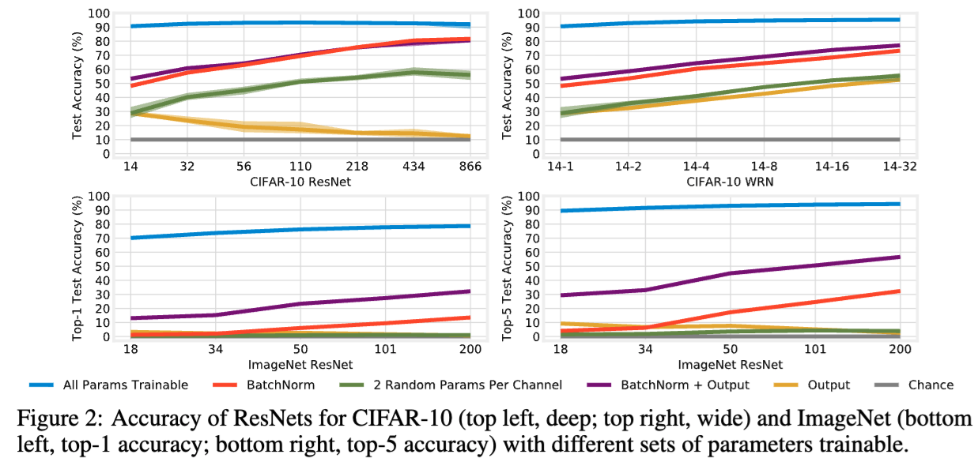
2. Training Only BatchNorm – Case Study: ResNet-110
“When training just the 8.3K (0.48%) affine parameters that can only shift and rescale random features, the network achieves surprisingly high test accuracy of 69.5% (CIFAR-10), suggesting that these parameters have noteworthy representational capacity.”
CIFAR-10
Notes:
실제 BN parameter 제외한 모든 parameter를 freeze하고 학습을 돌려봄

Slide 9
2. Training Only BatchNorm – Increasing available features by varying depth and width
“If we increase the number of features, we expect that accuracy will improve. We can do so in two ways: increasing the network’s depth or increasing its width.”
Increasing the
(depth)
(width)
CIFAR-10
ImageNet

Slide 10
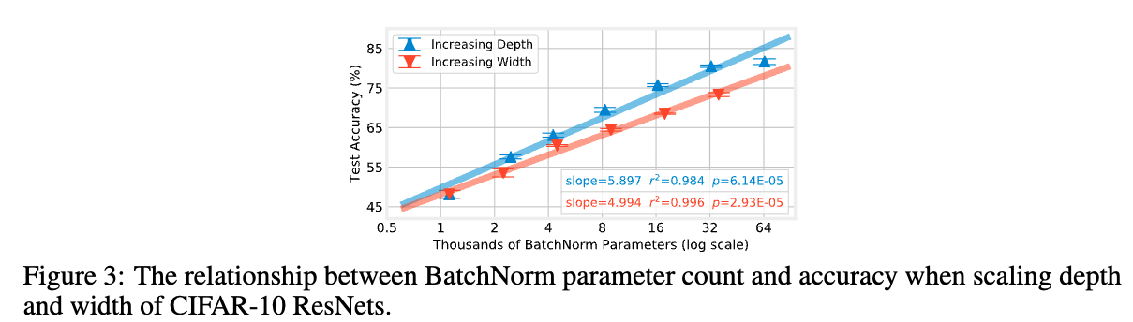
2. Training Only BatchNorm – Increasing available features by varying depth and width
“This raises a further question: for a fixed budget of BatchNorm parameters (and, thereby, a fixed number of random features), is performance always better when increasing depth rather than increasing width?”
→ “The trend is 18% steeper when increasing depth than width, meaning that, for the networks we consider, increasing depth leads to higher accuracy than increasing width for a fixed BatchNorm parameter budget.”

Slide 11
2. Training Only BatchNorm – Are affine parameters special?
“This result appears more important to have coarse-grained control over entire random features (BatchNorm) than to learn small axis-aligned modifications (2 Random Params per Channel) of the features themselves.”
Increasing the
(depth)
(width)
BatchNorm: Per-feature >
2 Random: Per-channel
CIFAR-10
ImageNet
Notes:
Batchnorm parameter와 2 random parameter per channel의
Parameter 개수는 똑같지만
BN은 per-feature를 control 가능
2 random parameter는 per-channel에만 control 가능.
이 차이에서 비롯한 성능차이.

Slide 12
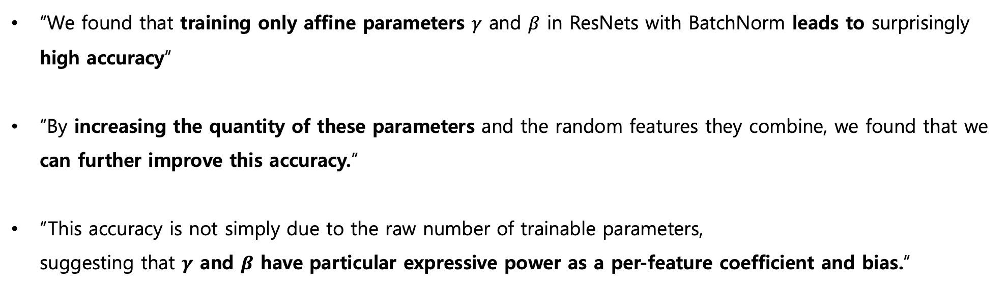
2. Training Only BatchNorm – Summary
“We found that training only affine parameters $γ$ and $β$ in ResNets with BatchNorm leads to surprisingly high accuracy”
“By increasing the quantity of these parameters and the random features they combine, we found that we can further improve this accuracy.”
“This accuracy is not simply due to the raw number of trainable parameters, suggesting that $γ$ and $β$ have particular expressive power as a per-feature coefficient and bias.”

Slide 13
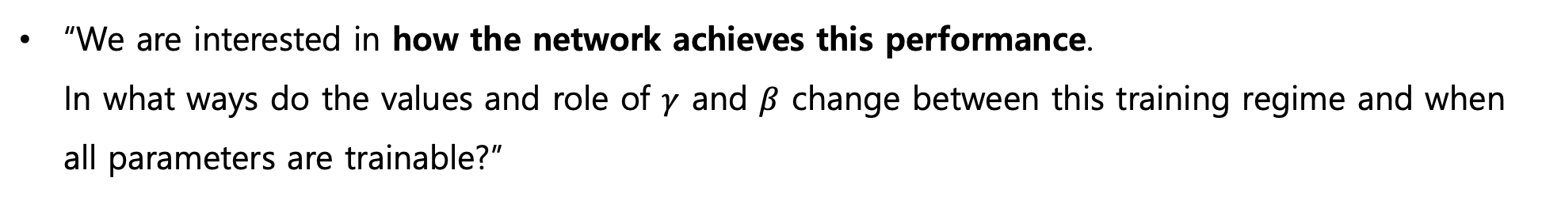
3. Examining The Values of $γ$ and $β$ – Examining $γ$
“We are interested in how the network achieves this performance. In what ways do the values and role of $γ$ and $β$ change between this training regime and when all parameters are trainable?”

Slide 14
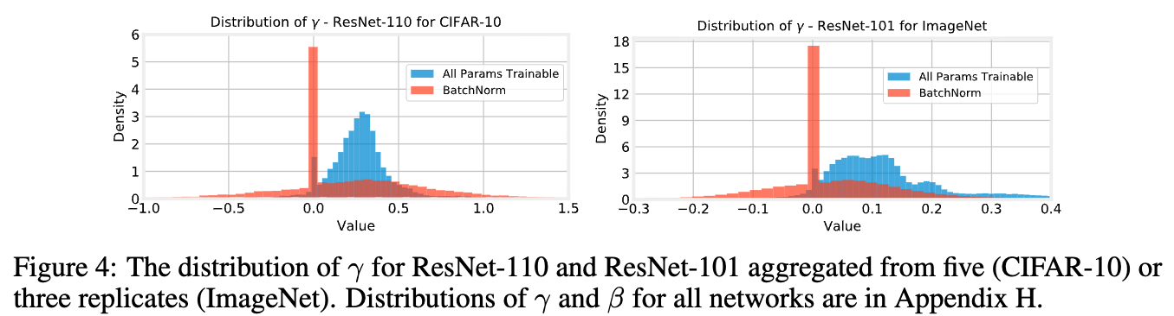
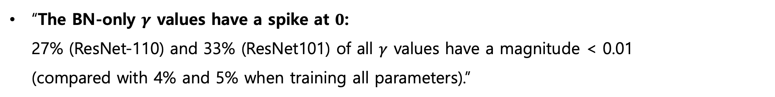
3. Examining The Values of $γ$ and $β$ – Examining $γ$
“The BN-only $γ$ values have a spike at $0$: 27% (ResNet-110) and 33% (ResNet101) of all $γ$ values have a magnitude < 0.01 (compared with 4% and 5% when training all parameters).”

Slide 15
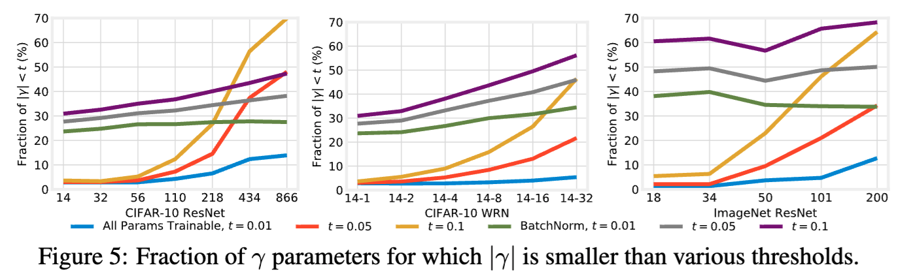
3. Examining The Values of $γ$ and $β$ – Examining $γ$
“The BN-only $γ$ values have a spike at $0$:“ → “The same behavior holds across all depths and widths”

Slide 16
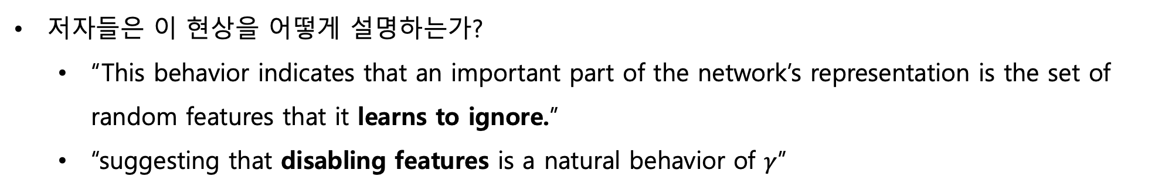
3. Examining The Values of $γ$ and $β$ – Examining $γ$
저자들은 이 현상을 어떻게 설명하는가?
“This behavior indicates that an important part of the network’s representation is the set of random features that it learns to ignore.”
“suggesting that disabling features is a natural behavior of $γ$”

Slide 17
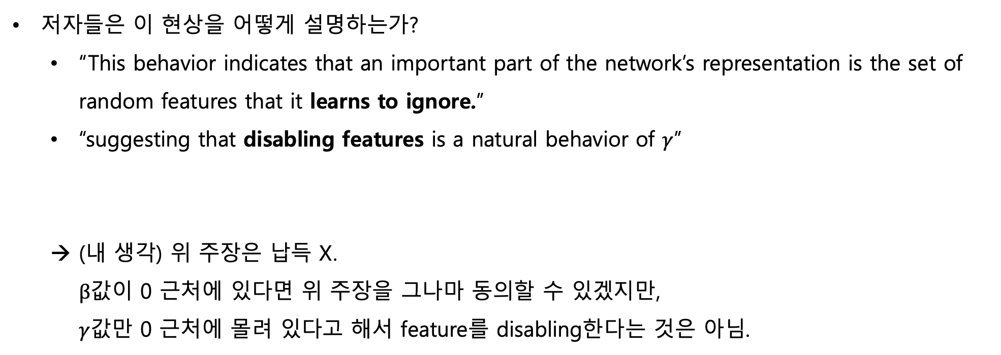
3. Examining The Values of $γ$ and $β$ – Examining $γ$
저자들은 이 현상을 어떻게 설명하는가?
“This behavior indicates that an important part of the network’s representation is the set of random features that it learns to ignore.”
“suggesting that disabling features is a natural behavior of $γ$”
(내 생각) 위 주장은 납득 X. $β$값이 0 근처에 있다면 위 주장을 그나마 동의할 수 있겠지만, $γ$값만 0 근처에 몰려 있다고 해서 feature를 disabling한다는 것은 아님.

Slide 18
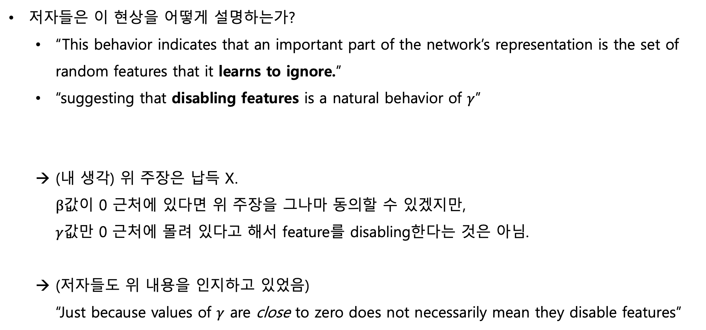
3. Examining The Values of $γ$ and $β$ – Examining $γ$
저자들은 이 현상을 어떻게 설명하는가?
“This behavior indicates that an important part of the network’s representation is the set of random features that it learns to ignore.”
“suggesting that disabling features is a natural behavior of $γ$”
(내 생각) 위 주장은 납득 X. $β$값이 0 근처에 있다면 위 주장을 그나마 동의할 수 있겠지만, $γ$값만 0 근처에 몰려 있다고 해서 feature를 disabling한다는 것은 아님.
(저자들도 위 내용을 인지하고 있었음) “Just because values of $γ$ are close to zero does not necessarily mean they disable features”

Slide 19
3. Examining The Values of $γ$ and $β$ – Small values of $γ$ disable features
“To evaluate the extent to which small values of $γ$ are, in fact, removing features, we explicitly set these parameters to zero and measure the accuracy of the network”

Slide 20
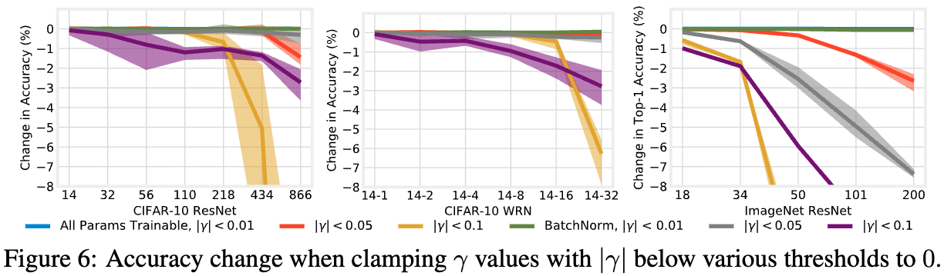
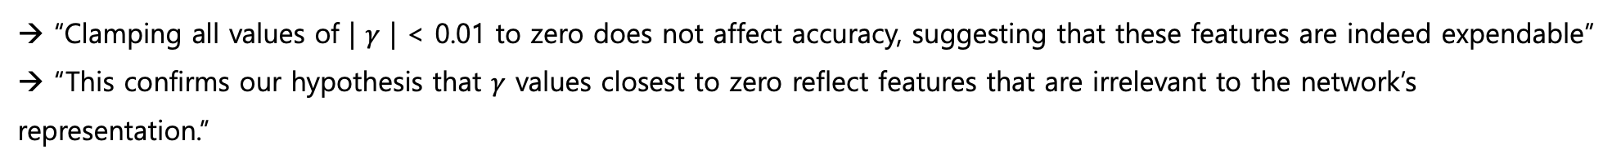
3. Examining The Values of $γ$ and $β$ – Small values of $γ$ disable features
“To evaluate the extent to which small values of $γ$ are, in fact, removing features, we explicitly set these parameters to zero and measure the accuracy of the network”
→ “Clamping all values of | $γ$ | < 0.01 to zero does not affect accuracy, suggesting that these features are indeed expendable” → “This confirms our hypothesis that $γ$ values closest to zero reflect features that are irrelevant to the network’s representation.”

Slide 21
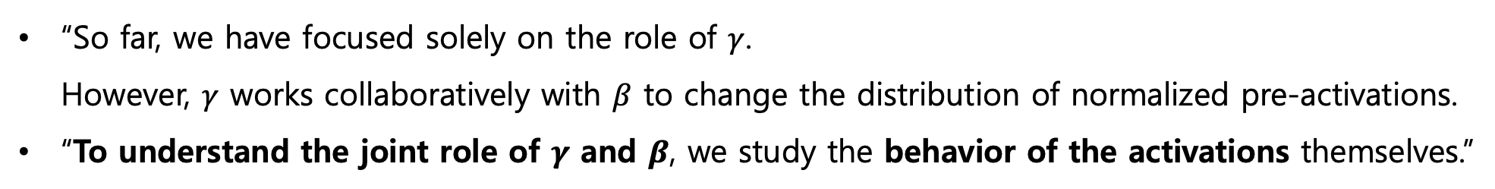
3. Examining The Values of $γ$ and $β$ – Training only BN sparsifies activations
“So far, we have focused solely on the role of $γ$. However, $γ$ works collaboratively with $β$ to change the distribution of normalized pre-activations.
“To understand the joint role of $γ$ and $β$, we study the behavior of the activations themselves.”

Slide 22
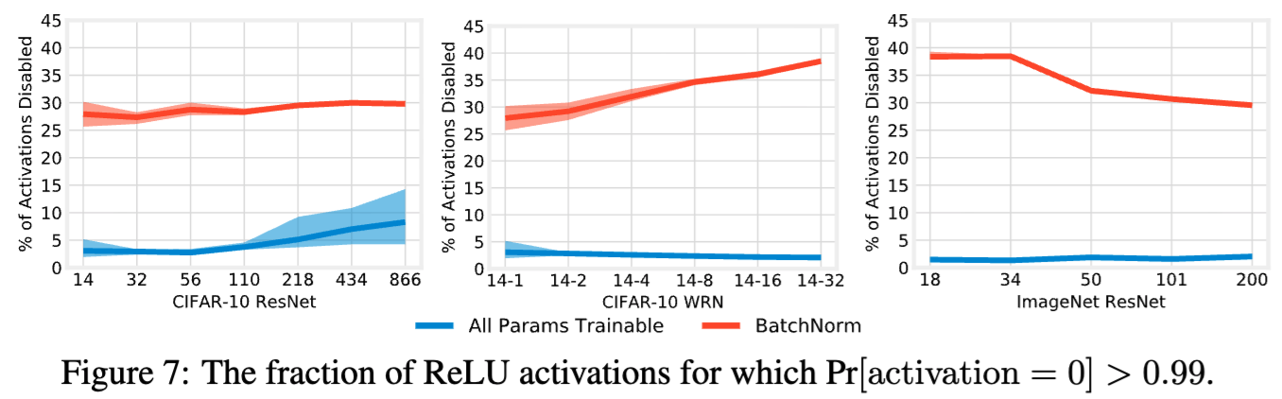
3. Examining The Values of $γ$ and $β$ – Training only BN sparsifies activations
“So far, we have focused solely on the role of $γ$. However, $γ$ works collaboratively with $β$ to change the distribution of normalized pre-activations.
“To understand the joint role of $γ$ and $β$, we study the behavior of the activations themselves.”
→ “When training only BatchNorm, 28% to 39% of activations are disabled, meaning $γ$ and $β$ indeed sparsify activations in practice.”

Slide 23
3. Examining The Values of $γ$ and $β$ – Summary
“When training only BatchNorm, we found $γ$ to have a larger variance and a spike at 0 and that $γ$ was learning to disable entire features.”

Slide 24
4. Discussion
이 논문에 대해 어떻게 리뷰하셨는지?
왜 normalization layer를 없애려는 연구를 하는 걸까? → normalization layer를 없애는 것(statistics 학습이 없어지는 것)으로 할 수 있는 것?

