Slide 1


Slide 2
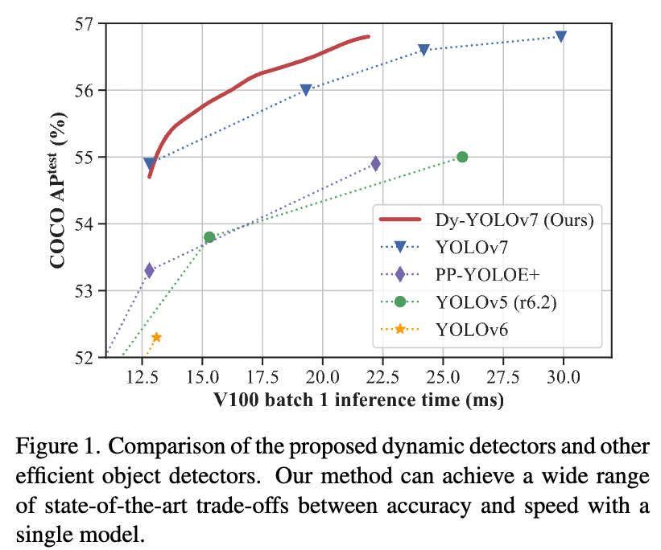
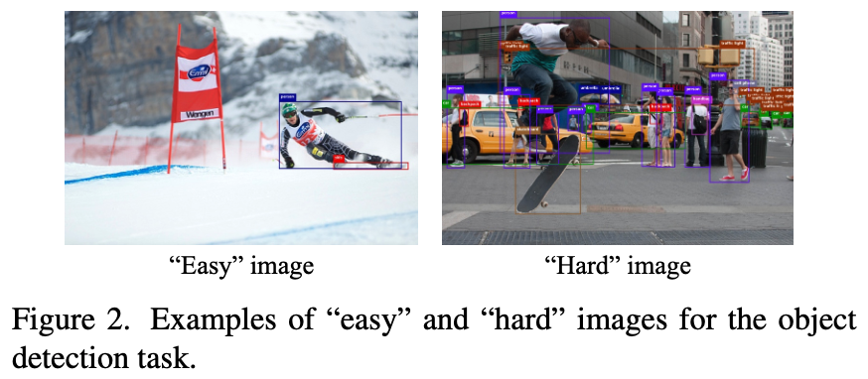
Motivation
→ Image-wise dynamic detector

Slide 3
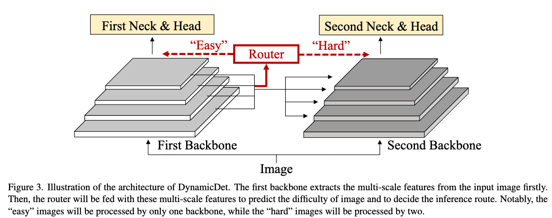







DynamicDet > Overall architecture
Step 1
$$F_{1}=B_{1}\left(x\right)=\left[f_{1}^{\{1\}},f_{1}^{\{2\}},f_{1}^{\{3\}},f_{1}^{\{4\}}\right]$$
$$f_{1}^{\{4\}}$$
$$f_{1}^{\{3\}}$$
$$f_{1}^{\{2\}}$$
$$f_{1}^{\{1\}}$$
$$x$$
$$x$$

Slide 4
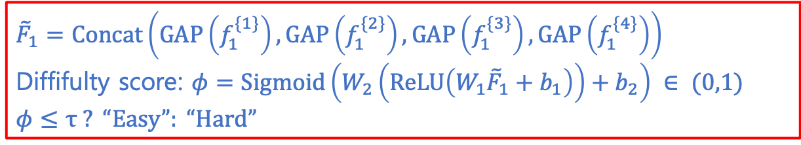
DynamicDet > Overall architecture
$${\tilde{F}}_{1}=Concat\left(GAP\left(f_{1}^{\{1\}}\right),GAP\left(f_{1}^{\{2\}}\right),GAP\left(f_{1}^{\{3\}}\right),GAP\left(f_{1}^{\{4\}}\right)\right)$$ Diffifulty score: $φ=Sigmoid\left(W_{2}\left(ReLU\left(W_{1}{\tilde{F}}_{1}+b_{1}\right)\right)+b_{2}\right) ∈ (0,1)$
$$φ≤τ ? “Easy”: “Hard”$$
Step 1
Step 2
$$F_{1}=B_{1}\left(x\right)=\left[f_{1}^{\{1\}},f_{1}^{\{2\}},f_{1}^{\{3\}},f_{1}^{\{4\}}\right]$$
$$f_{1}^{\{4\}}$$
$$f_{1}^{\{3\}}$$
$$f_{1}^{\{2\}}$$
$$f_{1}^{\{1\}}$$
$$x$$
$$x$$

Slide 5











DynamicDet > Overall architecture
Step 3 (if ”easy”)
Step 3 (if ”hard”)
$$y=D_{1}\left(F_{1}\right)$$
$$y=D_{2}\left(F_{2}\right)$$
Step 1
Step 2
$$F_{1}=B_{1}\left(x\right)=\left[f_{1}^{\{1\}},f_{1}^{\{2\}},f_{1}^{\{3\}},f_{1}^{\{4\}}\right]$$
$$F_{2}=B_{2}\left(x, H\right)=\left[f_{2}^{\{1\}},f_{2}^{\{2\}},f_{2}^{\{3\}},f_{2}^{\{4\}}\right]$$
$$f_{1}^{\{4\}}$$
$$h^{\left\{4\right\}}$$
$$f_{2}^{\{4\}}$$
$$f_{1}^{\{3\}}$$
$$h^{\left\{3\right\}}$$
$$f_{2}^{\{3\}}$$
$$f_{1}^{\{2\}}$$
$$h^{\left\{2\right\}}$$
$$f_{2}^{\{2\}}$$
$$f_{1}^{\{1\}}$$
$$f_{2}^{\{1\}}$$
$$h^{\left\{1\right\}}$$
$$x$$
$$x$$

Slide 6
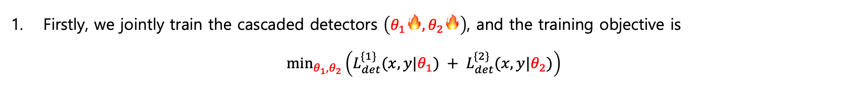
DynamicDet > Optimization strategy
Firstly, we jointly train the cascaded detectors $\left(θ_{1}🔥,θ_{2}🔥\right)$, and the training objective is $\min_{θ_{1},θ_{2}}\left(L_{det}^{\{1\}}(x, y|θ_{1}) + L_{det}^{\{2\}}(x, y|θ_{2})\right)$

Slide 7
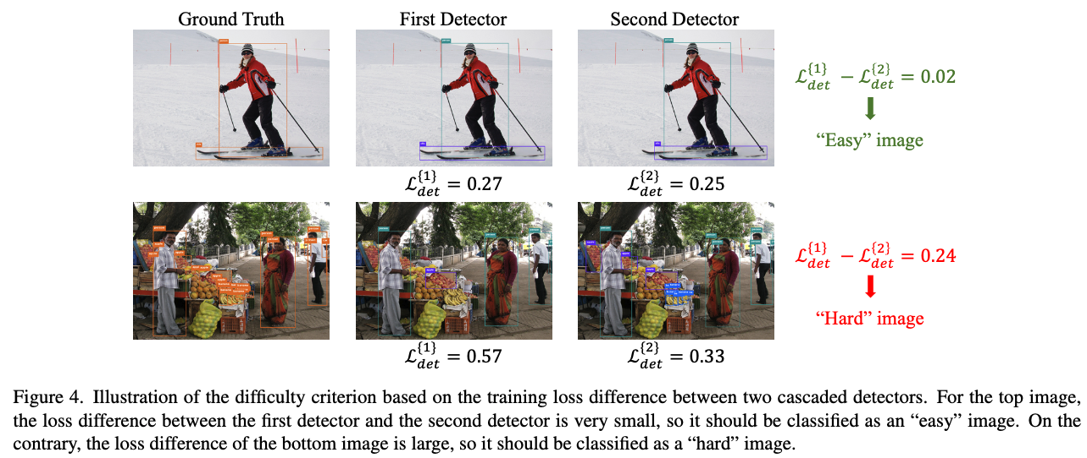
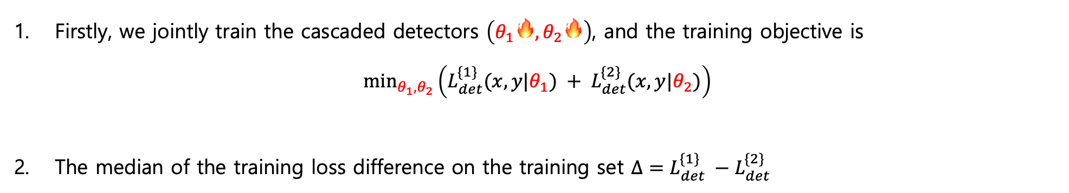
DynamicDet > Optimization strategy
Firstly, we jointly train the cascaded detectors $\left(θ_{1}🔥,θ_{2}🔥\right)$, and the training objective is $\min_{θ_{1},θ_{2}}\left(L_{det}^{\{1\}}(x, y|θ_{1}) + L_{det}^{\{2\}}(x, y|θ_{2})\right)$
The median of the training loss difference on the training set $Δ=L_{det}^{\{1\}} −L_{det}^{\{2\}}$

Slide 8
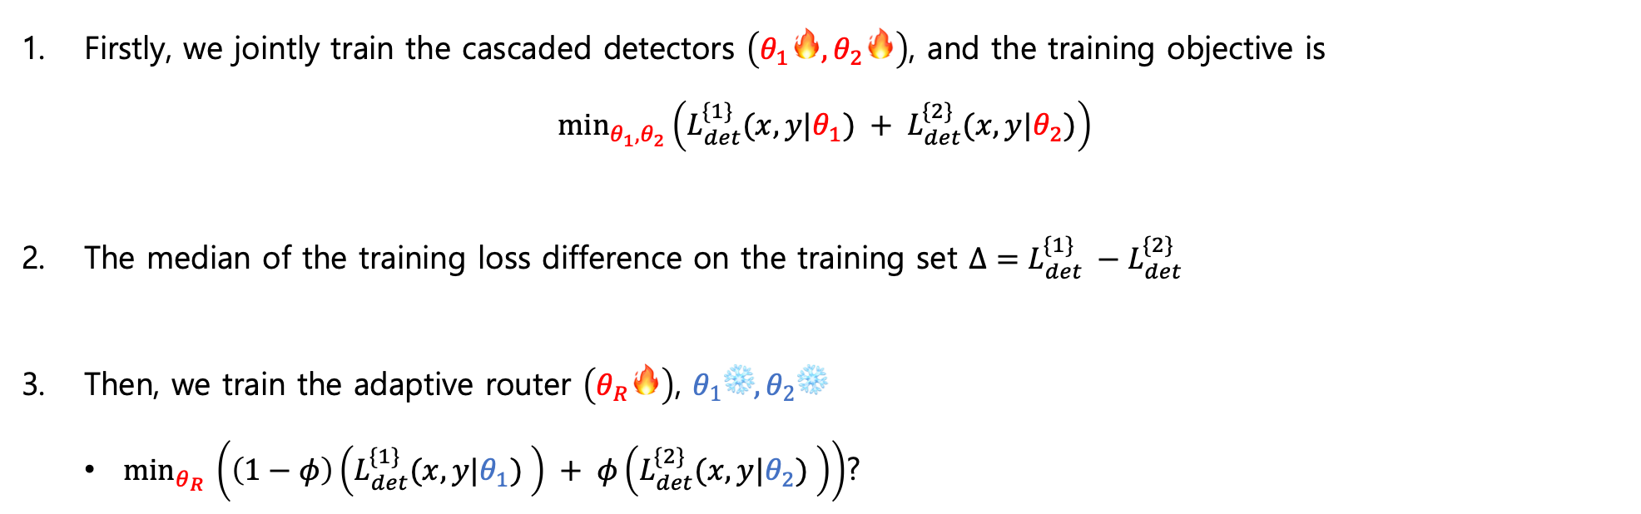
DynamicDet > Optimization strategy
Firstly, we jointly train the cascaded detectors $\left(θ_{1}🔥,θ_{2}🔥\right)$, and the training objective is $\min_{θ_{1},θ_{2}}\left(L_{det}^{\{1\}}(x, y|θ_{1}) + L_{det}^{\{2\}}(x, y|θ_{2})\right)$
The median of the training loss difference on the training set $Δ=L_{det}^{\{1\}} −L_{det}^{\{2\}}$
Then, we train the adaptive router $\left(θ_{R}🔥\right)$, $θ_{1}\text{❄️},θ_{2}\text{❄️}$
$min_{θ_{R} }\left(\left(1−φ\right)\left(L_{det}^{\{1\}}(x, y|θ_{1}) \right) + φ\left(L_{det}^{\{2\}}(x, y|θ_{2}) \right)\right)$?

Slide 9
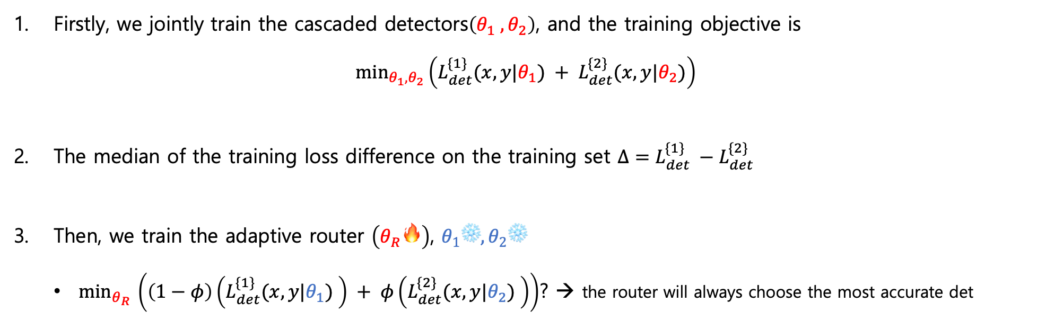
DynamicDet > Optimization strategy
Firstly, we jointly train the cascaded detectors$\left(θ_{1} ,θ_{2}\right)$, and the training objective is $\min_{θ_{1},θ_{2}}\left(L_{det}^{\{1\}}(x, y|θ_{1}) + L_{det}^{\{2\}}(x, y|θ_{2})\right)$
The median of the training loss difference on the training set $Δ=L_{det}^{\{1\}} −L_{det}^{\{2\}}$
Then, we train the adaptive router $\left(θ_{R}🔥\right)$, $θ_{1}\text{❄️},θ_{2}\text{❄️}$
$min_{θ_{R} }\left(\left(1−φ\right)\left(L_{det}^{\{1\}}(x, y|θ_{1}) \right) + φ\left(L_{det}^{\{2\}}(x, y|θ_{2}) \right)\right)$? → the router will always choose the most accurate det

Slide 10
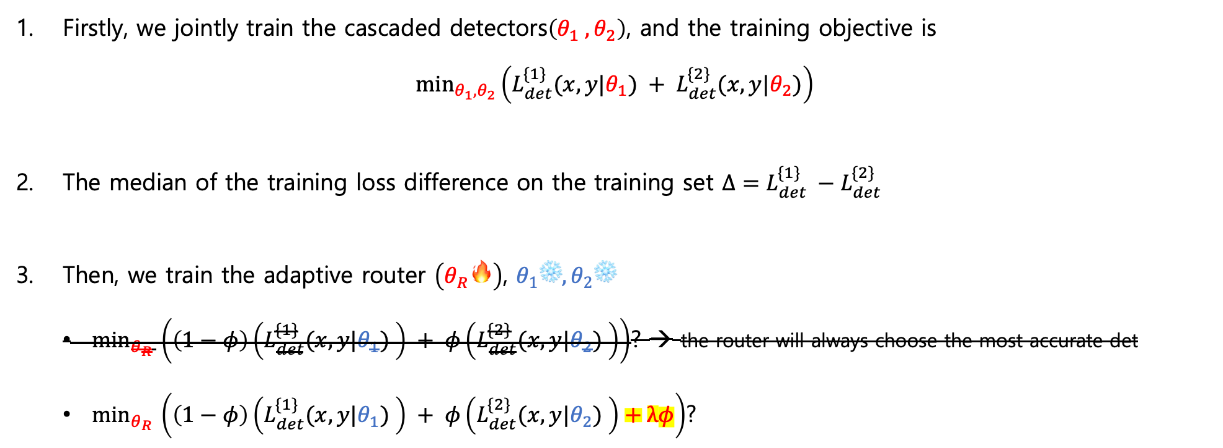
DynamicDet > Optimization strategy
Firstly, we jointly train the cascaded detectors$\left(θ_{1} ,θ_{2}\right)$, and the training objective is $\min_{θ_{1},θ_{2}}\left(L_{det}^{\{1\}}(x, y|θ_{1}) + L_{det}^{\{2\}}(x, y|θ_{2})\right)$
The median of the training loss difference on the training set $Δ=L_{det}^{\{1\}} −L_{det}^{\{2\}}$
Then, we train the adaptive router $\left(θ_{R}🔥\right)$, $θ_{1}\text{❄️},θ_{2}\text{❄️}$
$min_{θ_{R} }\left(\left(1−φ\right)\left(L_{det}^{\{1\}}(x, y|θ_{1}) \right) + φ\left(L_{det}^{\{2\}}(x, y|θ_{2}) \right)\right)$? → the router will always choose the most accurate det
$min_{θ_{R} }\left(\left(1−φ\right)\left(L_{det}^{\{1\}}(x, y|θ_{1}) \right) + φ\left(L_{det}^{\{2\}}(x, y|θ_{2}) \right)+λφ\right)$?

Slide 11
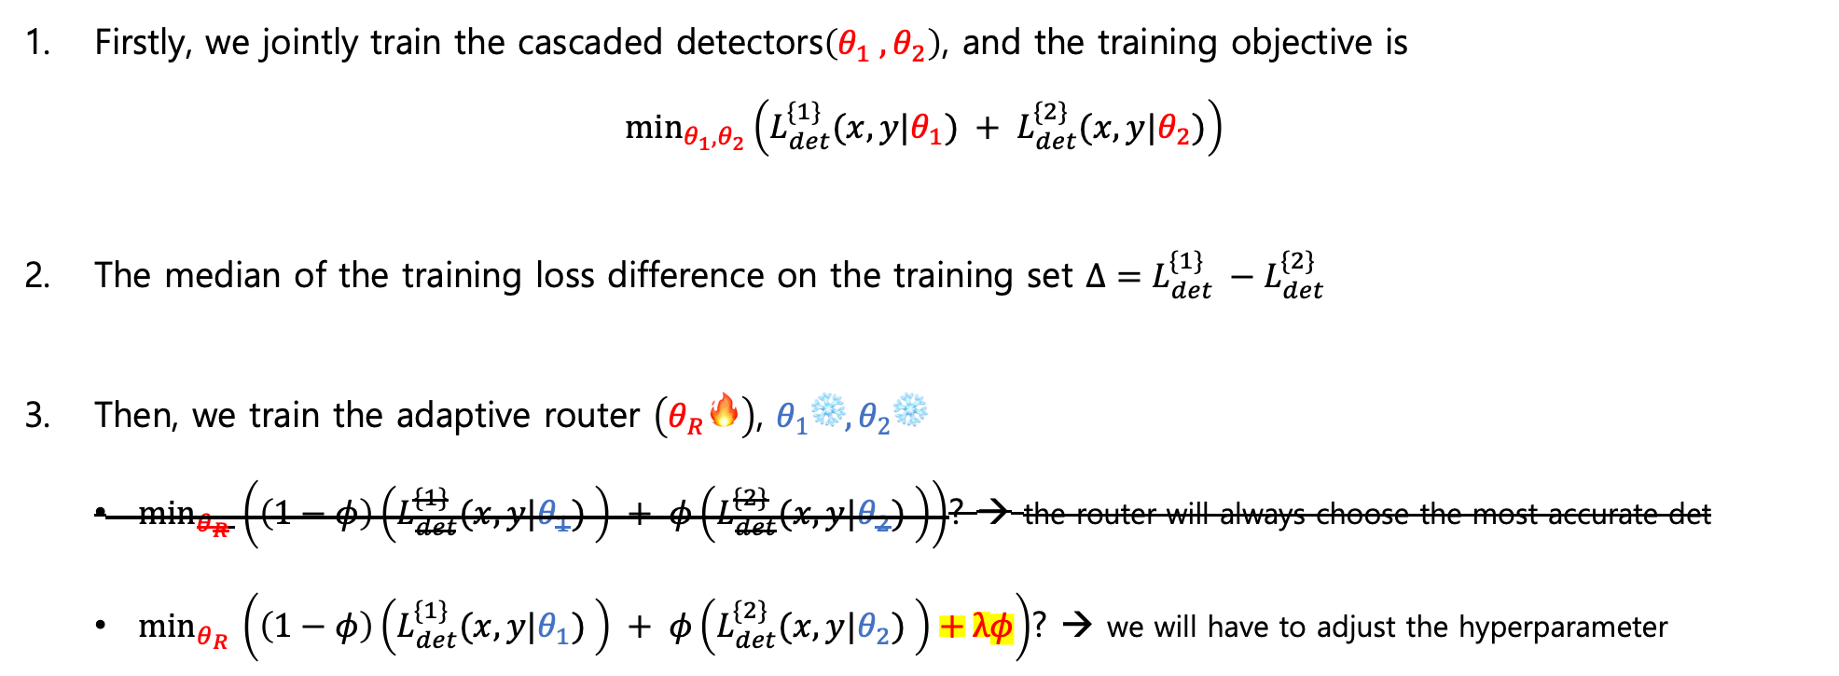
DynamicDet > Optimization strategy
Firstly, we jointly train the cascaded detectors$\left(θ_{1} ,θ_{2}\right)$, and the training objective is $\min_{θ_{1},θ_{2}}\left(L_{det}^{\{1\}}(x, y|θ_{1}) + L_{det}^{\{2\}}(x, y|θ_{2})\right)$
The median of the training loss difference on the training set $Δ=L_{det}^{\{1\}} −L_{det}^{\{2\}}$
Then, we train the adaptive router $\left(θ_{R}🔥\right)$, $θ_{1}\text{❄️},θ_{2}\text{❄️}$
$min_{θ_{R} }\left(\left(1−φ\right)\left(L_{det}^{\{1\}}(x, y|θ_{1}) \right) + φ\left(L_{det}^{\{2\}}(x, y|θ_{2}) \right)\right)$? → the router will always choose the most accurate det
$min_{θ_{R} }\left(\left(1−φ\right)\left(L_{det}^{\{1\}}(x, y|θ_{1}) \right) + φ\left(L_{det}^{\{2\}}(x, y|θ_{2}) \right)+λφ\right)$? → we will have to adjust the hyperparameter

Slide 12
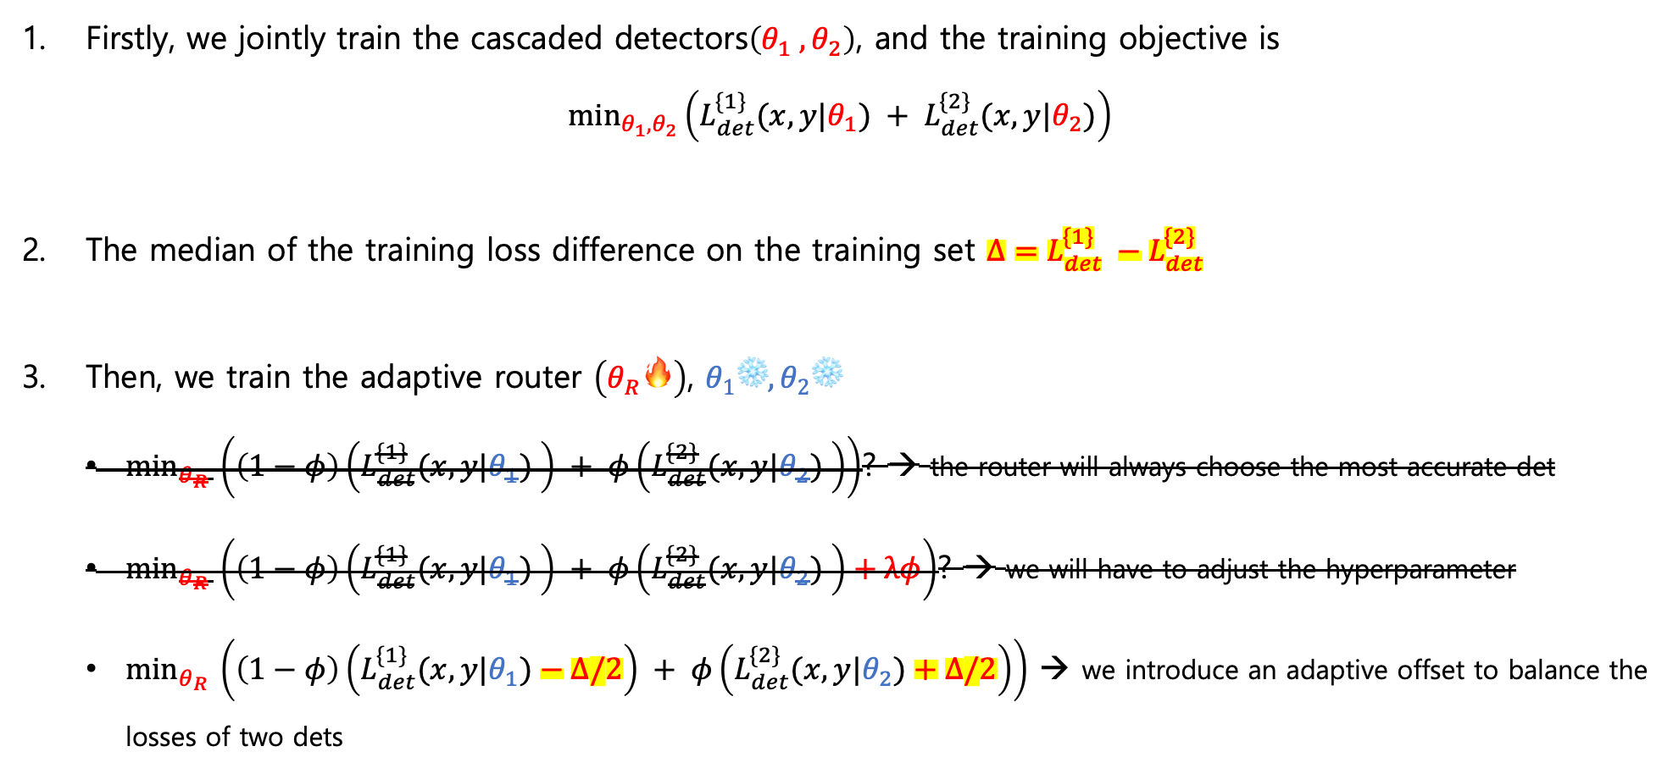
DynamicDet > Optimization strategy
Firstly, we jointly train the cascaded detectors$\left(θ_{1} ,θ_{2}\right)$, and the training objective is $\min_{θ_{1},θ_{2}}\left(L_{det}^{\{1\}}(x, y|θ_{1}) + L_{det}^{\{2\}}(x, y|θ_{2})\right)$
The median of the training loss difference on the training set $Δ=L_{det}^{\{1\}} −L_{det}^{\{2\}}$
Then, we train the adaptive router $\left(θ_{R}🔥\right)$, $θ_{1}\text{❄️},θ_{2}\text{❄️}$
$min_{θ_{R} }\left(\left(1−φ\right)\left(L_{det}^{\{1\}}(x, y|θ_{1}) \right) + φ\left(L_{det}^{\{2\}}(x, y|θ_{2}) \right)\right)$? → the router will always choose the most accurate det
$min_{θ_{R} }\left(\left(1−φ\right)\left(L_{det}^{\{1\}}(x, y|θ_{1}) \right) + φ\left(L_{det}^{\{2\}}(x, y|θ_{2}) \right)+λφ\right)$? → we will have to adjust the hyperparameter
$min_{θ_{R} }\left(\left(1−φ\right)\left(L_{det}^{\{1\}}(x, y|θ_{1})−Δ/2\right) + φ\left(L_{det}^{\{2\}}(x, y|θ_{2})+Δ/2\right)\right)$ → we introduce an adaptive offset to balance the losses of two dets

Slide 13
DynamicDet > Optimization strategy
$Δ$: the median of the training loss difference between the first and the second detector on the training set
$$min_{θ_{R} }\left(\left(1−φ\right)\left(L_{det}^{\{1\}}(x, y|θ_{1})−Δ/2\right) + φ\left(L_{det}^{\{2\}}(x, y|θ_{2})+Δ/2\right)\right)$$
reward to the first detector
penalty to the second detector

Slide 14
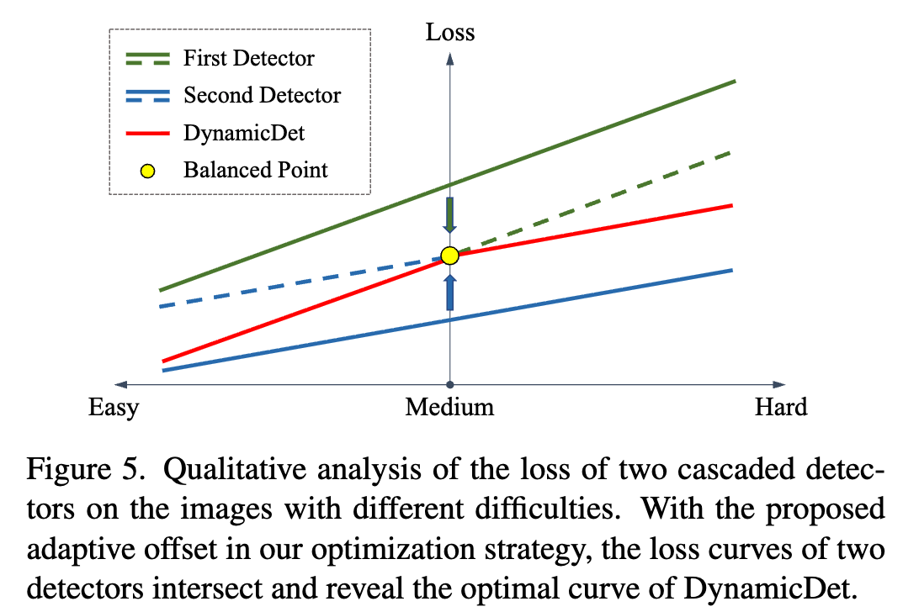
DynamicDet > Optimization strategy
$Δ$: the median of the training loss difference between the first and the second detector on the training set
$$min_{θ_{R} }\left(\left(1−φ\right)\left(L_{det}^{\{1\}}(x, y|θ_{1})−Δ/2\right) + φ\left(L_{det}^{\{2\}}(x, y|θ_{2})+Δ/2\right)\right)$$
reward to the first detector
penalty to the second detector
reward
penalty

Slide 15
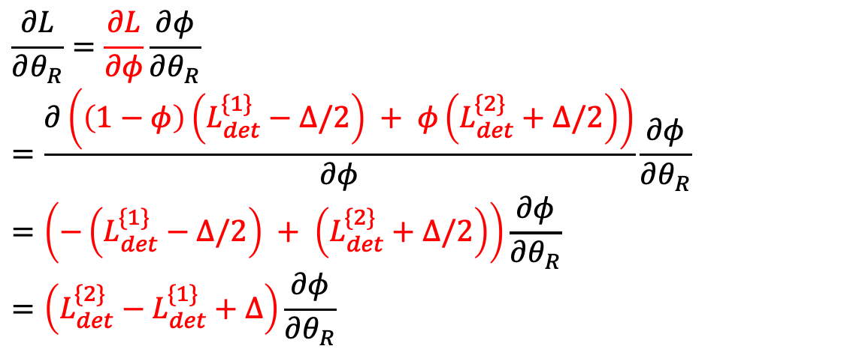
DynamicDet > Optimization strategy
$Δ$: the median of the training loss difference between the first and the second detector on the training set
$$L=min_{θ_{R} }\left(\left(1−φ\right)\left(L_{det}^{\{1\}}(x, y|θ_{1})−Δ/2\right) + φ\left(L_{det}^{\{2\}}(x, y|θ_{2})+Δ/2\right)\right)$$
reward to the first detector
penalty to the second detector
$$\frac{∂L}{∂θ_{R}}=\frac{∂L}{∂φ}\frac{∂φ}{∂θ_{R}} \\ =\frac{∂\left(\left(1−φ\right)\left(L_{det}^{\{1\}}−Δ/2\right) + φ\left(L_{det}^{\{2\}}+Δ/2\right)\right)}{∂φ}\frac{∂φ}{∂θ_{R}} \\ =\left(−\left(L_{det}^{\{1\}}−Δ/2\right) + \left(L_{det}^{\{2\}}+Δ/2\right)\right)\frac{∂φ}{∂θ_{R}} \\ =\left(L_{det}^{\{2\}}−L_{det}^{\{1\}}+Δ\right)\frac{∂φ}{∂θ_{R}}$$
reward
penalty

Slide 16
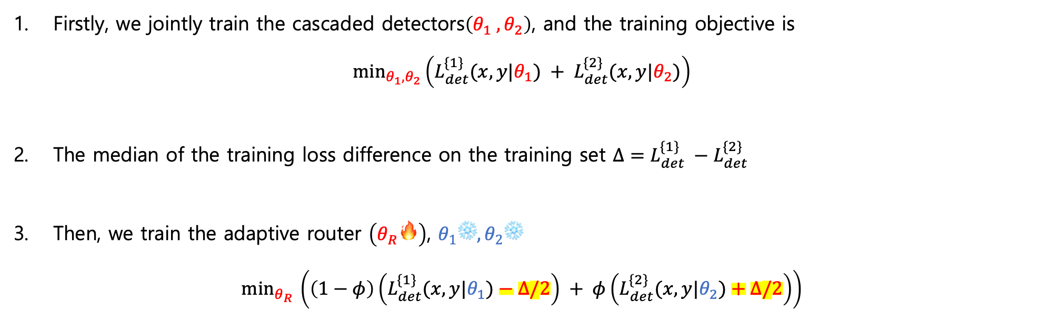
DynamicDet > Optimization strategy
Firstly, we jointly train the cascaded detectors$\left(θ_{1} ,θ_{2}\right)$, and the training objective is $\min_{θ_{1},θ_{2}}\left(L_{det}^{\{1\}}(x, y|θ_{1}) + L_{det}^{\{2\}}(x, y|θ_{2})\right)$
The median of the training loss difference on the training set $Δ=L_{det}^{\{1\}} −L_{det}^{\{2\}}$
Then, we train the adaptive router $\left(θ_{R}🔥\right)$, $θ_{1}\text{❄️},θ_{2}\text{❄️}$ $min_{θ_{R} }\left(\left(1−φ\right)\left(L_{det}^{\{1\}}(x, y|θ_{1})−Δ/2\right) + φ\left(L_{det}^{\{2\}}(x, y|θ_{2})+Δ/2\right)\right)$

Slide 17
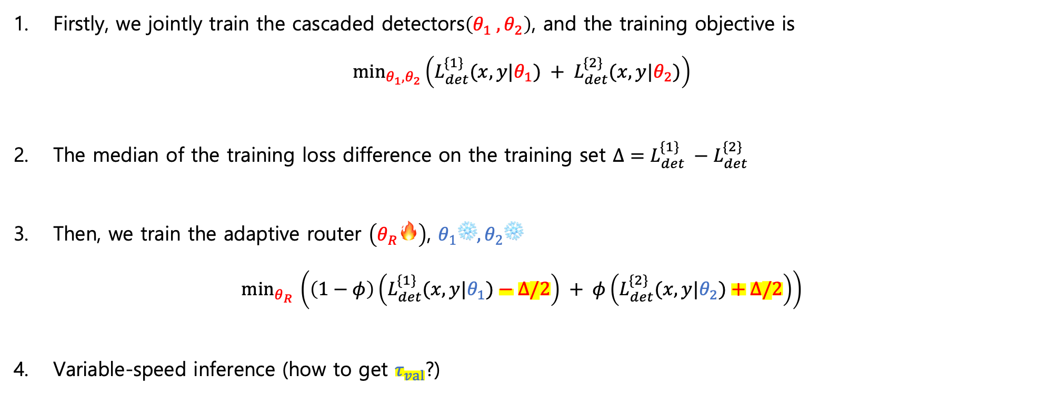
DynamicDet
Firstly, we jointly train the cascaded detectors$\left(θ_{1} ,θ_{2}\right)$, and the training objective is $\min_{θ_{1},θ_{2}}\left(L_{det}^{\{1\}}(x, y|θ_{1}) + L_{det}^{\{2\}}(x, y|θ_{2})\right)$
The median of the training loss difference on the training set $Δ=L_{det}^{\{1\}} −L_{det}^{\{2\}}$
Then, we train the adaptive router $\left(θ_{R}🔥\right)$, $θ_{1}\text{❄️},θ_{2}\text{❄️}$ $min_{θ_{R} }\left(\left(1−φ\right)\left(L_{det}^{\{1\}}(x, y|θ_{1})−Δ/2\right) + φ\left(L_{det}^{\{2\}}(x, y|θ_{2})+Δ/2\right)\right)$
Variable-speed inference (how to get $τ_{val}$?)

Slide 18
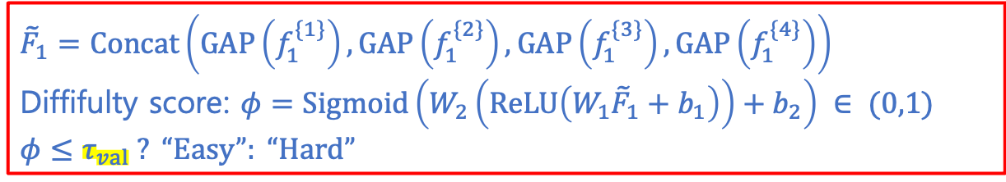
DynamicDet > Overall architecture
$${\tilde{F}}_{1}=Concat\left(GAP\left(f_{1}^{\{1\}}\right),GAP\left(f_{1}^{\{2\}}\right),GAP\left(f_{1}^{\{3\}}\right),GAP\left(f_{1}^{\{4\}}\right)\right)$$ Diffifulty score: $φ=Sigmoid\left(W_{2}\left(ReLU\left(W_{1}{\tilde{F}}_{1}+b_{1}\right)\right)+b_{2}\right) ∈ (0,1)$
$$φ≤τ_{val} ? “Easy”: “Hard”$$
Step 1
Step 2
$$F_{1}=B_{1}\left(x\right)=\left[f_{1}^{\{1\}},f_{1}^{\{2\}},f_{1}^{\{3\}},f_{1}^{\{4\}}\right]$$
$$f_{1}^{\{4\}}$$
$$f_{1}^{\{3\}}$$
$$f_{1}^{\{2\}}$$
$$f_{1}^{\{1\}}$$
$$x$$
$$x$$

Slide 19
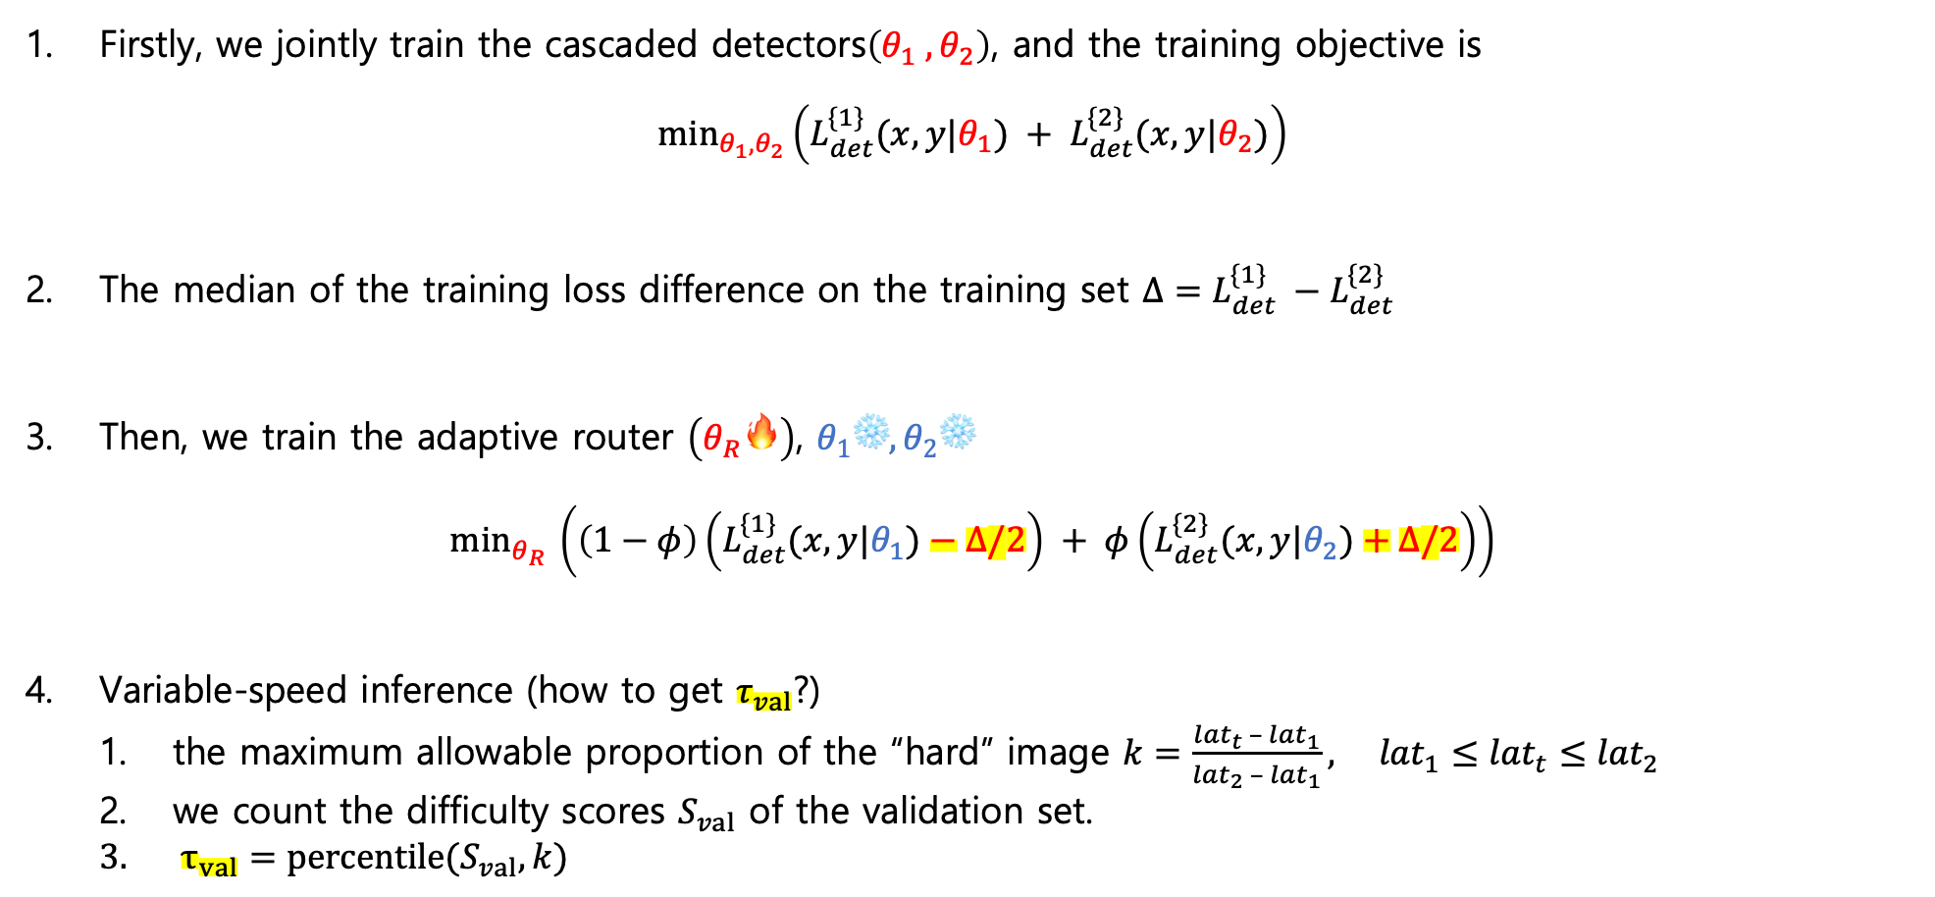
DynamicDet
Firstly, we jointly train the cascaded detectors$\left(θ_{1} ,θ_{2}\right)$, and the training objective is $\min_{θ_{1},θ_{2}}\left(L_{det}^{\{1\}}(x, y|θ_{1}) + L_{det}^{\{2\}}(x, y|θ_{2})\right)$
The median of the training loss difference on the training set $Δ=L_{det}^{\{1\}} −L_{det}^{\{2\}}$
Then, we train the adaptive router $\left(θ_{R}🔥\right)$, $θ_{1}\text{❄️},θ_{2}\text{❄️}$ $min_{θ_{R} }\left(\left(1−φ\right)\left(L_{det}^{\{1\}}(x, y|θ_{1})−Δ/2\right) + φ\left(L_{det}^{\{2\}}(x, y|θ_{2})+Δ/2\right)\right)$
Variable-speed inference (how to get $τ_{val}$?)
the maximum allowable proportion of the “hard” image $k=\frac{{lat}_{t} – {lat}_{1}}{{lat}_{2} – {lat}_{1}}, {lat}_{1}≤{lat}_{t}≤{lat}_{2}$
we count the difficulty scores $S_{val}$ of the validation set.
$τ_{val}=percentile(S_{val}, k)$

Slide 20
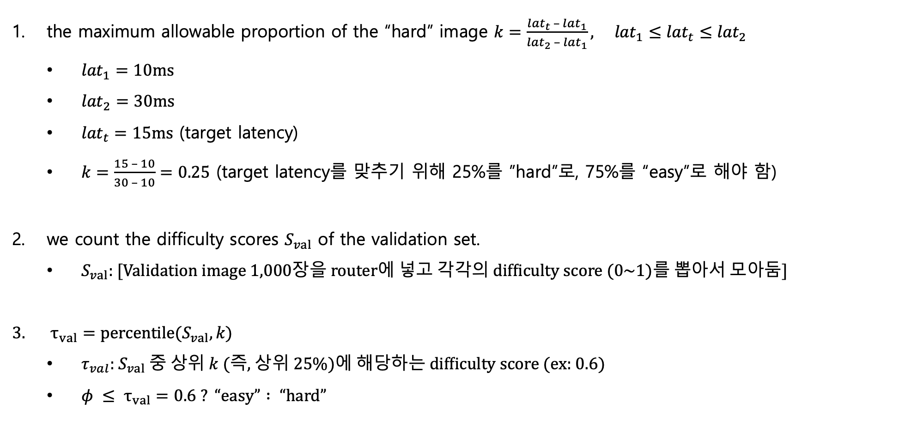
Variable-speed inference (how to get $τ_{val}$?) > Example
the maximum allowable proportion of the “hard” image $k=\frac{{lat}_{t} – {lat}_{1}}{{lat}_{2} – {lat}_{1}}, {lat}_{1}≤{lat}_{t}≤{lat}_{2}$
${lat}_{1}=10ms$
${lat}_{2}=30ms$
${lat}_{t}=15ms$ (target latency)
$k=\frac{15 – 10}{30 – 10}=0.25$ (target latency를 맞추기 위해 25%를 ”hard”로, 75%를 “easy”로 해야 함)
we count the difficulty scores $S_{val}$ of the validation set.
$S_{val}$: [Validation image 1,000장을 router에 넣고 각각의 difficulty score (0~1)를 뽑아서 모아둠]
$τ_{val}=percentile(S_{val}, k)$
$τ_{val}$: $S_{val}$ 중 상위 $k$ (즉, 상위 25%)에 해당하는 difficulty score (ex: 0.6)
$φ ≤ τ_{val}=0.6 ? “easy” : “hard”$

Slide 21
Experiments
We use brief notation to indicate the easy-hard proportion for each dynamic detector: for instance, “Dy-YOLOv7-X/10” means the dynamic YOLOv7-X model with 10% images are classified as “hard” and the rest are classified as “easy”.

Slide 22
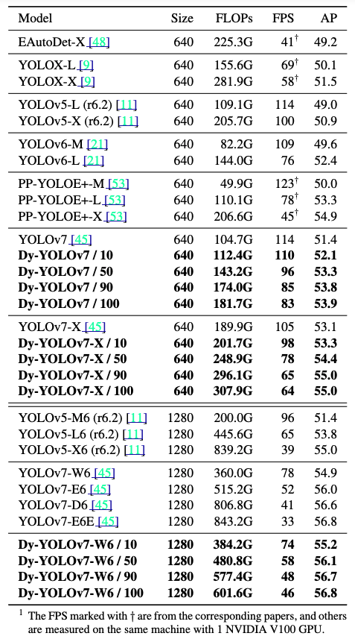
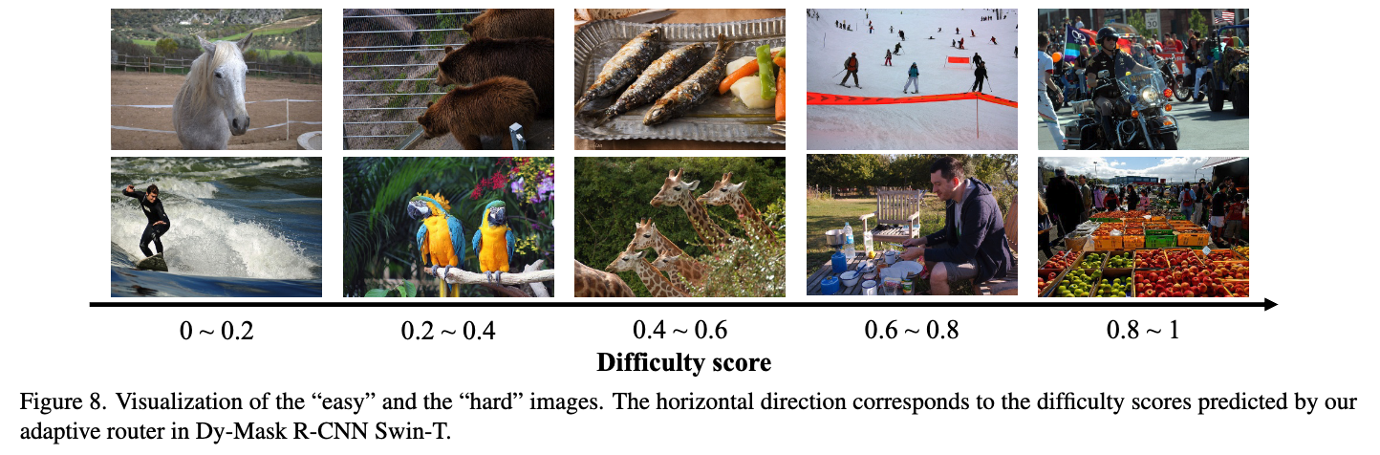
Experiments

