Slide 1
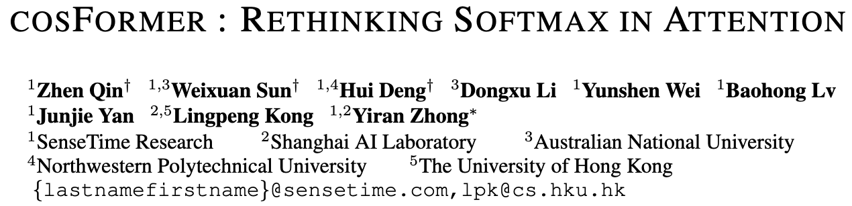

| Paper Review & 연구 진행 상황 공유 |
Hyungseop Lee
Department of Embedded Systems Engineering, INU hhss0927@inu.ac.kr
ICLR 2022
ICCV 2023

Slide 2
Outline
Softmax-based Self-Attention
Linear Attention
Sparse Attention
Low-rank representations
*Kernel-based methods
EfficientViT: ReLU-based Linear Self-Attention
CosFormer: ReLU-based Linear Self-Attention + cosine-based re-weighting scheme
Applying CosFormer to My Research

Slide 3
Outline
Softmax-based Self-Attention
Linear Attention
Sparse Attention
Low-rank representations
*Kernel-based methods
EfficientViT: ReLU-based Linear Self-Attention
CosFormer: ReLU-based Linear Self-Attention + cosine-based re-weighting scheme
Applying CosFormer to My Research

Slide 4
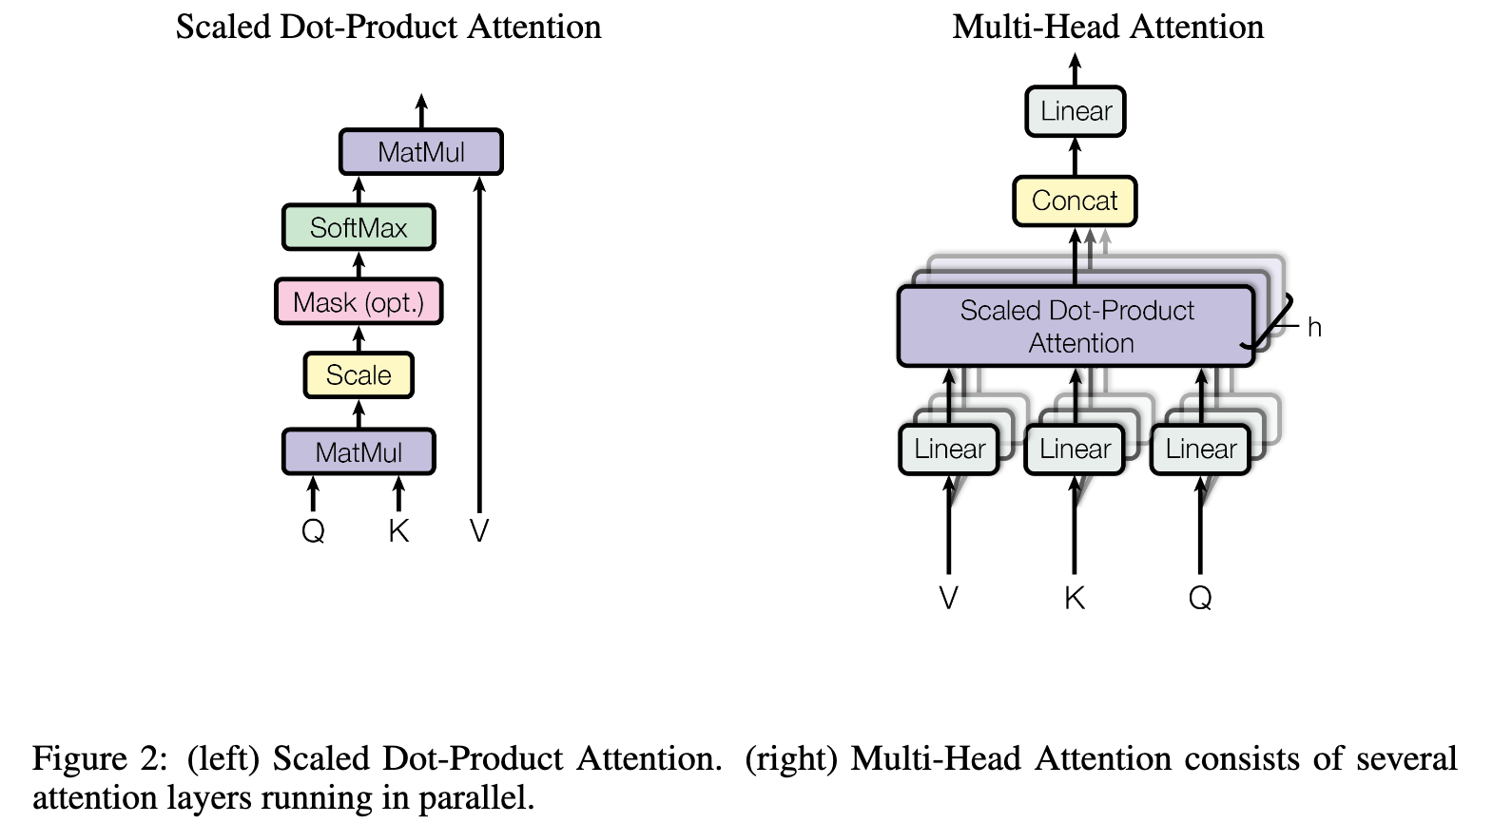
Softmax-based self-attention
“Dot-product attention with softmax normalization is the cornerstone of the transformer to capture long-range dependencies.”
Vaswani, Ashish, et al. "Attention is all you need." Advances in neural information processing systems 30 (2017).

Slide 5

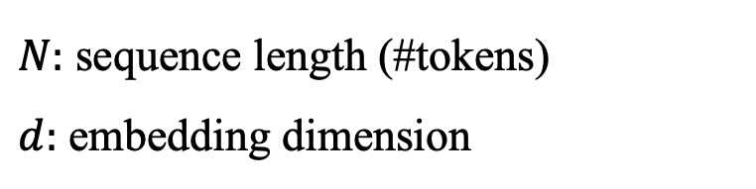
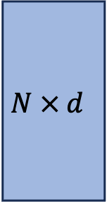


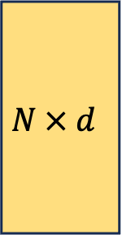
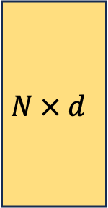

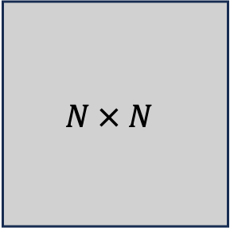
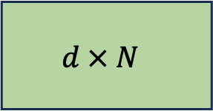

Softmax-based self-attention
$N:$ sequence length (#tokens)
$d:$ embedding dimension
$$N × d$$
$$N × d$$
$$N × N$$
$$N × d$$
$$d × N$$
$$Softmax$$
$$Q$$
$$K^{T}$$
$$V$$
$$S\left(Q, K^{T}\right)V$$

Slide 6

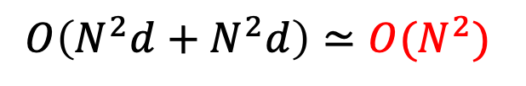






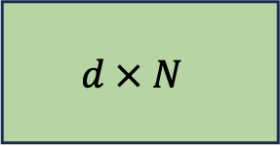


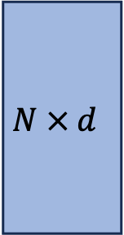


Softmax-based self-attention
“Vanilla self-attention suffers from quadratic time and memory complexity with respect to the input sequence length ($N$).”
→ “To address this issue, numerous methods are proposed recently, such as …”
$$O\left(N^{2}d\right)$$
$$O\left(N^{2}d+N^{2}d\right)≃O(N^{2})$$
$$O\left(N^{2}d\right)$$
$$N × d$$
$$N × d$$
$$N × N$$
$$N × d$$
$$d × N$$
$$Softmax$$
$$Q$$
$$K^{T}$$
$$V$$
$$S\left(Q, K^{T}\right)V$$

Slide 7
Outline
Softmax-based Self-Attention
Linear Attention
Sparse Attention
Low-rank representations
*Kernel-based methods
EfficientViT: ReLU-based Linear Self-Attention
CosFormer: ReLU-based Linear Self-Attention + cosine-based re-weighting scheme
Applying CosFormer to My Research

Slide 8
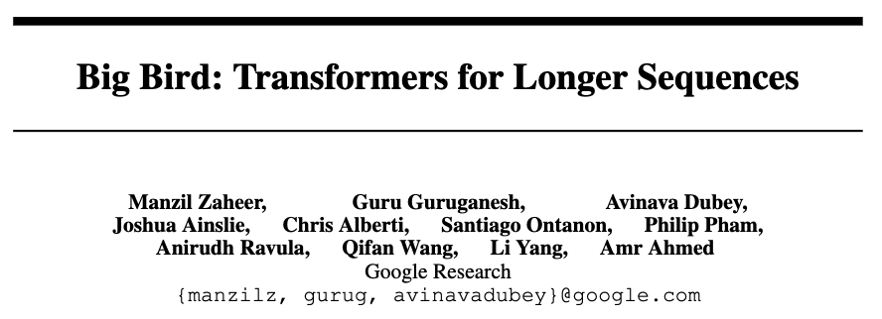
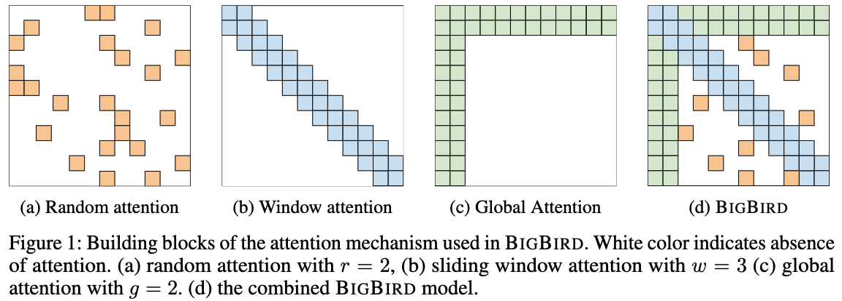
Linear Attention
Sparse attention matrix
Low-rank representations
Kernel-based methods
Zaheer, Manzil, et al. "Big bird: Transformers for longer sequences." Advances in neural information processing systems 33 (2020): 17283-17297.

Slide 9
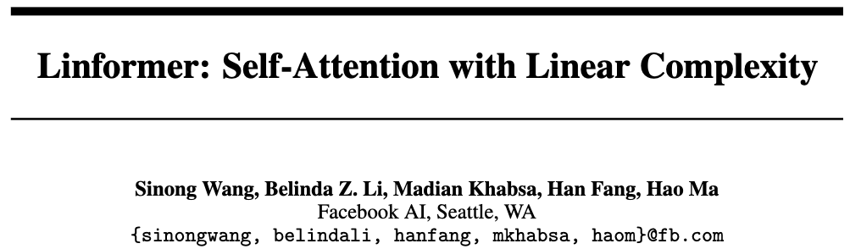
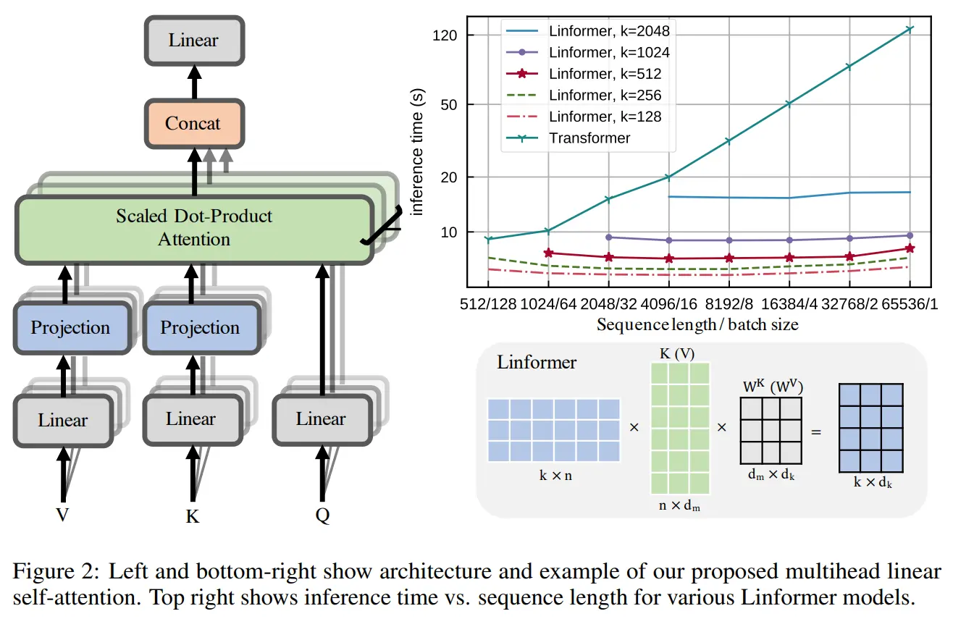
Linear Attention
Sparse attention matrix
Low-rank representations
Kernel-based methods
Wang, Sinong, et al. "Linformer: Self-attention with linear complexity." arXiv preprint arXiv:2006.04768 (2020).

Slide 10



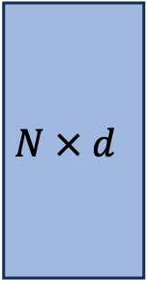


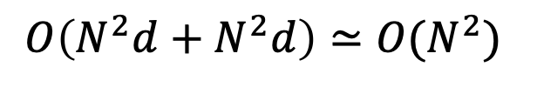

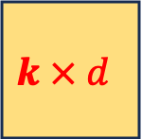
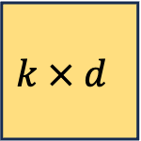
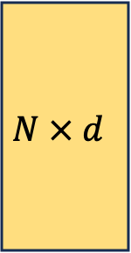
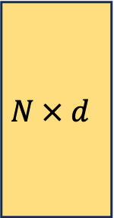

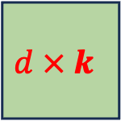

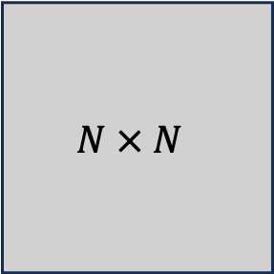
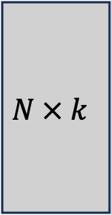
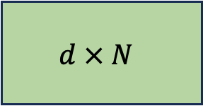



$$O\left(N^{2}d\right)$$
$$O\left(N^{2}d+N^{2}d\right)≃O(N^{2})$$
$$O\left(N^{2}d\right)$$
$$N × d$$
$$N × d$$
$$N × N$$
$$N × d$$
$$d × N$$
$$Softmax$$
$$Q$$
$$K^{T}$$
$$V$$
Low Rank Approximation
$$O\left(Ndk\right)$$
$$O\left(2Ndk\right)≃O(N)$$
$$O\left(Ndk\right)$$
$$N × d$$
$$N × k$$
$$d × k$$
$$k × d$$
$$k × d$$
$$Softmax$$
$$Q$$
$${K′}^{T}$$
$$V′$$

Slide 11
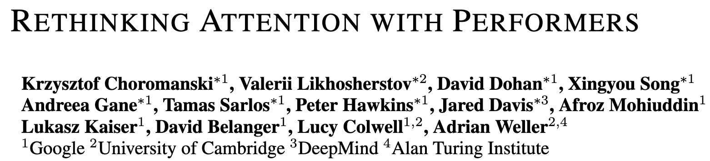
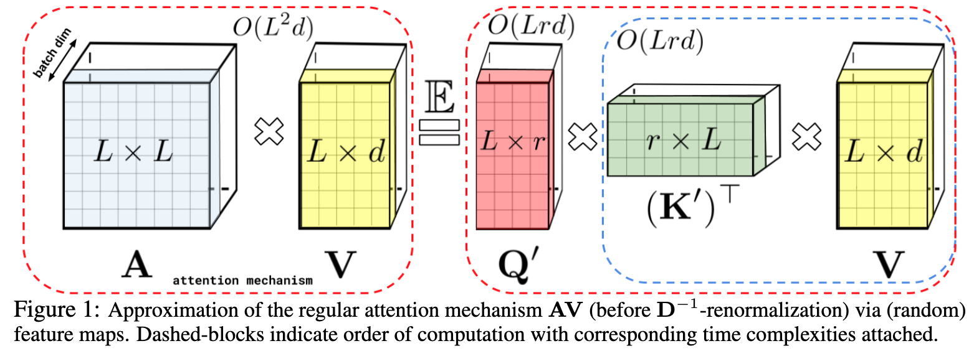
Linear Attention
Sparse attention matrix
Low-rank representations
Kernel-based methods
Choromanski, K. et al. Rethinking attention with performers. In International Conference on Learning Representations (2021).

Slide 12



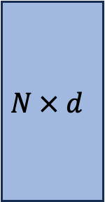
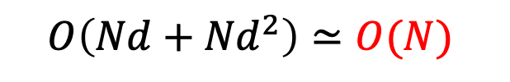

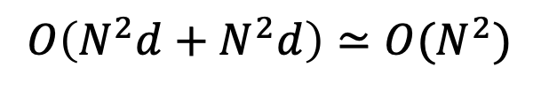

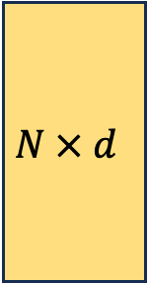
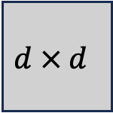
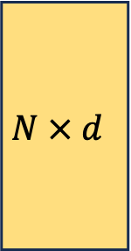
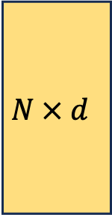


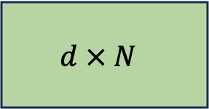
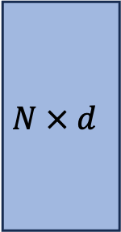
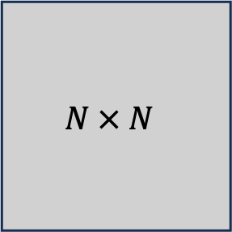

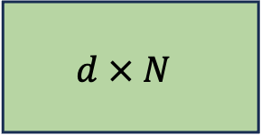



$$O\left(N^{2}d\right)$$
$$O\left(N^{2}d+N^{2}d\right)≃O(N^{2})$$
$$O\left(N^{2}d\right)$$
$$N × d$$
$$N × d$$
$$N × N$$
$$N × d$$
$$d × N$$
$$Softmax$$
$$Q$$
$$K^{T}$$
$$V$$
Associative property
$$O\left(Nd\right)$$
$$O\left(Nd+{Nd}^{2}\right)≃O(N)$$
$$O\left(Nd^{2}\right)$$
$$N × d$$
$$N × d$$
$$N × d$$
$$d × N$$
$$d × d$$
$$Q$$
$$K^{T}$$
$$V$$

Slide 13
$$O\left(N^{2}d\right)$$
$$O\left(N^{2}d+N^{2}d\right)≃O(N^{2})$$
$$O\left(N^{2}d\right)$$
$$N × d$$
$$N × d$$
$$N × N$$
$$N × d$$
$$d × N$$
$$Softmax$$
$$Q$$
$$K^{T}$$
$$V$$
Associative property
$$O\left(Nd\right)$$
$$O\left(Nd+{Nd}^{2}\right)≃O(N)$$
$$O\left(Nd^{2}\right)$$
$$N × d$$
$$N × d$$
$$N × d$$
$$d × N$$
$$d × d$$
$$Q$$
$$K^{T}$$
$$V$$
이게 왜 kernel-based methods인가?

Slide 14
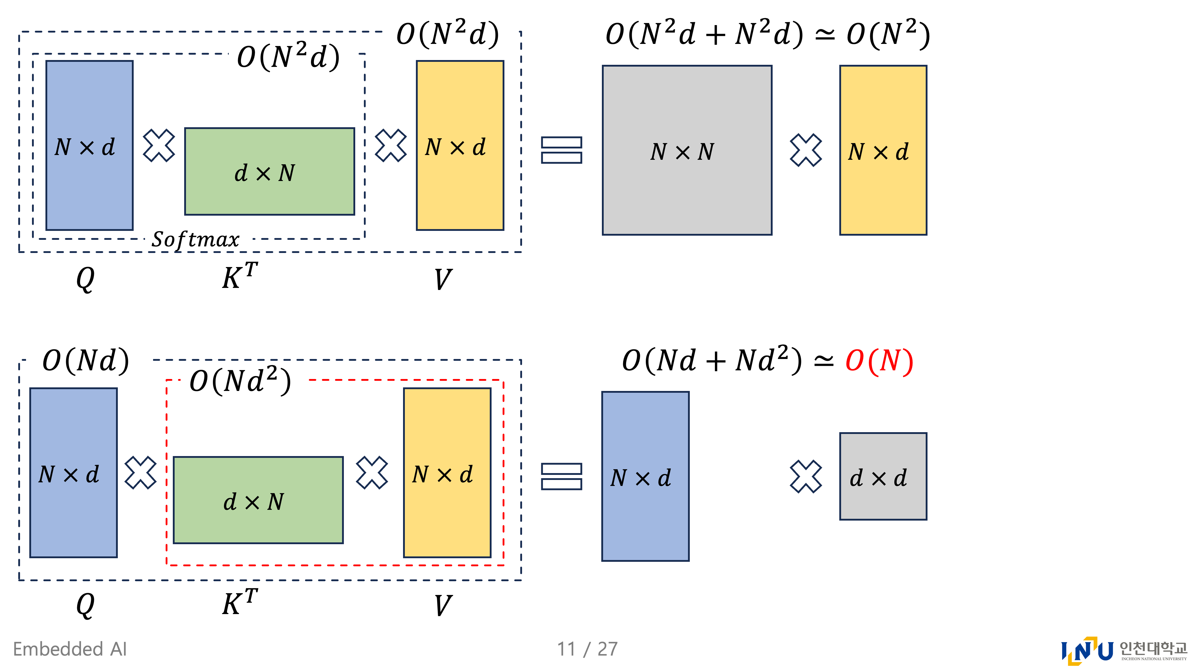


$$S\left(Q,K^{T}\right)=Softmax\left(Q, K^{T}\right)$$
$$S\left(Q, K^{T}\right)V$$
$$Similarty\left(⋅,⋅\right)=Softmax\left(⋅, ⋅\right)$$
$Q(K^{T},V)$ Where is $S\left(⋅,⋅\right)$?
Let. $S\left(Q, K^{T}\right)≃φ\left(Q, K^{T}\right)$ $φ\left(⋅\right)$ must be decomposable
$S\left(Q, K^{T}\right)V≃φ\left(Q\right)φ\left(K^{T}\right)V$ $φ\left(⋅\right)$ is called kernel function
$$\left\{φ\left(Q\right)φ\left(K^{T}\right)\right\}V$$
$$=φ\left(Q\right)\{φ\left(K^{T}\right)V\}$$

Slide 15

Let. $Softmax\left(Q, K^{T}\right)≃φ\left(Q, K^{T}\right)$
How can we define the kernel function $φ\left(⋅, ⋅\right)$?
→ 기존의 $softmax$–based $S(⋅, ⋅)$의 속성:
$$S(Q, K^{T})=\frac{exp⁡\left(\frac{QK^{T}}{\sqrt{d_{k}}}\right)}{Σexp⁡\left(\frac{QK^{T}}{\sqrt{d_{k}}}\right)}$$
“Non-negativeness of the attention matrix”
“A non-linear re-weighting scheme”

Slide 16
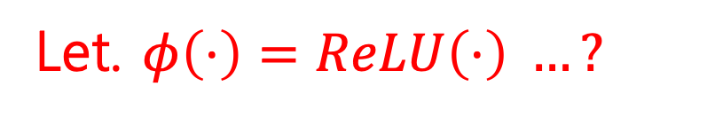
Let. $Softmax\left(Q, K^{T}\right)≃φ\left(Q, K^{T}\right)$
How can we define the kernel function $φ\left(⋅, ⋅\right)$?
→ 기존의 $softmax$–based $S(⋅, ⋅)$의 속성:
$$S(Q, K^{T})=\frac{exp⁡\left(\frac{QK^{T}}{\sqrt{d_{k}}}\right)}{Σexp⁡\left(\frac{QK^{T}}{\sqrt{d_{k}}}\right)}$$
“Non-negativeness of the attention matrix”
“A non-linear re-weighting scheme”
Let. $φ\left(⋅\right)=ReLU\left(⋅\right) …?$

Slide 17
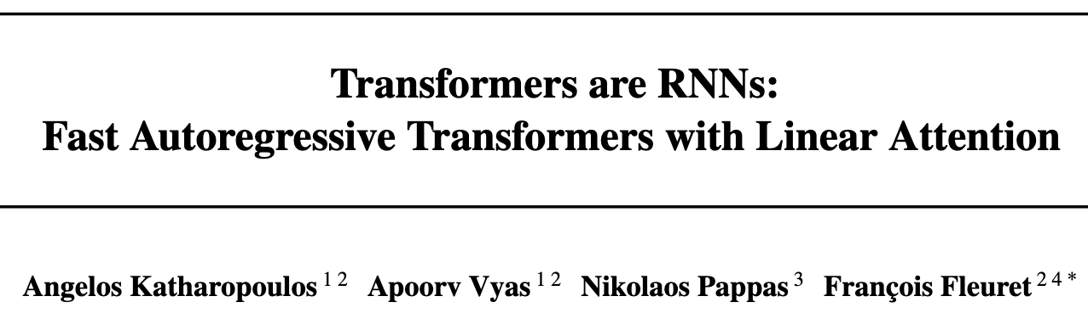
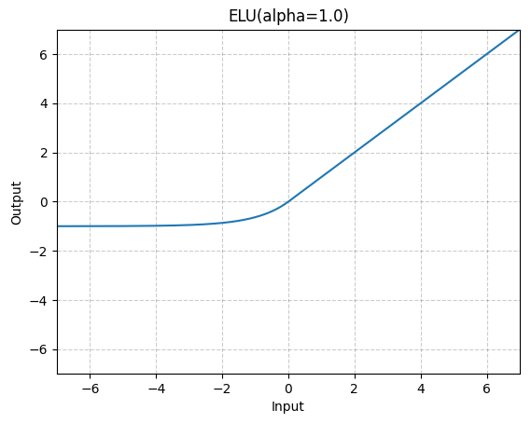
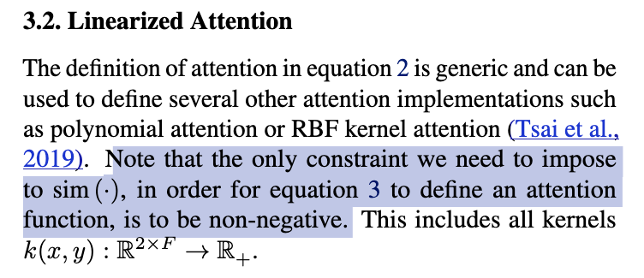



Katharopoulos, Angelos, et al. "Transformers are rnns: Fast autoregressive transformers with linear attention." International conference on machine learning. PMLR, 2020.

Slide 18




Cai, Han, et al. "Efficientvit: Lightweight multi-scale attention for high-resolution dense prediction." Proceedings of the IEEE/CVF international conference on computer vision. 2023.

Slide 19


Let. $Softmax\left(Q, K^{T}\right)≃φ\left(Q, K^{T}\right)$
How can we define the kernel function $φ\left(⋅, ⋅\right)$?
→ 기존의 $softmax$–based attention의 속성:
$$S(Q, K^{T})=\frac{exp⁡\left(\frac{QK^{T}}{\sqrt{d_{k}}}\right)}{Σexp⁡\left(\frac{QK^{T}}{\sqrt{d_{k}}}\right)}$$
“Non-negativeness of the attention matrix”
“A non-linear re-weighting scheme”
$$S\left(Q,K^{T}\right)V≃φ\left(Q\right)\left\{φ\left(K^{T}\right)V\right\}$$
$=ReLU\left(Q\right)\{ReLU\left(K^{T}\right)V\}$

Slide 20
Let. $Softmax\left(Q, K^{T}\right)≃φ\left(Q, K^{T}\right)$
How can we define the kernel function $φ\left(⋅, ⋅\right)$?
→ 기존의 $softmax$–based attention의 속성:
$$S(Q, K^{T})=\frac{exp⁡\left(\frac{QK^{T}}{\sqrt{d_{k}}}\right)}{Σexp⁡\left(\frac{QK^{T}}{\sqrt{d_{k}}}\right)}$$
“Non-negativeness of the attention matrix”
“A non-linear re-weighting scheme”
$$S\left(Q,K^{T}\right)V≃φ\left(Q\right)\left\{φ\left(K^{T}\right)V\right\}$$
$=ReLU\left(Q\right)\{ReLU\left(K^{T}\right)V\}$
Notes:
그런데… A non-linear re-weighting scheme을 고려하지 않고 있었음..
가중합으로 나눔으로써 정규화 → 이는 non-linear re-weighting임
ReLU만 사용하면 re-weighting scheme이 없음.

Slide 21


Let. $Softmax\left(Q, K^{T}\right)≃φ\left(Q, K^{T}\right)$
How can we define the kernel function $φ\left(⋅, ⋅\right)$?
→ 기존의 $softmax$–based attention의 속성:
$$S(Q, K^{T})=\frac{exp⁡\left(\frac{QK^{T}}{\sqrt{d_{k}}}\right)}{Σexp⁡\left(\frac{QK^{T}}{\sqrt{d_{k}}}\right)}$$
“Non-negativeness of the attention matrix”
“A non-linear re-weighting scheme”
$$S\left(Q,K^{T}\right)V≃φ\left(Q\right)\left\{φ\left(K^{T}\right)V\right\}$$
$=ReLU\left(Q\right)\{ReLU\left(K^{T}\right)V\}$
→ $\left\{ReLU\left(Q\right)ReLU\left(K^{T}\right)\right\}cos\left(\frac{π}{2} ×\frac{i−j}{M}\right)V$
Notes:
그래서 cos-former는 cosine 기반 re-weighting scheme을 도입함

Slide 22



$$S\left(Q,K^{T}\right)V≃φ\left(Q\right)\left\{φ\left(K^{T}\right)V\right\}$$
$=ReLU\left(Q\right)\{ReLU\left(K^{T}\right)V\}$
→ $\left\{ReLU\left(Q\right)ReLU\left(K^{T}\right)\right\}cos\left(\frac{π}{2} ×\frac{i−j}{M}\right)V$
$cos\left(\frac{π}{2} ×\frac{i−j}{M}\right)$가 갖는 의미?

Slide 23






$$S\left(Q,K^{T}\right)V≃φ\left(Q\right)\left\{φ\left(K^{T}\right)V\right\}$$
$=ReLU\left(Q\right)\{ReLU\left(K^{T}\right)V\}$
→ $\left\{ReLU\left(Q\right)ReLU\left(K^{T}\right)\right\}cos\left(\frac{π}{2} ×\frac{i−j}{M}\right)V$
$cos\left(\frac{π}{2} ×\frac{i−j}{M}\right)$가 갖는 의미?
$M$: sequence length (500)
$i,j$: 각각 $Q, K$ sequence 내 index (0~499)
$$\frac{i−j}{M}∈(−1, 1)$$
$$i=j$$
$$i=0$$
$$j=499$$
$$i=499$$
$$j=0$$
Notes:
그래서 $\frac{i−j}{M}$은 -1부터 1로 정규화된 거리를 의미함
그래서 cos(-pi/2) 부터 cos(pi/2)까지만 잘라서 가져왔음

Slide 24



$$S\left(Q,K^{T}\right)V≃φ\left(Q\right)\left\{φ\left(K^{T}\right)V\right\}$$
$=ReLU\left(Q\right)\{ReLU\left(K^{T}\right)V\}$
→ $\left\{ReLU\left(Q\right)ReLU\left(K^{T}\right)\right\}cos\left(\frac{π}{2} ×\frac{i−j}{M}\right)V$
$cos\left(\frac{π}{2} ×\frac{i−j}{M}\right)$가 갖는 의미?
$M$: sequence length (500)
$i,j$: 각각 $Q, K$ sequence 내 index (0~499)
$$\frac{i−j}{M}∈(−1, 1)$$
$$i$$
1
0
$$i=j$$
0
$$j$$
$$i=0$$
$$j=499$$
$$i=499$$
$$j=0$$
Notes:
따라서 가까이에 있는 token. 즉 서로 인접한 token에 대해서는 weight를 1로 주고
서로 멀리 떨어져있는 token에 대해서는 weight를 0으로 줘서 re-weighting하는 방법을 도입했다.

Slide 25

$$S\left(Q,K^{T}\right)V≃φ\left(Q\right)\left\{φ\left(K^{T}\right)V\right\}$$
$=ReLU\left(Q\right)\{ReLU\left(K^{T}\right)V\}$
→ $\left\{ReLU\left(Q\right)ReLU\left(K^{T}\right)\right\}cos\left(\frac{π}{2} ×\frac{i−j}{M}\right)V$
$cos\left(\frac{π}{2} ×\frac{i−j}{M}\right)$가 갖는 의미?

Slide 26

Linear Attention
Sparse attention matrix
Low-rank representations
Kernel-based methods
$$S\left(Q,K^{T}\right)V≃φ\left(Q\right)\left\{φ\left(K^{T}\right)V\right\}$$
→ $\left\{φ\left(Q\right)φ\left(K^{T}\right)\right\}cos\left(\frac{π}{2} ×\frac{i−j}{M}\right)V$

Slide 27
Outline
Softmax-based Self-Attention
Linear Attention
Sparse Attention
Low-rank representations
*Kernel-based methods
EfficientViT: ReLU-based Linear Self-Attention
CosFormer: ReLU-based Linear Self-Attention + cosine-based re-weighting scheme
Applying CosFormer to My Research

Slide 28

Applying CosFormer to My Research
Notes:
지금 투고중인 논문에서는 cross attention의 경량화를 위해 가장 작은 해상도를 갖는 feature map의 sequence length N으로 downsampling 했었다.. 만약 이게 없었더라면?

Slide 29

















Applying CosFormer to My Research
$$\tilde{P_{l}}$$
$$inject$$
$$A_{l→l+1}^{up}$$
$$20 × 20$$
$Up(⋅)$ to $P_{l}$ resolution
$$A_{l→l+1}$$
$$CrossAttn(⋅)$$
$$40 × 40$$
$$Q$$
$$K$$
$$V$$
$Down(⋅)$ to the smallest $N$
$$80 × 80=N$$
$$P_{l}$$
$$F_{l+1}$$
$$O\left(N^{2}\right) \\ =O\left({80}^{2}{80}^{2}\right) \\ =40,960,000$$

Slide 30




Applying CosFormer to My Research
$$\tilde{P_{l}}$$
$$inject$$
$$A_{l→l+1}^{up}$$
$$20 × 20=N$$
$Up(⋅)$ to $P_{l}$ resolution
$$A_{l→l+1}$$
$$CrossAttn(⋅)$$
$$40 × 40$$
$$Q$$
$$K$$
$$V$$
$Down(⋅)$ to the smallest $N$
$$80 × 80$$
$$P_{l}$$
$$F_{l+1}$$
$$O\left(N^{2}\right) \\ =O\left({20}^{2}{20}^{2}\right) \\ =160,000$$

Slide 31




Applying CosFormer to My Research
Quadratic
$$O\left(N^{2}\right) \\ =O\left({\left(80^{2}\right)}^{2}\right) \\ =40,960,000$$
$N=H × W$ → $\frac{H}{4} ×\frac{W}{4}$
Quadratic, Smallest N
$$O\left(N^{2}\right) \\ =O\left({\left(20^{2}\right)}^{2}\right) \\ =160,000$$
$$× 0.0039$$

Slide 32


Applying CosFormer to My Research
Quadratic
$$O\left(N^{2}\right) \\ =O\left({\left(80^{2}\right)}^{2}\right) \\ =40,960,000$$
$N=H × W$ → $\frac{H}{4} ×\frac{W}{4}$
Quadratic, Smallest N
Linear (EfficientViT, CosFormer)
$$O\left(N^{2}\right) \\ =O\left({\left(20^{2}\right)}^{2}\right) \\ =160,000$$
$$× 0.0039$$
$$O\left(N\right) \\ =O\left(80^{2}\right) \\ =64,000$$
$$× 0.0015$$

Slide 33



Applying CosFormer to My Research
Quadratic
$$O\left(N^{2}\right) \\ =O\left({\left(80^{2}\right)}^{2}\right) \\ =40,960,000$$
$N=H × W$ → $\frac{H}{4} ×\frac{W}{4}$
Quadratic, Smallest N
Linear (EfficientViT, CosFormer)
$$O\left(N^{2}\right) \\ =O\left({\left(20^{2}\right)}^{2}\right) \\ =160,000$$
$$× 0.0039$$
$$O\left(N\right) \\ =O\left(80^{2}\right) \\ =64,000$$
$$× 0.0015$$
Smallest N + Linear
$$× 0.0025$$
$$O\left(N\right) \\ =O\left({20}^{2}\right) \\ =400$$
$$× 0.00625$$

Slide 34


























Applying CosFormer to My Research
Quadratic, Smallest N
Smallest N + Linear
$$O\left(N^{2}\right) \\ =O\left({\left(20^{2}\right)}^{2}\right) \\ =160,000$$
$$O\left(N\right) \\ =O\left({20}^{2}\right) \\ =400$$
$$\tilde{P_{l}}$$
$$\tilde{P_{l}}$$
$$inject$$
$$inject$$
$$A_{l→l+1}^{up}$$
$$A_{l→l+1}^{up}$$
$Up(⋅)$ to $P_{l}$ resolution
$Up(⋅)$ to $P_{l}$ resolution
$$A_{l→l+1}$$
$$A_{l→l+1}$$
$$CrossAttn(⋅)$$
$$Linear CrossAttn(⋅)$$
$$Q$$
$$K$$
$$V$$
$$Q$$
$$K$$
$$V$$
$Down(⋅)$ to the smallest $N$
$Down(⋅)$ to the smallest $N$
$$P_{l}$$
$$F_{l+1}$$
$$P_{l}$$
$$F_{l+1}$$

Slide 35


Applying CosFormer to My Research

Slide 36

Applying CosFormer to My Research

Slide 37

Applying CosFormer to My Research
Notes:
flops 대 performance plot을 그리면 좋을 거 같다 (SOTA 비교)

Slide 38

Applying CosFormer to My Research

Slide 39


Applying CosFormer to My Research
Ablation Study
Other Tasks
Instance segmentation
Visualization
Detection
Baseline
Ours
Label
Segmentation
Baseline
Ours
Label

