Slide 1

{name}
{name_en}
+82
{extension}
{mobile}
{position}
{position_en}
{email}
Cardmaker Inc.
123 Main Street, Anytown
Seoul, Korea
{qrcode}

Slide 2
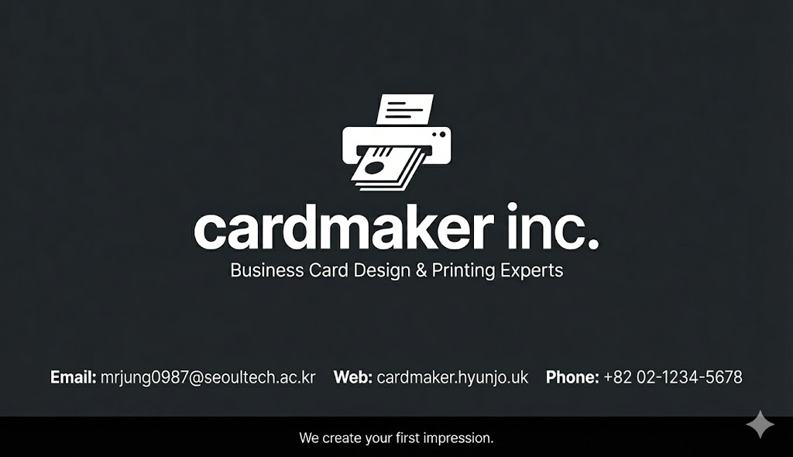
Notes:
ㅋ

