Slide 1

Software engineering project: yes24 Ticket sales notification Twitter bot
Computer engineering, 성현주 (20011614)

Slide 2
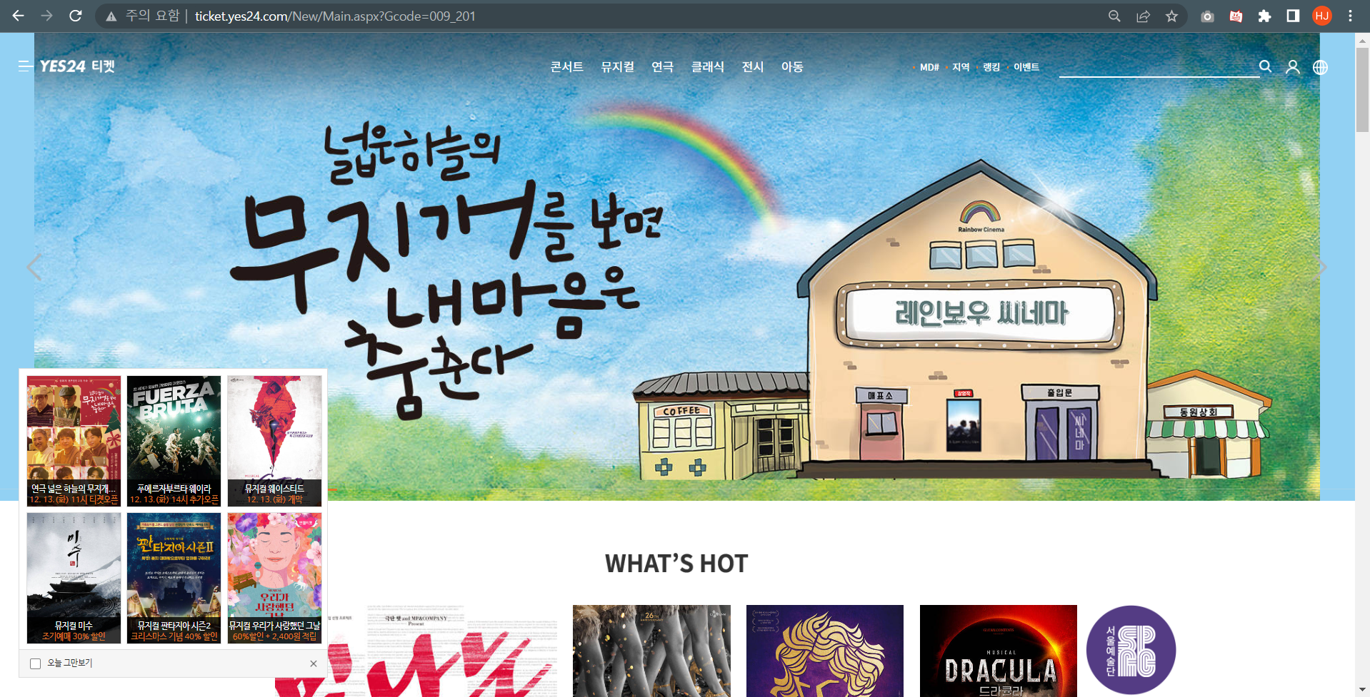
What is http://ticket.yes24.com/
ticket.yes24.com is Korea-based website that sells tickets to most concerts, musicals, plays and exhibitions held in the country.

Slide 3
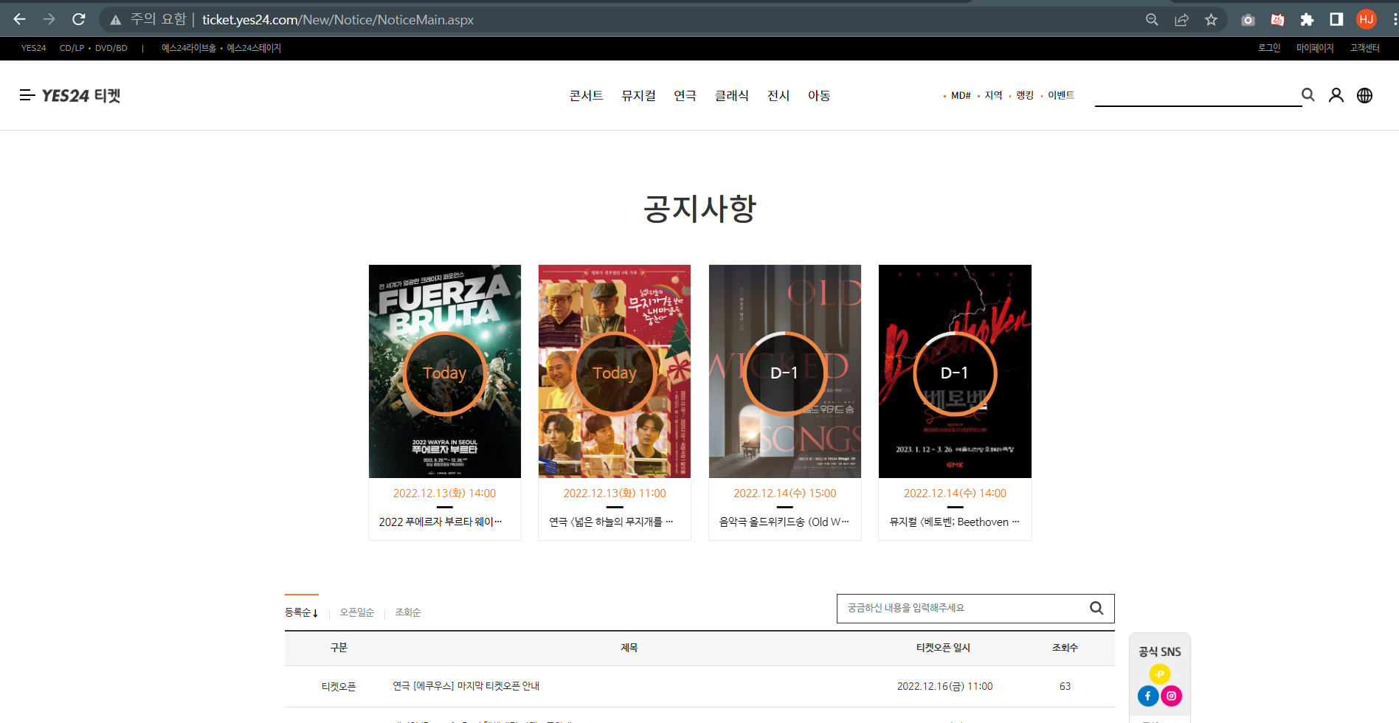
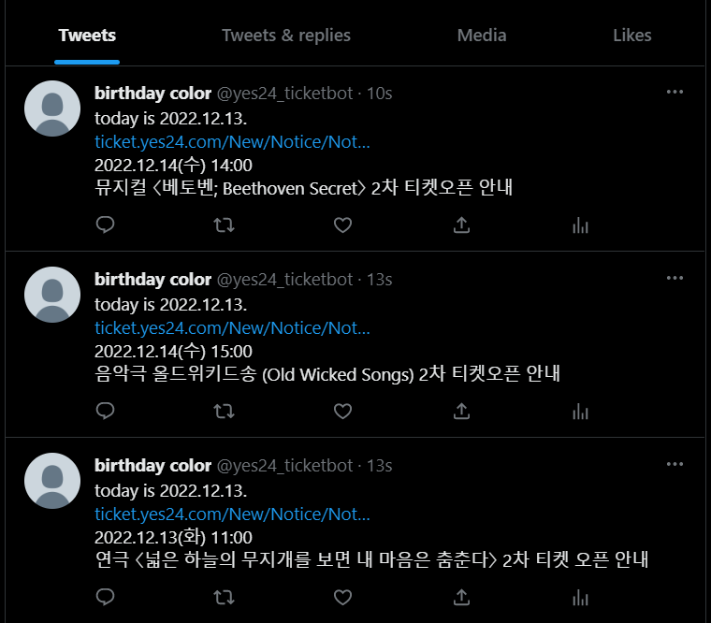
Objective
Extract banners on http://ticket.yes24.com/New/Notice/NoticeMain.aspx, and turn it into tweet.

Slide 4
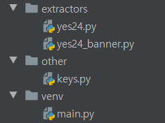
Structure of the project
Extracts banners from the website and return them
Stores key values for twitter account
Main function

Slide 5



Used library
1. Tweepy : to get access to twitter account (@yes24_ticketbot)
2. bs4(BeautifulSoup) : to parse webpage and find specific html tag
3. Selenium : to open a web browser through python
4. Datetime : to get today’s date

Slide 6
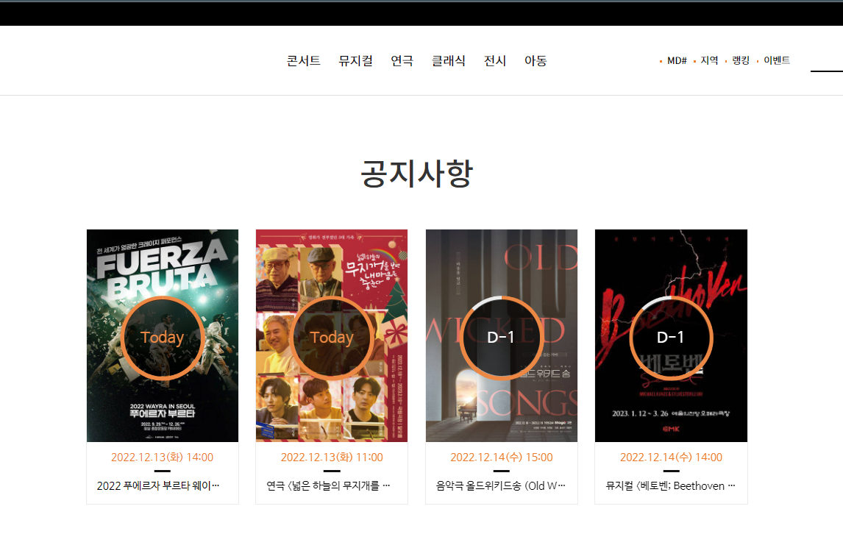
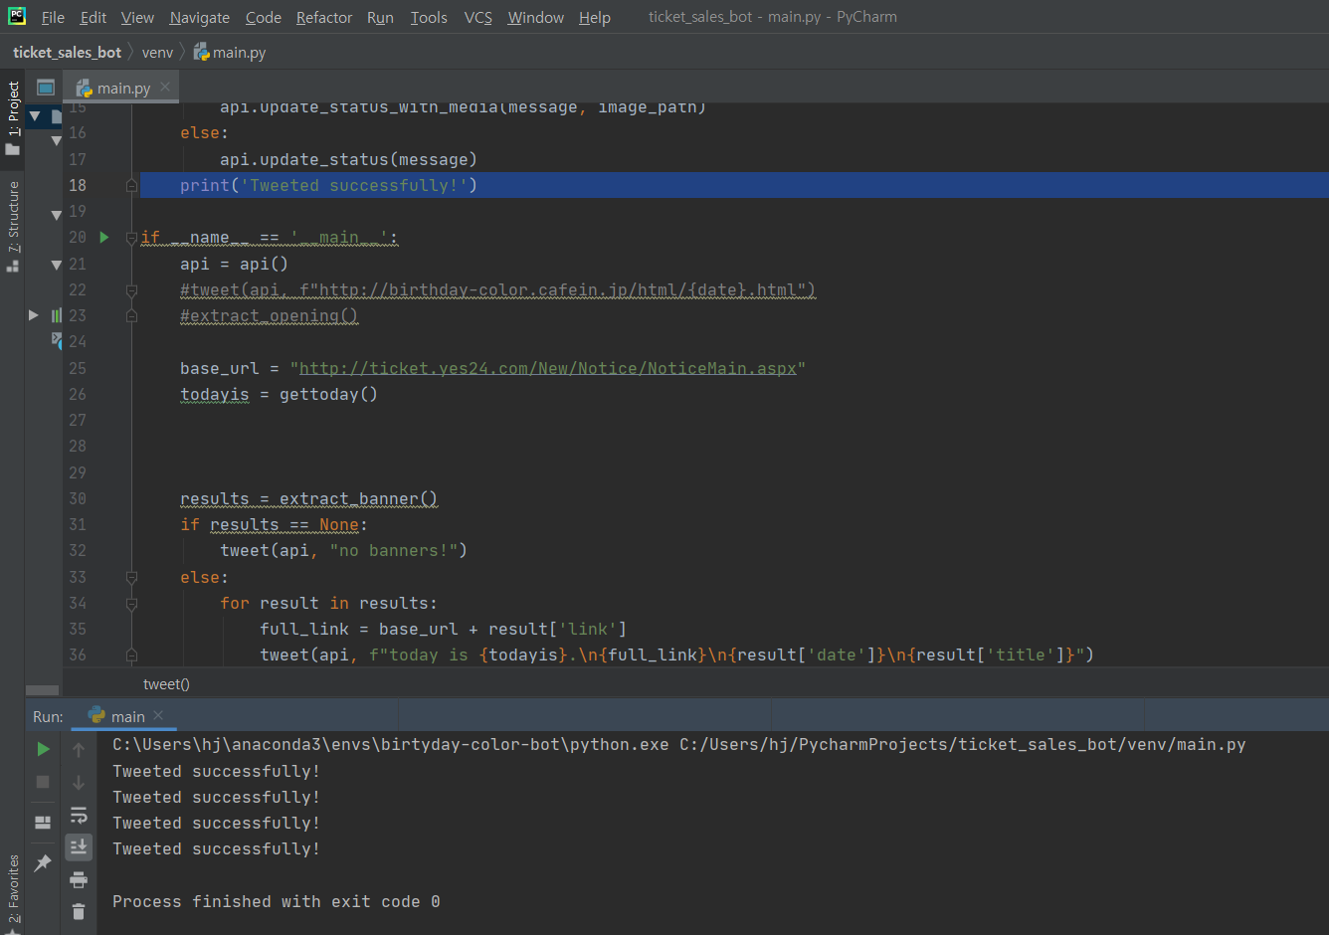
Screenshot of operation
↑4 banners
↑4 successful tweet message

Slide 7
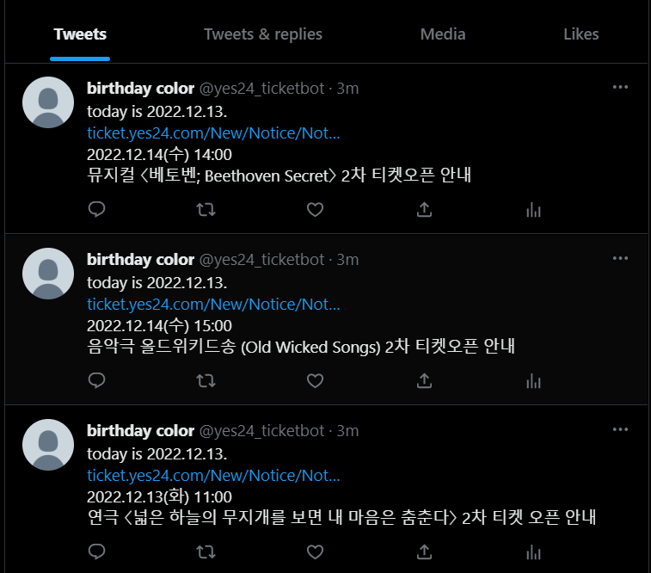
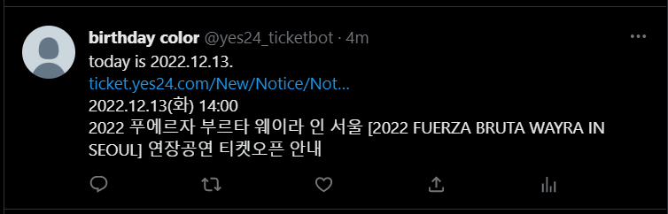
Screenshot of operation
Tweeted four times

Slide 8
A) Context and Process model
Context model
ticket.yes24.com
Twitter bot
Upload tweet
Twitter account(@yes24_ticketbot)
scrap

Slide 9
A) Context and Process model
Process model (Activity diagram)
Get twitter api
Tweet “No banners”
# banners = 0
Open a browser
Parse html
Find banners and store information
Tweet ticket opening informations
# banners >=1

Slide 10

B) Interaction model
Interaction model (Sequence diagram)
Account owner
main.py
tweepy
Yes24_banner.py
ticket.yes24.com
Twitter profile(@yes24-ticketbot)
Run main()
api()
Extract_banner()
find() (beautifulsoup)
tweet()
Tweepy API with authrozation
Banners information list (or empty list)

Slide 11
C) Structure model
Structure model (class diagram)
API KEY
API key API Secret key
API key
Access token
Access token Secret access token
1
1
Tweet
Twitter account
@yes24_ticketbot
Access token
1…*
1
1
1
1
1…*
Ticket opening information
Booking link Opening date Title of the show
1
1
Ticket opening banner list
Ticket opening information
1
1…*

Slide 12
D) Behavioral model
Behavioral model (State diagram)
Get info&tweet
Receive the list containing information about ticket sale openings and tweet all of them(separately)
waiting
Do: wait to execute main.py
waiting
Do: wait to execute main.py
API key, Access token
Ready to tweet
Do: get API
address
list
Visiting website
Visit ticket.yes24.com by opening browser through selenium
Scraping
Find banners and store them in the list
Html tag info

Slide 13
Thank you!

