Slide 1
CS499 - Open Source software development
Lecture #08: Social and Political Infrastructure of OSS Projects
Dr. Igor Steinmacher

Slide 2
Governance Vs. License
What’s the difference?

Slide 3
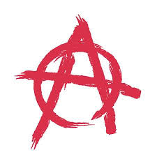
Questions And More Questions
How does it work?
What keeps a project running?
Who makes the decisions?

Slide 4
How it Works? Beyond Meritocracy
“Technical success is not hard to achieve, but without a robust developer base and social foundation, a project may be unable to handle the growth that initial success brings, or the departure of charismatic individuals.” – Fogel
Operational health
Survivability

Slide 5
Forkability
Forks can be:
Short
Social/Political
The power of someone is dictated by the decisions and the project conduction
Social Forks give the power to the contributors
Bad decisions → New project

Slide 6
Balance is Key
RULES
vs.
TOTAL FREEDOM

Slide 7
Balance is Key
PEOPLE
vs.
PROCESS

Slide 8
Balance is Key
EMPOWERING
vs.
DIRECTING

Slide 9
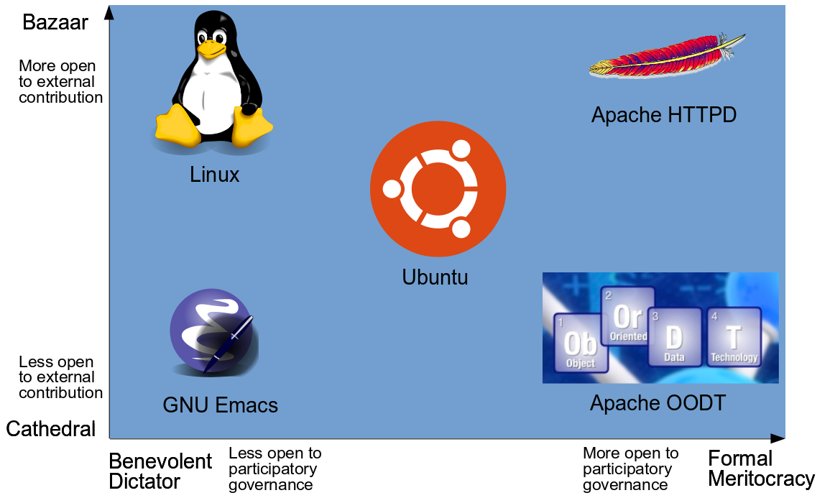

Slide 10

Benevolent Dictators Governance Model
Final decision-making authority rests with one person
“Dictator” is more like a judge or arbitrator

Slide 11
Benevolent Dictators Governance Model
BD recognizes people
BD drives consensus
BD nominates leaders

Slide 12
Benevolent Dictators Governance Model
PROS
Simple
Efficient
CONS
Single point of failure
Easily questionable

Slide 13

Consensus-based Democracy Model

Slide 14
Consensus-based Democracy Model
But not so much…
Voting mechanisms can be used
Version Control is key
Small changes are assumed to be OK
More complex changes can generate discussions

Slide 15
Consensus-based Democracy Model
PROS
No power hierarchy
Efficient
CONS
Evaluation/Merit are relative
Oligarchies may be a problem

Slide 16
Discussion
Company-owned projects → How does it work?
I open-sourced a project → How does it work?
I forked a project → How does it work?

Slide 17




Another level: NPO
Successful open source projects → Formal entities
Money
Legal
Create a new organization
Join existing organization
Distinguish between social/development and legal/bureaucracy

