Slide 1
CS499 - Open Source software development
Creating an OSS project
Dr. Igor Steinmacher
e-mail: Igor.Steinmacher@nau.edu
Twitter: @igorsteinmacher

Slide 2
Starting…
A3: Review your colleague’s code!
P2: You have one more paper to read
A4: Starting today
ST1: Answers on GitHub
P1: Which group will present? I will randomly select.

Slide 3
POLL: What is important when open-sourcing a project?

Slide 4
Slides Based on
https://opensource.guide/starting-a-project/
Fogel, Karl. Producing Open Source Software. https://producingoss.com/
Steinmacher, Igor; Treude, Christoph; Gerosa, Marco. Let me in: Guidelines for the Successful Onboarding of Newcomers to Open Source Projects, IEEE Software. http://www.igor.pro.br/publica/papers/IEEESoft_2018.pdf

Slide 5

Starting It
Use what you have
Different paths
Own project → Open
Corporate project → Open
Decide the scope and make it clear
What is it about?
What is it not about?

Slide 6
Make things clear
All the knowledge about the project needs to:
Be public
Be detailed
Outsiders need to quickly understand all the details
Design docs
User manuals
Next steps (future features)
How To’s
Code standards
Reduce the “hacktivation energy” [See Fogel’s]

Slide 7
Name and Surroundings
Choose a name that represents the goal of the project
But easy to say and remember
Look around for trademarks, projects with the same name, etc.
Domain: check for the name looking for the .org, .net, .com also helps look for already existing things

Slide 8
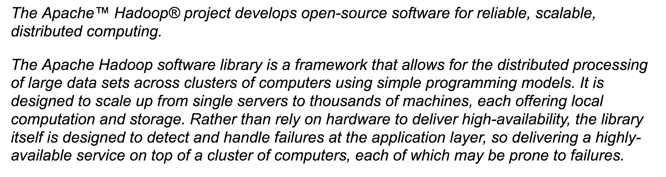
Starting the Readme file
When creating your page/repository make it clear that the project is free/open
Create one short paragraph describing the mission of the project

Slide 9
List the features and Requirements
What does this software do?
What is planned for it? (Future features)
What do I need to run your project?
OS, compiler, disk space, etc.
https://github.com/JabRef/jabref

Slide 10
Issue Tracker
Public issue tracker is needed
Report bugs
Check the project activity
Contribute
Curating the issue tracker is a constant and infinite task

Slide 11
Version Control
You MUST have your code in a version control system
For GitHub it is easy, we know
It is not only about having it
Maintaining
Receiving/reviewing code
Use the same way as ANYONE needs to use

Slide 12
Create Communication Means
More than the Issue Tracker
Open Source is a collaborative endeavor
Communication is key
Extra ways to communicate are interesting
Slack, Discourse, IRC, mailing list
Challenge!!!!
Answering
Empty channels/quiet forums are demotivating

Slide 13
Make It Easy to Contribute
Create a contribution (newcomer-friendly) page or portal
What are the REQUIRED Skills
Structured documentation
Give one tutorial-style example of how to do a common task
Maintain a FAQ

Slide 14
Make It Easy to Contribute
Create a contribution (newcomer-friendly) page or portal
Identify and/or dismiss outdated information
Point newcomers to easy tasks
Keep the issue list up-to-date
Make it easy for newcomers to build the system locally
Document the code structure

Slide 15

How?!?
https://opensource.guide/starting-a-project/

Slide 16
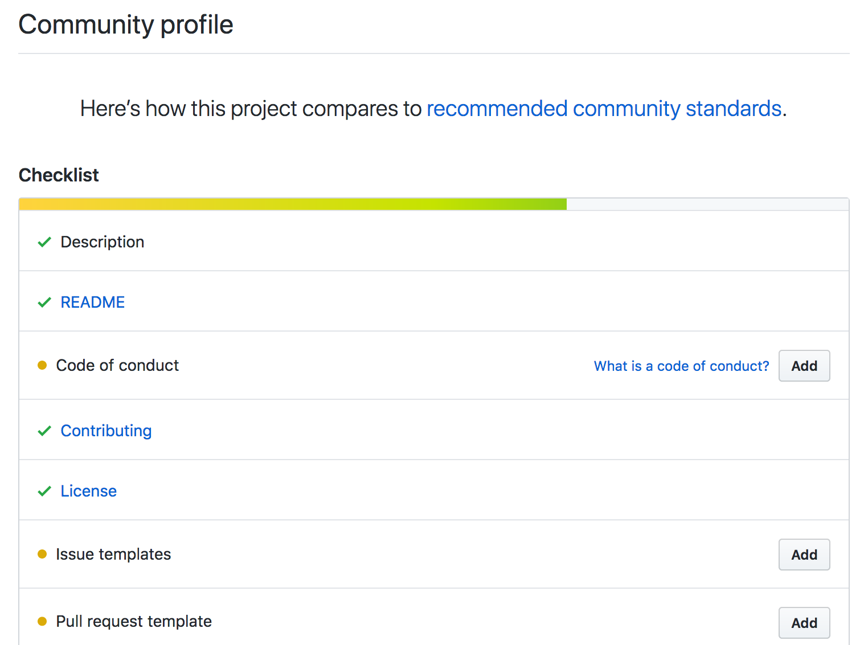
How?
https://github.com/electron/electron/community

Slide 17
README File
What does this project do?
Why is this project useful?
How do I get started?
Where can I get more help, if I need it?
How you handle contributions,
What are the goals of the project?

Slide 18
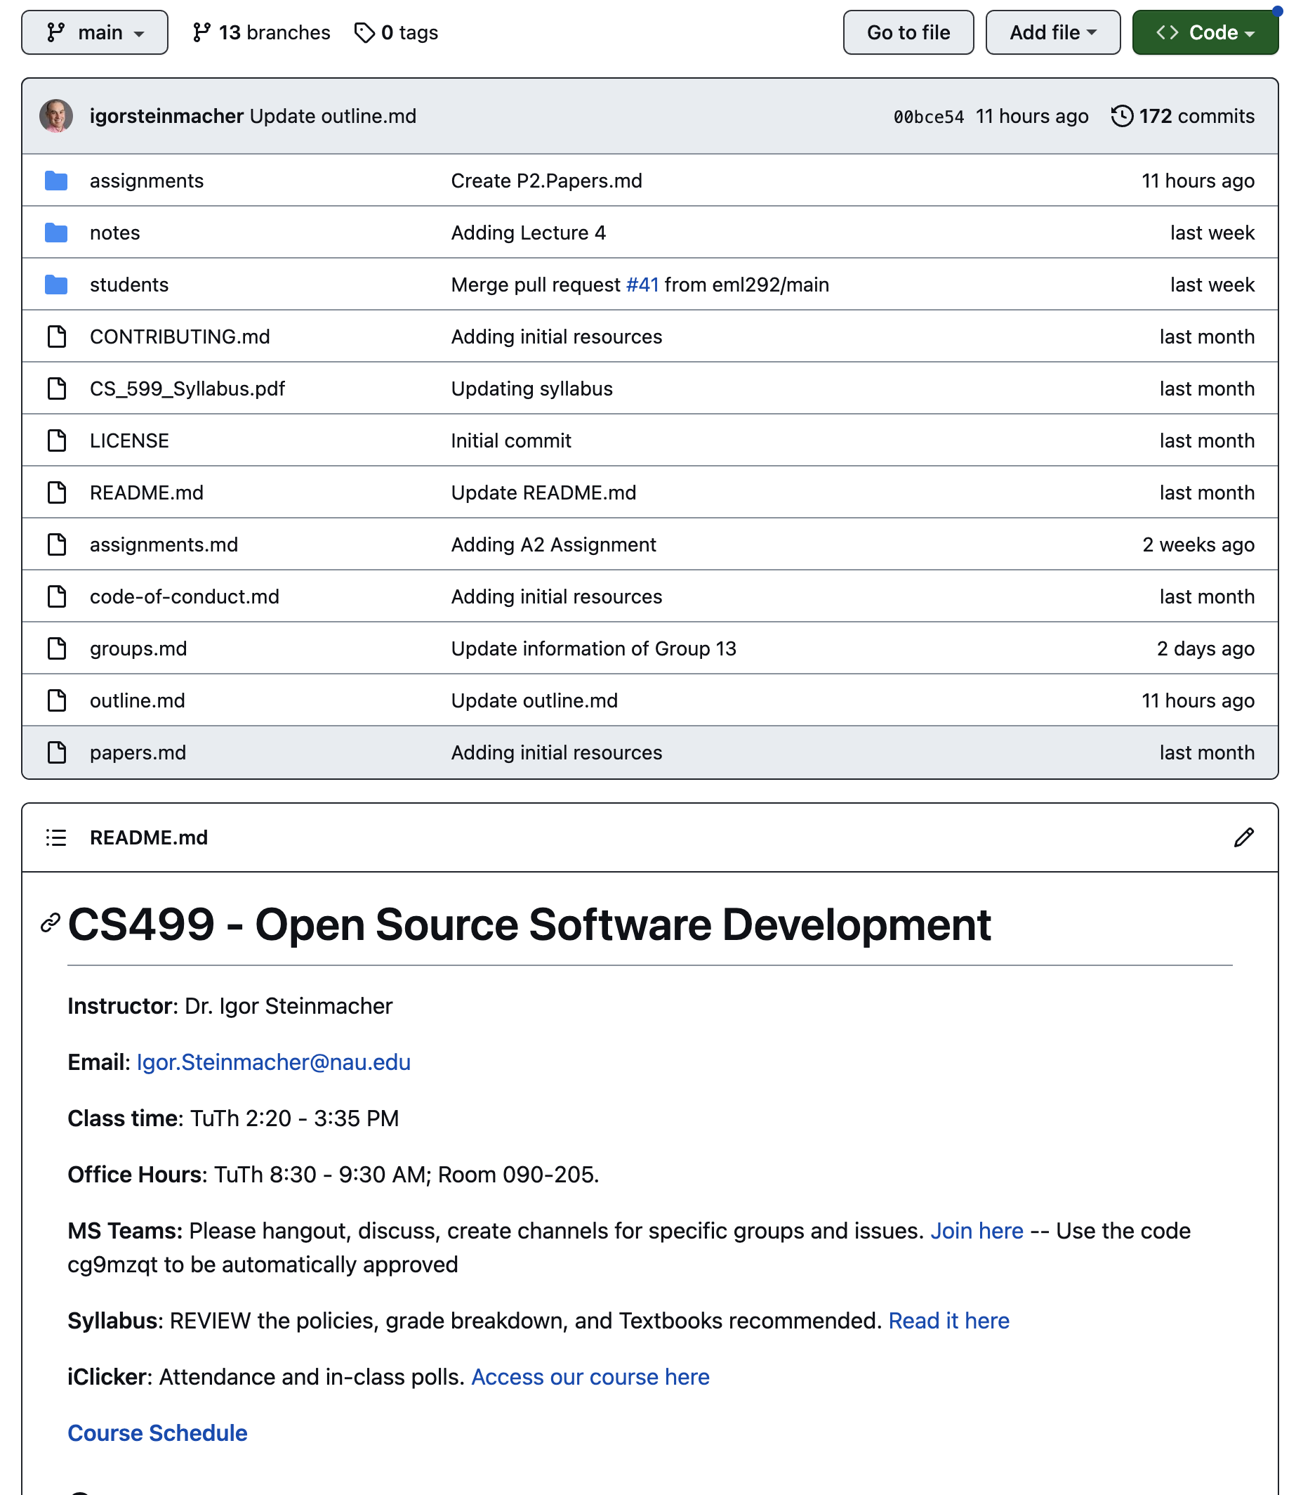
README File

Slide 19
Contributing File
How to file a bug report
How to suggest a new feature
How to set up your environment
Coding standards/code styles
Your roadmap or vision for the project
How contributors should (or should not) get in touch with you

Slide 20
Contributing File
CONTRIBUTING file can be simple (for starters)
FAQ section fits well here
Link to your CONTRIBUTING file from your README
Nice template: https://github.com/nayafia/contributing-template/blob/master/CONTRIBUTING-template.md

Slide 21
Code of Conduct
Sets ground rules for behavior for the participants
Facilitates healthy, constructive community behavior
Describes who these expectations apply to when they apply, and what to do if a violation occurs

Slide 22
You can also do
Create Issues and Pull requests templates
Checklist of what is expected for the Pull request or Issue
Communicate what you want the contributors to report/do

Slide 23
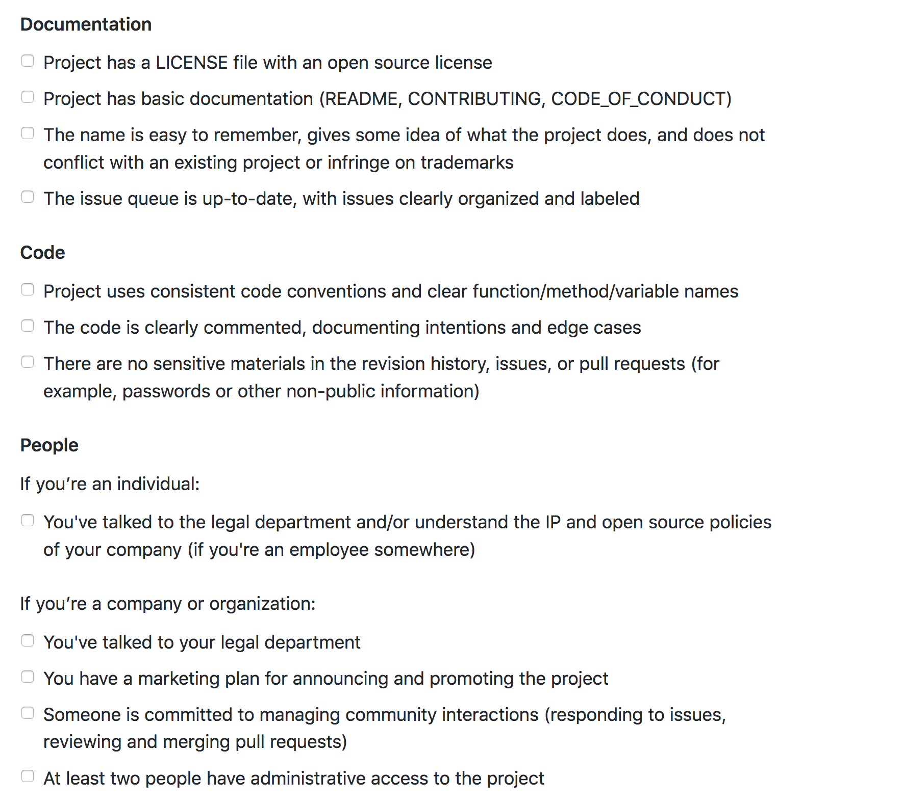

Slide 24
THE ASSIGNMENT!!!
Using your project under github.com/NAU-OSS
Follow the guidelines at http://opensource.guide
Think about all the details of the project
Deadline: March 2

