Slide 1



Genetic Algorithm
for MountainCar-v0
BIAI FINAL PROJECT
Hyunseok Cho, Jakub Zajac
June 2026

Slide 2
SUPERVISED FLOW
Today's Agenda
01
Project topic and environment
02
Genetic Algorithm design
03
Fitness and policy representation
04
Implementation workflow
05
Experimental results
06
Conclusions and future work
BIAI Project | Genetic Algorithm for MountainCar-v0
02

Slide 3
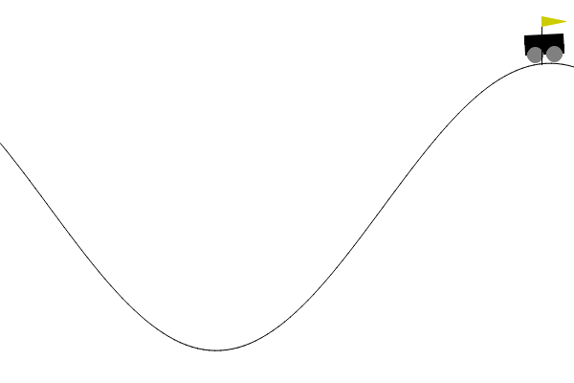
ENVIRONMENT
Problem: Reach The MountainCar Goal
The car must build momentum because direct acceleration is not enough.
Observation: position and velocity
Actions: accelerate left, do nothing, accelerate right
Reward: -1 for every time step
Goal: reach the flag in as few steps as possible
Visual proof: saved policy reaches the goal area without retraining.
BIAI Project | Genetic Algorithm for MountainCar-v0
03

Slide 4
METHOD CHOICE
Why A Genetic Algorithm?
We evolve policies directly instead of learning gradients.
Fits the course objective
Simple policy representation
Easy to compare generations
Demonstrates selection, crossover, mutation, elitism, and generations.
A chromosome is a policy table, so every individual is a complete controller.
Each generation champion is saved and validated under the same seed set.
Selected over random search because GA improves the population systematically.
BIAI Project | Genetic Algorithm for MountainCar-v0
04

Slide 5
FITNESS DESIGN
Policy Representation And Fitness
The policy table maps discretized states to actions.
Raw reward alone makes failed policies look too similar.
20
20
400
position bins
velocity bins
policy genes
Progress bonus rewards movement toward the goal.
Goal bonus rewards actual success.
fitness = total_reward + progress_bonus + goal_bonus
Fewer steps still produce better total reward.
BIAI Project | Genetic Algorithm for MountainCar-v0
05

Slide 6
ALGORITHM
Main Algorithm Workflow
The detailed report contains the full flowchart; this slide shows the presentation version.
1
Create population
2
Evaluate policies
3
Calculate fitness
80 random policy tables
Run each policy in MountainCar
Reward + progress + goal bonus
4
Preserve elites
5
Reproduce
6
Repeat
Copy top 6 policies directly
Tournament selection, crossover, mutation
Build next generation up to 60
Saved during training: generation champions, overall best policy, CSV metrics, and plots.
BIAI Project | Genetic Algorithm for MountainCar-v0
06

Slide 7
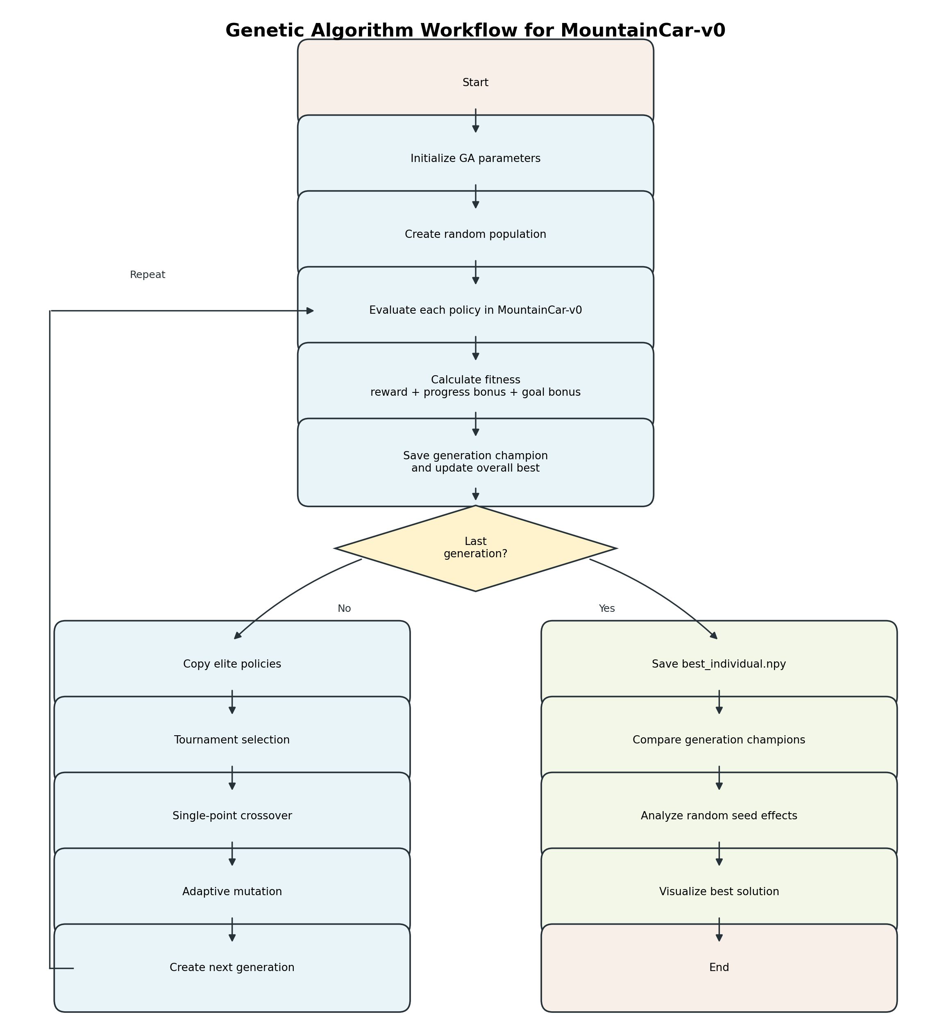
ALGORITHM FLOW-CHART
Task 3
Algorithm Flow Chart
The complete GA process: initialization, generation loop, champion saving, final validation, and visualization.
BIAI Project | Genetic Algorithm for MountainCar-v0
07

Slide 8
REPOSITORY STRUCTURE
Implementation Overview
The repository is organized for final submission.
IMPL
DATA
DOC
mountain_car_ga.py
visualize_best_solution.py
requirements.txt
CSV results
training and validation plots
best_individual.npy
generation champions
final report
task reports
algorithm details
presentation
Run from project root: python IMPL/mountain_car_ga.py
README.md is kept at the project root; generated outputs are saved under DATA/.
BIAI Project | Genetic Algorithm for MountainCar-v0
08

Slide 9
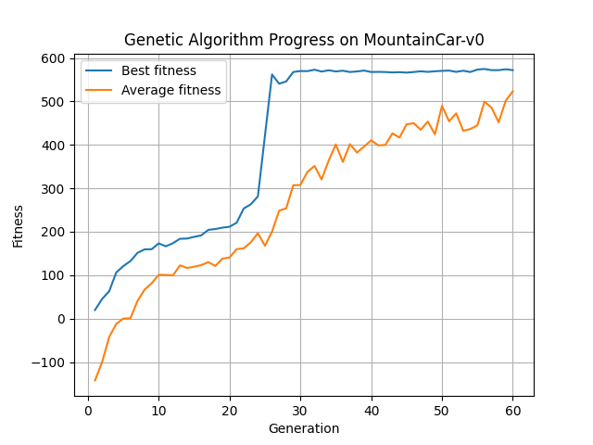
EXPERIMENTS
Experiment 1: Training Progress
Fitness improves strongly over generations.
19.78
Gen 1 best
574.67
Gen 56 best
572.00
Gen 60 best
Gen 56 is training-best; Gen 55 is validation-best because validation uses fixed seeds.
BIAI Project | Genetic Algorithm for MountainCar-v0
09

Slide 10
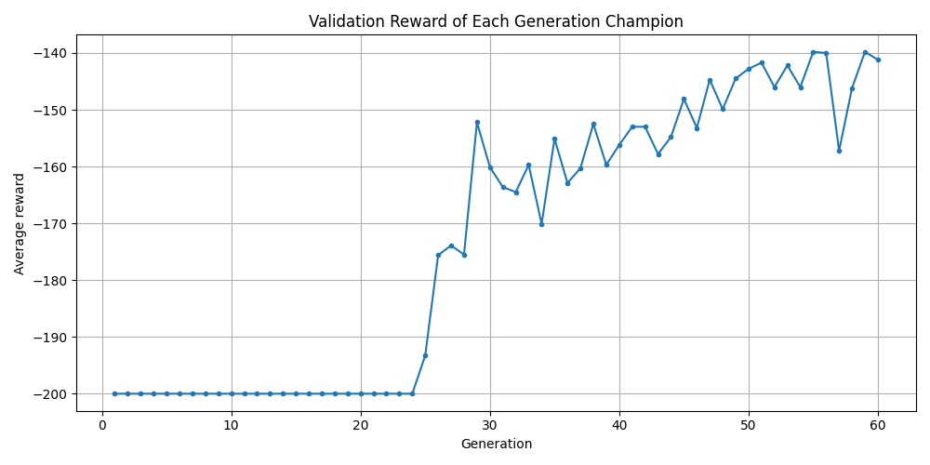
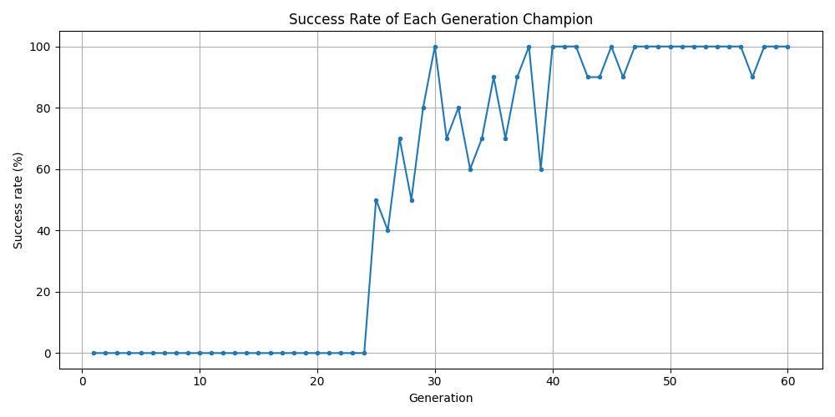
VALIDATION
Experiment 2: Champion Comparison
Each generation best policy is re-tested using the same validation seeds.
Generation 1: 0% success
Generation 55: 100% success, avg fitness 560.20
Generation 60: 100% success, avg fitness 558.80
BIAI Project | Genetic Algorithm for MountainCar-v0
10

Slide 11
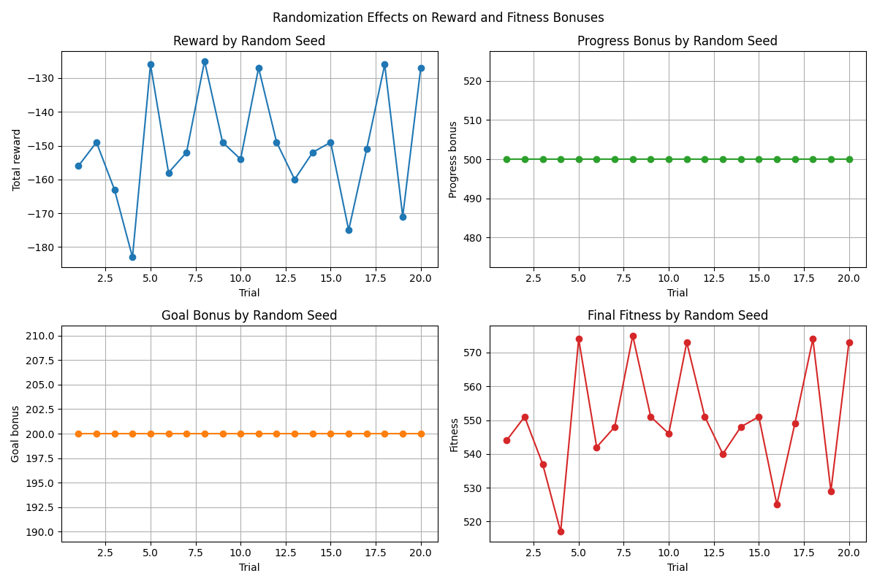
ROBUSTNESS
Experiment 3: Randomization Effects
The final policy was tested under 20 different reset seeds.
20/20
trials succeeded
-150.10
avg reward
549.90
avg fitness
Step count changes by seed, but the policy reaches the goal every time.
BIAI Project | Genetic Algorithm for MountainCar-v0
11

Slide 12
DEMO
Graphical Demonstration
The saved best policy can be shown without retraining.
Demo command
python IMPL/visualize_best_solution.py
Seed 2042 screenshot run
Steps to goal: 156
Total reward: -156
Progress bonus: 500
Goal bonus: 200
Fitness: 544
BIAI Project | Genetic Algorithm for MountainCar-v0
12

Slide 13
SUMMARY
Conclusions And Future Work
The Genetic Algorithm solves the selected graphical control problem.
Main conclusions
Future work
Policy tables can control MountainCar-v0 effectively
Test more seeds and repeated training runs
Progress-based fitness gives a better learning signal
Tune GA parameters more systematically
Elitism preserves strong solutions
Compare with Q-learning or neural methods
Generation champion comparison improves result analysis
Add video or GIF recording for presentation
The final policy is robust across tested seeds
Repository: https://github.com/Hyunseok-Cho/BIAI
BIAI Project | Genetic Algorithm for MountainCar-v0
13

