Slide 1
Progress Presentation
Navy Team
박민혁, 이준엽, 이현수

Slide 2
Our Plan
Week 1~2: Midterm & Planning
Week 3~5: Study & Design
Week 6: Code
Week 7~8: Test
Meeting: Once a week, face-to-face

Slide 3

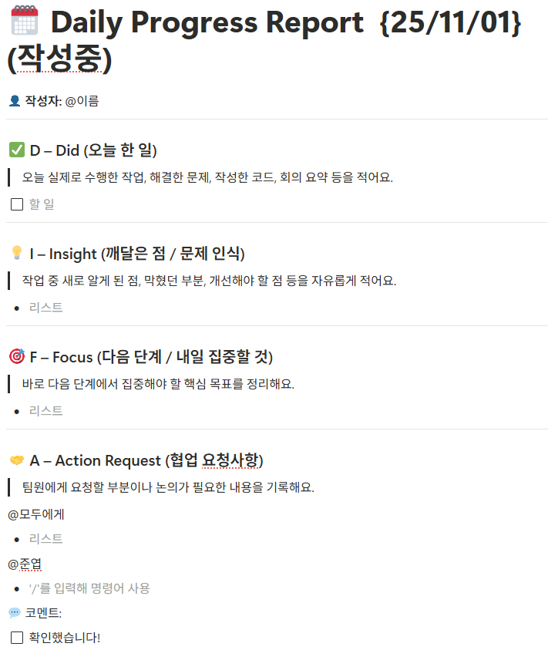
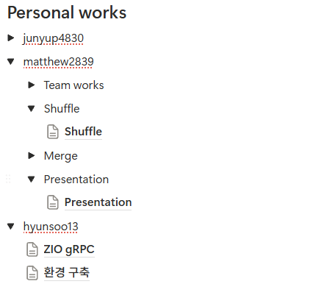
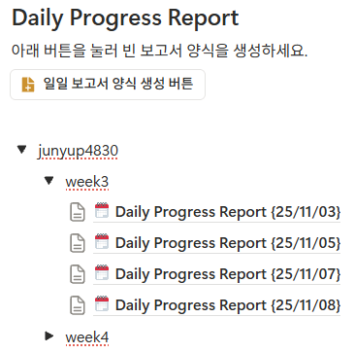
How we worked

Slide 4

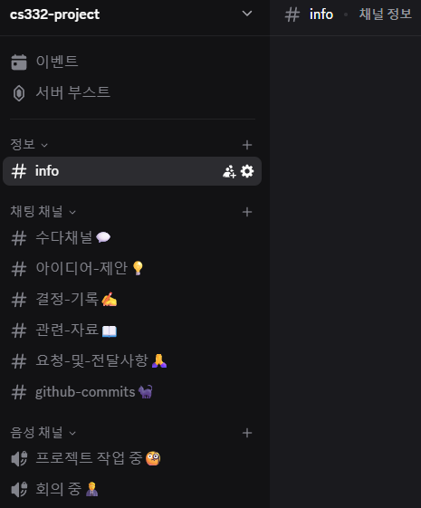
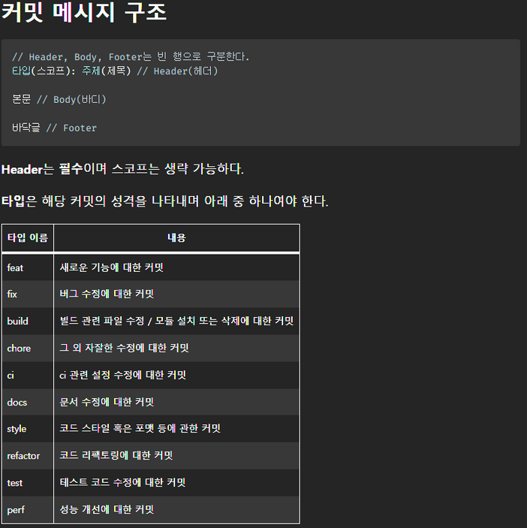
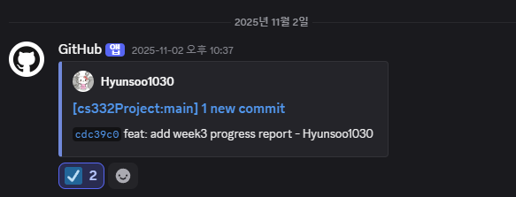
How we worked

Slide 5


How It went(with The Mythical Man-Month)
Calling the Shot
The Surgical Team
Why Did the Tower of Babel Fail?
Ten Pounds in a Five-Pound Sack
The Documentary Hypothesis

Slide 6

Problem Definition
master
step1. master samples some data from workers and determines the key range each worker will be responsible for
step2. each worker splits its local data into chunks, sorts it, and then partitions the sorted data according to the global key ranges
worker0
worker1
worker19
step3. workers exchanged the partitioned data with each other
cpu
cpu
cpu
…
RAM
RAM
RAM
step4. each worker merge the data sorted in their own disk
disk
disk
disk

Slide 7
Overall Flow
worker
1. Register each worker’s ip to the master
master
worker
4. return sample datas
5. sorting
2. Gather the all Ips and send them back to all workers
4. Calculate each key range and send them back to each worker
3. Sampling request
worker

Slide 8
Master Design - abstraction
Master – Worker = kernel – user program
worker
Disk overflow
Memory overflow
Program fail
…
master
0 | handler 0
1 | handler 1
… | …
n | handler n
Notes:
Worker 관점에서 문제가 발생했을 때 master만 호출하면 됨

Slide 9
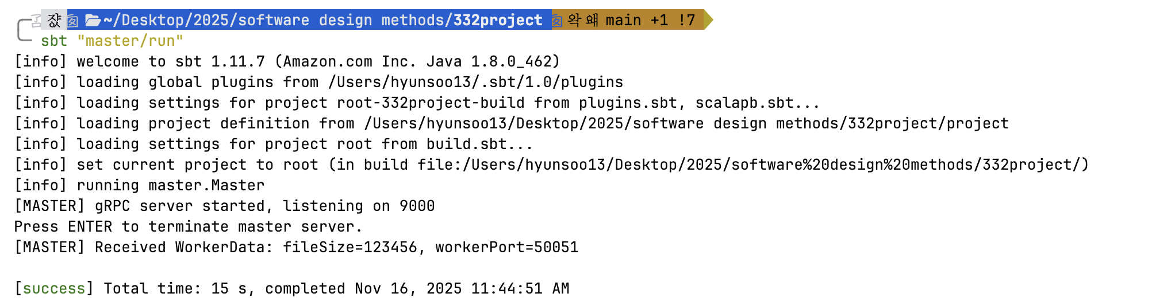
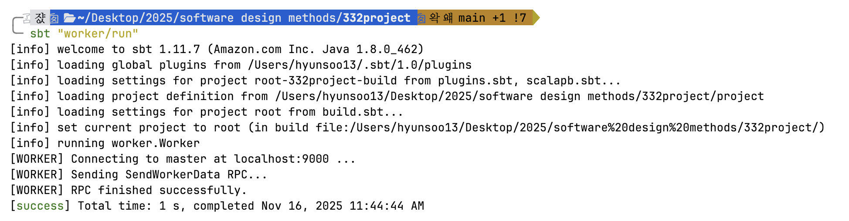
Current Progress
ZIO gRPC communication

Slide 10
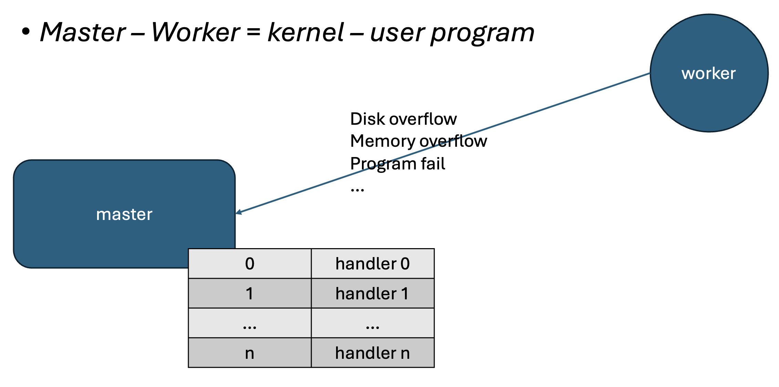
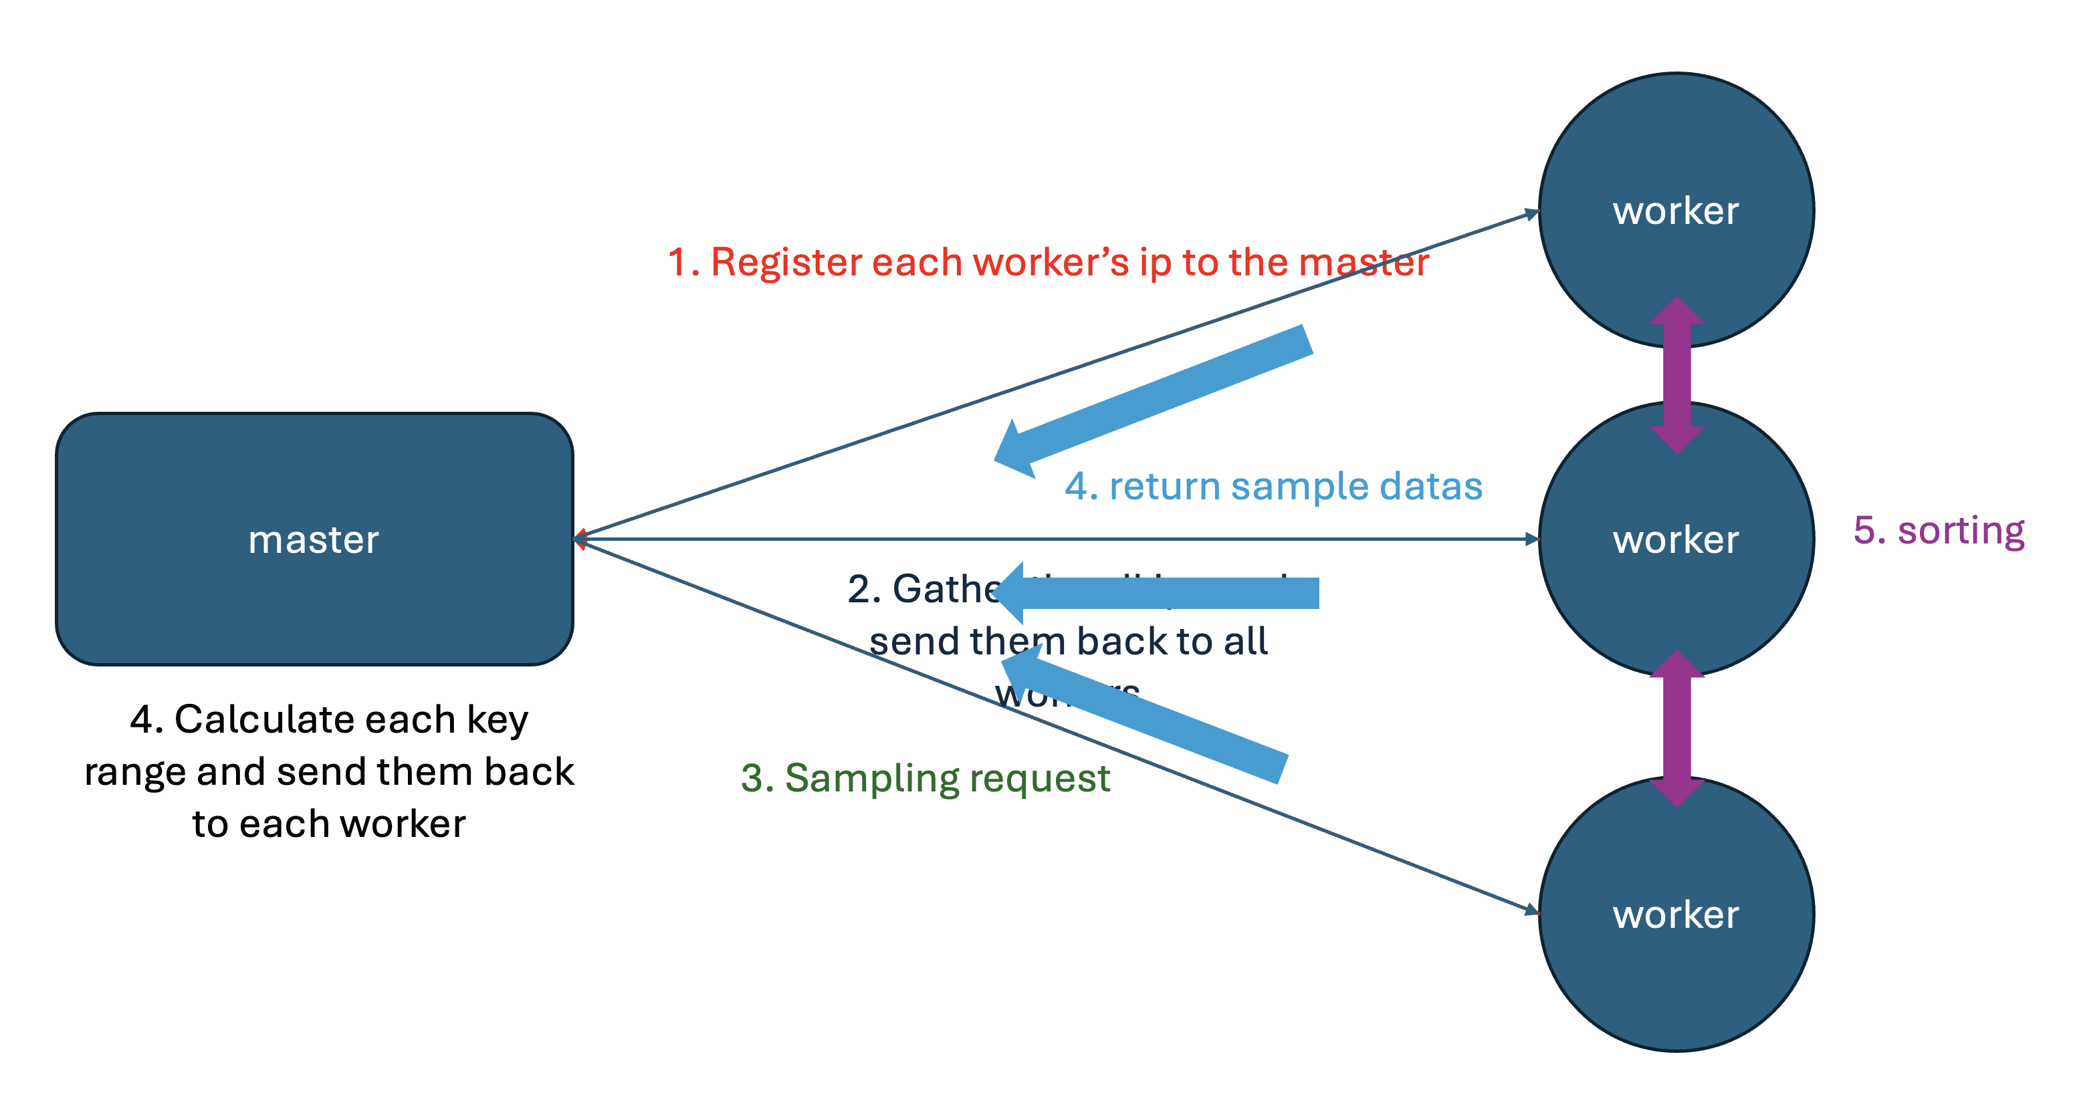
Master Plan
Implement some message structures in proto file
Implement error handling logic
Implement some message structures in proto file
Implement sampling logic

Slide 11


Worker Design
- abstraction
Worker 1
Sorting Algorithm
disk
Input data
1
3
2
Worker 1
Worker 2
Merge
Master
. . .
5
Worker 20
Output data
6
4
Worker 2
. . .
Worker 20

Slide 12
Worker Design – Concurrent Programming
Thread 1
Read
Sort
Partition
Shuffle
Thread 2
Thread 3
Thread 4
Read
Thread 1
Thread 1
Thread 1
Thread 1
Sort
Thread 2
Thread 2
Thread 2
Thread 2
Partition
Thread 3
Thread 3
Thread 3
Thread 3
Shuffle
Thread 4
Thread 4
Thread 4
Thread 4

