Slide 1
Progress Presentation
Navy Team
박민혁, 이준엽, 이현수

Slide 2
Our plan
Navy Team
Week 1~2: Midterm & Planning
Week 3~5: Study & Design
Week 6: Code
Week 7~8: Test

Slide 3
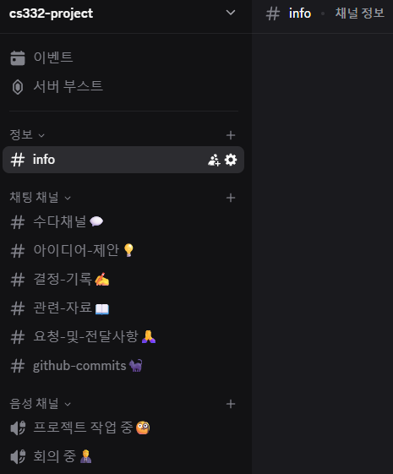
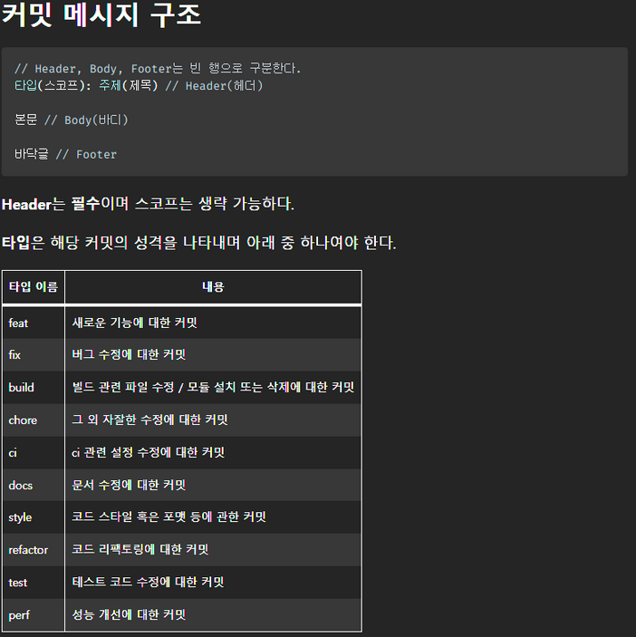
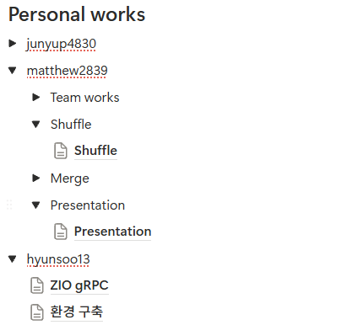
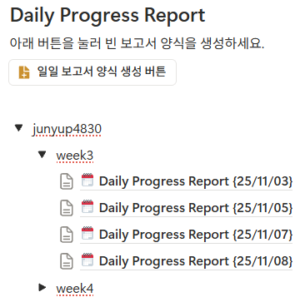
How we worked
Navy Team

Slide 4

Problem Definition
master
step1. master samples some data from workers and determines the key range each worker will be responsible for
step2. each worker splits its local data into chunks, sorts it, and then partitions the sorted data according to the global key ranges
worker0
worker1
worker19
step3. workers exchanged the partitioned data with each other
cpu
cpu
cpu
…
RAM
RAM
RAM
step4. each worker merge the data sorted in their own disk
disk
disk
disk

Slide 5
Overall Flow
worker
1. Register each worker’s ip to the master
master
worker
4. return sample datas
5. sorting
2. Gather the all Ips and send them back to all workers
4. Calculate each key range and send them back to each worker
3. Sampling request
worker

Slide 6
Master Design - abstraction
Master – Worker = kernel – user program
worker
Disk overflow
Memory overflow
Program fail
…
master
0 | handler 0
1 | handler 1
… | …
n | handler n
Notes:
Worker 관점에서 문제가 발생했을 때 master만 호출하면 됨

Slide 7
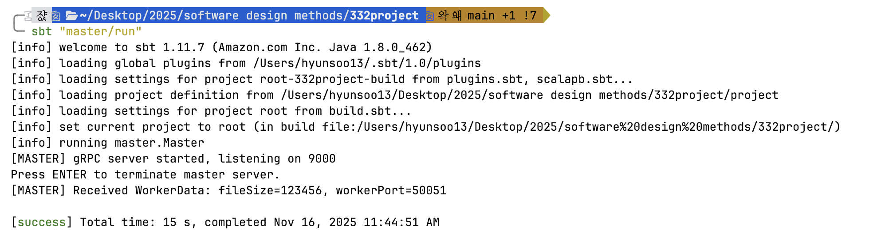
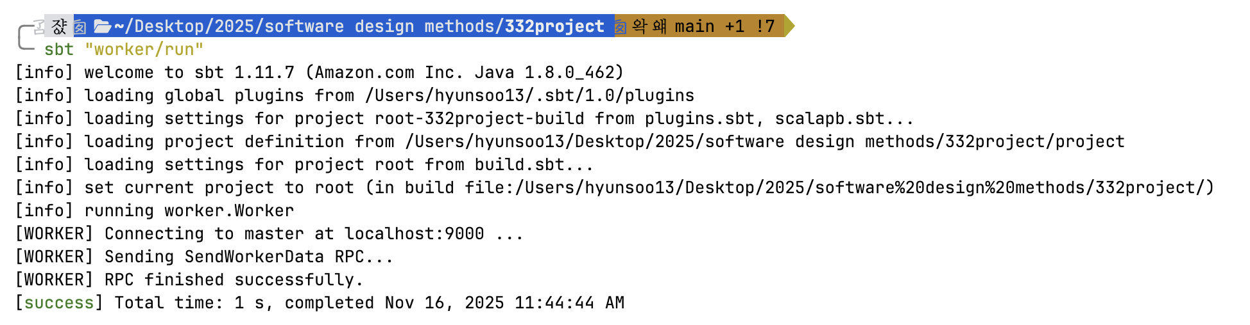
Current Progress
ZIO gRPC communication

Slide 8
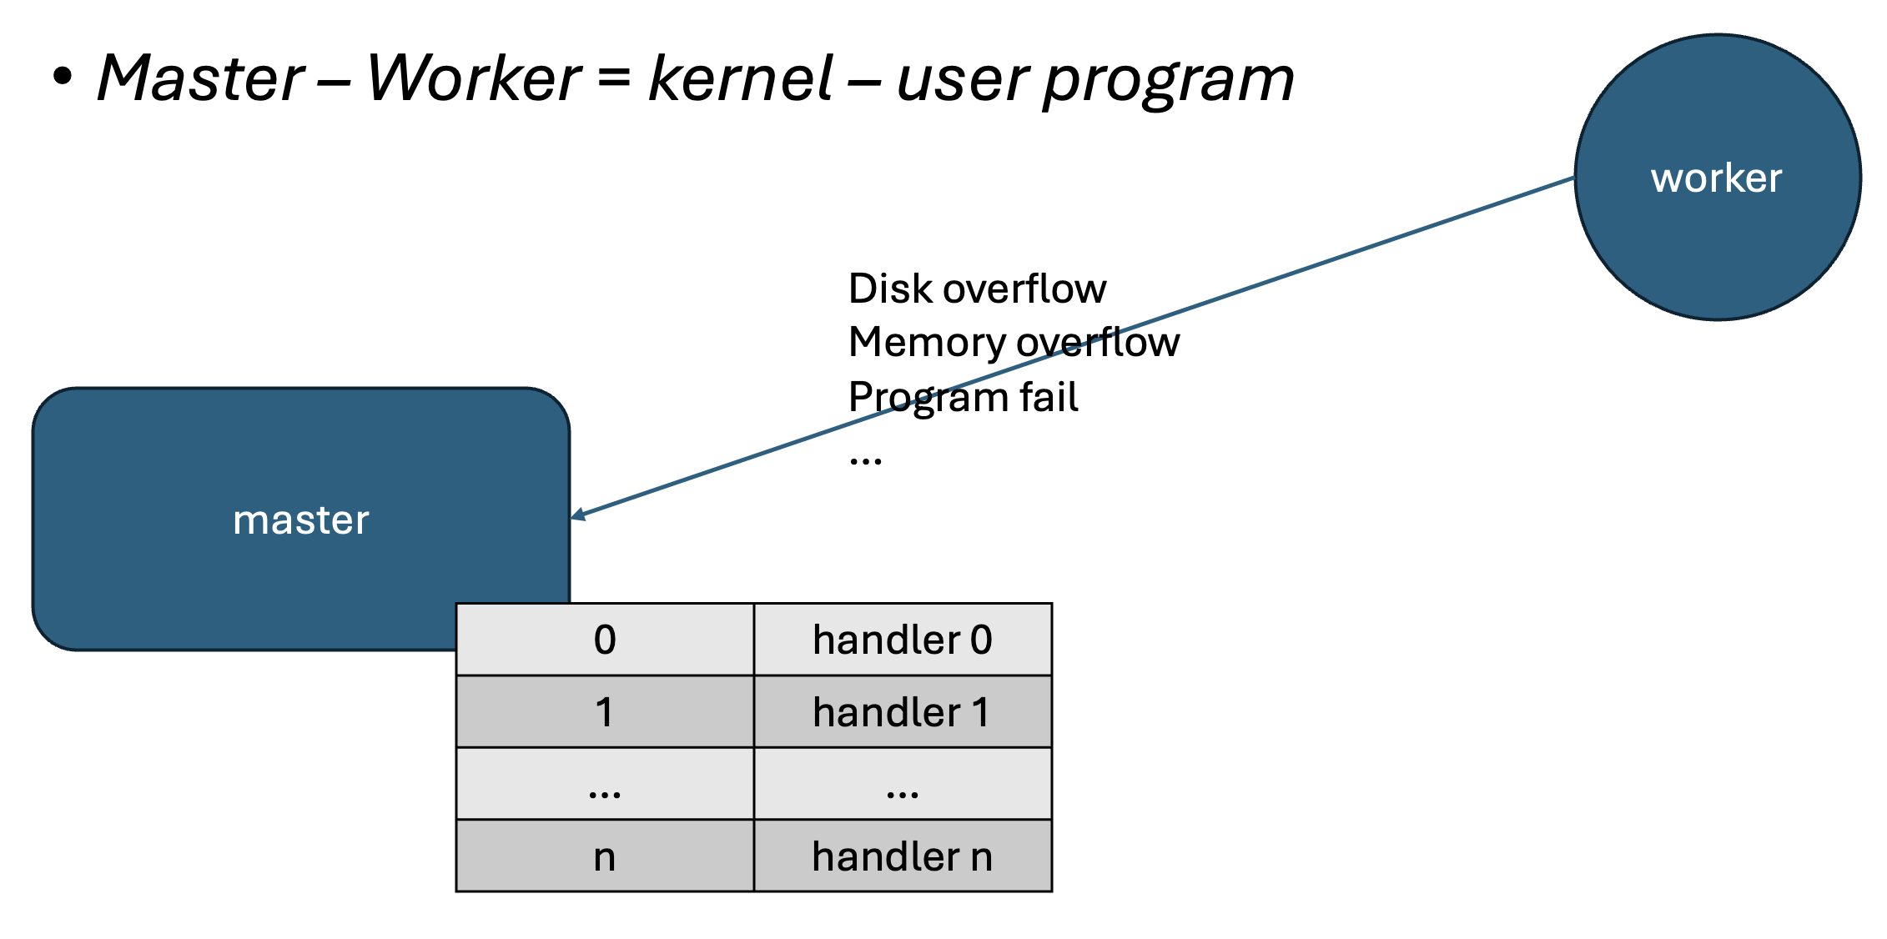
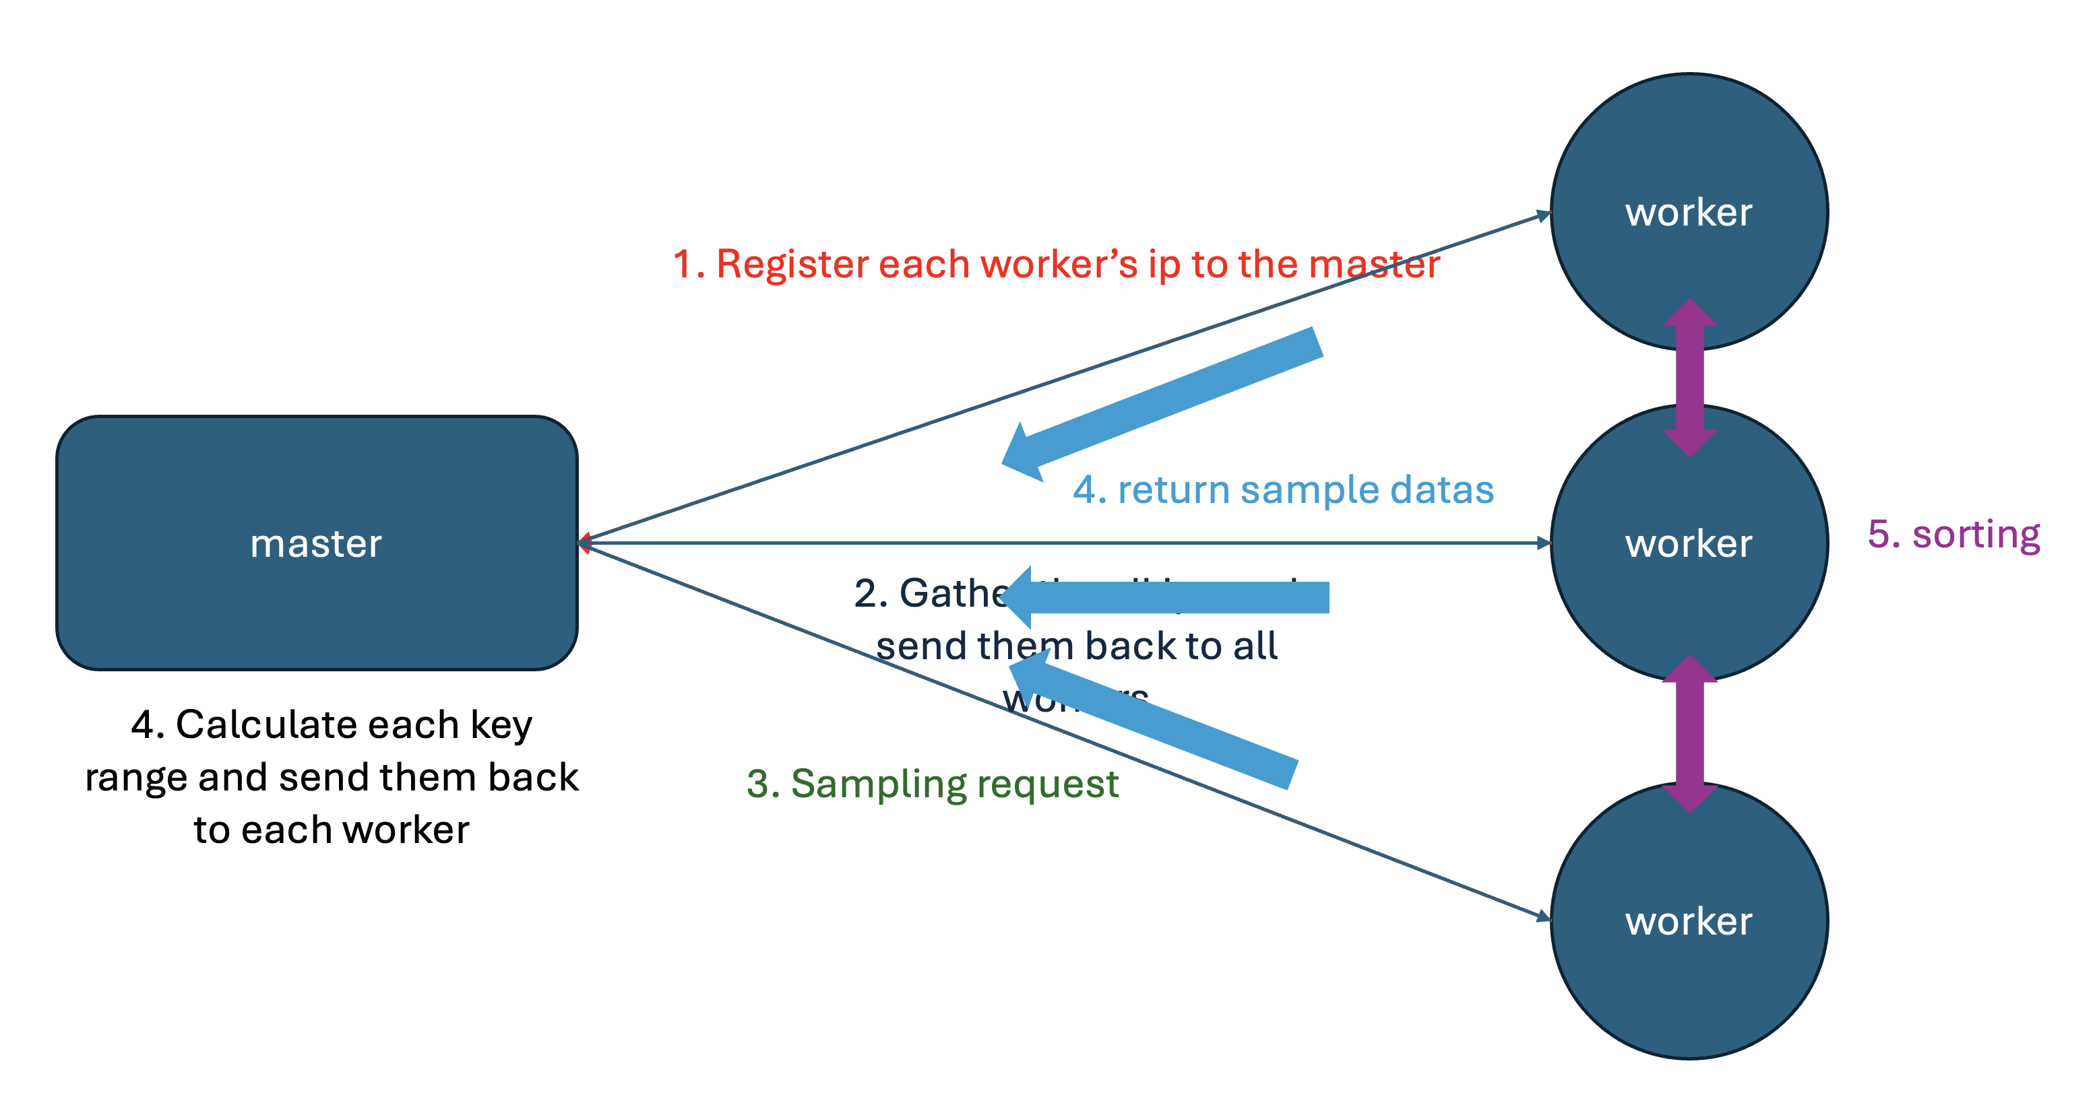
Master Plan
Implement some message structures in proto file
Implement error handling logic
Implement some message structures in proto file
Implement sampling logic

Slide 9


Worker 1
Sorting Algorithm
disk
Input data
Worker 1
Master
Worker 2
Merge
. . .
Worker 20
Output data
Worker 2
. . .
Worker 20

