Slide 1
Y86-64 Simulator in GUI Mode SNU CSE 4190.308 Lab #3
Sungmin Kim
Sangjin Ha
Architecture & Code optimization (ARC) Lab
November 11th, 2016

Slide 2
GUI Configuration (1)
You need Linux environment
Install tk & tcl libraries
$> sudo apt-get install tk-dev tk8.5-dev tcl-dev tcl8.5-dev
Download Lab3.tar from eTL
$> tar xvf Lab3.tar
$> cd Lab3
$> tar xvf sim.tar
$> cd sim

Slide 3
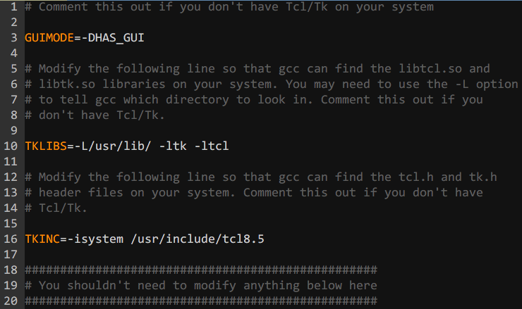
GUI Configuration (2)
Open & Modify three “Makefile”s
$> vi Makefile
$> vi seq/Makefile
$> vi pipe/Makefile
Uncomment 3 lines described as below (i.e., delete #)
Line #3, #10, #16
Notes:
Line #3: #GUIMODE=-DHAS_GUI
Line #10: #TKLIBS=-L/usr/lib/ -ltk -ltcl
Line #16: #TKINC=-isystem /usr/include/tcl8.5

Slide 4
GUI Configuration (3)
Build the simulator
$> make clean; make
Now you can execute the simulators in GUI mode
Specify command line flag -g instead of –t
$> ./ssim -g ../y86-code/asumi.yo
Notes:
Line #3: #GUIMODE=-DHAS_GUI
Line #10: #TKLIBS=-L/usr/lib/ -ltk -ltcl
Line #16: #TKINC=-isystem /usr/include/tcl8.5

Slide 5
NOTE
GUI mode is not available in Software Lab (Bldg. # 302, Rm. # 311-1). Only on your personal environment.
Because you don’t have privilege to install libraries
GUI mode can help you debug the program
By design, both sdriver.yo and ldriver.yo are small enough to debug with in GUI mode

