Slide 1
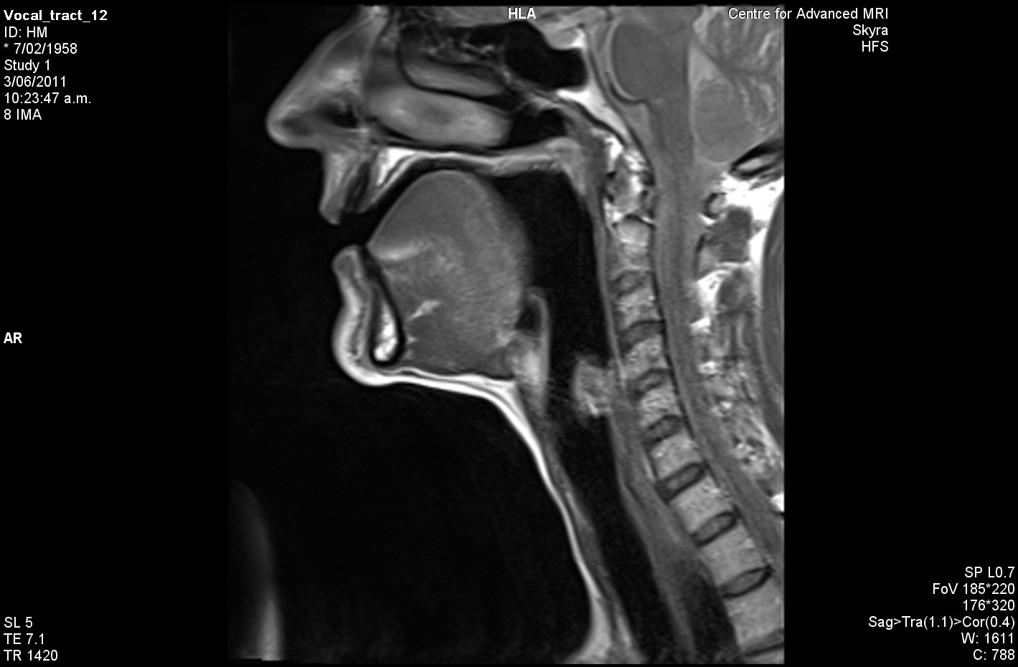
The vowel in “HEED”

Slide 2
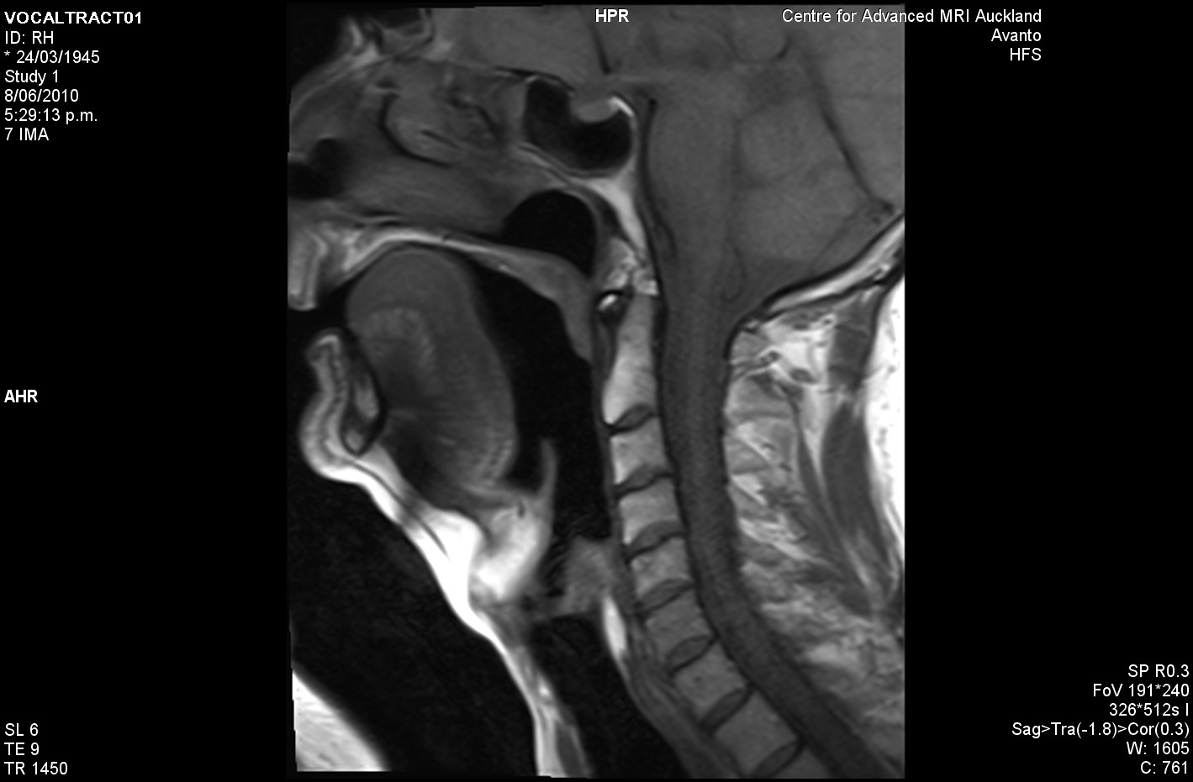
The vowel in “HEED”

Slide 3
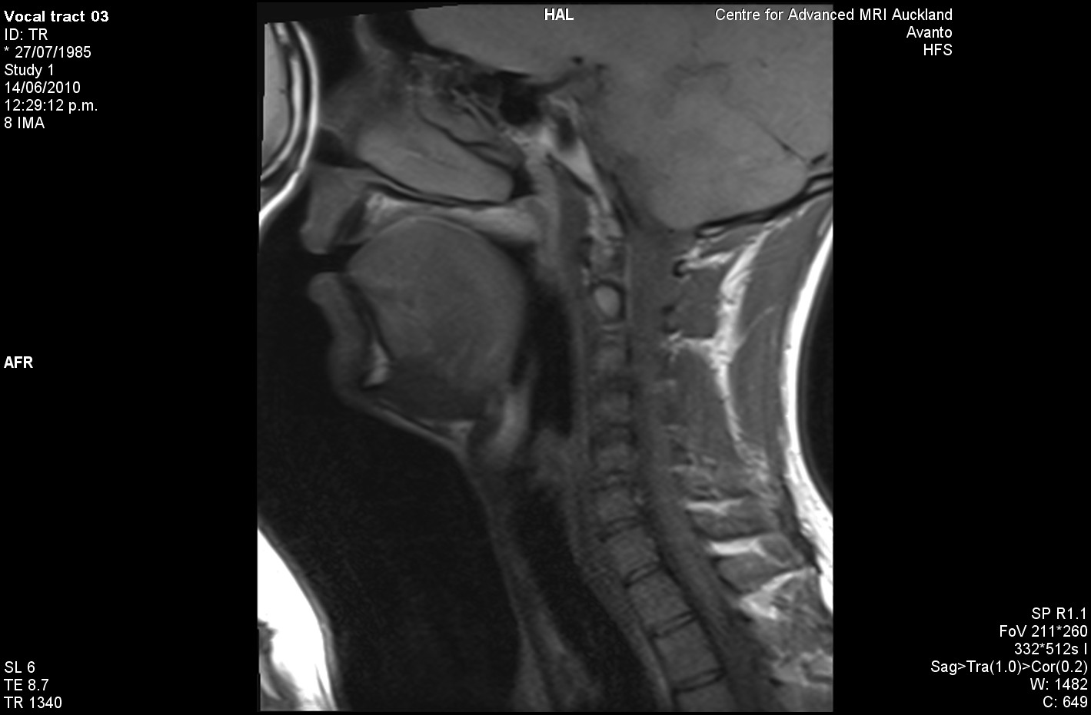
The vowel in “HEED”

Slide 4
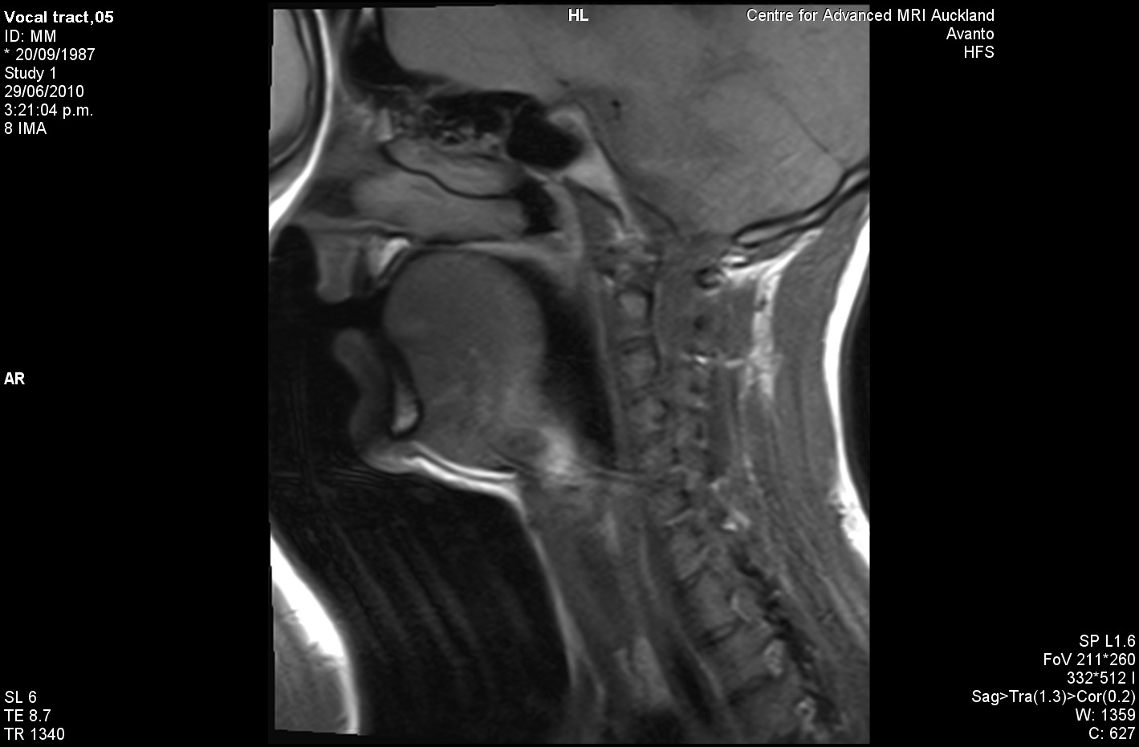
The vowel in “HEED”

Slide 5
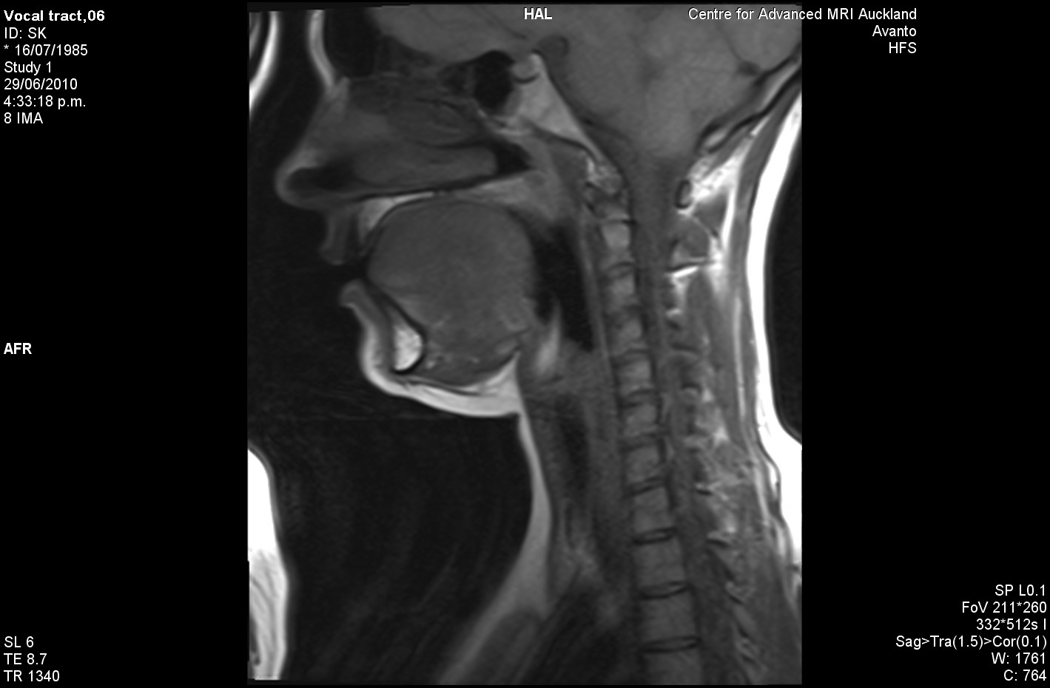
The vowel in “HEED”

Slide 6
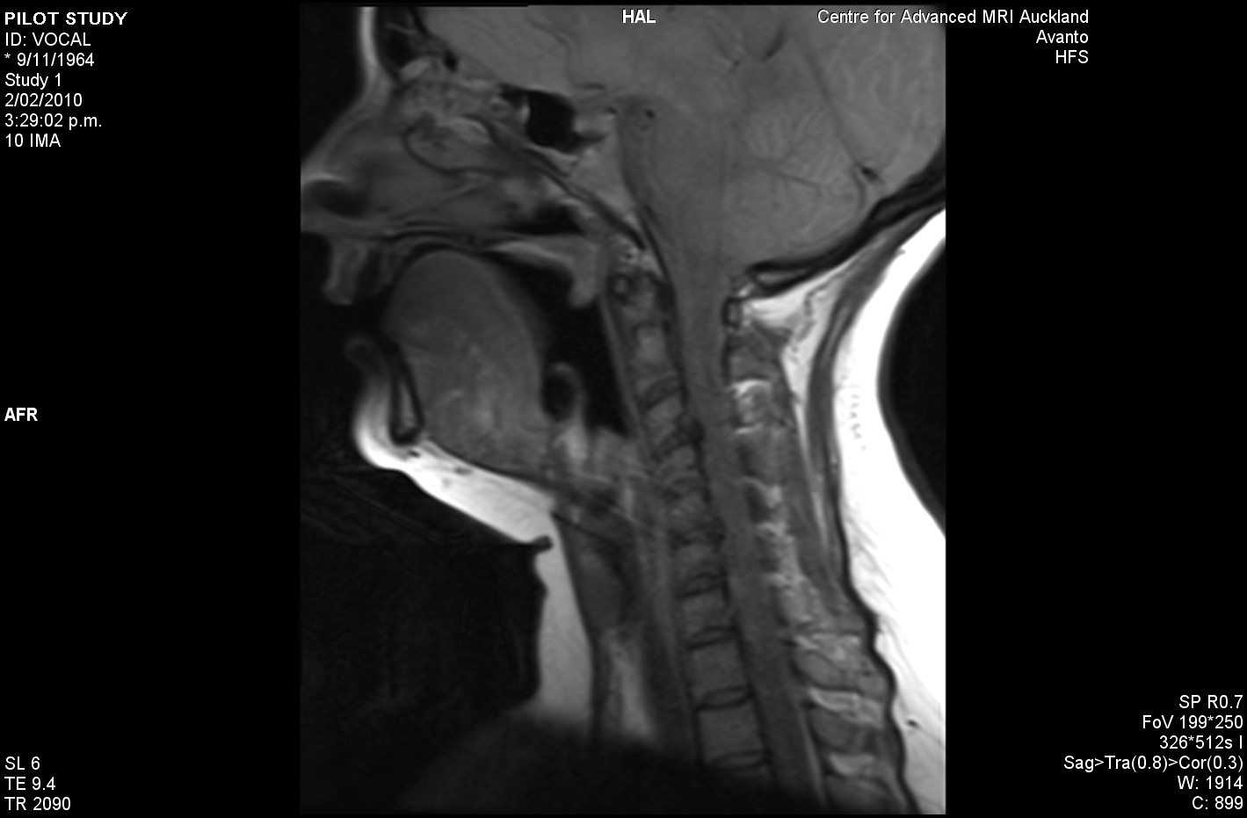
The vowel in “HEED”

Slide 7
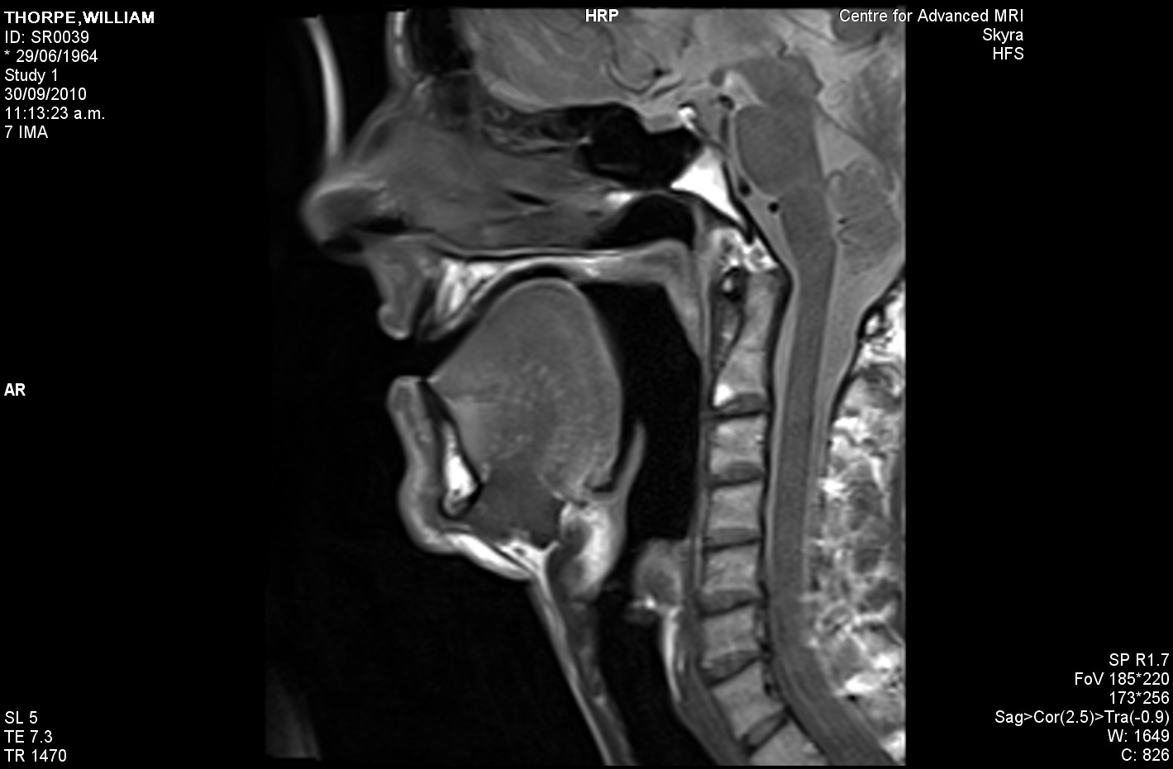
The vowel in “HEED”

Slide 8
Notes:
HEED

Slide 9

Notes:
HEAD

Slide 10
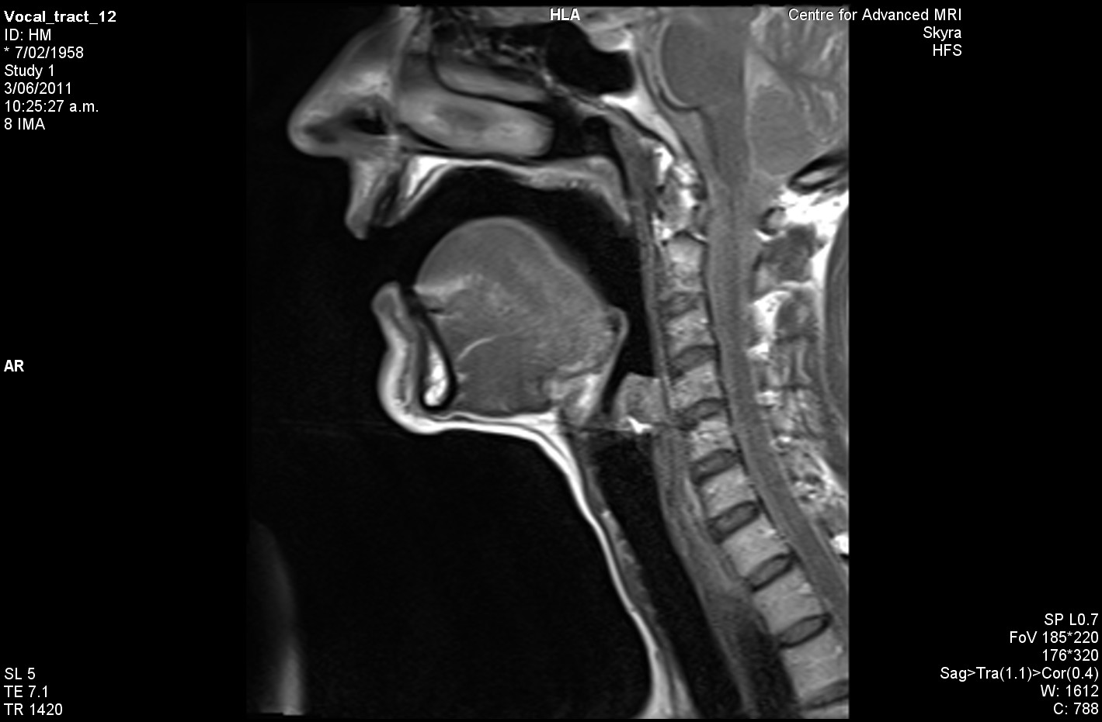
Notes:
HAD

Slide 11
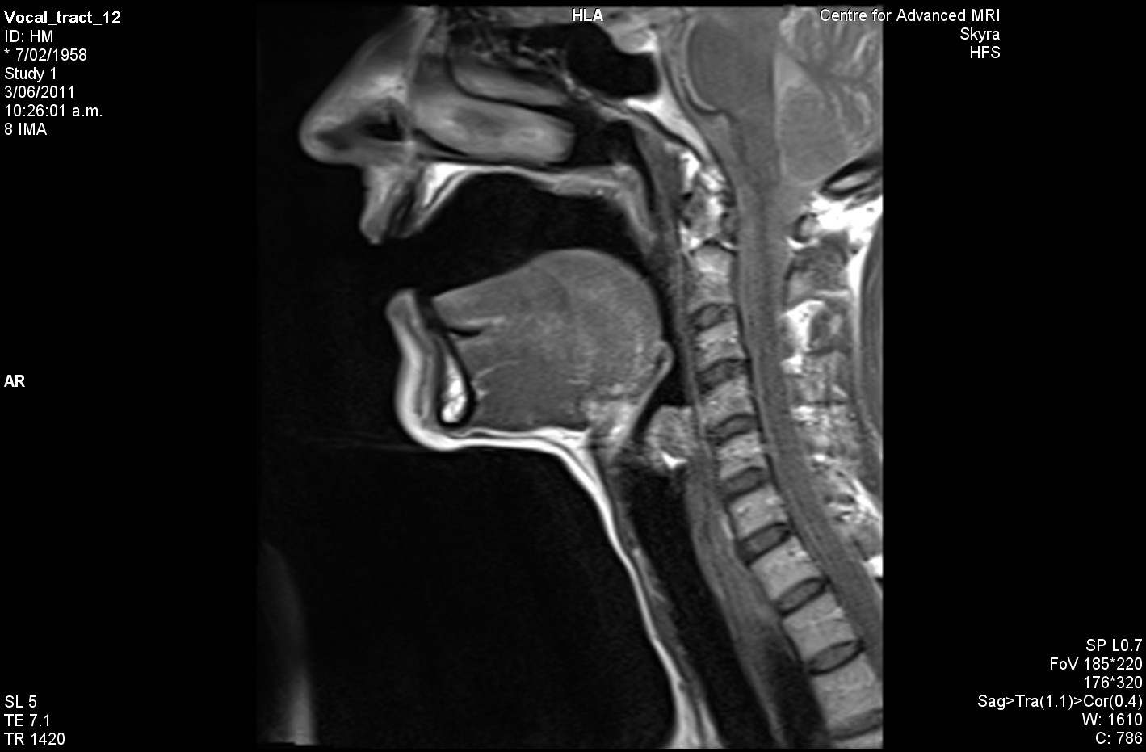
Notes:
HARD

Slide 12
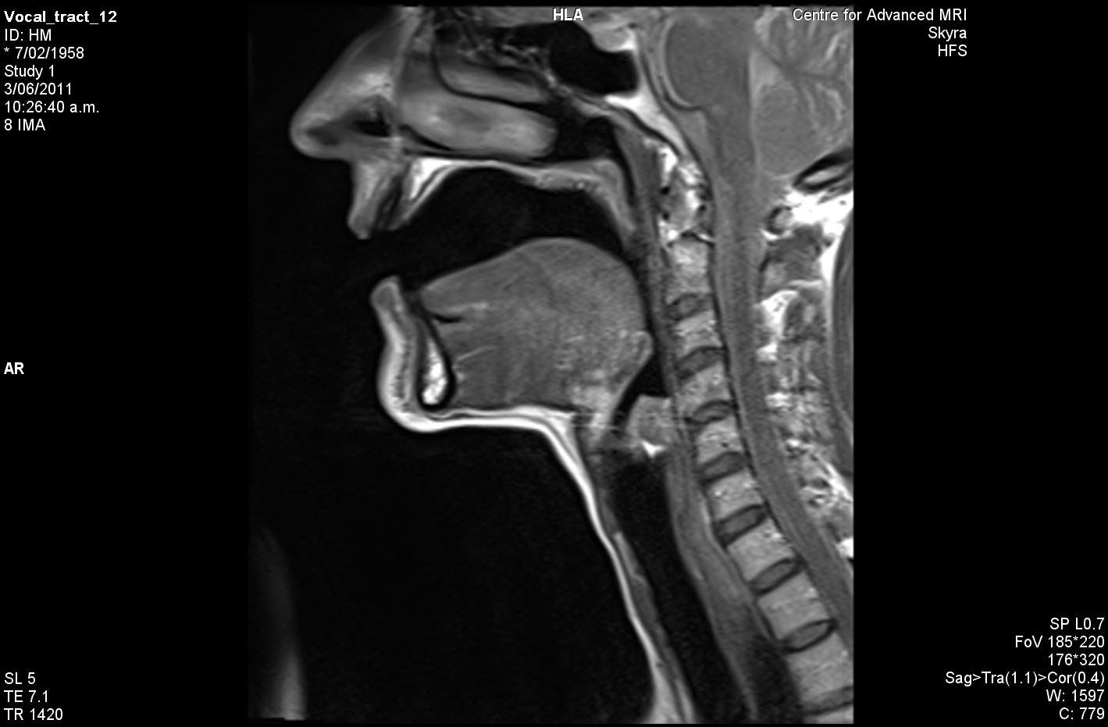
Notes:
HUD

Slide 13
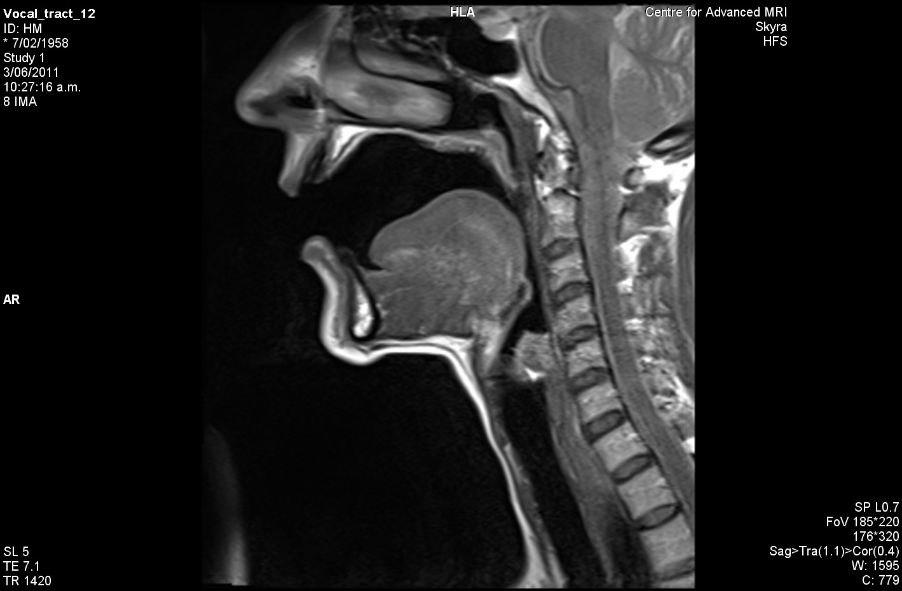
Notes:
HOD

Slide 14
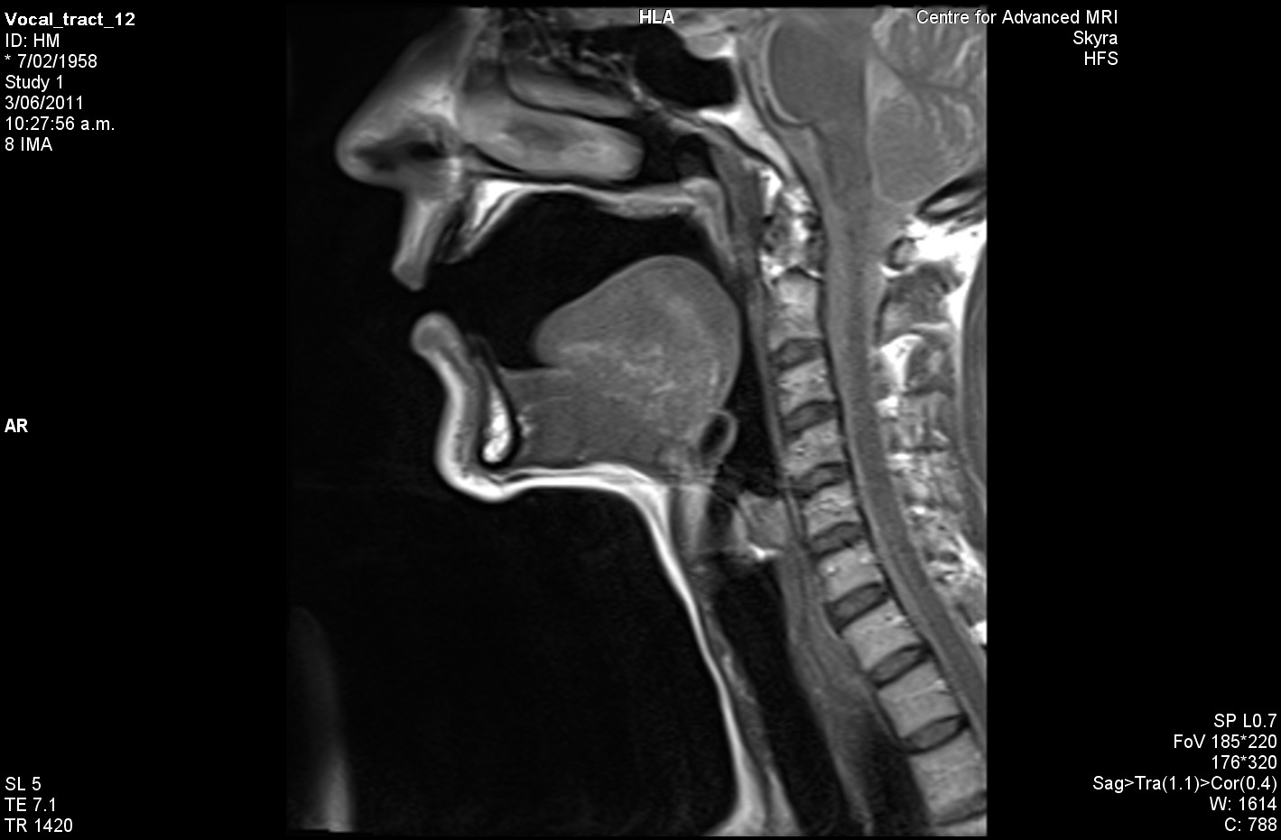
Notes:
HOARD

Slide 15
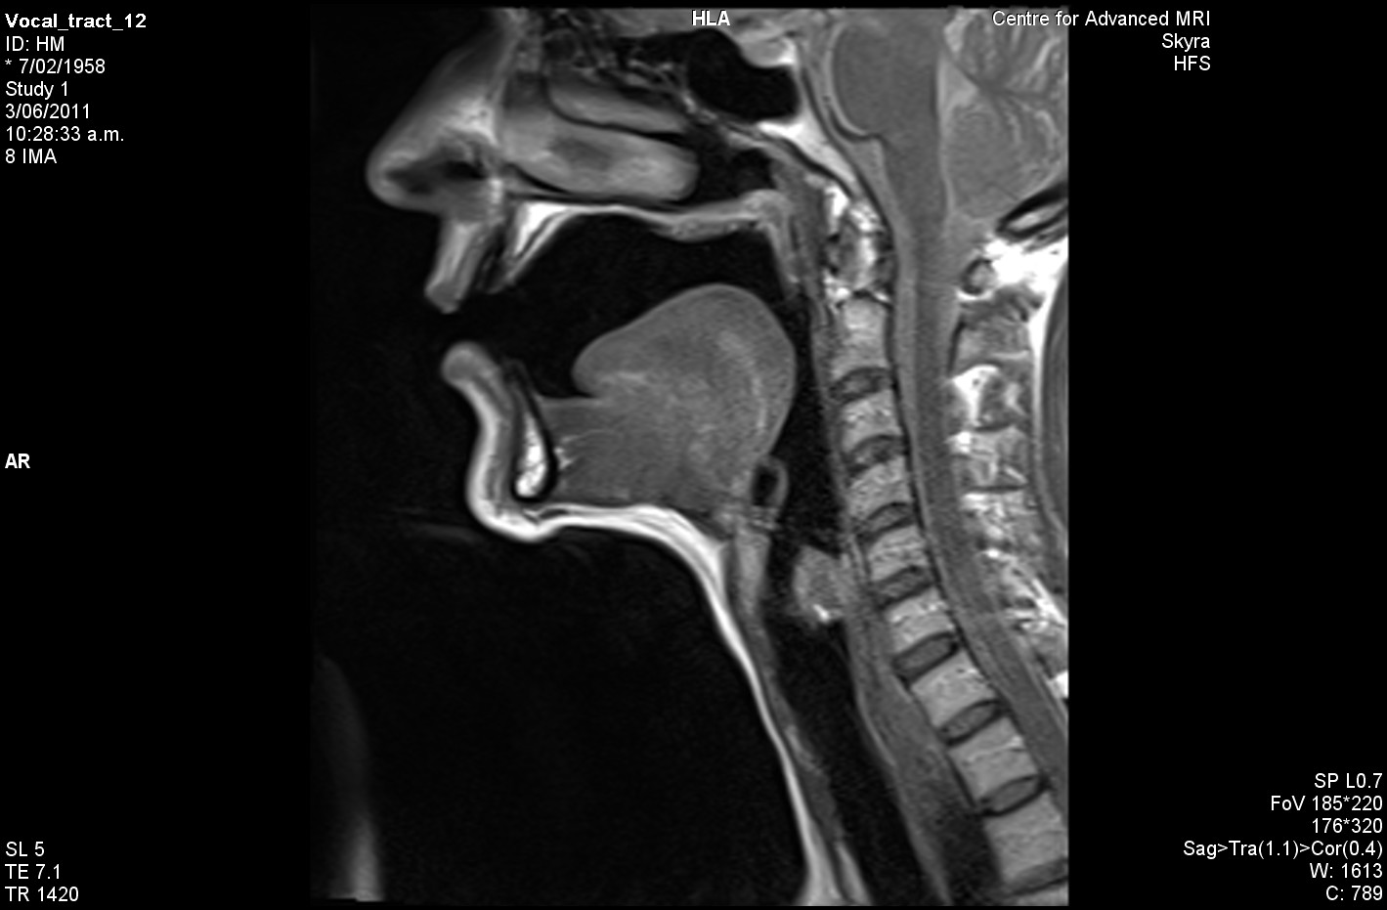
Notes:
HOOD

Slide 16
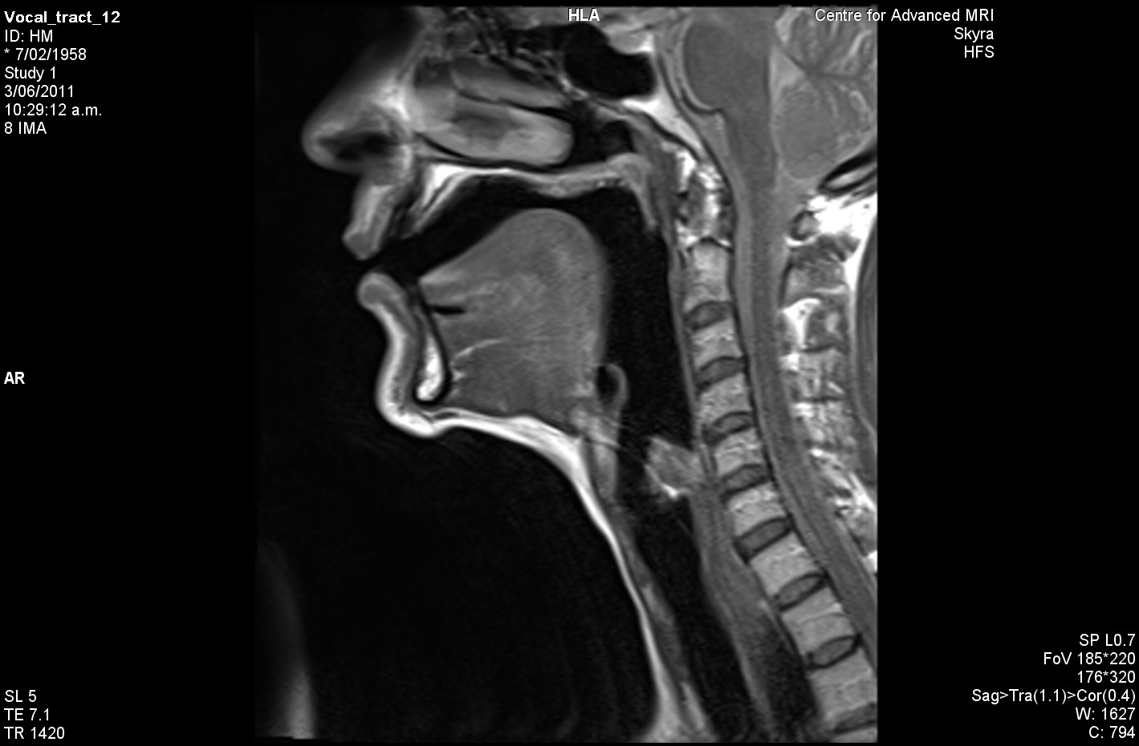
Notes:
WHO’D

Slide 17
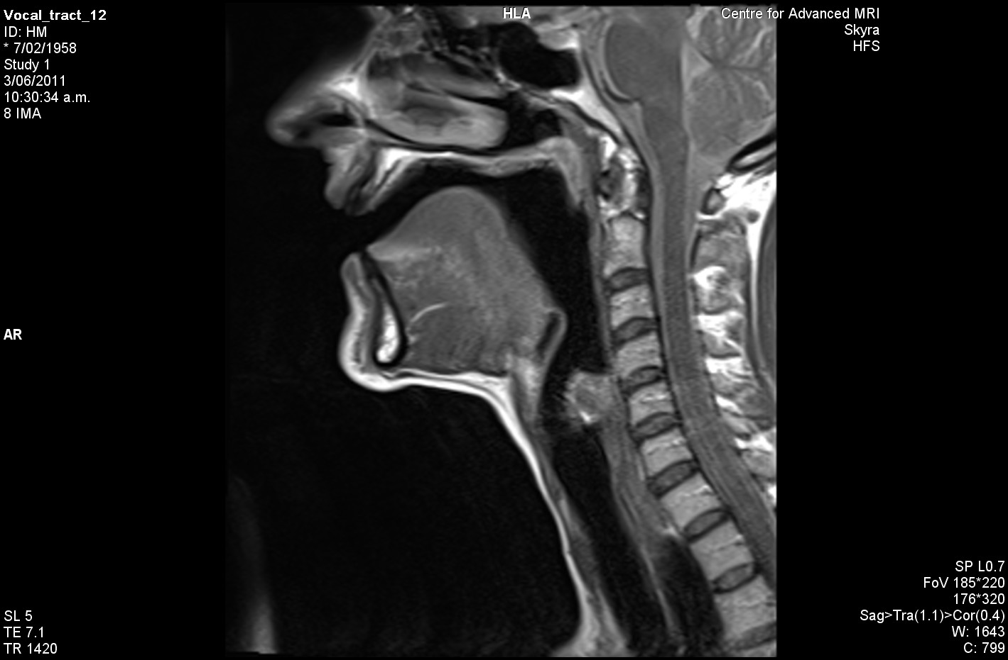
Notes:
HID

Slide 18
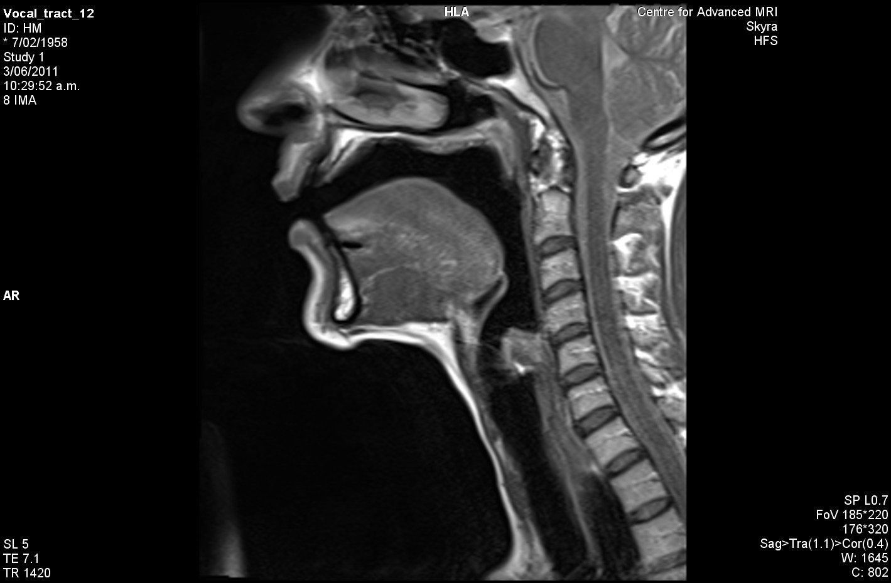
Notes:
HERD

Slide 19
Notes:
HEED

Slide 20
Notes:
HEAD

Slide 21
Notes:
HAD

Slide 22
Notes:
HARD

Slide 23
Notes:
HUD

Slide 24
Notes:
HOD

Slide 25
Notes:
HOARD

Slide 26
Notes:
HOOD

Slide 27
Notes:
WHO’D

Slide 28
Notes:
HID

Slide 29
Notes:
HERD

Slide 30
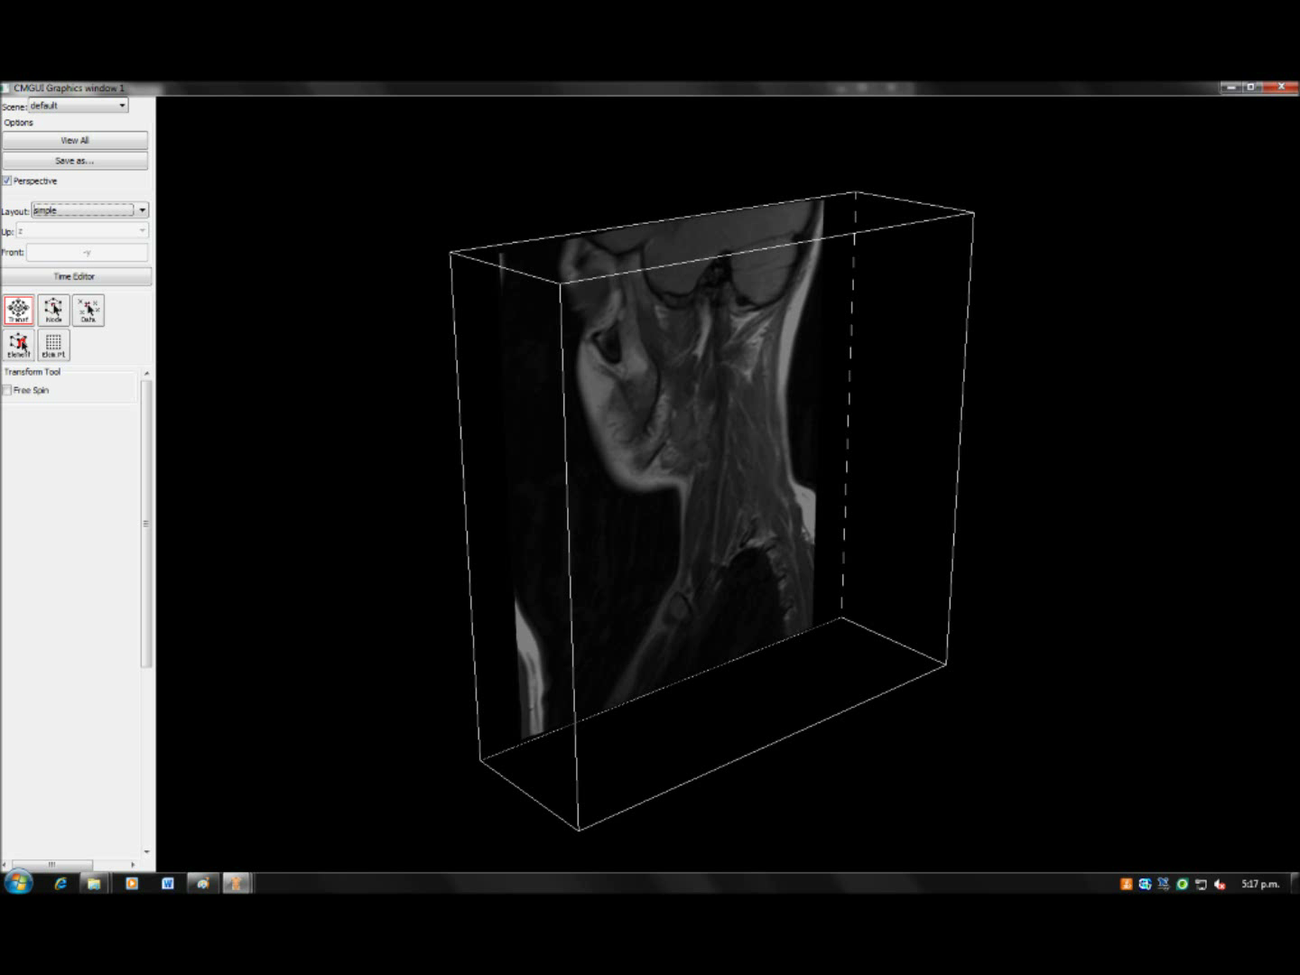

Slide 31
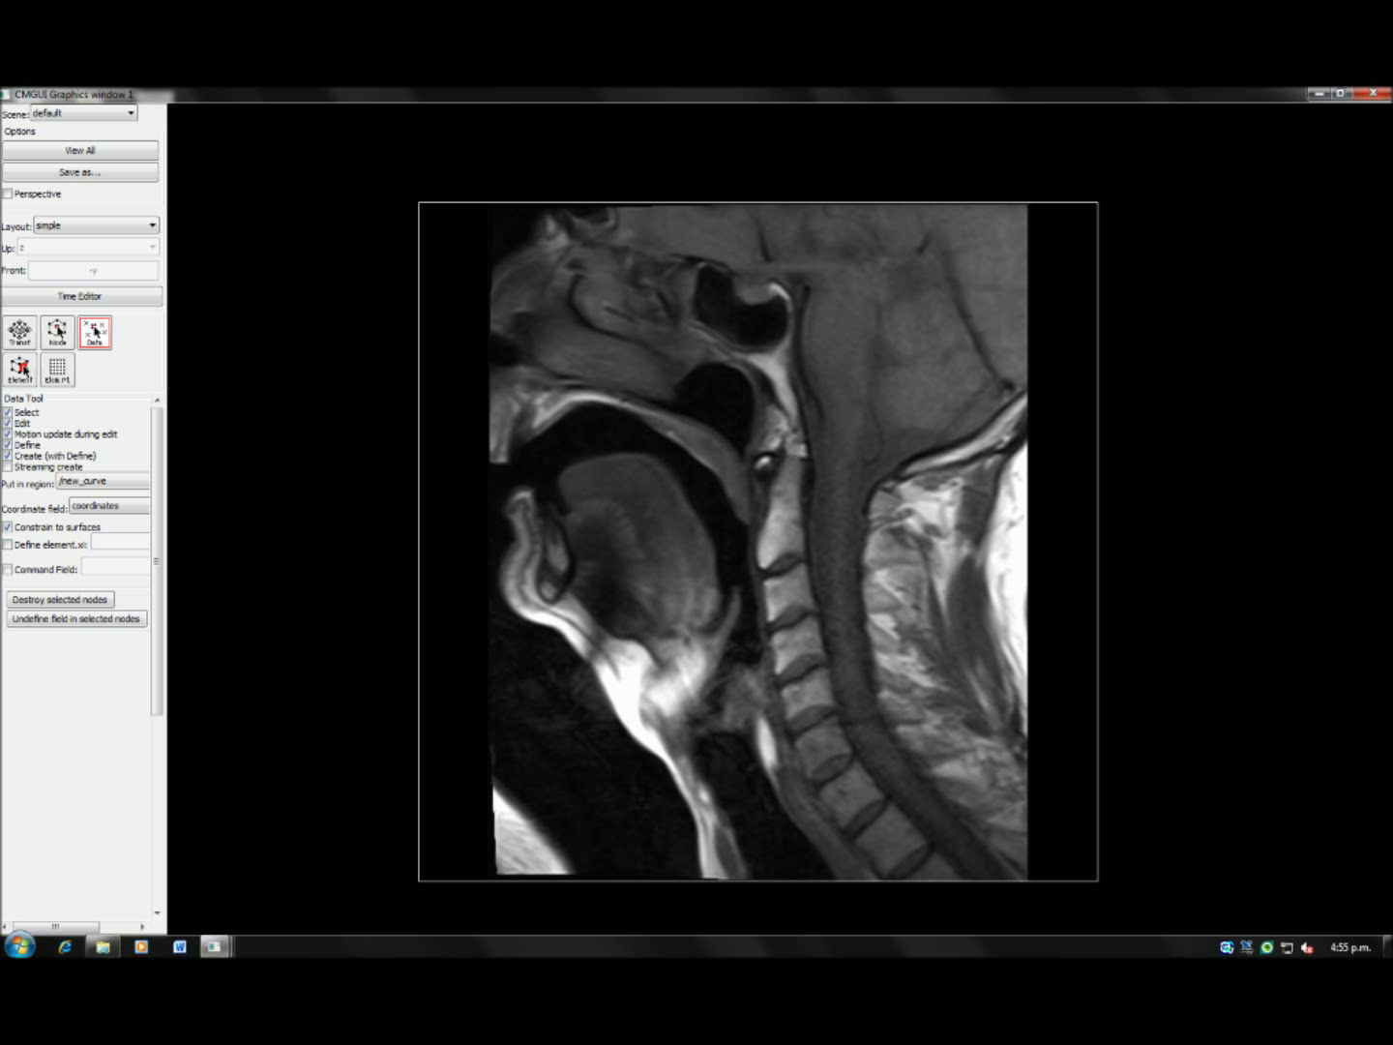

Slide 32
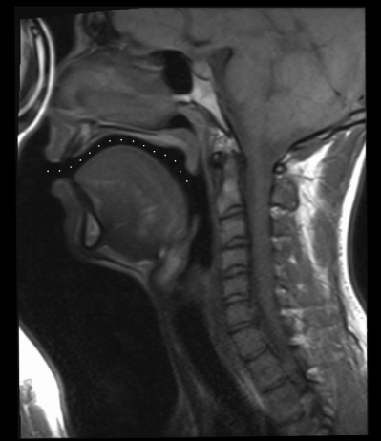
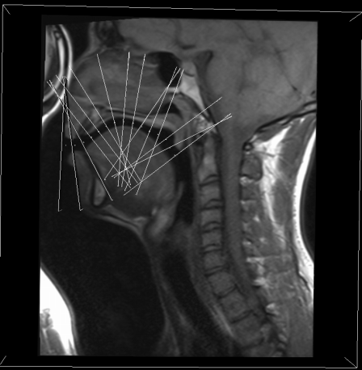
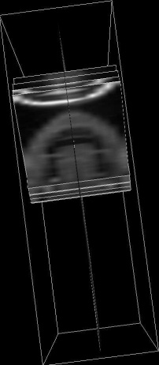
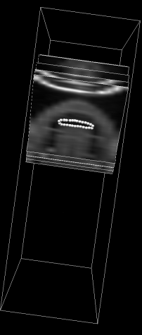
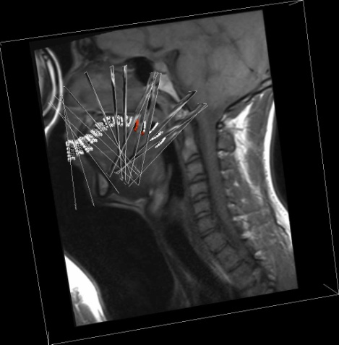
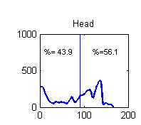
Obtaining the vocal tract data using CMGUI
1. Identify the vocal tract
mid-line
2. For each node obtain plane
Perpendicular to the centre line .
3. Mark out the
vocal tract
5 Calculate the
area of each segment
(perl script)
Repeat steps 1-5
for the pharyngeal
cavity
7. Combine oral and pharyngeal
data, for plot of cross-sectional
areas from lips to glottis
4. Repeat steps 1-3 for each of
the 15 planes in the oral cavity

Slide 33
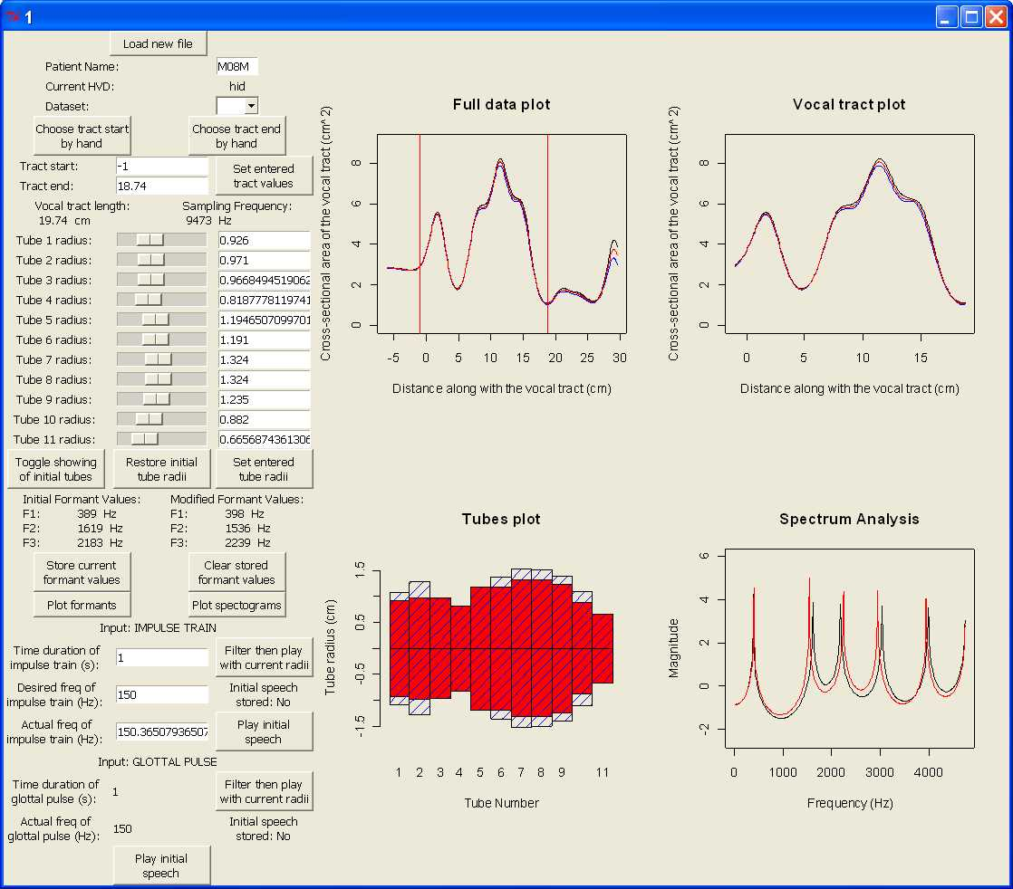
Vocal Tract Analysis Tool

Slide 34
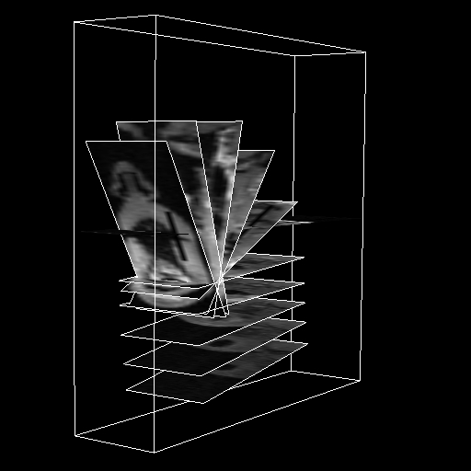
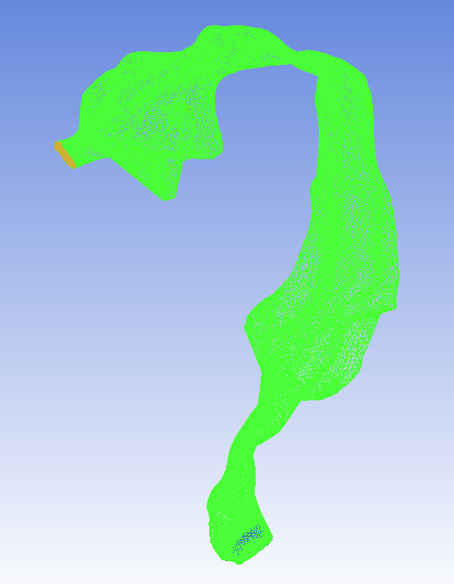
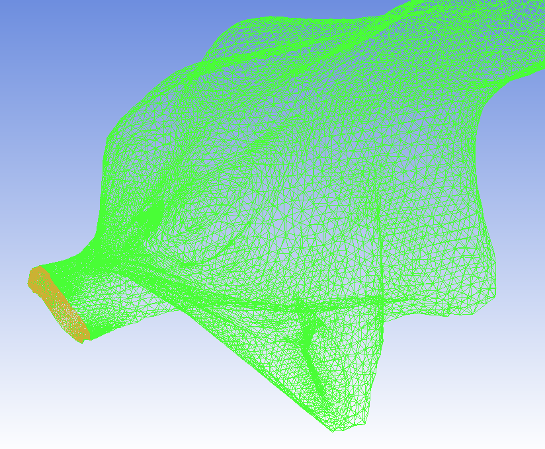
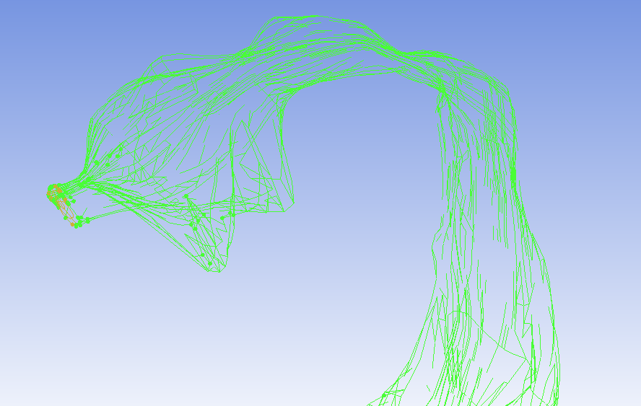
Mesh form the Geometry in ICEM
Thanks to Michael Hanks and Scott Walbran for the images
Notes:
Catherine and her students take MRI data and process it into image slices.
Scott Uses CMISS to create geometry with help from code written by Peter Bier.
I create a mesh from the geometry in ICEM.

Slide 35
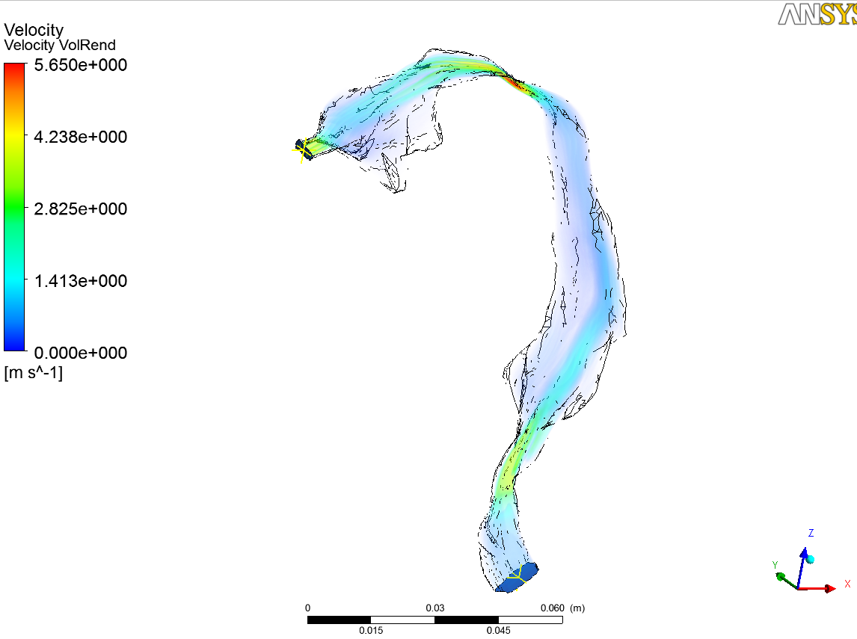
Airflow simulation in CFX
Thanks to Michael Hanks for the images
Notes:
The mesh is imported into CFX, where a flow simulation is set up.
Steady mass flux then oscillation.
Average speech is based on previous studies of speech air velocity.
Turbulence ignored (fricative sound unimportant & Rnum ~=1900 < 4000 -- for average)

