Slide 1
Cutting edge Njangi (ceJ.apk)
Group presentation on:

Slide 2

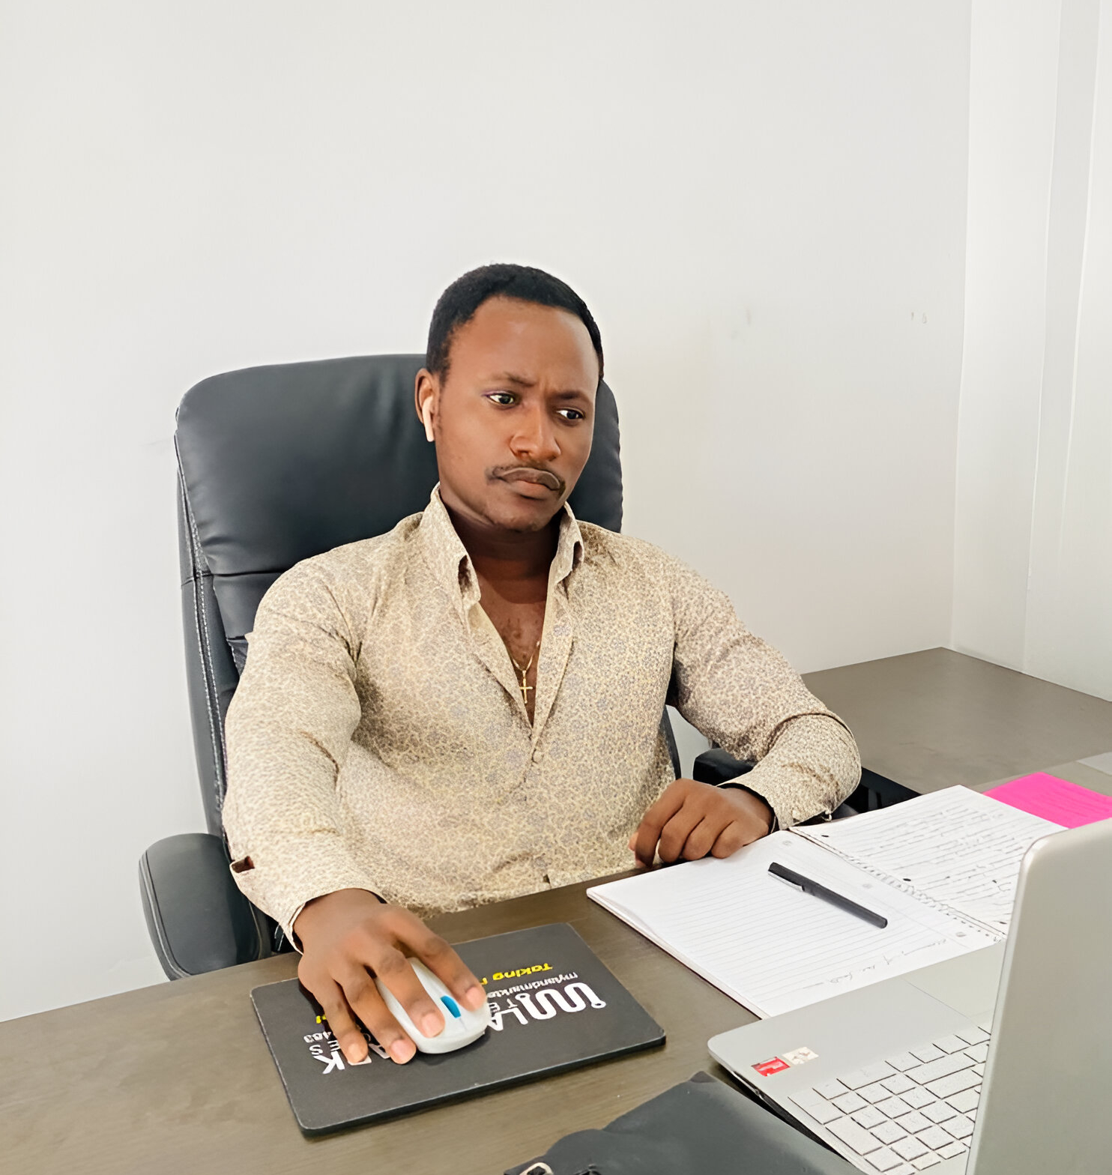


Group members
Hyzeal Achungha
Nzenze Lovis
Lum Bless
Anyia Tandu
70% UI/UX design
50% System analysis
20% System analysis
20% System analysis
10% System analysis
10% UI/UX design
10% UI/UX design
10% UI/UX design

Slide 3
PLAN
Objective.
Requirements.

Slide 4
Objective
Creating an easy-to-navigate mobile application to enable individuals to save at their own expends.
Give individuals the possibility of getting a load depending on their trust level not just their earnings
Keep track of their financial growth and development.
Enable communications of members including reminder, contribution and notification.

Slide 5
REQUIREMENTS
Functional requirements
Allow users to register and upload profile
Enable users to pay contributions
Allow users to take and pay loans
Allow notifications inform users about up coming request
Provide a strong record keeping of all transactions
Integration with several payment gateways like momo

Slide 7
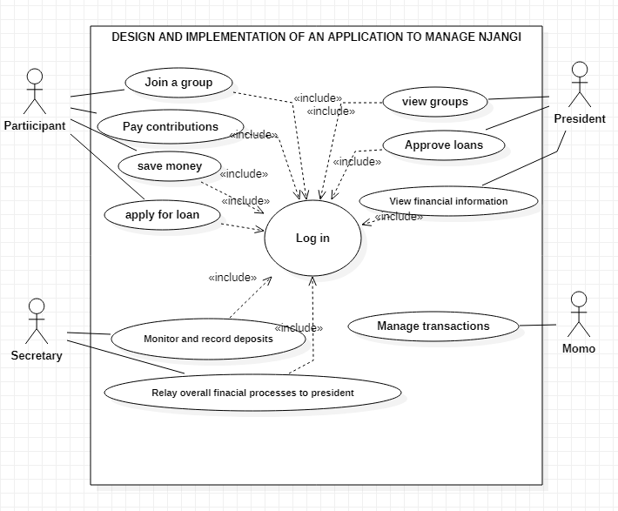

Slide 8
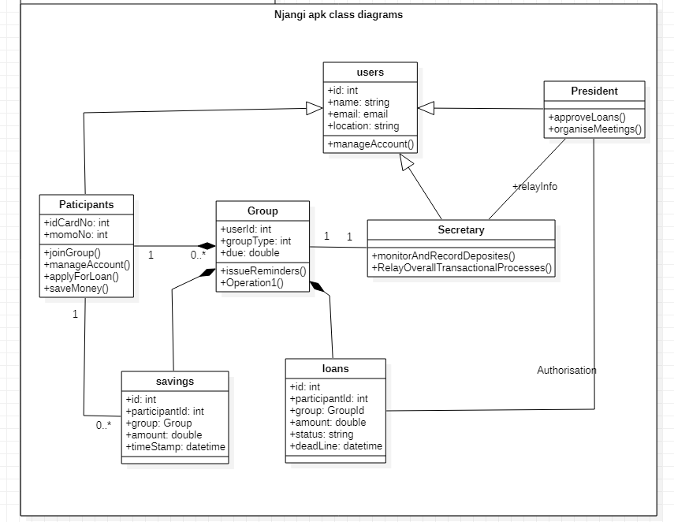

Slide 9
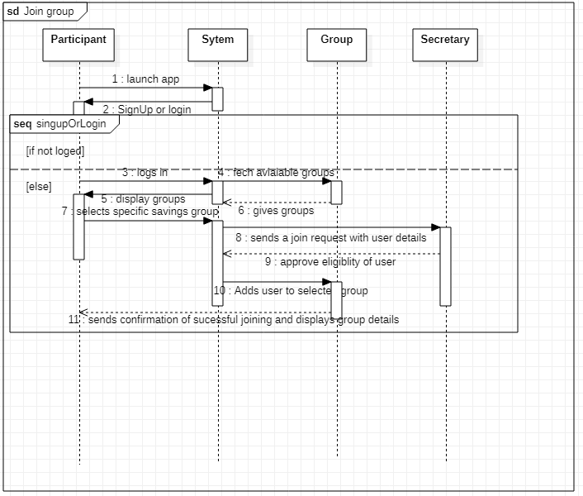

Slide 10
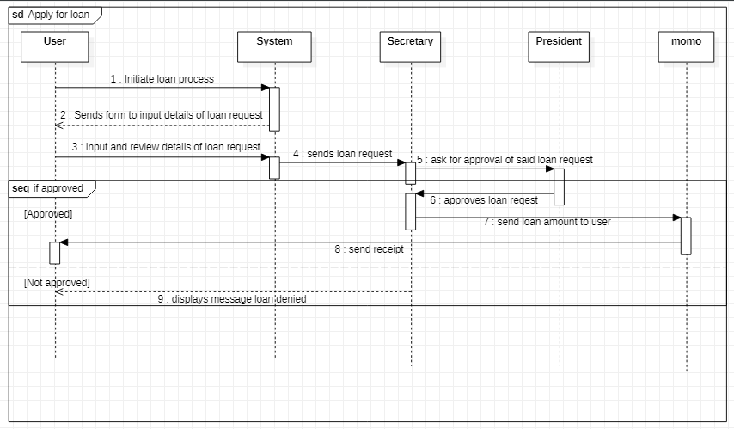

Slide 11
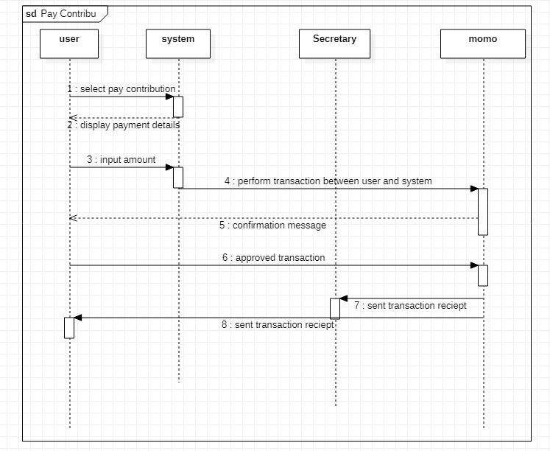

Slide 12
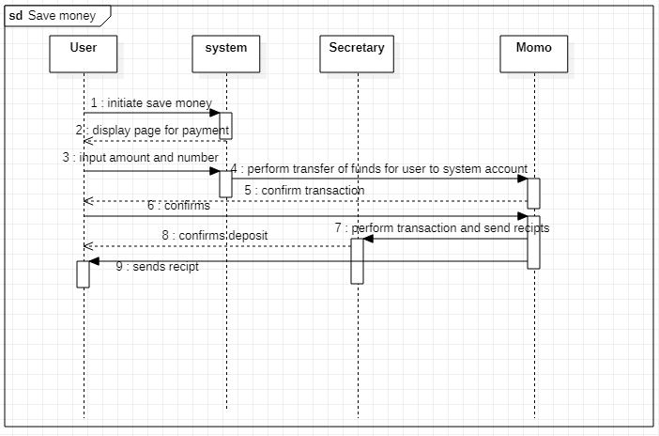

Slide 13
