Slide 1
Distinct Pollutants Vs Country

Slide 2
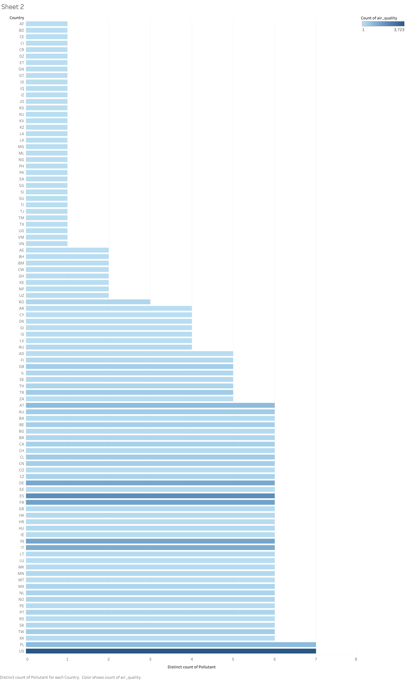
This graph essentially gives you the idea that how many number of pollutants are present in different country. The amount of harm caused by every pollutant differs.
Currently, the USA and countries like India, Poland, Kosovo have a high number of pollutants.
This essentially does not mean that they are polluted and have a bad air quality index.
This only proves that there are a number of pollutants present.

