Slide 1
Without Tree height

Slide 2
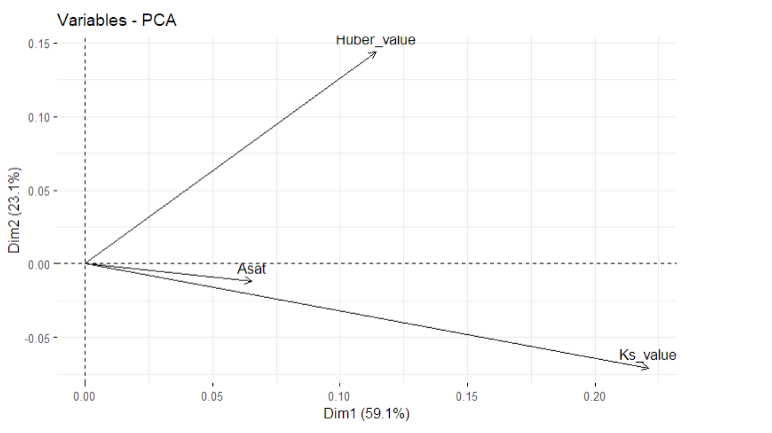

Slide 3
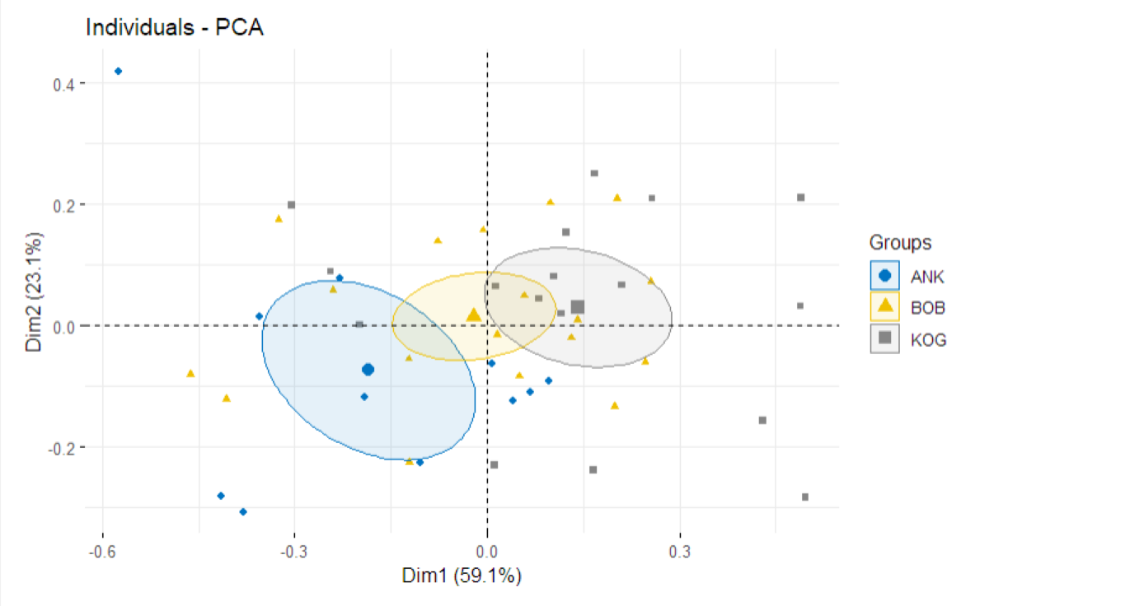

Slide 4
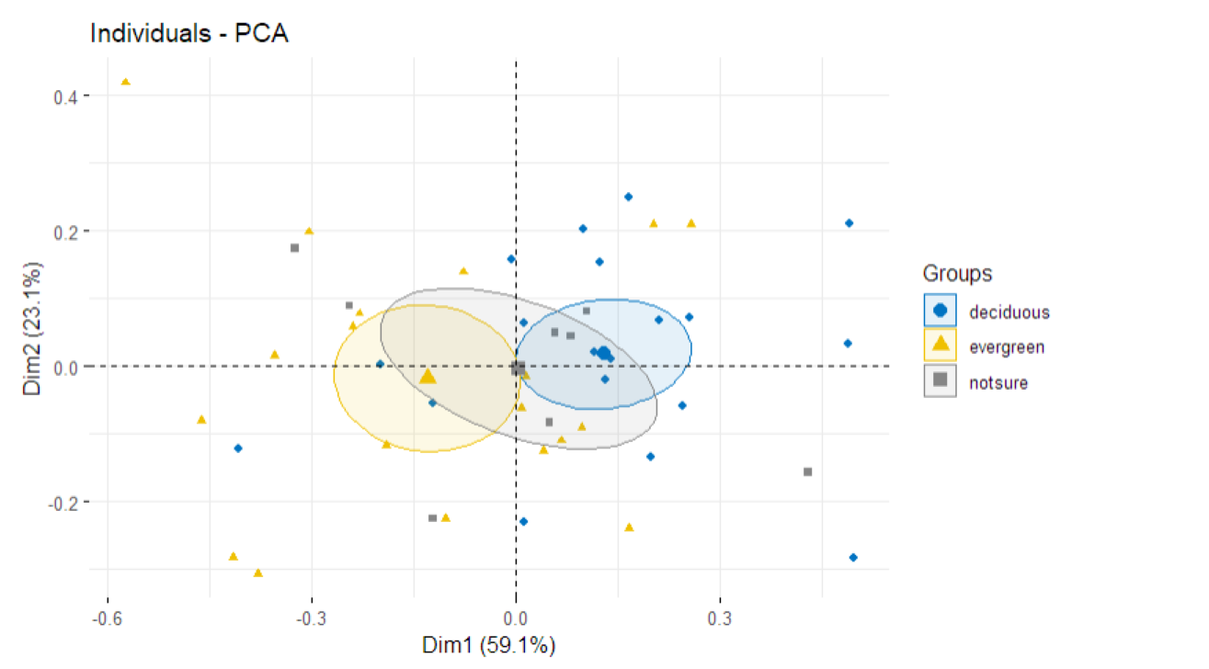

Slide 5
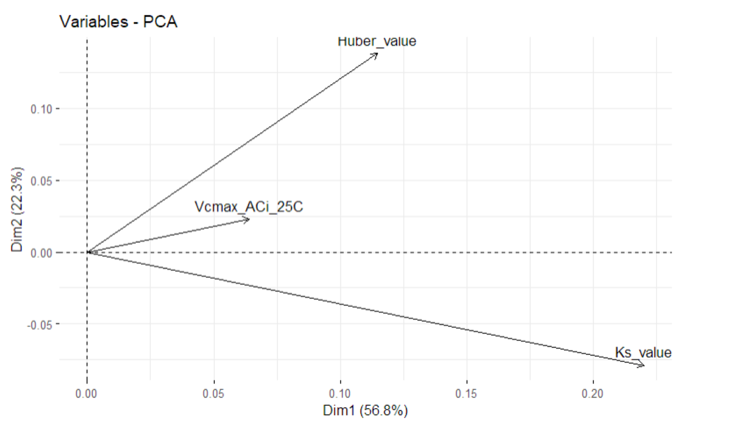

Slide 6
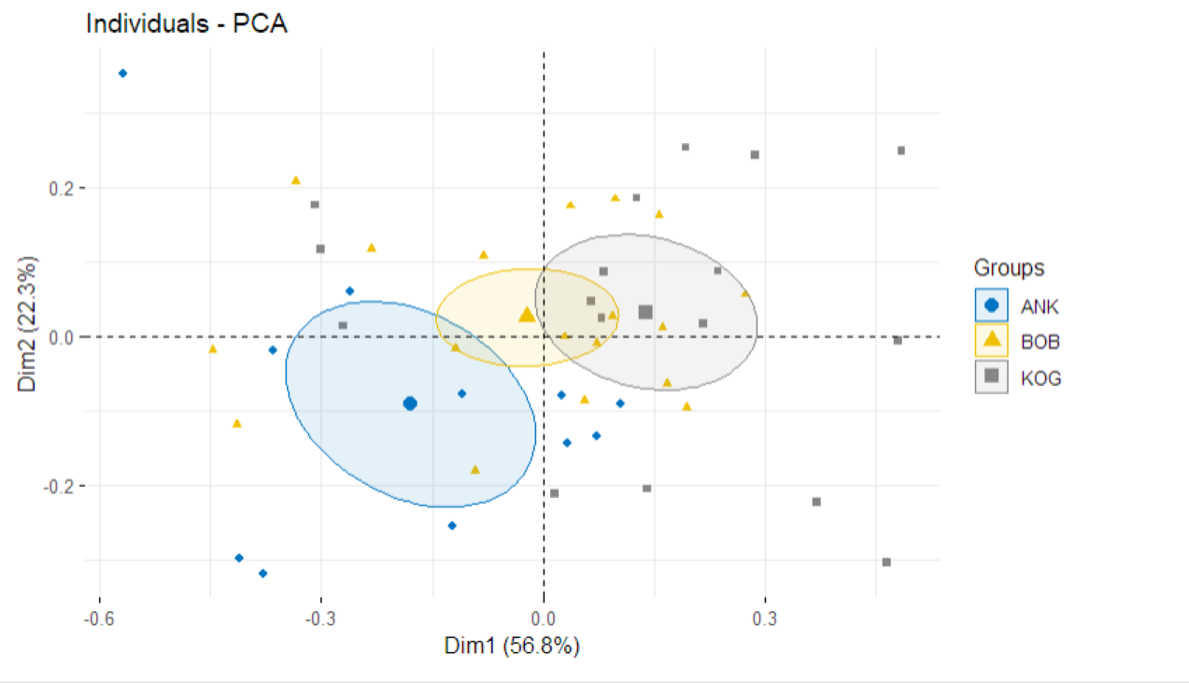

Slide 7
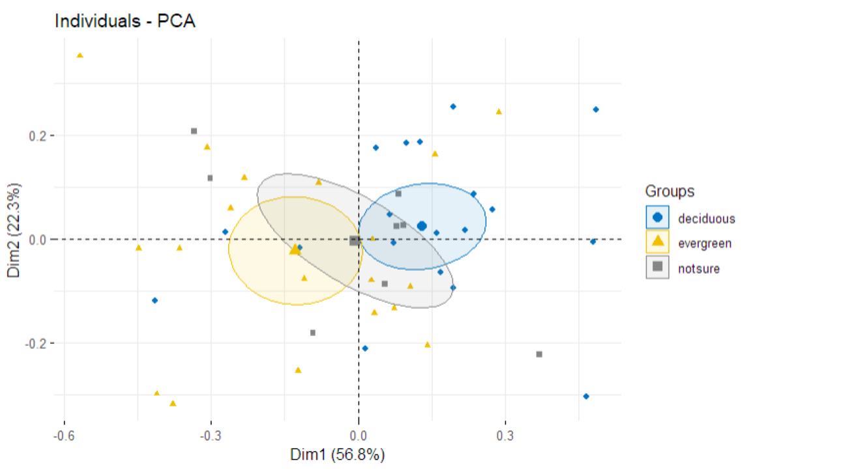

Slide 8
With Tree height
Ok, it is very messy, tree height is not relevant to anything else and sit on its own….

Slide 9
Now let’s think about whether we should have Vcmax or Asat

Slide 10
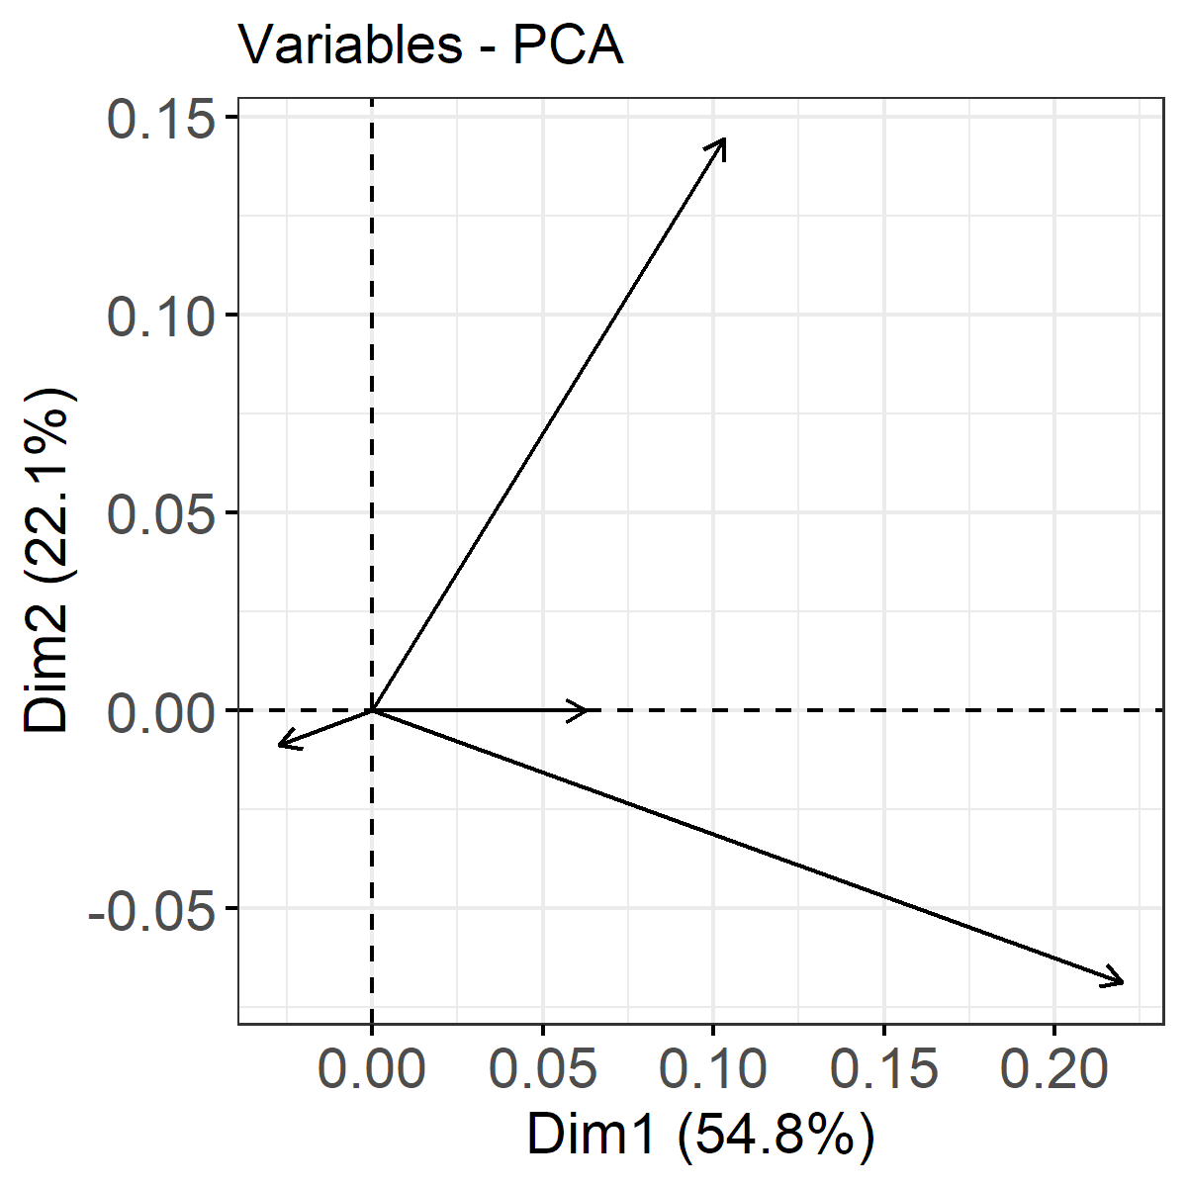
AS/AL
Vcmax
ci/ca
Kp

Slide 11
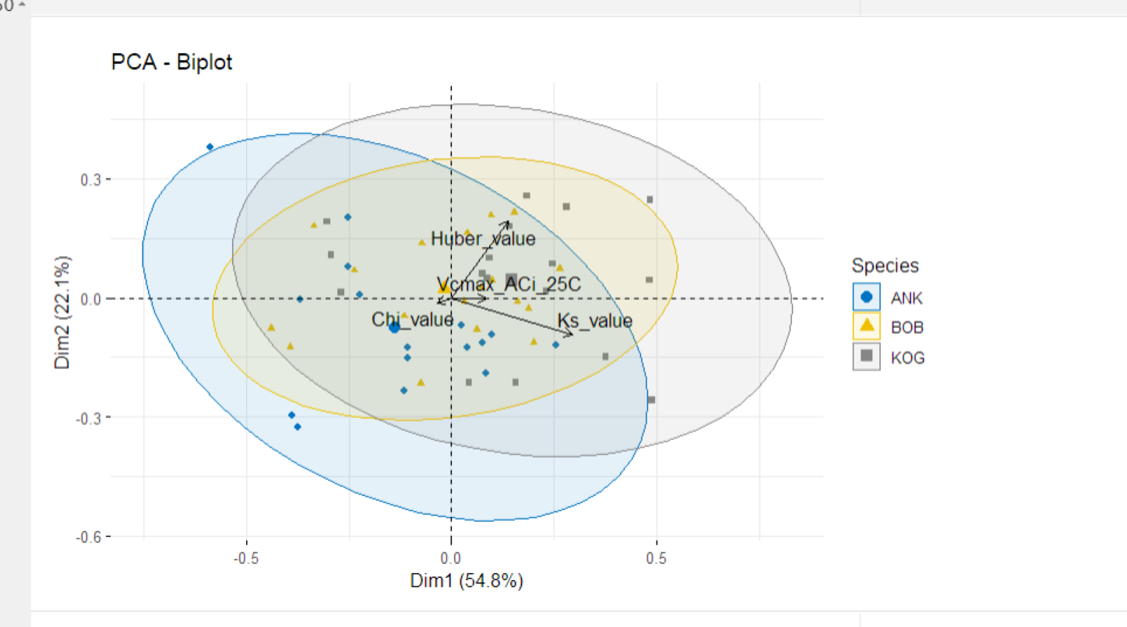

Slide 12
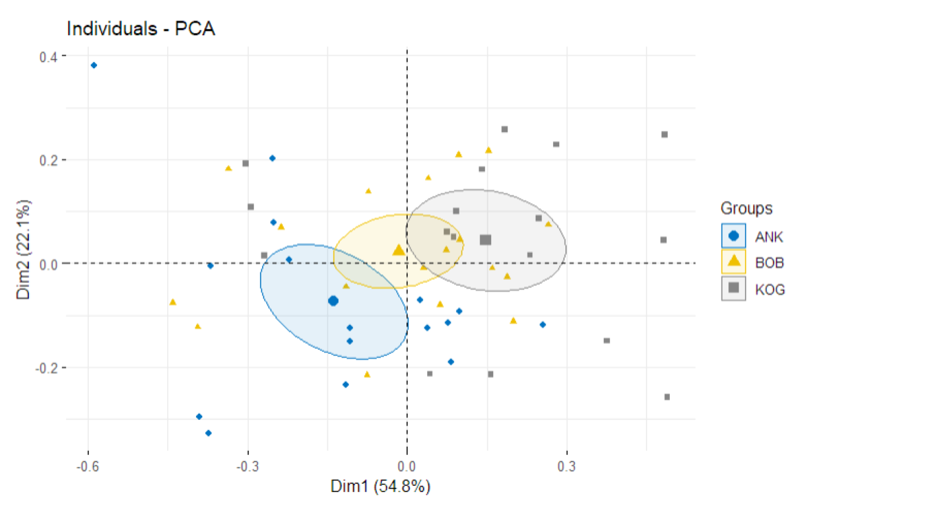

Slide 13
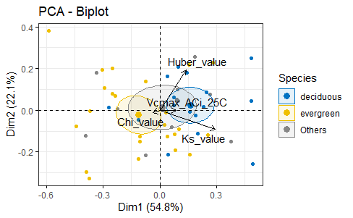
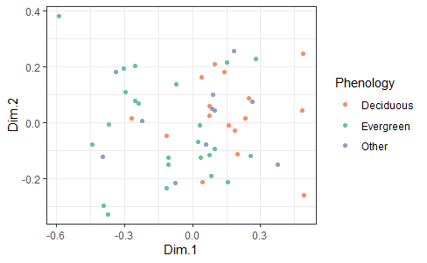

Slide 15
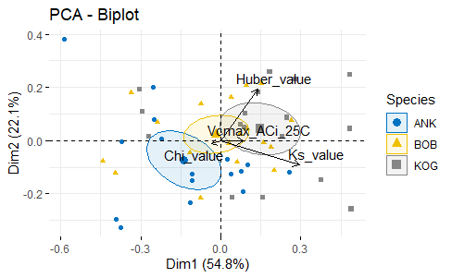
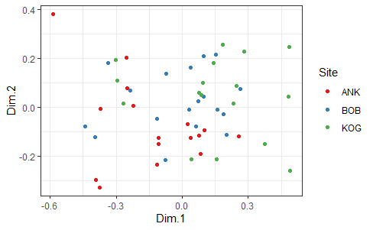

Slide 16
(22.1%)
(wet)
(mid)
(dry)
(54.8%)

Slide 17
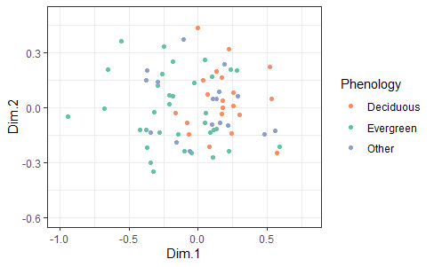
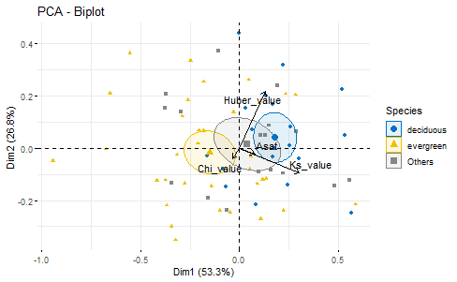

Slide 18
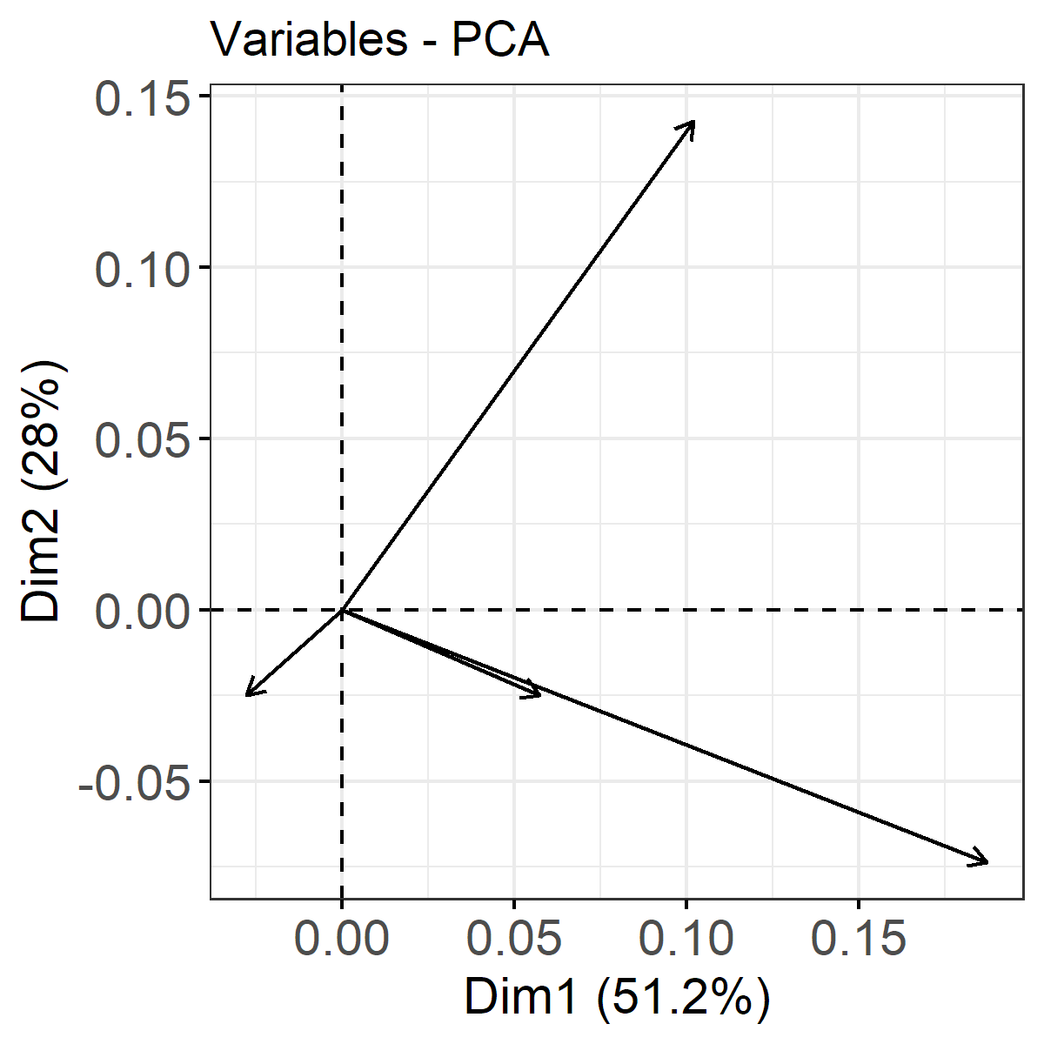
Huber
Chi
Asat
Kp

Slide 19
Huber
Asat
Chi
Kp

Slide 20
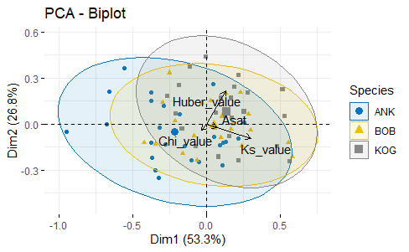
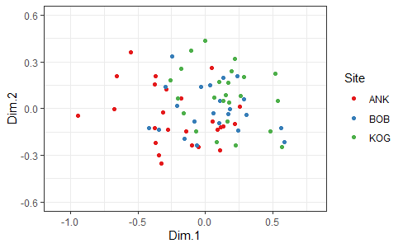

Slide 21
Huber
Asat
Chi
Kp

