Slide 1
Finding a Solution for A290250 for n=1
CS566 A3 Analysis of Algorithms
Prof. Alexander Belyaev
Spring 2024

Slide 2
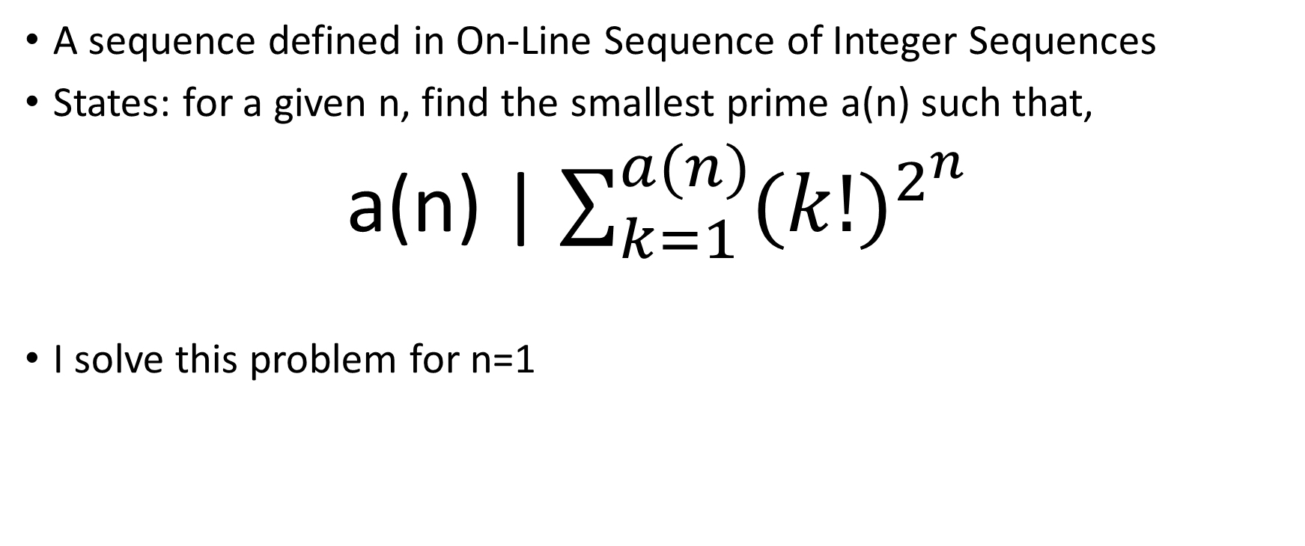
What is A290250?
A sequence defined in On-Line Sequence of Integer Sequences
States: for a given n, find the smallest prime a(n) such that,
a(n) | $\sum_{k=1}^{a(n)}{{(k!)}^{2^{n}}}$
I solve this problem for n=1

Slide 3
Solving the Problem
I approach the problem in 2 main parts,
First, generation of prime numbers,
Three methods, Sieve of Eratosthenes, Using sympy in Python, Implementing Croft’s Algorithm
Benchmark
Use the fastest
Next, I compute the sum and perform the division
Two basic, very similar algorithms
Benchmark
Compute the solution
I use the Python profiler Scalene for profiling my code. One of its salient features is the step-by-step execution and its reltively low overhead of 10-20%.

Slide 4
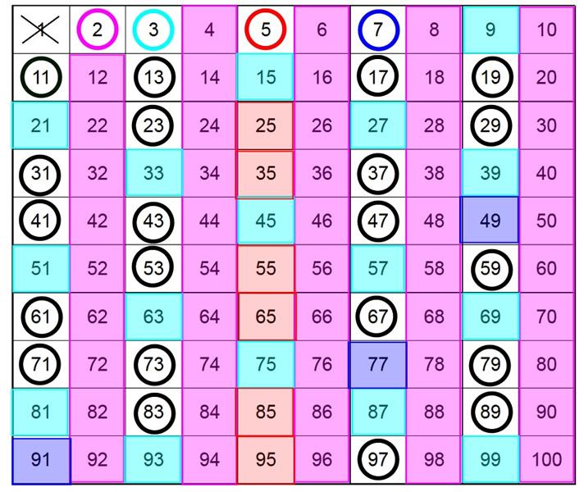
Sieve of Eratosthenes
Developed back in 200BC by Eratosthenes
The basic idea is simple:
make a list of numbers, starting with 2
repeat:
the first number in the list is prime
cross off multiples of the most recent prime

Slide 5
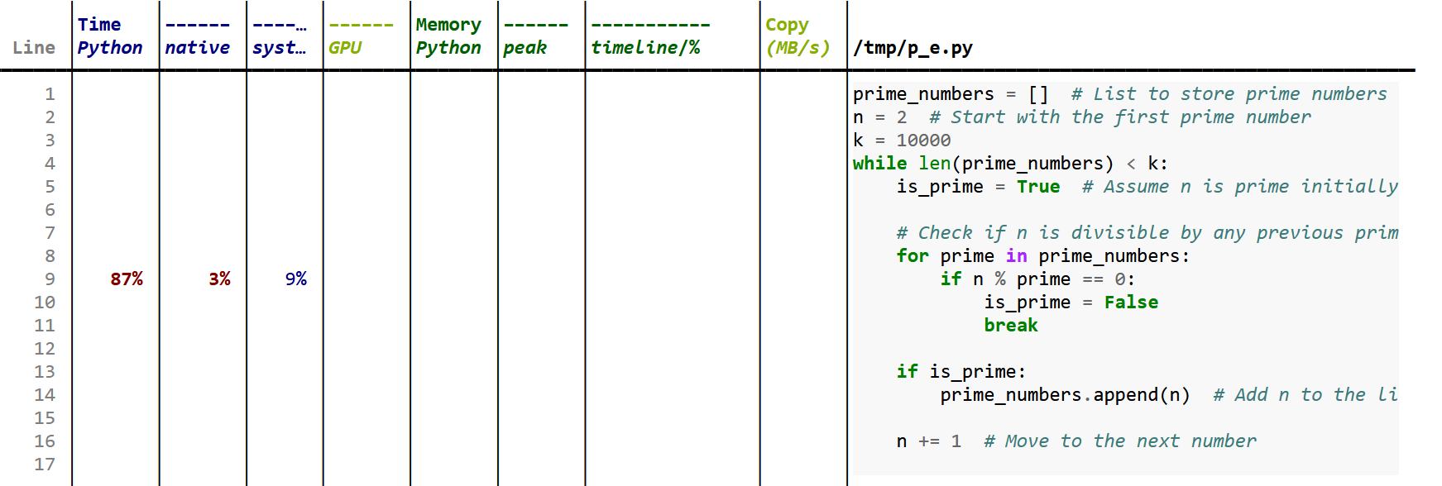
Profiling Sieve of Eratosthenes
We see that about 87% of the time taken is in the branching of if loop when n is divided prime

Slide 6
Croft’s Algorithm
Based on Croft’s Spiral Sieve
I utilize the fact that only(1, 7, 11, 13, 17, 19, 23, 29) are possible as residues mod 30 for prime numbers. The first three primes (2, 3, 5) are hardcoded.
Utilizes a dictionary to track the squares of primes and the corresponding prime.
Employs a set to filter out numbers that can’t be prime.
Uses a tuple to mask out numbers that can’t be prime. Iterates over potential prime candidates.
If a candidate is in the dictionary, it’s not prime. The code finds the next number that is not a multiple of any smaller primes and not in the dictionary, and adds it to the dictionary.
If a candidate is not in the dictionary, it’s a prime. The code adds its square to the dictionary.
Uses a wheel factorization to skip numbers that are definitely not prime.

Slide 7
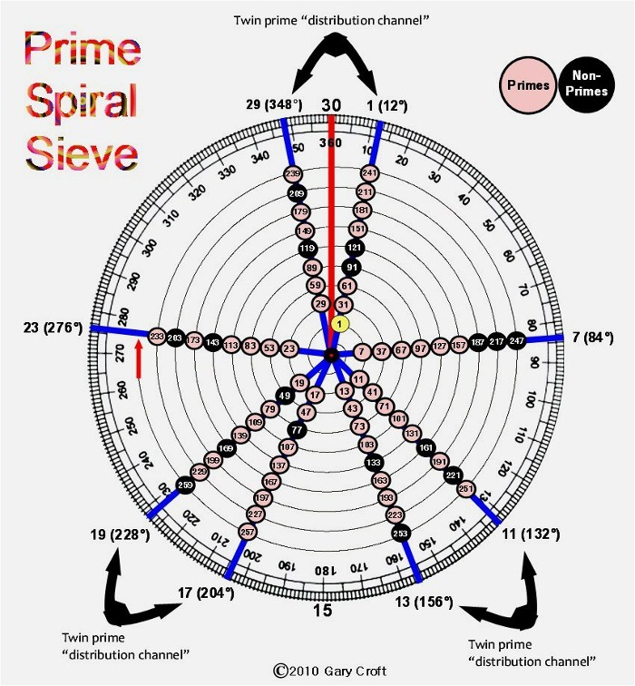
Croft Spiral Sieve
The memory consumption is roughly linear for large primes.

Slide 8
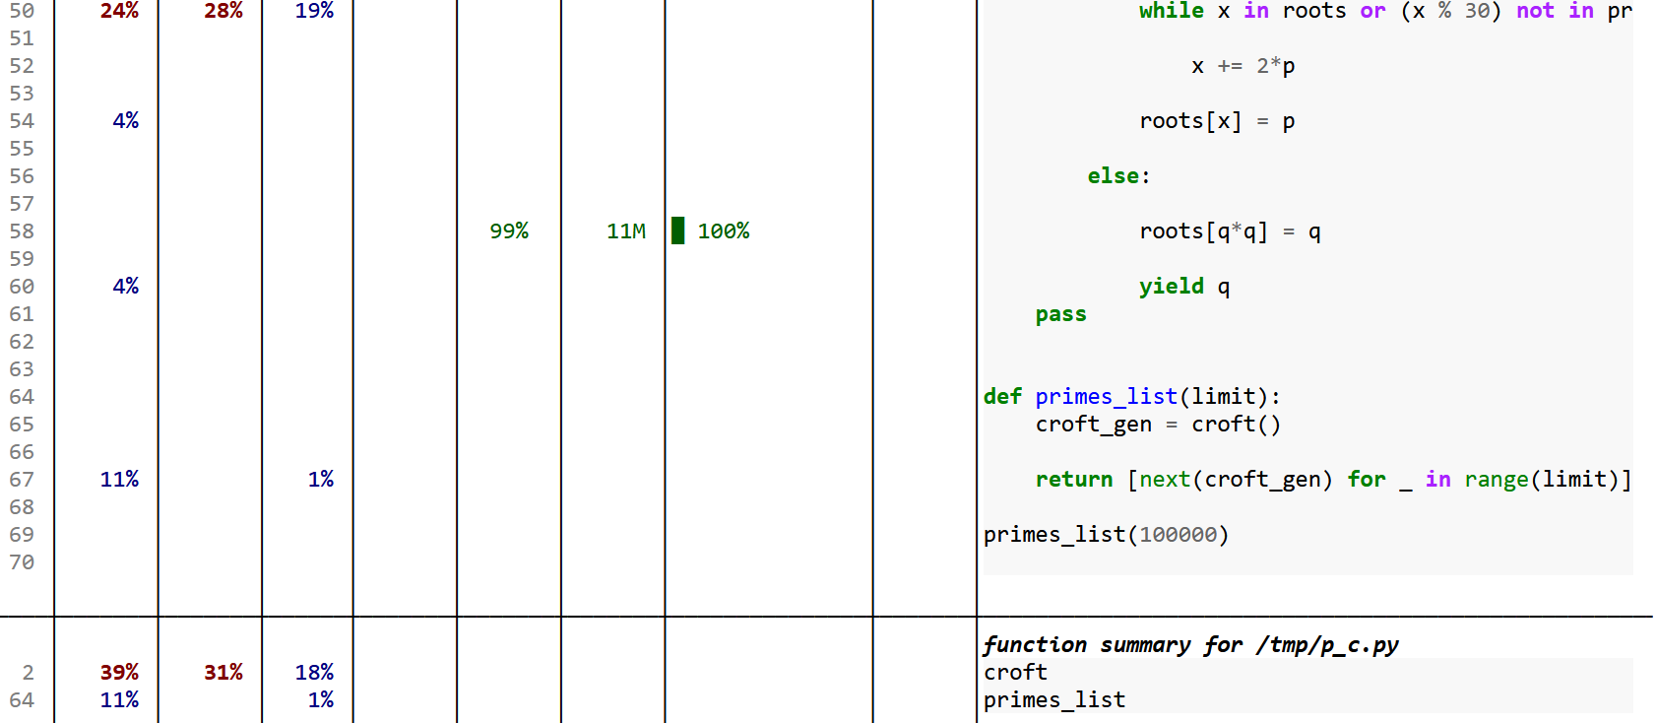
Profiling Croft’s Algorithm
I see that, maximum memory consumption occurs when the dictionary of square roots get updated. And maximum time is consumed when I search for the next prime after a current prime.

Slide 9
sympy.primerange(a,b)
The sympy library in Python provides an inbuilt function to compute the primes in a given range.
Function: sympy.primerange(a,b)
Output: Prime numbers in the range(a, b)
From the implementation available here, it divides the interval into smaller chunks, then create a list starting from a, based on certain parameters used in its implementation.

Slide 10
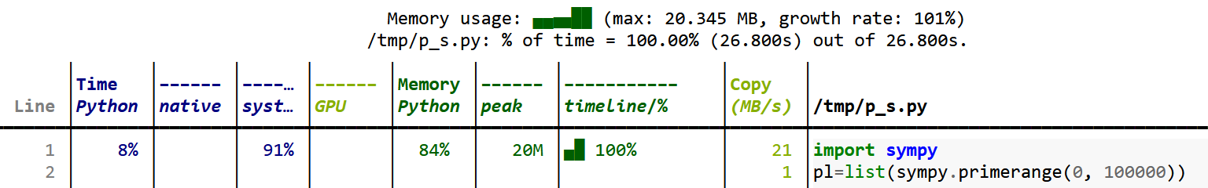
Profiling sympy.primerange(a,b)
As predicted, the overhead of importing sympy seems to be the highest.

Slide 11
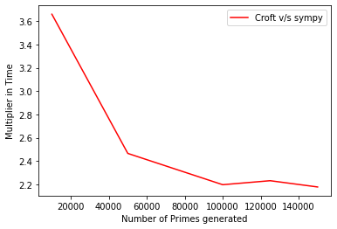
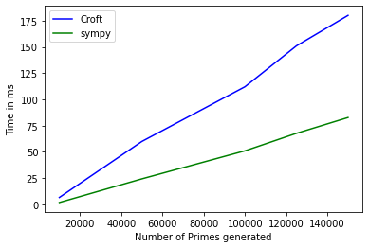
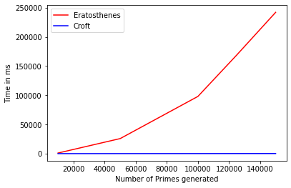
Comparison
I test for n = 100, 10,000, 50,000, 100,000, 125,000, 150,000
Observations: sympy is the fastest for the tests, the relative speed up between sympy.primerange() and Croft’s Spiral Sieve has also been shown.
However due to the overhead caused by importing synpy, I choose Croft’s Spiral Sieve for generation of prime numbers.

Slide 12
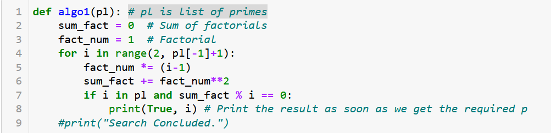
Implementing Computation: Algorithm-1
Once I receive the prime numbers from the previous steps, I compute the required sum using two basic algorithms,

Slide 13
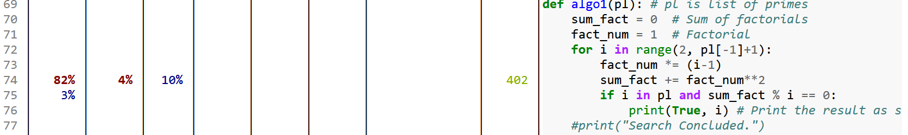
Profiling Algorithm-1
Here, I see that, in the step where we compute the factorial sum, its very inefficient, since over 80% of the time is being consumed.
I also see that a copy of about 402MB/s is taking place in this step which is not good since copying data always slows down our program.

Slide 14
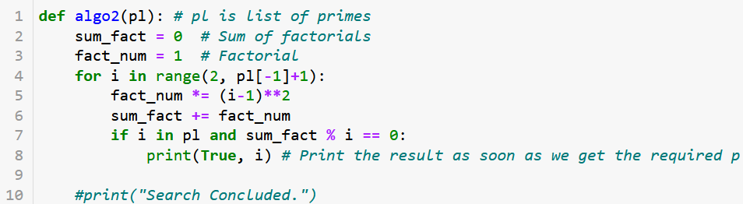
Algorithm-2
Here, as one can see, there’s a very small change, but check how it changes the computation time!
The change is in line 5, and 6, instead of squaring the fact_sum and adding it, we are computing the fact_num itself by squaring the individual numbers.

Slide 15
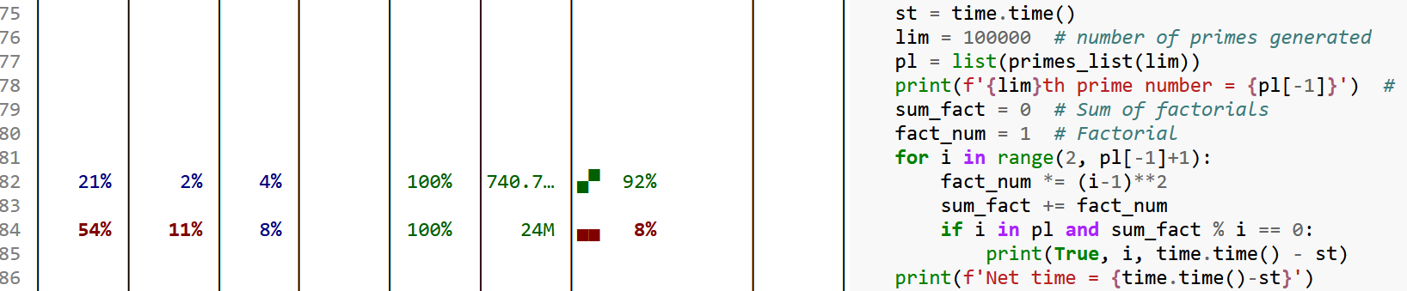
Profiling Algorithm-2
Here, we can see that majority of the memory consumption occurred in the step where we compute the square of the factorial.
And a substantial amount of time as well. But this is a much better result compared to Algorithm-1

Slide 16
Benchmarking Algorithm-1 and Algorithm-2
1248829 (96379th prime).
2381149
1248829 (96379th prime).
I compare them both for prime numbers for n=100, 1000, 5000, 10000, 15000, 16384.
Following this, due to memory issues, I only used Algorithm-2 to compute our result, which I computed for n=25000, 75000, 100000, 125000, 150000. Note that these are number of prime numbers tested. The last prime number tested is, 2381149.
I find that there’s only one solution till then.
96379th prime number, 1248829

Slide 17
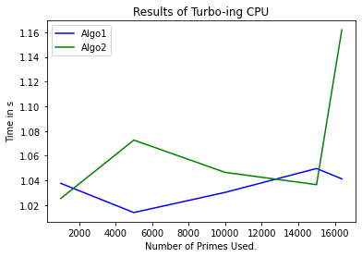
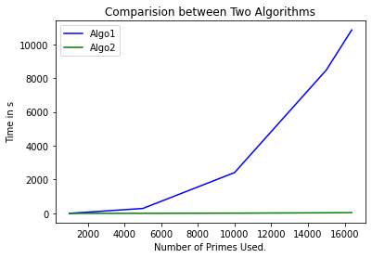
Benchmarking
Just to get an idea how CPU frequencies matter, I ran a few tests, with CPU in normal, and once in turbo mode. The tests were done for n=100, 1000, 5000, 10000, 15000, 16384.
Its interesting to see how much difference such a small change makes,

Slide 18
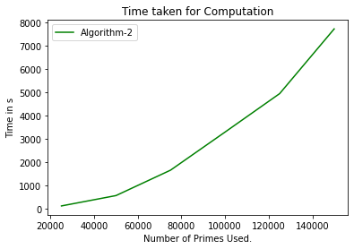
Finding a Solution
After n=16384, Algorithm-1 became too expensive to run, so I proceed to run the next cases with Algorithm-2.
I find a solution at n=100000, and verify that there are none more upto n=150000.
The time taken for the entire process for 150000 primes was about 2hr 10min.

Slide 19
References
sympy.primerange(): https://github.com/sympy/sympy/blob/74c56ac8d664356c6dc065da0dfdb10771591a17/sympy/ntheory/generate.py#L120
Croft’s Sieve: https://discuss.python.org/t/sieve-of-eratosthenes-in-python/17130/4
Scalene: Berger, E. D., Stern, S., & Pizzorno, J. A. (2023, July). Triangulating Python Performance Issues with Scalene. 17th USENIX Symposium on Operating Systems Design and Implementation (OSDI 23), 51–64. Retrieved from https://www.usenix.org/conference/osdi23/presentation/berger

Slide 20
Thank You
Please feel free to contact me if you wish to connect or discuss further upon this topic. I will be happily willing to work together if anybody is interested.
pratham9@bu.edu

