Slide 1
For Website

Slide 2
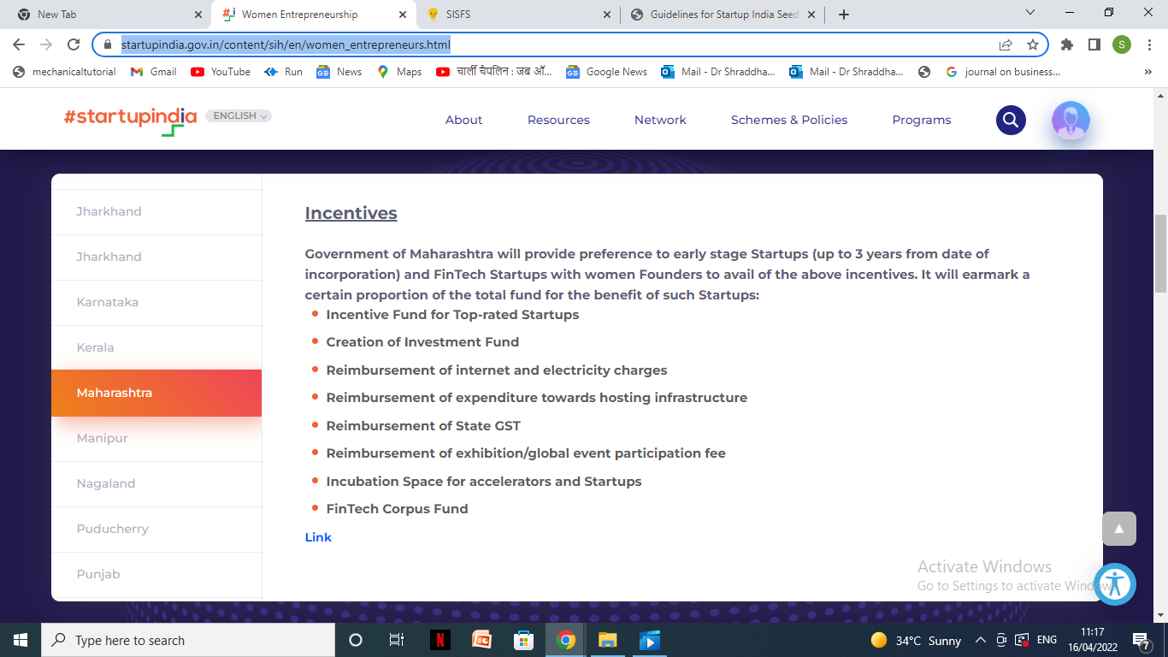

Slide 3
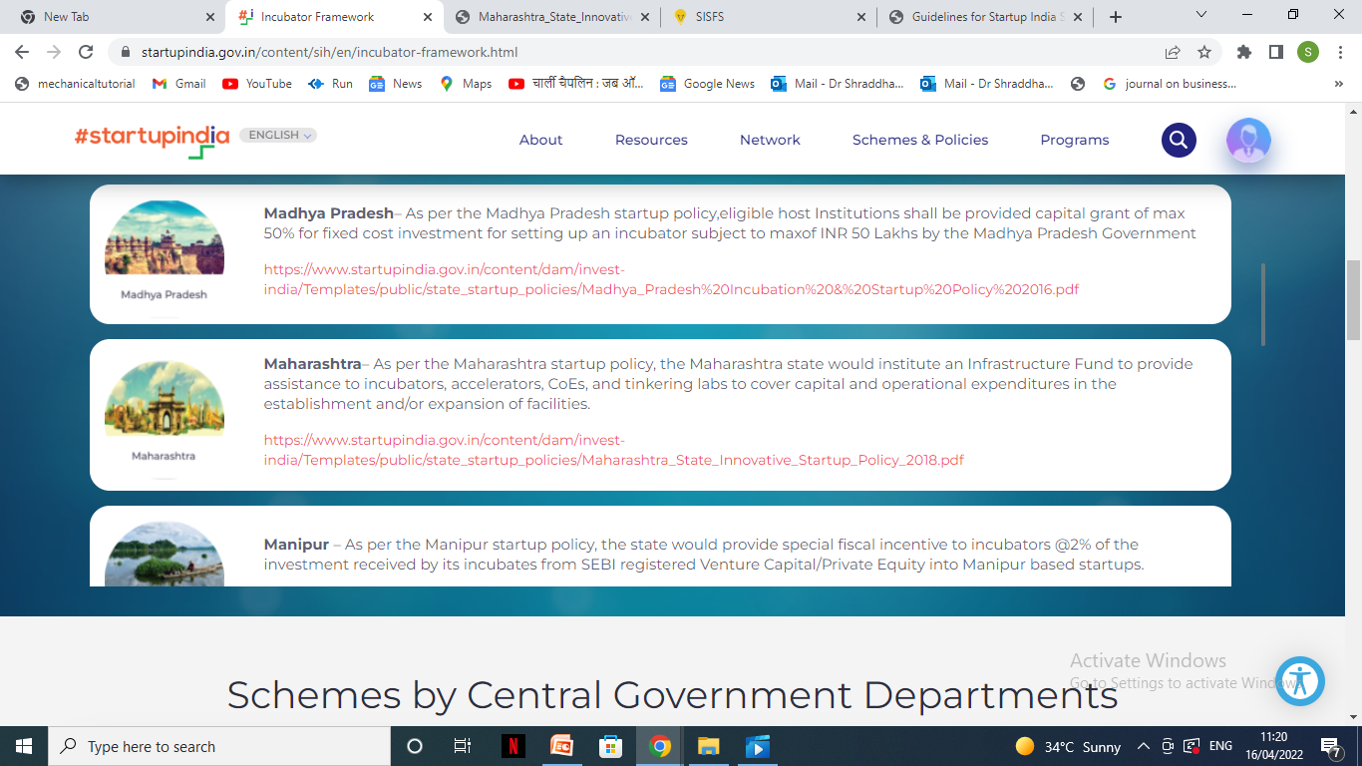

Slide 4
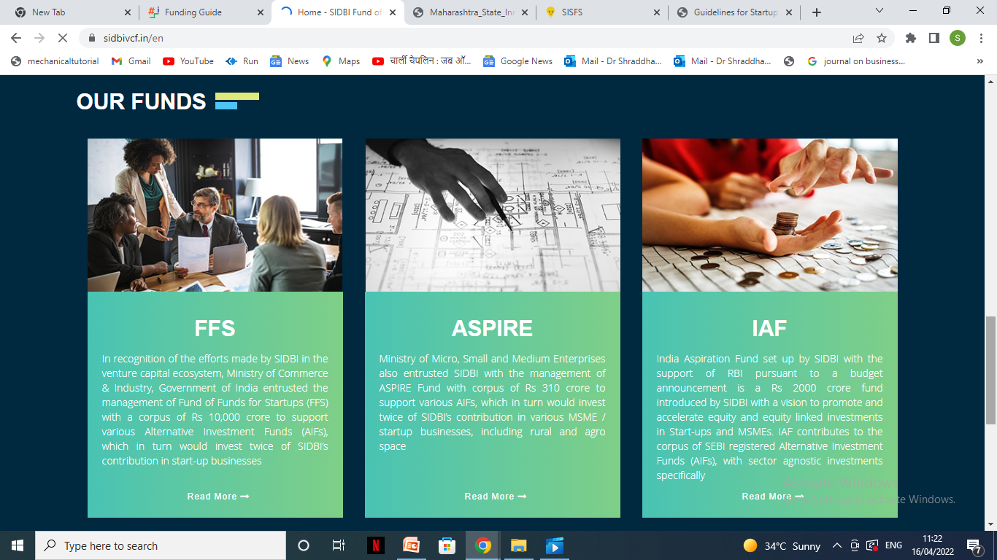

Slide 5
Important links
https://msins.in/guidelines_docs/english/2018-02-05-Maharashtra%20State%20Startup%20policy%20-%202018_GR.pdf
https://www.startupindia.gov.in/content/sih/en/funding.html
https://www.startupindia.gov.in/content/sih/en/government-schemes.html
https://msins.in/
https://msins.in/women-entrepreneurship-cell

Slide 6
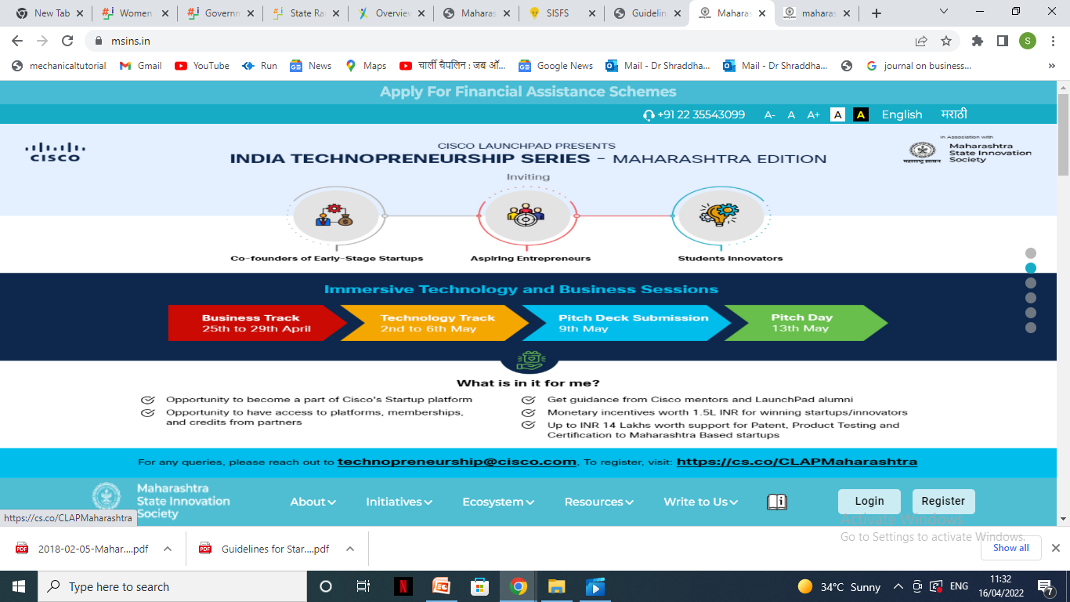

Slide 7
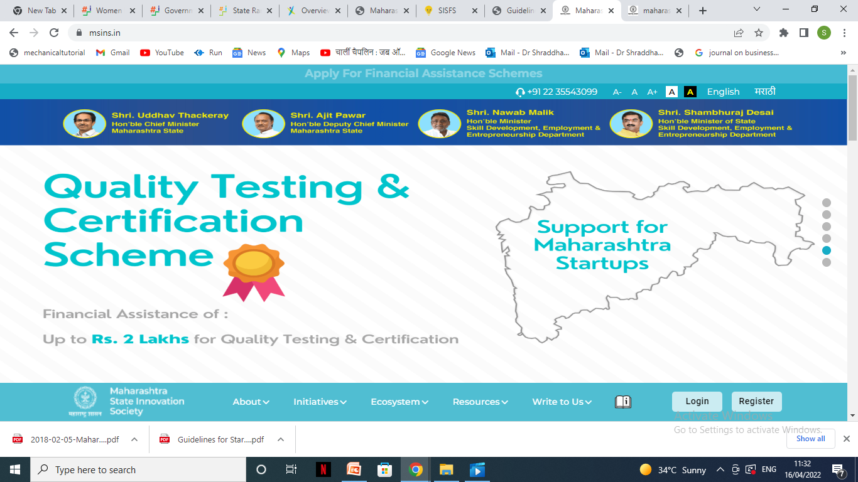

Slide 8
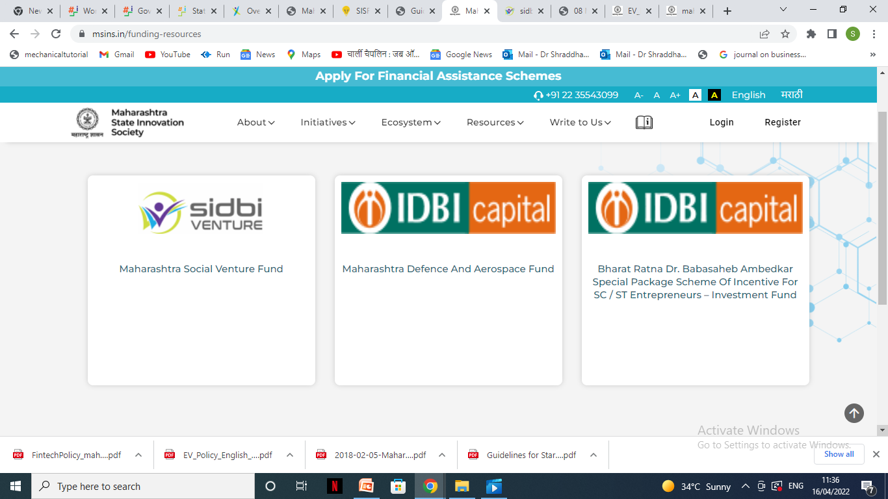

Slide 9
